Slide 1
2023 EESC W3400
Lec 15: Gravity anomalies computed using the FFT
Computational Earth Science
Bill Menke, Instructor
Emily Glazer, Teaching Assistant
TR 2:40 – 3:55

Slide 2
Today
Use of the Fast Fourier Transform in Gravity Modeling

Slide 3
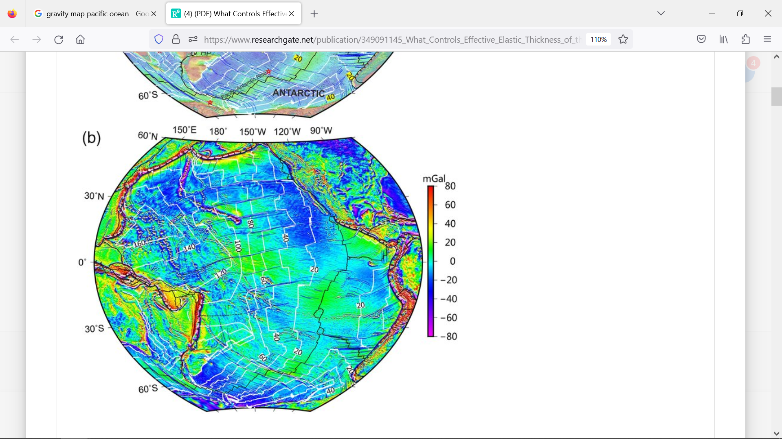

Slide 4

$$Flexural bulge$$

Slide 5
Part 1: Gravity Anomaly from corrugated bathymetry

Slide 6


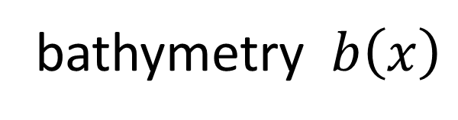





$$y$$
$$ρ_{1}$$
lineated topography
$$y_{0}$$
$$x$$
$$0$$
$$ρ_{2}$$
bathymetry $b\left(x\right)$
$$z$$

Slide 7









$$y$$
lineated mass anomalies
$$+$$
$$−$$
$$+$$
$$−$$
$$+$$
$$−$$
$$0$$
$$x$$
$$z$$
density anomaly $∆ρ\left(x,y,z\right)=−(ρ_{2}−ρ_{1}) b\left(x\right)δ\left(z\right)$

Slide 8





vertical component of gravity
$$f$$
$$y$$
$$h$$
$$+$$
$$−$$
$$+$$
$$−$$
$$+$$
$$−$$
$$y$$
$$x$$
$$x$$
$$z$$

Slide 9
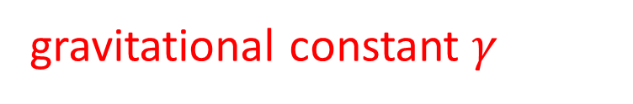
$$f\left(k_{x},z=h\right)=−2πγ\left(ρ_{2}−ρ_{1}\right) b\left(k_{x}\right)\exp\left(−\left|k_{x}\right|h\right)$$
gravitational constant $γ$

Slide 10
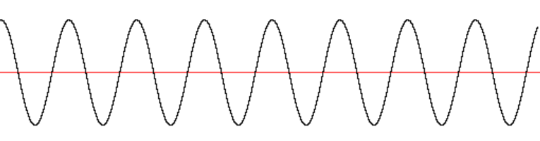








$$f\left(x,h\right)$$
$$x$$
$$f\left(x,h_{2}\right)$$
increasing heighr
$$x$$
$$f\left(x,h_{1}\right)$$
$$x$$
$$b\left(x\right)$$
$$x$$

Slide 11
Method of Computation
$$b\left(x\right)$$
$$FFT to b\left(k_{x}\right)$$
$$f\left(k_{x}\right)=−2πγ\left(ρ_{2}−ρ_{1}\right)\exp\left(−\left|k_{x}\right|h\right) × b\left(k_{x}\right)$$
$$IFFT to f\left(x\right)$$

Slide 12
Part 2: plate flexure

Slide 13
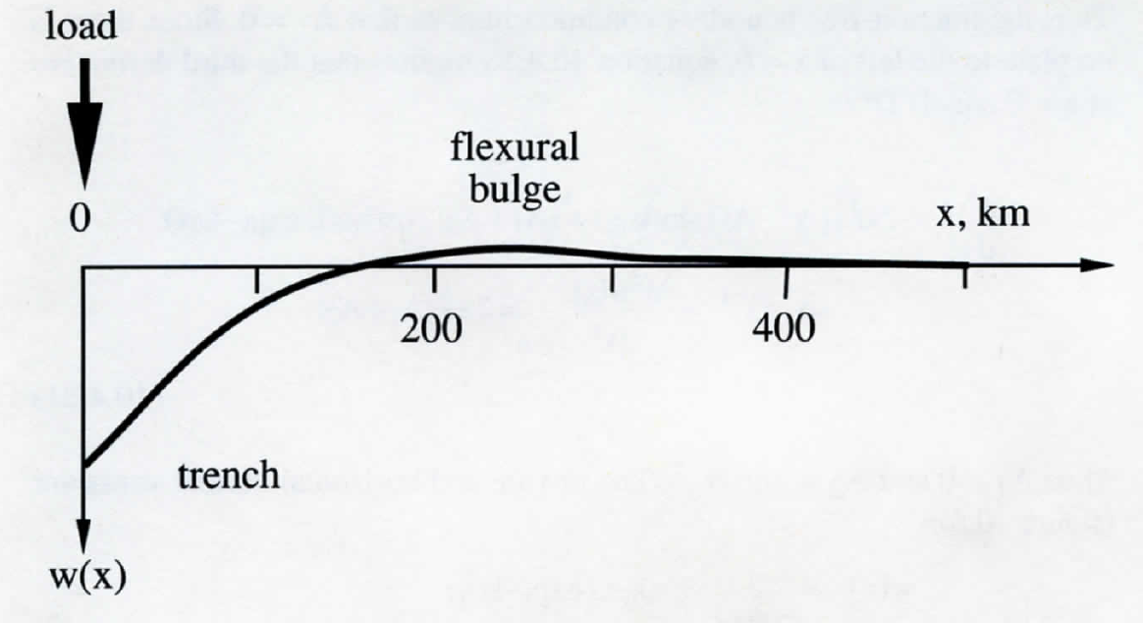
Ocean Island

Slide 14
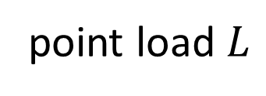





Flexure $w\left(x\right)$ of the median surface due to load $L\left(x\right)$
$$−h/2$$
point load $L$
$$h/2$$
$$w$$
$$x$$
median surface
$$z$$

Slide 15
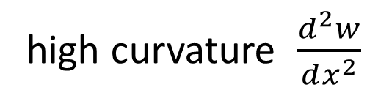
extension and compression related to curvature
$$−h/2$$
high curvature $\frac{d^{2}w}{dx^{2}}$
$$h/2$$
$$x$$
$$z$$

Slide 16

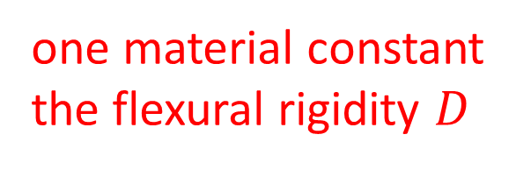
stretching and squeezing of the elastic plate
$$−h/2$$
squeezing
$$h/2$$
$$x$$
stretching
$$z$$
one material constant
the flexural rigidity $D$
$$D≈5×{10}^{21} N−m$$

Slide 17
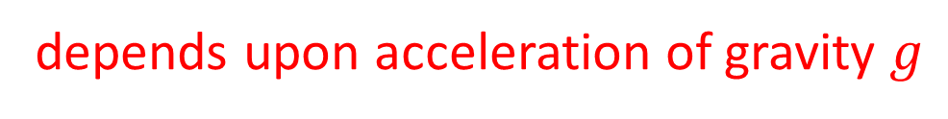
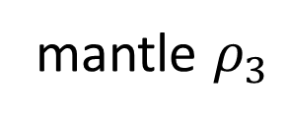
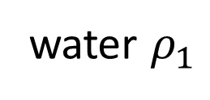
buoyancy forces due to density difference between ocean and mantle
$$−h/2$$
water $ρ_{1}$
$$h/2$$
$$x$$
negative buoyancy
mantle $ρ_{3}$
negative buoyancy
$$z$$
positive buoyancy
depends upon acceleration of gravity $g$

Slide 18



Newton’s Law
$$f=ma$$
at equilibrium
$$f=0$$
because
$a=0$

Slide 19

Newton’s Law
$$f=ma$$
at equilibrium
because
$a=0$
$$f=0$$
load
buoyancy
contact forces

Slide 20

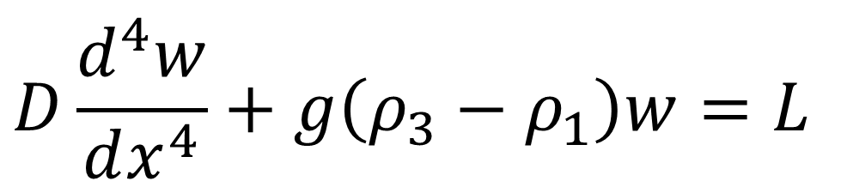
Newton’s law in terms of flexure $w$
$$D\frac{d^{4}w}{dx^{4}}+g\left(ρ_{3}−ρ_{1}\right)w=L$$
-contact forces
-buoyancy
load

Slide 21
Part 3: load due to bathymetry

Slide 22
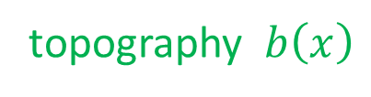
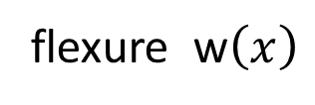
flexure w$\left(x\right)$
topography $b\left(x\right)$
bathymetry $b\left(x\right)$

Slide 23
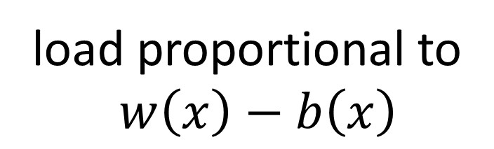


$$x$$
flexure w$\left(x\right)$
topography $b\left(x\right)$
load proportional to
$w\left(x\right)−b\left(x\right)$
$$z$$

Slide 24
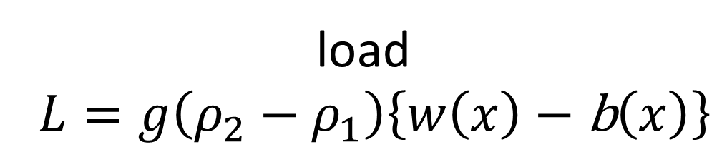
$$x$$
flexure w$\left(x\right)$
topography $b\left(x\right)$
load
$L=g\left(ρ_{2}−ρ_{1}\right)\left\{w\left(x\right)−\text{b}\left(x\right)\right\}$
$$z$$

Slide 25
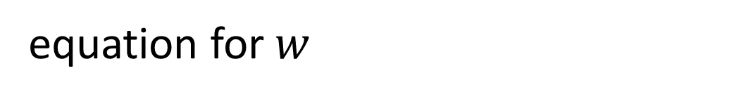
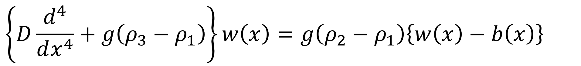
equation for $w$
$$\left\{D\frac{d^{4}}{dx^{4}}+g\left(ρ_{3}−ρ_{1}\right)\right\}w\left(x\right)=g\left(ρ_{2}−ρ_{1}\right)\left\{w\left(x\right)−b\left(x\right)\right\}$$

Slide 26
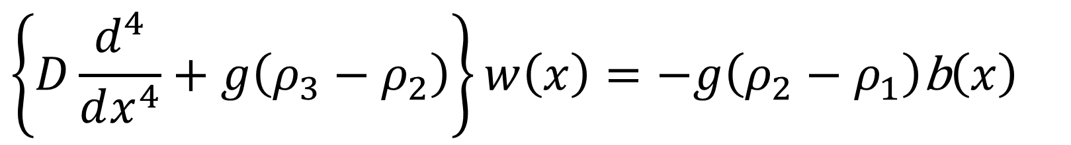
equation for $w$
$$\left\{D\frac{d^{4}}{dx^{4}}+g\left(ρ_{3}−ρ_{1}\right)\right\}w\left(x\right)=g\left(ρ_{2}−ρ_{1}\right)\left\{w\left(x\right)−b\left(x\right)\right\}$$
add
$$g\left({−ρ}_{2}+ρ_{1}\right)w\left(x\right)=g\left(−ρ_{2}+ρ_{1}\right)w\left(x\right)$$
becomes
$$\left\{D\frac{d^{4}}{dx^{4}}+g\left(ρ_{3}−ρ_{2}\right)\right\}w\left(x\right)=−g\left(ρ_{2}−ρ_{1}\right)\text{b}\left(x\right)$$

Slide 27

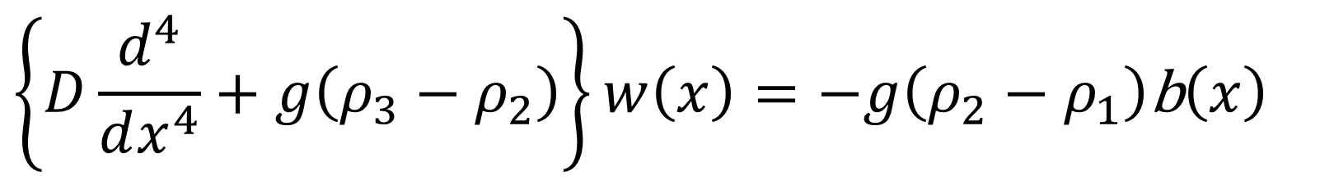
$$\left\{D\frac{d^{4}}{dx^{4}}+g\left(ρ_{3}−ρ_{2}\right)\right\}w\left(x\right)=−g\left(ρ_{2}−ρ_{1}\right)\text{b}\left(x\right)$$
take FFT
note $\frac{d^{4}}{dx^{4}}$ becomes ${\left(ik_{x}\right)}^{4}=k_{x}^{4}$
$$\left\{Dk_{x}^{4}+g\left(ρ_{3}−ρ_{2}\right)\right\}\overline{w}\left(k_{x}\right)=−g\left(ρ_{2}−ρ_{1}\right)\overline{b}\left(k_{x}\right)$$

Slide 28
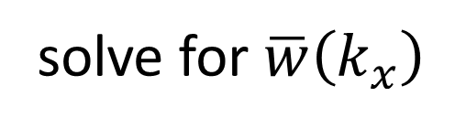
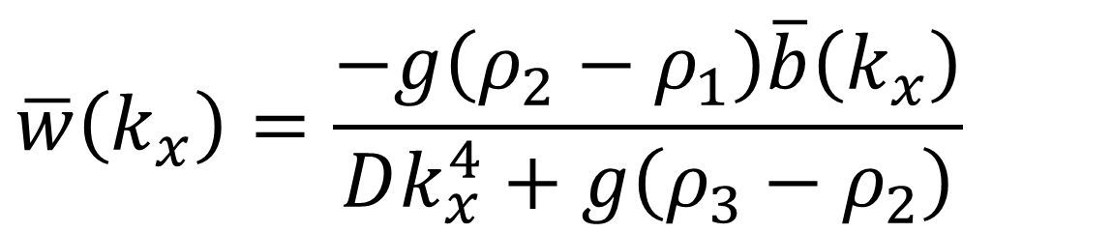
$$\left\{Dk_{x}^{4}+g\left(ρ_{3}−ρ_{2}\right)\right\}\overline{w}\left(k_{x}\right)=−g\left(ρ_{2}−ρ_{1}\right)\overline{b}\left(k_{x}\right)$$
solve for $\overline{w}\left(k_{x}\right)$
$$\overline{w}\left(k_{x}\right)=\frac{−g\left(ρ_{2}−ρ_{1}\right)\overline{b}\left(k_{x}\right)}{Dk_{x}^{4}+g\left(ρ_{3}−ρ_{2}\right)}$$
Then take IFFT

Slide 29
Part 4: gravity anomaly

Slide 30

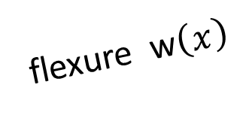
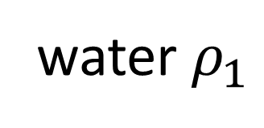
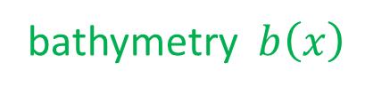
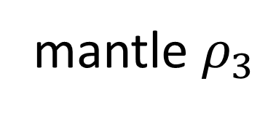

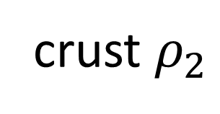
water $ρ_{1}$
bathymetry $b\left(x\right)$
$$x$$
crust $ρ_{2}$
flexure w$\left(x\right)$
mantle $ρ_{3}$
$$z$$
$$z$$

Slide 31
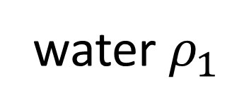

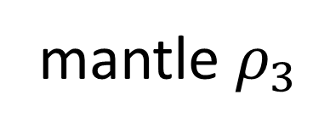
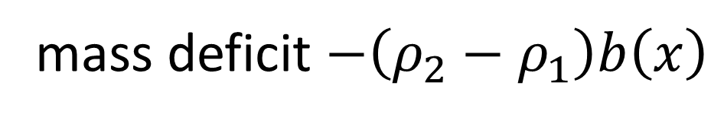
mass deficit $−\left(ρ_{2}−ρ_{1}\right)b\left(x\right)$
$$h$$
water $ρ_{1}$
bathymetry $b\left(x\right)$
$$x$$
crust $ρ_{2}$
flexure w$\left(x\right)$
mantle $ρ_{3}$
$$z$$
$$z$$

Slide 32

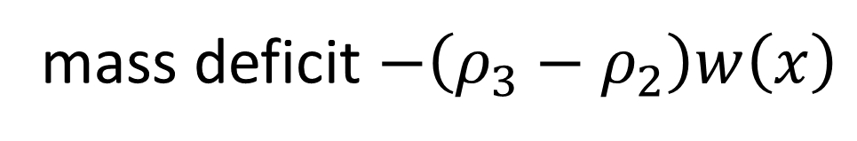
water $ρ_{1}$
$$h+T$$
bathymetry $b\left(x\right)$
$$x$$
crust $ρ_{2}$
flexure w$\left(x\right)$
mantle $ρ_{3}$
mass deficit $−\left(ρ_{3}−ρ_{2}\right)w\left(x\right)$
$$z$$
$$z$$

Slide 33
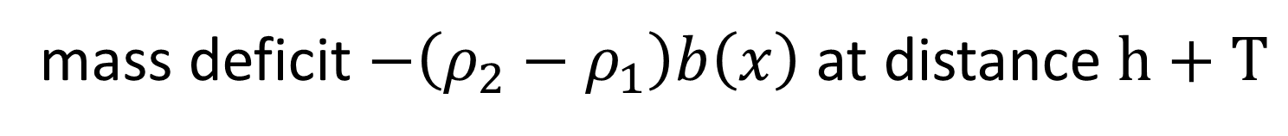
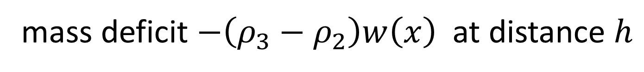
mass deficit $−\left(ρ_{2}−ρ_{1}\right)b\left(x\right)$ at distance $h+T$
mass deficit $−\left(ρ_{3}−ρ_{2}\right)w\left(x\right)$ at distance $h$
$$x$$
$$f\left(k_{x}\right)=−2πγ\left(ρ_{2}−ρ_{1}\right) b\left(k_{x}\right)\exp\left(−\left|k_{x}\right|h\right)$$
$$−2πγ\left(ρ_{3}−ρ_{2}\right) w\left(k_{x}\right)\exp\left(−\left|k_{x}\right|\left(h+T\right)\right)$$
now take IFFT

Slide 34

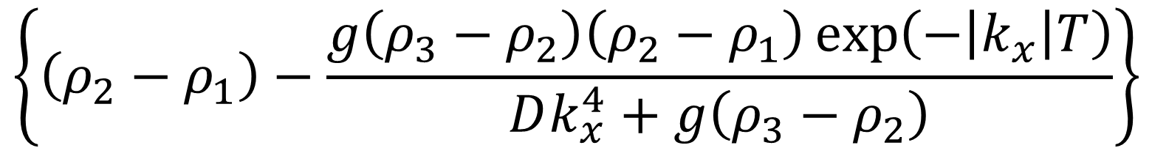
you could ...
$$f\left(k_{x}\right)=−2πγ\left(ρ_{2}−ρ_{1}\right) b\left(k_{x}\right)\exp\left(−\left|k_{x}\right|h\right)$$
$$−2πγ\left(ρ_{3}−ρ_{2}\right) w\left(k_{x}\right)\exp\left(−\left|k_{x}\right|\left(h+T\right)\right)$$
$$x$$
insert formula for $w\left(k_{x}\right)$
$$f\left(k_{x}\right)=−2πγ b\left(k_{x}\right)\exp\left(−\left|k_{x}\right|h\right)×$$
$$\left\{\left(ρ_{2}−ρ_{1}\right)−\frac{g\left(ρ_{3}−ρ_{2}\right)\left(ρ_{2}−ρ_{1}\right)\exp\left(−\left|k_{x}\right|T\right)}{Dk_{x}^{4}+g\left(ρ_{3}−ρ_{2}\right)}\right\}$$
but on a computer, there is no pressing reason to so so. Note however that its shows $w\left(k_{x}=0\right)=0$; that is; the mean anomaly is zero.

Slide 35
# bathymetry
bt = np.fft.fft( b, axis=0 );
# flexure
q = np.reciprocal( D*np.power(kx,4) + g*(rho3-rho2) );
wt = np.multiply( -g*(rho2-rho1)*bt, q);
wtabsmax = np.max(np.abs(wt));
w = np.real(np.fft.ifft(wt, axis=0));
# gravity anomaly
e1 = np.exp(-kxabs*h);
e2 = np.exp(-kxabs*(T+h));
term1 = -2*pi*gamma*(rho2-rho1)*np.multiply(bt,e1);
term2 = -2*pi*gamma*(rho3-rho2)*np.multiply(wt,e2);
ft = term1 + term2
f = np.real(np.fft.ifft(ft, axis=0));

Slide 36
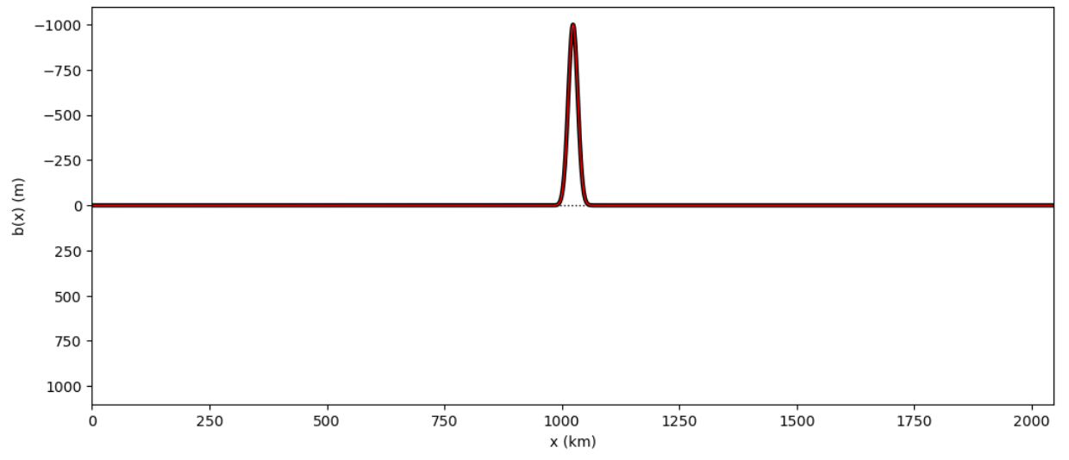
bathymetry: note high bathymetry is down deep!
seamount
shallower

Slide 37
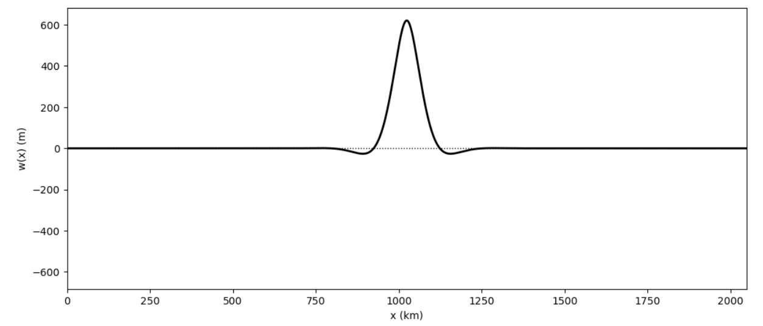
flexure: note flexural moats!
deeper

Slide 38
flexure: note flexural motes!
deeper

Slide 39
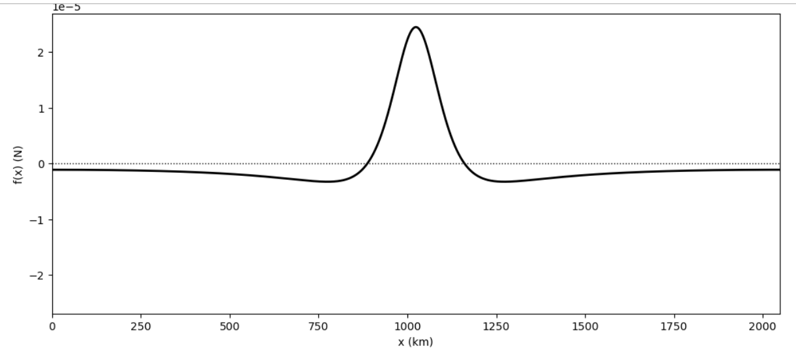
gravity: positive = stronger downward pull
stronger downward pull

Slide 40
gravity: positive = stronger downward pull
pull from mass excess of seamount
stronger downward pull
push from mass deficit of displaced mantle

Slide 41


satellite observes gravity
$$f$$
$$x$$
what’s the bathymetry?
?
?
?
?
?

Slide 42
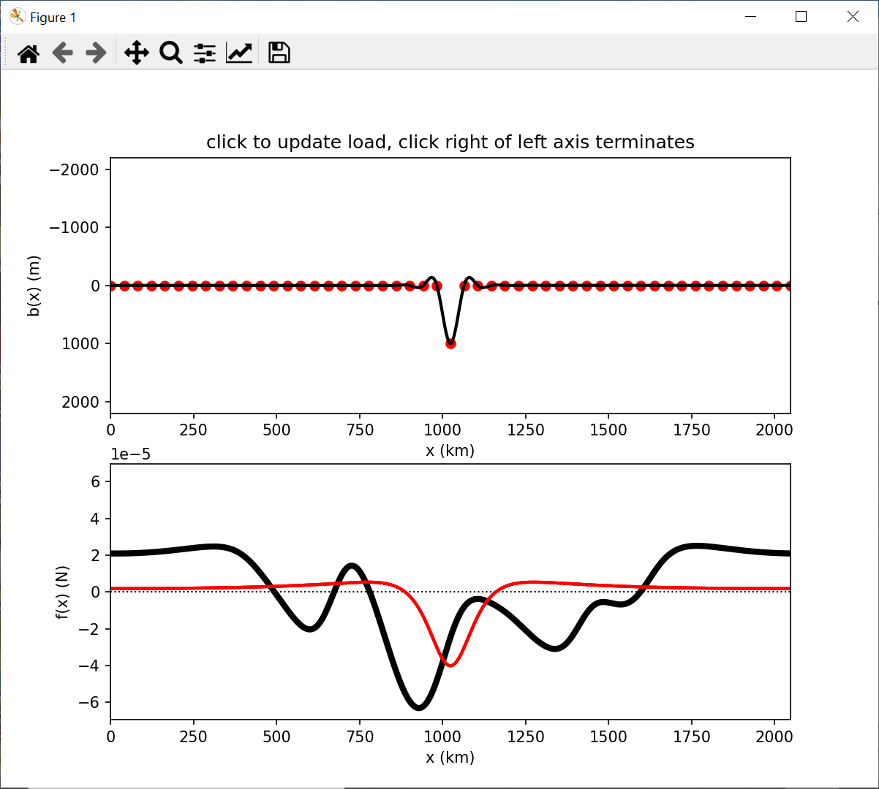
use mouse clicks to alter bathymetry
observed satellite gravity
your prediction

Slide 43
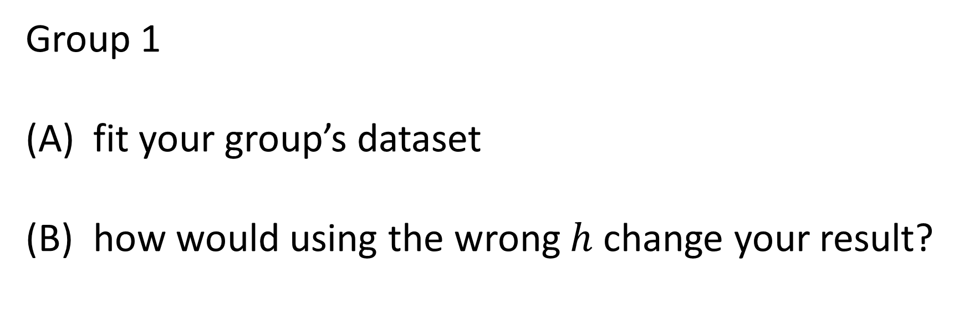
Group 1
fit your group’s dataset
how would using the wrong $h$ change your result?

Slide 44
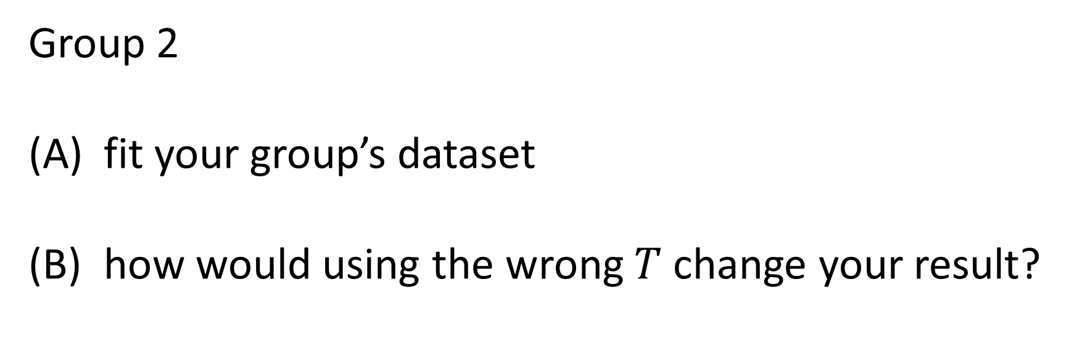
Group 2
fit your group’s dataset
how would using the wrong $T$ change your result?

Slide 45
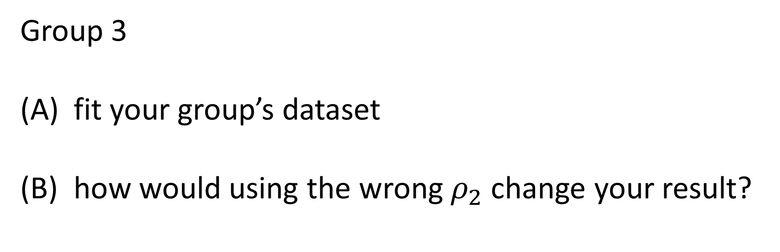
Group 3
fit your group’s dataset
how would using the wrong $ρ_{2}$ change your result?

Slide 46
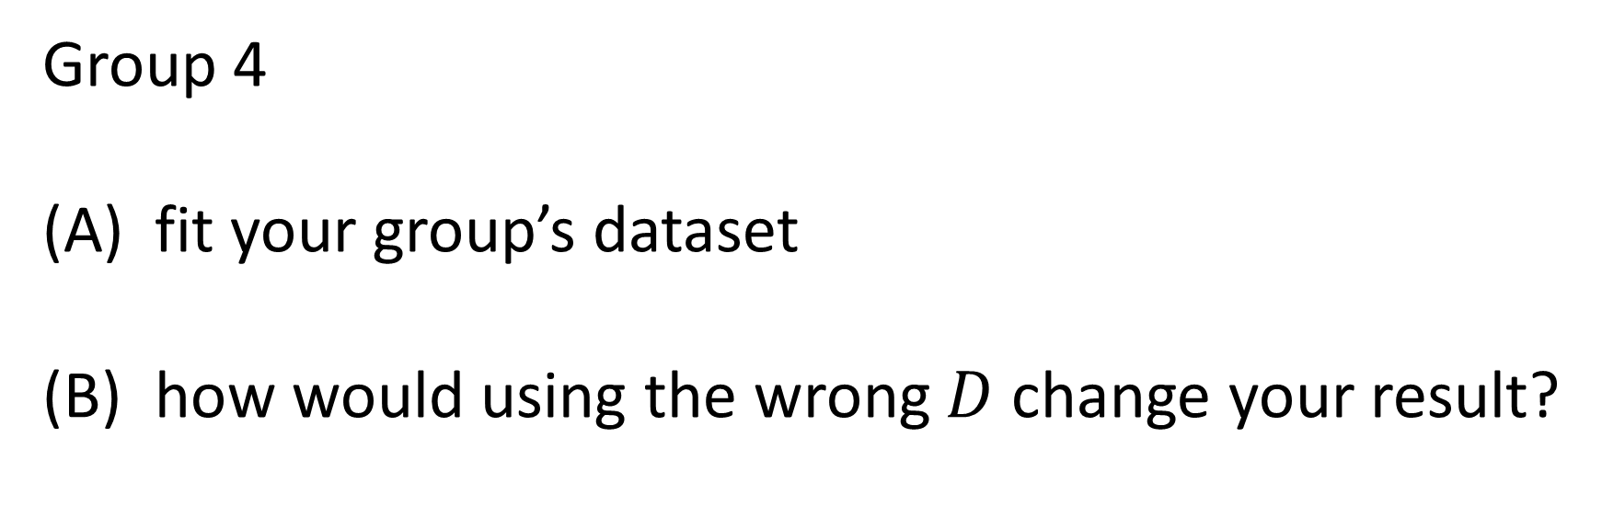
Group 4
fit your group’s dataset
how would using the wrong $D$ change your result?

