Slide 1
2023 EESC W3400
Lec 16: Natural textures created using the 2D FFT
Computational Earth Science
Bill Menke, Instructor
Emily Glazer, Teaching Assistant
TR 2:40 – 3:55

Slide 2
Today
Use of the Fast Fourier Transform in Modeling
“random textures”
of natural phenomenon

Slide 3
look at these two random “datasets”

Slide 4
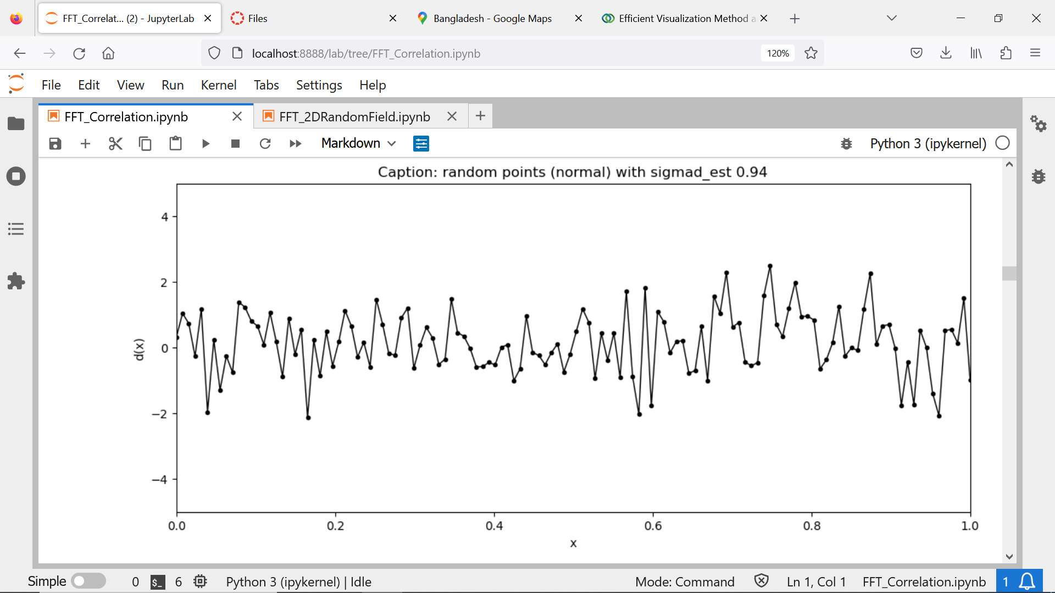

Slide 5
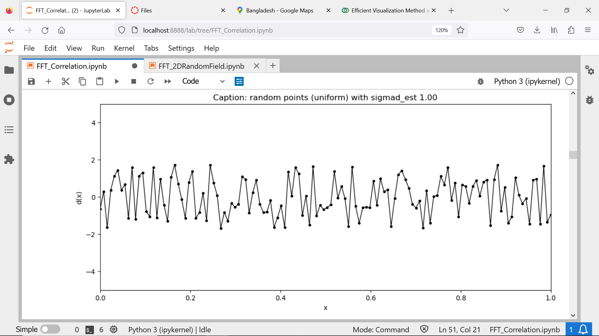

Slide 6
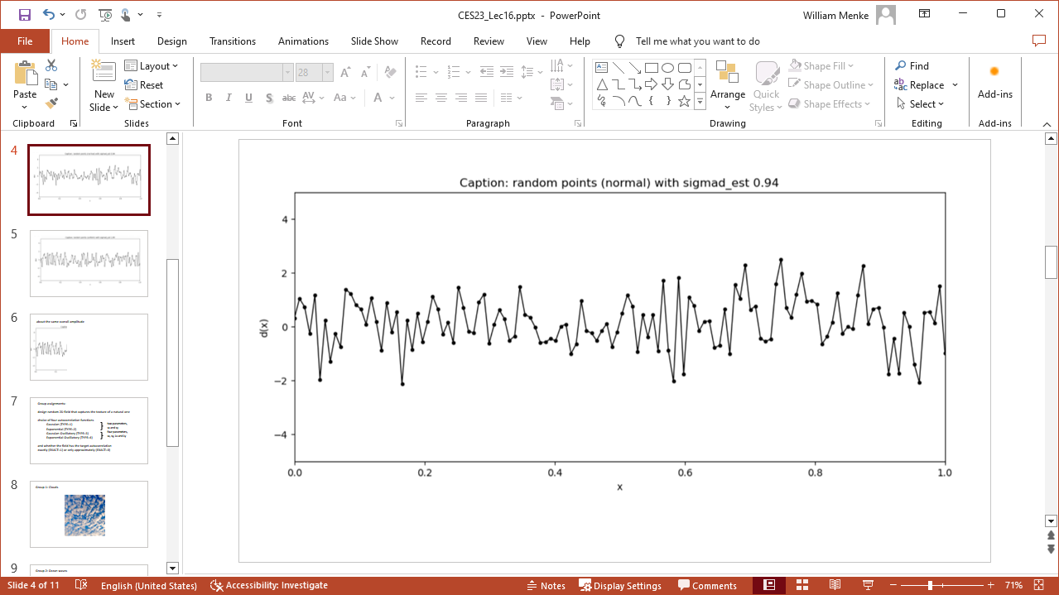
about the same overall amplitude
in fact, they have the same variance $σ_{d}^{2}=1$

Slide 7



but they are different in that the second is bounded, ${−\sqrt{3}≤d}_{i}<1=\sqrt{3}$
(whereas the first isn’t)
$$\sqrt{3}$$
$$0$$
$$−\sqrt{3}$$

Slide 8









they have different probability density functions
normal
uniform
$$p\left(d\right)$$
$$p\left(d\right)$$
$$d$$
$$d$$
$$−\sqrt{3}$$
$$\sqrt{3}$$
$$−\sqrt{3}$$
$$\sqrt{3}$$

Slide 9
very easy to make random data with python
# normal with mean 0 and stddev of sigmad
d=np.random.normal(loc=0.0,scale=sigmad,size=(Nx,1));
# uniform with mean 0 and stddev of sigmad
dhigh = sqrt(3)*sigmad;
d=np.random.uniform(low=-dhigh,high=dhigh,size=(Nx,1));

Slide 10
many uses for random data
the one we’ll investigate today
is making data that
“matches the texture”
natural data
(which could then be used to test data analysis code)

Slide 11
most “real” data doesn’t look like this
and the reason is that this fake data lacks “correlation” between neighboring data points

Slide 12
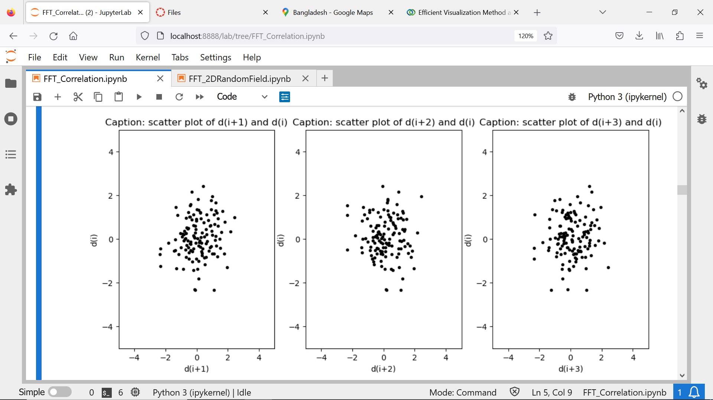

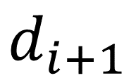
no correlation:
if a point is high,
equal probability that a neighboring point is low or high
$$d_{i}$$
$$d_{i+1}$$

Slide 13
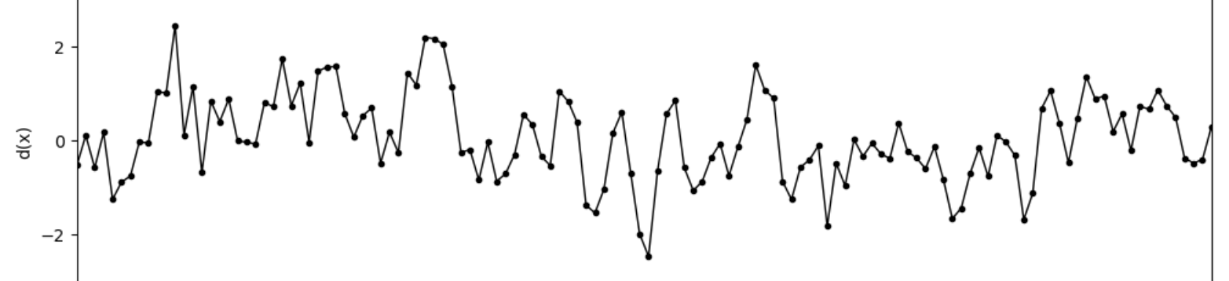
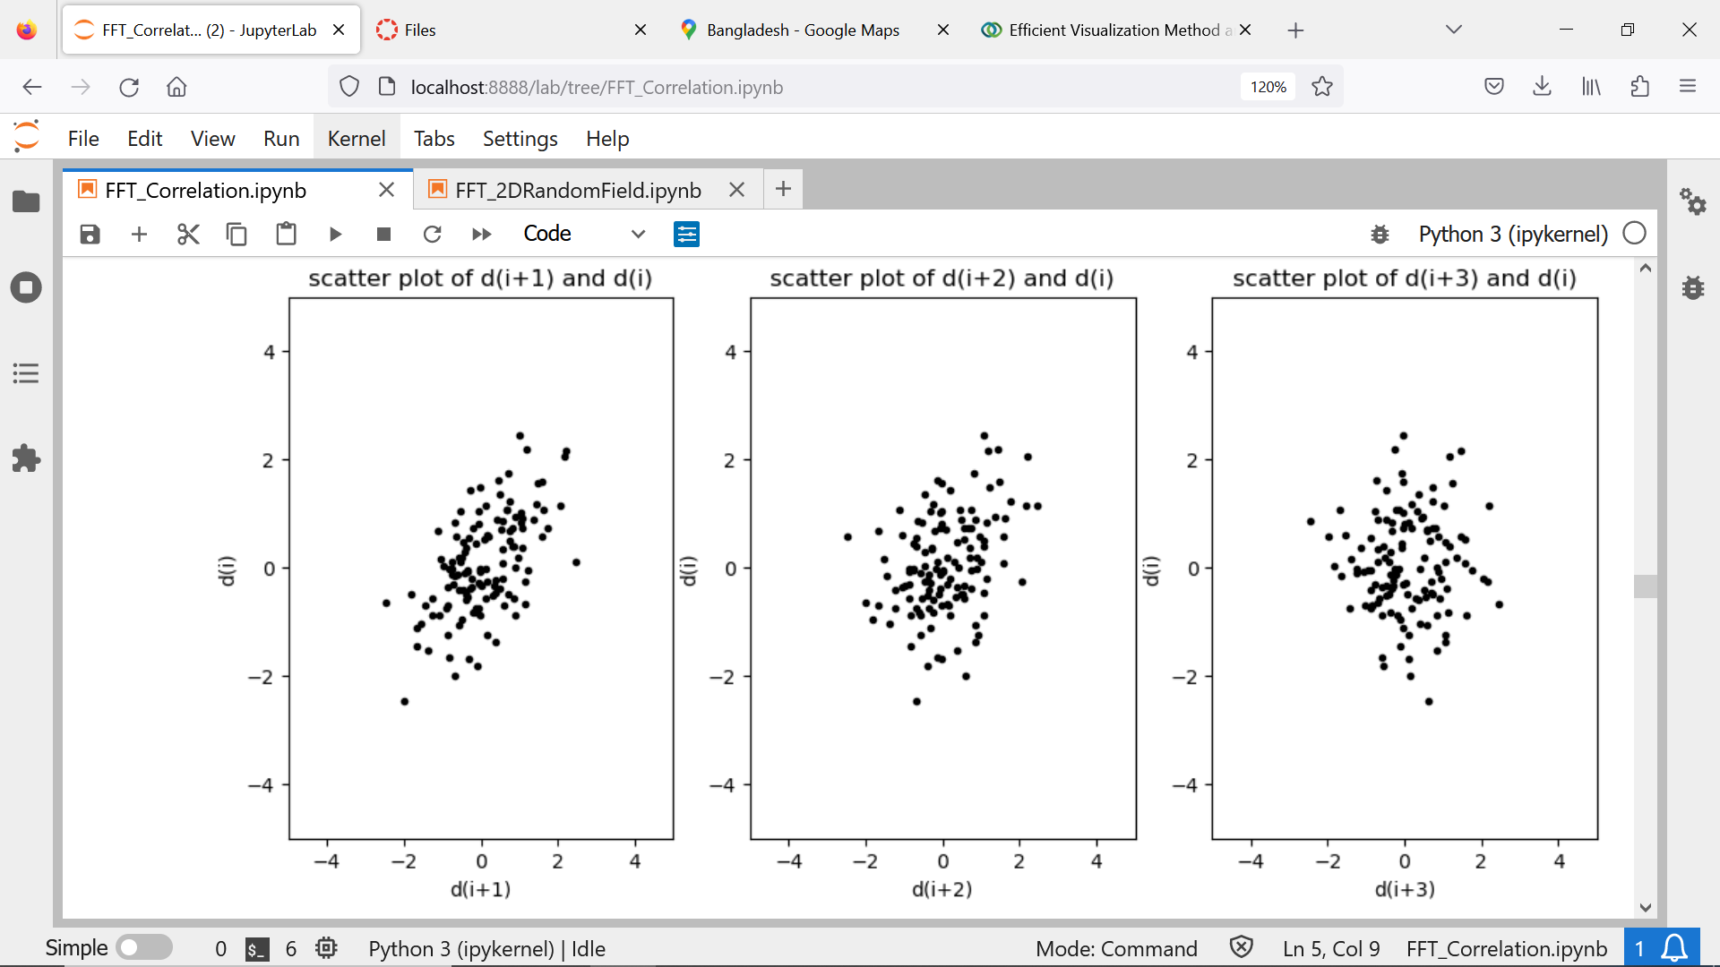
here’s a dataset with some correlation
$$d_{i}$$
$$d_{i+1}$$

Slide 14
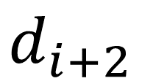
but scatter plot of points offset by two has little correlation
$$d_{i}$$
$$d_{i+1}$$
$$d_{i+2}$$

Slide 15
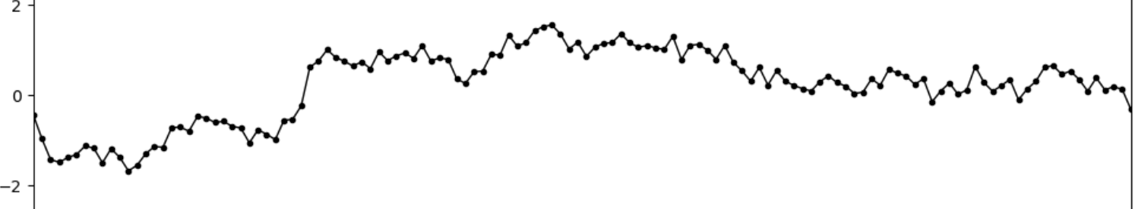
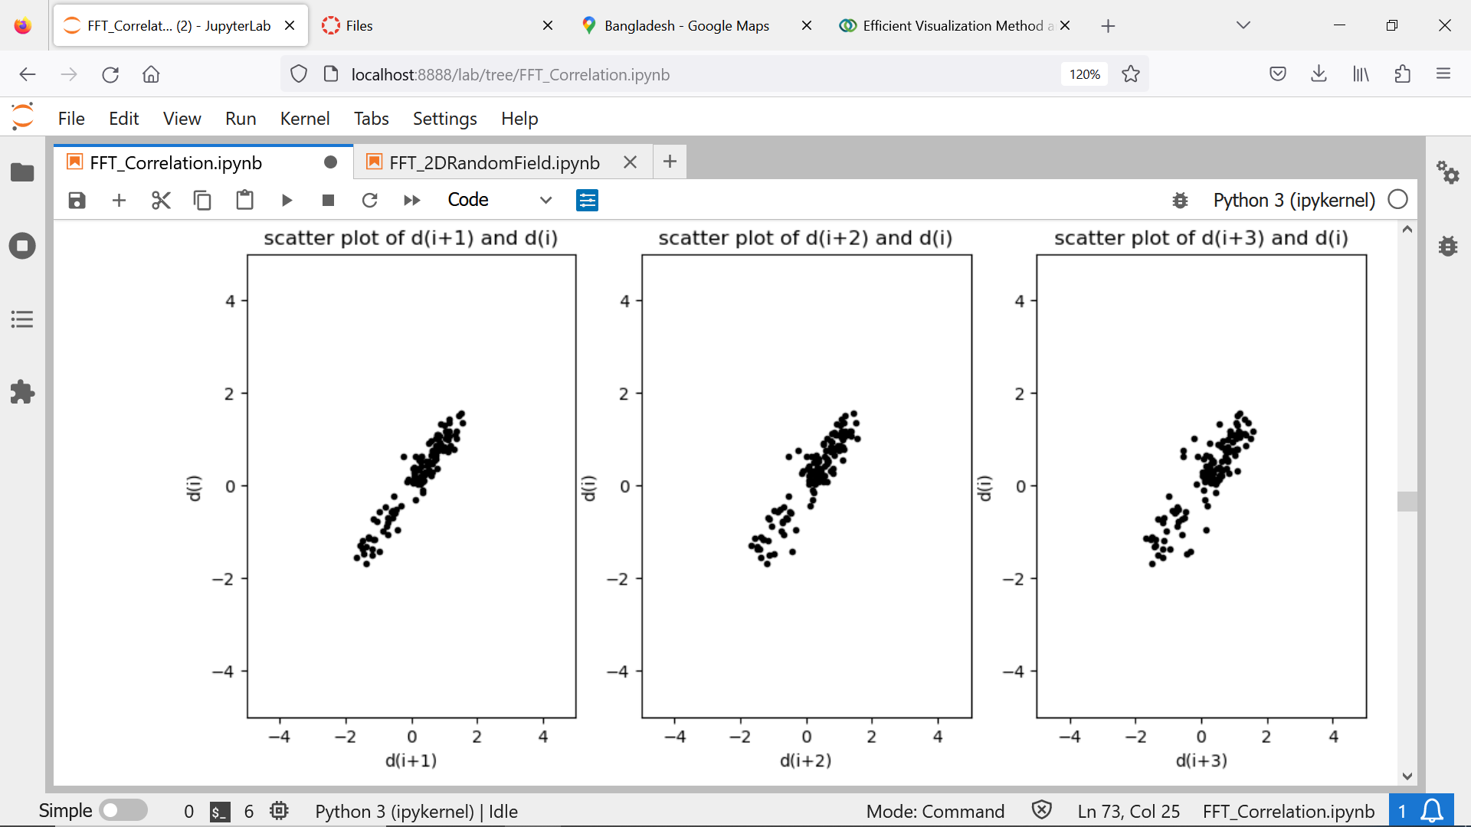
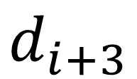
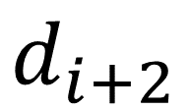
here’s a dataset with more correlation
$$d_{i}$$
$$d_{i+1}$$
$$d_{i+2}$$
$$d_{i+3}$$

Slide 16


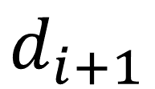
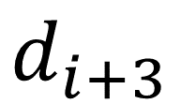








correlation coefficient $r$: measure of how “linear” the scatter plot
$$0.9$$
$$0.8$$
$$0.7$$
$$d_{i}$$
$$d_{i+1}$$
$$d_{i+2}$$
$$d_{i+3}$$
$$r$$
$$lag i$$
$$1$$
$$2$$
$$3$$

Slide 17












autocorrelation $c\left(x_{i}\right)$
$$r$$
$$lag i$$
$$1$$
$$2$$
$$3$$
$$1$$
$$c\left(x_{i}\right)$$
$$lag i$$
$$0$$
$$1$$
$$2$$
$$3$$

Slide 18
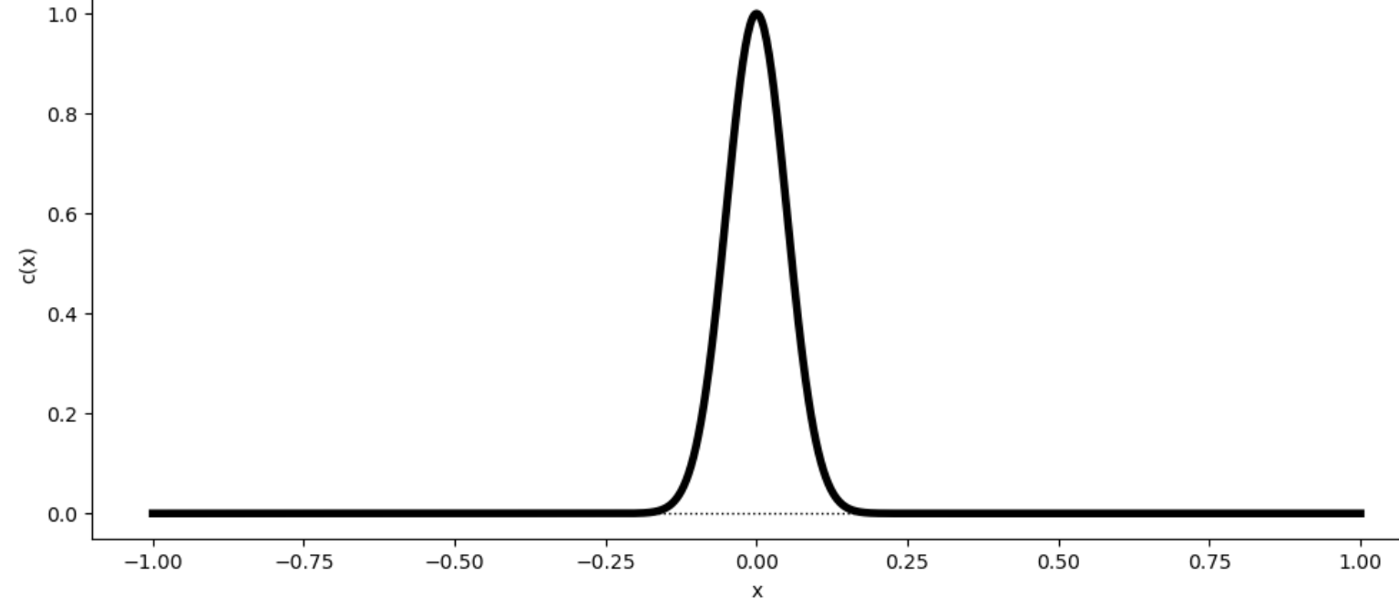
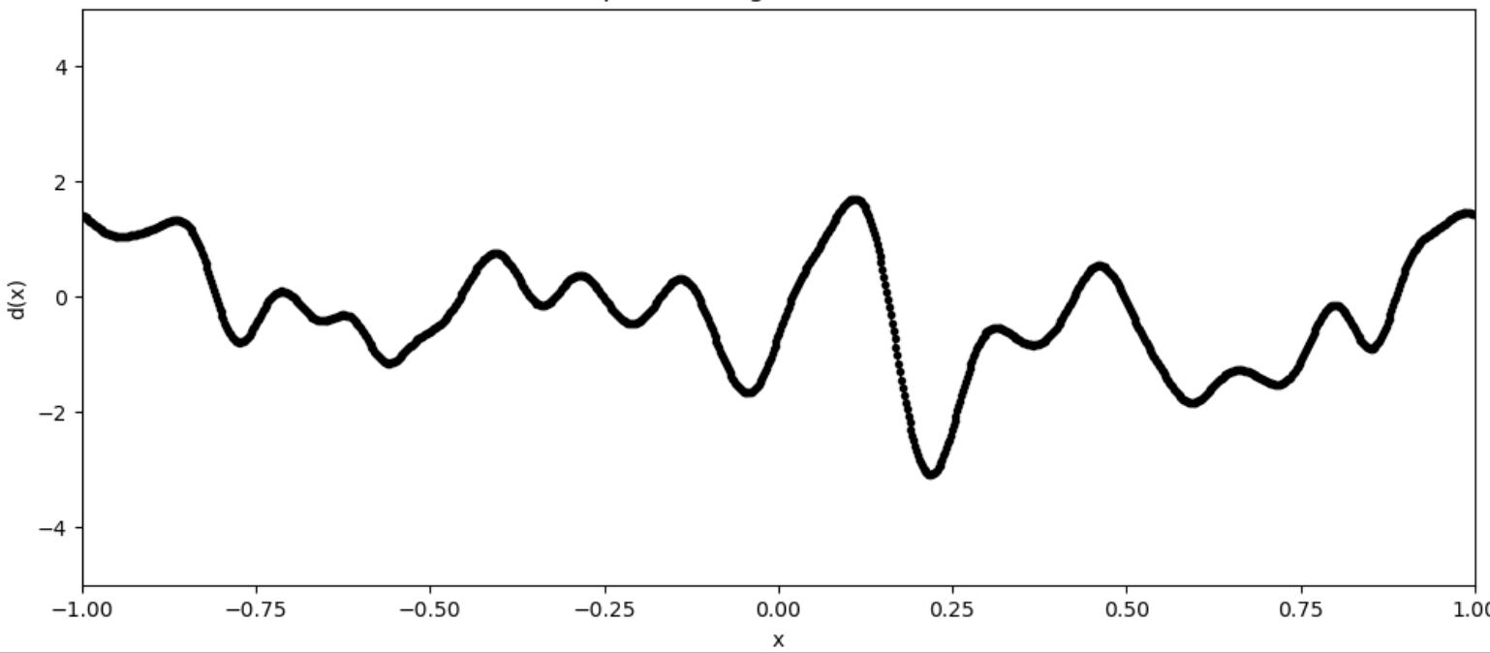
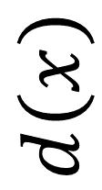


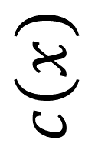
shape of autocorrelation matters
$$c\left(x\right)$$
$$d\left(x\right)$$
wide
$$x$$
$$x$$

Slide 19
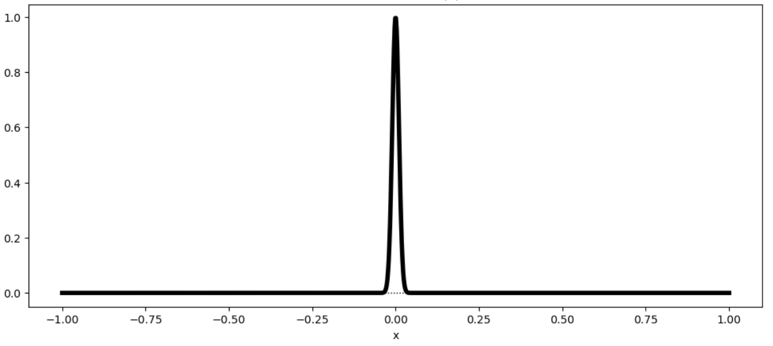
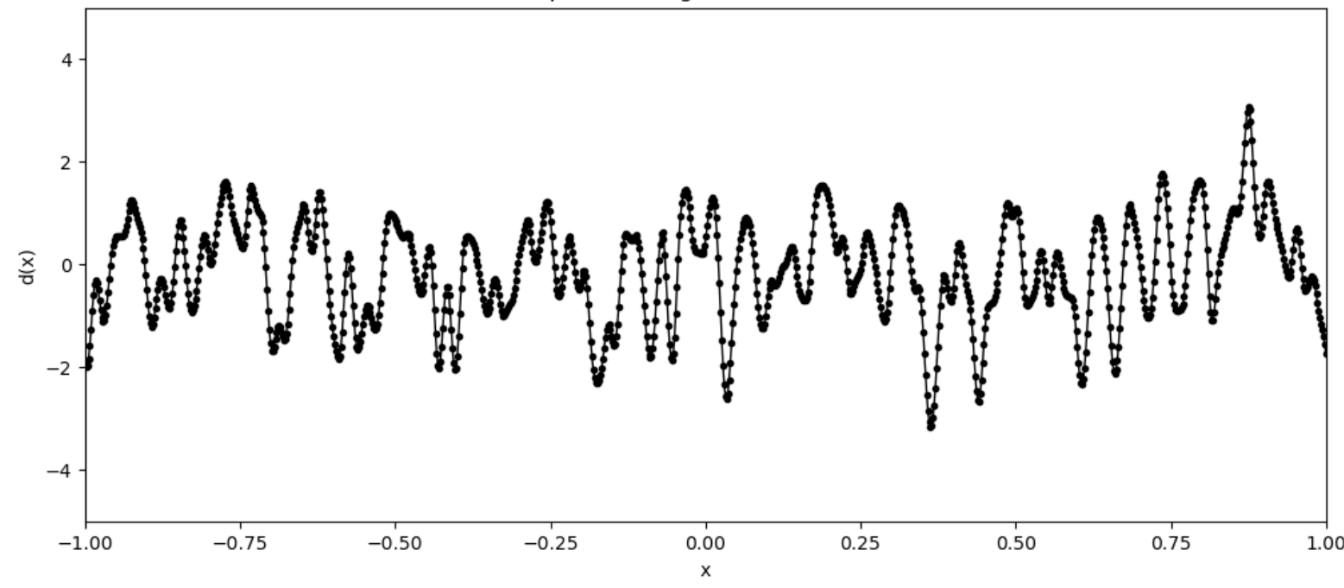
shape of autocorrelation matters
$$c\left(x\right)$$
$$d\left(x\right)$$
narrow
$$x$$
$$x$$

Slide 20
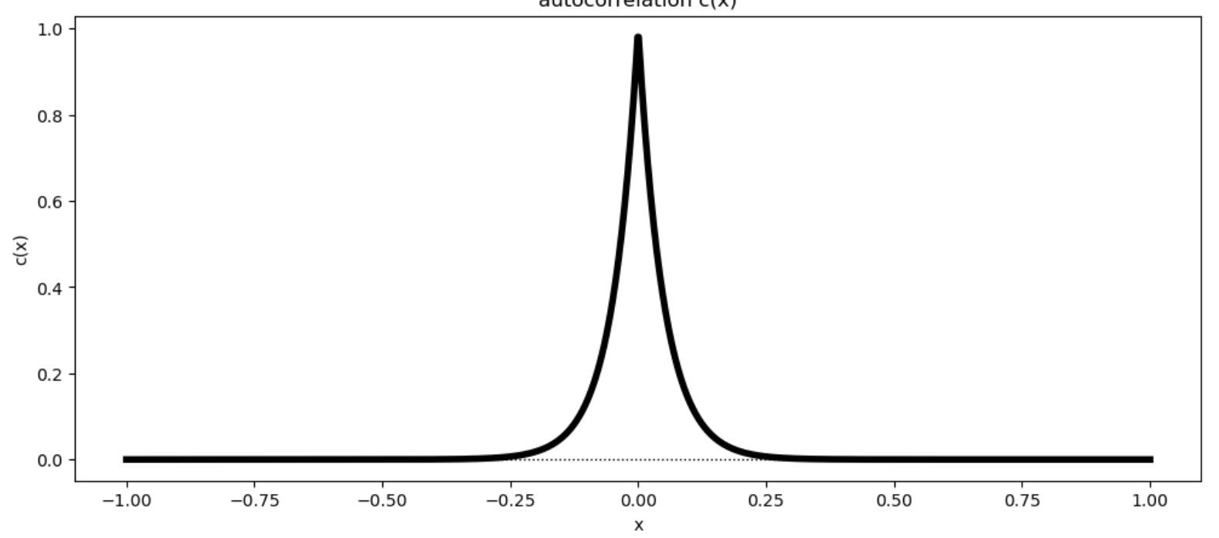
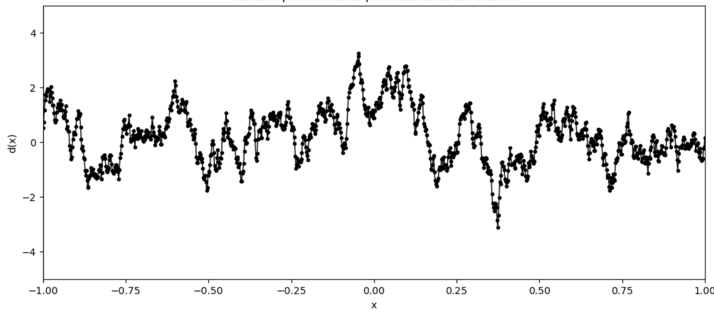








shape of autocorrelation matters
smooth
$$c\left(x\right)$$
$$d\left(x\right)$$
$$x$$
$$x$$
cusp
$$c\left(x\right)$$
$$d\left(x\right)$$
$$x$$
$$x$$

Slide 21
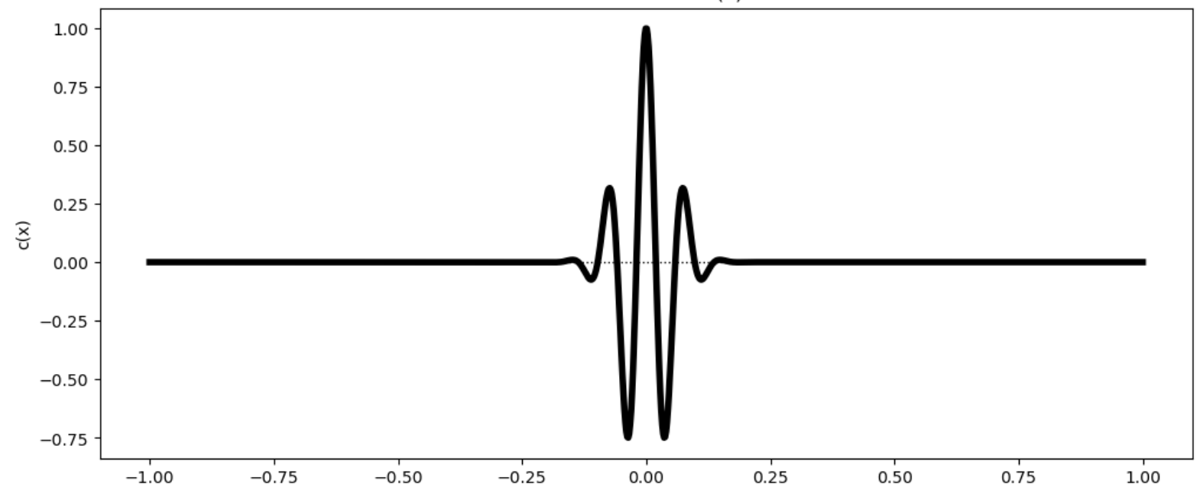
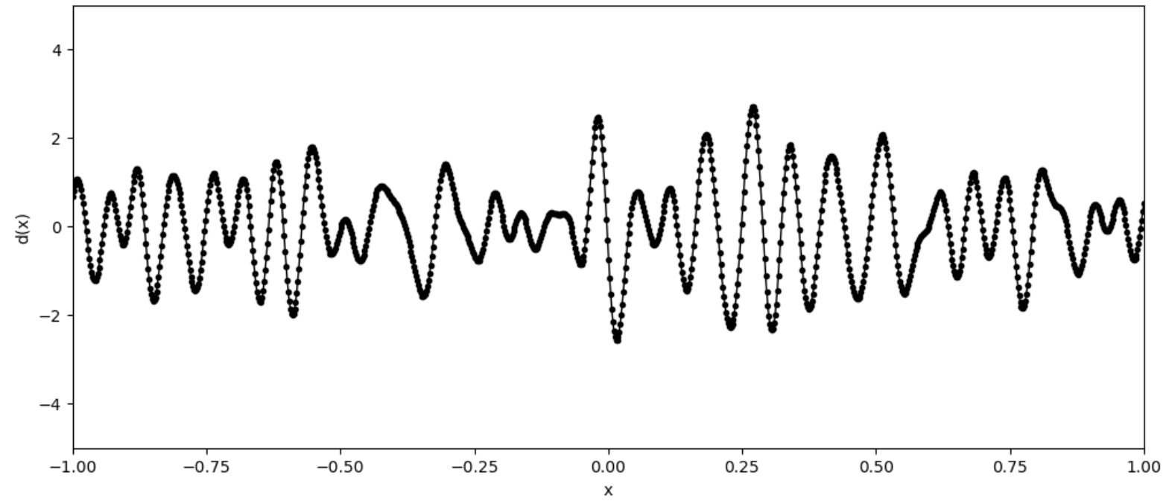


autocorrelation can be oscillatory
wavelength $λ$
wavelength $λ$
$$c\left(x\right)$$
$$d\left(x\right)$$
$$x$$
$$x$$

Slide 22
making a random dataset with a specified autocorrelation
relies on two rules
Rule 1:
ASD of autocorrelation is PSD of dataset
Rule 2:
ASD of uncorrelated noise is approximately constant
ASD = amplitude spectral density = | FT d |
PSD = power spectral density = ASD²

Slide 23
start with
desired c
desired standard deviation sd
d = uncorrelated noise
take FT
dt = FT d
ct = FT c
ASD(d) = |dt|
ASD(c) = |ct|
modify d
replace dt with
dt sqrt [ASD(c)] / ASD(d)
take IFT
d = IFT dt
scale to desired
d = sd d / STD(d)
ASD = amplitude spectral density = | FT d |
PSD = power spectral density = ASD²
STD = standard deviation
rescale

Slide 24
start with
desired c
desired standard deviation sd
d = uncorrelated noise
take FT
dt = FT d
ct = FT c
ASD(d) = |dt|
ASD(c) = |ct|
if you omit this division,
the result is inexact but
“more random”
and that sometimes is helpful
modify d
replace dt with
dt sqrt [ASD(c)] / ASD(d)
take IFT
d = IFT dt
scale to desired
d = sd d / STD(d)
rescale

Slide 25
start with
d=np.random.normal(loc=0.0,scale=1.0,size=(Nx,1));
ct = np.fft.fft(c,axis=0);
casd = np.sqrt(cpsd);
dt = np.fft.fft(d,axis=0);
if( EXACT ):
dasd = np.abs(dt);
dt = np.multiply(casd, np.divide(dt,dasd));
else:
dt = np.multiply(casd, dt);
d = np.real(np.fft.fft(dt,axis=0));
d = sigmad*d/np.std(d);
dabsmax = np.max(np.abs(d));
take FT
modify d
take IFT
rescale

Slide 26
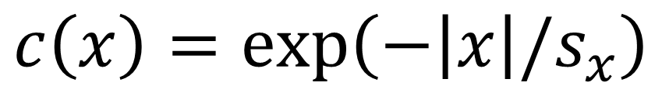
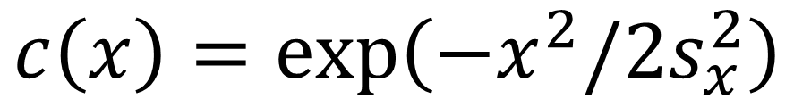
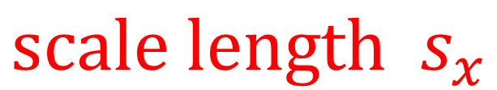
several useful autocorrelation functions
$$c\left(x\right)=\exp\left(−x^{2}/2s_{x}^{2}\right)$$
Gaussian
Exponential
$$c\left(x\right)=\exp\left(−\left|x\right|/s_{x}\right)$$
$$scale length s_{x}$$

Slide 27
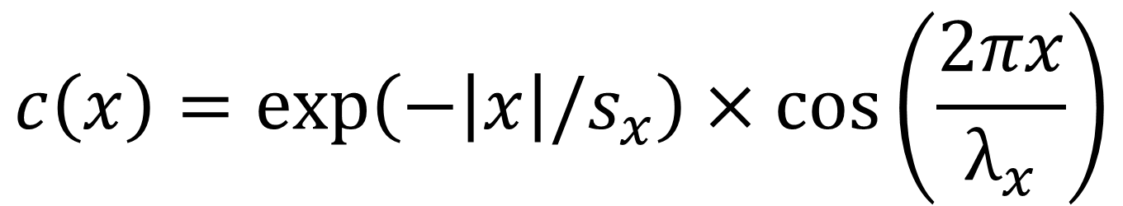
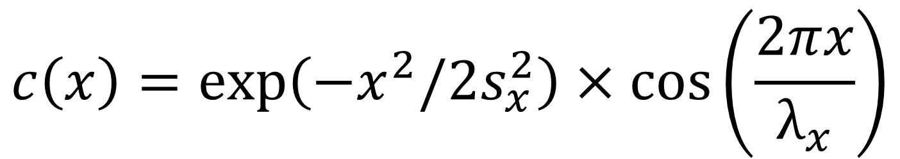
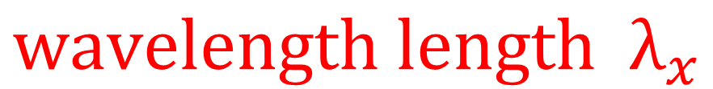
several useful autocorrelation functions
$$c\left(x\right)=\exp\left(−x^{2}/2s_{x}^{2}\right)×\cos\left(\frac{2πx}{λ_{x}}\right)$$
Gaussian-
oscillatory
$$c\left(x\right)=\exp\left(−\left|x\right|/s_{x}\right)×\cos\left(\frac{2πx}{λ_{x}}\right)$$
Exponential
oscillatory
$$scale length s_{x}$$
$$wavelength length λ_{x}$$

Slide 28
2D (and higher datasets) are easy
because
the algorithm works in any number of dimensions

Slide 29
d = np.random.normal(loc=0.0,scale=1.0,size=(Nx,Ny));
casd = np.sqrt(np.abs(np.fft.fft2(c)));
dt = np.fft.fft2(d);
dasd = np.abs(dt);
if( EXACT ):
dasd = np.abs(dt);
dt = np.multiply(casd, np.divide(dt,dasd));
else:
dt = np.multiply(casd, dt);
d = np.real(np.fft.ifft2(dt));
d = (sigmad/np.std(d))*d;

Slide 30
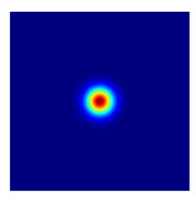
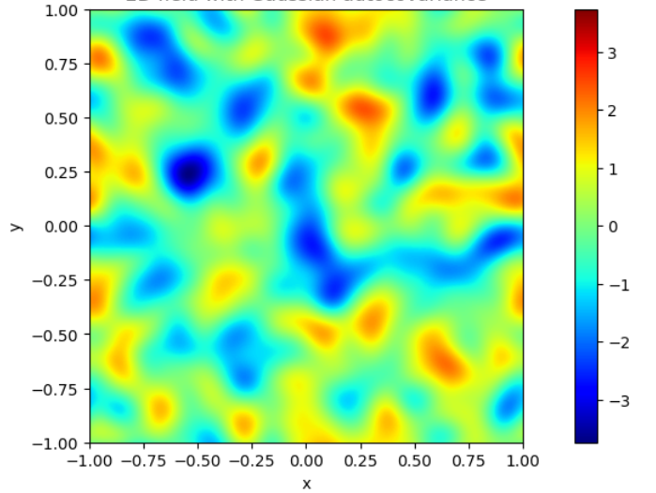
Gaussian autocorrelation
dataset
y
x
with sy=sx

Slide 31
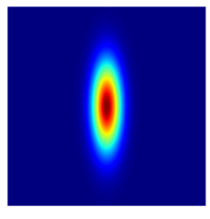
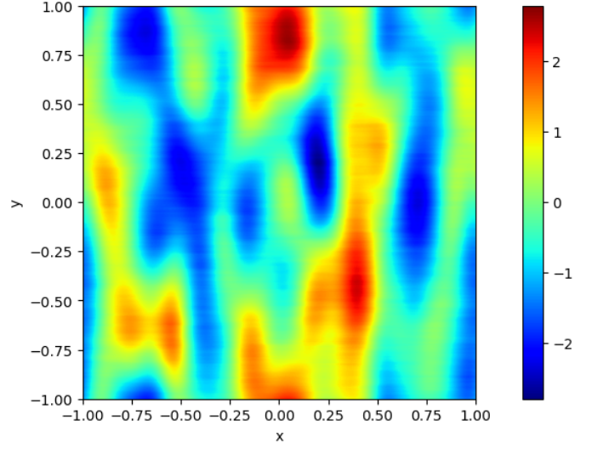
Gaussian autocorrelation
dataset
y
x
with sy=3sx

Slide 32
Group assignments:
design random 2D field that captures the texture of a natural one
choice of four autocorrelation functions
Gaussian (TYPE=1)
Exponential (TYPE=2)
Gaussian-Oscillatory (TYPE=3)
Exponential-Oscillatory (TYPE=4)
and whether the field has the target autocorrelation
exactly (EXACT=1) or only approximately (EXACT=0)
two parameters,
sx and sy
four parameters,
sx, sy, Lx and Ly

Slide 33

Group 1: Clouds

Slide 34

Group 2: Ocean waves

Slide 35
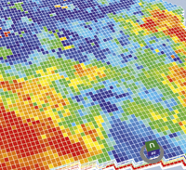
Group 3: Oil reservoir

Slide 36
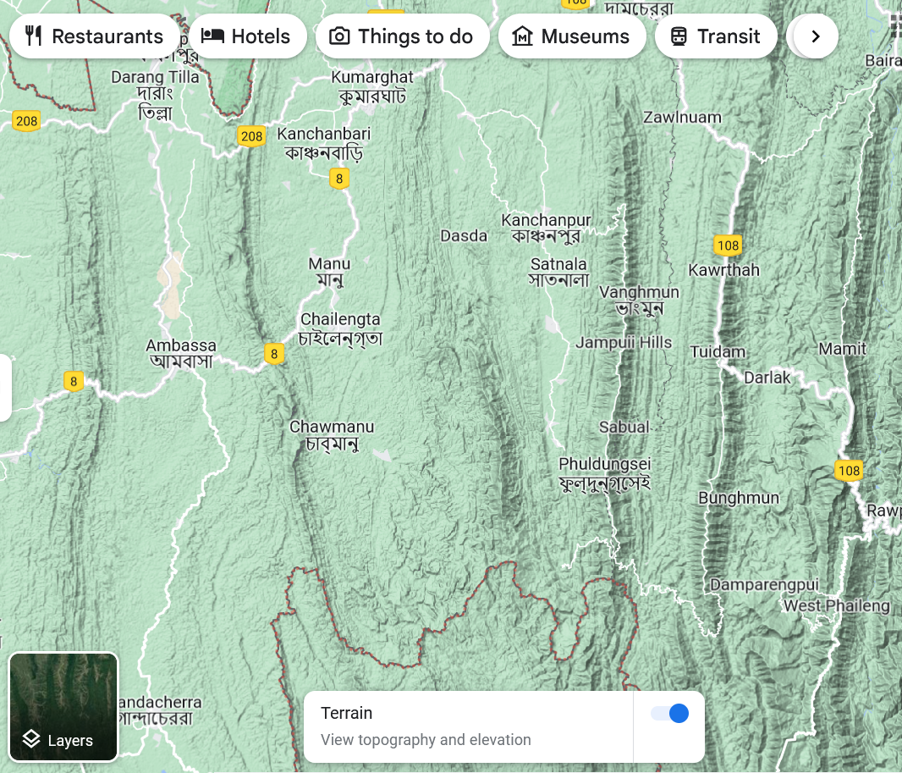
Group 4: hilly topography

