Slide 1
2023 EESC W3400
Lec 01: Introduction and Goals of Course
Computational Earth Science
Bill Menke, Instructor
Emily Glazer, Teaching Assistant
TR 2:40 – 3:55

Slide 2
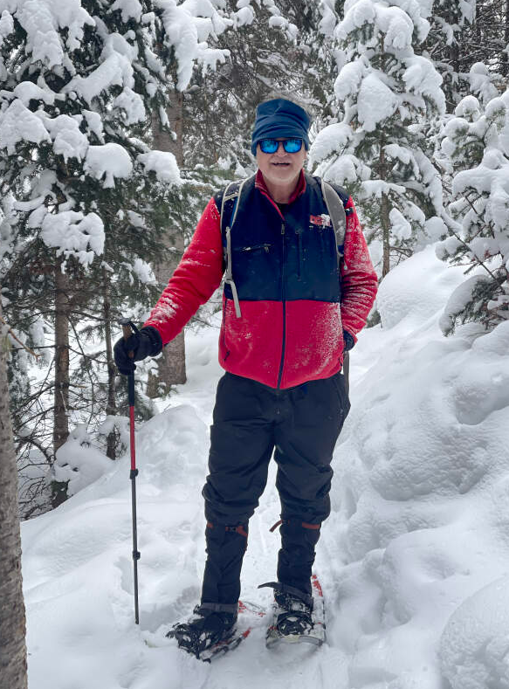
Bill Menke
PhD, Geophysics, Columbia 1982
Instructor
menke@ldeo.columbia.edu

Slide 3
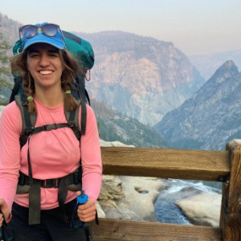
Emily Glazer
BA, Physics, UC Berkeley, 2019
Teaching Assistant
ecg2191@columbia.edu

Slide 4
Goal
For you to become experienced in applying Python-based computational methods to Earth Science phenomena, and especially in using models of dynamic phenomena to understand how the world works.

Slide 5
Why Modeling?

Slide 6
from the humanistic perspective ...
One of the great intellectual achievements of the modern era
some aspects of the future can be
accurately predicted

Slide 7
from a scientist’s perspective ...
a key tool in testing the
correctness of scientific explanations
and more broadly in understanding how
specific phenomena behave

Slide 8
from an environmentalist’s perspective ...
familiarity with the principles of modeling allows one assessing the credibility of
proposed solutions to environmental and climatological problems

Slide 9
Phenomenon
Method
Analysis
Visualization
Interpretation

Slide 10
Phenomenon
planetary motions
cooling of the Earth
transport of chemicals
seismic wave propagation
mantle convection
ocean currents

Slide 11
Method
Runge-Kutta integration
least squares curve fitting
Fourier analysis
mode summation
Finite difference method

Slide 12
Analysis
Python coding
solution methods
bookkeeping

Slide 13
scatter plots
time series plots
histograms
images
animations
Visualization

Slide 14
cause and effect
scale lengths and rates of change
periodicities
asymptotic behavior
sensitivity to parameters
comparison to observations
Interpretation

Slide 15
Phenomenon
Method
Analysis
Visualization
Interpretation

Slide 16
Syllabus
Sept 5 and 7
Getting started
EF_SimplePlots.ipynb
EF_ThermalGreenFcn.ipynb
Sept 12 and 14
Simple Time-Dependent Differntial Equations
RK_FallingRock.ipynb
RK_Slider.ipynb
Sept 19 and 12`
RKNM_CircularOrbit.ipynb
RKNM_TwoPlanets.ipynb
RKNM_animateplanets.ipynb

Slide 17
Syllabus
Sept 16 and 28
RK_lakes.ipynb
RK_Rays.ipynb
Oct 3
RK_temperature.ipynb
Oct 5 and 10
Least Squares
LSpolynomial.ipynb
LSsawtooth.ipynb
LSlegendre.ipynb

Slide 18
Syllabus
Oct 12 and 17
Fourier Analysis
FFT_ExponentialFunction.ipynb
FFT_dispersion.ipynb
Oct 19 and 24
FFT_PlaneWave.ipynb
FFT_2DGreenFcn2.ipynb
Oct 26 and 31
FFT_1DRandomField.ipynb
FFT_2DRandomField.ipynb
Nov 2
FFT_thermal.ipynb

Slide 19
Syllabus
Nov 9 and 14
Mode Summation
MS_OrganPipe.ipynb
MS_Membrane.ipynb
Nov 16, 21 and 23
Finite Differnce Method
FDpoisson.ipynb
FDlaplace.ipynb
Nov 28 and 30
FDdiffusion.ipynb
FDconvection.ipynb
Dec 5
FDfluiddynamics.ipynb
Dec 7 and 12
Class Presentations

Slide 20
Syllabus
Nov 9 and 14
Mode Summation
MS_OrganPipe.ipynb
MS_Membrane.ipynb
Nov 16, 21 and 23
Finite Differnce Method
FDpoisson.ipynb
FDlaplace.ipynb
Nov 28 and 30
FDdiffusion.ipynb
FDconvection.ipynb
Dec 5
Fdfluiddynamcis. .ipynb
Dec 7 and 12
Class Presentations
Whether we actually get through this material with depend on the pace you find acceptable.

Slide 21
Syllabus
Nov 9 and 14
Mode Summation
MS_OrganPipe.ipynb
MS_Membrane.ipynb
Nov 16, 21 and 23
Finite Differnce Method
FDpoisson.ipynb
FDlaplace.ipynb
Nov 28 and 30
FDdiffusion.ipynb
FDconvection.ipynb
Dec 5
Fdfluiddynamcis. .ipynb
Dec 7 and 12
Class Presentations
I don’t have any problem with getting through less in order for you to learn new material more thoroughly

Slide 22
Class Organization
Short lecture by me describing phenomenon and methodology
Everyone runs and discusses exemplary code
In class small group assignments (typically follow up idea by modifying code)
group presentations and discussion

Slide 23
Homework
Write up of in-class assignments
Read my policies at
https://www.ldeo.columbia.edu/users/menke/gradingpolicy.html
Collaborations of <= 3 people OK if acknowledged
You are expected to make >= 1/3 contribution
Copying disallowed
All write-ups must be in your own (individual) words
Due Fridays at 11:59 PM summarizing in-class presentations of previous week
Graded only acceptable / unacceptable

Slide 24
Term Project
Individualized
Fairly substantial analysis of a phenomenon different from but of similar complexity to those we cover in class
Project idea due mid-November and must be approved by me.
Presented in class at the end of the term
Graded according to rubric that will be provided beforehand
Term Paper verssion last day of finals week at 11:59 PM.

Slide 25
Grading
Class Participation (including acceptable write-ups): 50%
Term Project: 50%
(No midterm, no final)

Slide 26
Questions?

Slide 27
Installation of Python & etc.

Slide 28
Step 1
Download Python from Python webpage:
https://www.python.org/downloads/

Slide 29
Step 2
Download Anaconda from Anaconda webpage:
https://www.anaconda.com/products/individual

Slide 30
Step 3
Bring up the Anacona Powershell window
and see if your installation contains
Jupyter Lab by typing the command:
jupyter lab
If it can’t find this command, then install Jupyter Lab by typing the command:
conda install -c conda-forge jupyterlab

Slide 31
Step 4
Install various packages by typing
into the Anacona Powershell window the commands:
conda install numpy
conda install scipy
conda install matplotlib
conda install ipython
conda install -c conda-forge ffmpeg

Slide 32
Step 5
Create a class folder at a location you can remember and with a path name that fairly easy to type
Mine’s called
CES23
And copy all the class files from the Canvas Code directory into it.

Slide 33
Step 6
Bring up a browser like Chrome or Firefox
Bring up an Anaconda PowerShell Prompt window
Change to your class directory
e.g.
cd C:\bill\CES23
launch Jupyter Lab
jupyter lab
a Juyter Lab window should appear in your browser

Slide 34
After installing Python Environment
Break into two groups
- Group 1: little or no familiarity with coding
Bill leads tutorial on getting started
- Group 2: work through topics which your less familiar with in
MenkeOnPython.ipynb
and especially matrix arithmetic (with Emily’s assistance)

