Slide 1
2023 EESC W3400
Lec 03: Runge Kutta method illustrated by falling objects
Computational Earth Science
Bill Menke, Instructor
Emily Glazer, Teaching Assistant
TR 2:40 – 3:55

Slide 2
Dynamics
study of forces and their effects on motion

Slide 3
Dynamics
Method of studying phenomena that change with time

Slide 4
100
height, z
gravity
0

Slide 5
time t=0
100
height, z
gravity
0

Slide 6
time t=0
100
z(t) = ?
height, z
gravity
0

Slide 7
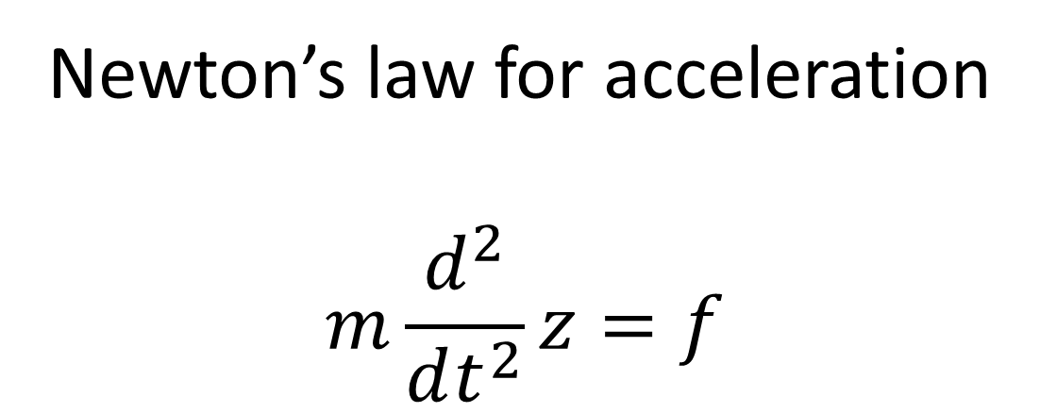
Newton’s law for acceleration
$$m\frac{d^{2}}{dt^{2}}z=f$$

Slide 8
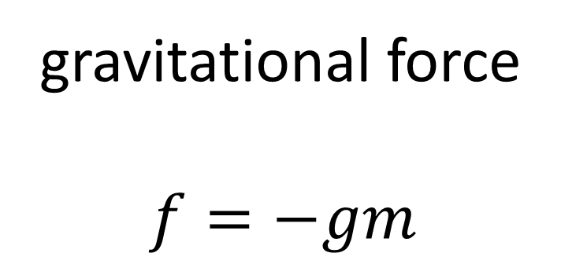
gravitational force
$$f=−gm$$

Slide 9
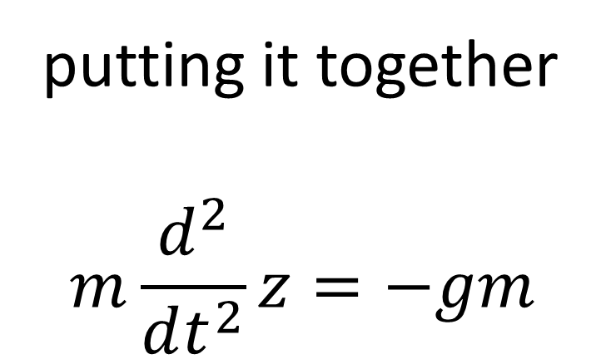
putting it together
$$m\frac{d^{2}}{dt^{2}}z=−gm$$

Slide 10
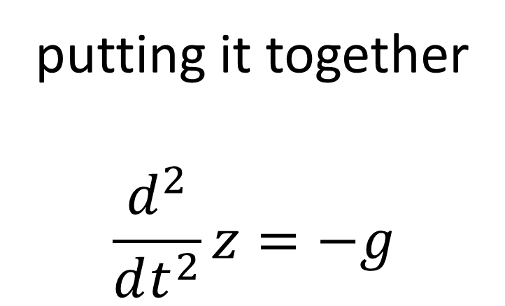
putting it together
$$\frac{d^{2}}{dt^{2}}z=−g$$

Slide 11
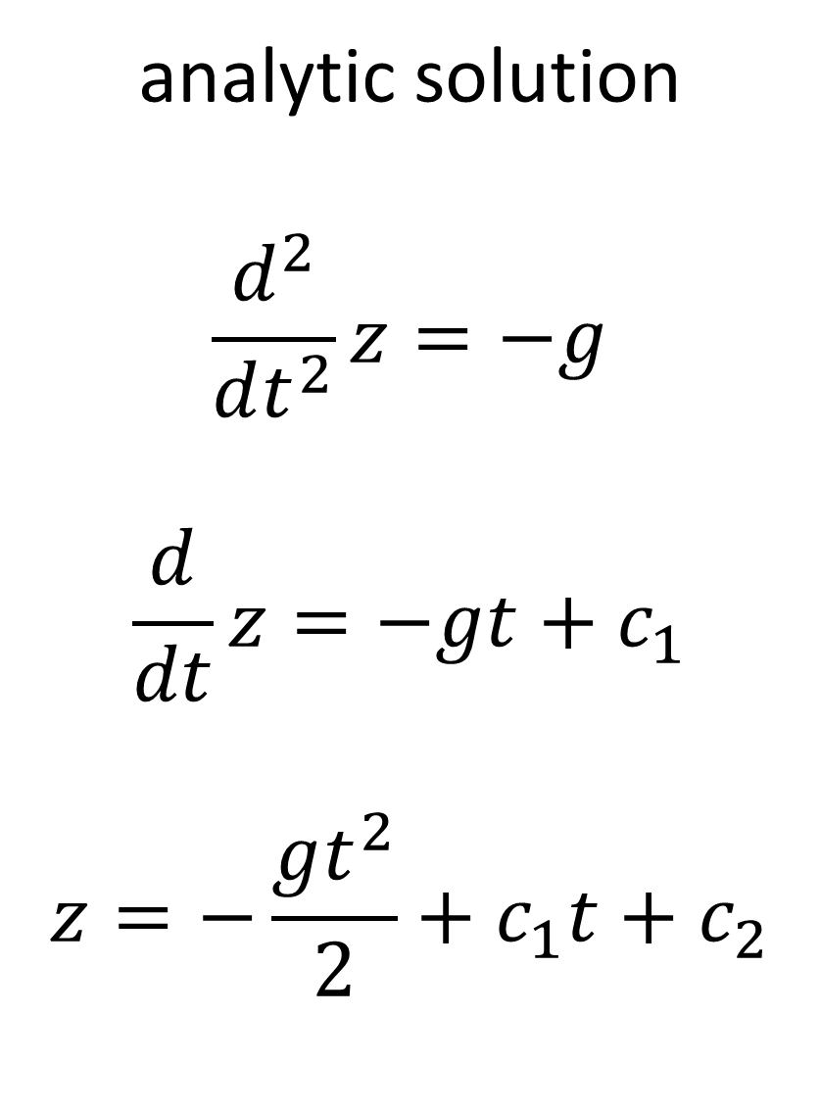
analytic solution
$$\frac{d^{2}}{dt^{2}}z=−g$$
$$\frac{d}{dt}z=−gt+c_{1}$$
$$z=−\frac{gt^{2}}{2}+c_{1}t+c_{2}$$

Slide 12

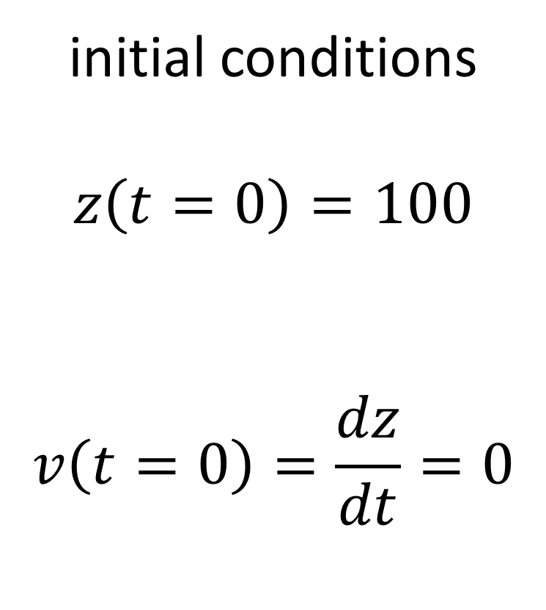


initial conditions
$$z\left(t=0\right)=100$$
$$v\left(t=0\right)=\frac{dz}{dt}=0$$
$$z=−\frac{gt^{2}}{2}+c_{1}t+c_{2}$$
$$v=−gz+c_{1}$$
$$c_{2}=100$$
$$c_{1}=0$$

Slide 13
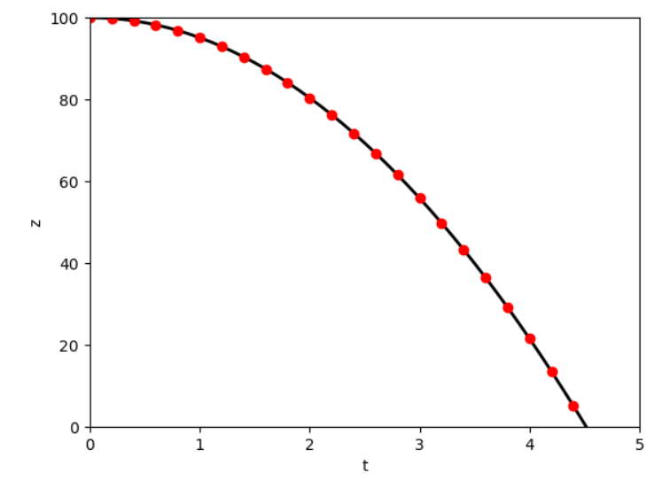
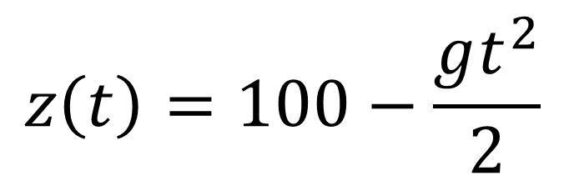
$$z\left(t\right)=100−\frac{gt^{2}}{2}$$

Slide 14




reorganization of the equation
$$\frac{d}{dt}z=v$$
$$\frac{d^{2}}{dt^{2}}z=−g$$
$$\frac{d}{dt}\left[\begin{matrix}z \\ v\end{matrix}\right]=\left[\begin{matrix}v \\ −g\end{matrix}\right]$$
$$\frac{d}{dt}v=−g$$

Slide 15

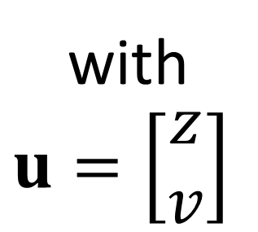




reorganization of the equation
$$\frac{d}{dt}\left[\begin{matrix}z \\ v\end{matrix}\right]=\left[\begin{matrix}v \\ −g\end{matrix}\right]$$
$$\frac{d}{dt}u=f\left(u,t\right)$$
$$z\left(t=0\right)=z_{0}$$
$$u\left(t=0\right)=u_{0}$$
with
$$u=\left[\begin{matrix}z \\ v\end{matrix}\right]$$
$$v\left(t=0\right)=v_{0}$$

Slide 16
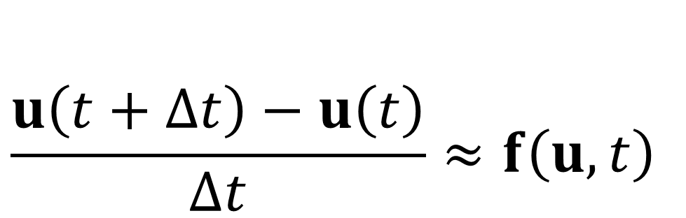
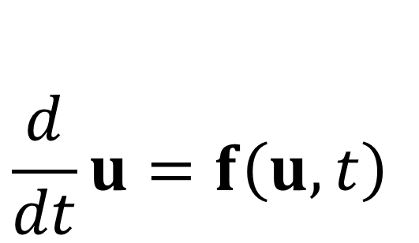
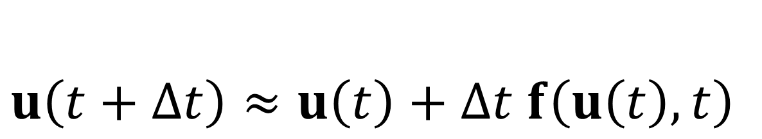
Euler’s Method
$$\frac{d}{dt}u=f\left(u,t\right)$$
$$\frac{u\left(t+∆t\right)−u\left(t\right)}{∆t}≈f\left(u,t\right)$$
$$u\left(t+∆t\right)≈u\left(t\right)+∆t f\left(u\left(t\right),t\right)$$

Slide 17
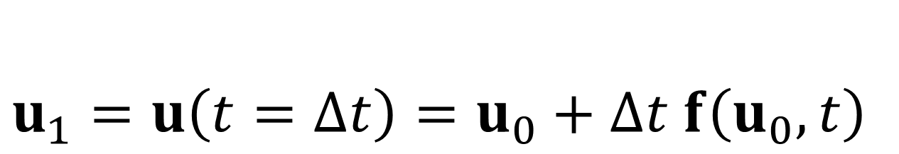

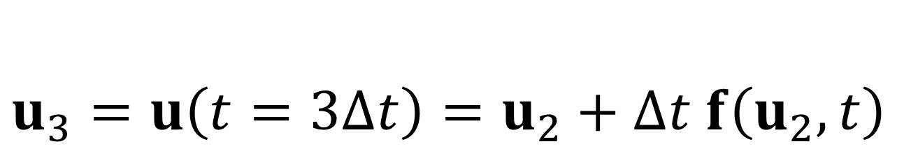
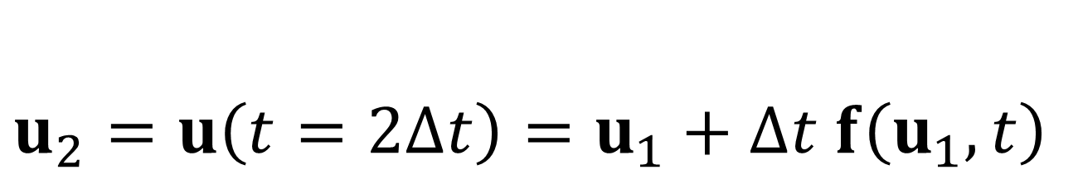
Euler’s Method
$$u_{0}=u\left(t=0\right)$$
$$u_{1}=u\left(t=∆t\right)=u_{0}+∆t f\left(u_{0},t\right)$$
$$u_{2}=u\left(t=2∆t\right)=u_{1}+∆t f\left(u_{1},t\right)$$
$$u_{3}=u\left(t=3∆t\right)=u_{2}+∆t f\left(u_{2},t\right)$$
…

Slide 18




$$u$$
$$u_{0}$$
$$0$$
$$t$$

Slide 19




$$u$$
$$u_{1}$$
$$u_{0}$$
$$∆t$$
$$0$$
$$t$$

Slide 20

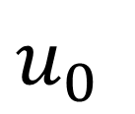
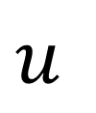

$$u$$
$$u_{2}$$
$$u_{1}$$
$$u_{0}$$
$$∆t$$
$$∆t$$
$$0$$
$$t$$

Slide 21








One big step vs two half-steps
$$y$$
$$y$$
$$y_{0}$$
$$y_{0}$$
$$0$$
$$t$$
$$0$$
$$t$$

Slide 22
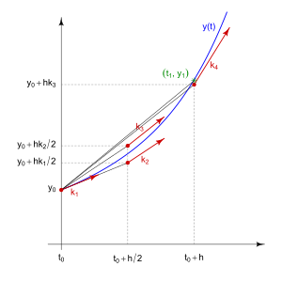
Runge Kutta Method
combine info for several
different step sizes to
reduce error

Slide 23
# equation for rock position z
# u = [z, v]
# d/dt z = v
# d/dt v = -g
N=100;
t0=0.0;
tmax=5.0;
t = np.linspace(t0,tmax,N);
def myfun( t, u ):
f = np.zeros((2,));
f[0] = u[1];
f[1] = -g;
return f;
# initial conditions
u0 = np.zeros((2,));
u0[0] = z0;
u0[1] = 0.0;

Slide 24
# Python built in
sol=solve_ivp(myfun, [t0, tmax], u0, method = 'DOP853', t_eval=t);
fig1 = plt.figure(1);
ax2 = plt.subplot(1,1,1);
plt.axis( [0, tmax, 0.0, z0 ] );
plt.plot( sol.t, sol.y[0], 'k-', lw=2);
plt.xlabel('t');
plt.ylabel('z');
plt.show();
vector of times
sol.t
sol.y[0]
sol.y[1]
vector of positions
vector of velocities

Slide 25
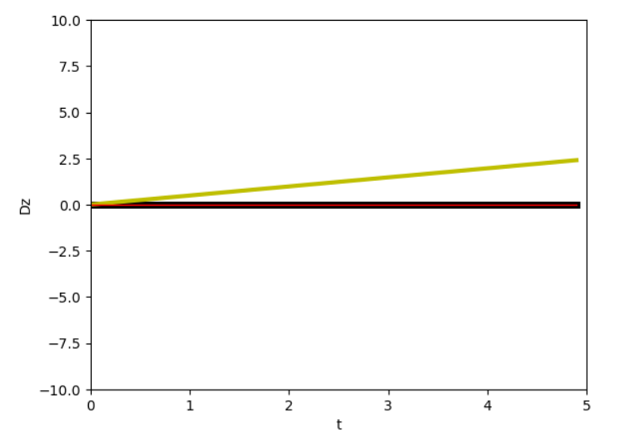
Euler
analytic, Runge Kutta

Slide 26
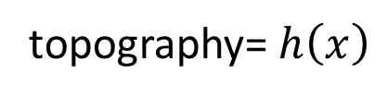






slider
force of gravity = $−g\sin{θ}$
force of friction = $−c v\cos{θ}$
topography= $h\left(x\right)$
frictional force
slope angle $\tan{θ=\frac{dh}{dx}}$
xxxx
$$θ$$
force of gravity
$$h\left(x\right)$$
$$x$$
gravity

Slide 27
slider
force of gravity = $−g\sin{θ}$
force of friction = $−c v\cos{θ}$
topography= $h\left(x\right)$
frictional force
slope angle $\tan{θ=\frac{dh}{dx}}$
xxxx
$$θ$$
force of gravity
$$h\left(x\right)$$
$$x$$
gravity
coefficient of friction
friction increases with velocity

Slide 28
def ground(x):
A = 1.0;
L = 10.0;
kx = 2*pi/L;
h = A*cos(kx*x); # +h is up
dhdx = -A*kx*sin(kx*x);
theta = atan(dhdx);
return h, (180.0/pi)*theta;

Slide 29
# newton's law
# u = [x, vx]
# d/dt [x] = [vx] = fun(x,y,vx)
# [vx] = -g sin(theta) – c vx cos(theta)
def myfun( t, u ):
h, theta = ground(u[0]);
f = np.zeros((2,));
f[0] = u[1];
f[1] = -g*sin((pi/180)*theta)-c*u[1]*cos((pi/180)*theta);
return f;
# initial conditions
u0 = np.zeros((2,));
u0[0] = 0.0;
u0[1] = 7.0;

Slide 30


Slide 31


Slide 32




group 1
the force of friction is currently = $−c v\cos{θ}$
where= $v=\frac{dx}{dt}$ is the x-component of velocity
however, a better model would be to replace $v$ with the total velocity $v_{T}$
$v_{T}= \sqrt{v^{2}+v_{h}^{2}}$ where $v_{h}=\frac{dh}{dt}=\frac{dh}{dx}\frac{dx}{dt}=\tan{θ }v$ so
$$v_{T}=v\sqrt{1+\tan^{2}{θ }}$$
how much difference does this change make?

Slide 33

group 2
the force of friction is currently = $−c v\cos{θ}=−cv_{0}\left(v/v_{0}\right)\cos{θ}$
let’s write $\left(v/v_{0}\right)$ as $\operatorname{sign}\left(v/v_{0}\right){\left|v/v_{0}\right|}^{n}$
the current case $n=1$ corresponds to friction linearly increasing with velocity
the case $n=0$ corresponds to friction independent of velocity (but opposing motion)
the case $n=2$ corresponds to friction strongly increasing with velocity
how much difference does the choice of $n$ (in the range 0-2) make?

Slide 34

group 3
the slider always wins up in a trough
figure out how to identify the number, $N$, of the trough it winds up in
create and interpret a plot of $N\left(v_{0}\right)$

Slide 35


group 4
the slider always wins up in a trough
figure out how to identify the number, $N$, of the trough it winds up in
create and interpret a plot of $N\left(c\right)$
where $c$ is the coefficient of friction

