Slide 1
2023 EESC W3400
Lec 04: Planetary Orbits
Computational Earth Science
Bill Menke, Instructor
Emily Glazer, Teaching Assistant
TR 2:40 – 3:55

Slide 2
Announcement
First Assignment due Friday nite
Emily our TA travelling this week but will take questions via Slack
Today’s code include animated gif to solve mac problem
(but not sure it works)

Slide 3


Orbit of Planet $\left(x,y\right)$ plane
$$r$$
sun, M
planet, m

Slide 4
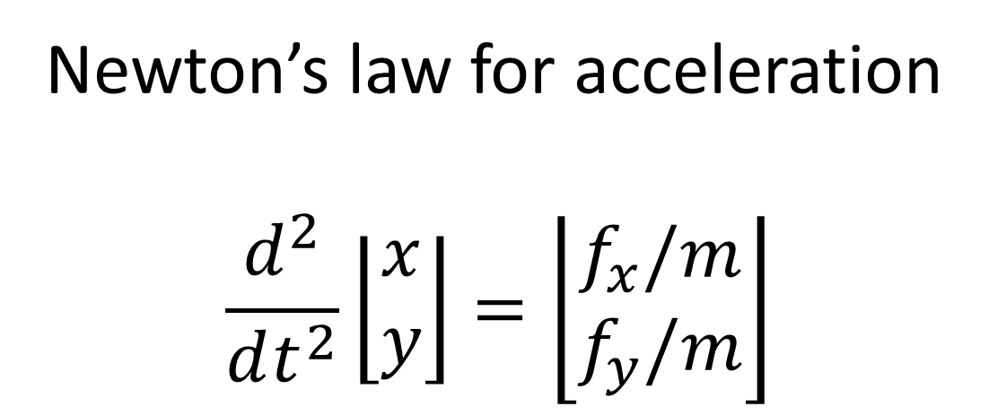
Newton’s law for acceleration
$$\frac{d^{2}}{dt^{2}}\left\lfloor \begin{matrix}x \\ y\end{matrix}\right\rfloor =\left\lfloor \begin{matrix}f_{x}/m \\ f_{y}/m\end{matrix}\right\rfloor$$

Slide 5
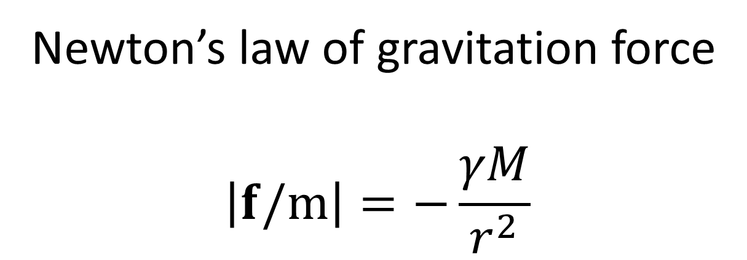
Newton’s law of gravitation force
$$\left|f/m\right|=−\frac{γM}{r^{2}}$$
along line from sun to planet

Slide 6
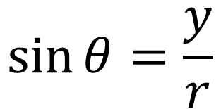

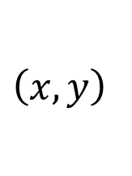
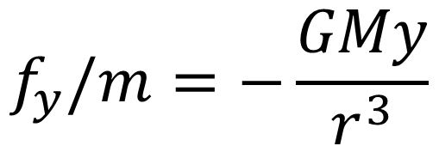

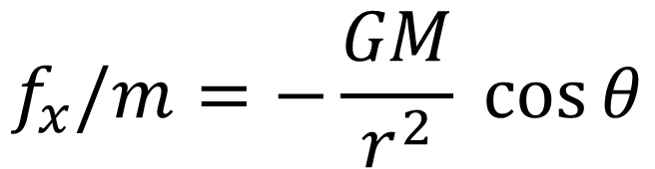
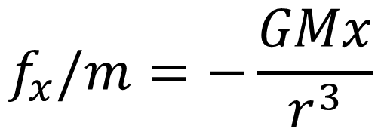

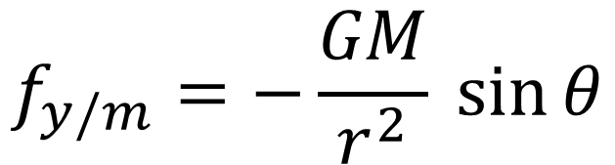

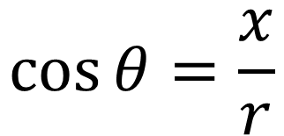
$$\left(x,y\right)$$
$$y$$
$$f_{x}/m=−\frac{GM}{r^{2}} \cos{θ}$$
$$f_{y/m}=−\frac{GM}{r^{2}} \sin{θ}$$
$$r$$
$$θ$$
$$\cos{θ=\frac{x}{r}}$$
$$x$$
$$\sin{θ=\frac{y}{r}}$$
$$f_{x}/m=−\frac{GMx}{r^{3}}$$
$$f_{y}/m=−\frac{GMy}{r^{3}}$$

Slide 7
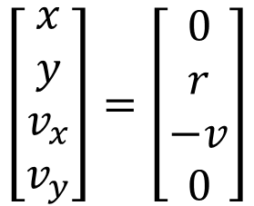

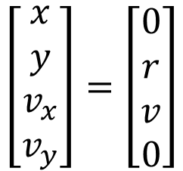

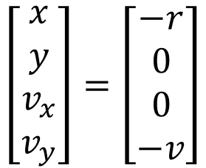
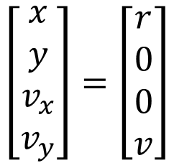

ccw motion
$$y$$
$$\left[\begin{matrix}x \\ y \\ v_{x} \\ v_{y}\end{matrix}\right]=\left[\begin{matrix}0 \\ r \\ −v \\ 0\end{matrix}\right]$$
$$r$$
$$\left[\begin{matrix}x \\ y \\ v_{x} \\ v_{y}\end{matrix}\right]=\left[\begin{matrix}−r \\ 0 \\ 0 \\ −v\end{matrix}\right]$$
$$\left[\begin{matrix}x \\ y \\ v_{x} \\ v_{y}\end{matrix}\right]=\left[\begin{matrix}r \\ 0 \\ 0 \\ v\end{matrix}\right]$$
$$x$$
$$\left[\begin{matrix}x \\ y \\ v_{x} \\ v_{y}\end{matrix}\right]=\left[\begin{matrix}0 \\ r \\ v \\ 0\end{matrix}\right]$$

Slide 8
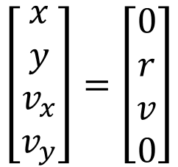
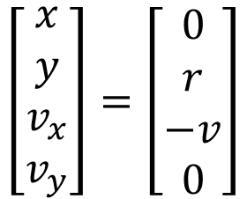
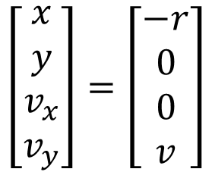
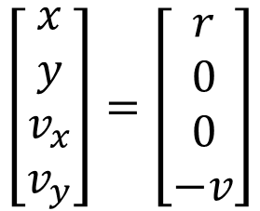
cw motion
$$y$$
$$\left[\begin{matrix}x \\ y \\ v_{x} \\ v_{y}\end{matrix}\right]=\left[\begin{matrix}0 \\ r \\ v \\ 0\end{matrix}\right]$$
$$r$$
$$\left[\begin{matrix}x \\ y \\ v_{x} \\ v_{y}\end{matrix}\right]=\left[\begin{matrix}−r \\ 0 \\ 0 \\ v\end{matrix}\right]$$
$$\left[\begin{matrix}x \\ y \\ v_{x} \\ v_{y}\end{matrix}\right]=\left[\begin{matrix}r \\ 0 \\ 0 \\ −v\end{matrix}\right]$$
$$x$$
$$\left[\begin{matrix}x \\ y \\ v_{x} \\ v_{y}\end{matrix}\right]=\left[\begin{matrix}0 \\ r \\ −v \\ 0\end{matrix}\right]$$

Slide 9
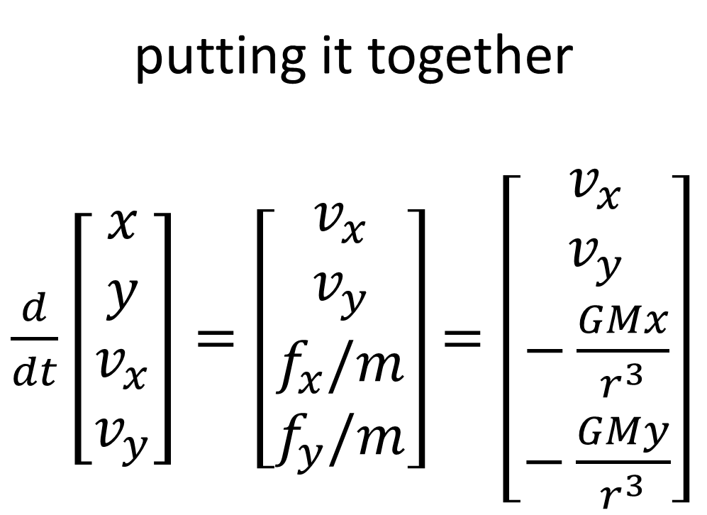
putting it together
$\frac{d}{dt}\left[\begin{matrix}x \\ y \\ v_{x} \\ v_{y}\end{matrix}\right]=\left[\begin{matrix}v_{x} \\ v_{y} \\ f_{x}/m \\ f_{y}/m\end{matrix}\right]$ $=\left[\begin{matrix}v_{x} \\ v_{y} \\ −\frac{GMx}{r^{3}} \\ −\frac{GMy}{r^{3}}\end{matrix}\right]$

Slide 10










$$\left(x_{1},y_{1}\right)$$
two planets
$$y$$
$$m_{1}$$
$$r_{1}$$
$$r_{12}$$
$$\left(x_{2},y_{2}\right)$$
$$r_{2}$$
$$m_{2}$$
$$x$$
$$M$$

Slide 11
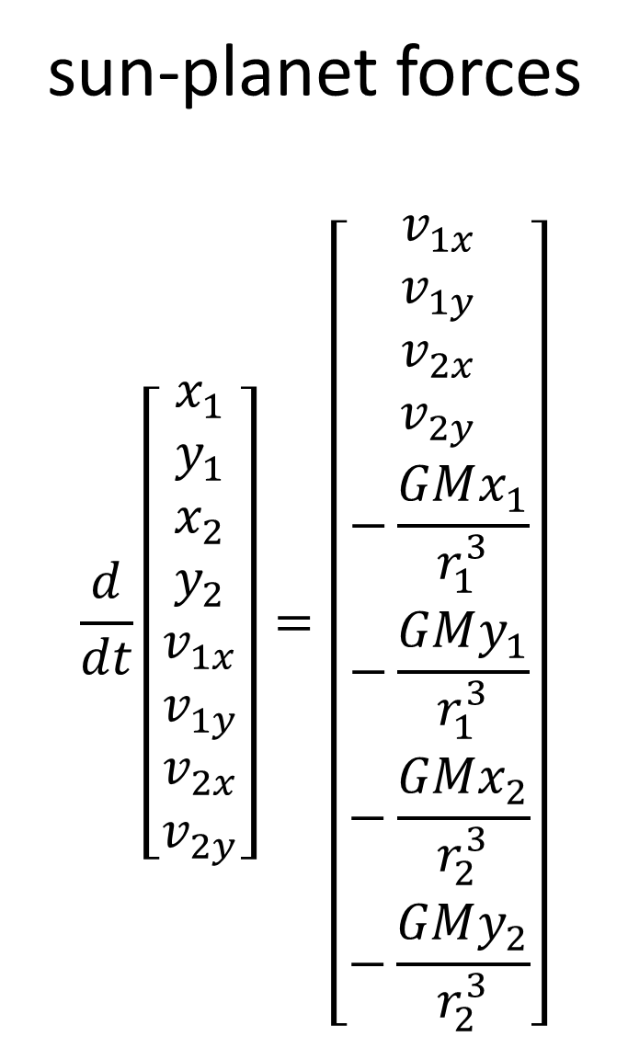
sun-planet forces
$$\frac{d}{dt}\left[\begin{matrix}x_{1} \\ y_{1} \\ x_{2} \\ y_{2} \\ v_{1x} \\ v_{1y} \\ v_{2x} \\ v_{2y}\end{matrix}\right]=\left[\begin{matrix}v_{1x} \\ v_{1y} \\ v_{2x} \\ v_{2y} \\ −\frac{GMx_{1}}{r_{1}^{3}} \\ −\frac{GMy_{1}}{r_{1}^{3}} \\ −\frac{GMx_{2}}{r_{2}^{3}} \\ −\frac{GMy_{2}}{r_{2}^{3}}\end{matrix}\right]$$

Slide 12

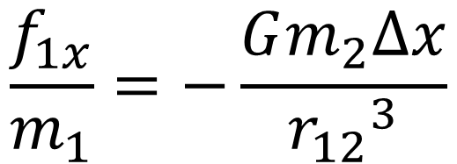
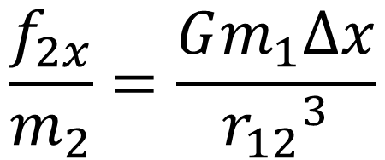









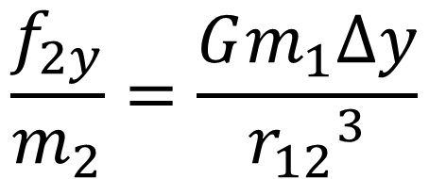


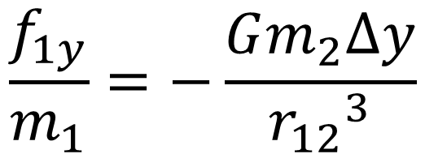
$$\left(x_{1},y_{1}\right)$$
$$y$$
$$∆x=x_{1}−x_{2}$$
$$(pos)$$
$$m_{1}$$
$$∆y=y_{1}−y_{2}$$
$$(pos)$$
$$r_{12}$$
$$r_{AB}=\sqrt{{\left(∆y\right)}^{2}+{\left(∆y\right)}^{2}}$$
$$\left(x_{2},y_{2}\right)$$
$f_{1}$ $(neg)$
$$m_{2}$$
$$x$$
$$M$$
$$\frac{f_{2x}}{m_{2}}=\frac{Gm_{1}∆x}{{r_{12}}^{3}}$$
$$\frac{f_{1x}}{m_{1}}=−\frac{Gm_{2}∆x}{{r_{12}}^{3}}$$
$$\frac{f_{2y}}{m_{2}}=\frac{Gm_{1}∆y}{{r_{12}}^{3}}$$
$$\frac{f_{1y}}{m_{1}}=−\frac{Gm_{2}∆y}{{r_{12}}^{3}}$$

Slide 13
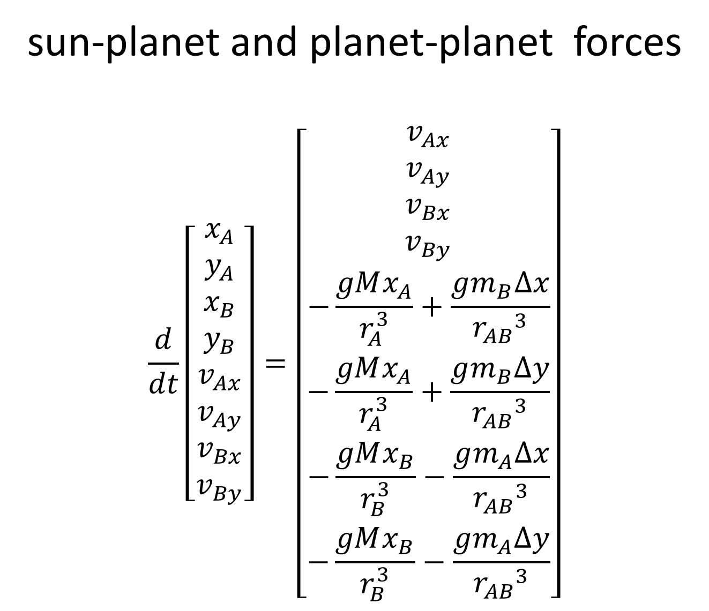
sun-planet and planet-planet forces
$$\frac{d}{dt}\left[\begin{matrix}x_{A} \\ y_{A} \\ x_{B} \\ y_{B} \\ v_{Ax} \\ v_{Ay} \\ v_{Bx} \\ v_{By}\end{matrix}\right]=\left[\begin{matrix}v_{Ax} \\ v_{Ay} \\ v_{Bx} \\ v_{By} \\ −\frac{gMx_{A}}{r_{A}^{3}}+\frac{gm_{B}∆x}{{r_{AB}}^{3}} \\ −\frac{gMx_{A}}{r_{A}^{3}}+\frac{gm_{B}∆y}{{r_{AB}}^{3}} \\ −\frac{gMx_{B}}{r_{B}^{3}}−\frac{gm_{A}∆x}{{r_{AB}}^{3}} \\ −\frac{gMx_{B}}{r_{B}^{3}}−\frac{gm_{A}∆y}{{r_{AB}}^{3}}\end{matrix}\right]$$

Slide 14
# u0 u1 u2 u3 u4 u5 u6 u7
# x1 y1 x2 y2 vx1 vy1 vx2 vy2
def myfun( t, u ):
f = np.zeros((8,));
f[0] = u[4];
f[1] = u[5];
f[2] = u[6];
f[3] = u[7];
R1 = sqrt((u[0]**2) + (u[1]**2));
R2 = sqrt((u[2]**2) + (u[3]**2));
dx = u[0]-u[2];
dy = u[1]-u[3];
R12 = sqrt((dx**2) + (dy**2));
q1 = -G*Ms/(R1**3);
q2 = -G*Ms/(R2**3);
q12 = -G*Mp2/(R12**3);
q21 = -G*Mp1/(R12**3);
c=1.0; # coupling between planets
f[4] = u[0]*q1 + c*dx*q12;
f[5] = u[1]*q1 + c*dy*q12;
f[6] = u[2]*q2 - c*dx*q21;
f[7] = u[3]*q2 - c*dy*q21;
return(f);

Slide 15
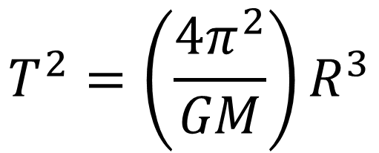
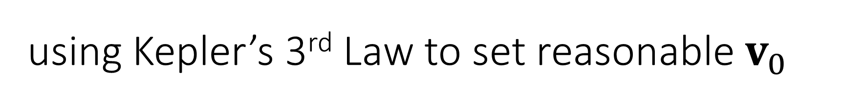
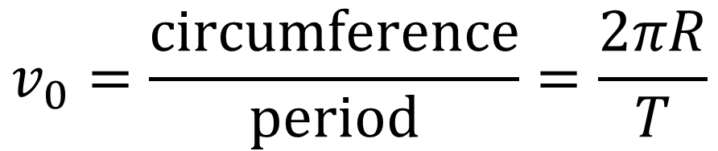
using Kepler’s 3rd Law to set reasonable $v_{0}$
for 1 planet with a circular orbit
$$T^{2}=\left(\frac{4π^{2}}{GM}\right)R^{3}$$
$$v_{0}=\frac{circumference}{period}=\frac{2πR}{T}$$

Slide 16

















if( MYCASE == 0 ):
q1 = 0.0; # angle (with respect to x-axis in rads) of planet 1 (u0[0] = cos(q1)*Rp1; u0[1] = sin(q1)*Rp1)
q2 = 0.0; # angle (with respect to x-axis in rads) of planet 2 (u0[2] = cos(q2)*Rp2; u0[3] = sin(q2)*Rp2)
fR = 0.95; # planet 2 has this fraction of its normal radius (Rp2 = fR*Rp1)
sv2 = -1.0; # sign of planet 2 velocity (sv2)
fv2 = 1.0; # planet 2 has this fraction of its normal velocity (u0[7] = fv2*sv2*Vp2)
fM2 = 1.0; # planet 2 has this fraction of its normal mass (Mp2 = fM2*Mp1)
setup
CASE 0
$$y$$
$$y$$
$$v_{y1}$$
$$v_{y1}$$
circular orbit
$$r_{1}$$
$$m_{1}$$
$$v_{y2}$$
5% difference in radii
$$θ_{1}$$
$$θ_{2}$$
$$x$$
$$m_{1}=m_{2}$$
$$x$$
$$r_{2}$$
$$m_{2}$$
$$M$$
$$M$$
$$v_{y2}$$
circular orbit

Slide 17
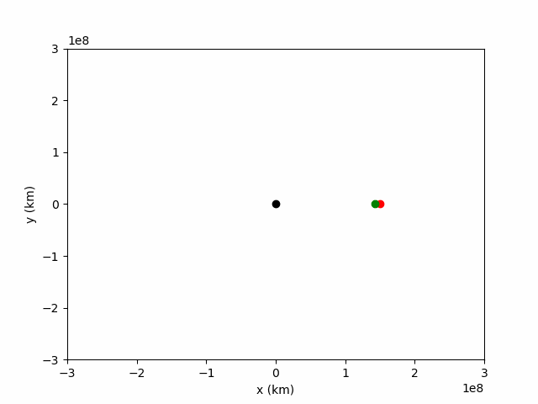
u0: [ 1.500e+11 0.0
1.425e+11 0.0
0.0 2.96e+04
0.0 -3.04e+04]
x axis bigger radius
x axis smaller radius
going towards +y, smaller velocity
going towards -y, bigger velocity
velocities set for circular orbits

Slide 18
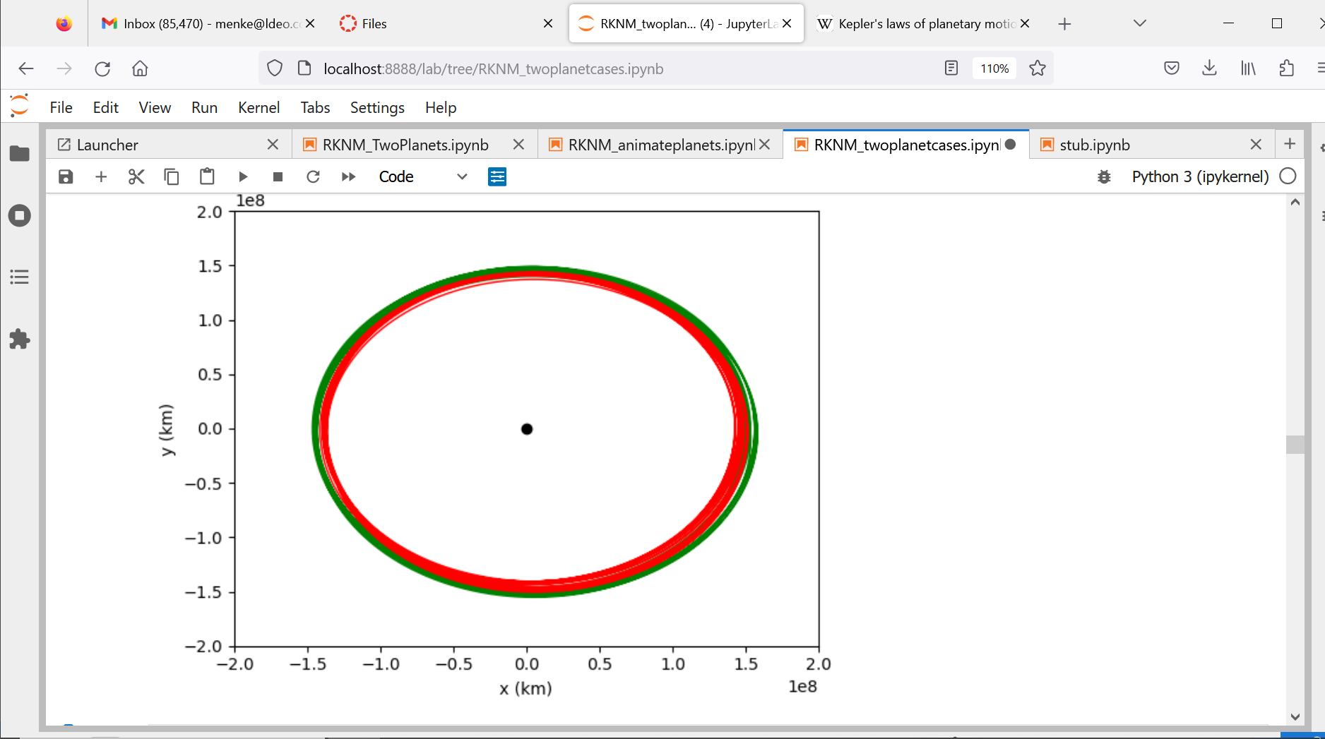

Slide 19
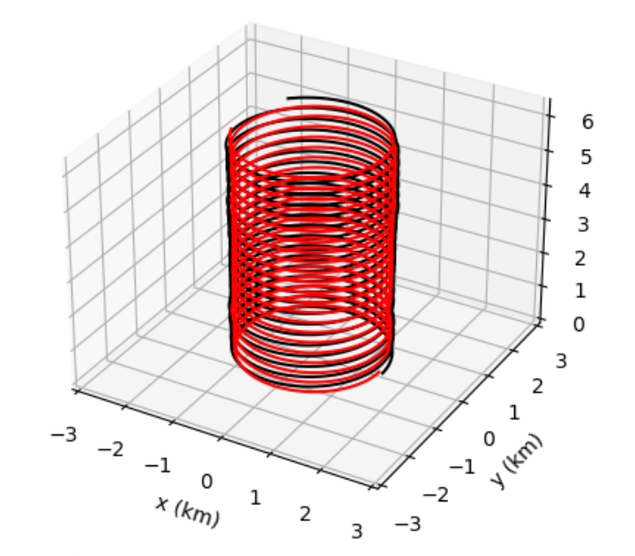
time

Slide 20
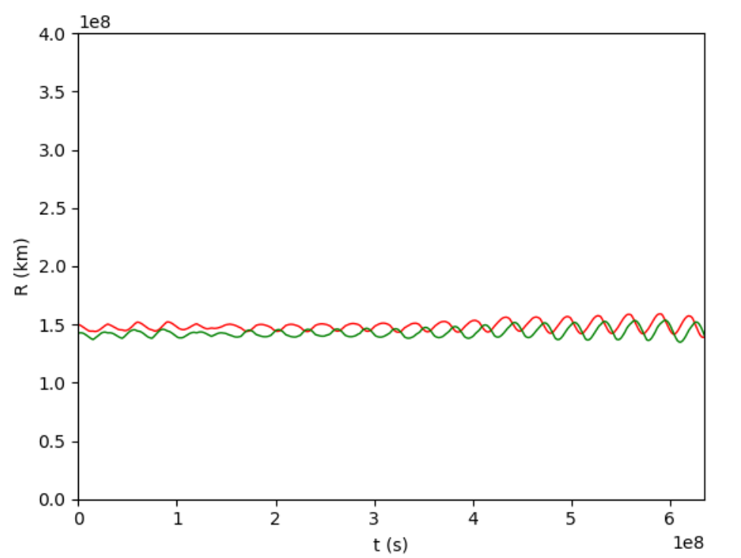

Slide 21
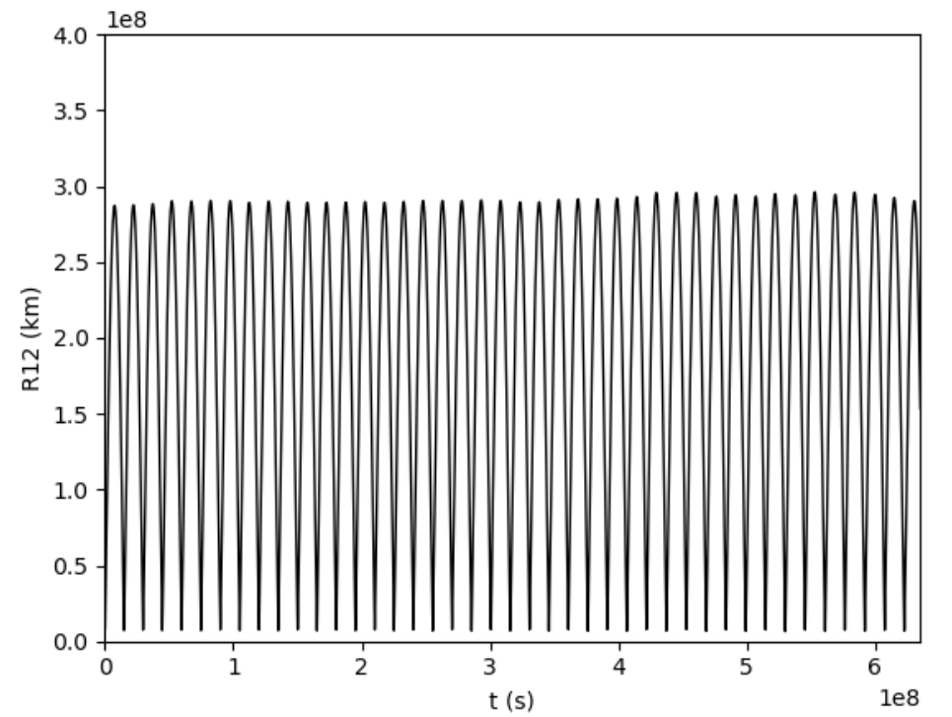

Slide 22
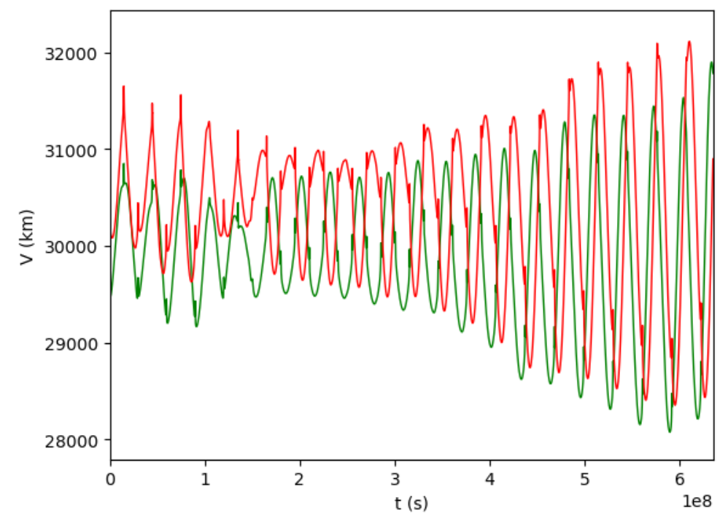

Slide 23
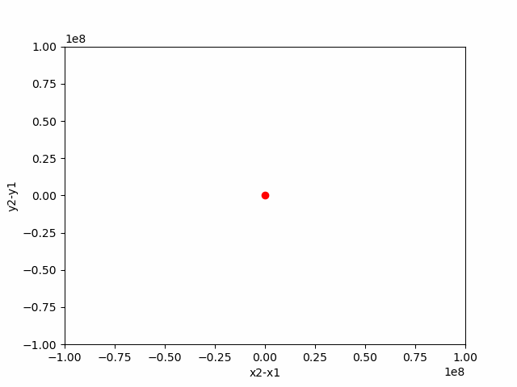
zoom of one close-encounter interaction
moving coordinate system centered on planet 1

Slide 24
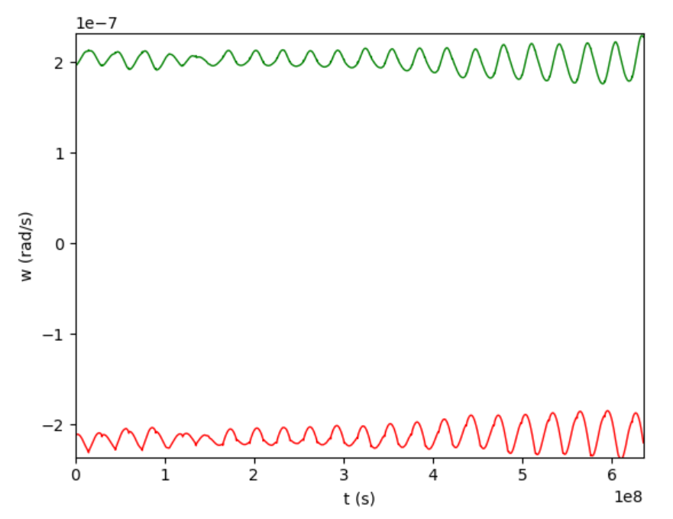
angular velocity
tells you how its circling the sun
sign tells you whether motion is clockwise (+) or counterclockwise (-)

Slide 25
Group assignments
CASES 1 through 4
what is the configuration and initial conditions?
what is the big picture of the evolution of orbits ?
zoom in to one interesting moment and describe what happened

Slide 26
conda install -c anaconda pillow
might need to use anaconda to install pillow

