Slide 1
2023 EESC W3400
Lec 05: Reservoir models illustrated by cascade of lakes
Computational Earth Science
Bill Menke, Instructor
Emily Glazer, Teaching Assistant
TR 2:40 – 3:55

Slide 2
Announcement
Second Assignment due Friday nite
Emily our TA is back
We believe we have solved the Mac animated mpeg problem
(tell us if we’re wrong)

Slide 3
today:
Reservoir Models

Slide 4
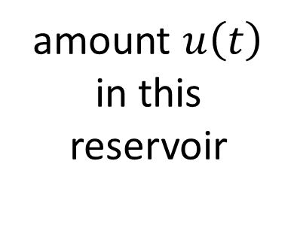
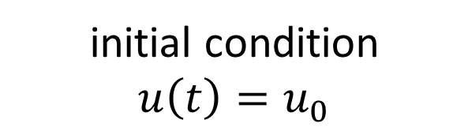

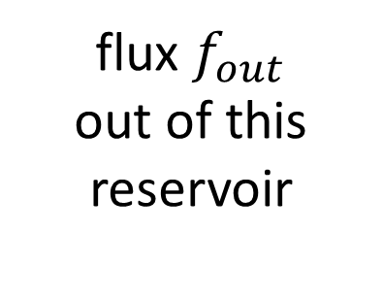
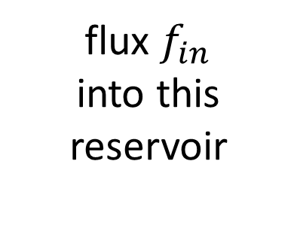
Reservoir
flux in
flux out
amount $u\left(t\right)$
in this reservoir
flux $f_{in}$
into this reservoir
flux $f_{out}$
out of this reservoir
differential
equation
$$\frac{d}{dt}u\left(t\right)=f_{in}−f_{out}$$
initial condition
$u\left(t\right)=u_{0}$

Slide 5
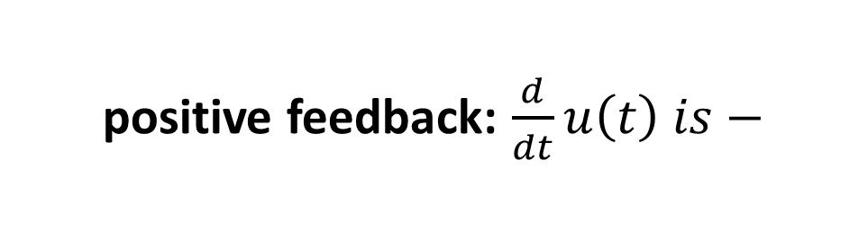
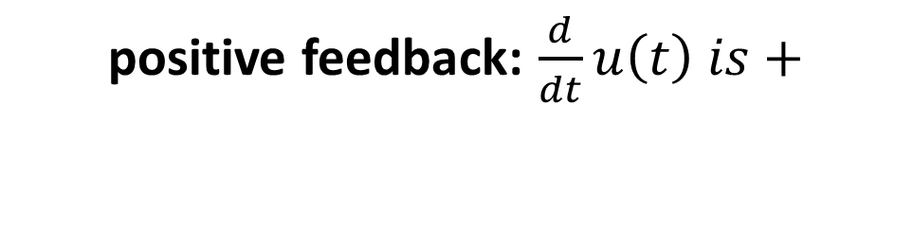
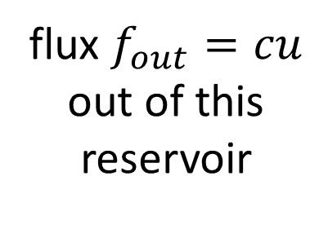
Feedback:
flux depends on amount
Reservoir
flux in
flux out
amount $u\left(t\right)$
in this reservoir
flux $f_{in}$
into this reservoir
flux $f_{out}=cu$
out of this reservoir
positive feedback: $\frac{d}{dt}u\left(t\right) is+$
positive feedback: $\frac{d}{dt}u\left(t\right) is−$

Slide 6


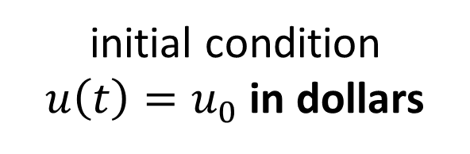


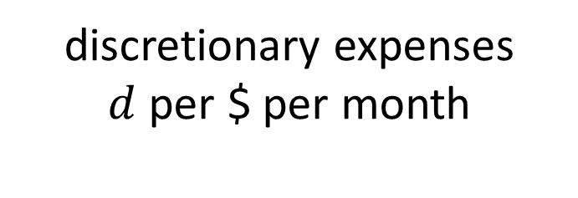

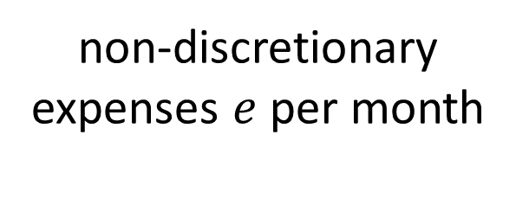
Bank Account
flux out
flux in
non-discretionary expenses $e$ per month
salary $s$ per month
amount $u\left(t\right)$
in $
in this reservoir
discretionary expenses
$d$ per $ per month
interest $r$ per $ per month
$$f_{in}=s+ru$$
$$f_{out}=e+du$$
initial condition
$u\left(t\right)=u_{0}$ in dollars

Slide 7
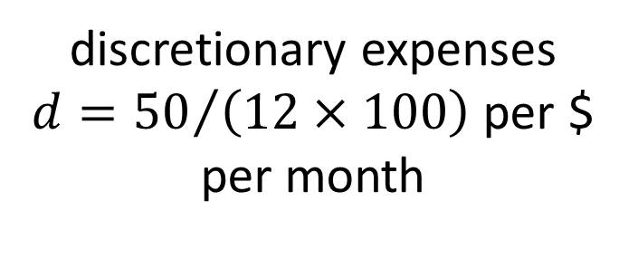
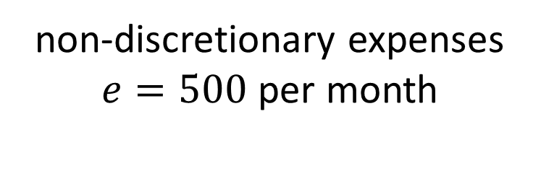
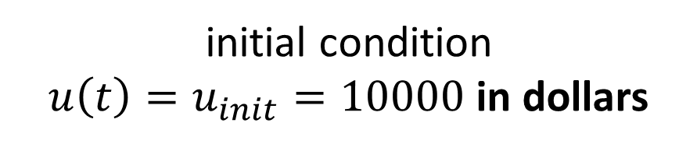
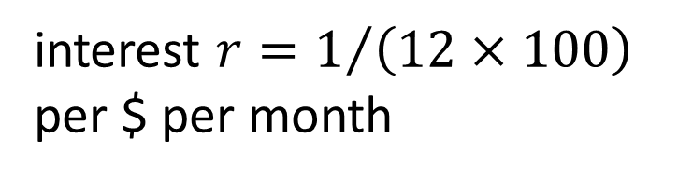

Reservoir
flux out
non-discretionary expenses $e=500$ per month
flux in
salary $s=1000$ per month
amount $u\left(t\right)$
in $
in this reservoir
discretionary expenses
$d={50}/{\left(12×100\right)}$ per $ per month
interest $r=1/{\left(12×100\right)}$
per $ per month
initial condition
$u\left(t\right)=u_{init}=10000$in dollars

Slide 8
M=1; # one variable
balance0 = 10000.0; # initial balance
salary = 1000.0; # salary in $/mo
nondis = 500.0; # non-discretionary spending in $/mo
interest = 1.0/(100.0*12); # interest in fraction of balance per month
discetionary = 50.0/(100.0*12.0); # discretionary spending in fraction of balance per month
# equation for balance u
# d/dt u = salary - nondis + interest*u - dis*u;
def myfun( t, u ):
f = np.zeros((M,));
f[0] = salary - nondis + interest*u[0] - discetionary*u[0];
return f;
# initial conditions
u0 = np.zeros((M,));
u0[0] = balance0;

Slide 9
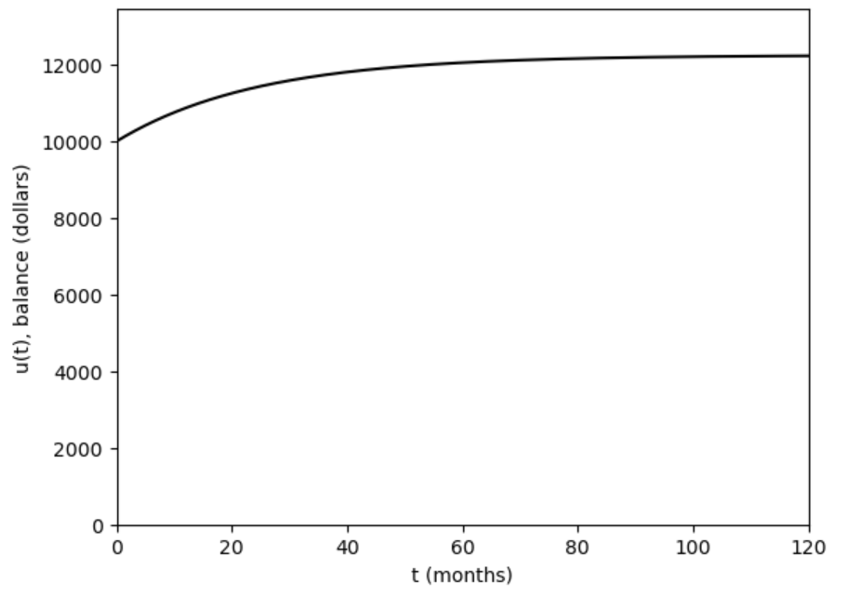
discretionary = 50.0/(100.0*12.0); # discretionary spending in fraction of balance per month

Slide 10
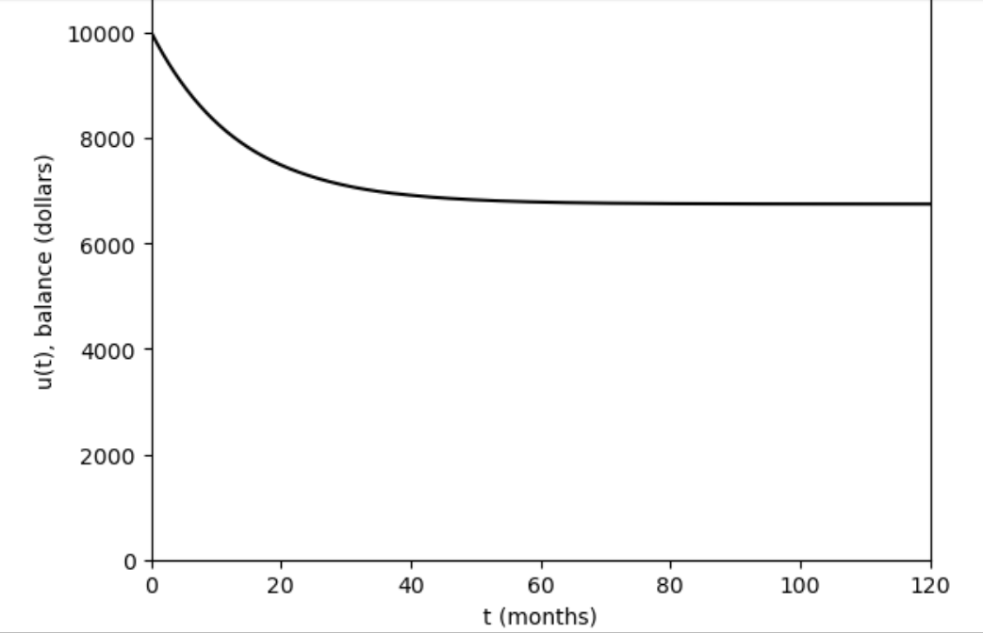
discretionary = 90.0/(100.0*12.0); # discretionary spending in fraction of balance per month

Slide 11


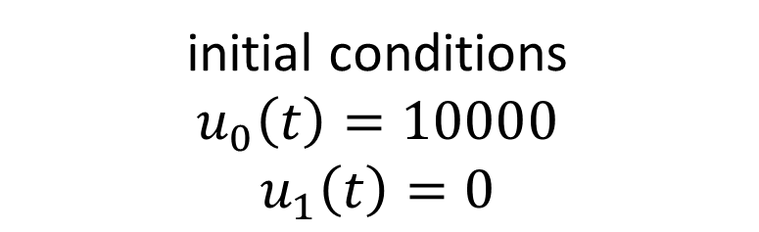
your balance
flux out
flux in
salary
non-discretionary
amount $u_{0}\left(t\right)$
in $
in this reservoir
vendor’s balance
interest
discretionary
amount${ u}_{1}\left(t\right)$
in $
in this reservoir
interest
initial conditions
$$u_{0}\left(t\right)=10000$$
$$u_{1}\left(t\right)=0$$

Slide 12
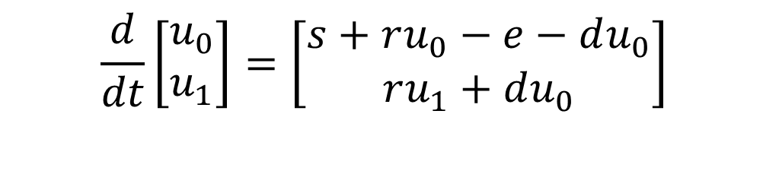
$$\frac{d}{dt}\left[\begin{matrix}u_{0} \\ u_{1}\end{matrix}\right]=\left[\begin{matrix}s+ru_{0}−e−du_{0} \\ ru_{1}+du_{0}\end{matrix}\right]$$

Slide 13
you lose your discretionary spending
$$\frac{d}{dt}\left[\begin{matrix}u_{0} \\ u_{1}\end{matrix}\right]=\left[\begin{matrix}s+ru_{0}−e−du_{0} \\ ru_{1}+du_{0}\end{matrix}\right]$$
vendor gains your discretionary spending

Slide 14
M=2; # two variables
balance0 = 10000.0; # initial balance
balance1 = 0.0; # initial balance of vendor
salary = 1000.0; # salary in $/mo
nondis = 500.0; # non-discretionary spending in $/mo
interest = 1.0/(100.0*12); # interest in fraction of balance per month
discretionary = 90.0/(100.0*12.0); # discretionary spending in fraction of balance per month
def myfun( t, u ):
f = np.zeros((M,));
f[0] = salary - nondis + interest*u[0] - discetionary*u[0];
f[1] = discretionary*u[0] + interest*u[1];
return f;
# initial conditions
u0 = np.zeros((M,));
u0[0] = balance0;
u0[0] = balance1;

Slide 15
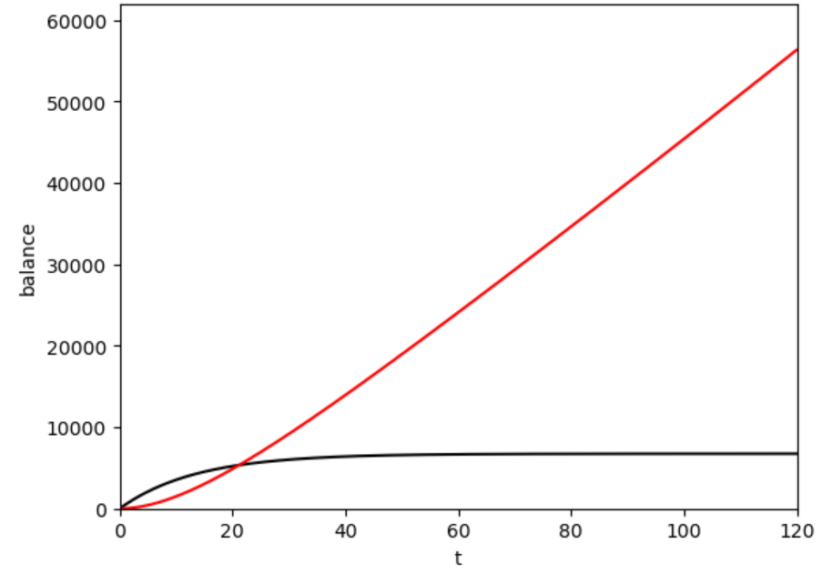
vendor’s balance
your balance

Slide 16
note time delay:
takes a while before vendor has more $ than you
vendor’s balance
your balance

Slide 17
lakes on a hillside
melting
glacier
seepage
thru
ground
seepage
thru
ground
seepage
thru
ground

Slide 18







lakes on a hillside
$$f_{in}$$
$$u_{0}$$
$$\left({c/u}_{ref}\right)\left({u_{0}/u}_{ref}\right)$$
$$u_{1}$$
$$\left(cu_{ref}\right)\left({u_{1}/u}_{ref}\right)$$
$$u_{2}$$
$$\left(cu_{ref}\right)\left({u_{2}/u}_{ref}\right)$$

Slide 19


differential
equation
$$\frac{d}{dt}\left[\begin{matrix}u_{0} \\ u_{1} \\ u_{2}\end{matrix}\right]=\left[\begin{matrix}u_{in}−cu_{0} \\ cu_{0}−cu_{1} \\ cu_{1}−cu_{2}\end{matrix}\right]$$
$$at time t=0 \left[\begin{matrix}u_{0} \\ u_{1} \\ u_{2}\end{matrix}\right]=\left[\begin{matrix}0 \\ 0 \\ 0\end{matrix}\right]$$
initial
condition

Slide 20
what leaves lake 0
$$\frac{d}{dt}\left[\begin{matrix}u_{0} \\ u_{1} \\ u_{2}\end{matrix}\right]=\left[\begin{matrix}u_{in}−cu_{0} \\ cu_{0}−cu_{1} \\ cu_{1}−cu_{2}\end{matrix}\right]$$
flows into lake 1

Slide 21
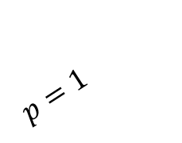


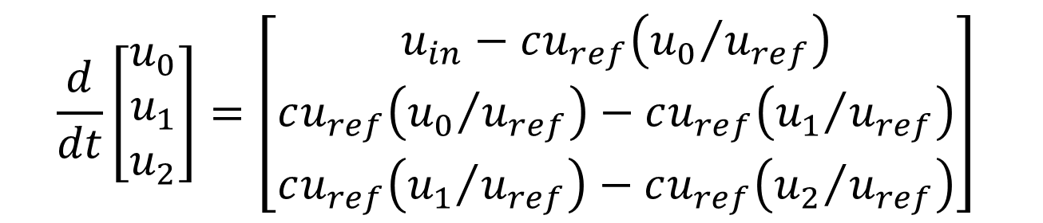
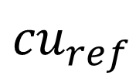
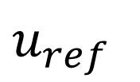

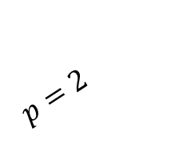
write this way instead
$$\frac{d}{dt}\left[\begin{matrix}u_{0} \\ u_{1} \\ u_{2}\end{matrix}\right]=\left[\begin{matrix}u_{in}−cu_{ref}\left({u_{0}}/{u_{ref}}\right) \\ cu_{ref}\left({u_{0}}/{u_{ref}}\right)−cu_{ref}\left({u_{1}}/{u_{ref}}\right) \\ cu_{ref}\left({u_{1}}/{u_{ref}}\right)−cu_{ref}\left({u_{2}}/{u_{ref}}\right)\end{matrix}\right]$$
so at a later time we can examine the case
$$flux=cu_{ref}{\left({u_{0}}/{u_{ref}}\right)}^{p}$$
$$flux$$
$${cu}_{ref}$$
$$p=1$$
$$p=2$$
$$u_{ref}$$
$$u_{0}$$

Slide 22
Groups
prepare a 1-slide PPTX with your plot of lake levels and email it to me so I can show it in class.
MENKE@LDEO.COLUMBIA.EDU
put group # in subject

Slide 23
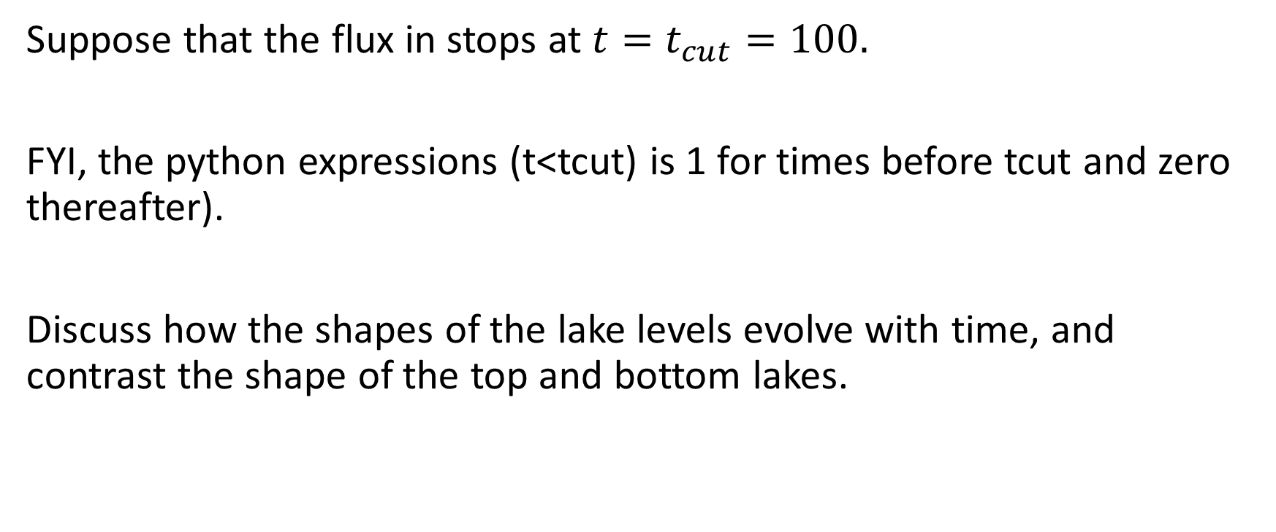
Group 1
Suppose that the flux in stops at $t=t_{cut}=100.$
FYI, the python expressions (t<tcut) is 1 for times before tcut and zero thereafter).
Discuss how the shapes of the lake levels evolve with time, and contrast the shape of the top and bottom lakes.

Slide 24
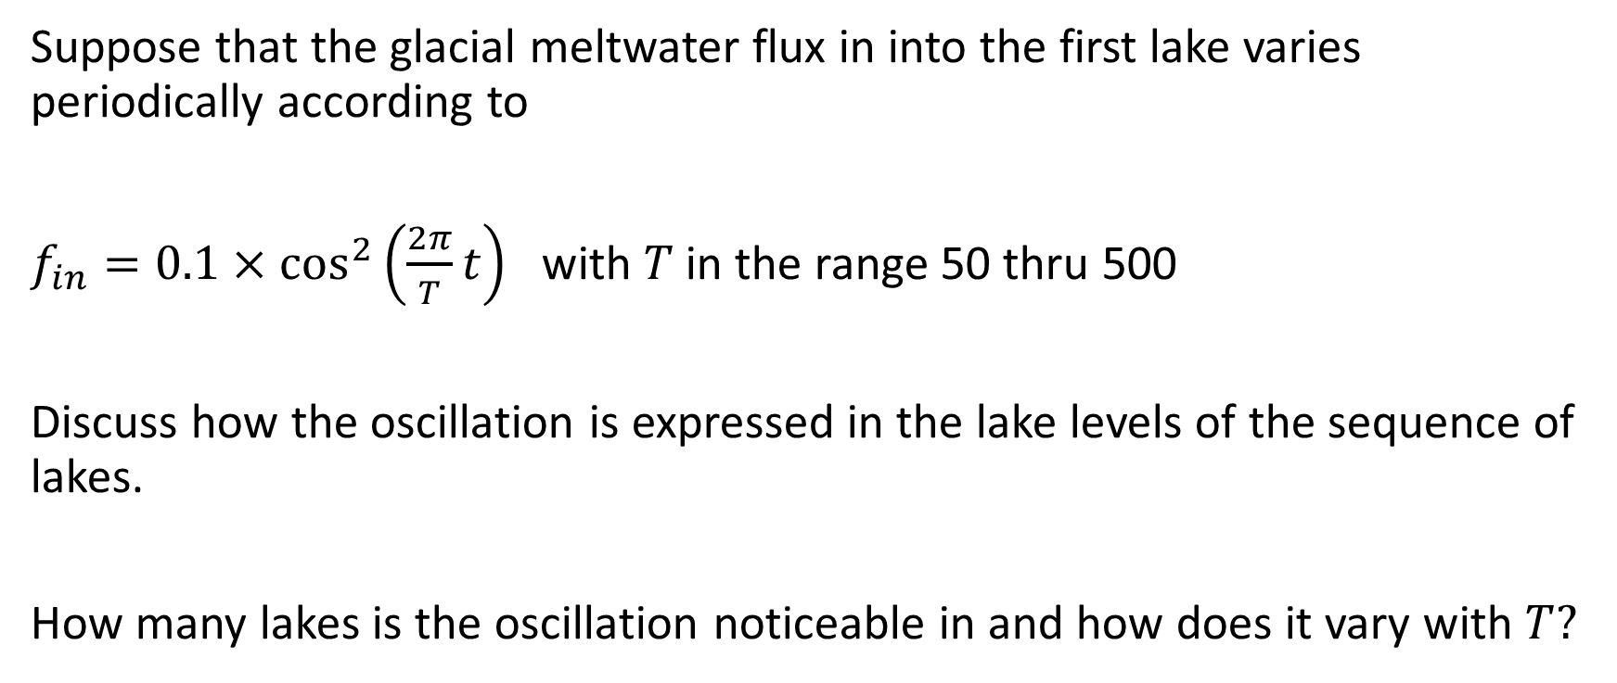
Group 2
Suppose that the glacial meltwater flux in into the first lake varies periodically according to
$f_{in}=0.1×\cos^{2}\left(\frac{2π}{T}t\right)$ with $T$ in the range 50 thru 500
Discuss how the oscillation is expressed in the lake levels of the sequence of lakes.
How many lakes is the oscillation noticeable in and how does it vary with $T?$

Slide 25
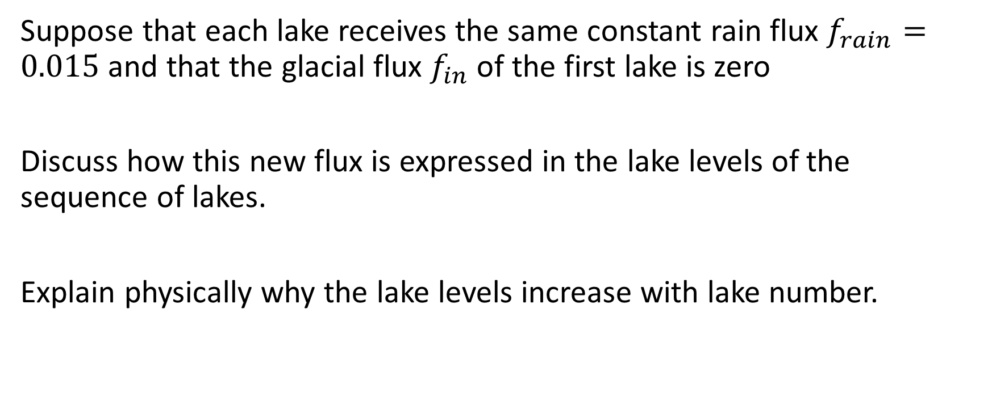
Group 3
Suppose that each lake receives the same constant rain flux $f_{rain}=0.015$ and that the glacial flux $f_{in}$ of the first lake is zero
Discuss how this new flux is expressed in the lake levels of the sequence of lakes.
Explain physically why the lake levels increase with lake number.

Slide 26
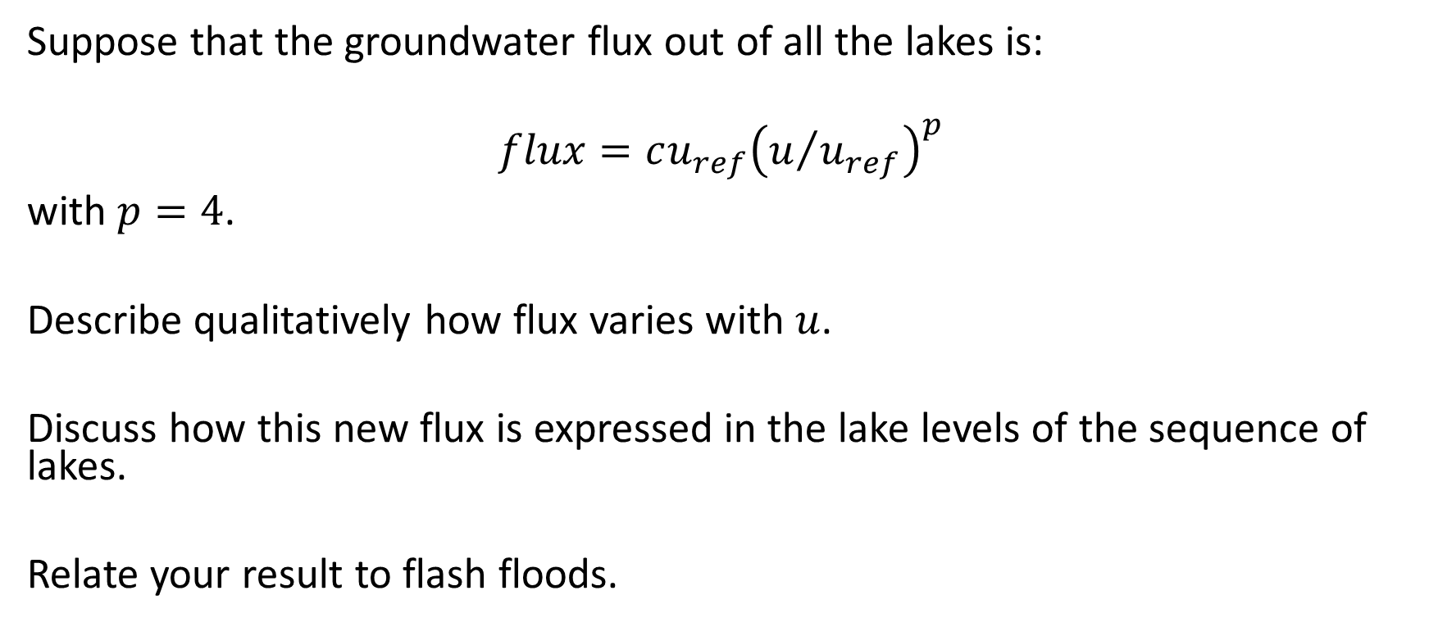
Group 4
Suppose that the groundwater flux out of all the lakes is:
$$flux=cu_{ref}{\left(u/{u_{ref}}\right)}^{p}$$
with $p=4$.
Describe qualitatively how flux varies with $u$.
Discuss how this new flux is expressed in the lake levels of the sequence of lakes.
Relate your result to flash floods.

