Slide 1
2023 EESC W3400
Lec 06: Seismic rays
Computational Earth Science
Bill Menke, Instructor
Emily Glazer, Teaching Assistant
TR 2:40 – 3:55

Slide 2
today:
Global Warming
we are going to use Reservoir Modeling to construct
a simple model of Global Warming
that incorporates SOME of the physics of climate change

Slide 3
caveat
into order to create model within 1 lecture, I’m going to be
very sloppy about units
not distinguish “heat content” from “temperature”
and set a lot of constants arbitrarily to 1

Slide 4
Physical Principle 1
visible light from the sun is the main source of the Earth’s heat energy
Sunlight
ground
solar constant = 1361 W/sq-m at Equator

Slide 5
Physical Principle 2
some visible light just reflected back to space
Sunlight
ground
fraction reflected: albedo, about 30%

Slide 6
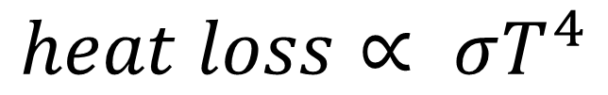

Physical Principle 3
Heat Loss doe to Infrared Radiation (IR) depends
on fourth power of temperature
HOT
$$heat loss∝ σT^{4}$$
$$σ:Stefan−Boltzman constant$$

Slide 7
Physical Principle 4
IR is absorbed in the atmosphere over a length scale about twice the thickness of the atmosphere
upper atmosphere
lower atmosphere

Slide 8
Our model of radiative heat balance
upper atmosphere
lower atmosphere

Slide 9
lower atmosphere
is warmed by
sunlight (really it warms the ground)
IR from upper atmosphere
is cooled by
Its IR radiation (to upper atmosphere)
upper atmosphere
is warmed by
IR from lower atmosphere
is cooled by
its IR radiation (to space)
upper atmosphere
lower atmosphere

Slide 10
M=2;
solarconstant = 1.0;
albedo = 0.3;
stefanboltzman = 1e-3;
p=4;
two unknowns, u[0] and u[1]
heat content / temperature
of lower and upper atmosphere
# time axis
Dt = 1.0
t0 = 0.0;
tmax = 200.0;
heatcapacity=0.02;

Slide 11
M=2;
solarconstant = 1.0;
albedo = 0.3;
stefanboltzman = 1e-3;
p=4;
solar constant (ridiculous units)
# time axis
Dt = 1.0
t0 = 0.0;
tmax = 200.0;
heatcapacity=0.02;

Slide 12
M=2;
solarconstant = 1.0;
albedo = 0.3;
stefanboltzman = 1e-3;
p=4;
albedo (correct)
# time axis
Dt = 1.0
t0 = 0.0;
tmax = 200.0;
heatcapacity=0.02;

Slide 13
M=2;
solarconstant = 1.0;
albedo = 0.3;
stefanboltzman = 1e-3;
p=4;
Stefan-Boltzman constant (ridiculous units)
power in Stefan-boltzman law (correct)
# time axis
Dt = 1.0
t0 = 0.0;
tmax = 200.0;
heatcapacity=0.02;

Slide 14
M=2;
solarconstant = 1.0;
albedo = 0.3;
stefanboltzman = 1e-3;
p=4;
# time axis
Dt = 1.0
t0 = 0.0;
tmax = 200.0;
(time ridiculous units)
heatcapacity=0.02;

Slide 15
M=2;
solarconstant = 1.0;
albedo = 0.3;
stefanboltzman = 1e-3;
p=4;
# time axis
Dt = 1.0
t0 = 0.0;
tmax = 200.0;
heatcapacity=0.02;
(heat capacity, ridiculous, used for plotting)

Slide 16
def myfun( t, u ):
f = np.zeros((M,));
f[0] = solarconstant*(1.0-albedo) - stefanboltzman*(u[0]**p) + stefanboltzman*(u[1]**p);
f[1] = stefanboltzman*(u[0]**p) - 2.0*stefanboltzman*(u[1]**p);
return f;
# initial conditions
u0 = np.zeros((M,));
upper atmosphere
u[1]
u[0]
lower atmosphere

Slide 17
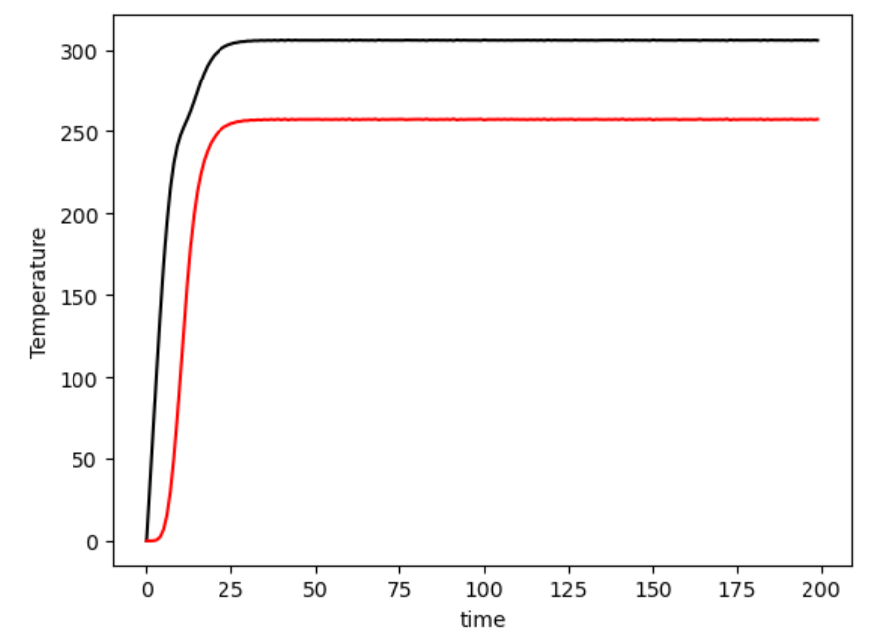
u[0]
u[1]

Slide 18
u[0]
u[1]
greenhouse effect
lower atmosphere is hotter than upper atmosphere

Slide 19
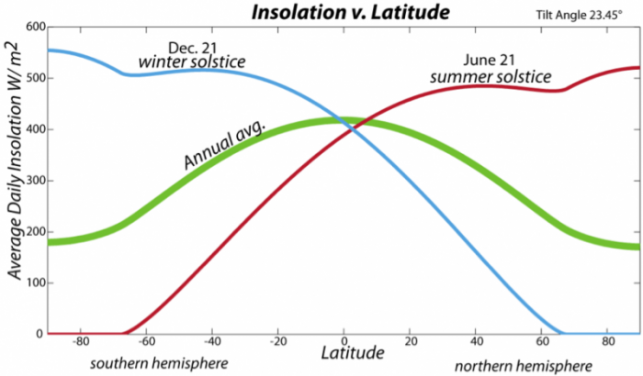
Physical Principle 5
because of the curvature of the Earth
the poles get less sunlight than the equator
Sunlight
equator
pole

Slide 20
Improved model of radiative heat balance
reduced
upper atmosphere
upper atmosphere
u[1]
u[3]
lower atmosphere
lower atmosphere
u[0]
u[2]
low latutude
high latitude

Slide 21
M=4; # two-zone, two-layer atmosphere
solarconstant = 1.0;
albedo = 0.3;
stefanboltzman = 1e-3;
zona1reduction = 0.6;
reduction of sunlight relative to
equator (fairly correct)

Slide 22
what to do
increase M to four and define zone1reduction as 0.6
add two lines to myfun that set f[2] and f[3]
they should be analogous to f[0] and f[1]
except
solarconstant in f[3] is multiplied by zona1reduction
also add two line to figure section to plot
u[2] in green
u[3] in blue

Slide 23
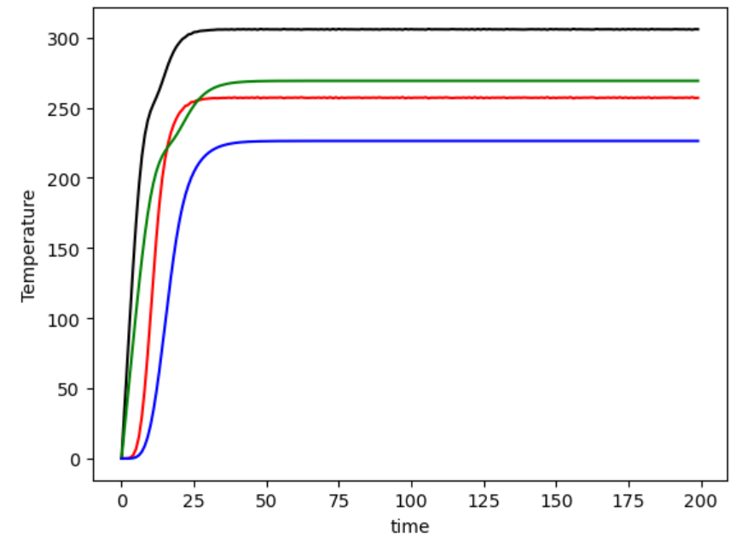
u[0]
u[2]
u[1]
u[3]

Slide 24
Physical Principle 6
temperature differences between equator and poles
cause winds that move heat poleward
Hadley Cell
(we’re ignoring the Ferrel cell)
equator
pole

Slide 25
we will assume that strength of wind depends linearly
on temperature difference between equator and pole
M=4; # two-zone, two-layer atmosphere
solarconstant = 1.0;
albedo = 0.3;
stefanboltzman = 1e-3;
zona1reduction = 0.6;
windfactor=0.1;
wind heat flux scaling, ridiculous units

Slide 26
upper atmosphere
upper atmosphere
u[1]
u[3]
lower atmosphere
lower atmosphere
u[0]
u[2]
low latutude
high latitude
wind = windfactor*(u[0]+u[1]-u[2]-u[3])
heat flux fin into this box from that = wind*u[that]
heat flux fout out of this box = -wind*u[this]

Slide 27
what to do
define windfactor as 0.1 and
inside myfun
calculate wind
add TWO terms to each of f[0], f[1], f[2], f[3]
one of which is a fin and the other an fout
check signs and this’s and that’s
upper atmosphere
upper atmosphere
u[1]
u[3]
lower atmosphere
lower atmosphere
u[0]
u[2]
low latutude
high latitude

Slide 28
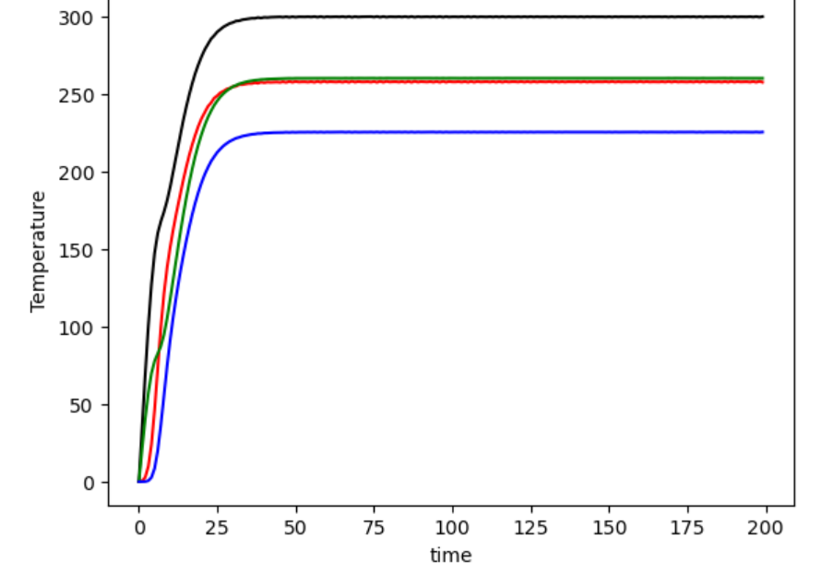
u[0]
u[1]
u[2]
u[3]

Slide 29
Physical Principle 7
seasons have a big affect on solar insolation
at high latitudes but not so much at low latitudes

Slide 30
M=4; # wo-zone, two-layer atmosphere
solarconstant = 1.0;
albedo = 0.3;
stefanboltzman = 1e-3;
zona1reduction = 0.6;
windfactor=0.1;
seasonfactor=0.4;
T = 50;
seasonal amplitude (reasonable)
length of year in the ridiculous time units we’re using
not clear whether this is reasonable

Slide 31
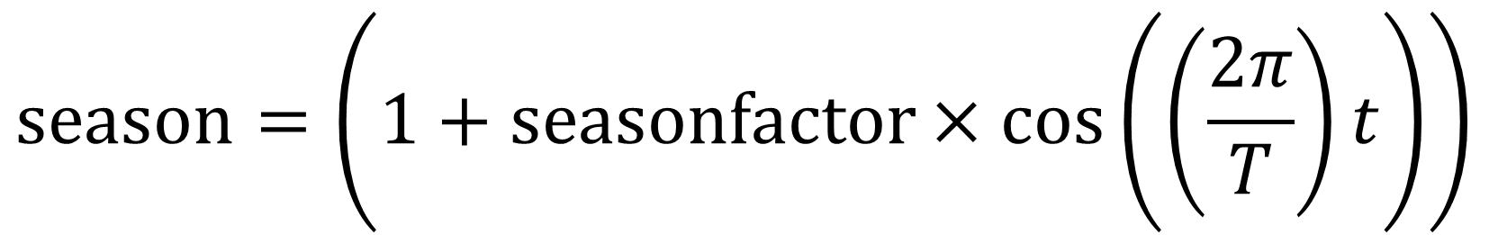
in low latitudes, insolation is unaffected
at high latitudes, insolation is modulated by a factor
$$season=\left(1+seasonfactor×cos\left(\left(\frac{2π}{T}\right)t\right)\right)$$

Slide 32
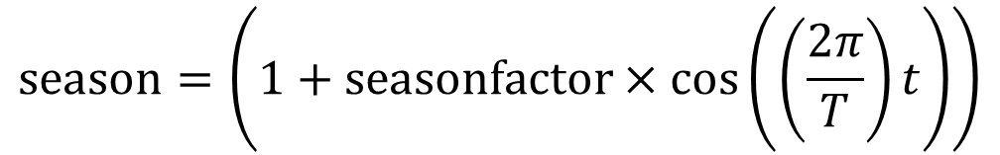
what to do
define seasonfactor as 0.4 and T as 50
inside myfun
calculate season according to formula
modify f[2] by multiplying solarconstant by season
$$season=\left(1+seasonfactor×cos\left(\left(\frac{2π}{T}\right)t\right)\right)$$

Slide 33
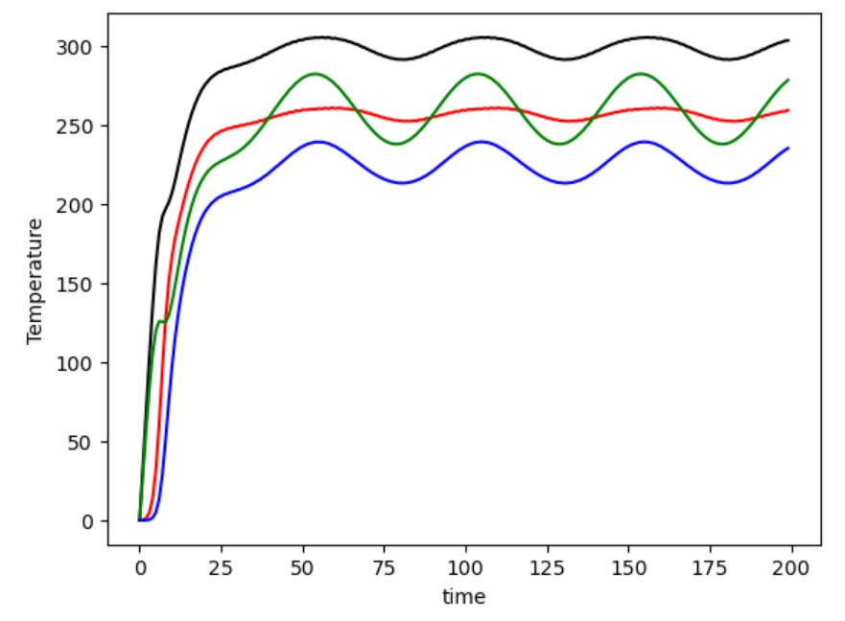
u[0]
u[2]
u[1]
u[3]

Slide 34
Physical Principle 8
increased IR absorption by anthropogenic CO2
is approximately equivalent to an increased solar constant

Slide 35
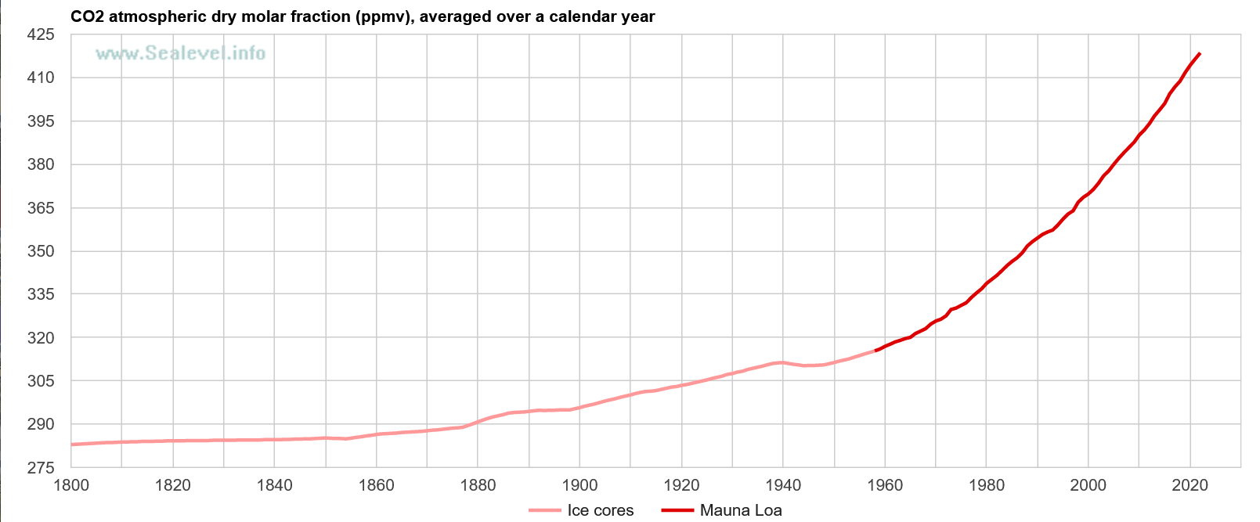
Physical Principle 9
burning of fossil fuels increase the CO2 in the atmosphere
315 in 1954
415
today

Slide 36
M=5;
burning = 0.001;
CO2sensitivity = 0.1;
u[4] is excess CO2
(ridiculous units)
tmax = 10000.0;;

Slide 37
M=5;
burning = 0.001;
CO2sensitivity = 0.1;
rate that we’re increasing CO2 (ridiculous units)
proportionaly between
excess CO2
and solar radiation
not clear whether this is reasonable
tmax = 10000.0;;
calculate long time so we can see temperature increase

Slide 38
what to do
increase M to five
define burning as 0.001 and CO2sensitivity as 0.1;
inside myfun
calculate anthro according to formula
modify f[0] and f[3] by multiplying solarconstant by forcing
add line that defines f[4] equal to burning
change tmax to 10000
create second plot that plots u[4] against time
$$forcing=\left(1+CO2sensitivity×u\left[4\right]\right)$$

Slide 39
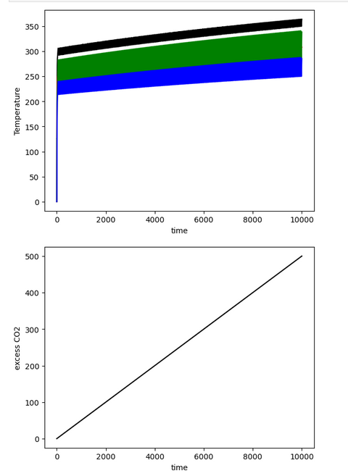

Slide 40
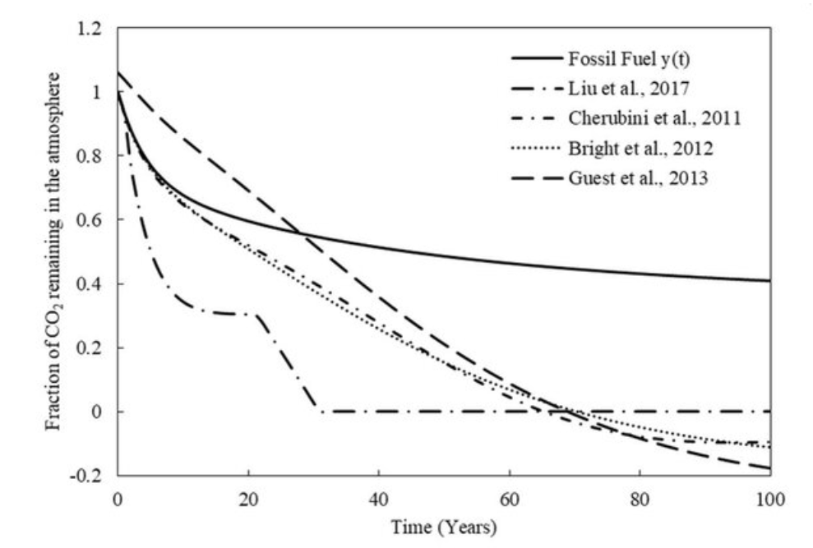
Physical Principle 10
excess CO2 is eventually absorbed by the Ocean (and biosphere) atmosphere
looks vaguely like
exponential decay
so rate of absorption
proportional to amount

Slide 41
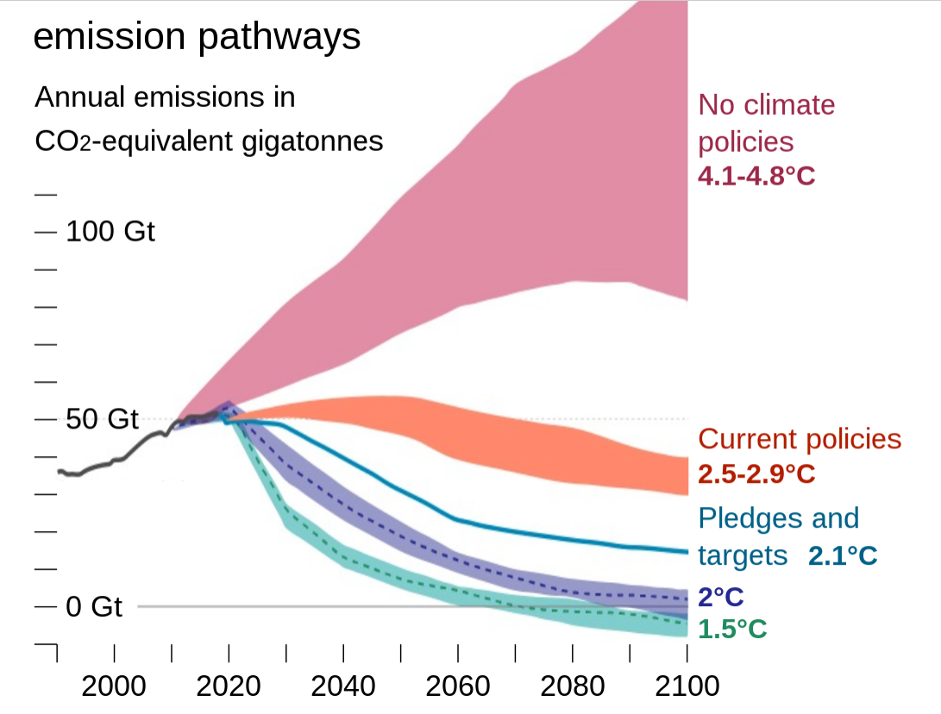
Physical Principle 11
it is possible that we might stop emitting CO2
suppose that we stop after Tstop

Slide 42
oceanuptake=0.0005;
Tstop = 2000;
rate that CO2 is absorbed (ridiculous units)
time at which CO2 emissions stop
(matter of opinion)

Slide 43
what to do
define oceanuptake as 0.0005 and Tstop as 2000;
inside myfun, modify f[4] by
multiplying burning by (t<Tstop)
adding a term -oceanuptake*u[4]

Slide 44
