Slide 1
2023 EESC W3400
Lec 09: Temperature of cooling conductive rod
Computational Earth Science
Bill Menke, Instructor
Emily Glazer, Teaching Assistant
TR 2:40 – 3:55

Slide 2
today:
more on
cooling of the Earth

Slide 3

today:
rod
$$x$$

Slide 4
today:
rod
initial temperature known
top and bottom held at fixed temperatures
$$x$$

Slide 5

today:
model of earth where all heat flows vertically
$$x=0$$
heat
heat
heat
heat
$$x$$

Slide 6

physical principle 1
heat content is proportional to temperature
$$Q=ρc_{p}T$$
heat content in J/m³

Slide 7
physical principle 1
heat content is proportional to temperature
$$Q=ρc_{p}T$$
density in kg/m³

Slide 8
physical principle 1
heat content is proportional to temperature
$$Q=ρc_{p}T$$
heat capacity in J/m³-K

Slide 9
physical principle 1
heat content is proportional to temperature
$$Q=ρc_{p}T$$
temperature in K

Slide 10

physical principle 2
heat flows from cold to hot
$$q=−k \frac{∂}{∂x}T$$
heat flux in J/m²-s

Slide 11
physical principle 2
heat flows from cold to hot
$$q=−k \frac{∂}{∂x}T$$
thermal conductivity J/m-s-K

Slide 12

physical principle 3
heat flows from cold to hot
$$q=−k \frac{∂}{∂x}T$$
gradient in temperature in K/m

Slide 13

physical principle 4
heat flows from cold to hot
$$q=−k \frac{∂}{∂x}T$$
hot to cold

Slide 14

physical principle 3
heat can be produced by a source
$$h$$
heat production in J/m³-s

Slide 15
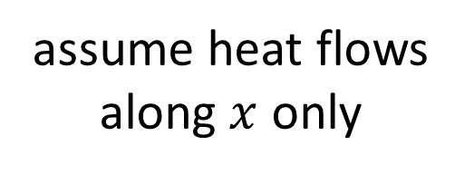
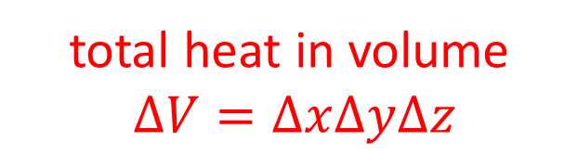

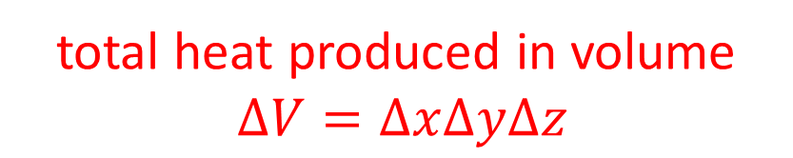
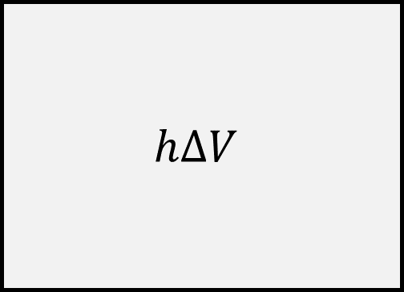
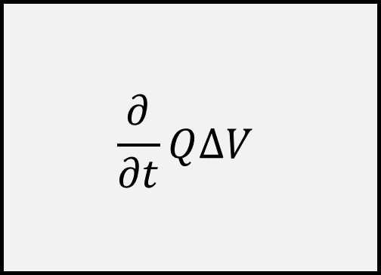
physical principle 4
heat is conserved
assume heat flows along $x$ only
$$\frac{∂}{∂t}Q∆V$$
$$h∆V$$
=
-
$$\frac{∂q}{∂x}∆V$$
total heat in volume
$∆V=∆x∆y∆z$
total heat produced in volume
$∆V=∆x∆y∆z$
flow in – flow out

Slide 16


physical principle 4
heat is conserved
assume heat flows along $x$ only
$$\frac{∂}{∂t}Q∆V$$
$$h∆V$$
=
+
$$\left(q_{in}−q_{out}\right)∆A$$
total heat in volume
$∆V=∆x∆y∆z$
total heat produced in volume
$∆V=∆x∆y∆z$
flow in – flow out
$∆A=∆y∆z$

Slide 17
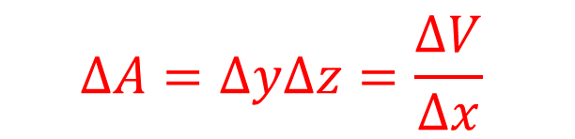
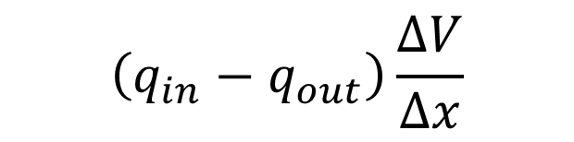
physical principle 4
heat is conserved
assume heat flows along $x$ only
$$\frac{∂}{∂t}Q∆V$$
$$h∆V$$
=
+
$$\left(q_{in}−q_{out}\right)\frac{∆V}{∆x}$$
$$∆A=∆y∆z=\frac{∆V}{∆x}$$

Slide 18
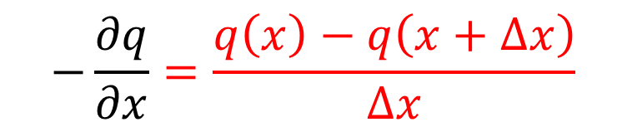

physical principle 4
heat is conserved
assume heat flows along $x$ only
$$\frac{∂}{∂t}Q∆V$$
$$h∆V$$
=
+
$$−\frac{∂q}{∂x}∆V$$
$$−\frac{∂q}{∂x}=\frac{q\left(x\right)−q\left(x+∆x\right)}{∆x}$$

Slide 19


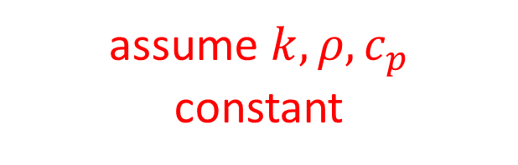

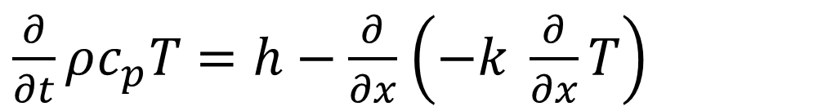

Heat Equation for constant k
$$\frac{∂}{∂t}Q∆V=h∆V−\frac{∂q}{∂x}∆V$$
$$\frac{∂}{∂t}Q=h−\frac{∂q}{∂x}$$
cancel $∆V$
$\frac{∂}{∂t}ρc_{p}T=h−\frac{∂}{∂x}$ $\left(−k \frac{∂}{∂x}T\right)$
insert #1 and #3
$$ρc_{p}\frac{∂}{∂t}T=k\frac{∂^{2}}{∂x^{2}}T+h$$
assume $k,ρ{, c}_{p}$
constant

Slide 20
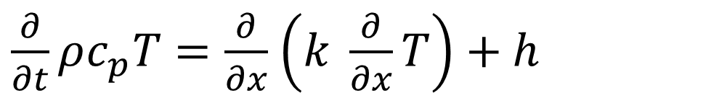
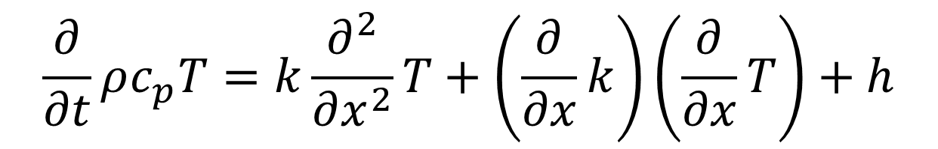
Heat Equation variable k(x)
$\frac{∂}{∂t}ρc_{p}T=\frac{∂}{∂x}$ $\left(k \frac{∂}{∂x}T\right)+h$
$$\frac{∂}{∂t}ρc_{p}T=k\frac{∂^{2}}{∂x^{2}}T+\left(\frac{∂}{∂x}k\right)\left(\frac{∂}{∂x}T\right)+h$$

Slide 21

















how to implement as reservoir model
$$ρc_{p}\frac{∂}{∂t}T=k\frac{∂^{2}}{∂x^{2}}T+h$$
initial condition: all known
$$T_{0}$$
$$T_{1}$$
$$T_{2}$$
$$T_{3}$$
$$T_{4}$$
$$T_{5}$$
$$…$$
$$T_{M−1}$$
$$t=0$$
$$∆x$$
$$∆x$$
$$∆x$$
$$∆x$$
$$∆x$$
$$∆x$$
$$∆x$$
$$∆x$$

Slide 22








how to implement as reservoir model
$$ρc_{p}\frac{∂}{∂t}T=k\frac{∂^{2}}{∂x^{2}}T+h$$
initial condition: all known
$$u_{0}$$
$$u_{1}$$
$$u_{2}$$
$$u_{3}$$
$$u_{4}$$
$$u_{5}$$
$$…$$
$$u_{M−1}$$
$$t=0$$
$$∆x$$
$$∆x$$
$$∆x$$
$$∆x$$
$$∆x$$
$$∆x$$
$$∆x$$
$$∆x$$

Slide 23

















how to implement as reservoir model
$$ρc_{p}\frac{∂}{∂t}T=k\frac{∂^{2}}{∂x^{2}}T+h$$
boundary condition: known
boundary condition: known
$$u_{0}$$
$$u_{1}$$
$$u_{2}$$
$$u_{3}$$
$$u_{4}$$
$$u_{5}$$
$$…$$
$$u_{M−1}$$
$$t>0$$
$$∆x$$
$$∆x$$
$$∆x$$
$$∆x$$
$$∆x$$
$$∆x$$
$$∆x$$
$$∆x$$

Slide 24


















how to get from $t$ to $t+∆t$
$$ρc_{p}\frac{∂}{∂t}T=k\frac{∂^{2}}{∂x^{2}}T+h$$
boundary condition: known
boundary condition: known
$$u_{0}$$
$$u_{1}$$
$$u_{2}$$
$$u_{3}$$
$$u_{4}$$
$$u_{5}$$
$$…$$
$$u_{M−1}$$
$$t$$
$$∆x$$
$$∆x$$
$$∆x$$
$$∆x$$
$$∆x$$
$$∆x$$
$$∆x$$
$$∆x$$
$$t+∆t$$
$$u_{0}$$
$$u_{1}$$
$$u_{2}$$
$$u_{3}$$
$$u_{4}$$
$$u_{5}$$
$$…$$
$$u_{M−1}$$
$$∆x$$
$$∆x$$
$$∆x$$
$$∆x$$
$$∆x$$
$$∆x$$
$$∆x$$
$$∆x$$

Slide 25

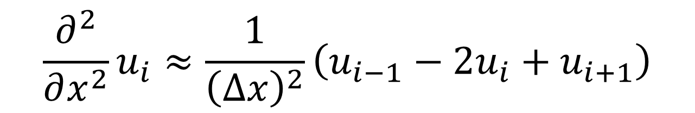
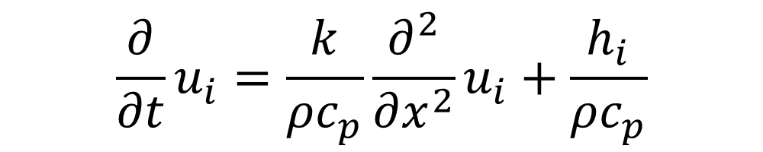
how to get from $t$ to $t+∆t$
$$κ$$
$$\frac{∂}{∂t}u_{i}=\frac{k}{ρc_{p}}\frac{∂^{2}}{∂x^{2}}u_{i}+\frac{h_{i}}{ρc_{p}}$$
$$\frac{∂^{2}}{∂x^{2}}u_{i}≈\frac{1}{{\left(∆x\right)}^{2}}\left(u_{i−1}−{2u}_{i}+u_{i+1}\right)$$

Slide 26




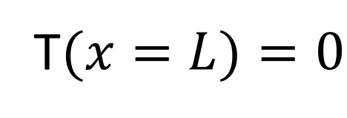
Boundary conditions
$$T(x=0)=0$$
T$(x=L)=0$
insulated
Heating
$$h=0$$
$$T_{0}$$
spike
initial conditions
$$x$$

Slide 27
def myfun( t, u ):
f = np.zeros((M,));
f[0] = 0.0; # no change in u[0]
# kappa * second derivative
for i in range(1,M-1):
f[i] = kappa*(u[i-1]-2.0*u[i]+u[i+1])/Dx2
f[M-1] = 0.0; # no change in u[end]
return f;
# initial conditions for spike
u0 = np.zeros((M,));
u0[Mo2] = 1.0;

Slide 28
def myfun( t, u ):
f = np.zeros((M,));
f[0] = 0.0; # no change in u[0]
# kappa * second derivative
for i in range(1,M-1):
f[i] = kappa*(u[i-1]-2.0*u[i]+u[i+1])/Dx2
f[M-1] = 0.0; # no change in u[end]
return f;
# initial conditions for spike
u0 = np.zeros((M,));
u0[Mo2] = 1.0;
left BC

Slide 29
def myfun( t, u ):
f = np.zeros((M,));
f[0] = 0.0; # no change in u[0]
# kappa * second derivative
for i in range(1,M-1):
f[i] = kappa*(u[i-1]-2.0*u[i]+u[i+1])/Dx2
f[M-1] = 0.0; # no change in u[end]
return f;
# initial conditions for spike
u0 = np.zeros((M,));
u0[Mo2] = 1.0;
interior eqn

Slide 30
def myfun( t, u ):
f = np.zeros((M,));
f[0] = 0.0; # no change in u[0]
# kappa * second derivative
for i in range(1,M-1):
f[i] = kappa*(u[i-1]-2.0*u[i]+u[i+1])/Dx2
f[M-1] = 0.0; # no change in u[end]
return f;
# initial conditions for spike
u0 = np.zeros((M,));
u0[Mo2] = 1.0;
right BC

Slide 31
def myfun( t, u ):
f = np.zeros((M,));
f[0] = 0.0; # no change in u[0]
# kappa * second derivative
for i in range(1,M-1):
f[i] = kappa*(u[i-1]-2.0*u[i]+u[i+1])/Dx2
f[M-1] = 0.0; # no change in u[end]
return f;
# initial conditions for spike
u0 = np.zeros((M,));
u0[Mo2] = 1.0;
initial conditions

Slide 32
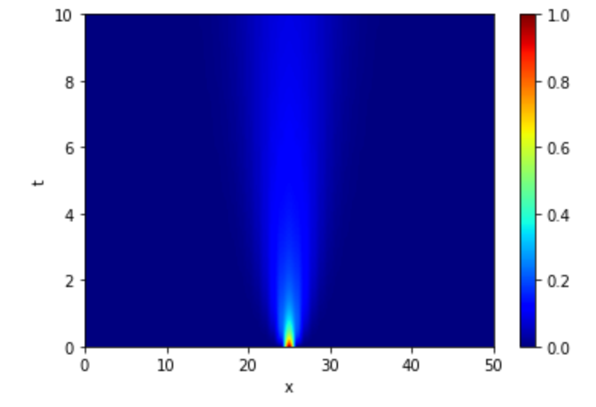
temperature, T
time, t
position, x

Slide 33




$$h=0$$
Boundary conditions
$$T(x=0)=0$$
$$q(x=L)=0$$
insulated
$${dT}/{dx}=0$$
$$T_{0}$$
initial conditions
$$x$$

Slide 34
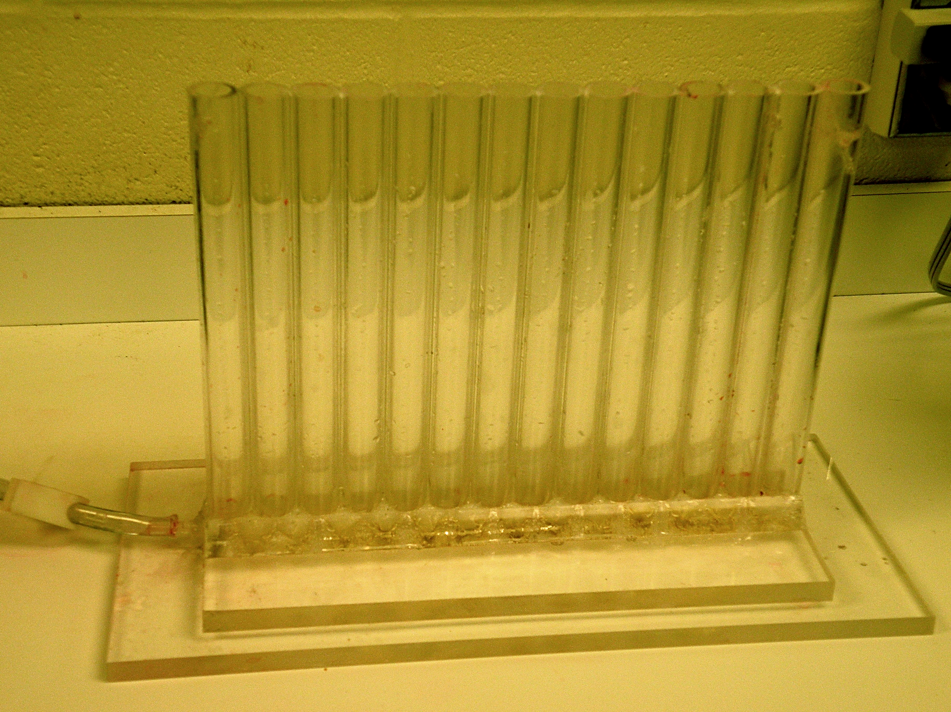
A discrete analog of temperature ... courtesy of Roger Buck

Slide 35
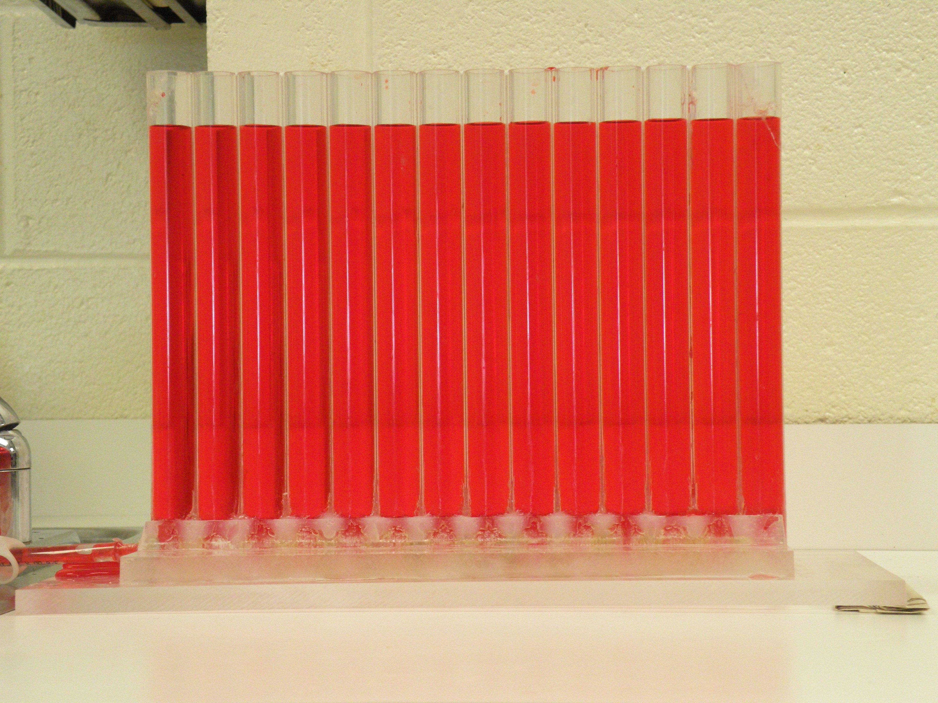

Slide 36
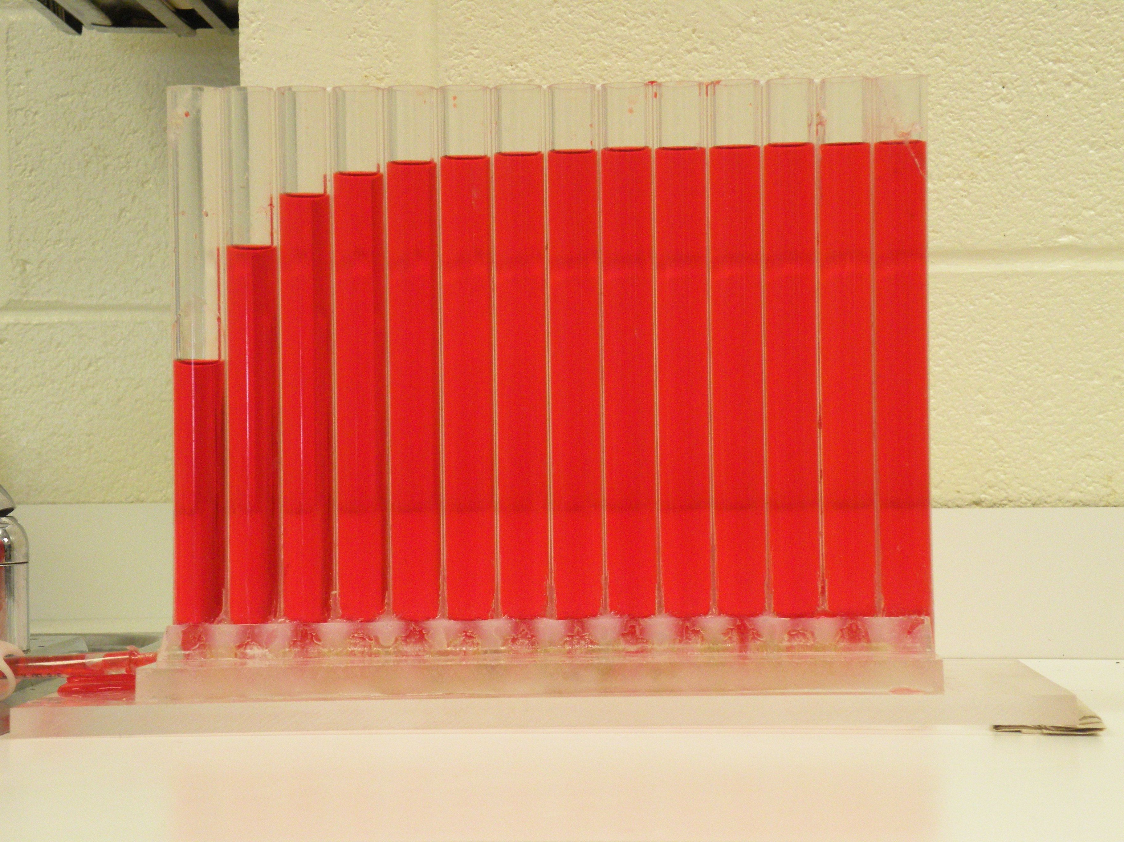

Slide 37


Slide 38


Slide 39


Slide 40


Slide 41


Slide 42


Slide 43


f$or variable k case$
$$\frac{∂}{∂t}u_{i}=κ\frac{∂^{2}}{∂x^{2}}u_{i}+\left(\frac{∂κ}{∂x}\right)\left(\frac{∂}{∂x}u_{i}\right)+\frac{h}{ρc_{p}}$$
$$\frac{∂}{∂x}u_{i}≈\frac{1}{∆x}\left(u_{i}−u_{i−1}\right)$$

Slide 44
def myfun( t, u ):
f = np.zeros((M,));
f[0] = 0.0; # no change in u[0]
# kappa * second_deriv + dkappa/dx * first devic
for i in range(1,M-1):
f[i] = ( kappa[i]*(u[i-1]-2.0*u[i]+u[i+1])/Dx2 +
(kappa[i]-kappa[i-1])*(u[i]-u[i-1])/Dx2+
h[i]/rhocp );
f[M-1] = 0.0; # no change in u[end]
return f;

Slide 45
Group 1
model of the cooling oceanic lithosphere
kappa=constant, h is zero
initial conditions: all lithosphere is hot, except surface which is cold
boundary conditions:
top is cold
bottom is hot

Slide 46
Group 2
model of the cooling continental lithosphere
kappa= constant, h = constant (due to radioactivity)
initial conditions: all lithosphere is warm, except very top, which is cold
boundary conditions:
top of lithosphere cold
bottom of lithosphere is hot

Slide 47
Group 3
model of warming sea ice
kappa=non-constant (due to air bubbles in ice)
h is zero
initial conditions: all ice is cold, including surface which is zero
boundary conditions:
top is zero
bottom is hot
kappa increases linearly with depth, reaching two times its top value at bottom

Slide 48
Group 4
model of warming subducting slab
kappa=constant, h is zero
initial conditions: temperature in slab
increases linearly from cold at top to warm at bottom
(due to originally being normal lithosphere).
boundary conditions:
top is hot
bottom hot
(due to surrounding mantle being hot)

