Slide 1
2023 EESC W3400
Lec 10: Least squares estimation illustrated using global warming data
Computational Earth Science
Bill Menke, Instructor
Emily Glazer, Teaching Assistant
TR 2:40 – 3:55

Slide 2
today:
curve fitting
a simple form of data analysis

Slide 3
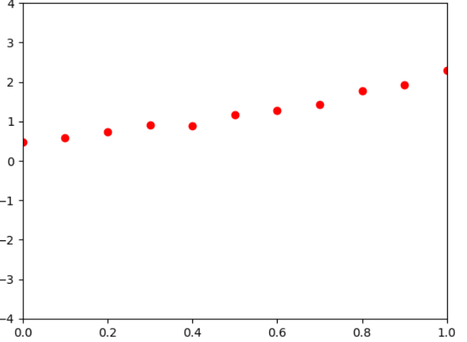
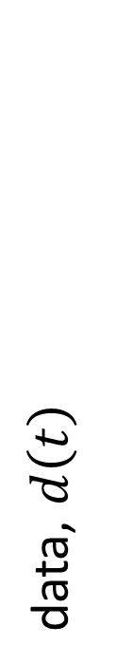



observed data, $d_{i}^{obs}$
data, $d\left(t\right)$
time, $t$
observation time, $t_{i}$

Slide 4
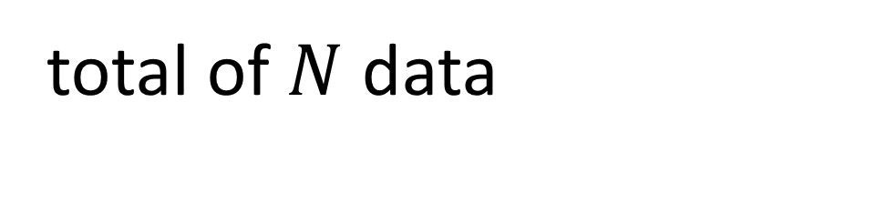
total of $N$ data
observed data, $d_{i}^{obs}$
data, $d\left(t\right)$
time, $t$
observation time, $t_{i}$

Slide 5


observed data, $d_{i}^{obs}$ is noisy
assumptions:
observation time, $t_{i}$ is known exactly
observed data, $d_{i}^{obs}$
data, $d\left(t\right)$
time, $t$
observation time, $t_{i}$

Slide 6
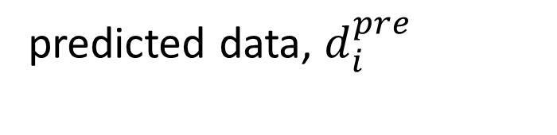
data predicted at same time as observed data
model
predicted data, $d_{i}^{pre}$
by
predicted
observed data, $d_{i}^{obs}$
data
data, $d\left(t\right)$
time, $t$
observation time, $t_{i}$

Slide 7
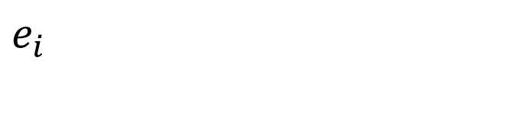
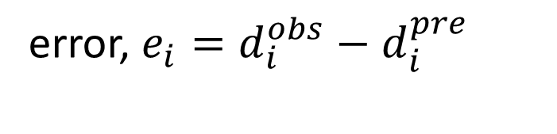
error, $e_{i}=d_{i}^{obs}−d_{i}^{pre}$
$$e_{i}$$
data, $d\left(t\right)$
time, $t$
observation time, $t_{i}$

Slide 8
Not perpendicular distance!
$$e_{i}$$
No!
data, $d\left(t\right)$
time, $t$
observation time, $t_{i}$

Slide 9

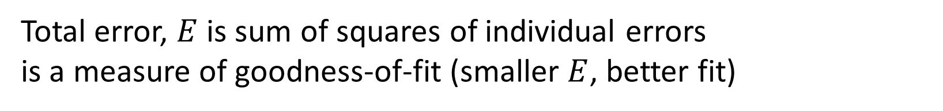
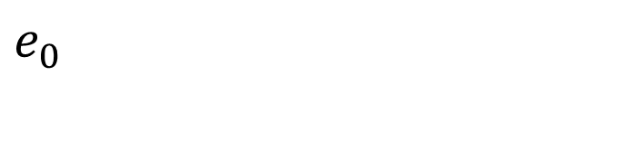





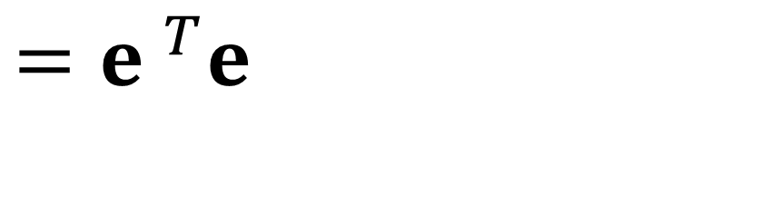
Total error, $E$ is sum of squares of individual errors
is a measure of goodness-of-fit (smaller $E$, better fit)
$$E=\sum_{i=1}^{N}{e_{i}^{2}}$$
$$e_{N}$$
. . .
data, $d\left(t\right)$
$$e_{4}$$
$$={e }^{T}e$$
$$e_{3}$$
$$e_{1}$$
$$e_{2}$$
$$e_{0}$$
time, $t$
observation time, $t_{i}$

Slide 10

some formula called the “model” makes this curve
model
$$d^{pre}\left(t\right)=g\left(t\right)$$
by
predicted
data
data, $d\left(t\right)$
time, $t$
observation time, $t_{i}$

Slide 11


this formula contains $M$ unknown constants, $A, B, C, D …$
model
$$d^{pre}\left(t\right)=g\left(t,A,B,C,D\right)$$
by
predicted
data
data, $d\left(t\right)$
time, $t$
observation time, $t_{i}$

Slide 12


all these $M$ unknown constants “model parameters”,
$$m=\left[\begin{matrix}A \\ B \\ C \\ D \\ ⋮\end{matrix}\right]=\left[\begin{matrix}m_{1} \\ m_{2} \\ m_{3} \\ ⋮ \\ m_{M}\end{matrix}\right]$$
model
$$d^{pre}\left(t\right)=g\left(t,m\right)$$
by
predicted
data
data, $d\left(t\right)$
time, $t$
observation time, $t_{i}$

Slide 13


example: straight line, $M=2$
$$d^{pre}\left(t\right)=g\left(t,m\right)$$
model
by
$$=m_{0}+m_{1}t$$
predicted
data
data, $d\left(t\right)$
time, $t$
observation time, $t_{i}$

Slide 14

Linear Model
$$d^{pre}=Gm$$
matrix that may involve the time of observation, but NOT any model parameters

Slide 15
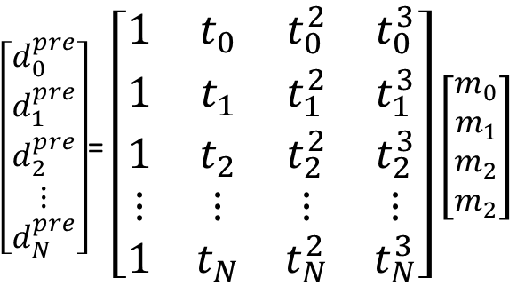

example cubic polynomial
$$d^{pre}\left(t\right)=m_{0}+m_{1}t+m_{2}t^{2}+m_{3}t^{3}$$
$\left[\begin{matrix}d_{0}^{pre} \\ d_{1}^{pre} \\ d_{2}^{pre} \\ ⋮ \\ d_{N}^{pre}\end{matrix}\right]$= $\left[\begin{matrix}1 & t_{0} & t_{0}^{2} & t_{0}^{3} \\ 1 & t_{1} & t_{1}^{2} & t_{1}^{3} \\ 1 & t_{2} & t_{2}^{2} & t_{2}^{3} \\ ⋮ & ⋮ & ⋮ & ⋮ \\ 1 & t_{N} & t_{N}^{2} & t_{N}^{3}\end{matrix}\right]$ $\left[\begin{matrix}m_{0} \\ m_{1} \\ m_{2} \\ m_{2}\end{matrix}\right]$
$$d^{pre}=Gm$$

Slide 16
problem
use the observed data to determine a best-estimate of the model parameters
and some notion of how well they are determined

Slide 17
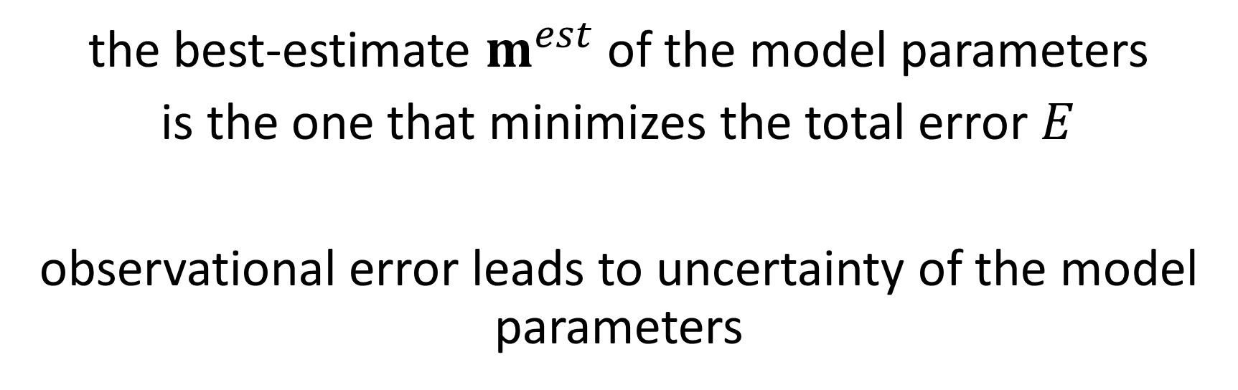
solution in words
the best-estimate $m^{est}$ of the model parameters
is the one that minimizes the total error $E$
observational error leads to uncertainty of the model parameters

Slide 18

mathematic solution
$m^{est}={\left[G^{T}G\right]}^{−1}$ $G^{T}$ $d^{obs}$
$d^{pre}=G$ $m^{est}$
$$e=d^{obs}−d^{pre}$$
$E=e^{T}$ $e$
$$σ_{d}^{2}=E/\left(N−M\right)$$
$$C=σ_{d}^{2}{\left[G^{T}G\right]}^{−1}$$
$$σ_{m_{i}}=2 \sqrt{C_{ii}} (95\% confidence)$$
always the same
so
only hard part is
setting up G

Slide 19
$m^{est}={\left[G^{T}G\right]}^{−1}$ $G^{T}$ $d^{obs}$
$d^{pre}=G$ $m^{est}$
$$e=d^{obs}−d^{pre}$$
$E=e^{T}$ $e$
$$σ_{d}^{2}=E/\left(N−M\right)$$
$$C=σ_{d}^{2}{\left[G^{T}G\right]}^{−1}$$
$$σ_{m_{i}}=2 \sqrt{C_{ii}} (95\% confidence)$$
estimated model parameters
GTG = np.matmul( G.T, G);
GTd = np.matmul( G.T, dobs);
mest = la.solve(GTG,GTd);

Slide 20
$m^{est}={\left[G^{T}G\right]}^{−1}$ $G^{T}$ $d^{obs}$
$d^{pre}=G$ $m^{est}$
$$e=d^{obs}−d^{pre}$$
$E=e^{T}$ $e$
$$σ_{d}^{2}=E/\left(N−M\right)$$
$$C=σ_{d}^{2}{\left[G^{T}G\right]}^{−1}$$
$$σ_{m_{i}}=2 \sqrt{C_{ii}} (95\% confidence)$$
predicted data
dpre = np.matmul( G, mest);

Slide 21
mathematic solution
$m^{est}={\left[G^{T}G\right]}^{−1}$ $G^{T}$ $d^{obs}$
$d^{pre}=G$ $m^{est}$
$$e=d^{obs}−d^{pre}$$
$E=e^{T}$ $e$
$$σ_{d}^{2}=E/\left(N−M\right)$$
$$C={σ_{d}^{2}\left[G^{T}G\right]}^{−1}$$
$$σ_{m_{i}}=2 \sqrt{C_{ii}} (95\% confidence)$$
prediction error
e = dobs - dpre;

Slide 22
mathematic solution
$m^{est}={\left[G^{T}G\right]}^{−1}$ $G^{T}$ $d^{obs}$
$d^{pre}=G$ $m^{est}$
$$e=d^{obs}−d^{pre}$$
$E=e^{T}$ $e$
$$σ_{d}^{2}=E/\left(N−M\right)$$
$$C=σ_{d}^{2}{\left[G^{T}G\right]}^{−1}$$
$$σ_{m_{i}}=2 \sqrt{C_{ii}} (95\% confidence)$$
total error
E = np.matmul( e.T, e);

Slide 23
mathematic solution
$m^{est}={\left[G^{T}G\right]}^{−1}$ $G^{T}$ $d^{obs}$
$d^{pre}=G$ $m^{est}$
$$e=d^{obs}−d^{pre}$$
$E=e^{T}$ $e$
$$σ_{d}^{2}=E/\left(N−M\right)$$
$$C=σ_{d}^{2}{\left[G^{T}G\right]}^{−1}$$
$$σ_{m_{i}}=2 \sqrt{C_{ii}} (95\% confidence)$$
Estimated variance of the data
sigmad2 = E/(N-M);

Slide 24
mathematic solution
$m^{est}={\left[G^{T}G\right]}^{−1}$ $G^{T}$ $d^{obs}$
$d^{pre}=G$ $m^{est}$
$$e=d^{obs}−d^{pre}$$
$E=e^{T}$ $e$
$$σ_{d}^{2}=E/\left(N−M\right)$$
$$C=σ_{d}^{2}{\left[G^{T}G\right]}^{−1}$$
$$σ_{m_{i}}=2 \sqrt{C_{ii}} (95\% confidence)$$
covariance of the model parameters
(an MxM matrix)
C = sigmad2*la.inv(GTG);

Slide 25
mathematic solution
$m^{est}={\left[G^{T}G\right]}^{−1}$ $G^{T}$ $d^{obs}$
$d^{pre}=G$ $m^{est}$
$$e=d^{obs}−d^{pre}$$
$E=e^{T}$ $e$
$$σ_{d}^{2}=E/\left(N−M\right)$$
$$C={σ_{d}^{2}\left[G^{T}G\right]}^{−1}$$
$$σ_{m_{i}}=2 \sqrt{C_{ii}} (95\% confidence)$$
95% confidence interval of
model parameters
sm = 2.0*np.sqrt(gda_cvec(np.diag(C)));

Slide 26
Step 1: Get the data from a file as a matrix
# get data from file
D = np.genfromtxt('test_data.txt', delimiter='\t’);
N, i = np.shape(D);

Slide 27
Step 2: identify time and observed-data columns
# break out columns of table
t = np.copy( D[0:N,0:1] );
dobs = np.copy( D[0:N,1:2] );
# x-axis info
tmin = np.min(t);
tmax = np.max(t);

Slide 28

Step 3: set up the matrix G (the hard part)
# set up cubic polynomial model
M = 4; # number of terms in the polynomial
# create G
G = np.zeros((N,M));
G[0:N,0:1] = np.ones((N,1));
G[0:N,1:2] = t;
G[0:N,2:3] = np.power(t,2);
G[0:N,3:4] = np.power(t,3);
$G$= $\left[\begin{matrix}1 & t_{0} & t_{0}^{2} & t_{0}^{3} \\ 1 & t_{1} & t_{1}^{2} & t_{1}^{3} \\ 1 & t_{2} & t_{2}^{2} & t_{2}^{3} \\ ⋮ & ⋮ & ⋮ & ⋮ \\ 1 & t_{N} & t_{N}^{2} & t_{N}^{3}\end{matrix}\right]$

Slide 29
Step 4: compute the least-squares solution
# basic least squares
GTG = np.matmul(G.T,G);
GTd = np.matmul(G.T,dobs);
mest = la.solve(GTG,GTd);

Slide 30
Step 5: compute ancillary information
# error and confidence limits
dpre = np.matmul(G,mest); # prediction
e = dobs-dpre; # prediction error
sigmad2pos = np.matmul(e.T,e)/(N-M); # data variance
Cd = sigmad2pos*la.inv(GTG); # covariance matrix
sm = np.sqrt(gda_cvec(np.diag(Cd))); # confidence limits

Slide 31
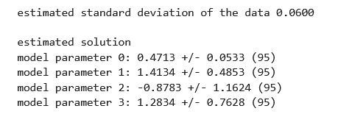
Step 6: print out the solution and its confidence limits
print("estimated standard deviation of the data %.4f“
% (sqrt(sigmad2pos)) );
print(" ");
print("estimated solution");
for i in range(M):
print("model parameter %d: %.4f +/- %.4f (95)“
% (i,mest[i,0],sm[i,0]) );

Slide 32
well determined
poorly determined

Slide 33
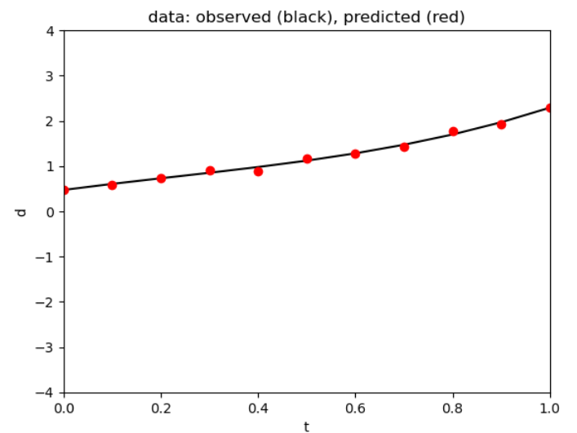
Step 7: plot the observed and predicted data
fig1 = plt.figure();
ax1 = plt.subplot(1,1,1);
plt.axis( [tmin, tmax, -4, 4]);
#plt.plot(t,dpre,'k-');
plt.plot(t,dobs,'ro');
plt.xlabel('t');
plt.ylabel('d');
plt.title('data: observed (black),
predicted (red)');
plt.show();

Slide 34
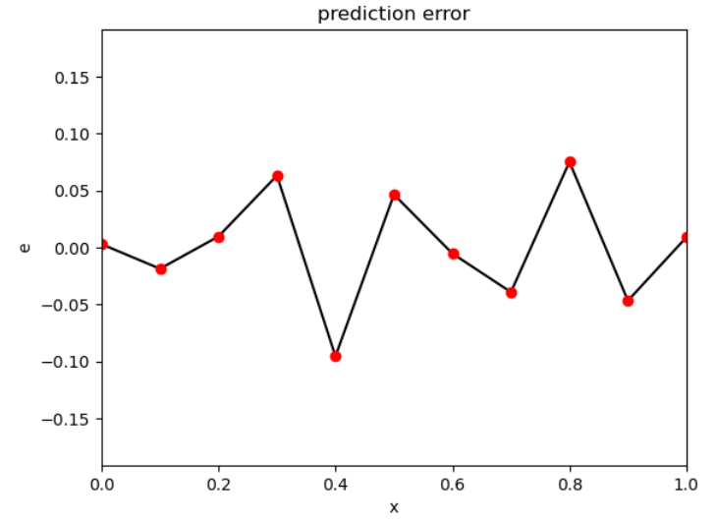
Step 8: plot the error (at a different scale)
fig2 = plt.figure();
ax1 = plt.subplot(1,1,1);
absmaxe = np.max(np.abs(e));
plt.axis([tmin,tmax,-2*absmaxe,2*absmaxe]);
plt.plot(t,e,'k-');
plt.plot(t,e,'ro');
plt.xlabel('x');
plt.ylabel('e');
plt.title('prediction error');
plt.show();

Slide 35
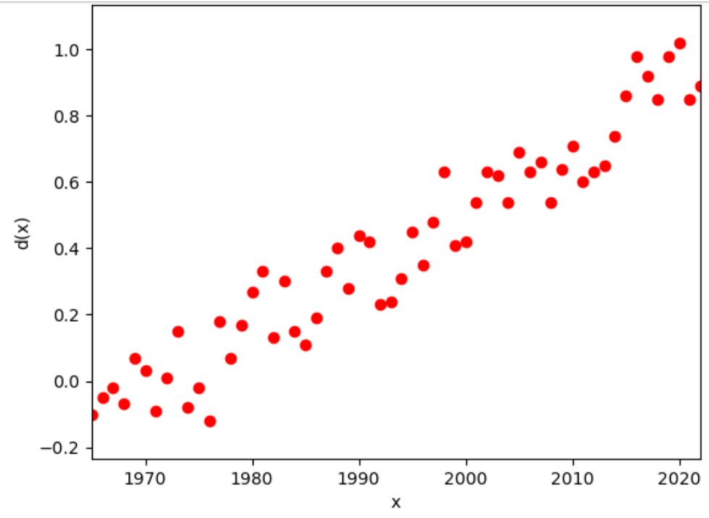

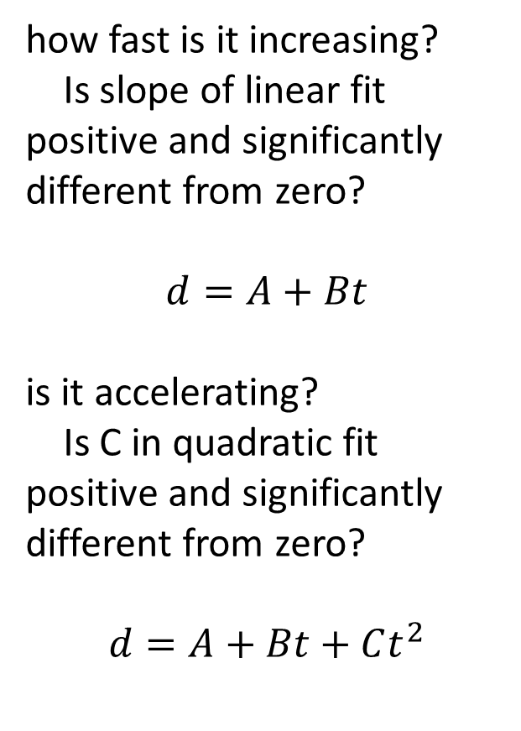
Group 1: global_temp.txt (years, $∆$deg C)
how fast is it increasing?
Is slope of linear fit positive and significantly different from zero?
$$d=A+Bt$$
is it accelerating?
Is C in quadratic fit positive and significantly different from zero?
$$d=A+Bt+Ct^{2}$$

Slide 36
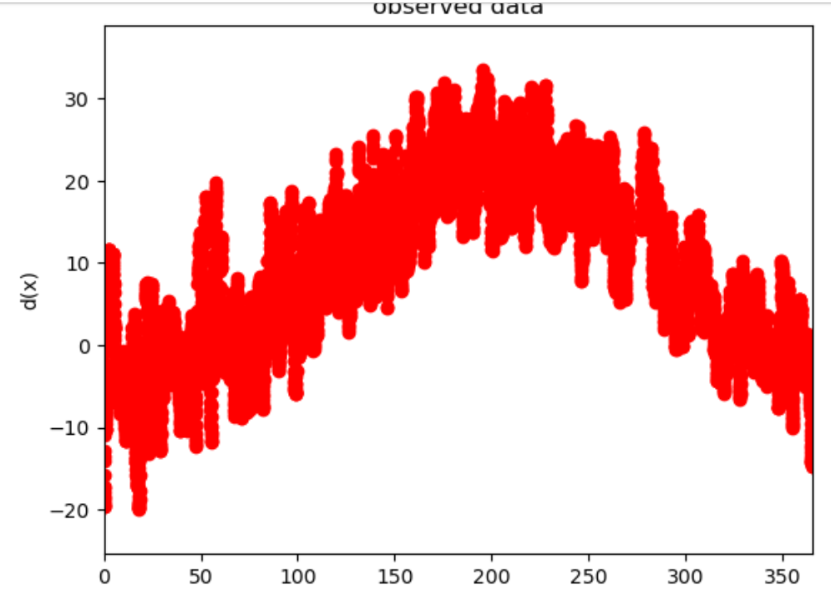
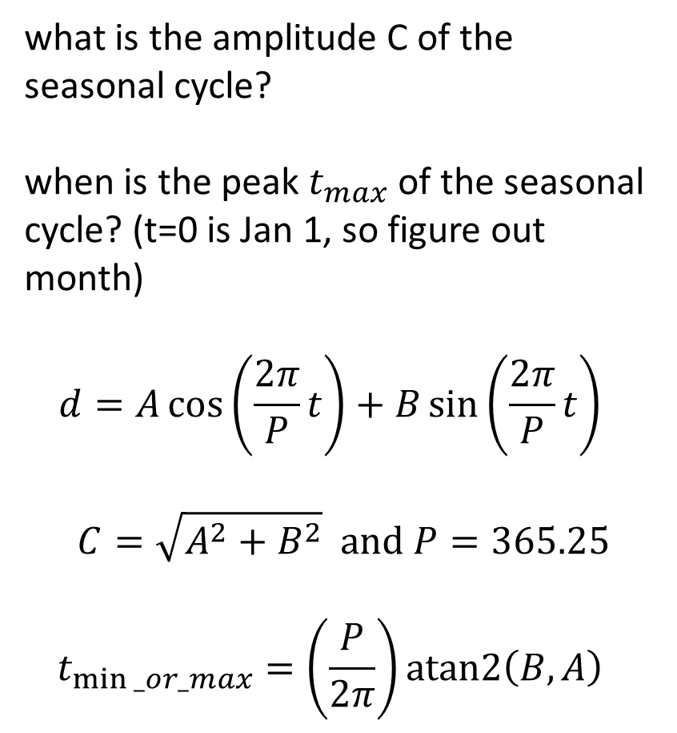
Group 2: brf_temp.txt (days, deg C)
what is the amplitude C of the seasonal cycle?
when is the peak $t_{max}$ of the seasonal cycle? (t=0 is Jan 1, so figure out month)
$$d=A\cos\left(\frac{2π}{P}t\right)+B\sin\left(\frac{2π}{P}t\right)$$
$$C=\sqrt{A^{2}+B^{2}} and P=365.25$$
$$t_{min⁡_or_max}=\left(\frac{P}{2π}\right)atan2\left(B,A\right)$$

Slide 37
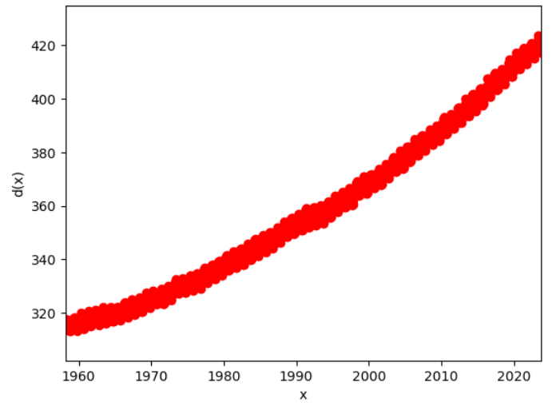
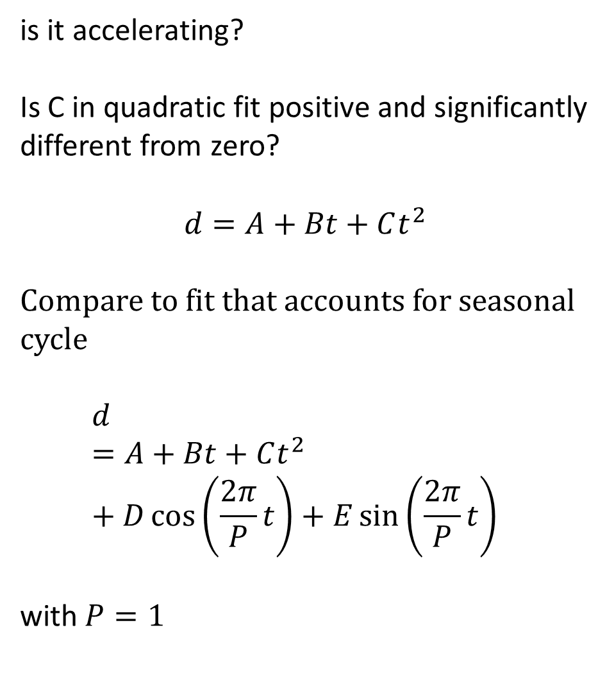
Group 3: keeling.txt (years, ppm CO2)
is it accelerating?
Is C in quadratic fit positive and significantly different from zero?
$$d=A+Bt+Ct^{2}$$
Compare to fit that accounts for seasonal cycle
$$d=A+Bt+Ct^{2}+D\cos\left(\frac{2π}{P}t\right)+E\sin\left(\frac{2π}{P}t\right)$$
with $P=1$

Slide 38
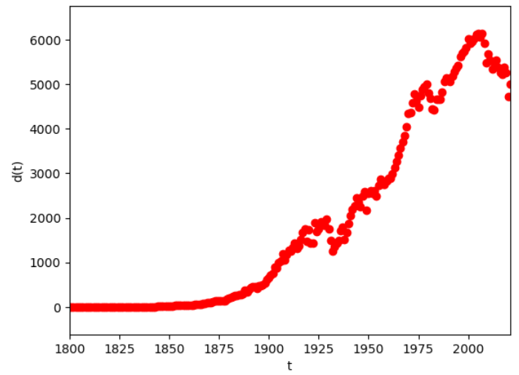
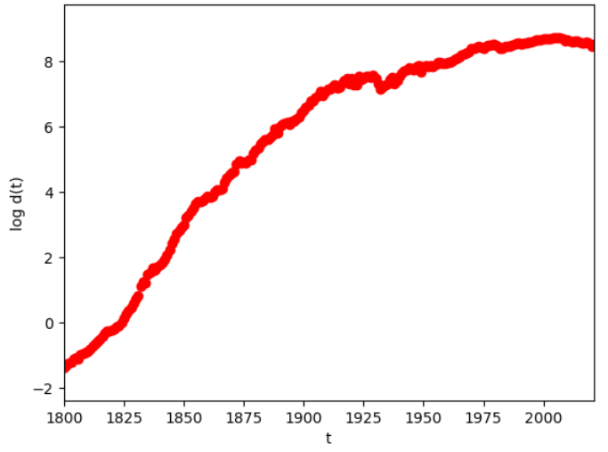
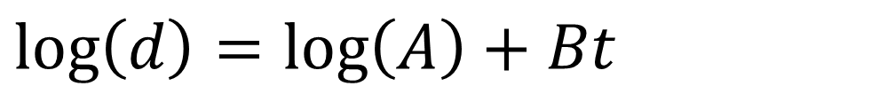
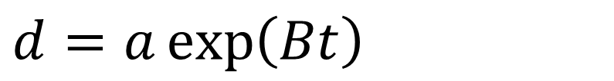
Group 3: emissionsUSA.txt (years, Mt Carbon)
exponential growth is linear when you take the log of the data
In about what year Y does US emissions depart from an exponential growth curve?
Do a linear fit of log(d) for 1800 through year Y, for a variety of Ys, and see when the posterior standard error of the data starts to get big.
$$d=a\exp\left(Bt\right)$$
$$\log\left(d\right)=\log\left(A\right)+Bt$$

