Slide 1
2023 EESC W3400
Lec 14: 2D FFT illustrated by propagating waves
Computational Earth Science
Bill Menke, Instructor
Emily Glazer, Teaching Assistant
TR 2:40 – 3:55

Slide 2
Today
Use of the Fast Fourier Transform in Modeling

Slide 3
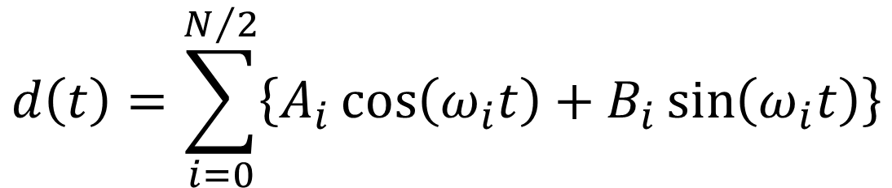
$$d\left(t\right)=\sum_{i=0}^{N/2}{\left\{A_{i}\cos\left(ω_{i}t\right)+B_{i}\sin\left(ω_{i}t\right)\right\}}$$
Notes:
Mention that this brings the discussion back techniques that they already understand, that is,
linear models and their solution by least squares.

Slide 4
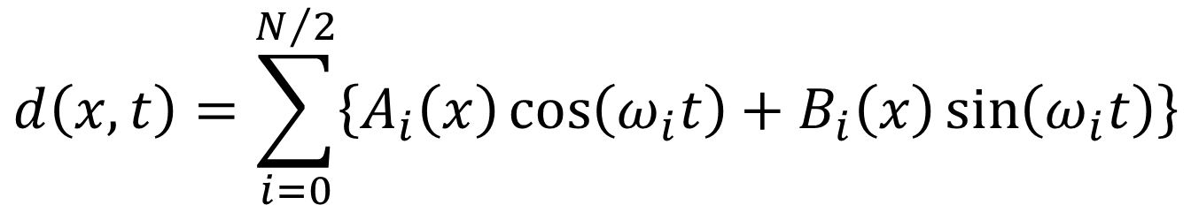
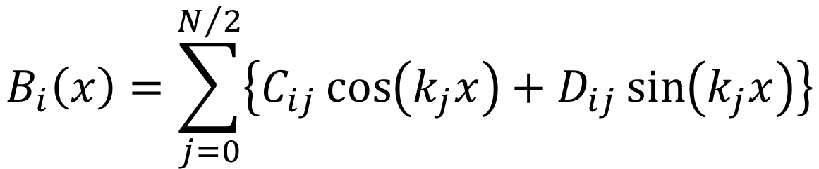
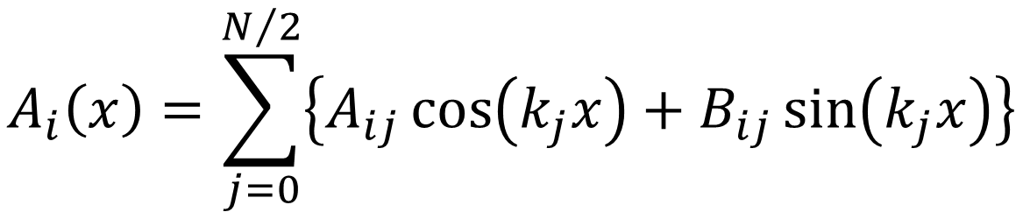
$$d\left(x,t\right)=\sum_{i=0}^{N/2}{\left\{A_{i}\left(x\right)\cos\left(ω_{i}t\right)+B_{i}\left(x\right)\sin\left(ω_{i}t\right)\right\}}$$
$$A_{i}\left(x\right)=\sum_{j=0}^{N/2}{\left\{A_{ij}\cos\left(k_{j}x\right)+B_{ij}\sin\left(k_{j}x\right)\right\}}$$
$$B_{i}\left(x\right)=\sum_{j=0}^{N/2}{\left\{C_{ij}\cos\left(k_{j}x\right)+D_{ij}\sin\left(k_{j}x\right)\right\}}$$
Notes:
Mention that this brings the discussion back techniques that they already understand, that is,
linear models and their solution by least squares.

Slide 5
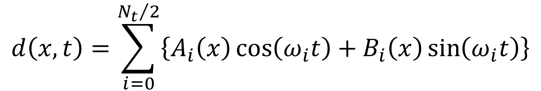
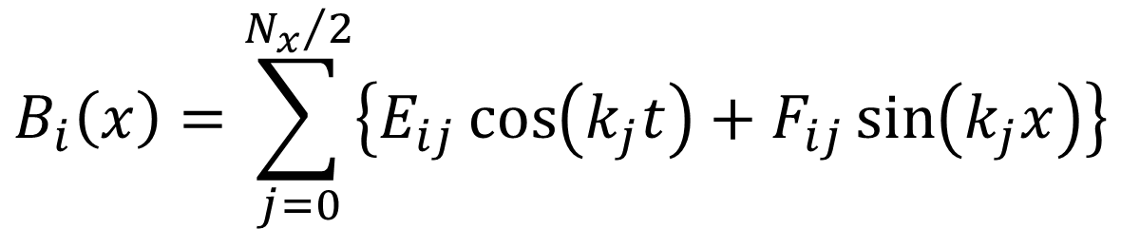
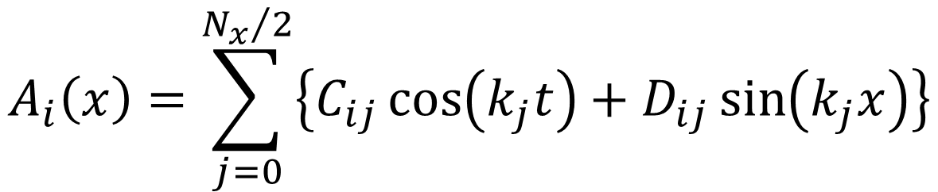
$$d\left(x,t\right)=\sum_{i=0}^{{N_{t}}/2}{\left\{A_{i}\left(x\right)\cos\left(ω_{i}t\right)+B_{i}\left(x\right)\sin\left(ω_{i}t\right)\right\}}$$
$$A_{i}\left(x\right)=\sum_{j=0}^{{N_{x}}/2}{\left\{C_{ij}\cos\left(k_{j}t\right)+D_{ij}\sin\left(k_{j}x\right)\right\}}$$
$$B_{i}\left(x\right)=\sum_{j=0}^{{N_{x}}/2}{\left\{E_{ij}\cos\left(k_{j}t\right)+F_{ij}\sin\left(k_{j}x\right)\right\}}$$
Notes:
Mention that this brings the discussion back techniques that they already understand, that is,
linear models and their solution by least squares.

Slide 6
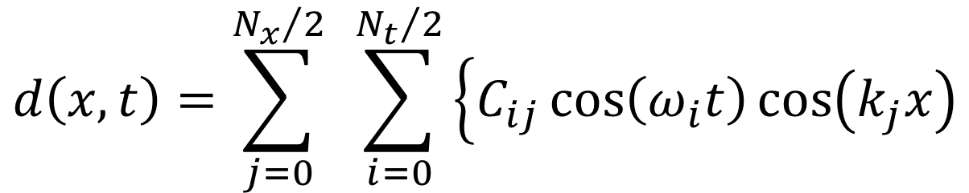



$$d\left(x,t\right)=\sum_{j=0}^{{N_{x}}/2}{ }\sum_{i=0}^{{N_{t}}/2}{\left\{C_{ij}\cos\left(ω_{i}t\right)\cos\left(k_{j}x\right)\right.}$$
$$+D_{ij}\cos\left(ω_{i}t\right)\sin\left(k_{j}x\right)$$
$$+E_{ij}\sin\left(ω_{i}t\right)\cos\left(k_{j}x\right)$$
$$\left.+F_{ij}\sin\left(ω_{i}t\right)\sin\left(k_{j}x\right)\right\}$$
Notes:
Mention that this brings the discussion back techniques that they already understand, that is,
linear models and their solution by least squares.

Slide 7
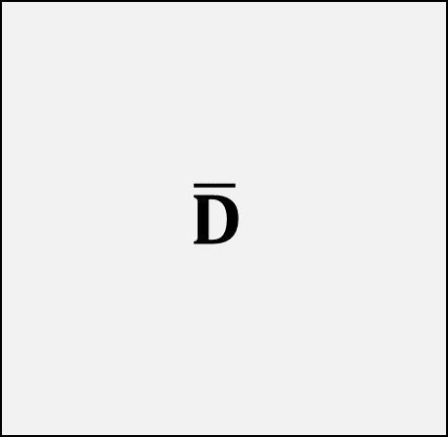
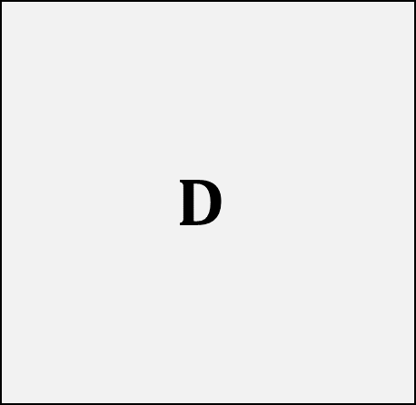



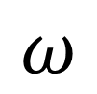

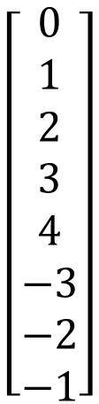
FFT2
Dbar = np.fft.fft2(D);
IFFT2
D = np.fft.ifft2(Dbar);
$$\left[\begin{matrix}0 \\ 1 \\ 2 \\ 3 \\ 4 \\ 5 \\ 6 \\ 7\end{matrix}\right]$$
$$D$$
$$\left[\begin{matrix}0 \\ 1 \\ 2 \\ 3 \\ 4 \\ −3 \\ −2 \\ −1\end{matrix}\right]$$
$$\overline{D}$$
$$x$$
$$k$$
$$\left[\begin{matrix}0 & 1 & 2 & 3 & 4 & 5 & 6 & 7\end{matrix}\right]$$
$$\left[\begin{matrix}0 & 1 & 2 & 3 & 4 & −3 & −2 & −1\end{matrix}\right]$$
$$t$$
$$ω$$
Notes:
Mention that this brings the discussion back techniques that they already understand, that is,
linear models and their solution by least squares.

Slide 8
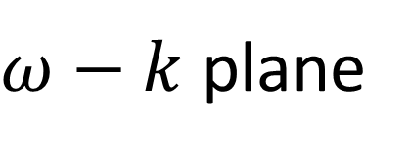






$ω−k$ plane
$$k$$
$$k_{ny}$$
$$ω$$
$${−ω}_{ny}$$
$$ω_{ny}$$
$${−k}_{ny}$$

Slide 9

$ω−k$ plane
$$k$$
$$k_{ny}$$
$$ω_{0},k_{0}$$
$$ω$$
$${−ω}_{ny}$$
$$ω_{ny}$$
$${−k}_{ny}$$

Slide 10

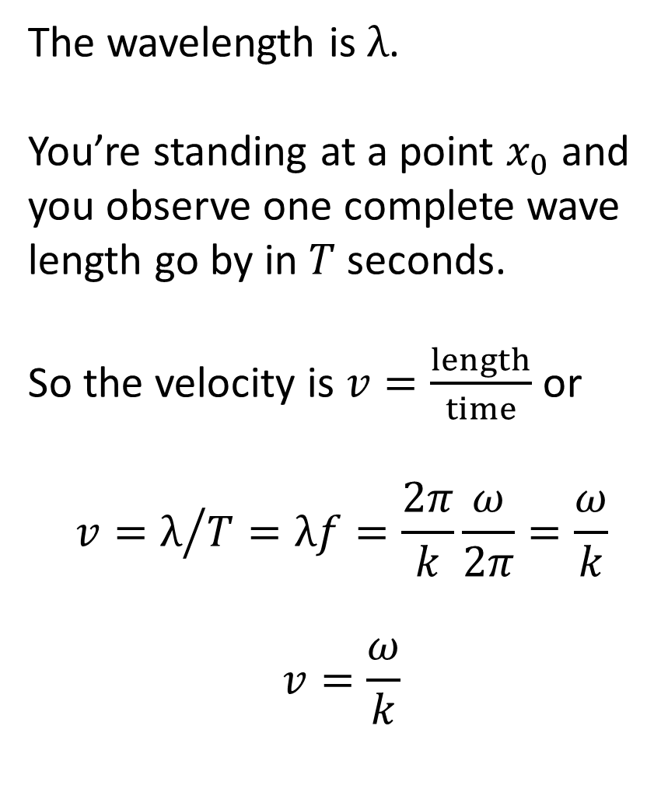




velocity = frequency times wavelength
The wavelength is $λ$.
You’re standing at a point $x_{0}$ and you observe one complete wave length go by in $T$ seconds.
So the velocity is $v=\frac{length}{time}$ or
$$v=λ/{T=λf=\frac{2π}{k}\frac{ω}{2π}=\frac{ω}{k}}$$
$$v=\frac{ω}{k}$$
$$λ$$
$$x$$
$$x_{0}$$
$$T$$
$$x$$

Slide 11

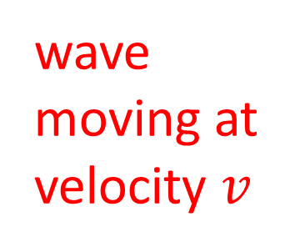
$ω−k$ plane
$$k$$
wave moving at velocity $v$
$$k_{ny}$$
$$\overline{u}\left(ω_{0},k_{0}\right)$$
$$ω$$
$${−ω}_{ny}$$
$$ω_{ny}$$
$${−k}_{ny}$$

Slide 12
$ω−k$ plane
$$k$$
$$k_{ny}$$
to get a real cosine wave you have to add this point
with the same
amplitude
$$\overline{u}\left(ω_{0},k_{0}\right)$$
$$ω$$
$${−ω}_{ny}$$
$$ω_{ny}$$
$${−k}_{ny}$$

Slide 13
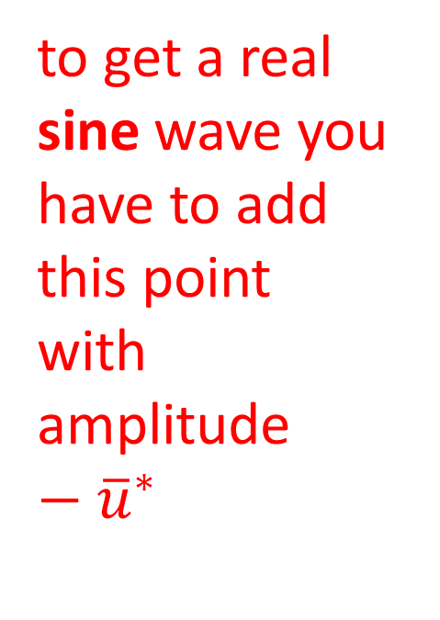
$ω−k$ plane
$$k$$
$$k_{ny}$$
to get a real sine wave you have to add this point
with amplitude $−{\overline{u}}^{∗}$
$$\overline{u}\left(ω_{0},k_{0}\right)$$
$$ω$$
$${−ω}_{ny}$$
$$ω_{ny}$$
$${−k}_{ny}$$

Slide 14

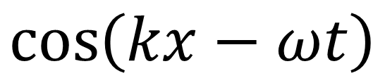

$$\left[\begin{matrix}0 \\ 1 \\ 2 \\ 3 \\ 4 \\ −3 \\ −2 \\ −1\end{matrix}\right]$$
$$\overline{D}$$
$$1$$
$$\cos\left(kx−ωt\right)$$
IFFT2
$$k$$
$$1$$
$$\left[\begin{matrix}0 & 1 & 2 & 3 & 4 & −3 & −2 & −1\end{matrix}\right]$$
$$ω$$
Notes:
Mention that this brings the discussion back techniques that they already understand, that is,
linear models and their solution by least squares.

Slide 15
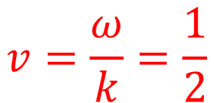
$$v=\frac{ω}{k}=\frac{1}{2}$$
$$\left[\begin{matrix}0 \\ 1 \\ 2 \\ 3 \\ 4 \\ −3 \\ −2 \\ −1\end{matrix}\right]$$
$$\overline{D}$$
$$1$$
$$\cos\left(kx−ωt\right)$$
IFFT2
$$k$$
$$1$$
$$\left[\begin{matrix}0 & 1 & 2 & 3 & 4 & −3 & −2 & −1\end{matrix}\right]$$
$$ω$$
Notes:
Mention that this brings the discussion back techniques that they already understand, that is,
linear models and their solution by least squares.

Slide 16
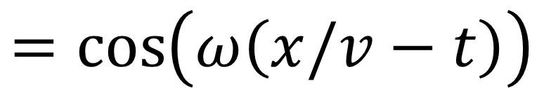
$$\left[\begin{matrix}0 \\ 1 \\ 2 \\ 3 \\ 4 \\ −3 \\ −2 \\ −1\end{matrix}\right]$$
$$\overline{D}$$
$$1$$
$$\cos\left(kx−ωt\right)$$
IFFT2
$$k$$
$$1$$
$$=cos\left(ω\left(x/v−t\right)\right)$$
$$\left[\begin{matrix}0 & 1 & 2 & 3 & 4 & −3 & −2 & −1\end{matrix}\right]$$
$$ω$$
Notes:
Mention that this brings the discussion back techniques that they already understand, that is,
linear models and their solution by least squares.

Slide 17
# sine wave
ut = np.zeros((Nt,Nx),dtype=complex);
iw=4;
ik=3;
v = w[iw,0]/k[ik,0];
ut[iw,ik] = complex(0.0,1.0);
ut[Nt-iw,Nx-ik] = np.conj(ut[iw,ik]);
# inverse fourier transform
u = np.fft.ifft2(ut);
u = np.real(u);

Slide 18
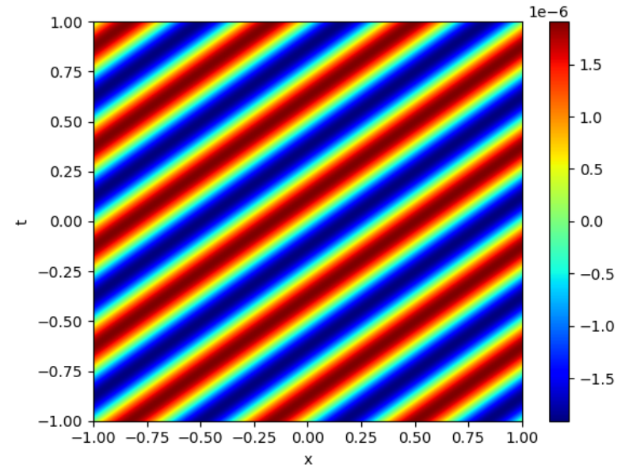

Slide 19
# can do any number of dimensions
ut = np.zeros((Nt,Nx,Ny),dtype=complex);
FFTn
Dbar = np.fft.fftn(D);
IFFTn
D = np.fft.ifftn(Dbar);
Notes:
Mention that this brings the discussion back techniques that they already understand, that is,
linear models and their solution by least squares.

Slide 20
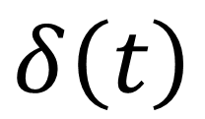

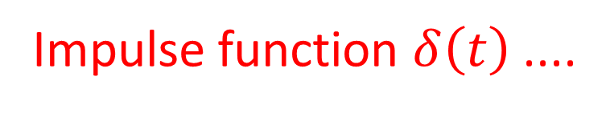

A useful fact that we’ll soon use
$$δ\left(t\right)$$
Impulse function $δ\left(t\right)$ ....
$$t$$
$$0$$

Slide 21
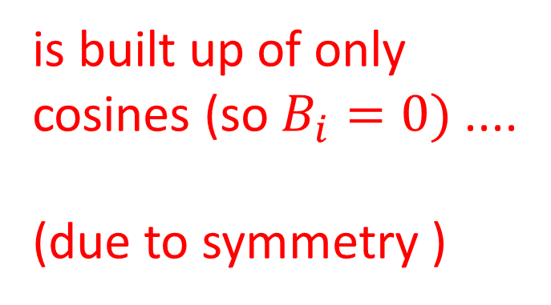
A useful fact that we’ll soon use
$$δ\left(t\right)$$
is built up of only
cosines (so $B_{i}=0)$....
(due to symmetry )
$$t$$
$$0$$

Slide 22
A useful fact that we’ll soon use
$$δ\left(t\right)$$
... and all the cosines have the same amplitude of 2
$$t$$
$$0$$

Slide 23
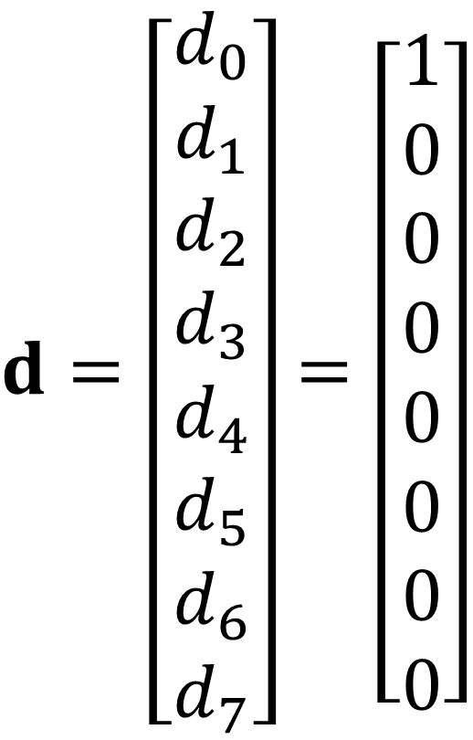
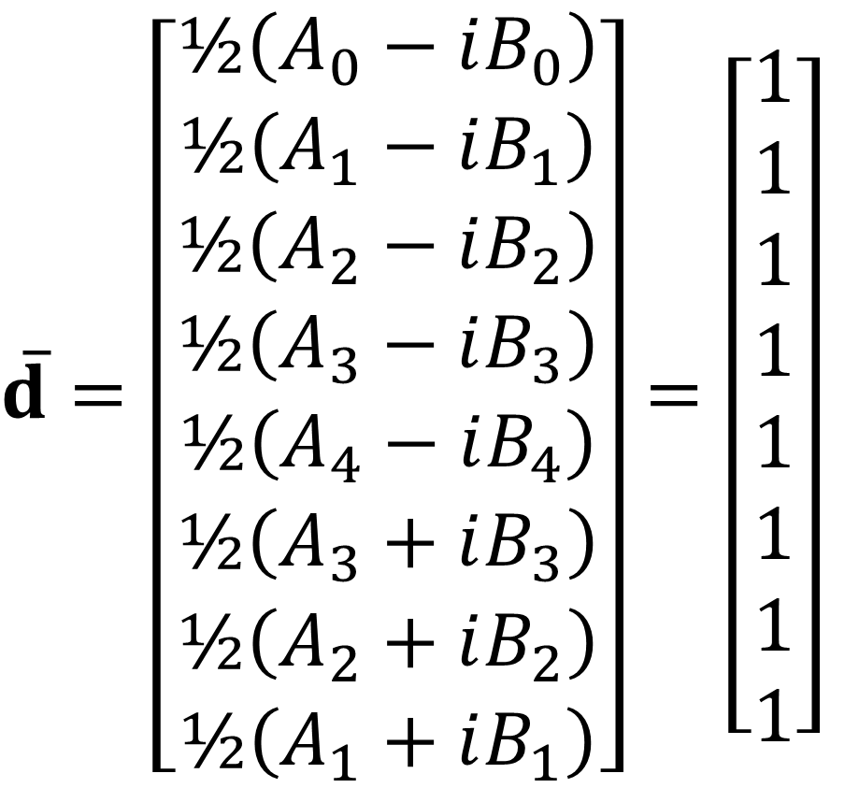
$\overline{d}=\left[\begin{matrix}½\left(A_{0}−iB_{0}\right) \\ ½\left(A_{1}−iB_{1}\right) \\ ½\left(A_{2}−iB_{2}\right) \\ ½\left(A_{3}−iB_{3}\right) \\ ½\left(A_{4}−iB_{4}\right) \\ ½\left(A_{3}+iB_{3}\right) \\ ½\left(A_{2}+iB_{2}\right) \\ ½\left(A_{1}+iB_{1}\right)\end{matrix}\right]$ $=\left[\begin{matrix}1 \\ 1 \\ 1 \\ 1 \\ 1 \\ 1 \\ 1 \\ 1\end{matrix}\right]$
$d=\left[\begin{matrix}d_{0} \\ d_{1} \\ d_{2} \\ d_{3} \\ d_{4} \\ d_{5} \\ d_{6} \\ d_{7}\end{matrix}\right]$ $=\left[\begin{matrix}1 \\ 0 \\ 0 \\ 0 \\ 0 \\ 0 \\ 0 \\ 0\end{matrix}\right]$

Slide 24

Using Fourier Transforms to model acoustic waves in $\left(x,y,t\right)$

Slide 25

acoustic wave equation based on newton’s law $$m a=f$$

Slide 26
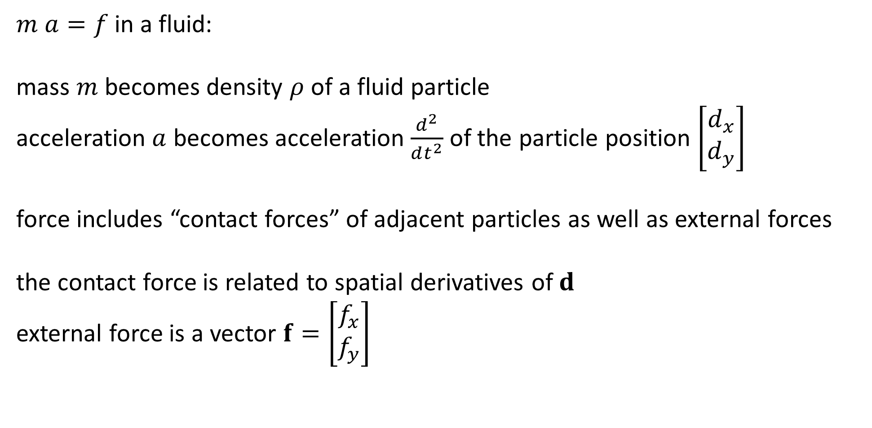
$m a=f$in a fluid:
mass $m$ becomes density $ρ$ of a fluid particle
acceleration $a$ becomes acceleration $\frac{d^{2}}{dt^{2}}$ of the particle position $\left[\begin{matrix}d_{x} \\ d_{y}\end{matrix}\right]$
force includes “contact forces” of adjacent particles as well as external forces
the contact force is related to spatial derivatives of $d$
external force is a vector $f=\left[\begin{matrix}f_{x} \\ f_{y}\end{matrix}\right]$

Slide 27

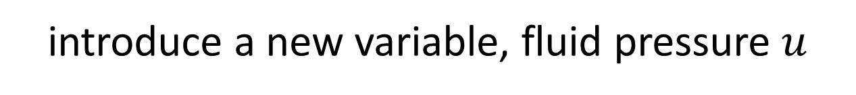
introduce a new variable, fluid pressure $u$
$$u=−κ\left(\frac{dd_{x}}{dx}+\frac{dd_{y}}{dy}\right)$$
pressure goes up as particles move towards one another
compressibility of the fluid $κ$

Slide 28
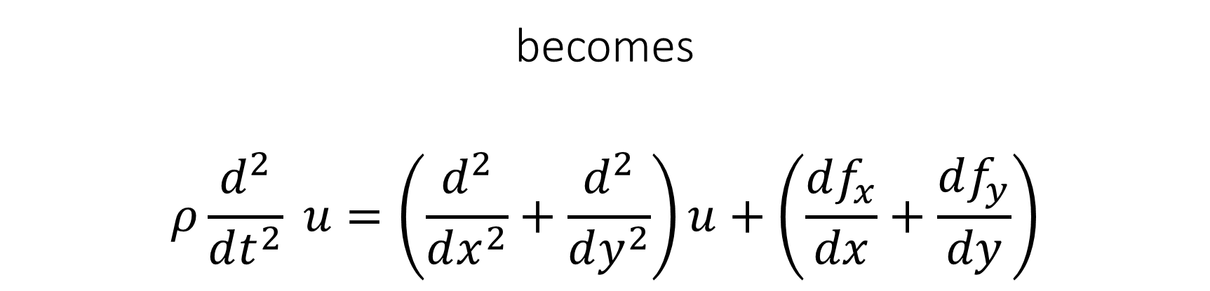

$$m a=f$$
becomes
$$ρ\frac{d^{2}}{dt^{2}} u=\left(\frac{d^{2}}{dx^{2}}+\frac{d^{2}}{dy^{2}}\right)u+\left(\frac{df_{x}}{dx}+\frac{df_{y}}{dy}\right)$$
acceleration
contact force
external force

Slide 29
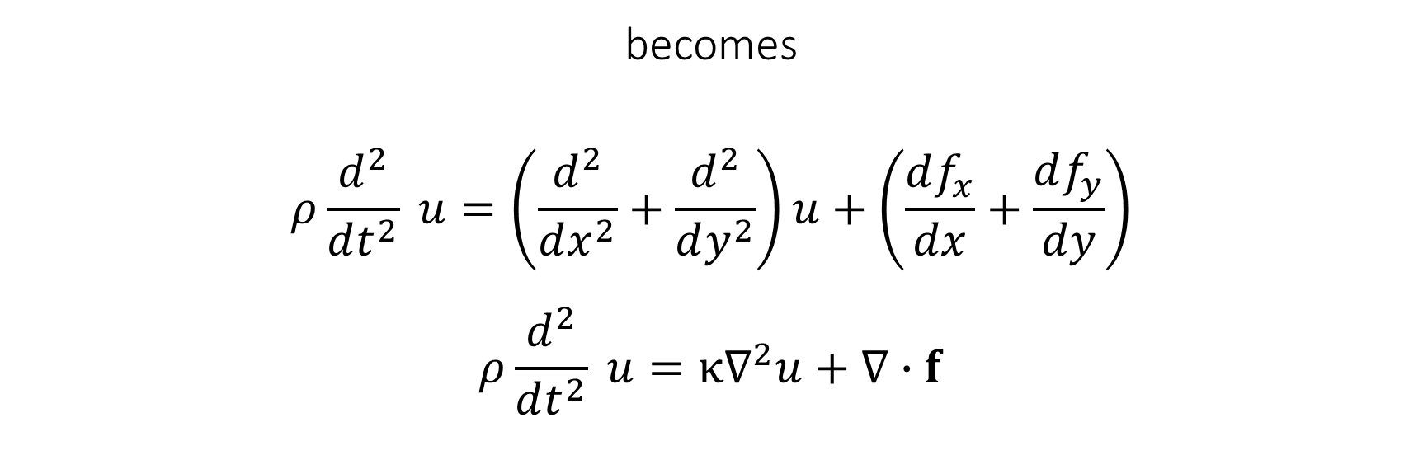
$$m a=f$$
becomes
$$ρ\frac{d^{2}}{dt^{2}} u=\left(\frac{d^{2}}{dx^{2}}+\frac{d^{2}}{dy^{2}}\right)u+\left(\frac{df_{x}}{dx}+\frac{df_{y}}{dy}\right)$$
$$ρ\frac{d^{2}}{dt^{2}} u=κ∇^{2}u+∇∙f$$

Slide 30

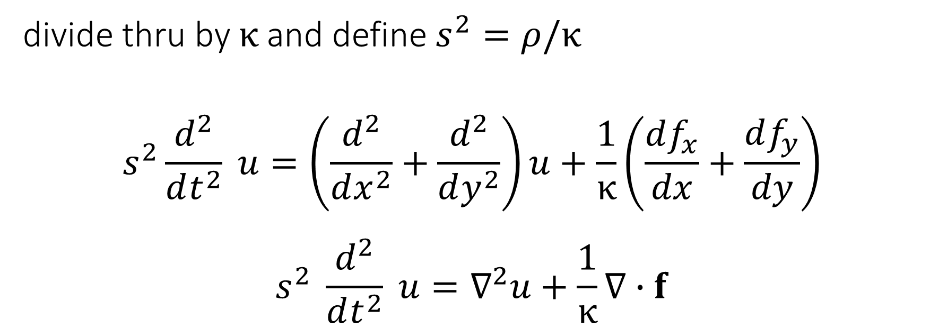

divide thru by $κ$ and define $s^{2}=ρ/κ$
$$s^{2}\frac{d^{2}}{dt^{2}} u=\left(\frac{d^{2}}{dx^{2}}+\frac{d^{2}}{dy^{2}}\right)u+\frac{1}{κ}\left(\frac{df_{x}}{dx}+\frac{df_{y}}{dy}\right)$$
$$s^{2} \frac{d^{2}}{dt^{2}} u=∇^{2}u+\frac{1}{κ}∇∙f$$
but we’ll assume $κ=1$ for simplicity
$s$ is slowness, by the way

Slide 31

Acoustic wave equation
$$\left(s^{2}\frac{d^{2}}{dt^{2}}−\frac{d^{2}}{dx^{2}}−\frac{d^{2}}{dy^{2}}\right)u=\left(\frac{df_{x}}{dx}+\frac{df_{y}}{dy}\right)$$

Slide 32

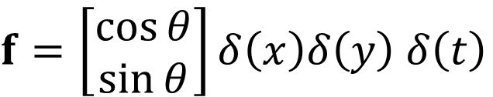



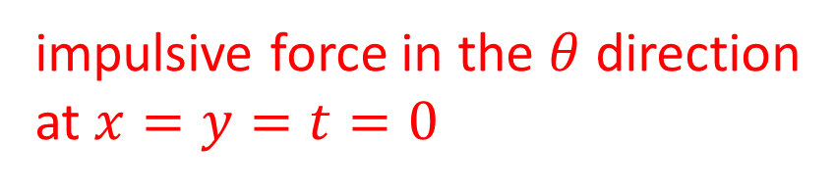


Acoustic wave equation
$$\left(s^{2}\frac{d^{2}}{dt^{2}}−\frac{d^{2}}{dx^{2}}−\frac{d^{2}}{dy^{2}}\right)u=\left(\frac{df_{x}}{dx}+\frac{df_{y}}{dy}\right)$$
$$y$$
$$f$$
$f=\left[\begin{matrix}\cos{θ} \\ \sin{θ}\end{matrix}\right]δ\left(x\right)δ\left(y\right)$ $δ\left(t\right)$
$$θ$$
$$x$$
$$0$$
impulsive force in the $θ$ direction
at $x=y=t=0$
$$\left(\frac{df_{x}}{dx}+\frac{df_{y}}{dy}\right)=\cos{θ\frac{dδ\left(x\right)}{dx}δ\left(y\right)+\sin{θ}δ\left(x\right)\frac{dδ\left(y\right)}{dy}}$$

Slide 33
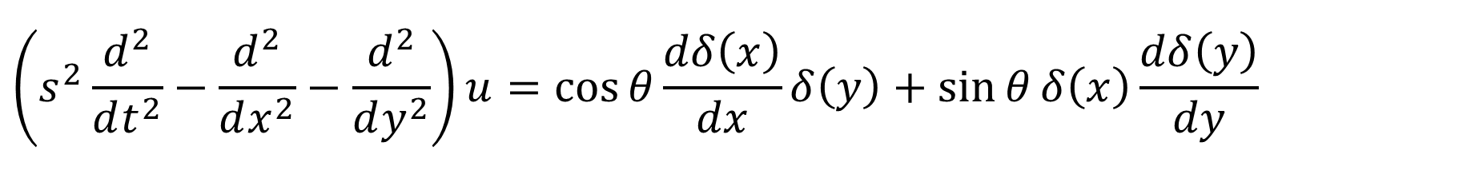
Acoustic wave equation for an impulsive force in the $θ$ direction
$$\left(s^{2}\frac{d^{2}}{dt^{2}}−\frac{d^{2}}{dx^{2}}−\frac{d^{2}}{dy^{2}}\right)u=\cos{θ\frac{dδ\left(x\right)}{dx}δ\left(y\right)+\sin{θ}δ\left(x\right)\frac{dδ\left(y\right)}{dy}}$$

Slide 34
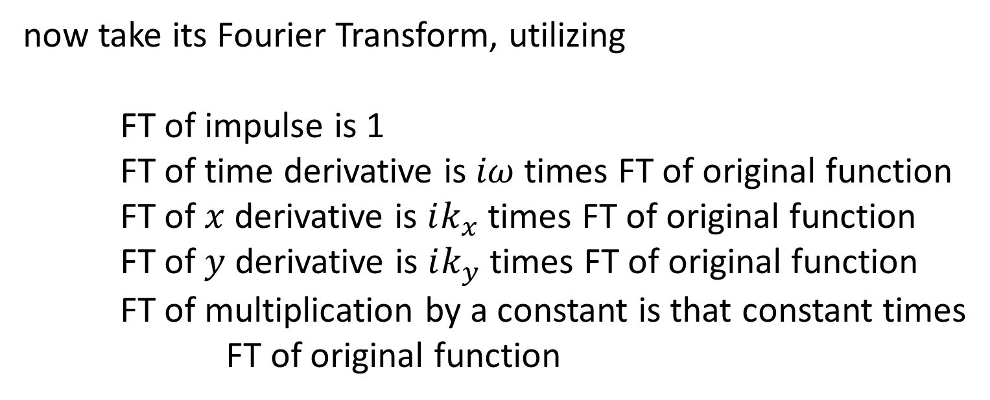
Acoustic wave equation for an impulsive force in the $θ$ direction
$$\left(s^{2}\frac{d^{2}}{dt^{2}}−\frac{d^{2}}{dx^{2}}−\frac{d^{2}}{dy^{2}}\right)u=\cos{θ\frac{dδ\left(x\right)}{dx}δ\left(y\right)+\sin{θ}δ\left(x\right)\frac{dδ\left(y\right)}{dy}}$$
now take its Fourier Transform, utilizing
FT of impulse is 1
FT of time derivative is $iω$ times FT of original function
FT of $x$ derivative is $ik_{x}$ times FT of original function
FT of $y$ derivative is $ik_{y}$ times FT of original function
FT of multiplication by a constant is that constant times
FT of original function

Slide 35
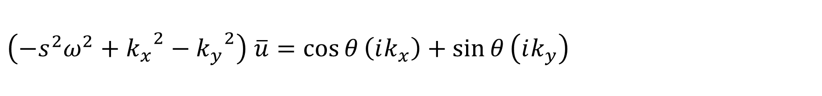
Acoustic wave equation for an impulsive force in the $θ$ direction
$$\left(s^{2}\frac{d^{2}}{dt^{2}}−\frac{d^{2}}{dx^{2}}−\frac{d^{2}}{dy^{2}}\right)u=\cos{θ\frac{dδ\left(x\right)}{dx}δ\left(y\right)+\sin{θ}δ\left(x\right)\frac{dδ\left(y\right)}{dy}}$$
$$\left(−s^{2}ω^{2}+{k_{x}}^{2}−{k_{y}}^{2}\right) \overline{u}=\cos{θ}\left(ik_{x}\right)+\sin{θ}\left(ik_{y}\right)$$

Slide 36
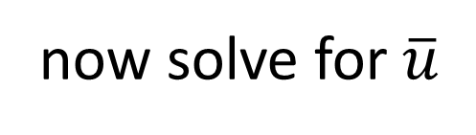
Acoustic wave equation for an impulsive force in the $θ$ direction
$$\left(s^{2}\frac{d^{2}}{dt^{2}}−\frac{d^{2}}{dx^{2}}−\frac{d^{2}}{dy^{2}}\right)u=\cos{θ\frac{dδ\left(x\right)}{dx}δ\left(y\right)+\sin{θ}δ\left(x\right)\frac{dδ\left(y\right)}{dy}}$$
$$\left(−s^{2}ω^{2}+{k_{x}}^{2}−{k_{y}}^{2}\right) \overline{u}=\cos{θ}\left(ik_{x}\right)+\sin{θ}\left(ik_{y}\right)$$
now solve for $\overline{u}$

Slide 37
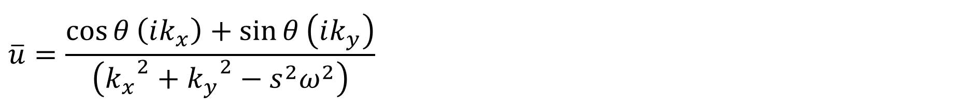
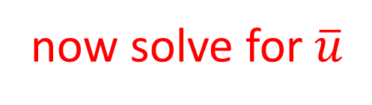
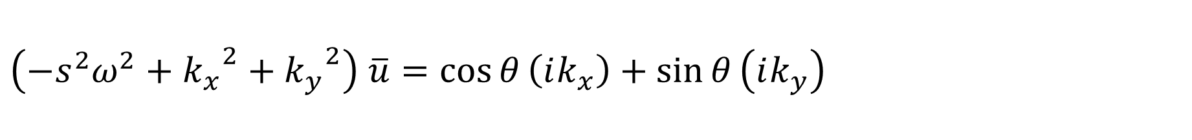
Acoustic wave equation for an impulsive force in the $θ$ direction
$$\left(s^{2}\frac{d^{2}}{dt^{2}}−\frac{d^{2}}{dx^{2}}−\frac{d^{2}}{dy^{2}}\right)u=\cos{θ\frac{dδ\left(x\right)}{dx}δ\left(y\right)+\sin{θ}δ\left(x\right)\frac{dδ\left(y\right)}{dy}}$$
$$\left(−s^{2}ω^{2}+{k_{x}}^{2}+{k_{y}}^{2}\right) \overline{u}=\cos{θ}\left(ik_{x}\right)+\sin{θ}\left(ik_{y}\right)$$
now solve for $\overline{u}$
$$\overline{u}=\frac{\cos{θ}\left(ik_{x}\right)+\sin{θ}\left(ik_{y}\right)}{\left({k_{x}}^{2}+{k_{y}}^{2}−s^{2}ω^{2}\right)}$$

Slide 38
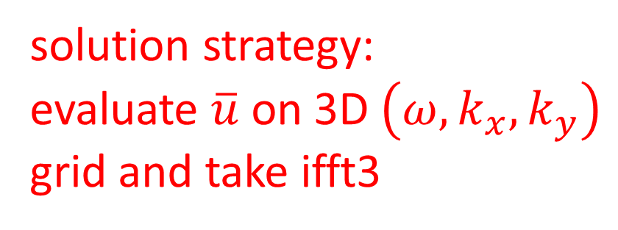
$$\overline{u}=\frac{\cos{θ}\left(ik_{x}\right)+\sin{θ}\left(ik_{y}\right)}{\left({k_{x}}^{2}+{k_{y}}^{2}−s^{2}ω^{2}\right)}$$
solution strategy:
evaluate $\overline{u}$ on 3D $\left(ω,k_{x},k_{y}\right)$
grid and take ifft3

Slide 39
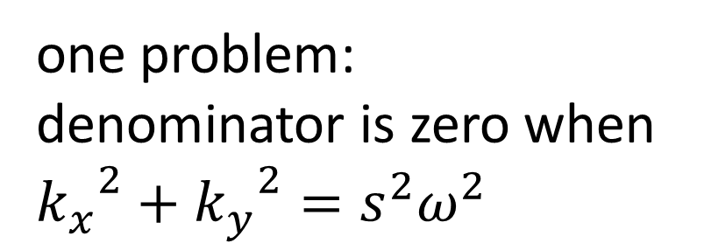
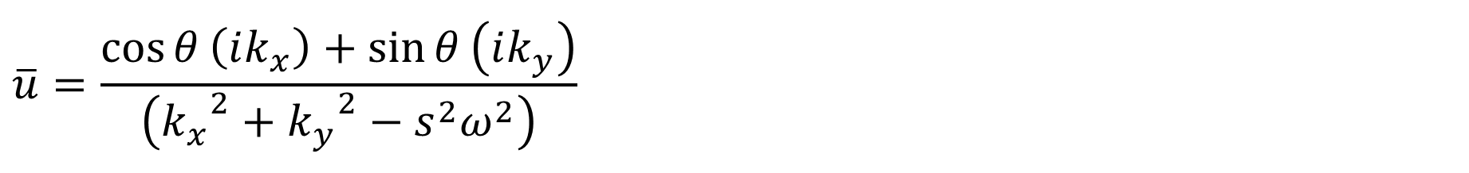
one problem: denominator is zero when ${k_{x}}^{2}+{k_{y}}^{2}=s^{2}ω^{2}$
$$\overline{u}=\frac{\cos{θ}\left(ik_{x}\right)+\sin{θ}\left(ik_{y}\right)}{\left({k_{x}}^{2}+{k_{y}}^{2}−s^{2}ω^{2}\right)}$$

Slide 40
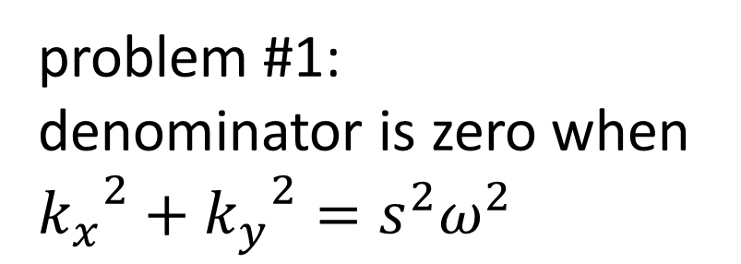
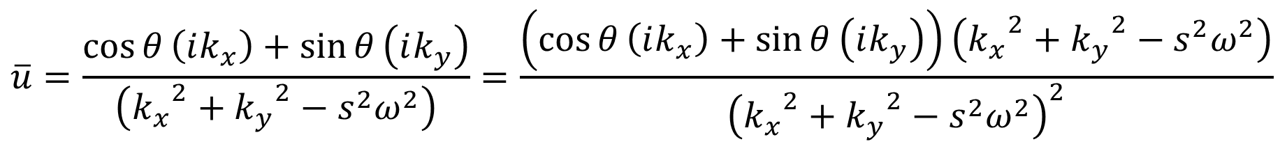

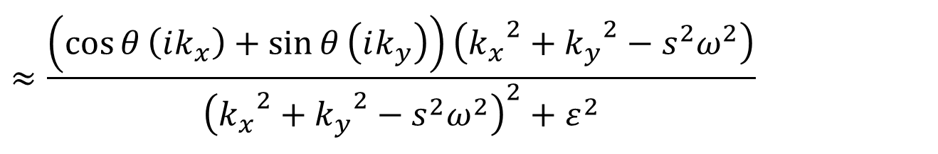
problem #1:
denominator is zero when ${k_{x}}^{2}+{k_{y}}^{2}=s^{2}ω^{2}$
approximate “patch”
$$\overline{u}=\frac{\cos{θ}\left(ik_{x}\right)+\sin{θ}\left(ik_{y}\right)}{\left({k_{x}}^{2}+{k_{y}}^{2}−s^{2}ω^{2}\right)}=\frac{\left(\cos{θ}\left(ik_{x}\right)+\sin{θ}\left(ik_{y}\right)\right)\left({k_{x}}^{2}+{k_{y}}^{2}−s^{2}ω^{2}\right)}{{\left({k_{x}}^{2}+{k_{y}}^{2}−s^{2}ω^{2}\right)}^{2}}$$
$$≈\frac{\left(\cos{θ}\left(ik_{x}\right)+\sin{θ}\left(ik_{y}\right)\right)\left({k_{x}}^{2}+{k_{y}}^{2}−s^{2}ω^{2}\right)}{{\left({k_{x}}^{2}+{k_{y}}^{2}−s^{2}ω^{2}\right)}^{2}+ε^{2}}$$
${ ε}^{2}$ a small number

Slide 41
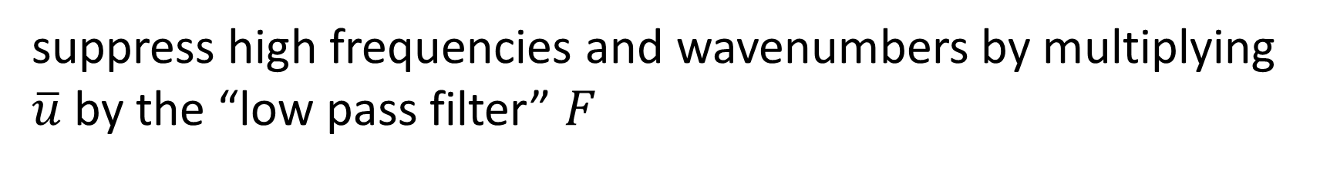
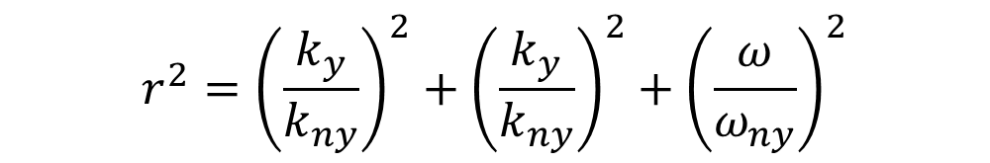
problem #2:
force is unrealistically impulsive
“patch”
suppress high frequencies and wavenumbers by multiplying $\overline{u}$ by the “low pass filter” $F$
$$F=exp\left(−½r^{2}/σ^{2}\right)$$
$$r^{2}={\left(\frac{k_{y}}{k_{ny}}\right)}^{2}+{\left(\frac{k_{y}}{k_{ny}}\right)}^{2}+{\left(\frac{ω}{ω_{ny}}\right)}^{2}$$

Slide 42
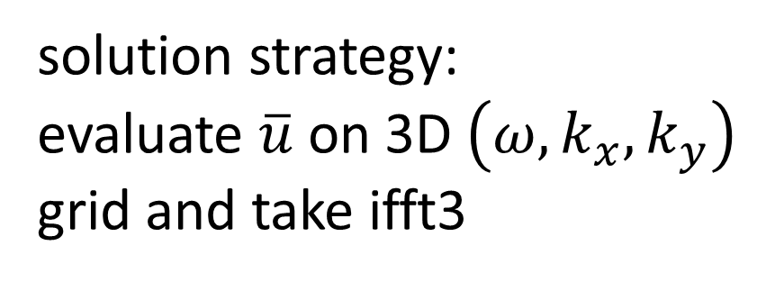
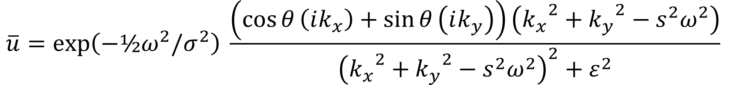
solution strategy:
evaluate $\overline{u}$ on 3D $\left(ω,k_{x},k_{y}\right)$
grid and take ifft3
$$\overline{u}=\exp\left(−½ω^{2}/σ^{2}\right) \frac{\left(\cos{θ}\left(ik_{x}\right)+\sin{θ}\left(ik_{y}\right)\right)\left({k_{x}}^{2}+{k_{y}}^{2}−s^{2}ω^{2}\right)}{{\left({k_{x}}^{2}+{k_{y}}^{2}−s^{2}ω^{2}\right)}^{2}+ε^{2}}$$

Slide 43
# transform of field, note order ut[iw, ikx, iky]
ut = np.zeros((Nt,Nx,Ny),dtype=complex);
# evaluate ut[iw, ikx, iky]
for iw in range(Nt):
for ikx in range(Nx):
for iky in range(Ny):
A = kx[ikx,0]**2 + ky[iky,0]**2 - s2*(w[iw,0]**2);
r2 = (kx[ikx,0]/kxmax)**2 + (ky[iky,0]/kymax)**2 + (w[iw,0]/wmax)**2;
F = exp(-0.5*r2/sigma);
ut[iw,ikx,iky]=F*(cosq*i*kx[ikx,0]+sinq*i*ky[iky,0]) * A/(A**2 + epsi2 );
# inverse fourier transform
u = np.fft.ifftn(ut);
u = np.real(u);

Slide 44


Slide 45
Group 1
Try a suite of different force angles.
How do the results differ? Pay attention to the sign of the amplitude.
Can one deduce the direction of the force from the results?

Slide 46
Group 2
Try a suite of slownesses.
What is the range of slowness that work? (In the sense of producing reasonable results).
Of those that work, Does the wave for a higher slowness go slower?

Slide 47
Group 3
One interpretation of a fourier method is that it represents a repeating grid of experiments, and as time progresses waves from neighboring experiments can enter yours.
Interpret the results in this context

