Slide 1
2023 EESC W3400
Lec 17: Chemical diffusion computed with the 2D FFT
Computational Earth Science
Bill Menke, Instructor
Emily Glazer, Teaching Assistant
TR 2:40 – 3:55

Slide 2
Today
Additional Uses of the Fast Fourier Transform
Chemical diffusion
(but same as heat diffusion)

Slide 3



Variables
Concentration of chemical
$$C$$
(volume fraction)
$$S$$
(volume fraction per unit time)
Source of chemical
$$q$$
Flux of chemical
(volume fraction crossing unit surface per unit time)

Slide 4


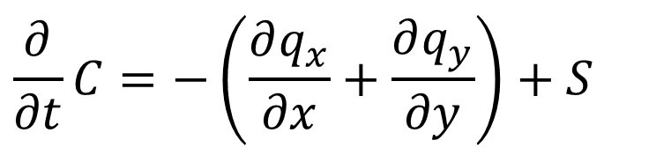



Conservation of mass
$$q_{y}\left(y+∆y\right)$$
$$q_{x}\left(x+∆x\right)$$
$$q_{x}\left(x\right)$$
$$\frac{∂}{∂t}C=−\left(\frac{∂q_{x}}{∂x}+\frac{∂q_{y}}{∂y}\right)+S$$
$$C and S$$
$$q_{y}\left(y\right)$$

Slide 5






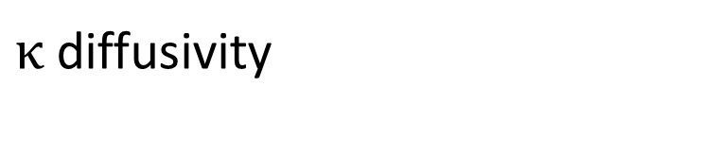
Conservation of mass
$$q_{y}\left(y+∆y\right)$$
$$q_{x}\left(x+∆x\right)$$
$$q_{x}\left(x\right)$$
$$\frac{∂}{∂t}C=−\left(\frac{∂q_{x}}{∂x}+\frac{∂q_{y}}{∂y}\right)+S$$
$$C and S$$
$$q_{y}\left(y\right)$$
$$q_{x}=−κ\frac{∂C}{∂x}$$
$$q_{x}=−κ\frac{∂C}{∂y}$$
Chemical diffusion
$$high C$$
$$low C$$
$$x+∆x$$
$$x$$
$κ$ diffusivity
$$q_{x}\left(x\right)$$

Slide 6

Conservation of mass
$$q_{y}\left(y+∆y\right)$$
$$q_{x}\left(x+∆x\right)$$
$$q_{x}\left(x\right)$$
$$\frac{∂}{∂t}C=−\left(\frac{∂q_{x}}{∂x}+\frac{∂q_{y}}{∂y}\right)+S$$
$$C and S$$
$$q_{x}=−κ\frac{∂C}{∂x}$$
$$q_{y}=−κ\frac{∂C}{∂y}$$
$$q_{y}\left(y\right)$$
Chemical diffusion
$$high C$$
$$low C$$
$$x+∆x$$
$$\frac{∂}{∂t}C=κ\left(\frac{∂^{2}}{∂x^{2}}+\frac{∂^{2}}{∂y^{2}}\right)C+S$$
$$x$$
$$q_{x}\left(x\right)$$

Slide 7
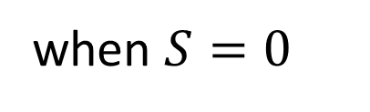
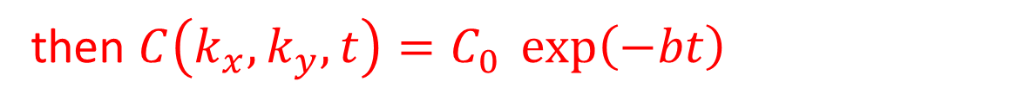
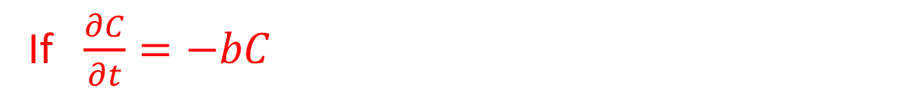
when $S=0$
$$\frac{∂}{∂t}C\left(x,y,t\right)=κ\left(\frac{∂^{2}}{∂x^{2}}+\frac{∂^{2}}{∂y^{2}}\right)C\left(x,y,t\right)$$
$$\frac{∂}{∂t}C\left(k_{x},k_{y},t\right)=−κ\left(k_{x}^{2}+k_{y}^{2}\right)C\left(k_{x},k_{y},t\right)$$
FT
If $\frac{∂C}{∂t}=−bC$
then $C\left(k_{x},k_{y},t\right)=C_{0} \exp\left(−bt\right)$

Slide 8
when $S=0$
$$\frac{∂}{∂t}C\left(x,y,t\right)=κ\left(\frac{∂^{2}}{∂x^{2}}+\frac{∂^{2}}{∂y^{2}}\right)C\left(x,y,t\right)$$
$$\frac{∂}{∂t}C\left(k_{x},k_{y},t\right)=−κ\left(k_{x}^{2}+k_{y}^{2}\right)C\left(k_{x},k_{y},t\right)$$
$$C\left(k_{x},k_{y},t\right)=C_{0} \exp\left(−κ\left(k_{x}^{2}+k_{y}^{2}\right)t\right)$$
$$with C_{0}\left(k_{x},k_{y}\right)=C\left(k_{x},k_{y},t=0\right)$$

Slide 9



procedure
Start with $C_{0}\left(x,y\right)$
FT to $C_{0}\left(k_{x},k_{y}\right)$
for each $t$
Multiply by $\exp\left(−κ\left(k_{x}^{2}+k_{y}^{2}\right)t\right)$ to get $C\left(k_{x},k_{y},t\right)$
IFT to $C\left(x,y,t\right)$

Slide 10
procedure
Start with $C_{0}\left(x,y\right)$
FT to $C_{0}\left(k_{x},k_{y}\right)$
for each $t$
Multiply by $\exp\left(−κ\left(k_{x}^{2}+k_{y}^{2}\right)t\right)$ to get $C\left(k_{x},k_{y},t\right)$
IFT to $C\left(x,y,t\right)$
Very similar to how we computed gravity anomalies

Slide 11
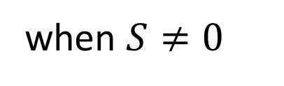
when $S≠0$
$$\frac{∂}{∂t}C\left(x,y,t\right)=κ\left(\frac{∂^{2}}{∂x^{2}}+\frac{∂^{2}}{∂x^{2}}\right)C\left(x,y,t\right)+S\left(x,y,t\right)$$
$$\frac{∂}{∂t}C\left(k_{x},k_{y},t\right)=−κ\left(k_{x}^{2}+k_{y}^{2}\right)C\left(k_{x},k_{y},t\right)+S\left(k_{x},k_{y},t\right)$$

Slide 12
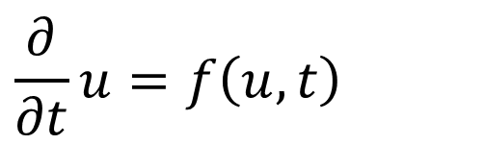
when $S≠0$
$$\frac{∂}{∂t}C\left(x,y,t\right)=κ\left(\frac{∂^{2}}{∂x^{2}}+\frac{∂^{2}}{∂x^{2}}\right)C\left(x,y,t\right)+S\left(x,y,t\right)$$
$$\frac{∂}{∂t}C\left(k_{x},k_{y},t\right)=−κ\left(k_{x}^{2}+k_{y}^{2}\right)C\left(k_{x},k_{y},t\right)+S\left(k_{x},k_{y},t\right)$$
$$\frac{∂}{∂t}u=f\left(u,t\right)$$
We know how to solve this form numerically

Slide 13


when $S≠0$
$$\frac{∂}{∂t}C\left(x,y,t\right)=κ\left(\frac{∂^{2}}{∂x^{2}}+\frac{∂^{2}}{∂x^{2}}\right)C\left(x,y,t\right)+S\left(x,y,t\right)$$
$$\frac{∂}{∂t}C\left(k_{x},k_{y},t\right)=−κ\left(k_{x}^{2}+k_{y}^{2}\right)C\left(k_{x},k_{y},t\right)+S\left(k_{x},k_{y},t\right)$$
$$\frac{∂}{∂t}u=f\left(u,t\right)$$
$$u=C\left(k_{x},k_{y},t\right)$$
$$f\left(u,t\right)=−κ\left(k_{x}^{2}+k_{y}^{2}\right)C\left(k_{x},k_{y},t\right)+S\left(k_{x},k_{y},t\right)$$
$$u_{0}=C\left(k_{x},k_{y},t=0\right)$$

Slide 14

Simple example
$$S\left(x,y,t\right)=S\left(x,y\right)$$
(constant in time)

Slide 15
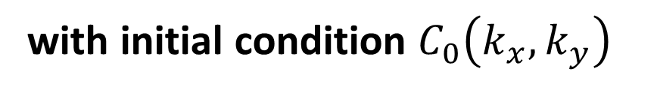
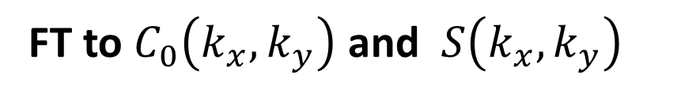




procedure
start with $C_{0}\left(x,y\right)$ and $S\left(x,y\right)$
FT to $C_{0}\left(k_{x},k_{y}\right)$ and $S\left(k_{x},k_{y}\right)$
for each $\left(k_{x},k_{y}\right)$
numerically solve $C\left(k_{x},k_{y},t\right)=−κ\left(k_{x}^{2}+k_{y}^{2}\right)C\left(k_{x},k_{y},t\right)+S\left(k_{x},k_{y}\right)$
with initial condition $C_{0}\left(k_{x},k_{y}\right)$
to get $C\left(k_{x},k_{y},t\right)$
for each $t$
IFT to $C\left(x,y,t\right)$

Slide 16
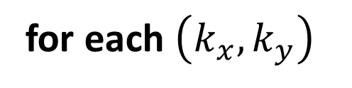
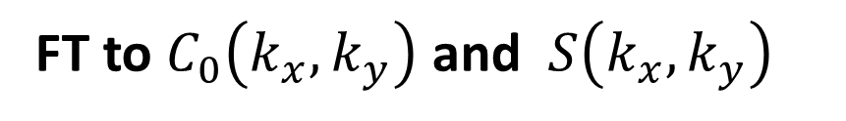


# Fourier Transforms
C0t = np.fft.fft2(C0);
St = np.fft.fft2(S);
# function for differential equation du/dt = f(u,t)
# here u=C(kx,ky,t) and f=-k(kx**2+ky**2)+S
def myfun( t, u ):
f = np.zeros((1,),dtype=complex);
f[0] = -b * u[0] + St[ikx,iky];
return f;
for ikx in range(Nx):
kx0 = kx[ikx,0];
for iky in range(Ny):
ky0 = ky[iky,0];
b = kappa*(kx0**2 + ky0**2);
u0 = np.zeros((1,),dtype=complex);
u0[0] = C0t[ikx,iky];
sol=solve_ivp(myfun, [t0, tmax], u0, method = 'RK45', t_eval=t);
Et = np.sum( np.power((t-sol.t)/tmax,2) );
Ct[ikx,iky,0:Nt]=sol.y[0];
for i in range(Nt):
C[0:Nx,0:Ny,i] = np.real(np.fft.ifft2( Ct[0:Nx,0:Ny,i] ));
FT to $C_{0}\left(k_{x},k_{y}\right)$ and $S\left(k_{x},k_{y}\right)$
for each $\left(k_{x},k_{y}\right)$
numerically solve
for each $t$
IFT to $C\left(x,y,t\right)$

Slide 17
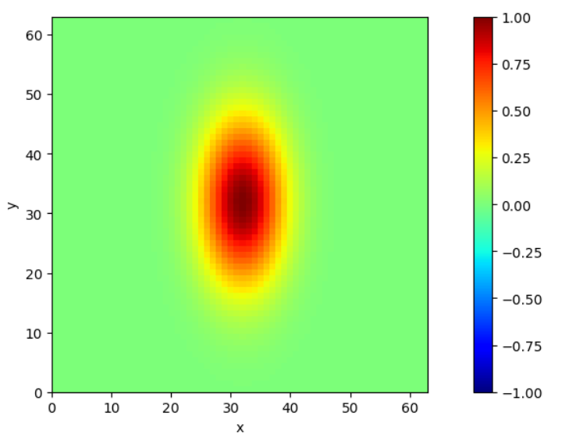

$$C_{0}\left(x,y\right)$$

Slide 18
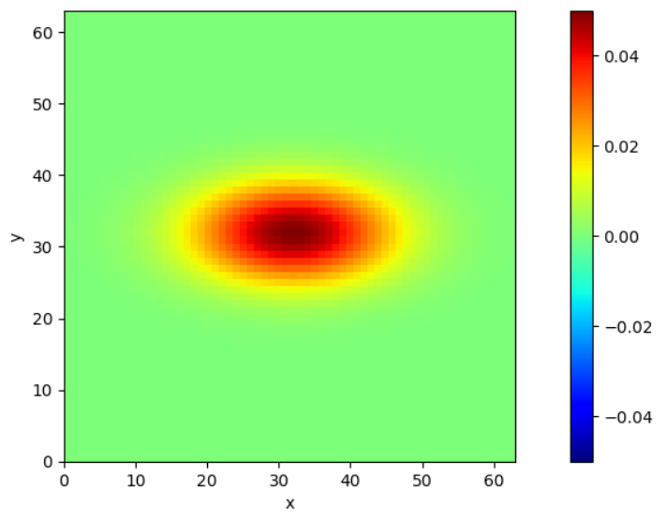

$$S\left(x,y\right)$$

Slide 19
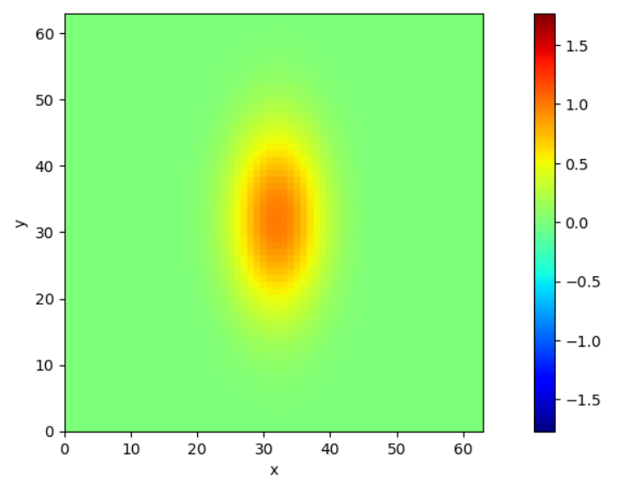
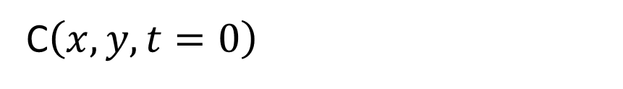
C$\left(x,y,t=0\right)$

Slide 20
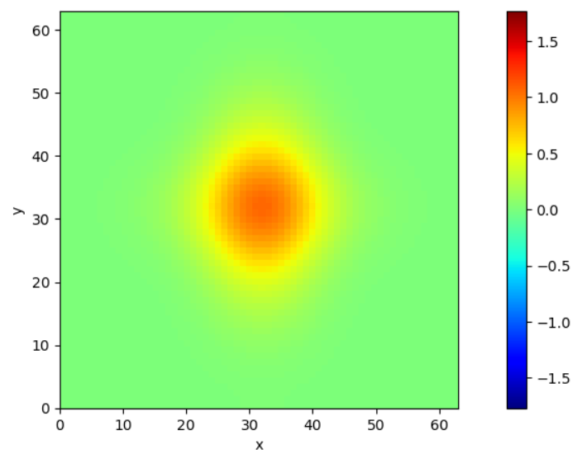
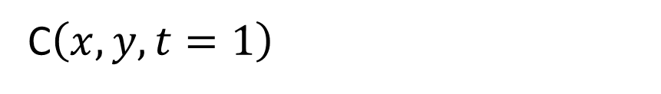
C$\left(x,y,t=1\right)$

Slide 21
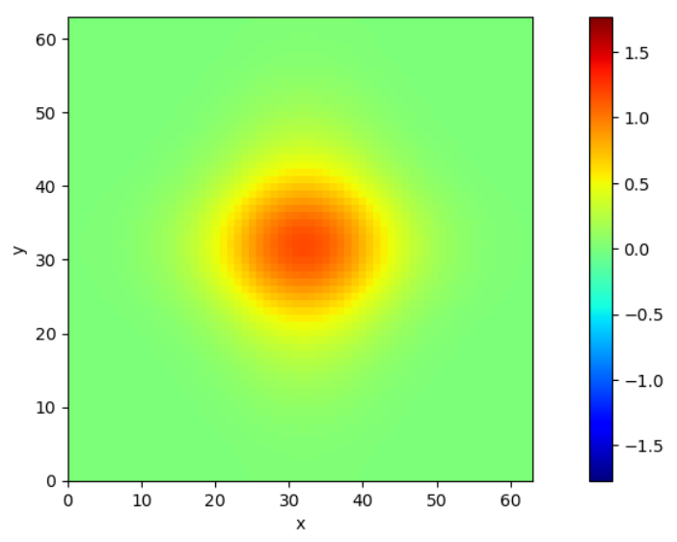
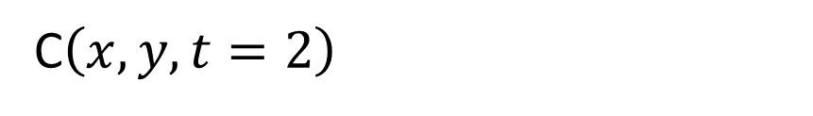
C$\left(x,y,t=2\right)$

Slide 22
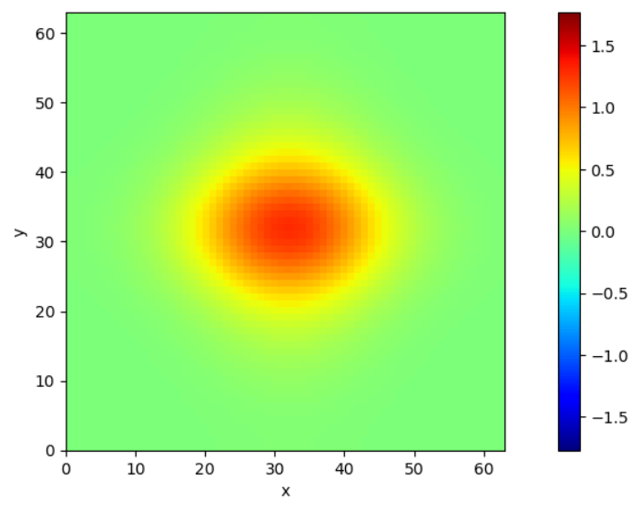
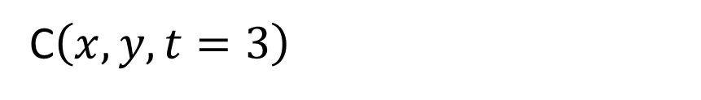
C$\left(x,y,t=3\right)$

Slide 23
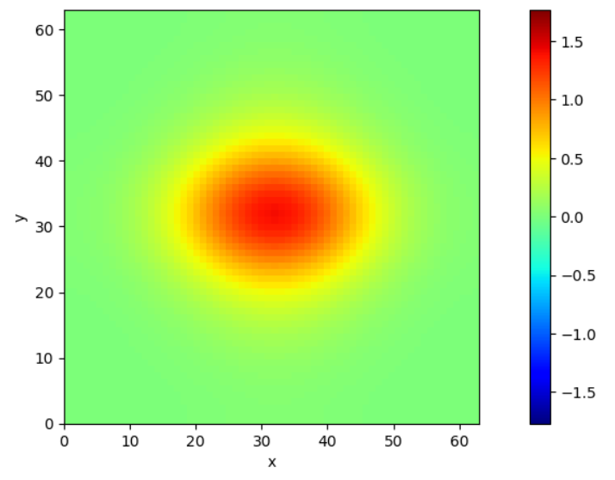
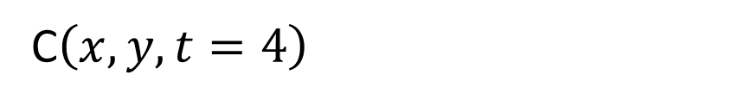
C$\left(x,y,t=4\right)$

Slide 24
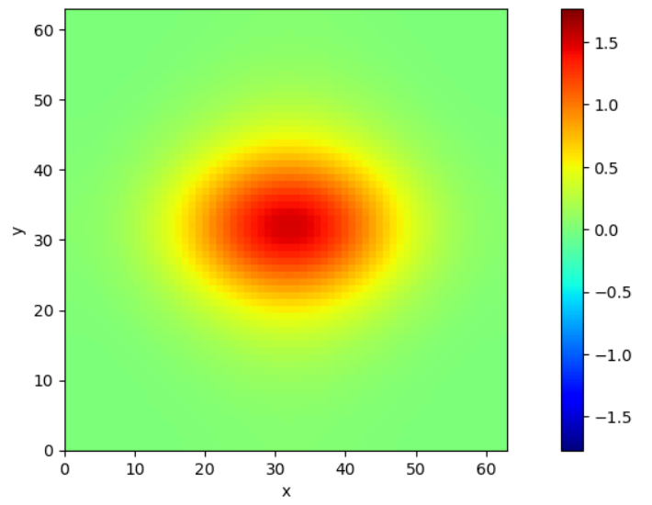
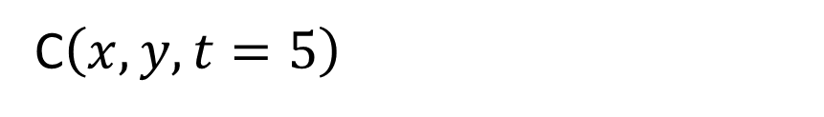
C$\left(x,y,t=5\right)$

Slide 25
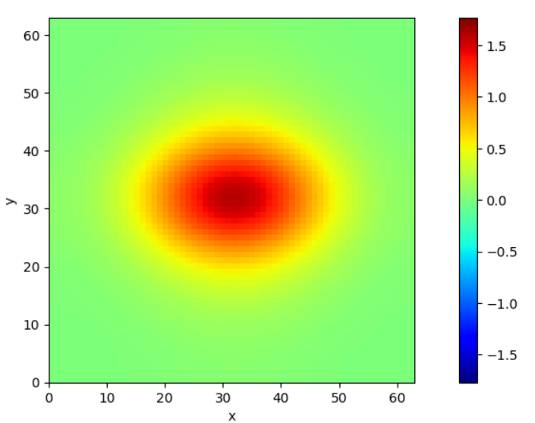
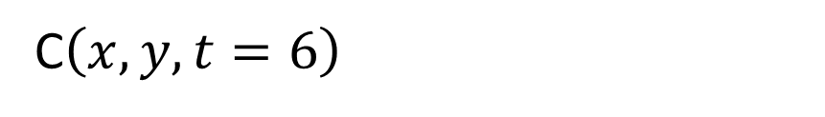
C$\left(x,y,t=6\right)$

Slide 26
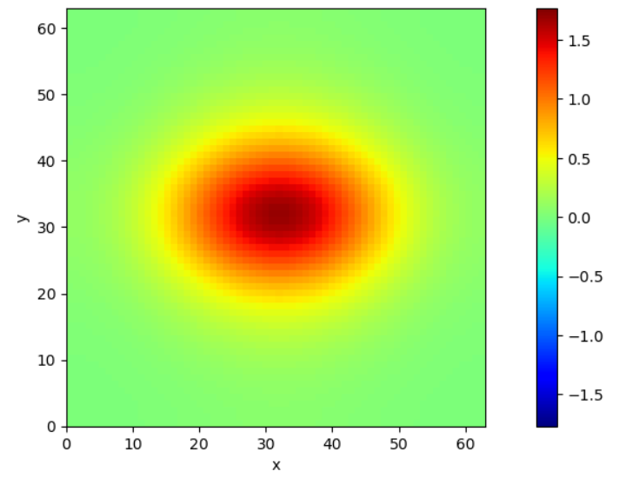
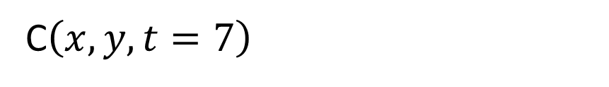
C$\left(x,y,t=7\right)$

Slide 27
PART 1 of code
Make file of random noise
dfilename='d.txt';
Purpose: allow random pattern to be reused

Slide 28

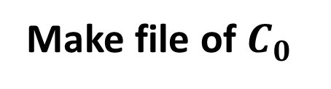
PART 2 of code
Make file of $C_{0}$
Based on correlated random noise
(as we did last week)
dfilename='d.txt';
C0filename=‘C0.txt';
A = 1.0; # 0 < C0 < A
Plus all the parameters from last week
Purpose: allow $C_{0}$ to be reused

Slide 29

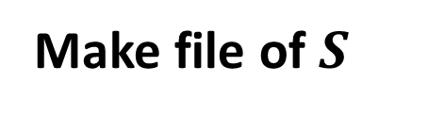
PART 3 of code
Make file of $S$
Based on correlated random noise
(as we did last week)
dfilename='d.txt';
Sfilename=‘S.txt';
A = 1.0; # 0 < S < A
Plus all the parameters from last week
Purpose: allow $S$ to be reused

Slide 30
PART 4 of code
$$\frac{∂}{∂t}C\left(x,y,t\right)=κ\left(\frac{∂^{2}}{∂x^{2}}+\frac{∂^{2}}{∂x^{2}}\right)C\left(x,y,t\right)+S\left(x,y,t\right)$$
Solve
numerically
C0filename=‘C0.txt';
Sfilename=‘S.txt';
kappa = 1.0; # diffusivity
PLOTSTEP = 2; # plot every PLOTSTEP time slice

Slide 31
Group 1
Case 1: Gaussian
$$C_{0} with A=0 and S with A=0.05$$
Case 2: exponential
and same d.txt
Compare how the concentration evolves with time
In particular, how does you ability to distinguish the two cases vary with time?

Slide 32
Group 2
Case 1: Gaussian
$$C_{0} with A=1.0 and S with A=0.0$$
Case 2: exponential
and same d.txt
Compare how the concentration evolves with time
In particular, how does you ability to distinguish the two cases vary with time?

Slide 33
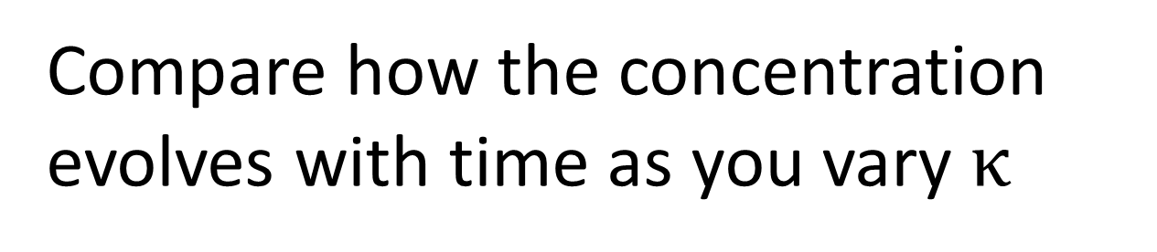
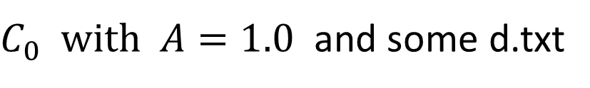
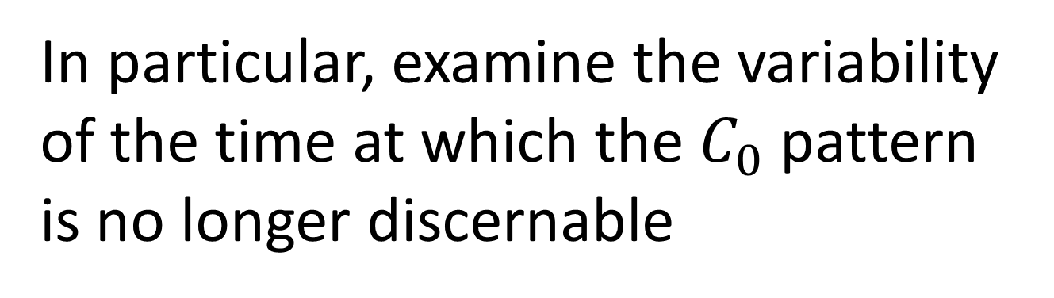
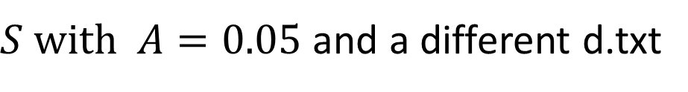
Group 3
exponential
$C_{0} with A=1.0$ and some d.txt
$S with A=0.05$ and a different d.txt
Compare how the concentration evolves with time as you vary $κ$
In particular, examine the variability of the time at which the $C_{0}$ pattern is no longer discernable

