Slide 1
2023 EESC W3400
Lec 18: Vibrations of 1D finite bodies
Computational Earth Science
Bill Menke, Instructor
Emily Glazer, Teaching Assistant
TR 2:40 – 3:55

Slide 2
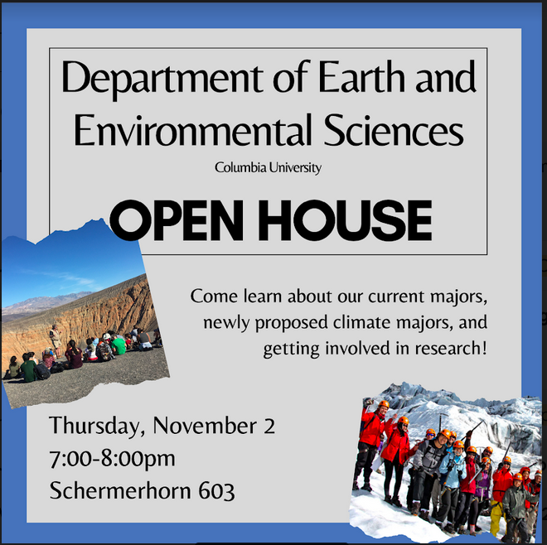
TODAY !
TODAY !

Slide 3
Today
Vibrations of finite bodies
E.g. Organ pipe, bell, Earth
Similar to the Fourier Transform

Slide 4
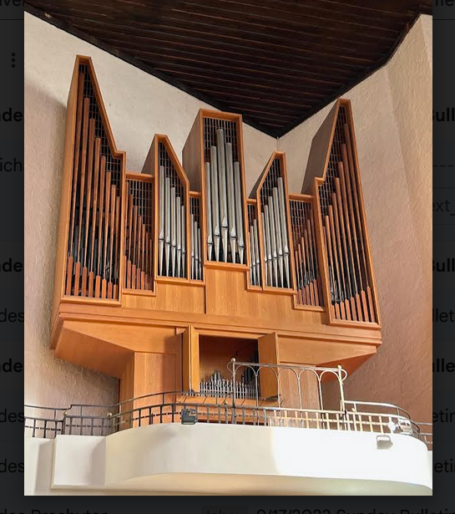

Slide 5
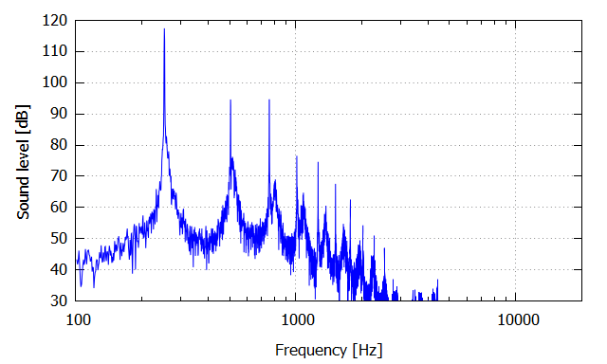
PSD of one continuously-played pipe

Slide 6
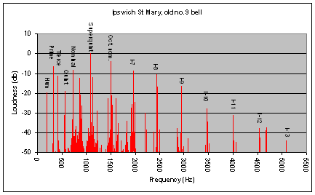
PSD of bell

Slide 7
PSD of ground motion at one observer on the earth’s surface after a very large earthquake

Slide 8
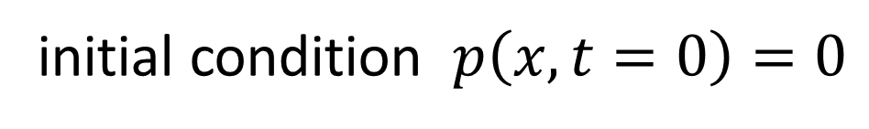
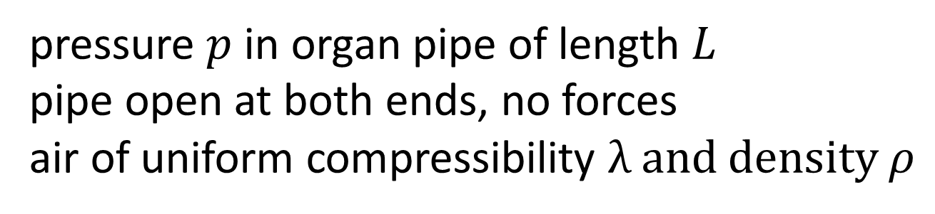




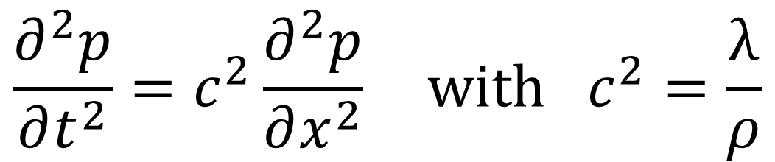

pressure $p$ in organ pipe of length $L$
pipe open at both ends, no forces
air of uniform compressibility λ and density $ρ$
$$x$$
$$0$$
$$L$$
$$p\left(x=0\right)=0$$
$$p\left(x=L\right)=0$$
$$\frac{∂^{2}p}{∂t^{2}}=c^{2}\frac{∂^{2}p}{∂x^{2}} with c^{2}=\frac{\text{λ}}{ρ}$$
initial condition $p\left(x,t=0\right)=0$

Slide 9
MODE
spatial pattern of pressure
with sinusoidal time variation

Slide 10
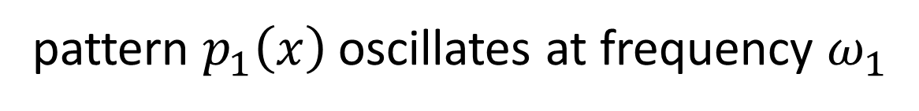


MODE
spatial pattern of pressure
with sinusoidal time variation
$$p\left(x,t\right)=p_{n}\left(x\right) \sin\left(ω_{n}t\right)$$
MODE
spatial pattern of pressure
with sinusoidal time variation
pattern $p_{1}\left(x\right)$ oscillates at frequency $ω_{1}$
pattern $p_{2}\left(x\right)$ oscillates at frequency $ω_{2}$
...

Slide 11
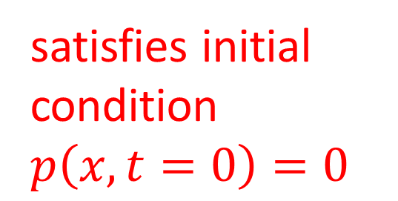
MODE
spatial pattern of pressure
with sinusoidal time variation
$$p\left(x,t\right)=p_{n}\left(x\right) \sin\left(ω_{n}t\right)$$
MODE
spatial pattern of pressure
with sinusoidal time variation
satisfies initial condition $p\left(x,t=0\right)=0$
pattern $p_{1}\left(x\right)$ oscillates at frequency $ω_{1}$
pattern $p_{2}\left(x\right)$ oscillates at frequency $ω_{2}$
...

Slide 12
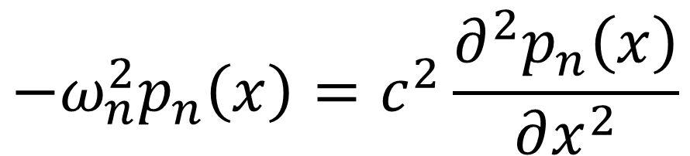

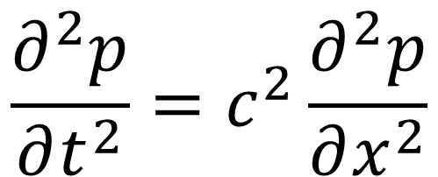
$$p\left(x,t\right)=p_{n}\left(x\right) \sin\left(ω_{n}t\right)$$
$$\frac{∂^{2}p}{∂t^{2}}=c^{2}\frac{∂^{2}p}{∂x^{2}}$$
$$−ω_{n}^{2}p_{n}\left(x\right)=c^{2}\frac{∂^{2}p_{n}\left(x\right)}{∂x^{2}}$$

Slide 13
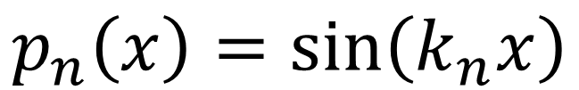
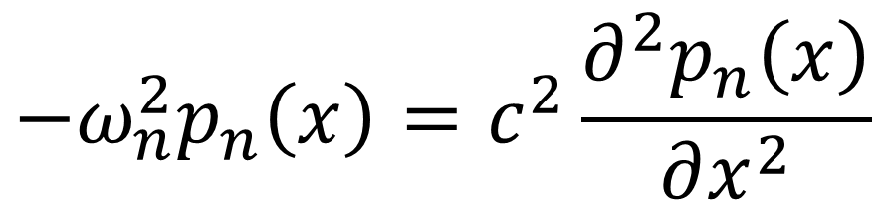
$$−ω_{n}^{2}p_{n}\left(x\right)=c^{2}\frac{∂^{2}p_{n}\left(x\right)}{∂x^{2}}$$
try
$$p_{n}\left(x\right)=\sin\left(k_{n}x\right)$$
$$−ω_{n}^{2}\sin\left(k_{n}x\right)=−c^{2}k_{n}^{2}\sin\left(k_{n}x\right)$$

Slide 14
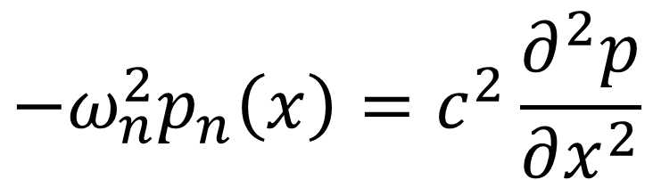
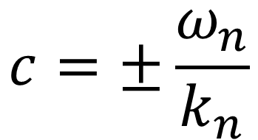
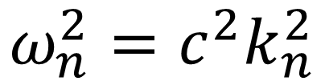
$$−ω_{n}^{2}p_{n}\left(x\right)=c^{2}\frac{∂^{2}p}{∂x^{2}}$$
try
$$p_{n}\left(x\right)=\sin\left(k_{n}x\right)$$
$$−ω_{n}^{2}\sin\left(k_{n}x\right)=−c^{2}k_{n}^{2}\sin\left(k_{n}x\right)$$
$$ω_{n}^{2}=c^{2}k_{n}^{2}$$
$$c=±\frac{ω_{n}}{k_{n}}$$

Slide 15
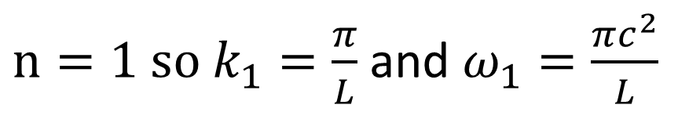




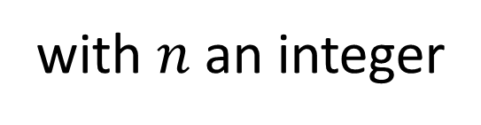

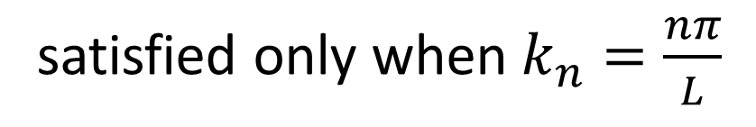

but what about the boundary conditions?
$$p_{n}\left(x=0\right)=\sin\left(k_{n}0\right)=0$$
always satisfied
$$p_{n} \left(x=L\right)=\sin\left(k_{n}L\right)=0$$
satisfied only when $k_{n}=\frac{nπ}{L}$
with $n$ an integer
$n=1 so k_{1}=\frac{π}{L}$ and $ω_{1}=\frac{πc^{2}}{L}$
$$p_{1}$$
$$x$$
$$0$$
$$L$$

Slide 16
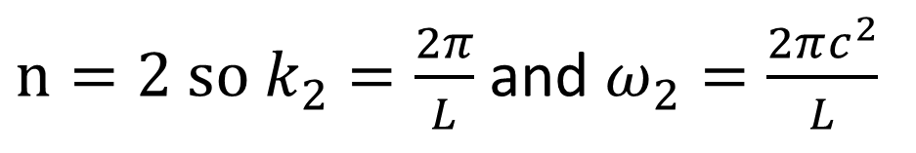

but what about the boundary conditions?
$$p_{n}\left(x=0\right)=\sin\left(k_{n}0\right)=0$$
always satisfied
$$p_{n} \left(x=L\right)=\sin\left(k_{n}L\right)=0$$
satisfied only when $k_{n}=\frac{nπ}{L}$
with $n$ an integer
$n=2 so k_{2}=\frac{2π}{L}$ and $ω_{2}=\frac{2πc^{2}}{L}$
$$p_{2}$$
$$x$$
$$0$$
$$L$$

Slide 17
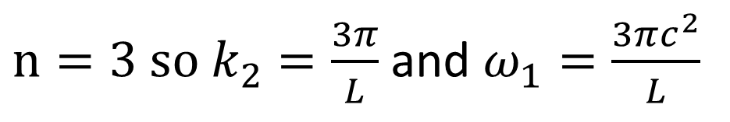

but what about the boundary conditions?
$$p_{n}\left(x=0\right)=\sin\left(k_{n}0\right)=0$$
always satisfied
$$p_{n} \left(x=L\right)=\sin\left(k_{n}L\right)=0$$
satisfied only when $k_{n}=\frac{nπ}{L}$
with $n$ an integer
$n=3 so k_{2}=\frac{3π}{L}$ and $ω_{1}=\frac{3πc^{2}}{L}$
$$p_{3}$$
$$x$$
$$0$$
$$L$$

Slide 18


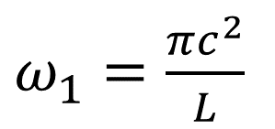
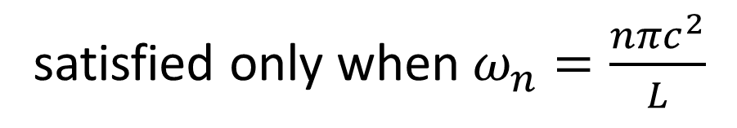
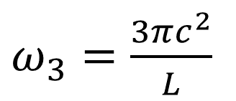




satisfied only when $ω_{n}=\frac{nπc^{2}}{L}$
$ω_{1}=\frac{πc^{2}}{L}$
$ω_{2}=\frac{2πc^{2}}{L}$
modal frequencies
evenly-spaced
$ω_{3}=\frac{3πc^{2}}{L}$
psd
...
$$ω$$
$$0$$
$$ω_{4}$$
$$ω_{1}$$
$$ω_{2}$$
$$ω_{3}$$

Slide 19
second overtone
third overtone
first overtone
fundamental
psd
...
$$ω$$
$$0$$
$$ω_{4}$$
$$ω_{1}$$
$$ω_{2}$$
$$ω_{3}$$

Slide 20
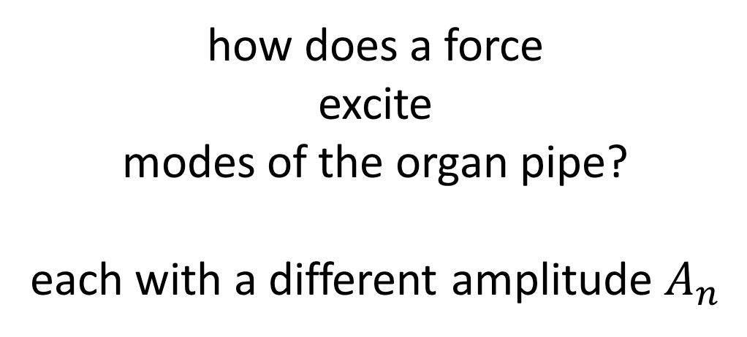
how does a force
excite
modes of the organ pipe?
each with a different amplitude $A_{n}$

Slide 21
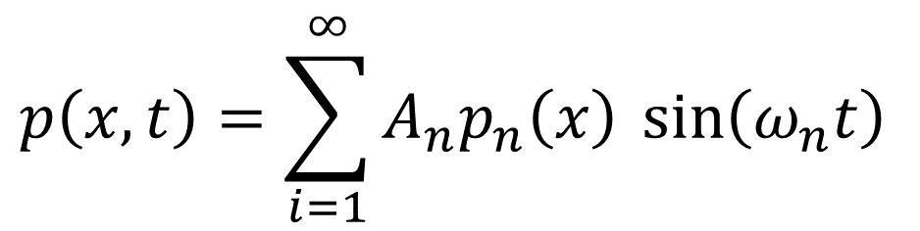
how does a force
excite
modes of the organ pipe?
each with a different amplitude $A_{n}$
$$p\left(x,t\right)=\sum_{i=1}^{∞}{A_{n}p_{n}\left(x\right) \sin\left(ω_{n}t\right)}$$

Slide 22




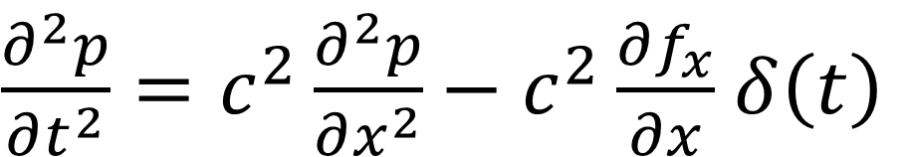
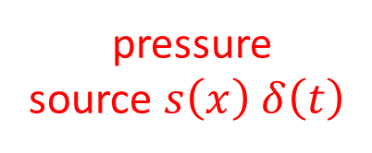
spatially impulsive force $f_{x}=δ\left(x−x_{0}\right)$ that’s also impulsive in time
$$f_{x}$$
$$x$$
$$0$$
$$x_{0}$$
$$L$$
$\frac{∂^{2}p}{∂t^{2}}=c^{2}\frac{∂^{2}p}{∂x^{2}}−c^{2}\frac{∂f_{x}}{∂x}$ $δ\left(t\right)$
equation with a source
pressure
source $s\left(x\right)$ $δ\left(t\right)$

Slide 23

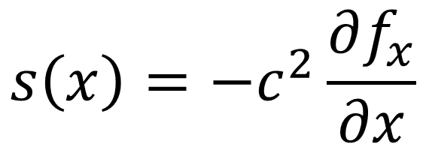

why is pressure source a derivative of the force?
$$−$$
$$+$$
$$x$$
$$0$$
$$x_{0}$$
$$L$$
force causes + pressure ahead, - behind
“dipolar”
$$s\left(x\right)=−c^{2}\frac{∂f_{x}}{∂x}$$

Slide 24

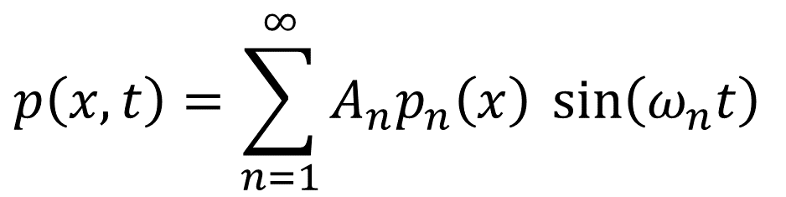
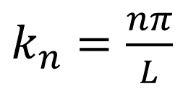
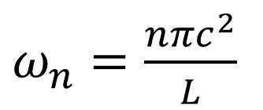
$$p\left(x,t\right)=\sum_{n=1}^{∞}{A_{n}p_{n}\left(x\right) \sin\left(ω_{n}t\right)}$$
$k_{n}=\frac{nπ}{L}$
$ω_{n}=\frac{nπc^{2}}{L}$
$$p_{n}\left(x\right)=\sin\left(k_{n}x\right)$$
What is $A_{n}$?

Slide 25
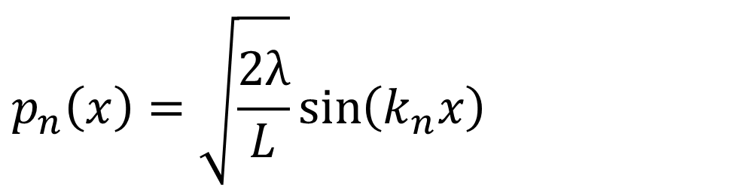
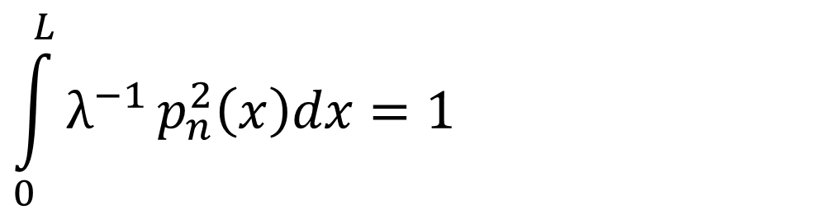
$$p\left(x,t\right)=\sum_{n=1}^{∞}{A_{n}p_{n}\left(x\right) \sin\left(ω_{n}t\right)}$$
$k_{n}=\frac{nπ}{L}$
$ω_{n}=\frac{nπc^{2}}{L}$
chosen so
$$\int_{0}^{L}{λ^{−1}}p_{n}^{2}\left(x\right)dx=1$$
$$p_{n}\left(x\right)=\sqrt{\frac{2λ}{L}}\sin\left(k_{n}x\right)$$

Slide 26
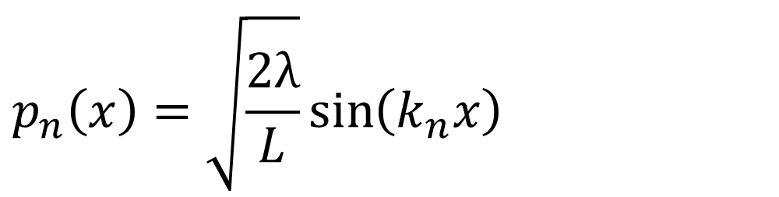
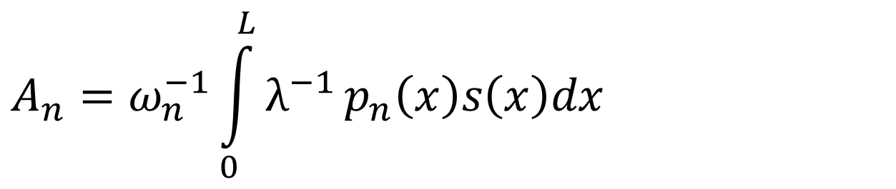
$$p\left(x,t\right)=\sum_{n=1}^{∞}{A_{n}p_{n}\left(x\right) \sin\left(ω_{n}t\right)}$$
$k_{n}=\frac{nπ}{L}$
$ω_{n}=\frac{nπc^{2}}{L}$
$$p_{n}\left(x\right)=\sqrt{\frac{2λ}{L}}\sin\left(k_{n}x\right)$$
$$A_{n}=ω_{n}^{−1}\int_{0}^{L}{λ^{−1}}p_{n}\left(x\right)s\left(x\right)dx$$

Slide 27
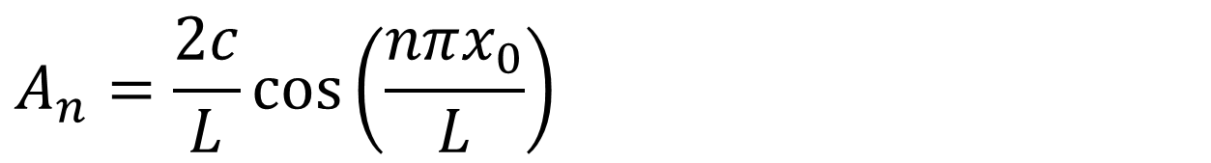

$$p\left(x,t\right)=\sum_{i=1}^{∞}{A_{n}p_{n}\left(x\right) \sin\left(ω_{n}t\right)}$$
$k_{n}=\frac{nπ}{L}$
$ω_{n}=\frac{nπc^{2}}{L}$
$$p_{n}\left(x\right)=\sqrt{\frac{2λ}{L}}\sin\left(k_{n}x\right)$$
$$A_{n}=\frac{2c}{L}\cos\left(\frac{nπx_{0}}{L}\right)$$

Slide 28
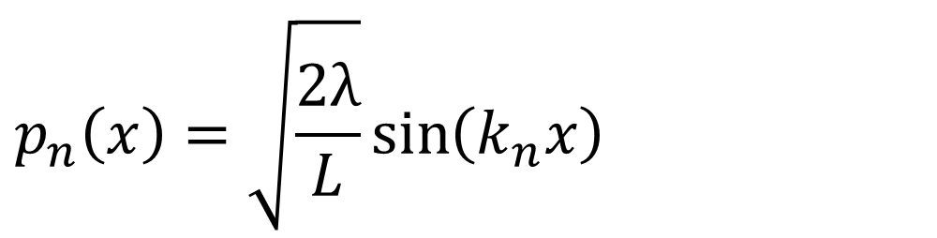
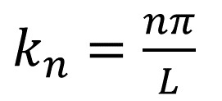

$$p\left(x,t\right)=\sum_{i=1}^{∞}{A_{n}p_{n}\left(x\right) \sin\left(ω_{n}t\right)}$$
$k_{n}=\frac{nπ}{L}$
$ω_{n}=\frac{nπc^{2}}{L}$
$$p_{n}\left(x\right)=\sqrt{\frac{2λ}{L}}\sin\left(k_{n}x\right)$$
code uses this version, because point source is not realistic
$$A_{n}=ω_{n}^{−1}\int_{0}^{L}{λ^{−1}}p_{n}\left(x\right)s\left(x\right)dx$$

Slide 29
# eigenfrequencies and eigenfunction of organ pipe
Nw = 100;
n = gda_cvec(np.linspace(1,Nw,Nw));
wn = n*pi*c/xmax;
pn = sqrt(2*lam/xmax) * np.sin( (pi/xmax)*np.matmul(x, n.T));
all modal shapes stored in a matrix pn[ix,n]

Slide 30



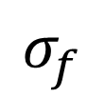


# force has a Gaussian shape
sf = 2.0;
sf2 = sf**2;
x0 = x[ix0,0];
f = (1.0/(sqrt(2*pi)*sf))*np.exp( -0.5*np.power(x-x0,2)/sf2 );
use small bell-shaped force instead of a point force
$$σ_{f}$$
$$f_{x}$$
$$x$$
$$0$$
$$L$$
$$x_{0}$$

Slide 31
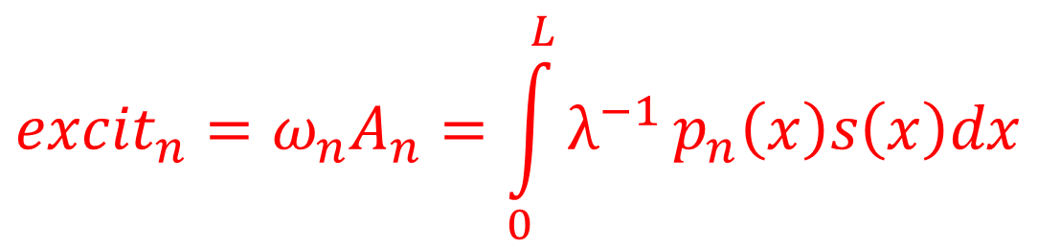
# excitation
excit = np.zeros((Nw,1));
for iw in range(Nw):
# excit = (1/lam) (integral) pn(x) f(s)
p = pn[0:Nx,iw:iw+1];
g = -c2 * np.matmul(D1,f);
excit[iw,0] = (1.0/lam) * Dx * np.sum( np.multiply(p,g) );
excitation of all modes stored in a vector
$${excit}_{n}=ω_{n}A_{n}=\int_{0}^{L}{λ^{−1}}p_{n}\left(x\right)s\left(x\right)dx$$
does the integral
by Reimann summation approximation

Slide 32


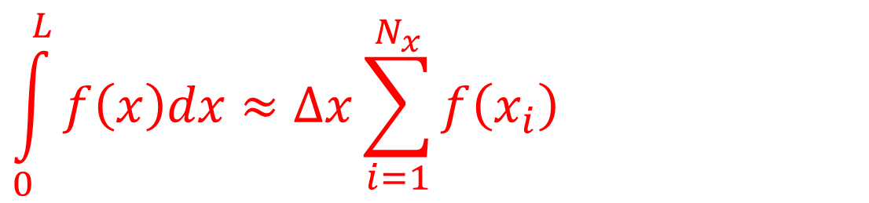




by Reimann summation approximation
$$\int_{0}^{L}{f\left(x\right)dx}≈∆x\sum_{i=1}^{N_{x}}{f\left(x_{i}\right)}$$
$$f\left(x\right)$$
$$≈$$
$$f\left(x\right)$$
$$x$$
$$x$$
$$0$$
$$L$$
$$0$$
$$L$$

Slide 33
by Reimann summation approximation
$$\int_{0}^{L}{f\left(x\right)dx}≈∆x\sum_{i=1}^{N_{x}}{f\left(x_{i}\right)}$$
= Dx * np.sum(f);

Slide 34
# excitation
excit = np.zeros((Nw,1));
for iw in range(Nw):
# excit = (1/lam) (integral) pn(x) f(s)
p = pn[0:Nx,iw:iw+1];
g = -c2 * np.matmul(D1,f);
excit[iw,0] = (1.0/lam) * Dx * np.sum( np.multiply(p,g) );
Reimann approximation

Slide 35
# compute pressure by performing mode sum
P = np.zeros((Nt,Nx));
for iw in range(Nw):
p = pn[0:Nx,iw:iw+1];
tfun = np.sin( wn[iw,0] * t );
P = P + (1.0/wn[iw,0]) * excit[iw,0] * np.matmul(tfun,p.T);
All times and positions calculated at once, P[t,x]
summation code relies very heavily on matrix math to improve speed

Slide 36
# compute pressure by performing mode sum
P = np.zeros((Nt,Nx));
for iw in range(Nw):
p = pn[0:Nx,iw:iw+1];
tfun = np.sin( wn[iw,0] * t );
P = P + (1.0/wn[iw,0]) * excit[iw,0] * np.matmul(tfun,p.T);
All times and positions calculated at once, P[t,x]
summation code relies very leavily on matrix math to improve speed
just 18 lines of code to do it all

Slide 37







Example
?
$$t$$
$$x$$
$$f_{x}$$
$$x$$
$$0$$
$$x_{0}$$
$$L$$

Slide 38
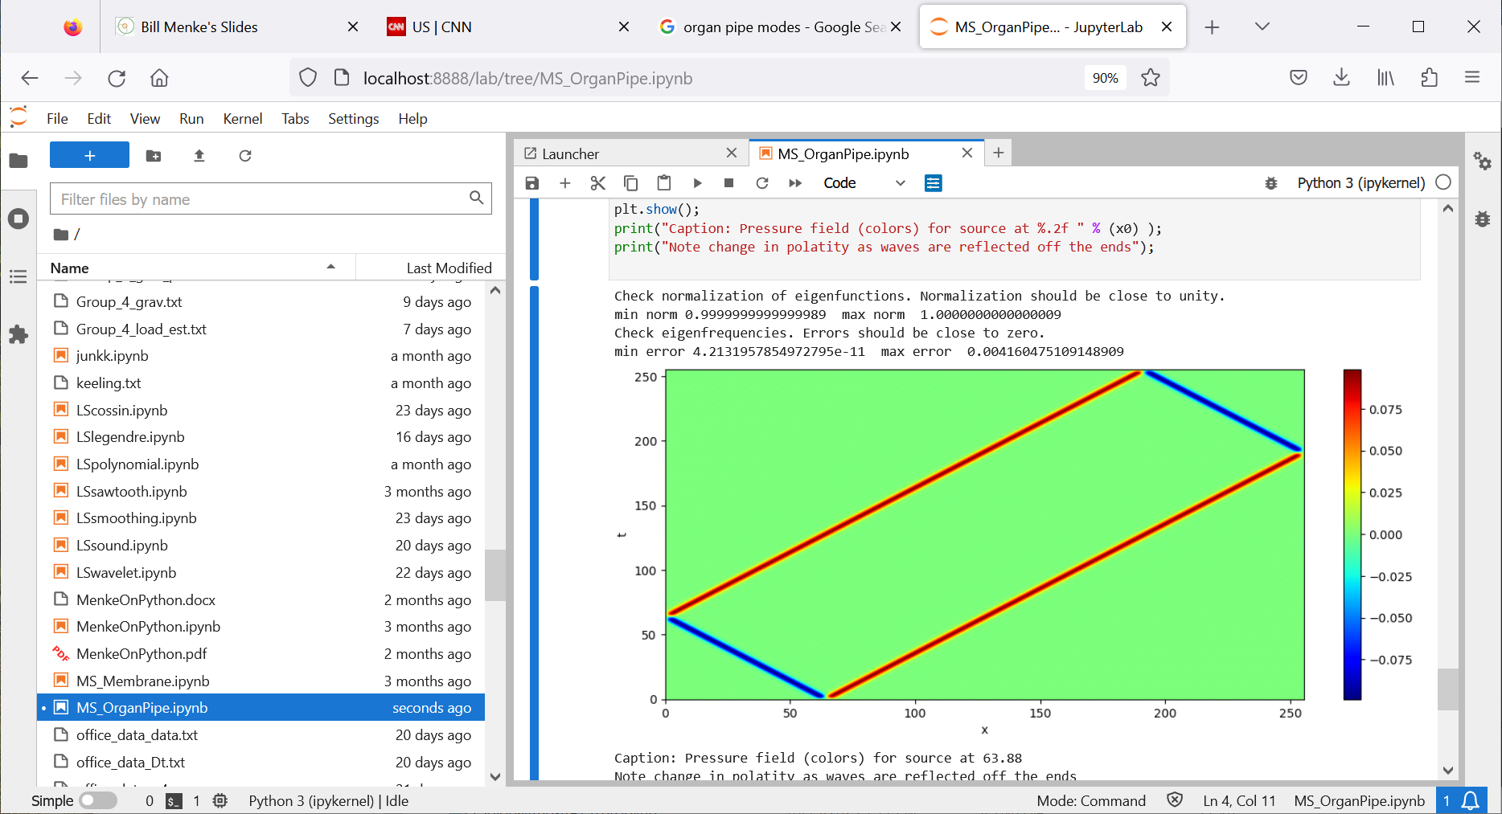



$$f_{x}$$
$$x$$
$$0$$
$$x_{0}$$
$$L$$

Slide 39
Where are the modes?
$$f_{x}$$
$$x$$
$$0$$
$$x_{0}$$
$$L$$

Slide 40
waves moving at velocity of c=1
50
50
$$f_{x}$$
$$x$$
$$0$$
$$x_{0}$$
$$L$$

Slide 41



dipolar near t=0
$$−$$
$$+$$
$$x$$
$$0$$
$$x_{0}$$
$$L$$

Slide 42
reflecting off the boundaries (and with a sign reversal)
$$f_{x}$$
$$x$$
$$0$$
$$x_{0}$$
$$L$$

Slide 43
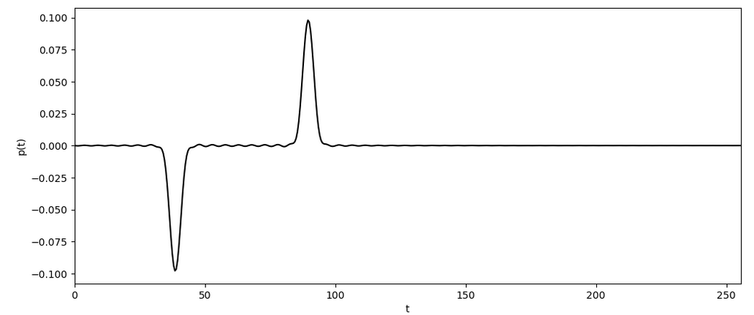
observer
pressure
time

Slide 44
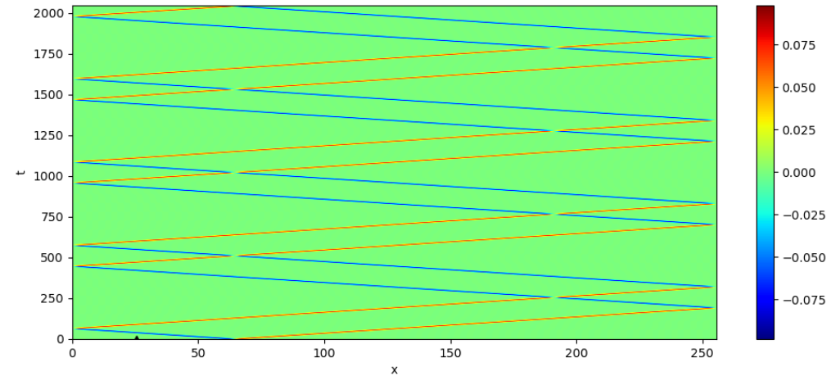
longer time

Slide 45
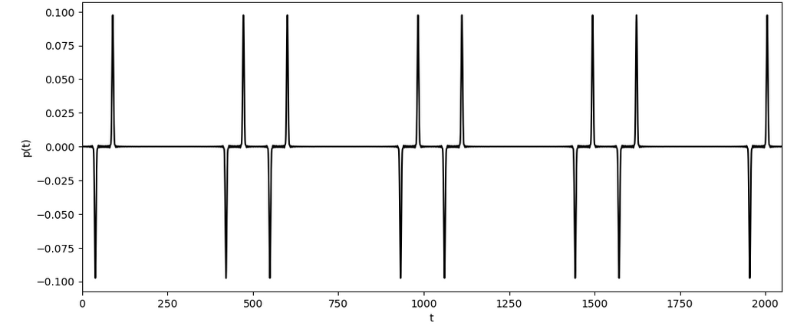
pressure
time

Slide 46
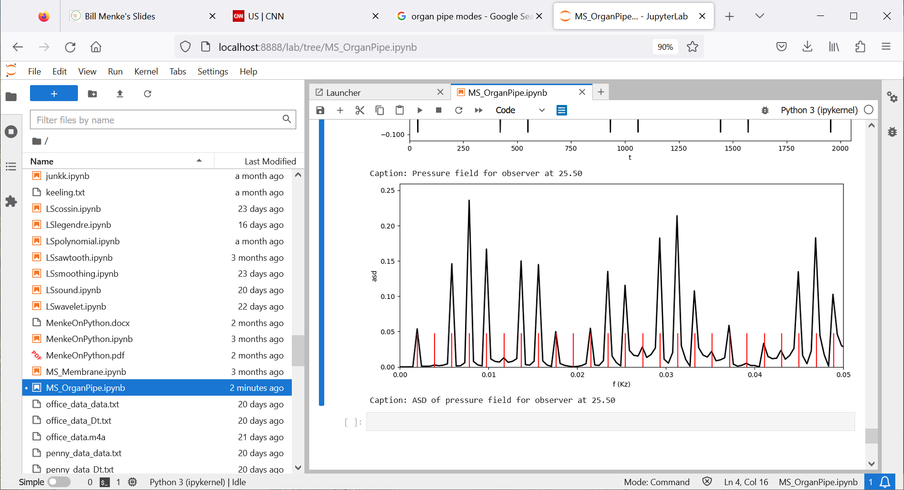
asd
frequency
modal
frequencies

Slide 47
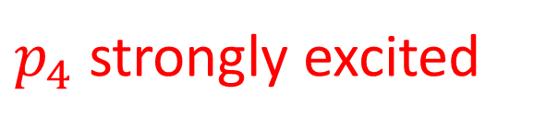
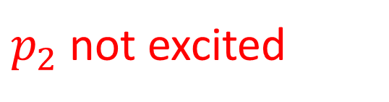
$p_{4}$ strongly excited
asd
frequency
modal
frequencies
$p_{2}$ not excited

Slide 48
Group 1
experiment with different source locations
can you find locations where a given mode is not excited
can you find interesting patterns, like alternate modes being excited

Slide 49
Group 2
experiment with different observer locations
can you find locations where a given mode is not excited
can you find interesting patterns, like alternate modes being excited

Slide 50
Group 3
experiment with making the source increasingly wider, try moving the source location around, too
how is the pressure field affected?
What happens to the ASD?
What are the fewest modes you can excite?

