Slide 1
2023 EESC W3400
Lec 21: 2D time-independent heat flow
in objects with complicated shape
Computational Earth Science
Bill Menke, Instructor
Emily Glazer, Teaching Assistant
TR 2:40 – 3:55

Slide 2
Today
Projects involving
Finite Difference Method for Solving
Static Heat Conduction Problem
a.k.a. the Poisson Equation

Slide 3
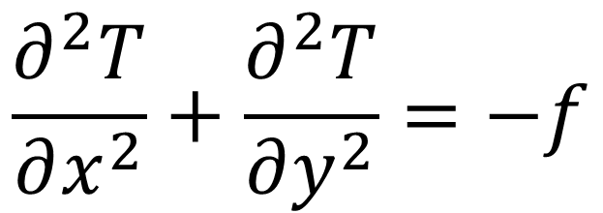
Today
Projects involving
Finite Difference Method for Solving
Static Heat Conduction Problem
a.k.a. the Poisson Equation
$$\frac{∂^{2}T}{∂x^{2}}+\frac{∂^{2}T}{∂y^{2}}=−f$$

Slide 4
Project A:
Testing Code “FDpoisson” for a square grid
boundary conditions given by vectors
source given by matrix
f = np.zeros((Lx,Ly));
ExTop = np.zeros((Lx,1));
ExBottom = np.zeros((Lx,1));
ExLeft = np.zeros((Ly,1));
ExRight = np.zeros((Ly,1));

Slide 6
Group A.1
Test 1.
zero boundary conditions
point source
f[ix,iy]=something
test symmetry of solution for sources placed in symmetrical positions
is just this rotated 180 deg
but do a few cases

Slide 7
Group A.1
Test 2.
zero boundary conditions
point source a dipole
f[ix,iy]=something or f[ix,iy]=something
f[ix+2,iy]=-something f[ix,iy+2]=-something
test symmetry of solution for sources placed in symmetrical positions
is just this rotated 180 deg
but do a few cases

Slide 8
Group A.2
Test 1.
one boundary a parabola x(1-x) or y(1-y)
x’s and y’s in vectors x and y;
elementwise multiply of two vectors np.multiply(a,b)
zero source
test symmetry of solution for sources placed in symmetrical positions
is just this rotated 90 deg
but do a few cases

Slide 9
Group A.3
Test 1.
Change boundary conditions for top and bottom to be insulating
(see next slide)
left boundary condition of zero, right of 1
zero source
test solution linearly increases from left to right
insulating
cold
hot
insulating

Slide 10
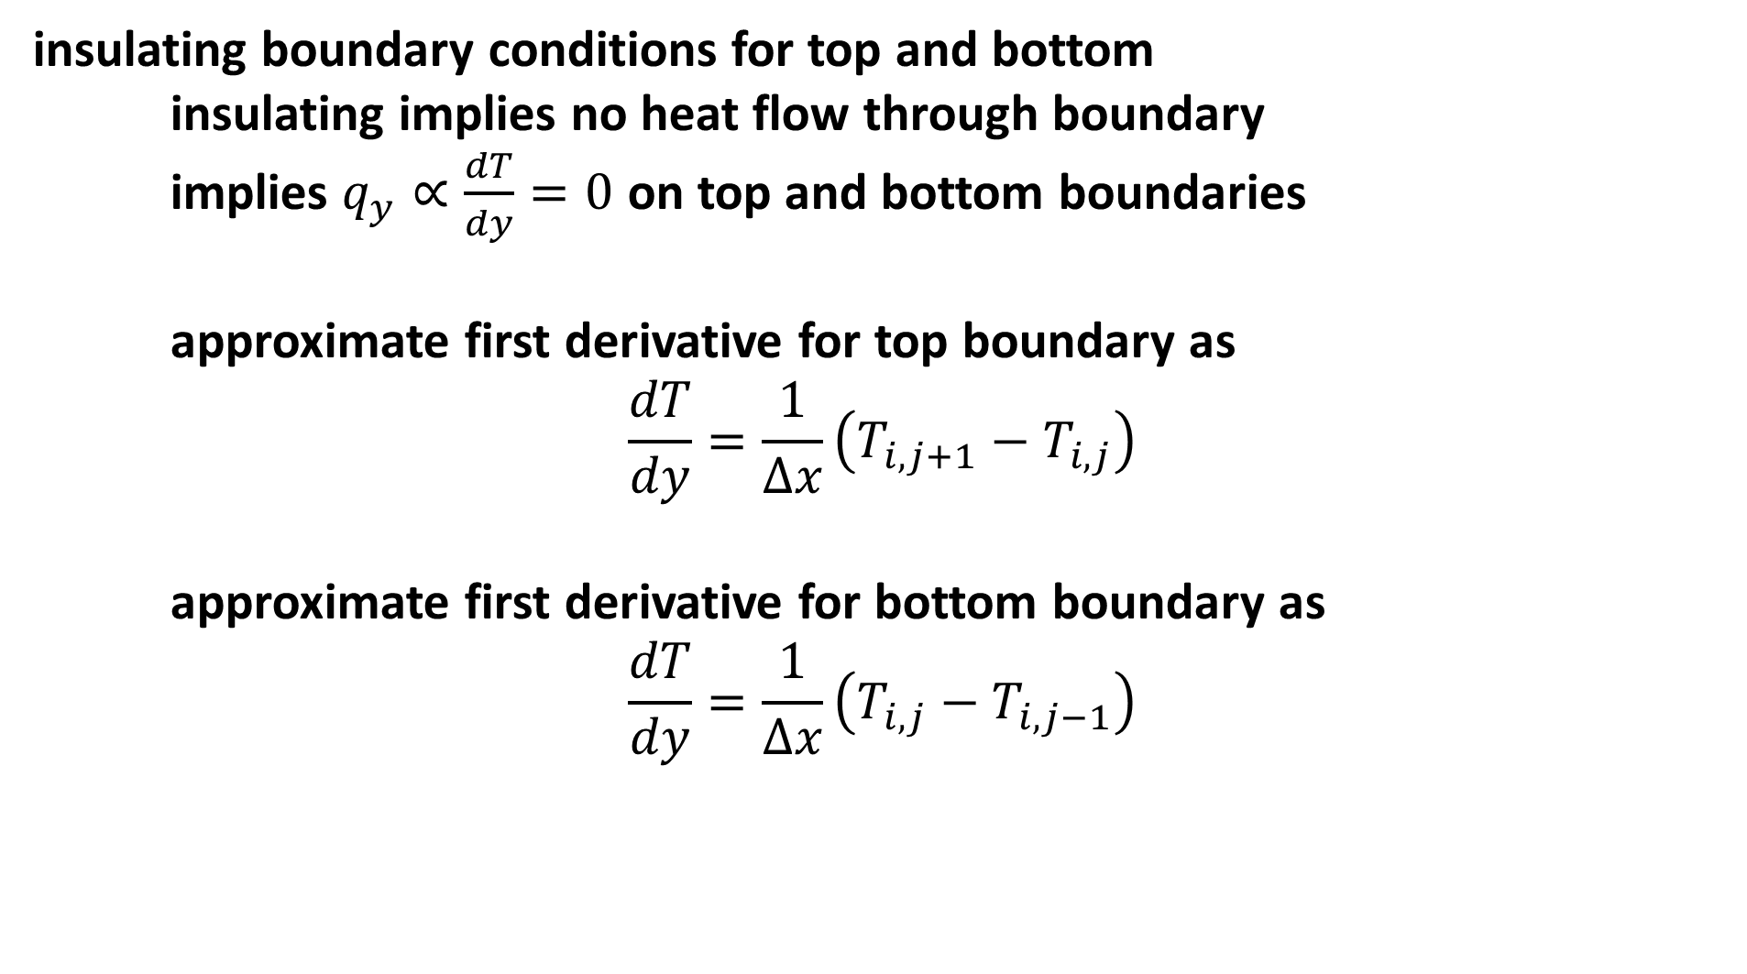
insulating boundary conditions for top and bottom
insulating implies no heat flow through boundary
implies $q_{y}∝\frac{dT}{dy}=0$ on top and bottom boundaries
approximate first derivative for top boundary as
$$\frac{dT}{dy}=\frac{1}{∆x}\left(T_{i,j+1}−T_{i,j}\right)$$
approximate first derivative for bottom boundary as
$$\frac{dT}{dy}=\frac{1}{∆x}\left(T_{i,j}−T_{i,j−1}\right)$$

Slide 11
An element of D is set with this group of code
k=kofij[some_x,some_y];
Dr[ne,0] = nr;
Dc[ne,0] = k;
Dv[ne,0] = 1.0;
ne=ne+1;

Slide 12
currently, the top boundary condition implements T[ix,iy]=0
so one element of D is set
k=kofij[ix,iy];
Dr[ne,0] = nr;
Dc[ne,0] = k;
Dv[ne,0] = 1.0;
ne=ne+1;
and the right-hand-side is set to the BC and the row incremented
s[k,0]=ExRight[iy,0];
nr=nr+1;

Slide 13
now the top boundary condition will implement
T[ix,iy+1]/Dx - T[ix,iy+1]/Dx = 0
so two elements of D need to be set, one for T[ix,iy+1]/Dx
k=kofij[ix,iy];
Dr[ne,0] = nr;
Dc[ne,0] = k;
Dv[ne,0] = 1.0/Dx;
ne=ne+1;
and another similar code block for - T[ix,iy+1]/Dx (you figure it out)
and the right-hand-side is set to zero and the row incremented
s[k,0]=0.0;
nr=nr+1;

Slide 14
Project B:
Using “FDPoissonWithHole” for a square grid with a rectangular hole

Slide 16
# x location of the hole (the bold begins at ixA+1 and ends at ixB-1)
ixA = 10;
ixB = 20;
# y location of the hole (the bold begins at iyA+1 and ends at iyB-1)
iyA = 15;
iyB = 32;

Slide 17
exterior boundary conditions given by vectors
ExTop = np.zeros((met,1));
ExBottom = np.zeros((meb,1));
ExLeft = np.zeros((mel,1));
ExRight = np.zeros((mer,1));
interior boundary conditions given by vectors
InTop = np.ones((mit,1));
InBottom = np.ones((mib,1));
InLeft = np.ones((mil,1));
InRight = np.ones((mir,1));
(Note different lengths, specified by met, meb, mel, etc.!)
source given by matrix
f = np.zeros((Lx,Ly));
(but part on boundaries and inside hole ignored!)
source given by matrix
f = np.zeros((Lx,Ly));

Slide 18
Scenario
The material is shale
and the hole is a magma conduit

Slide 19
Group B.1:
Material is shale
Interior boundary conditions T=1000
Exterior boundary conditions T=0
Shale metamorphoses at melts at T=500
square magma conduit
how does the zone of contact metamorphism grow as you increase the size of the magma conduit?

Slide 20
Group B.2:
Material is shale
Interior boundary conditions T=1000
Exterior boundary conditions T=0 at top, T=300 at bottom
with exterior side boundaries linearly increasing
from T=0 to T=300
Shale metamorphoses at melts at T=500
square magma conduit
how does the zone of contact metamorphism grow as you change the depth of the magma conduit?

