Slide 1
2023 EESC W3400
Lec 23: FD method illustrated by channel flow with eddy
Computational Earth Science
Bill Menke, Instructor
Emily Glazer, Teaching Assistant
TR 2:40 – 3:55

Slide 2
Today
the Navier Stokes Equation
trick of solving for pressure
trick of repeating boundaries
trick of particle tracking
eddy in a channel

Slide 3
Part 1
the Navier Stokes Equation
(equation for conservation of momentum in a moving fluid)

Slide 4
Conservation of a quantity $F$ in the presence of fluid motion
increase in $F$ with time = net flux of $F$ into volume + production of $F$ in volume

Slide 5


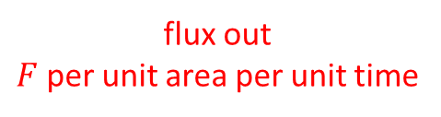

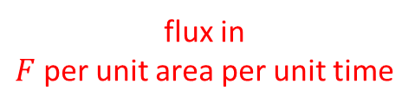



Conservation of a quantity $F$ in the presence of fluid motion
$F$ per unit volume
$F$ per unit volume per unit time
$$f_{x}\left(x\right)$$
$$f_{x}\left(x+∆x\right)$$
$$F and s$$
flux out
$F$ per unit area per unit time
flux in
$F$ per unit area per unit time
$$∆x$$
increase in $F$ with time = net flux of $F$ into volume + production of $F$ in volume

Slide 6
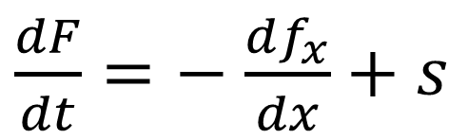
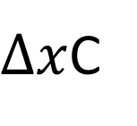
Conservation of a quantity $F$ in the presence of fluid motion
$F$ per unit volume
$F$ per unit volume per unit time
$$f_{x}\left(x\right)$$
$$f_{x}\left(x+∆x\right)$$
$$F and s$$
flux out
$F$ per unit area per unit time
flux in
$F$ per unit area per unit time
$∆x$C
$\frac{dF}{dt}=−$ $\frac{df_{x}}{dx}+s$

Slide 7
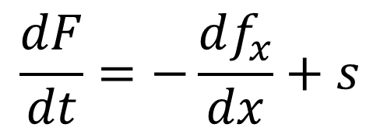

now suppose that $F$ is being transported by fluid motion
the flux of $F$ is the concentration of $F$ times the fluid velocity $v_{x}$
$$\frac{dF}{dt}=−\frac{df_{x}}{dx}+s$$
$f_{x}=v_{x}F$

Slide 8
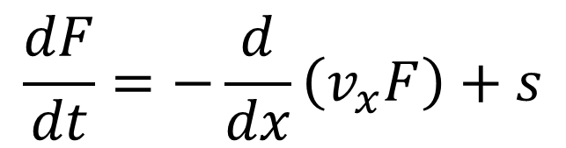
now suppose that $F$ is being transported by fluid motion
the flux of $F$ is the concentration of $F$ times the fluid velocity $v_{x}$
$$\frac{dF}{dt}=−\frac{df_{x}}{dx}+s$$
$f_{x}=v_{x}F$
$$\frac{dF}{dt}=−\frac{d}{dx}\left(v_{x}F\right)+s$$

Slide 9
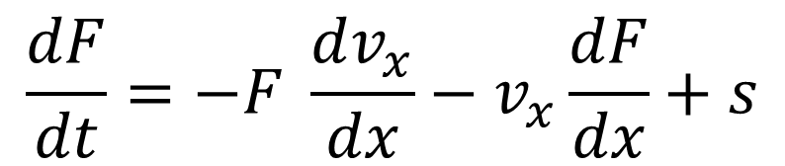
now suppose that $F$ is being transported by fluid motion
the flux of $F$ is the concentration of $F$ times the fluid velocity $v_{x}$
$$\frac{dF}{dt}=−\frac{df_{x}}{dx}+s$$
$f_{x}=v_{x}F$
$$\frac{dF}{dt}=−\frac{d}{dx}\left(v_{x}F\right)+s$$
$$\frac{dF}{dt}=−F \frac{dv_{x}}{dx}−v_{x}\frac{dF}{dx}+s$$

Slide 10
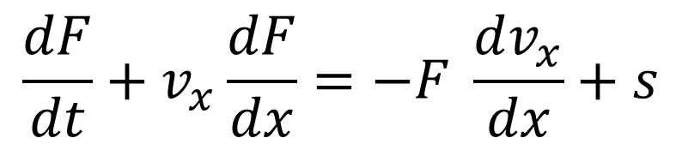
now suppose that $F$ is being transported by fluid motion
the flux of $F$ is the concentration of $F$ times the fluid velocity $v_{x}$
$$\frac{dF}{dt}=−\frac{df_{x}}{dx}+s$$
$f_{x}=v_{x}F$
$$\frac{dF}{dt}=−\frac{d}{dx}\left(v_{x}F\right)+s$$
$$\frac{dF}{dt}=−F \frac{dv_{x}}{dx}−v_{x}\frac{dF}{dx}+s$$
$$\frac{dF}{dt}+v_{x}\frac{dF}{dx}=−F \frac{dv_{x}}{dx}+s$$

Slide 11
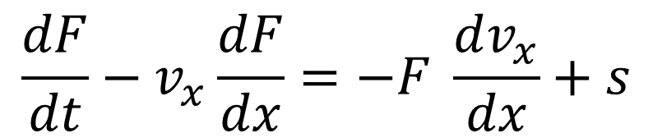
now suppose that $F$ is being transported by fluid motion
the flux of $F$ is the concentration of $F$ times the fluid velocity $v_{x}$
$$\frac{dF}{dt}=−\frac{df_{x}}{dx}+s$$
$f_{x}=v_{x}F$
$$\frac{dF}{dt}=−\frac{d}{dx}\left(v_{x}F\right)+s$$
$$\frac{dF}{dt}=−F \frac{dv_{x}}{dx}−v_{x}\frac{dF}{dx}+s$$
small if the fluid is incompressible
$$\frac{dF}{dt}−v_{x}\frac{dF}{dx}=−F \frac{dv_{x}}{dx}+s$$

Slide 12
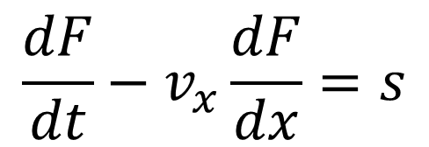
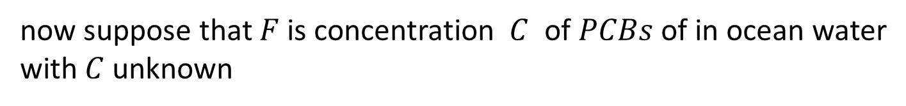
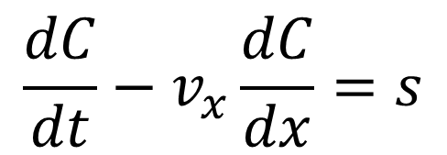
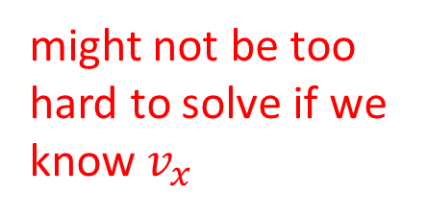
$$\frac{dF}{dt}−v_{x}\frac{dF}{dx}=s$$
now suppose that $F$ is concentration $C$ of $PCBs$ of in ocean water
with $C$ unknown
source like waste dumping
$$\frac{dC}{dt}−v_{x}\frac{dC}{dx}=s$$
might not be too hard to solve if we know $v_{x}$
could use the finite difference method

Slide 13
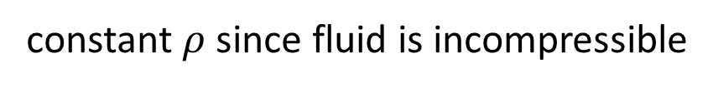
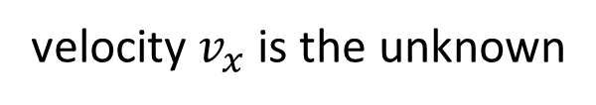
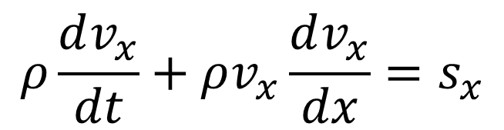
$$\frac{dF}{dt}−v_{x}\frac{dF}{dx}=s$$
forces like
contact forces
and gravity
now suppose that $F$ is momentum of the ocean water itself $F=p_{x}=ρv_{x}$
velocity $v_{x}$ is the unknown
constant $ρ$ since fluid is incompressible
$$ρ\frac{dv_{x}}{dt}+ρv_{x}\frac{dv_{x}}{dx}=s_{x}$$

Slide 14
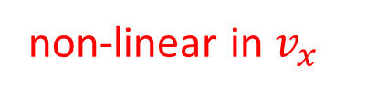
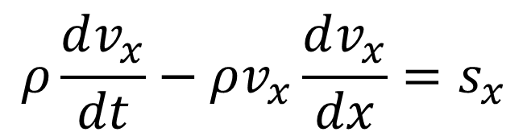
$$\frac{dF}{dt}−v_{x}\frac{dF}{dx}=s$$
now suppose that $F$ is momentum of the ocean water itself $F=p_{x}=ρv_{x}$
velocity $v_{x}$ is the unknown
constant $ρ$ since fluid is incompressible
$$ρ\frac{dv_{x}}{dt}−ρv_{x}\frac{dv_{x}}{dx}=s_{x}$$
non-linear in $v_{x}$
extremely difficult to solve

Slide 15

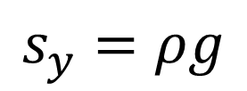
forces in a moving fluid
gravity
$$s_{x}=0$$
$$s_{y}=ρg$$

Slide 16
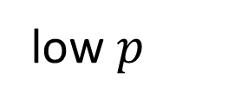
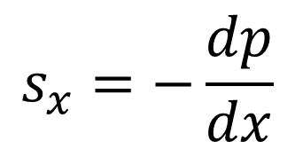
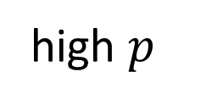
forces in a moving fluid
pressure
low $p$
high $p$
$$s_{x}=−\frac{dp}{dx}$$

Slide 17
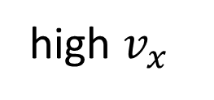
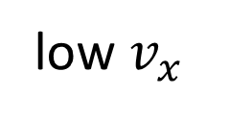


forces in a moving fluid
contact forces
shearing
fluid
$$x$$
shearing fluid
low $v_{x}$
$$y$$
high $v_{x}$

Slide 18


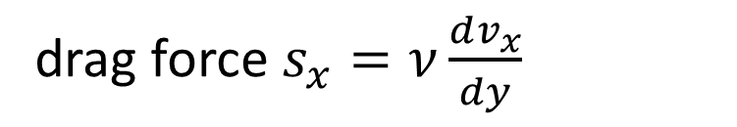

forces in a moving fluid
contact forces
viscosity
$$s_{x}=−ν\frac{dv_{x}}{dy}$$
stationary
$$x$$
stationary
$$x$$
low $v_{x}$
drag force $s_{x}=ν\frac{dv_{x}}{dy}$
$$y$$
$$y$$
high $v_{x}$

Slide 19



forces in a moving fluid
contact forces
$$s_{x}\left(y\right)$$
$$\frac{ds_{x}}{dy}$$
net force
$$s_{x}\left(y+∆y\right)$$

Slide 20
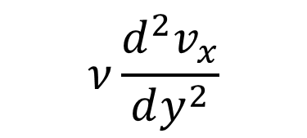
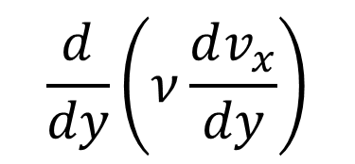

forces in a moving fluid
contact forces
$$s_{x}\left(y\right)$$
$$\frac{ds_{x}}{dy}$$
net force
$$\frac{d}{dy}\left(ν\frac{dv_{x}}{dy}\right)$$
$$s_{x}\left(y+∆y\right)$$
$$ν\frac{d^{2}v_{x}}{dy^{2}}$$

Slide 21
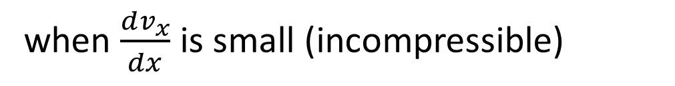
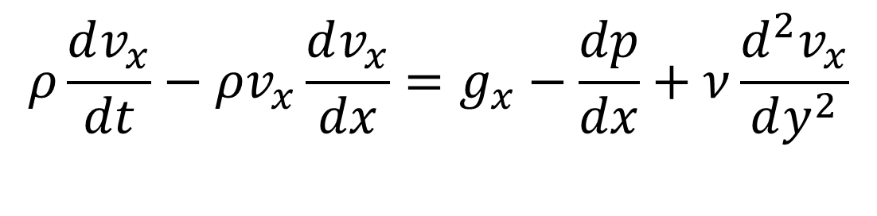
so the x-component only equation is
$$ρ\frac{dv_{x}}{dt}−ρv_{x}\frac{dv_{x}}{dx}=g_{x}−\frac{dp}{dx}+ν\frac{d^{2}v_{x}}{dy^{2}}$$
when $\frac{dv_{x}}{dx}$ is small (incompressible)

Slide 22
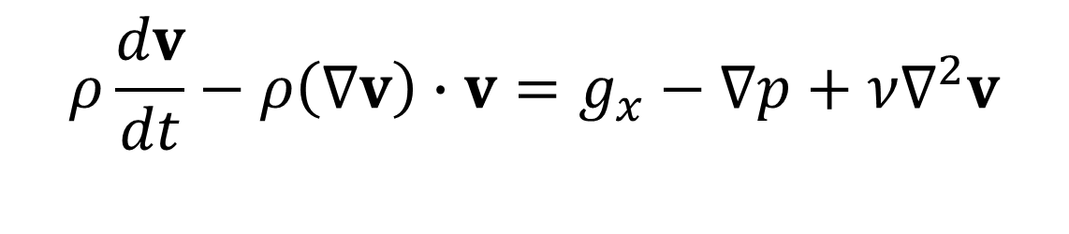
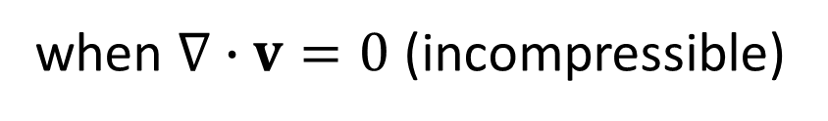
so the x-component only equation is
$$ρ\frac{dv_{x}}{dt}−ρv_{x}\frac{dv_{x}}{dx}=g_{x}−\frac{dp}{dx}+ν\frac{d^{2}v_{x}}{dy^{2}}$$
when $\frac{dv_{x}}{dx}$ is small (incompressible)
and the full Navier Stokes equation is
$$ρ\frac{dv}{dt}−ρ\left(∇v\right)∙v=g_{x}−∇p+ν∇^{2}v$$
when $∇∙v=0$ (incompressible)

Slide 23
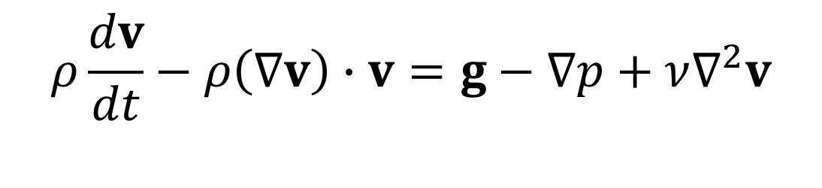
and the full Navier Stokes equation is
change in momentum with time
advection in momentum
gravity
pressure contact force
viscous contact forces
$$ρ\frac{dv}{dt}−ρ\left(∇v\right)∙v=g−∇p+ν∇^{2}v$$
when $∇∙v=0$ (incompressible)

Slide 24

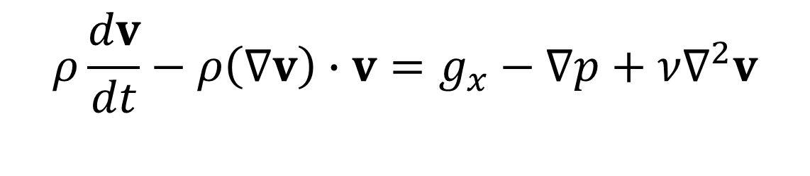
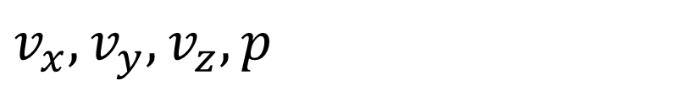
Navier Stokes equation for an incompressible viscous fluid
$$ρ\frac{dv}{dt}−ρ\left(∇v\right)∙v=g_{x}−∇p+ν∇^{2}v$$
3 equations
4 equations
1 equation
$$∇∙v=0$$
$$v_{x},v_{y},v_{z}, p$$
4 unknowns
same number of equations as unknowns, so solving equation may be possible

Slide 25
Part 2
trick to find pressure

Slide 26
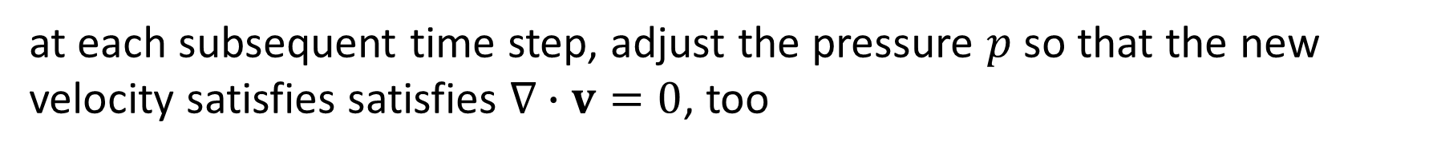
mathematical trick to find the pressure field
at time $t=0$, start with a velocity field that satisfies $∇∙v=0$
at each subsequent time step, adjust the pressure $p$ so that the new velocity satisfies satisfies $∇∙v=0$, too

Slide 27

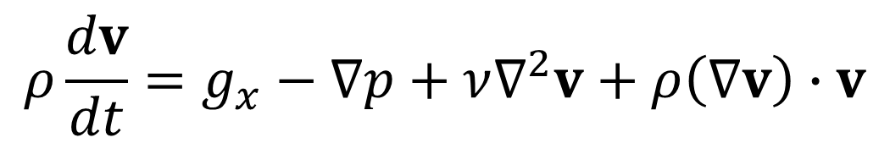
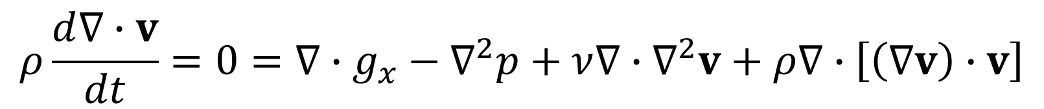
Navier Stokes equation for an incompressible viscous fluid
$$ρ\frac{dv}{dt}=g_{x}−∇p+ν∇^{2}v+ρ\left(∇v\right)∙v$$
take $∇∙$
$$ρ\frac{d∇∙v}{dt}=0={∇∙g}_{x}−∇^{2}p+ν∇∙∇^{2}v+ρ∇∙\left[\left(∇v\right)∙v\right]$$
at each time step, solve Poisson equation for pressure
$$∇^{2}p={∇∙g}_{x}+ν∇∙∇^{2}v+ρ∇∙\left[\left(∇v\right)∙v\right]$$

Slide 28
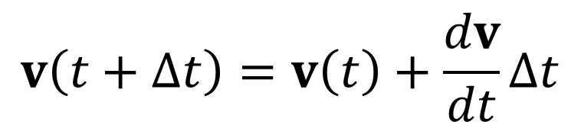
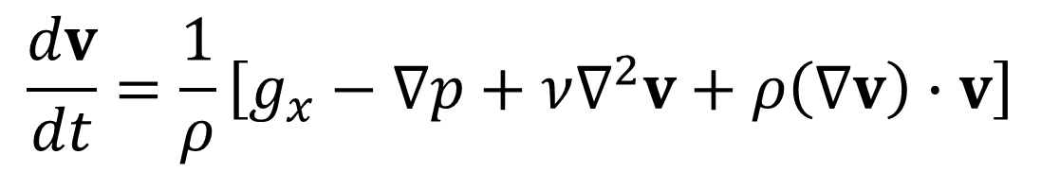
Step 1: use velocities at current time to calculate pressure
solve Poisson Equation
$$∇^{2}p={∇∙g}_{x}+ν∇∙∇^{2}v+ρ∇∙\left[\left(∇v\right)∙v\right]$$
Step 2: use Navier Stokes Equation to time step velocities one $∆t$ into the future
$$v\left(t+∆t\right)=v\left(t\right)+\frac{dv}{dt}∆t$$
with
$$\frac{dv}{dt}=\frac{1}{ρ}\left[g_{x}−∇p+ν∇^{2}v+ρ\left(∇v\right)∙v\right]$$
Step 3: go to step 1

Slide 29
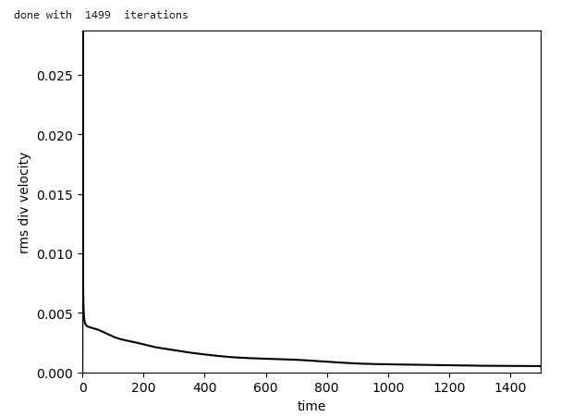
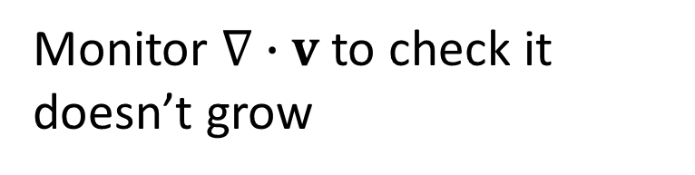
Monitor $∇∙v$ to check it doesn’t grow

Slide 30
Part 3
trick of repeating boundary conditions

Slide 31








Finite Difference grid
$$∆t$$
$$0$$
$$N_{t}−1$$
$$t$$
$$0$$
$$∆x$$
$$N_{x}−1$$
$$x$$

Slide 32
Finite Difference grid
$$∆t$$
$$0$$
$$N_{t}−1$$
$$t$$
$$0$$
$$∆x$$
$$N_{x}−1$$
$$x$$
require to be the same

Slide 33
Finite Difference grid
$$∆t$$
$$0$$
$$N_{t}−1$$
$$t$$
$$0$$
$$∆x$$
$$N_{x}−1$$
$$x$$
like you turned it into a cylinder
require to be the same

Slide 34
Part 4
trick of tracer particle tracking

Slide 35






$$y$$
velocity field
$$4$$
$$0$$
$$x$$
$$0$$
$$4$$

Slide 36









$$y$$
tracer particles at $t=0$
table of tracer particles
$$4$$
# | x | y
1 | 1 | 1
2 | 2 | 1
...
$$7$$
$$8$$
$$9$$
$$4$$
$$5$$
$$6$$
$$1$$
$$2$$
$$3$$
$$0$$
$$x$$
$$0$$
$$4$$

Slide 37
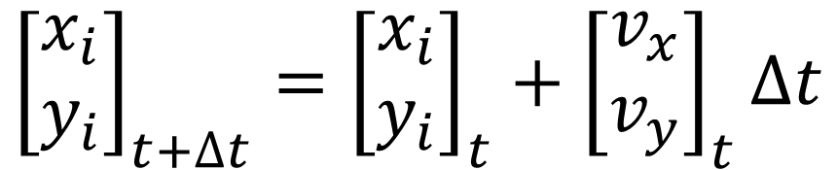
$$y$$
$$4$$
advance along velocity vector
$${\left[\begin{matrix}x_{i} \\ y_{i}\end{matrix}\right]}_{t+∆t}={\left[\begin{matrix}x_{i} \\ y_{i}\end{matrix}\right]}_{t}+{\left[\begin{matrix}v_{x} \\ v_{y}\end{matrix}\right]}_{t}∆t$$
$$7$$
$$8$$
$$9$$
$$4$$
$$5$$
$$6$$
$$1$$
$$2$$
$$3$$
$$0$$
$$x$$
$$0$$
$$4$$

Slide 38


$$y$$
$$4$$
advance along velocity vector
$$7$$
$$8$$
$$9$$
$$4$$
$$5$$
$$6$$
$$1$$
$$2$$
$$3$$
$$0$$
$$x$$
$$0$$
$$4$$

Slide 39










$$y$$
tracer particles at $t=∆t$
table of tracer particles
$$4$$
# | x | y
1 | 1.4 | 1.1
2 | 2.5 | 1.0
...
$$7$$
$$8$$
$$9$$
$$9$$
$$4$$
$$5$$
$$6$$
$$1$$
$$2$$
$$3$$
$$0$$
$$x$$
$$0$$
$$4$$
repeat for each time step

Slide 40
Part 5
eddy in a shearing channel

Slide 41













“background” solution
is shear flow in channel
$$v_{x}=v_{0}$$
$$y$$
$$L_{y}$$
$$L_{y}$$
$$v_{x}=v_{0}y/L_{y}$$
$$v_{y}=0$$
$$y$$
$$p=0$$
$$v_{x}$$
$$0$$
$$x$$
$$v_{x}=0$$
$$v_{0}$$

Slide 42











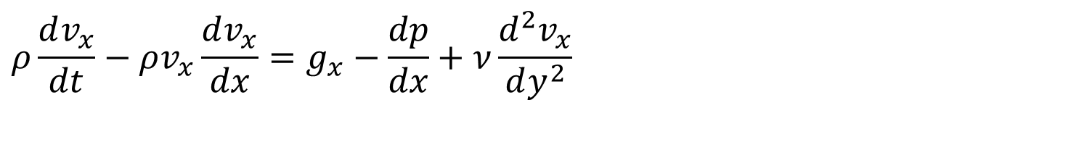

$$v_{x}=v_{0}$$
$$v_{x}=v_{0}y/L_{y}$$
$$v_{y}=0$$
$$y$$
$$p=0$$
$$x$$
$$v_{x}=0$$
satisfies equation
$$ρ\frac{dv_{x}}{dt}−ρv_{x}\frac{dv_{x}}{dx}=g_{x}−\frac{dp}{dx}+ν\frac{d^{2}v_{x}}{dy^{2}}$$
equation satisfied because
every term is zero
$$0$$
$$0$$
$$0$$
$$0$$
$$0$$

Slide 43

initial “eddy”
$$y$$
$$x$$
satisfies
because no flow into box
$$∇∙v=0$$

Slide 44
The eddy rotation is in the same sense of the background shear flow
$$y$$
$$x$$
so will the eddy grow with time?

