Slide 1
2023 EESC W3400
Lec 24: FD method illustrated by convection in box
Computational Earth Science
Bill Menke, Instructor
Emily Glazer, Teaching Assistant
TR 2:40 – 3:55

Slide 2
Today
1. review the Navier Stokes Equation
2. derive the incompressibility condition
3. review the heat flow equation
4. dynamics of convection
5. Boussinesq Approximation
6. Setup for convection is a box
7. Things we know about convection is a box
8. Finite Difference simulation of convection

Slide 3
Part 1
review of the Navier Stokes Equation
(equation for conservation of momentum in a moving fluid)

Slide 4
Conservation of momentum in a moving fluid
increase in momentum with time =
flow of momentum into box
+ external force
+ pressure force
+ viscous force

Slide 5
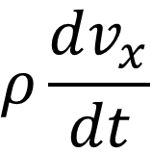
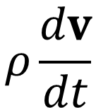
terms like
vector notation
$$ρ\frac{dv_{x}}{dt}$$
$$ρ\frac{dv}{dt}$$
increase in momentum with time =
flow of momentum into box
+ external force
+ pressure force
+ viscous force

Slide 6

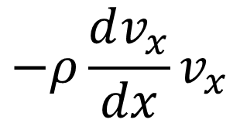
terms like
vector notation
$$ρ\frac{dv}{dt}$$
increase in momentum with time =
flow of momentum into box
+ external force
+ pressure force
+ viscous force
$$−ρ\frac{dv_{x}}{dx}v_{x}$$
$$−ρ\left(∇v\right)∙v$$

Slide 7


terms like
vector notation
$$ρ\frac{dv}{dt}$$
increase in momentum with time =
flow of momentum into box
+ external force
+ pressure force
+ viscous force
$$−ρ\left(∇v\right)∙v$$
$$f_{x}$$
$$f$$

Slide 8
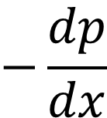

terms like
vector notation
$$ρ\frac{dv}{dt}$$
increase in momentum with time =
flow of momentum into box
+ external force
+ pressure force
+ viscous force
$$−ρ\left(∇v\right)∙v$$
$$f$$
$$−\frac{dp}{dx}$$
$$−∇p$$

Slide 9

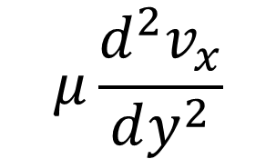
terms like
vector notation
$$ρ\frac{dv}{dt}$$
increase in momentum with time =
flow of momentum into box
+ external force
+ pressure force
+ viscous force
$$−ρ\left(∇v\right)∙v$$
$$f$$
$$−∇p$$
$$μ\frac{d^{2}v_{x}}{dy^{2}}$$
$${μ∇}^{2}v$$
viscosity

Slide 10

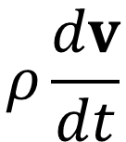



increase
in momentum
with time
flow of
momentum
into box
-
external
force
pressure
force
viscous
force
=
+
+
$$ρ\frac{dv}{dt}$$
$$+ ρ\left(∇v\right)∙v$$
=
$$f$$
$$−∇p$$
$${μ∇}^{2}v$$

Slide 11

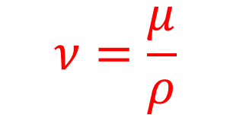
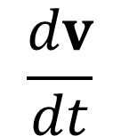


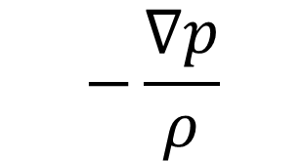
increase
in momentum
with time
flow of
momentum
into box
-
external
force
pressure
force
viscous
force
=
+
+
$$\frac{dv}{dt}$$
$$+ \left(∇v\right)∙v$$
=
$$\frac{f}{ρ}$$
$$−\frac{∇p}{ρ}$$
$${\text{ν}∇}^{2}v$$
$$ν=\frac{μ}{ρ}$$
kinematic viscosity

Slide 12
Part 2
incompressibility condition
no compression or extension of fluid,
so what goes in some faces of a box
must go out the others

Slide 13


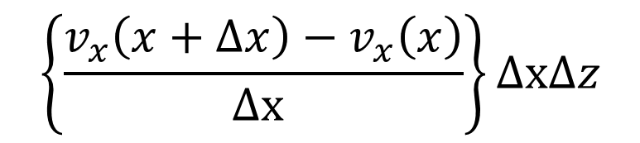




net horizontal loss
$$v_{x}\left(x\right)$$
$$v_{x}\left(x+∆x\right)$$
$$∆z$$
$$∆x$$
$$\left\{v_{x}\left(x+∆x\right)−v_{x}\left(x\right)\right\}∆z$$
$$\left\{\frac{v_{x}\left(x+∆x\right)−v_{x}\left(x\right)}{∆\text{x} }\right\}∆\text{x}∆z$$
$$\frac{{dv}_{x}}{d\text{x} } ∆\text{x}∆z$$

Slide 14



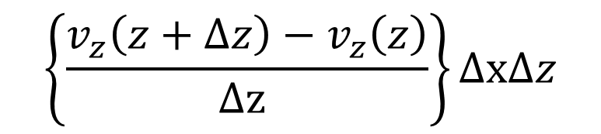




$$v_{z}\left(z+∆z\right)$$
net horizontal loss
net vertical loss
$$v_{x}\left(x\right)$$
$$v_{x}\left(x+∆x\right)$$
$$v_{x}\left(x\right)$$
$$∆z$$
$$∆z$$
$$∆x$$
$$∆x$$
$$v_{z}\left(z\right)$$
$$\left\{v_{z}\left(z+∆z\right)−v_{z}\left(z\right)\right\}∆x$$
$$\left\{\frac{v_{z}\left(z+∆z\right)−v_{z}\left(z\right)}{∆\text{z} }\right\}∆\text{x}∆z$$
$$\frac{{dv}_{x}}{d\text{x} } ∆\text{x}∆z$$
$$\frac{{dv}_{z}}{d\text{z} } ∆\text{x}∆z$$

Slide 15


no net loss
$$∆z$$
$$∆z$$
$$∆x$$
$$∆x$$
$$v_{z}\left(z\right)$$
$$\frac{{dv}_{x}}{d\text{x} } ∆\text{x}∆z$$
$$\frac{{dv}_{z}}{d\text{z} } ∆\text{x}∆z$$
$$+$$
$$= 0$$

Slide 16

no net loss
$$∆z$$
$$∆z$$
$$∆x$$
$$∆x$$
$$v_{z}\left(z\right)$$
$$\frac{{dv}_{x}}{d\text{x} }+\frac{{dv}_{z}}{d\text{z} }=0$$

Slide 17

no net loss
$$∆z$$
$$∆z$$
$$∆x$$
$$∆x$$
$$v_{z}\left(z\right)$$
divergence = zero
$$∇∙v=0$$
vector notation
$$\frac{{dv}_{x}}{d\text{x} }+\frac{{dv}_{z}}{d\text{z} }=0$$

Slide 18
Part 3
review of the Heat Conservation Equation
(equation for conservation of heat energy)

Slide 19
conservation of heat energy
increase in heat with time =
flow of heat into box
due to conduction
+ flow of heat into box
due to advection
+ heat source

Slide 20
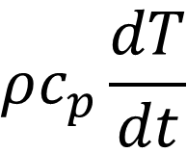
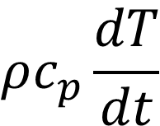
terms like
vector notation
$$ρc_{p}\frac{dT}{dt}$$
$$ρc_{p}\frac{dT}{dt}$$
increase in heat with time =
flow of heat into box
due to conduction
+ flow of heat into box
due to advection
+ heat source

Slide 21
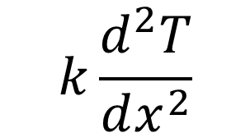

terms like
vector notation
$$ρc_{p}\frac{dT}{dt}$$
increase in heat with time =
flow of heat into box
due to conduction
+ flow of heat into box
due to advection
+ heat source
$$k\frac{d^{2}T}{dx^{2}}$$
$${k∇}^{2}T$$

Slide 22

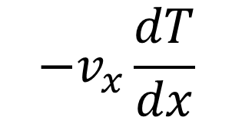
terms like
vector notation
$$ρc_{p}\frac{dT}{dt}$$
increase in heat with time =
flow of heat into box
due to conduction
+ flow of heat into box
due to advection
+ heat source
$${k∇}^{2}T$$
$$−v_{x}\frac{dT}{dx}$$
$$−v∙∇T$$

Slide 23


terms like
vector notation
$$ρc_{p}\frac{dT}{dt}$$
increase in heat with time =
flow of heat into box
due to conduction
+ flow of heat into box
due to advection
+ heat source
$${k∇}^{2}T$$
$$−v∙∇T$$
$$h$$
$$h$$

Slide 24

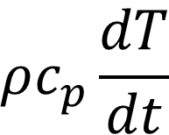



increase in heat with time
flow of heat into box due to advection
flow of heat into box due to conduction
-
=
heat source
$$ρc_{p}\frac{dT}{dt}$$
$$+ ρc_{p}v∙∇T$$
=
$${k∇}^{2}T$$
$$+$$
$$h$$
heat capacity
thermal conductivity

Slide 25

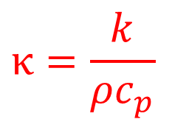
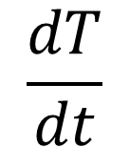
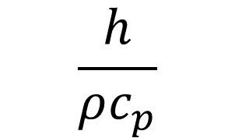

increase in heat with time
flow of heat into box due to advection
flow of heat into box due to conduction
-
=
heat source
$$\frac{h}{ρc_{p}}$$
$$\frac{dT}{dt}$$
$$+ v∙∇T$$
=
$${κ∇}^{2}T$$
$$+$$
$$κ=\frac{k}{ρc_{p}}$$
thermal diffusivity

Slide 26
Part 4
dynamics of convection

Slide 27
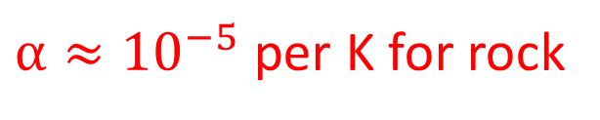


temperature change causes density change
$$ρ=ρ_{0}(1−α\left(T−T_{0}\right)$$
thermal expansion coefficient
reference density
reference temperature
$α≈{10}^{−5}$ per K for rock
0.1% for $∆T=100$ K
pretty small

Slide 28
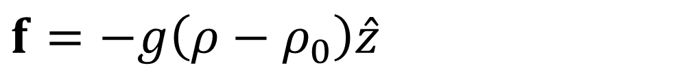

temperature change causes density change
$$ρ=ρ_{0}(1−α\left(T−T_{0}\right)$$
density change causes buoyancy change
$$f=−g\left(ρ−ρ_{0}\right)\hat{z}$$
reference density
acceleration of gravity

Slide 29

temperature change causes density change
$$ρ=ρ_{0}(1−α\left(T−T_{0}\right)$$
density change causes buoyancy change
$$f=−g\left(ρ−ρ_{0}\right)\hat{z}$$
$$\frac{dv}{dt}$$
buoyancy change causes velocity change
in Navier Stokes

Slide 30

temperature change causes density change
$$ρ=ρ_{0}(1−α\left(T−T_{0}\right)$$
density change causes buoyancy change
$$f=−g\left(ρ−ρ_{0}\right)\hat{z}$$
$$\frac{dv}{dt}$$
buoyancy change causes velocity change
velocity change causes advection of heat
$$v∙∇T$$
in Heat Equation

Slide 31

temperature change causes density change
$$ρ=ρ_{0}(1−α\left(T−T_{0}\right)$$
density change causes buoyancy change
$$f=−g\left(ρ−ρ_{0}\right)\hat{z}$$
$$\frac{dv}{dt}$$
buoyancy change causes velocity change
velocity change causes advection of heat
$$v∙∇T$$
in Heat Equation
$$\frac{dT}{dt}$$
advection of heat causes temperature change

Slide 32

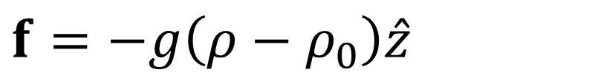

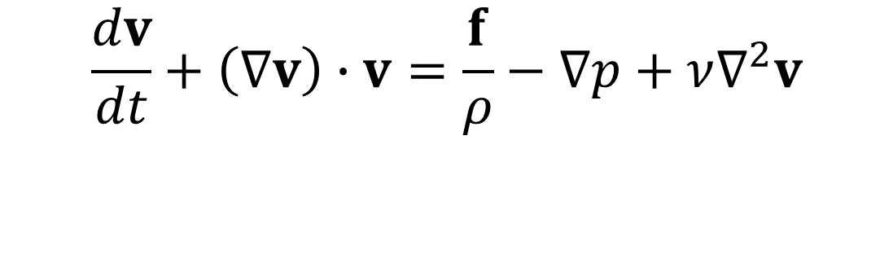
now suppose that $F$ is being transported by fluid motion
$$\frac{dv}{dt}+\left(∇v\right)∙v=\frac{f}{ρ}−∇p+ν∇^{2}v$$
$$f=−g\left(ρ−ρ_{0}\right)\hat{z}$$
$$ρ=ρ_{0}(1−α\left(T−T_{0}\right)$$
$$ρc_{p}\frac{dT}{dt}+v∙∇T={k∇}^{2}T+h$$
Feedback !

Slide 33
Part 5
Boussinesq Approximation
Changing density only affects buoyancy force

Slide 34

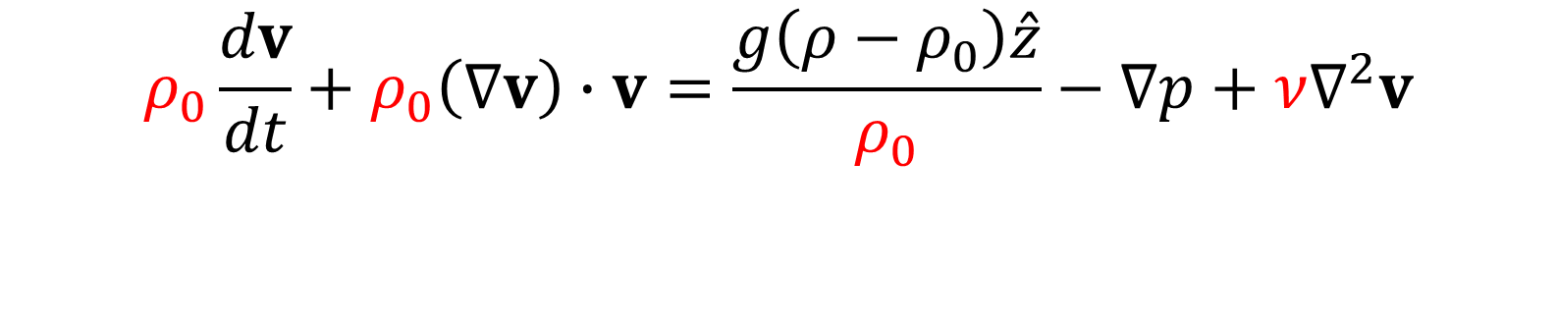

density change too small to affect fluid velocity or heat flow directly
$$ρ_{0}\frac{dv}{dt}+ρ_{0}\left(∇v\right)∙v=\frac{g\left(ρ−ρ_{0}\right)\hat{z}}{ρ_{0}}−∇p+ν∇^{2}v$$
$$ρ=ρ_{0}(1−α\left(T−T_{0}\right)$$
$$\frac{dT}{dt}+v∙∇T=κ∇^{2}T+\frac{h }{ρ_{0}c_{p}}$$

Slide 35
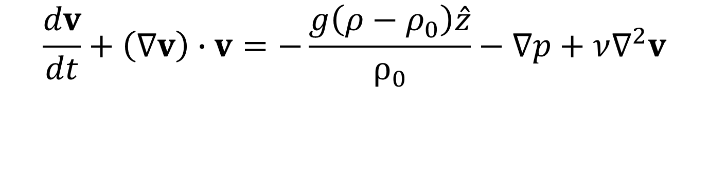
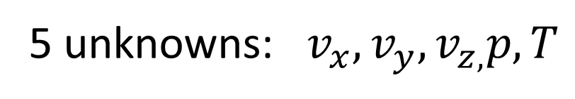


5 unknowns: $v_{x},v_{y},v_{z,}p,T$
$$\frac{dv}{dt}+\left(∇v\right)∙v=−\frac{g\left(ρ−ρ_{0}\right)\hat{z}}{ρ_{0}}−∇p+ν∇^{2}v$$
3 equations
5
equations
$$∇∙v=0$$
1 equation
$$\frac{dT}{dt}+v∙∇T={κ∇}^{2}T+\frac{h}{ρ_{0}c_{p}}$$
1 equation
so, some hope of a solution

Slide 36
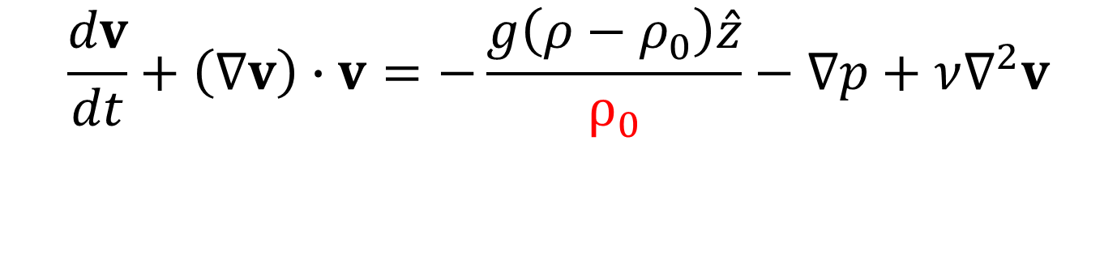

5 unknowns: $v_{x},v_{y},v_{z,}p,T$
$$\frac{dv}{dt}+\left(∇v\right)∙v=−\frac{g\left(ρ−ρ_{0}\right)\hat{z}}{ρ_{0}}−∇p+ν∇^{2}v$$
3 equations
5
equations
$$∇∙v=0$$
1 equation
$$\frac{dT}{dt}+v∙∇T=κ∇^{2}T+\frac{h}{ρ_{0}c_{p}}$$
1 equation
but non-linearities here

Slide 37
Part 6
Set up for
Convection in a Box

Slide 38

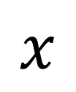
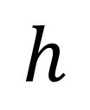
$$z$$
geometry of problem
no heat sources
$$h$$
gravity vertically downward
$$x$$

Slide 39
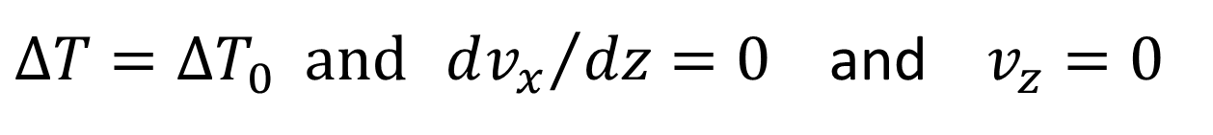
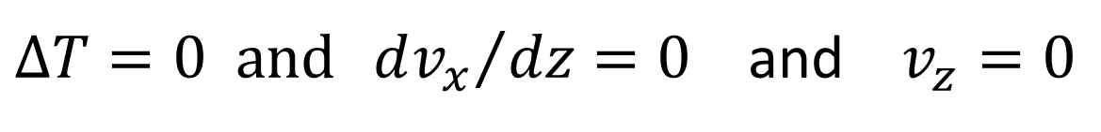
$$z$$
$∆T=0 and {dv_{x}}/{dz}=0$ and $v_{z}=0$
$$h$$
no flow through
top or bottom
$$x$$
$∆T=∆T_{0} and {dv_{x}}/{dz}=0$ and $v_{z}=0$

Slide 40
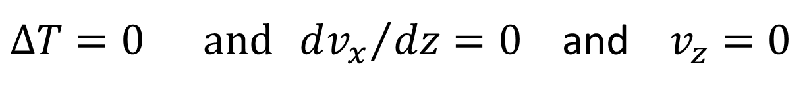
$$z$$
$∆T=0 and {dv_{x}}/{dz}=0$ and $v_{z}=0$
no drag
force
exerted
on top or
bottom
$$h$$
$$x$$
$∆T=∆T_{0} and {dv_{x}}/{dz}=0$ and $v_{z}=0$

Slide 41
$$z$$
$∆T=0 and {dv_{x}}/{dz}=0$ and $v_{z}=0$
heated from bottom
$$h$$
$$x$$
$∆T=∆T_{0} and {dv_{x}}/{dz}=0$ and $v_{z}=0$

Slide 42
$$z$$
$∆T=0 and {dv_{x}}/{dz}=0$ and $v_{z}=0$
$$h$$
repeating boundary conditions
repeating boundary conditions
$$x$$
$∆T=∆T_{0} and {dv_{x}}/{dz}=0$ and $v_{z}=0$

Slide 43
Part 7
five things we know about
Convection in a Box

Slide 44
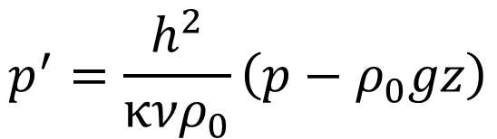

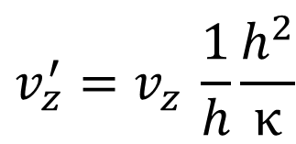

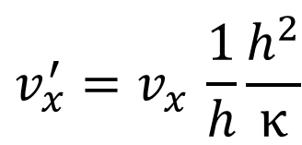


Thing We Know #1: If you work in scaled variables of order 1 in size
$$x^{′}=x/h$$
position scaled by height of box
$$x^{′}=z/h$$
$$t^{′}= tκ/h^{2}$$
time by rate at which heat conducts
$$T^{′}= \left(∆T_{0}−½∆T_{0}\right)/∆T_{0}$$
temperature as fractional
deviation from the mean
$${v_{x}^{′}=v}_{x }\frac{1}{h}\frac{h^{2}}{κ}$$
velocity by combining position and time scaling
$${v_{z}^{′}=v}_{z }\frac{1}{h}\frac{h^{2}}{κ}$$
pressure by scaled deviation from hydrostatic
$$p^{′}=\frac{h^{2}}{{κνρ}_{0}}\left(p−ρ_{0}gz\right)$$

Slide 45
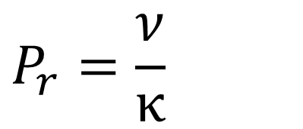
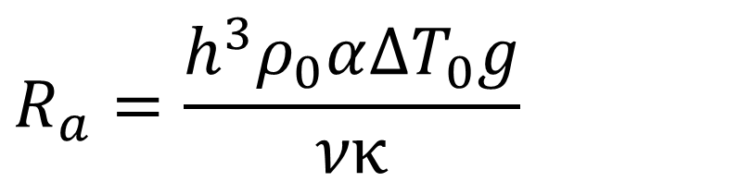
If you work in scaled variables ... (order 1 in size)
then the ONLY two material constant are the
Rayleigh Number
Prandtl Number
$$R_{a}=\frac{h^{3}ρ_{0}α∆T_{0}g}{νκ}$$
$$P_{r}=\frac{ν}{κ}$$
and
and only these two combinations of material parameters affects the pattern of convection

Slide 46
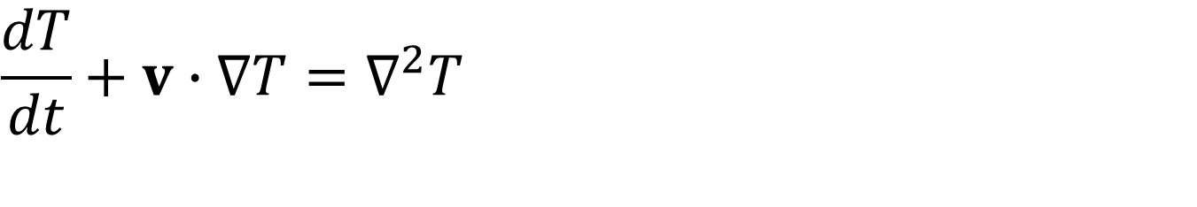
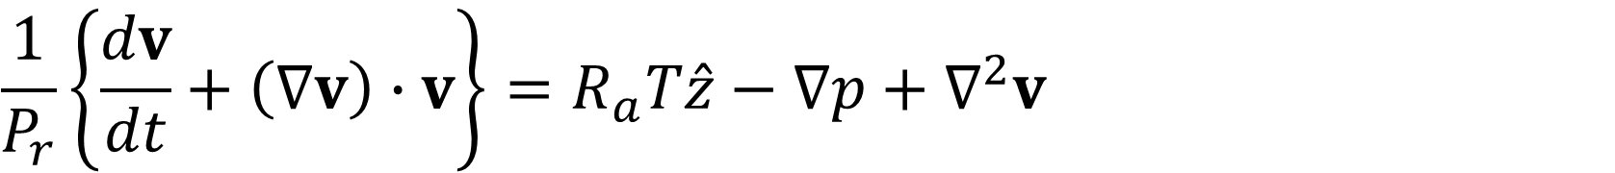

in primed variables (but omitting primes)
$$\frac{1}{P_{r}}\left\{\frac{dv}{dt}+\left(∇v\right)∙v\right\}=R_{a}T\hat{z}−∇p+∇^{2}v$$
$$∇∙v=0$$
$$\frac{dT}{dt}+v∙∇T=∇^{2}T$$

Slide 47

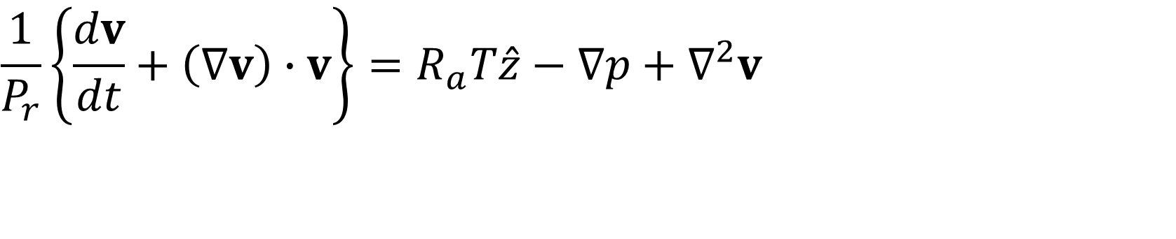
Thing We Know #3: For the earth’s mantle
$$P_{r}≈{10}^{24}$$
$$R_{a}≈{10}^{4}$$
so two terms can be eliminated from the Navier Stokes equations
$$\frac{1}{P_{r}}\left\{\frac{dv}{dt}+\left(∇v\right)∙v\right\}=R_{a}T\hat{z}−∇p+∇^{2}v$$
$$0{=R}_{a}T\hat{z}−∇p+∇^{2}v$$

Slide 48
Thing We Know #3: For the earth’s mantle
$$P_{r}≈{10}^{24}$$
$$R_{a}≈{10}^{4}$$
so two terms can be eliminated from the Navier Stokes equations
$$\frac{1}{P_{r}}\left\{\frac{dv}{dt}+\left(∇v\right)∙v\right\}=R_{a}T\hat{z}−∇p+∇^{2}v$$
for short time scales
buoyancy causes
steady flow
$$0{=R}_{a}T\hat{z}−∇p+∇^{2}v$$

Slide 49



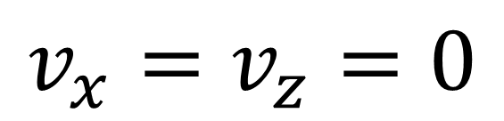



Thing We Know #4: “no convection” is a solution
$$0$$
$$∆T_{0}$$
$$∆T=0$$
$$∆T$$
$$v_{x}=v_{z}=0$$
$$z$$
$$∆T=∆T_{0}$$

Slide 50
but this solution is not always stable

Slide 51
Many possible convection patterns

Slide 52


One convective roll
$$v_{x}−$$
$$v_{x}+$$

Slide 53


$$v_{z}−$$
$$v_{z}+$$

Slide 54




Two convective rolls, side-by-side
$$v_{x}−$$
$$v_{x}+$$
$$v_{x}+$$
$$v_{x}−$$

Slide 55



$$v_{z}+$$
$$v_{z}−$$
$$v_{z}−$$

Slide 56



Two convective rolls, one atop the other
$$v_{x}−$$
$$v_{x}+$$
$$v_{x}−$$

Slide 57




Two convective rolls, one atop the other
$$v_{z}−$$
$$v_{z}+$$
$$v_{z}+$$
$$v_{z}−$$

Slide 58

Suppose that we start with zero velocity and a linear temperature profile
and add a tiny perturbation
v
$v_{z}=A sin\left(mπ\frac{x}{L}\right)$ $sin\left(nπ\frac{x}{L}\right)$

Slide 59

Suppose that we start with zero velocity and a linear temperature profile
and add a tiny perturbation
v
$v_{z}=A sin\left(mπ\frac{x}{L}\right)$ $sin\left(nπ\frac{z}{L}\right)$
$$get v_{x} from incompressibility equation$$

Slide 60

Suppose that we start with zero velocity and a linear temperature profile
and add a tiny perturbation
rate of roles horizontally
number of roles vertically
v
$v_{z}=A sin\left(mπ\frac{x}{L}\right)$ $sin\left(nπ\frac{z}{L}\right)$

Slide 61


Suppose that we start with zero velocity and a linear temperature profile
and add a tiny perturbation
does the pattern initially amplify
or dissipate with time
v
$∆T=A sin\left(mπ\frac{x}{L}\right)$ $sin\left(nπ\frac{z}{L}\right)exp(st′)$
$$t^{′}is scaled time, tκ/h^{2}$$

Slide 62
Suppose that we start with zero velocity and a linear temperature profile
and add a tiny perturbation
is s positive or negative?
v
$∆T=A sin\left(mπ\frac{x}{L}\right)$ $sin\left(nπ\frac{z}{L}\right)exp(st′)$
$$t^{′}is scaled time, tκ/h^{2}$$

Slide 63


s>0
s<0
Diagram for n=1
(one roll vertically)

Slide 64








Thing We Know #5: averaged over time, the solution is
consists of a central uniform region and boundary layers
$$0$$
$$u_{z}^{max}$$
$$0$$
$$∆T_{0}$$
$$u_{z}$$
$$∆T$$
top BL
central
bottom BL
$$z$$
$$z$$

Slide 65
$$0$$
$$u_{z}^{max}$$
$$0$$
$$∆T_{0}$$
$$u_{z}$$
$$∆T$$
by conduction
heat transfer by advection
isothermaal
by conduction
$$z$$
$$z$$

Slide 66
Part 8
Finite Difference Scheme for
Convection in a Box

Slide 67




Step 1: given $T$ at time $t$ find $v_{x}$, $v_{z}$ and $p$ at time $t$ by solving
$$∇p−∇^{2}v =R_{a}T\hat{z}$$
$$∇∙v=0$$
on a Finite Difference grid
Step 2: find $\frac{dT}{dt}$ at time $t$
$$\frac{dT}{dt}=−v∙∇T+∇^{2}T$$
using
Step 3: find $T$ at time $t+∆t$ by forward stepping
$$T\left(t+∆t\right)=T\left(t\right)+\frac{dT}{dt}∆t$$
Step 4: go to Step 1

