Slide 1
2025 EESC W3400
Computational Earth Science
Lec 01: Introduction

Slide 2
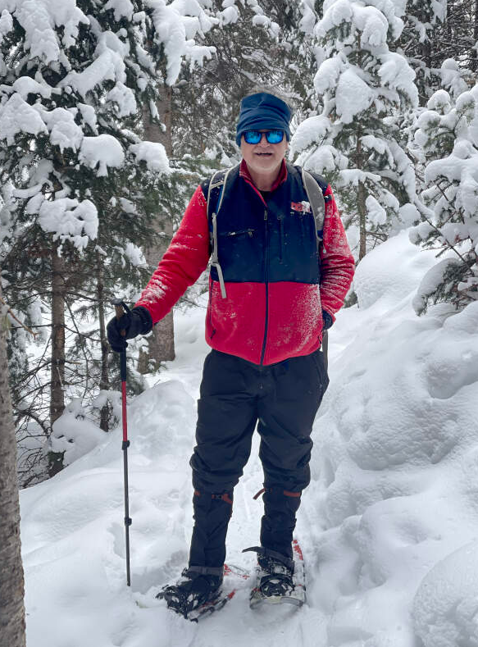
Bill Menke
PhD, Geophysics, Columbia 1982
Instructor
menke@ldeo.columbia.edu

Slide 3
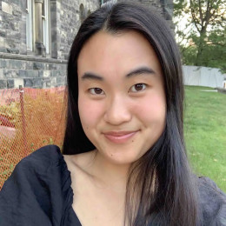
kathryn.cheng@columbia.edu
Kathryn Cheng
B.Sc, Geology, U Toronto, 2023
Teaching Assistant
kathryn.cheng@columbia.edu

Slide 4
Goal
For you to become experienced in applying Python-based computational methods to Earth Science phenomena, and especially in using models of dynamic phenomena to understand how the world works.

Slide 5
Why Modeling?

Slide 6
from the humanistic perspective ...
One of the great intellectual achievements of the modern era
some aspects of the future can be
accurately predicted

Slide 7
from a scientist’s perspective ...
a key tool in testing the
correctness of scientific explanations
and more broadly in understanding how
specific phenomena behave

Slide 8
from an environmentalist’s perspective ...
familiarity with the principles of modeling allows one assessing the credibility of
proposed solutions to environmental and climatological problems

Slide 9
Phenomenon
Method
Analysis
Visualization
Interpretation

Slide 10
Phenomenon
planetary motions
cooling of the Earth
transport of chemicals
seismic wave propagation
mantle convection
ocean currents

Slide 11
Method
Runge-Kutta integration
least squares curve fitting
Fourier analysis
mode summation
Finite difference method

Slide 12
Analysis
Python coding
solution methods
bookkeeping

Slide 13
scatter plots
time series plots
histograms
heat maps
animations
Visualization

Slide 14
cause and effect
scale lengths and rates of change
periodicities
asymptotic behavior
sensitivity to parameters
comparison to observations
Interpretation

Slide 15
Phenomenon
Method
Analysis
Visualization
Interpretation

Slide 16
Lec 01: Sept 2
Introduction and Goals of Course
Lec 02: Sept 4
Computing of simple formulas
Lec 03: Sept 9
Runge Kutta method illustrated by falling objects
Lec 04: Sept 11
Planetary Orbits
Lec 05: Sept 16
Reservoir models illustrated by cascade of lakes
Lec 06: Sept 18
Ultra-simplified global warming model
Lec 07: Sept 23
Seismic rays
Lec 08: Sept 25
Cooling of the solid Earth

Slide 17
Lec 09: Sept 30
Temperature of cooling conductive rod
Lec 10: Oct 2
Least squares estimation illustrated using global warming data
Lec 11: Oct 7
Periodicities and Fourier series
Lec 12: Oct 10
Fast Fourier Transform illustrated using environmental time series
Lec 13: Oct 14
Useful things that can be done using the Fast Fourier Transform
Lec 14: Oct 16
2D FFT illustrated by propagating waves
Lec 15: Oct 21
Gravity anomalies computed using the FFT
Lec 16: Oct 23
Natural textures created using the 2D FFT
Lec 17: Oct 28
Chemical diffusion computed with the 2D FFT

Slide 18
Lec 18: Nov 6
Vibrations of 1D finite bodies
Lec 19: Nov 11
Vibrations of 2D finite bodies
Lec 20: Nov 13
Finite difference method illustrated with 2D time-independent conductive heat flow
Lec 21: Nov 18
2D time-independent heat flow in objects with complicated shape
Lec 22: Nov 20
Writing a FD code illustrated with 1D+time heat flow equation
Lec 23: Nov 25
FD method illustrated by channel flow with eddy
Lec 24: Dec 2
FD method illustrated by convection in box
Lec 25: Dec 5
Writing a least squares code illustrated with planar fit problem
Class Presentations: Dec 9 and (possibly) 11

Slide 19
Syllabus
Syllabus Subject to Change
Whether we actually get through this material with depend on the pace you find acceptable.

Slide 20
I don’t have any problem with getting through less in order for you to learn new material more thoroughly

Slide 21
Class Organization
Short lecture by me describing phenomenon and methodology
Everyone runs and discusses exemplary code
In class small group projects (typically follow up idea by modifying code)
group presentations and discussion
(group submits short PPTX to Canvas/Assignments)

Slide 22
Homework
Write up of in-class group projects
Rubric and Example in Canvas/Files/Lec01
Read my policies at
https://www.ldeo.columbia.edu/users/menke/gradingpolicy.html
Collaborations of Group members OK if acknowledged
You are expected to make significant contribution
Copying disallowed
All text must be in your own (individual) words
Due Fridays at 11:59 PM summarizing in-class presentations of previous week
details in Canvas/Assignments
Graded only acceptable / unacceptable

Slide 23
Term Project
Individualized
Fairly substantial analysis of a phenomenon different from but of similar complexity to those we cover in class
Project idea due mid-November and must be approved by Instructor.
Presented in class at the end of the term
Graded according to rubric that will be provided beforehand
Term Paper version last day of finals week at 11:59 PM.

Slide 24
Grading
Class Participation (including acceptable write-ups): 50%
Term Project: 50%
(No midterm, no final)

Slide 25
Questions?

Slide 26
Installation of Python & etc.

Slide 27
Step 1 – folder for class material
Create a class folder at a location you can remember and with a path name that fairly easy to type
Mine’s called CES25
and has path /bill/CES25
Copy all the class files from Canvas’ Code folder into it.

Slide 28
Step 2 – install python
Download and install Python from Python webpage:
https://www.python.org/downloads/

Slide 29
Step 3 – Install Anaconda
Download Anaconda from Anaconda webpage:
https://www.anaconda.com/products/individual

Slide 30
Step 4: Change default directory
Launch the Anaconda Navigator and use it to launch a “Powershell Prompt” window. Type this command:
jupyter server --generate-config
Take note of the location of the config file. Mine is:
/Users/menke/.jupyter/jupyter_server_config.py

Slide 31
Step 4, con’t
In a Mac/finder or Window/explorer window, navigate to that directory and use a text editor such as Mac/SimpleText or Windows/Textedit to open
jupyter_notebook_config.py
Find the line
# c.ServerApp.root_dir = ‘’
and immedialey after it add a line like
c.ServerApp.root_dir = ‘/bill/CES25’
where you substitute in the path of your class directory.
Use forward slashes \ in the filename.
Save the file and exit the text editor.

Slide 32
Step 5 – install graphics packages
Lauch the Anaconda Navigator and use it to launch a “Powershell Prompt” window.
Install these packages by typing
into the Powershell window the commands:
conda install ipython
conda install conda-forge::ffmpeg
conda install -c anaconda pillow
conda install conda-forge::pydub

Slide 33
Step 6
Bring up a browser like Chrome or Firefox
Bring up an Anaconda Navigator and use it to launch JupyterLab. It should appear as a page in the browser.
Check the left panel to verify that it’s positioned to your class folder.

Slide 34
After installing Python Environment
Break into two groups
- Group 1: little or no familiarity with coding
Bill leads tutorial on getting started
- Group 2: work through topics which your less familiar with in
MenkeOnPython.ipynb
and especially matrix arithmetic (with TA’s assistance)

