Slide 1
2025 EESC W3400
Lec 02: Computing of simple formulas
Computational Earth Science
Lecture 2

Slide 2
Phenomenon
Method
Analysis
Visualization
today
Interpretation

Slide 3
Critically important to understand complicated behaviors
Visualization
today

Slide 4
today
y(x) functions
Visualization
I(x,y) images

Slide 5
today
Visualization
in the context of sensitivity analysis
how much the behavior changes when a parameter is changed

Slide 6
Preliminaries

Slide 7
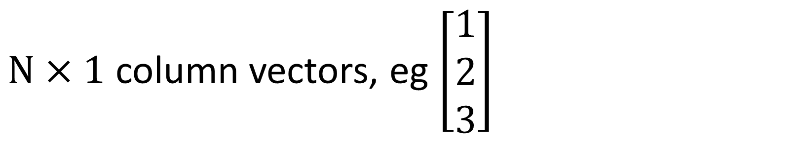
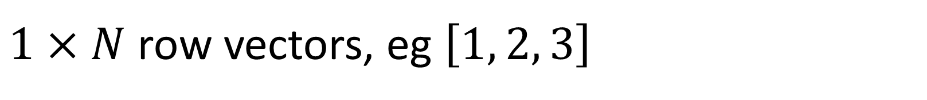
1. Vectors
$N×1$ column vectors, eg $\left[\begin{matrix}1 \\ 2 \\ 3\end{matrix}\right]$
$1×N$ row vectors, eg $\left[1, 2, 3\right]$

Slide 8
I always use this kind
$N×1$ column vectors, eg $\left[\begin{matrix}1 \\ 2 \\ 3\end{matrix}\right]$

Slide 9
I always use this kind
$N×1$ column vectors, eg $\left[\begin{matrix}1 \\ 2 \\ 3\end{matrix}\right]$
v = np.zeros((N,1));
v[2,0] = value;
v = gda_cvec( ... )
turns most anything into a column vector

Slide 10
2. axes ... vector of uniformly sampled variable
# x-axis
Lx = 41;
xmin = 0.0;
xmax = 1.0;
Dx = (xmax-xmin)/(Lx-1);
x = gda_cvec(Dx*np.linspace(0,Lx-1,Lx));

Slide 11
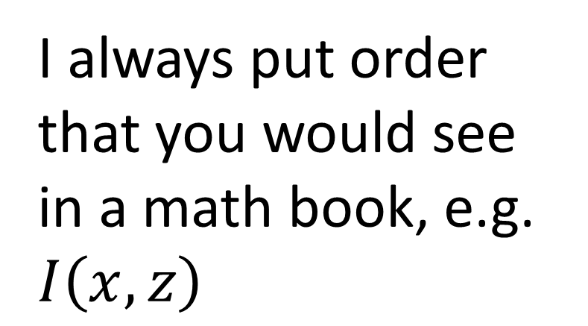
3. image ... 2D function
row of matrix
column of matrix
Lx = 41;
Lz = 41;
IMG = np.zeros((Lx,Lz));
I always put order
that you would see in a math book, e.g. $I\left(x,z\right)$

Slide 12
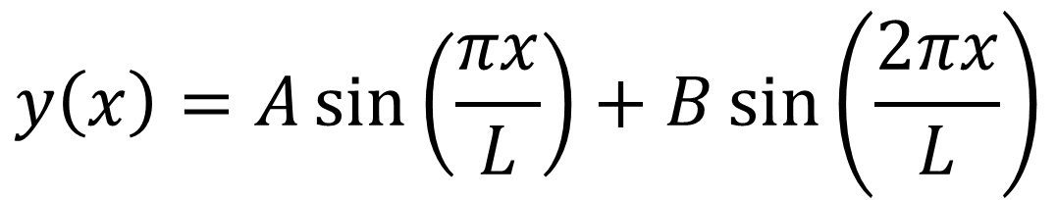
y(x) functions
$$y\left(x\right)=A\sin\left(\frac{πx}{L}\right)+B\sin\left(\frac{2πx}{L}\right)$$
y = A*np.sin(pi*x/L) + B*np.sin(2*pi*x/L);

Slide 13

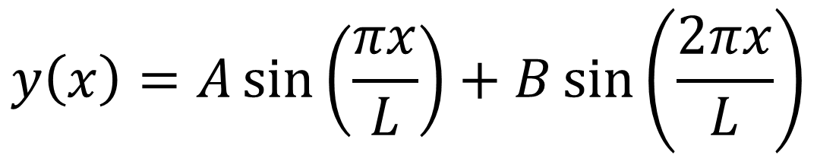
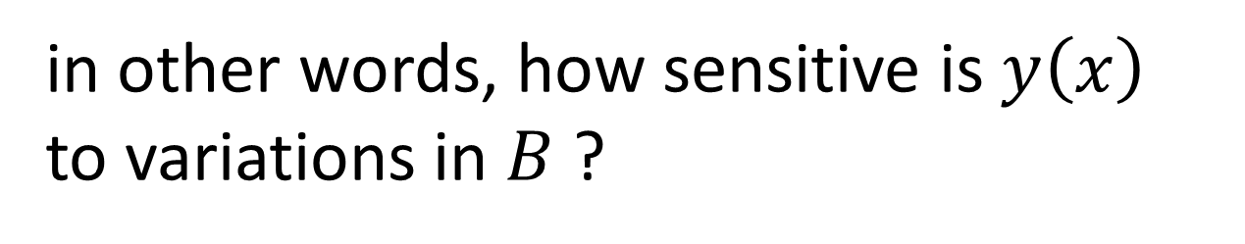
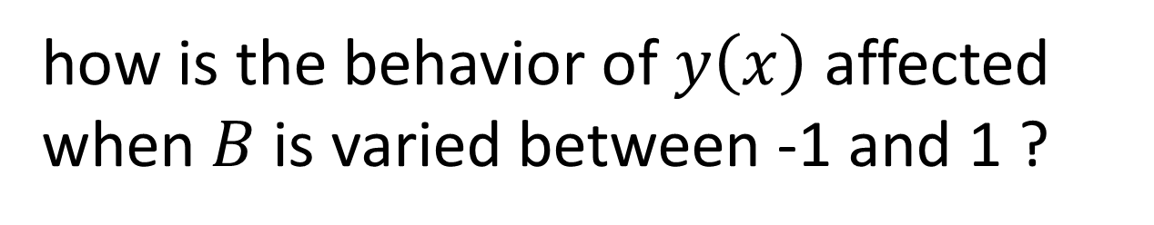
$$y\left(x\right)=A\sin\left(\frac{πx}{L}\right)+B\sin\left(\frac{2πx}{L}\right)$$
when $A=2$ and $L=5$
how is the behavior of $y\left(x\right)$ affected
when $B$ is varied between -1 and 1 ?
in other words, how sensitive is $y\left(x\right)$
to variations in $B$ ?

Slide 14
A=2.0;
L=5.0;
x=gda_cvec(np.linspace(0.0,L,20));
B=gda_cvec( -1.0, -0.5, 0.0, 0.5, 1.0 );
sym = ['r-', 'y-', 'g-', 'c-', 'b-'];
NB, i = np.shape(B);
fig = plt.figure();
ax = plt.subplot(1,1,1);
plt.axis( [0.0, L, -2.0*A, 2.0*A] );
for i in range(NB):
y = A * np.sin( pi*x/L ) + B[i,0] * np.sin( 2*pi*x/L );
plt.plot(x,y,sym[i]);
plt.xlabel('x (m)');
plt.ylabel('y (m)');
plt.show();
print('Fig. Graph of y(x) for B=-1 (red …
4. FOR loops ... repeat an action several times

Slide 15
A=2.0;
L=5.0;
x=gda_cvec(np.linspace(0.0,L,20));
B=gda_cvec( -1.0, -0.5, 0.0, 0.5, 1.0 );
sym = ['r-', 'y-', 'g-', 'c-', 'b-'];
NB, i = np.shape(B);
fig = plt.figure();
ax = plt.subplot(1,1,1);
plt.axis( [0.0, L, -2.0*A, 2.0*A] );
for i in range(NB):
y = A * np.sin( pi*x/L ) + B[i,0] * np.sin( 2*pi*x/L );
plt.plot(x,y,sym[i]);
plt.xlabel('x (m)');
plt.ylabel('y (m)');
plt.show();
print('Fig. Graph of y(x) for B=-1 (red …
x-axis

Slide 16
A=2.0;
L=5.0;
x=gda_cvec(np.linspace(0.0,L,20));
B=gda_cvec( -1.0, -0.5, 0.0, 0.5, 1.0 );
sym = ['r-', 'y-', 'g-', 'c-', 'b-'];
NB, i = np.shape(B);
fig = plt.figure();
ax = plt.subplot(1,1,1);
plt.axis( [0.0, L, -2.0*A, 2.0*A] );
for i in range(NB):
y = A * np.sin( pi*x/L ) + B[i,0] * np.sin( 2*pi*x/L );
plt.plot(x,y,sym[i]);
plt.xlabel('x (m)');
plt.ylabel('y (m)');
plt.show();
print('Fig. Graph of y(x) for B=-1 (red …
make list of Bs
each with its own
symbol

Slide 17
A=2.0;
L=5.0;
x=gda_cvec(np.linspace(0.0,L,20));
B=gda_cvec( -1.0, -0.5, 0.0, 0.5, 1.0 );
sym = ['r-', 'y-', 'g-', 'c-', 'b-'];
NB, i = np.shape(B);
fig = plt.figure();
ax = plt.subplot(1,1,1);
plt.axis( [0.0, L, -2.0*A, 2.0*A] );
for i in range(NB):
y = A * np.sin( pi*x/L ) + B[i,0] * np.sin( 2*pi*x/L );
plt.plot(x,y,sym[i]);
plt.xlabel('x (m)');
plt.ylabel('y (m)');
plt.show();
print('Fig. Graph of y(x) for B=-1 (red …
standard plot command sequence

Slide 18
A=2.0;
L=5.0;
x=gda_cvec(np.linspace(0.0,L,20));
B=gda_cvec( -1.0, -0.5, 0.0, 0.5, 1.0 );
sym = ['r-', 'y-', 'g-', 'c-', 'b-'];
NB, i = np.shape(B);
fig = plt.figure();
ax = plt.subplot(1,1,1);
plt.axis( [0.0, L, -2.0*A, 2.0*A] );
for i in range(NB):
y = A * np.sin( pi*x/L ) + B[i,0] * np.sin( 2*pi*x/L );
plt.plot(x,y,sym[i]);
plt.xlabel('x (m)');
plt.ylabel('y (m)');
plt.show();
print('Fig. Graph of y(x) for B=-1 (red …
FOR loop with
i =0, 1, 2, ... (NB-1)

Slide 19
A=2.0;
L=5.0;
x=gda_cvec(np.linspace(0.0,L,20));
B=gda_cvec( -1.0, -0.5, 0.0, 0.5, 1.0 );
sym = ['r-', 'y-', 'g-', 'c-', 'b-'];
NB, i = np.shape(B);
fig = plt.figure();
ax = plt.subplot(1,1,1);
plt.axis( [0.0, L, -2.0*A, 2.0*A] );
for i in range(NB):
y = A * np.sin( pi*x/L ) + B[i,0] * np.sin( 2*pi*x/L );
plt.plot(x,y,sym[i]);
plt.xlabel('x (m)');
plt.ylabel('y (m)');
plt.show();
print('Fig. Graph of y(x) for B=-1 (red …
different value of B
each iteration of loop

Slide 20
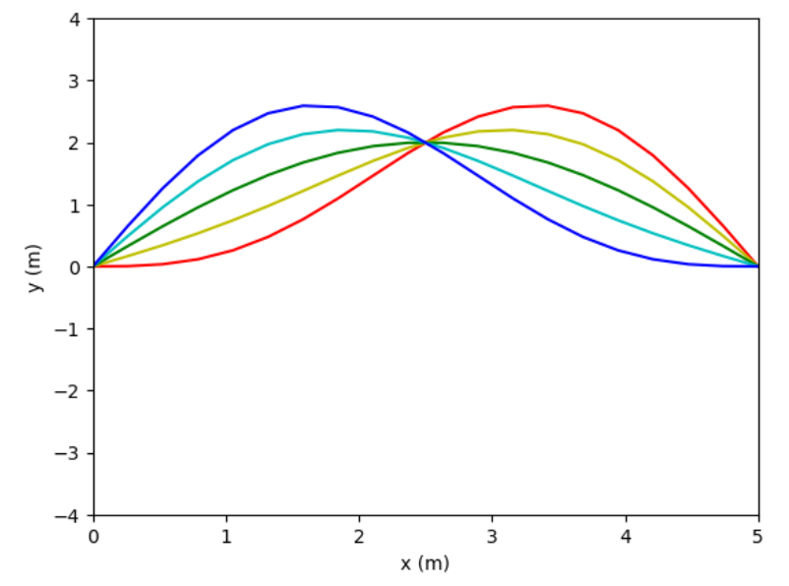
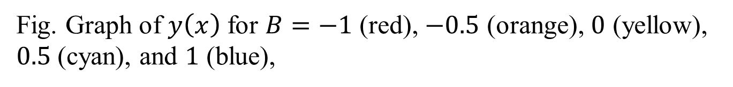
Fig. Graph of $y\left(x\right)$ for $B=−1$ (red), $−0.5$ (orange), $0$ (yellow), $0.5$ (cyan), and $1$ (blue),

Slide 21
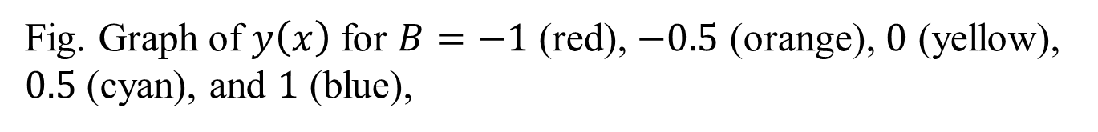
Your figures should have
labels (with units) and a caption
Fig. Graph of $y\left(x\right)$ for $B=−1$ (red), $−0.5$ (orange), $0$ (yellow), $0.5$ (cyan), and $1$ (blue),

Slide 22

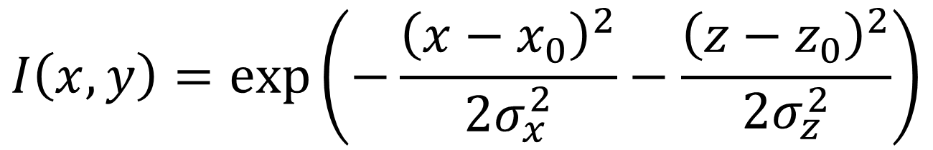
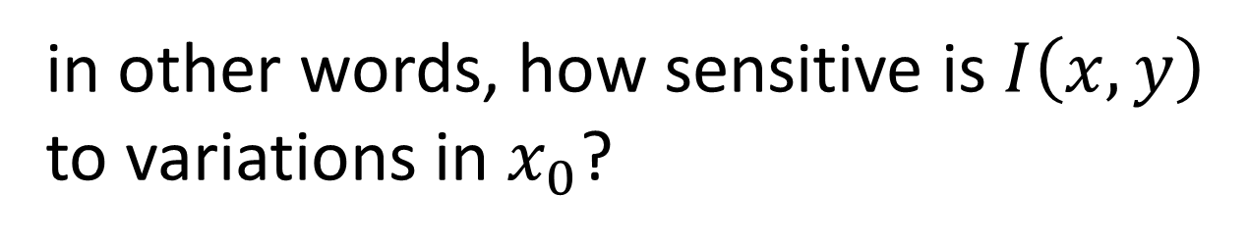
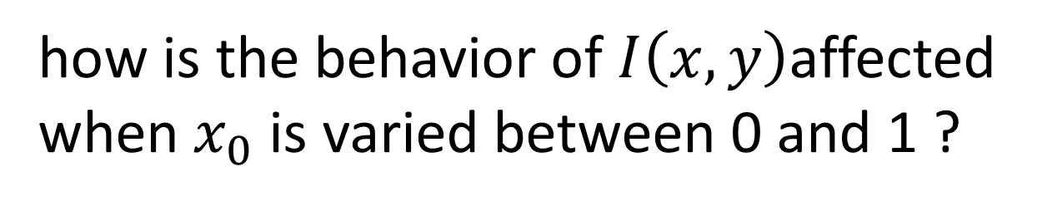
Gaussian function
$$I\left(x,y\right)=\exp\left(−\frac{{\left(x−x_{0}\right)}^{2}}{2σ_{x}^{2}}−\frac{{\left(z−z_{0}\right)}^{2}}{2σ_{z}^{2}}\right)$$
when $σ_{x}=σ_{y}=0.1$ and $z_{0}=L$/2
how is the behavior of $I\left(x,y\right)$affected
when $x_{0}$ is varied between 0 and 1 ?
in other words, how sensitive is $I\left(x,y\right)$
to variations in $x_{0}$?

Slide 23
5. create image using nested loops
IMG = np.zeros((Lx,Lz));
for ix in range(Lx):
for iz in range(Lz):
r2=((x[ix,0]-x0)**2)/sigmax2+((z[iz,0]-z0)**2)/sigmaz2;
IMG[ix,iz] = np.exp(-0.5*r2);

Slide 24
6. plot image
# limits of data values
dmin = 0.0;
dmax = 1.0;
left=0; right=xmax; # position of image
top=zmax; bottom=0;
mycmap=matplotlib.colormaps['jet']; # colormap
# plot initial zero
plt.imshow(np.flipud(IMG.T), cmap=mycmap, vmin=dmin,
vmax=dmax, extent=(left,right,bottom,top) );
plt.xlabel('x (m)');
plt.ylabel('z (m)');
plt.colorbar(shrink=0.5);
plt.show();
set the color palate (or “color map”)

Slide 25
# limits of data values
dmin = 0.0;
dmax = 1.0;
left=0; right=xmax; # position of image
top=zmax; bottom=0;
mycmap=matplotlib.colormaps['jet']; # colormap
# plot initial zero
plt.imshow(np.flipud(IMG.T), cmap=mycmap, vmin=dmin,
vmax=dmax, extent=(left,right,bottom,top) );
plt.xlabel('x (m)');
plt.ylabel('z (m)');
plt.colorbar(shrink=0.5);
plt.show();
plot the image

Slide 26
6. check image orientation
0 = don’t check, 1 = check
if(0):
for ix in range(Lx):
for iz in range(Lz):
IMG[ix,iz] = 0.0;
ix=5;
iz=5;
IMG[ix,iz]=0.3;
ix=Lx-5;
iz=5;
IMG[ix,iz]=0.6;
ix=5;
iz=Lz-5;
IMG[ix,iz]=0.9;
orientation of image altered
plt.imshow(np.flipud(IMG.T), cmap=mycmap, vmin=dmin,
vmax=dmax, extent=(left,right,bottom,top) );

Slide 27
