Slide 1
2025 EESC W3400
Computational Earth Science
Lec 04: Planetary Orbits

Slide 2


Orbit of Planet
$\left(x,y\right)$ plane
$$r$$
sun, M
planet, m

Slide 3
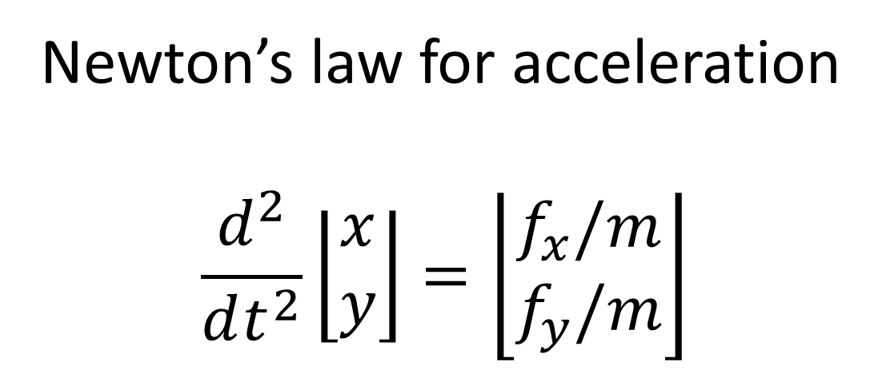
Newton’s law for acceleration
$$\frac{d^{2}}{dt^{2}}\left\lfloor \begin{matrix}x \\ y\end{matrix}\right\rfloor =\left\lfloor \begin{matrix}f_{x}/m \\ f_{y}/m\end{matrix}\right\rfloor$$

Slide 4
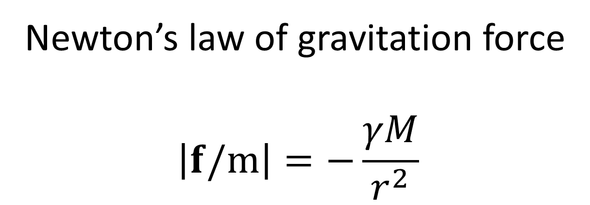
Newton’s law of gravitation force
$$\left|f/m\right|=−\frac{γM}{r^{2}}$$
along line from sun to planet

Slide 5
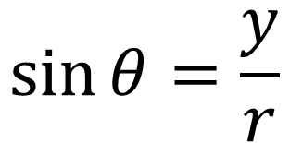

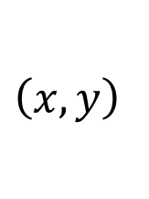
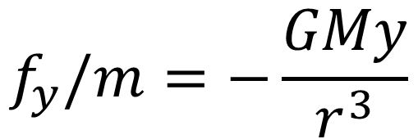

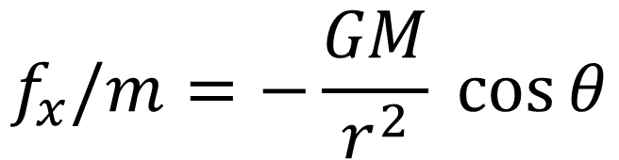
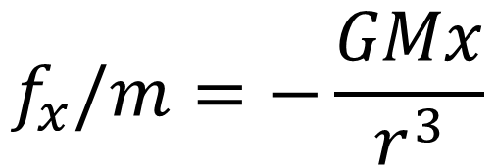

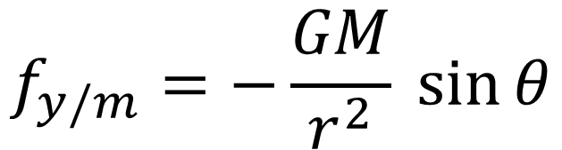

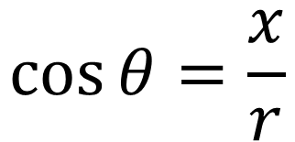
$$\left(x,y\right)$$
$$y$$
$$f_{x}/m=−\frac{GM}{r^{2}} \cos{θ}$$
$$f_{y/m}=−\frac{GM}{r^{2}} \sin{θ}$$
$$r$$
$$θ$$
$$\cos{θ=\frac{x}{r}}$$
$$x$$
$$\sin{θ=\frac{y}{r}}$$
$$f_{x}/m=−\frac{GMx}{r^{3}}$$
$$f_{y}/m=−\frac{GMy}{r^{3}}$$

Slide 6
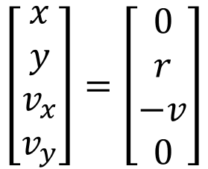

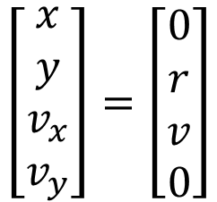

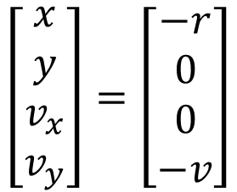
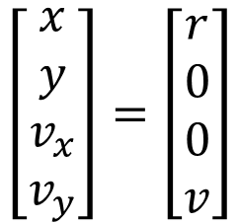

ccw motion
$$y$$
$$\left[\begin{matrix}x \\ y \\ v_{x} \\ v_{y}\end{matrix}\right]=\left[\begin{matrix}0 \\ r \\ −v \\ 0\end{matrix}\right]$$
$$r$$
$$\left[\begin{matrix}x \\ y \\ v_{x} \\ v_{y}\end{matrix}\right]=\left[\begin{matrix}−r \\ 0 \\ 0 \\ −v\end{matrix}\right]$$
$$\left[\begin{matrix}x \\ y \\ v_{x} \\ v_{y}\end{matrix}\right]=\left[\begin{matrix}r \\ 0 \\ 0 \\ v\end{matrix}\right]$$
$$x$$
$$\left[\begin{matrix}x \\ y \\ v_{x} \\ v_{y}\end{matrix}\right]=\left[\begin{matrix}0 \\ r \\ v \\ 0\end{matrix}\right]$$

Slide 7
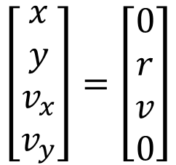
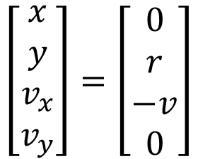
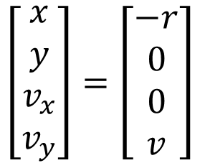
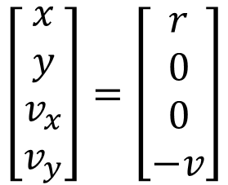
cw motion
$$y$$
$$\left[\begin{matrix}x \\ y \\ v_{x} \\ v_{y}\end{matrix}\right]=\left[\begin{matrix}0 \\ r \\ v \\ 0\end{matrix}\right]$$
$$r$$
$$\left[\begin{matrix}x \\ y \\ v_{x} \\ v_{y}\end{matrix}\right]=\left[\begin{matrix}−r \\ 0 \\ 0 \\ v\end{matrix}\right]$$
$$\left[\begin{matrix}x \\ y \\ v_{x} \\ v_{y}\end{matrix}\right]=\left[\begin{matrix}r \\ 0 \\ 0 \\ −v\end{matrix}\right]$$
$$x$$
$$\left[\begin{matrix}x \\ y \\ v_{x} \\ v_{y}\end{matrix}\right]=\left[\begin{matrix}0 \\ r \\ −v \\ 0\end{matrix}\right]$$

Slide 8
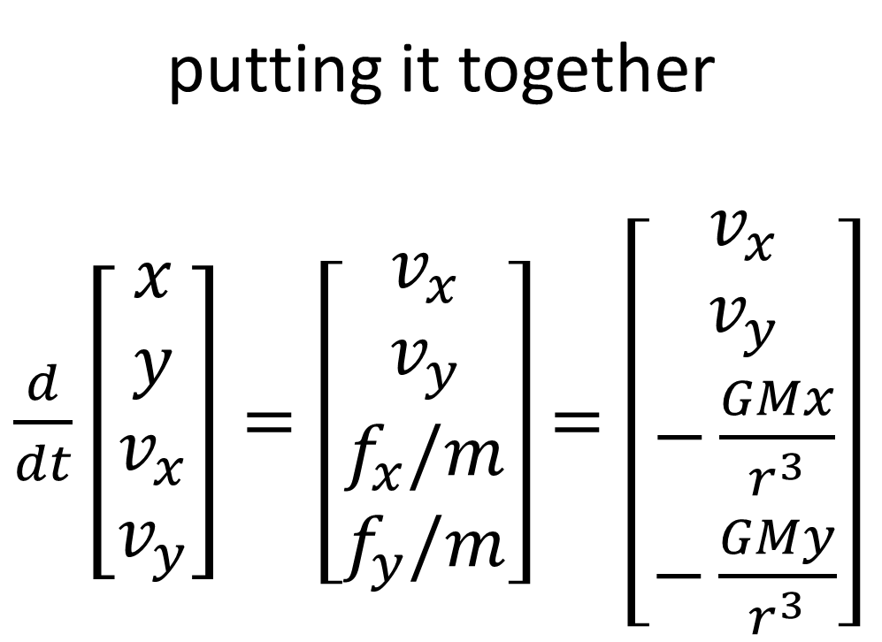
putting it together
$\frac{d}{dt}\left[\begin{matrix}x \\ y \\ v_{x} \\ v_{y}\end{matrix}\right]=\left[\begin{matrix}v_{x} \\ v_{y} \\ f_{x}/m \\ f_{y}/m\end{matrix}\right]$ $=\left[\begin{matrix}v_{x} \\ v_{y} \\ −\frac{GMx}{r^{3}} \\ −\frac{GMy}{r^{3}}\end{matrix}\right]$

Slide 9










$$\left(x_{1},y_{1}\right)$$
two planets
$$y$$
$$m_{1}$$
$$r_{1}$$
$$r_{12}$$
$$\left(x_{2},y_{2}\right)$$
$$r_{2}$$
$$m_{2}$$
$$x$$
$$M$$

Slide 10
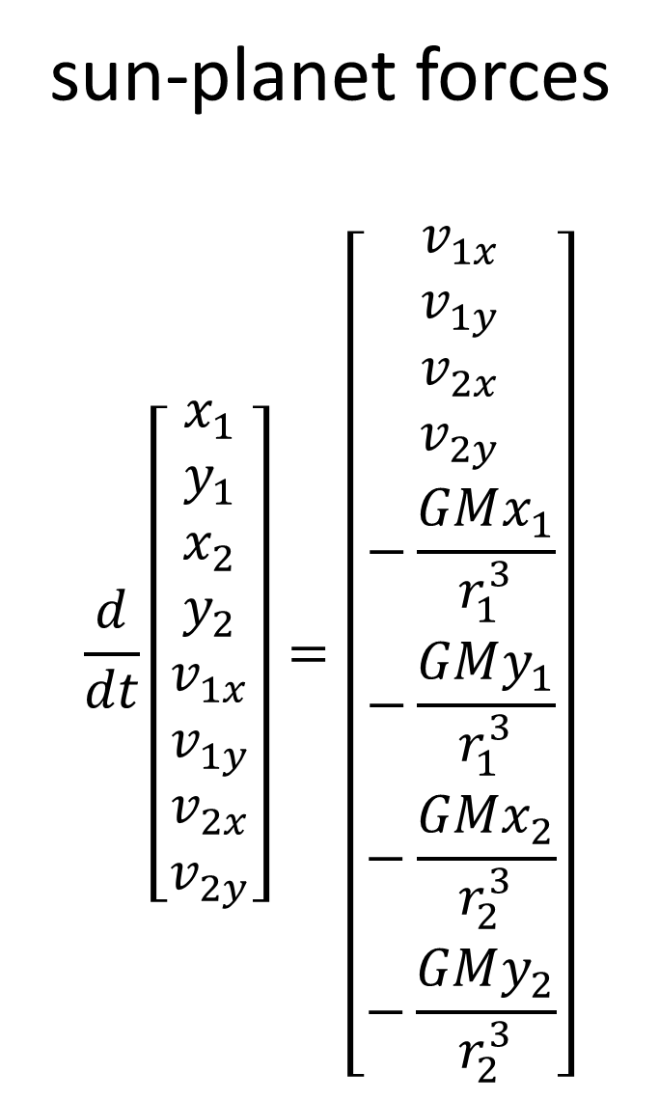
sun-planet forces
$$\frac{d}{dt}\left[\begin{matrix}x_{1} \\ y_{1} \\ x_{2} \\ y_{2} \\ v_{1x} \\ v_{1y} \\ v_{2x} \\ v_{2y}\end{matrix}\right]=\left[\begin{matrix}v_{1x} \\ v_{1y} \\ v_{2x} \\ v_{2y} \\ −\frac{GMx_{1}}{r_{1}^{3}} \\ −\frac{GMy_{1}}{r_{1}^{3}} \\ −\frac{GMx_{2}}{r_{2}^{3}} \\ −\frac{GMy_{2}}{r_{2}^{3}}\end{matrix}\right]$$

Slide 11

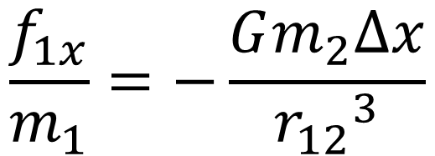
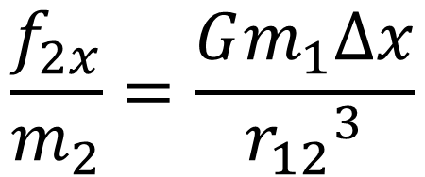









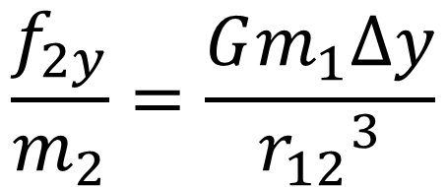


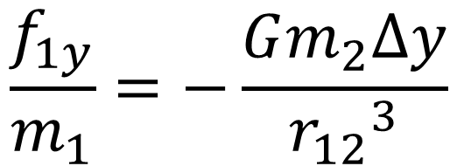
$$\left(x_{1},y_{1}\right)$$
$$y$$
$$∆x=x_{1}−x_{2}$$
$$(pos)$$
$$m_{1}$$
$$∆y=y_{1}−y_{2}$$
$$(pos)$$
$$r_{12}$$
$$r_{AB}=\sqrt{{\left(∆y\right)}^{2}+{\left(∆y\right)}^{2}}$$
$$\left(x_{2},y_{2}\right)$$
$f_{1}$ $(neg)$
$$m_{2}$$
$$x$$
$$M$$
$$\frac{f_{2x}}{m_{2}}=\frac{Gm_{1}∆x}{{r_{12}}^{3}}$$
$$\frac{f_{1x}}{m_{1}}=−\frac{Gm_{2}∆x}{{r_{12}}^{3}}$$
$$\frac{f_{2y}}{m_{2}}=\frac{Gm_{1}∆y}{{r_{12}}^{3}}$$
$$\frac{f_{1y}}{m_{1}}=−\frac{Gm_{2}∆y}{{r_{12}}^{3}}$$

Slide 12
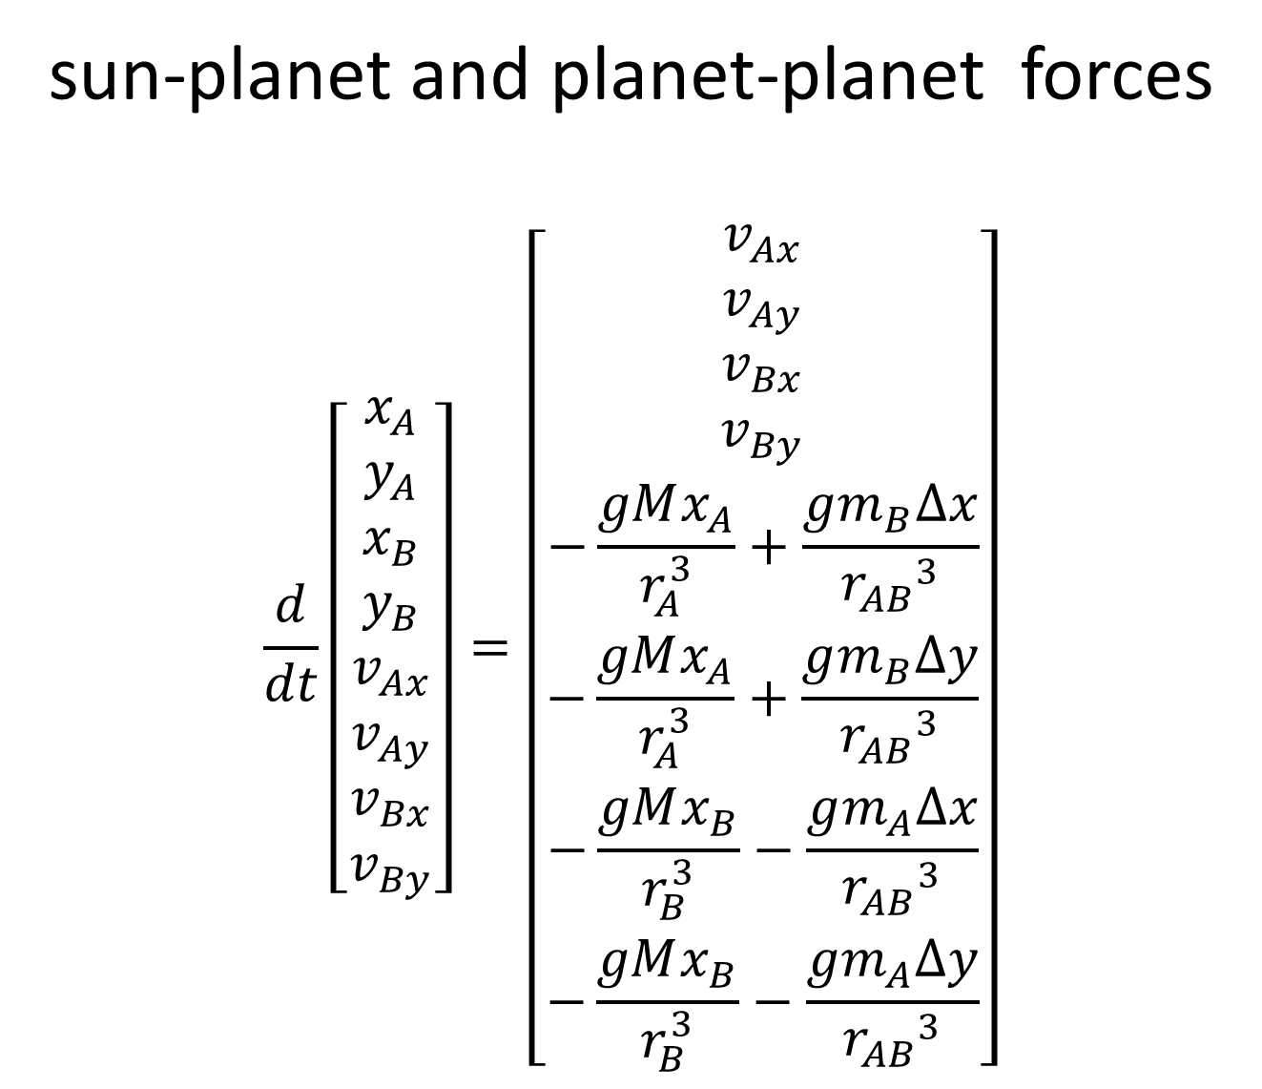
sun-planet and planet-planet forces
$$\frac{d}{dt}\left[\begin{matrix}x_{A} \\ y_{A} \\ x_{B} \\ y_{B} \\ v_{Ax} \\ v_{Ay} \\ v_{Bx} \\ v_{By}\end{matrix}\right]=\left[\begin{matrix}v_{Ax} \\ v_{Ay} \\ v_{Bx} \\ v_{By} \\ −\frac{gMx_{A}}{r_{A}^{3}}+\frac{gm_{B}∆x}{{r_{AB}}^{3}} \\ −\frac{gMx_{A}}{r_{A}^{3}}+\frac{gm_{B}∆y}{{r_{AB}}^{3}} \\ −\frac{gMx_{B}}{r_{B}^{3}}−\frac{gm_{A}∆x}{{r_{AB}}^{3}} \\ −\frac{gMx_{B}}{r_{B}^{3}}−\frac{gm_{A}∆y}{{r_{AB}}^{3}}\end{matrix}\right]$$

Slide 13
# u0 u1 u2 u3 u4 u5 u6 u7
# x1 y1 x2 y2 vx1 vy1 vx2 vy2
def myfun( t, u ):
f = np.zeros((8,));
f[0] = u[4];
f[1] = u[5];
f[2] = u[6];
f[3] = u[7];
R1 = sqrt((u[0]**2) + (u[1]**2));
R2 = sqrt((u[2]**2) + (u[3]**2));
dx = u[0]-u[2];
dy = u[1]-u[3];
R12 = sqrt((dx**2) + (dy**2));
q1 = -G*Ms/(R1**3);
q2 = -G*Ms/(R2**3);
q12 = -G*Mp2/(R12**3);
q21 = -G*Mp1/(R12**3);
c=1.0; # coupling between planets
f[4] = u[0]*q1 + c*dx*q12;
f[5] = u[1]*q1 + c*dy*q12;
f[6] = u[2]*q2 - c*dx*q21;
f[7] = u[3]*q2 - c*dy*q21;
return(f);

Slide 14
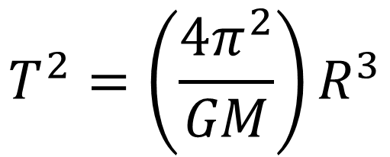
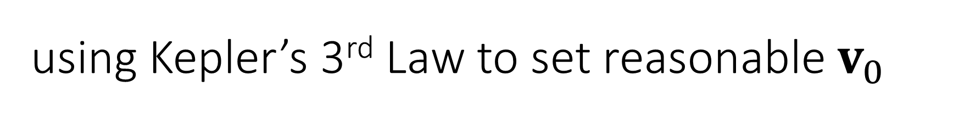
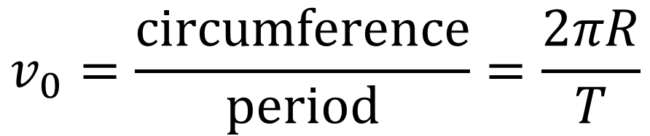
using Kepler’s 3rd Law to set reasonable $v_{0}$
for 1 planet with a circular orbit
$$T^{2}=\left(\frac{4π^{2}}{GM}\right)R^{3}$$
$$v_{0}=\frac{circumference}{period}=\frac{2πR}{T}$$

Slide 15

















if( MYCASE == 0 ):
q1 = 0.0; # angle (with respect to x-axis in rads) of planet 1 (u0[0] = cos(q1)*Rp1; u0[1] = sin(q1)*Rp1)
q2 = 0.0; # angle (with respect to x-axis in rads) of planet 2 (u0[2] = cos(q2)*Rp2; u0[3] = sin(q2)*Rp2)
fR = 0.95; # planet 2 has this fraction of its normal radius (Rp2 = fR*Rp1)
sv2 = -1.0; # sign of planet 2 velocity (sv2)
fv2 = 1.0; # planet 2 has this fraction of its normal velocity (u0[7] = fv2*sv2*Vp2)
fM2 = 1.0; # planet 2 has this fraction of its normal mass (Mp2 = fM2*Mp1)
setup
CASE 0
$$y$$
$$y$$
$$v_{y1}$$
$$v_{y1}$$
circular orbit
$$r_{1}$$
$$m_{1}$$
$$v_{y2}$$
5% difference in radii
$$θ_{1}$$
$$θ_{2}$$
$$x$$
$$m_{1}=m_{2}$$
$$x$$
$$r_{2}$$
$$m_{2}$$
$$M$$
$$M$$
$$v_{y2}$$
circular orbit

Slide 16
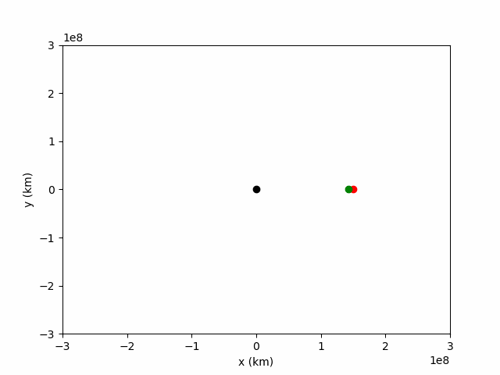
u0: [ 1.500e+11 0.0
1.425e+11 0.0
0.0 2.96e+04
0.0 -3.04e+04]
x axis bigger radius
x axis smaller radius
going towards +y, smaller velocity
going towards -y, bigger velocity
velocities set for circular orbits

Slide 17
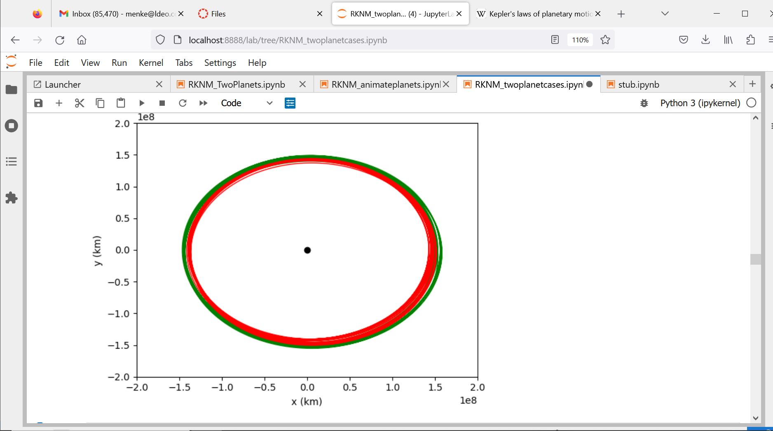

Slide 18
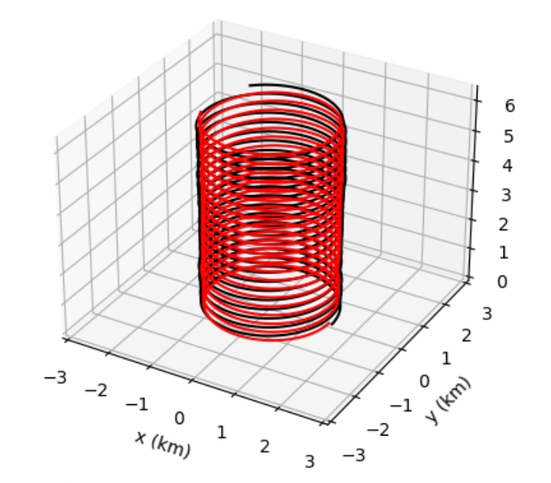
time

Slide 19
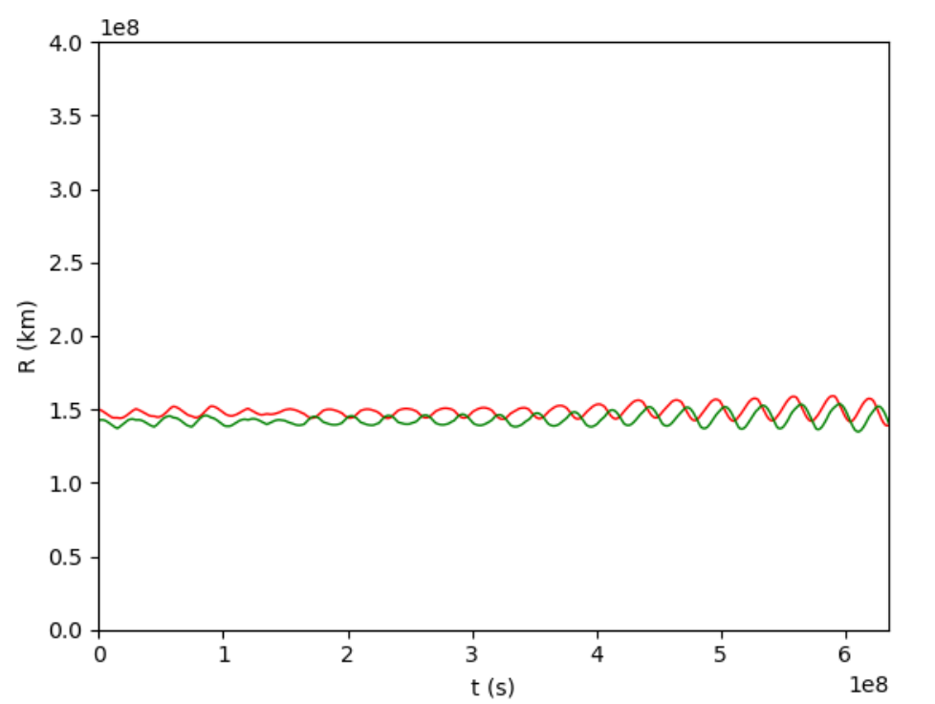

Slide 20
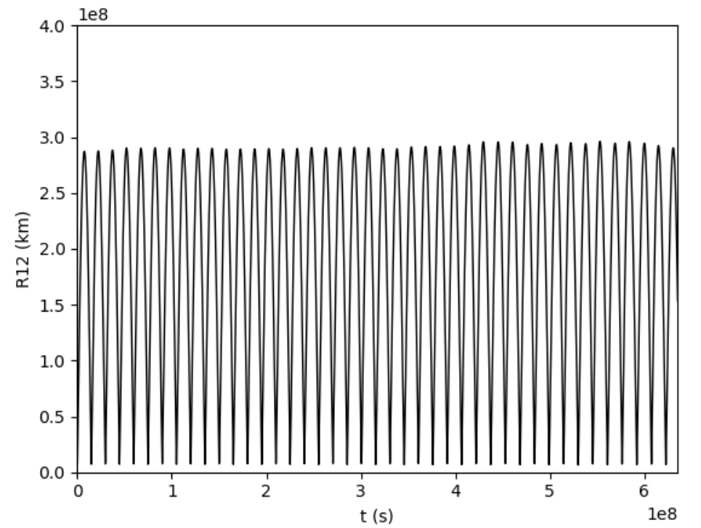

Slide 21
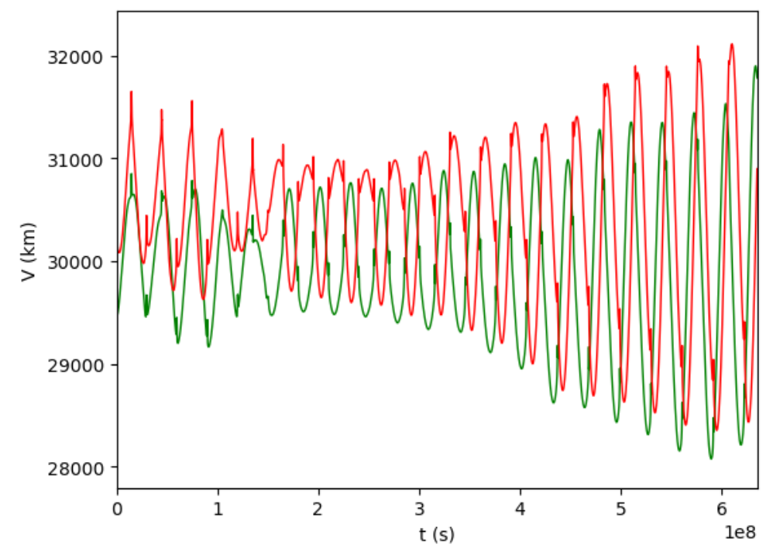

Slide 22
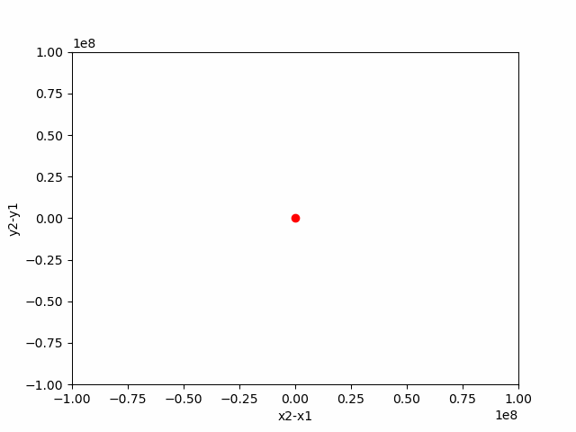
zoom of one close-encounter interaction
moving coordinate system centered on planet 1

Slide 23
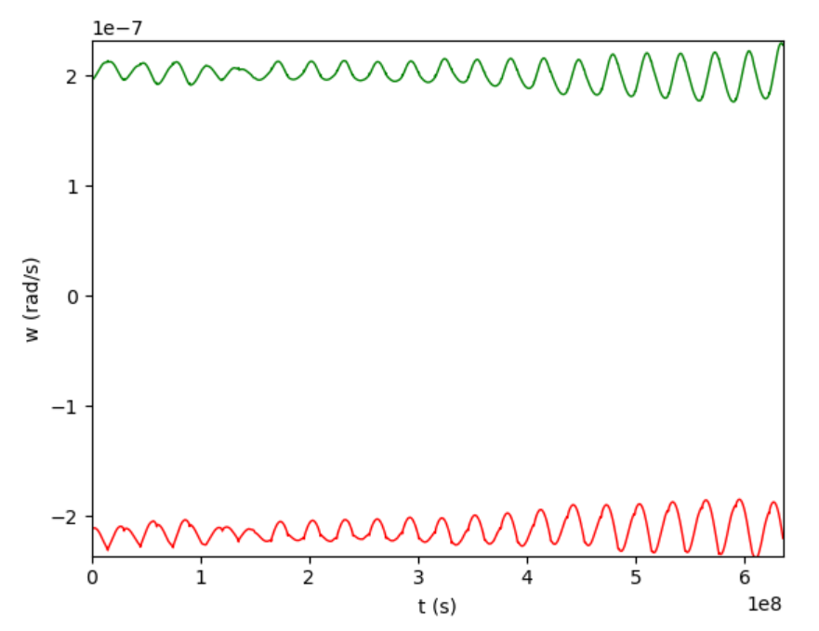
angular velocity
tells you how its circling the sun
sign tells you whether motion is clockwise (+) or counterclockwise (-)

Slide 24
conda install -c anaconda pillow
might need to use anaconda to install pillow

