Slide 1
2025 EESC W3400
Computational Earth Science
Lec 05: Reservoir models illustrated by cascade of lakes

Slide 2
today:
Reservoir Models

Slide 3
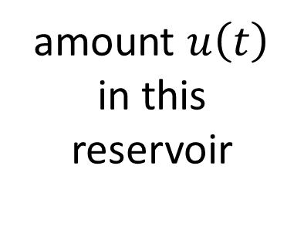
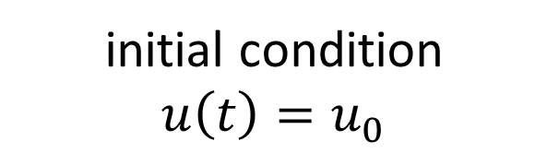

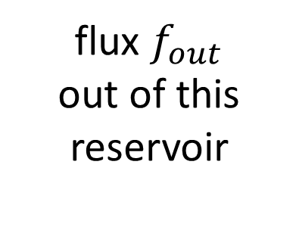
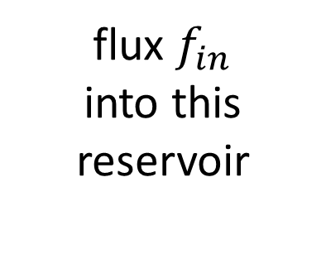
Reservoir
flux in
flux out
amount $u\left(t\right)$
in this reservoir
flux $f_{in}$
into this reservoir
flux $f_{out}$
out of this reservoir
differential
equation
$$\frac{d}{dt}u\left(t\right)=f_{in}−f_{out}$$
initial condition
$u\left(t\right)=u_{0}$

Slide 4
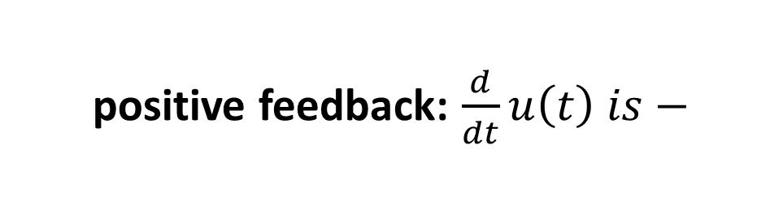
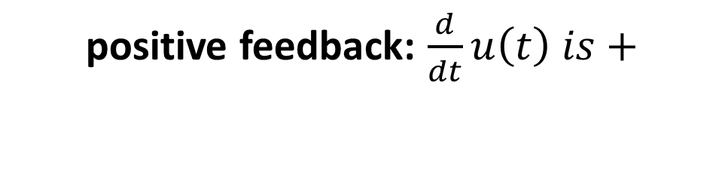
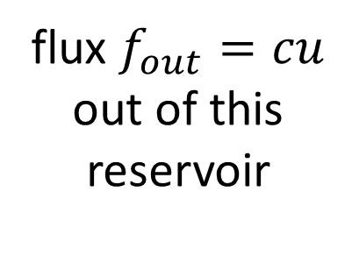
Feedback:
flux depends on amount
Reservoir
flux in
flux out
amount $u\left(t\right)$
in this reservoir
flux $f_{in}$
into this reservoir
flux $f_{out}=cu$
out of this reservoir
positive feedback: $\frac{d}{dt}u\left(t\right) is+$
positive feedback: $\frac{d}{dt}u\left(t\right) is−$

Slide 5


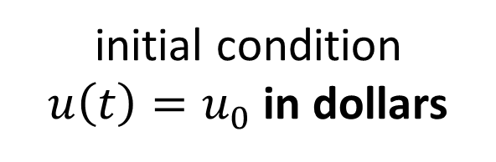

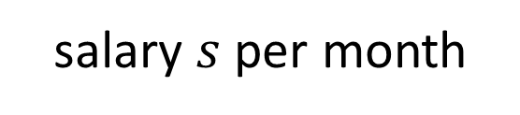
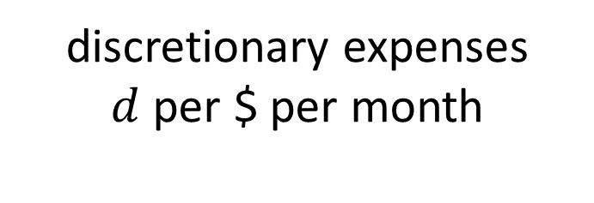

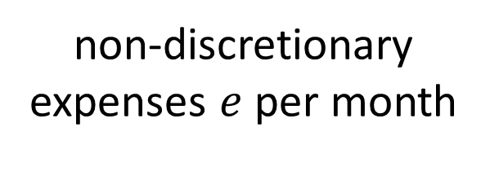
Bank Account
flux out
flux in
non-discretionary expenses $e$ per month
salary $s$ per month
amount $u\left(t\right)$
in $
in this reservoir
discretionary expenses
$d$ per $ per month
interest $r$ per $ per month
$$f_{in}=s+ru$$
$$f_{out}=e+du$$
initial condition
$u\left(t\right)=u_{0}$ in dollars

Slide 6
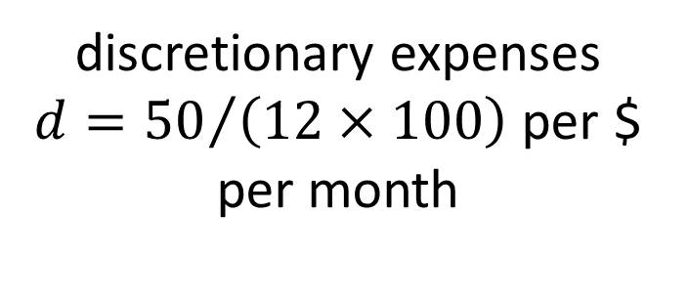
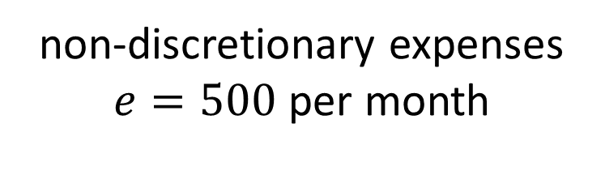
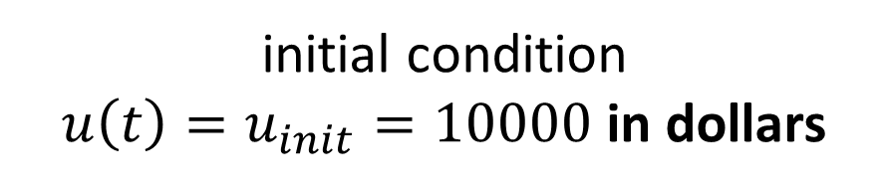
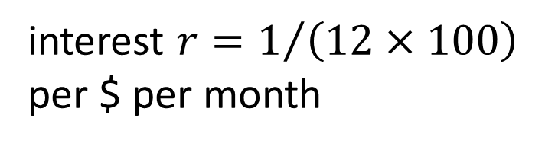
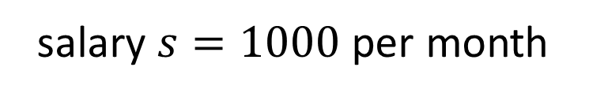
Reservoir
flux out
non-discretionary expenses $e=500$ per month
flux in
salary $s=1000$ per month
amount $u\left(t\right)$
in $
in this reservoir
discretionary expenses
$d={50}/{\left(12×100\right)}$ per $ per month
interest $r=1/{\left(12×100\right)}$
per $ per month
initial condition
$u\left(t\right)=u_{init}=10000$in dollars

Slide 7
M=1; # one variable
balance0 = 10000.0; # initial balance
salary = 1000.0; # salary in $/mo
nondis = 500.0; # non-discretionary spending in $/mo
interest = 1.0/(100.0*12); # interest in fraction of balance per month
discetionary = 50.0/(100.0*12.0); # discretionary spending in fraction of balance per month
# equation for balance u
# d/dt u = salary - nondis + interest*u - dis*u;
def myfun( t, u ):
f = np.zeros((M,));
f[0] = salary - nondis + interest*u[0] - discetionary*u[0];
return f;
# initial conditions
u0 = np.zeros((M,));
u0[0] = balance0;

Slide 8
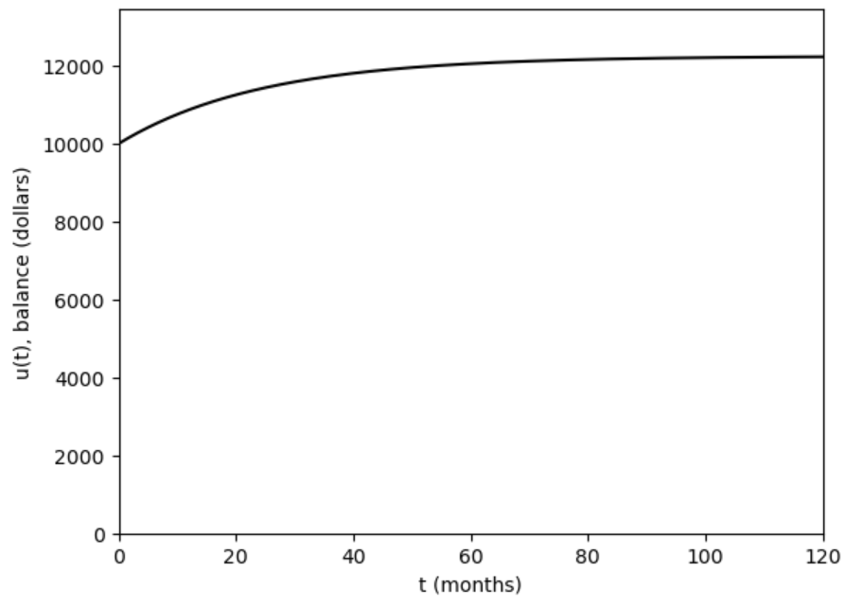
discretionary = 50.0/(100.0*12.0); # discretionary spending in fraction of balance per month

Slide 9
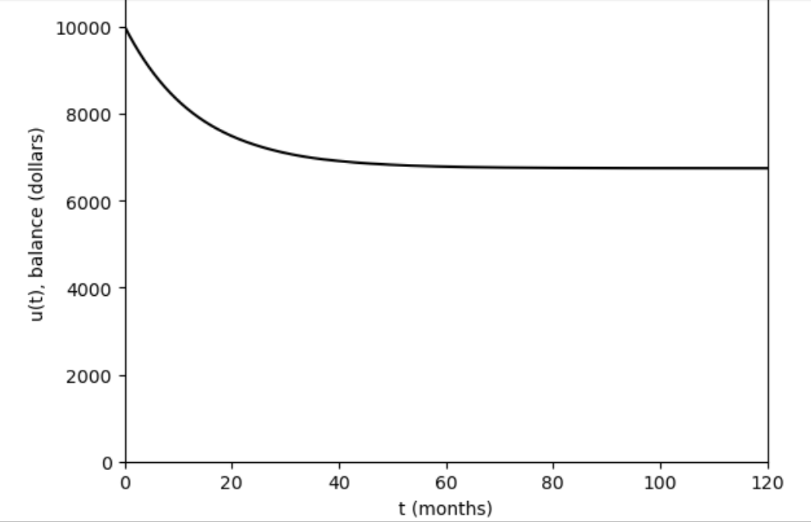
discretionary = 90.0/(100.0*12.0); # discretionary spending in fraction of balance per month

Slide 10


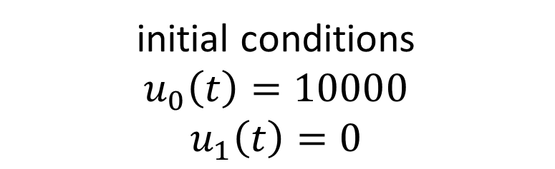
your balance
flux out
flux in
salary
non-discretionary
amount $u_{0}\left(t\right)$
in $
in this reservoir
vendor’s balance
interest
discretionary
amount${ u}_{1}\left(t\right)$
in $
in this reservoir
interest
initial conditions
$$u_{0}\left(t\right)=10000$$
$$u_{1}\left(t\right)=0$$

Slide 11
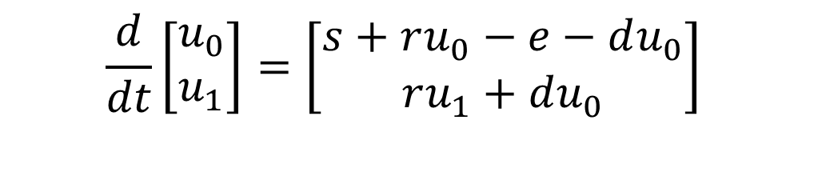
$$\frac{d}{dt}\left[\begin{matrix}u_{0} \\ u_{1}\end{matrix}\right]=\left[\begin{matrix}s+ru_{0}−e−du_{0} \\ ru_{1}+du_{0}\end{matrix}\right]$$

Slide 12
you lose your discretionary spending
$$\frac{d}{dt}\left[\begin{matrix}u_{0} \\ u_{1}\end{matrix}\right]=\left[\begin{matrix}s+ru_{0}−e−du_{0} \\ ru_{1}+du_{0}\end{matrix}\right]$$
vendor gains your discretionary spending

Slide 13
M=2; # two variables
balance0 = 10000.0; # initial balance
balance1 = 0.0; # initial balance of vendor
salary = 1000.0; # salary in $/mo
nondis = 500.0; # non-discretionary spending in $/mo
interest = 1.0/(100.0*12); # interest in fraction of balance per month
discretionary = 90.0/(100.0*12.0); # discretionary spending in fraction of balance per month
def myfun( t, u ):
f = np.zeros((M,));
f[0] = salary - nondis + interest*u[0] - discetionary*u[0];
f[1] = discretionary*u[0] + interest*u[1];
return f;
# initial conditions
u0 = np.zeros((M,));
u0[0] = balance0;
u0[0] = balance1;

Slide 14
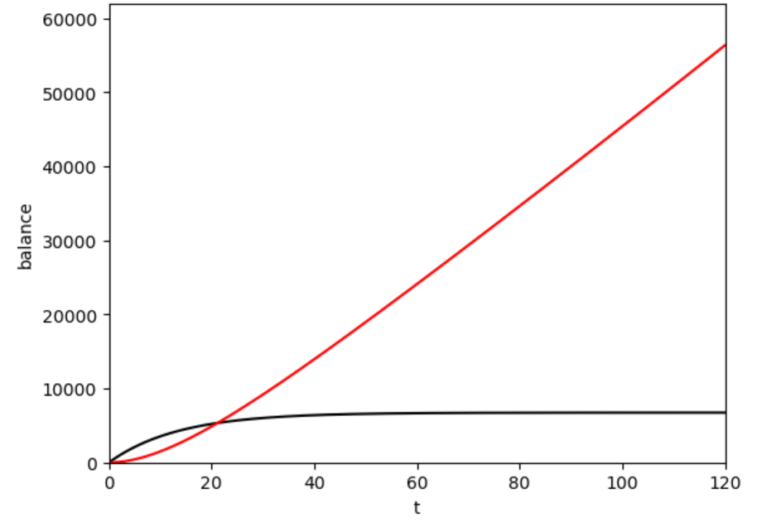
vendor’s balance
your balance

Slide 15
note time delay:
takes a while before vendor has more $ than you
vendor’s balance
your balance

Slide 16
lakes on a hillside
melting
glacier
seepage
thru
ground
seepage
thru
ground
seepage
thru
ground

Slide 17







lakes on a hillside
$$f_{in}$$
$$u_{0}$$
$$\left({c/u}_{ref}\right)\left({u_{0}/u}_{ref}\right)$$
$$u_{1}$$
$$\left(cu_{ref}\right)\left({u_{1}/u}_{ref}\right)$$
$$u_{2}$$
$$\left(cu_{ref}\right)\left({u_{2}/u}_{ref}\right)$$

Slide 18


differential
equation
$$\frac{d}{dt}\left[\begin{matrix}u_{0} \\ u_{1} \\ u_{2}\end{matrix}\right]=\left[\begin{matrix}u_{in}−cu_{0} \\ cu_{0}−cu_{1} \\ cu_{1}−cu_{2}\end{matrix}\right]$$
$$at time t=0 \left[\begin{matrix}u_{0} \\ u_{1} \\ u_{2}\end{matrix}\right]=\left[\begin{matrix}0 \\ 0 \\ 0\end{matrix}\right]$$
initial
condition

Slide 19
what leaves lake 0
$$\frac{d}{dt}\left[\begin{matrix}u_{0} \\ u_{1} \\ u_{2}\end{matrix}\right]=\left[\begin{matrix}u_{in}−cu_{0} \\ cu_{0}−cu_{1} \\ cu_{1}−cu_{2}\end{matrix}\right]$$
flows into lake 1

Slide 20
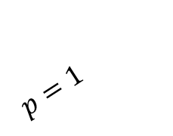


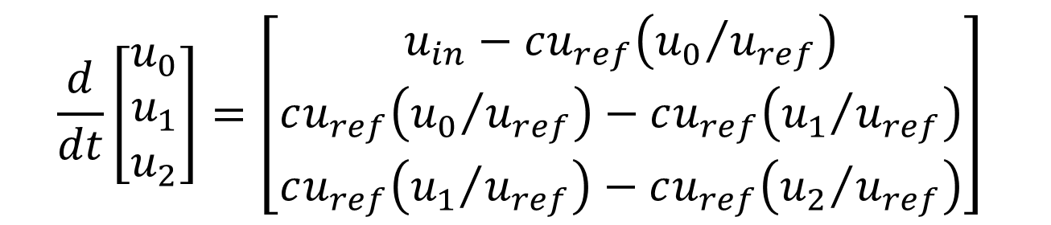
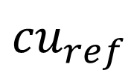
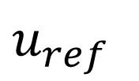

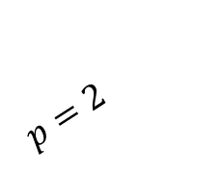
write this way instead
$$\frac{d}{dt}\left[\begin{matrix}u_{0} \\ u_{1} \\ u_{2}\end{matrix}\right]=\left[\begin{matrix}u_{in}−cu_{ref}\left({u_{0}}/{u_{ref}}\right) \\ cu_{ref}\left({u_{0}}/{u_{ref}}\right)−cu_{ref}\left({u_{1}}/{u_{ref}}\right) \\ cu_{ref}\left({u_{1}}/{u_{ref}}\right)−cu_{ref}\left({u_{2}}/{u_{ref}}\right)\end{matrix}\right]$$
so at a later time we can examine the case
$$flux=cu_{ref}{\left({u_{0}}/{u_{ref}}\right)}^{p}$$
$$flux$$
$${cu}_{ref}$$
$$p=1$$
$$p=2$$
$$u_{ref}$$
$$u_{0}$$

