Slide 1
2025 EESC W3400
Computational Earth Science
Lec 06: A Simple Model of Global Warming

Slide 2
today:
Global Warming
we are going to use Reservoir Modeling to construct
a simple model of Global Warming
that incorporates SOME of the physics of climate change

Slide 3
caveat
into order to create model within 1 lecture
my discussion of “units” is going to be very abridged
look at the code, if you’re interested in
how units are worked out

Slide 4
Choice of the main variables, t, u
t: time in seconds, but convert to days or years when plotting
u: heat content in J of a column of air 1 m² in area
T: temperature of the air calculated as needed using
heat content = specific_heat * temperature
T = u / specific_heat

Slide 5
Physical Principle 1
visible light from the sun is the main source of the Earth’s heat energy
Sunlight
ground
solar constant = 1361 W/sq-m at Equator

Slide 6
Physical Principle 2
some visible light just reflected back to space
Sunlight
ground
fraction reflected: albedo, about 30%

Slide 7
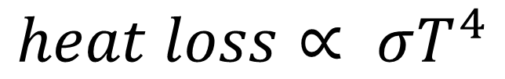

Physical Principle 3
Heat Loss doe to Infrared Radiation (IR) depends
on fourth power of temperature
HOT
$$heat loss∝ σT^{4}$$
$$σ:Stefan−Boltzman constant$$

Slide 8
Physical Principle 4
IR is absorbed in the atmosphere over a length scale about twice the thickness of the atmosphere
upper atmosphere
lower atmosphere

Slide 9
Our model of radiative heat balance
upper atmosphere
lower atmosphere

Slide 10
lower atmosphere
is warmed by
sunlight (really it warms the ground)
IR from upper atmosphere
is cooled by
Its IR radiation (to upper atmosphere)
upper atmosphere
is warmed by
IR from lower atmosphere
is cooled by
its IR radiation (to space)
upper atmosphere
lower atmosphere

Slide 11
two unknowns, u[0] and u[1]
heat content / temperature
of lower and upper atmosphere
M=2;
# Physical Constants
R = 6371000.0; # radius of earth in m
sun = 1361.0; # insolation in W/m2
daynite = 0.25 # (area capturing sunlight pi r2) / (area of earth 4 pi r2)
albedo = 0.3; # percent of sunlight reflected, dimensionless
secinday = 24.0*3600.0; # seconds in a day
massatm = 5.15E18; # mass of atmosphere in kg
areaatm = 4*pi*(R**2); # surface area of Earth, im m2
masscol = massatm/areaatm; # mass of 1-sq-m column of air
masshalf = 0.5*masscol; # mass of half of column of air
specificheat = 1005.0 # heat capacity of air in J / (kg-K)
stefanboltzman = 5.67E-8; # S-B constant in W / (m2 K4)
p=4; # exponent of temperature in S-B law

Slide 12
M=2;
# Physical Constants
R = 6371000.0; # radius of earth in m
sun = 1361.0; # insolation in W/m2
daynite = 0.25 # (area capturing sunlight pi r2) / (area of earth 4 pi r2)
albedo = 0.3; # percent of sunlight reflected, dimensionless
secinday = 24.0*3600.0; # seconds in a day
massatm = 5.15E18; # mass of atmosphere in kg
areaatm = 4*pi*(R**2); # surface area of Earth, im m2
masscol = massatm/areaatm; # mass of 1-sq-m column of air
masshalf = 0.5*masscol; # mass of half of column of air
specificheat = 1005.0 # heat capacity of air in J / (kg-K)
stefanboltzman = 5.67E-8; # S-B constant in W / (m2 K4)
p=4; # exponent of temperature in S-B law
Solar constant

Slide 13
M=2;
# Physical Constants
R = 6371000.0; # radius of earth in m
sun = 1361.0; # insolation in W/m2
daynite = 0.25 # (area capturing sunlight pi r2) / (area of earth 4 pi r2)
albedo = 0.3; # percent of sunlight reflected, dimensionless
secinday = 24.0*3600.0; # seconds in a day
massatm = 5.15E18; # mass of atmosphere in kg
areaatm = 4*pi*(R**2); # surface area of Earth, im m2
masscol = massatm/areaatm; # mass of 1-sq-m column of air
masshalf = 0.5*masscol; # mass of half of column of air
specificheat = 1005.0 # heat capacity of air in J / (kg-K)
stefanboltzman = 5.67E-8; # S-B constant in W / (m2 K4)
p=4; # exponent of temperature in S-B law
Specific heat

Slide 14
M=2;
# Physical Constants
R = 6371000.0; # radius of earth in m
sun = 1361.0; # insolation in W/m2
daynite = 0.25 # (area capturing sunlight pi r2) / (area of earth 4 pi r2)
albedo = 0.3; # percent of sunlight reflected, dimensionless
secinday = 24.0*3600.0; # seconds in a day
massatm = 5.15E18; # mass of atmosphere in kg
areaatm = 4*pi*(R**2); # surface area of Earth, im m2
masscol = massatm/areaatm; # mass of 1-sq-m column of air
masshalf = 0.5*masscol; # mass of half of column of air
specificheat = 1005.0 # heat capacity of air in J / (kg-K)
stefanboltzman = 5.67E-8; # S-B constant in W / (m2 K4)
p=4; # exponent of temperature in S-B law
Stefan-Boltzman
constant

Slide 15
# time axis
Dtday = 1.0
Dtsec = Dtday * secinday;
t0day = 0.0;
t0sec = t0day * secinday;
tmaxday = 1000.0;
tmaxsec = tmaxday * secinday;
tday = np.arange(t0day, t0day+tmaxday, Dtday);
tsec = tday * secinday;
N,=np.shape(tday);
(time vector in days)

Slide 16
# time axis
Dtday = 1.0
Dtsec = Dtday * secinday;
t0day = 0.0;
t0sec = t0day * secinday;
tmaxday = 1000.0;
tmaxsec = tmaxday * secinday;
tday = np.arange(t0day, t0day+tmaxday, Dtday);
tsec = tday * secinday;
N,=np.shape(tday);
(time vector in seconds)

Slide 17
def myfun( t, u ):
solarconstant = sun * daynite * (1.0-albedo);
T = u / (specificheat*masshalf);
f = np.zeros((M,));
f[0] = solarconstant - stefanboltzman*(T[0]**p) + stefanboltzman*(T[1]**p);
f[1] = stefanboltzman*(T[0]**p) - 2.0*stefanboltzman*(T[1]**p);
return f;
upper atmosphere
lower atmosphere

Slide 18
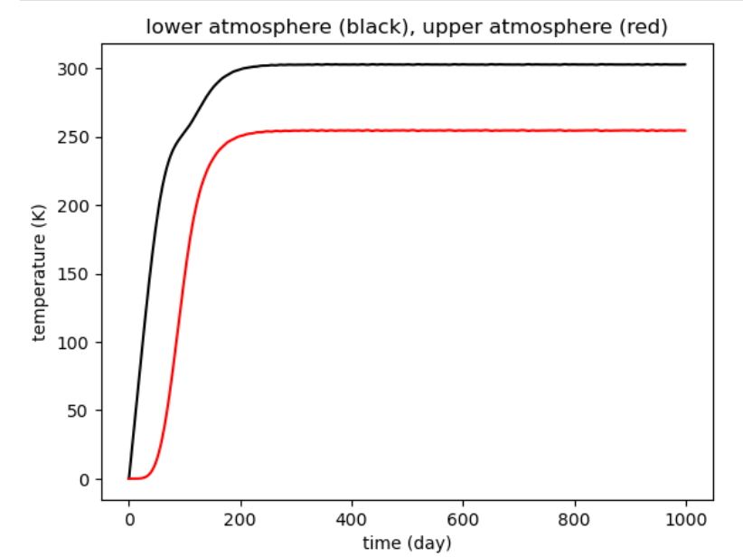
u[0]
Bottom Reservoir
u[1]
Top Reservoir

Slide 19
u[0]
Bottom Reservoir
u[1]
Top Reservoir
greenhouse effect
lower atmosphere is hotter than upper atmosphere

Slide 20
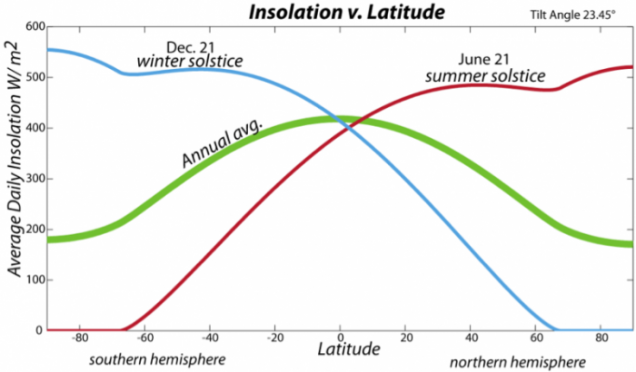
Physical Principle 5
because of the curvature of the Earth
the poles get less sunlight than the equator
Sunlight
equator
pole

Slide 21
Improved model of radiative heat balance
reduced
upper atmosphere
upper atmosphere
u[1]
u[3]
lower atmosphere
lower atmosphere
u[0]
u[2]
“equatorial” latitudes
“polar” latitudes

Slide 22
reduction = 0.4; # reduction of sun at higher latitudes
zone0 = 1.0+reduction; # enhancement of sunlight at equator
zone1 = 1.0-reduction; # reduction of sunlight at poles
reduction of sunlight at poles
relative to equator (fairly correct)

Slide 23
what to do
increase M to 4
add two lines to myfun that set f[2] and f[3]
they should be analogous to f[0] and f[1]
except
solarconstant is increased/reduced
also add two line to figure section to plot
u[2] in green
u[3] in blue

Slide 24
def myfun( t, u ):
solarconstant = sun * daynite * (1.0-albedo); # average insolatiojn of earth's surface
f = np.zeros((M,));
T = u / (specificheat*masshalf); # temperature
f[0] = solarconstant*zone0 - stefanboltzman*(T[0]**p) + stefanboltzman*(T[1]**p);
f[1] = stefanboltzman*(T[0]**p) - 2.0*stefanboltzman*(T[1]**p);
f[2] = solarconstant*zone1 - stefanboltzman*(T[2]**p) + stefanboltzman*(T[3]**p);
f[3] = stefanboltzman*(T[2]**p) - 2.0*stefanboltzman*(T[3]**p);
return f;

Slide 25
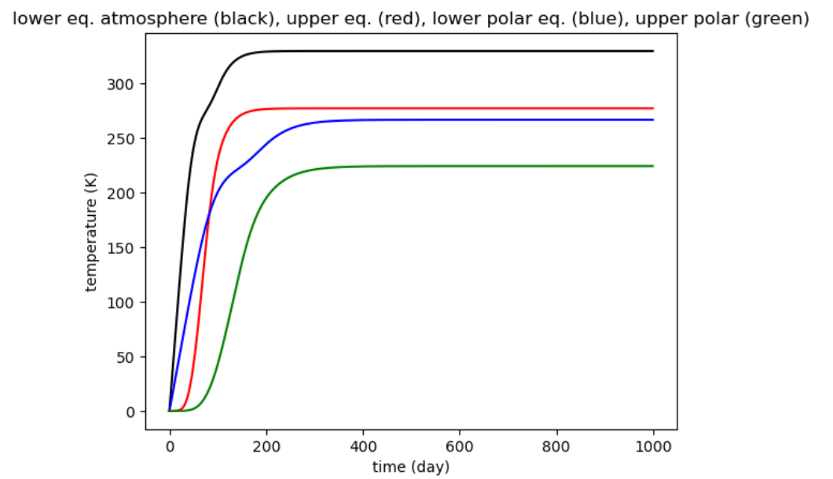

Slide 26
Physical Principle 6
temperature differences between equator and poles
cause winds that move heat poleward
Hadley Cell
(we’re ignoring the Ferrel cell)
equator
pole

Slide 27
we will assume that strength of wind depends linearly
on temperature difference between equator and pole
# parameterization of wind
# wind velocity depends on avarage temperature gradient
# velocity = Vwind * DELTAT where DELTAT = (T(0)+T(1)-T(2)-T(3))/2.0
Vwind = 0.1; # 50 K difference gives 5 m/s wind velocity (about right for Hadley cell)
# heat transport = Hwind * T where Hwind = specificheat * masshalf * Vwind / width
Hwind = specificheat * masshalf * Vwind / width;

Slide 28
upper atmosphere
upper atmosphere
u[1]
u[3]
lower atmosphere
lower atmosphere
u[0]
u[2]
low latutude
high latitude
DELTAT = u[0]+u[1]-u[2]-u[3])/2
heat flux fin into this box from that = Hwind*T[that]
heat flux fout out of this box = -Hwind*T[this]

Slide 29
what to do
define Hwind
inside myfun
calculate wind
add TWO terms to each of f[0], f[1], f[2], f[3]
one of which is a fin and the other an fout
check signs and this’s and that’s
upper atmosphere
upper atmosphere
u[1]
u[3]
lower atmosphere
lower atmosphere
u[0]
u[2]
low latutude
high latitude

Slide 30
def myfun( t, u ):
solarconstant = sun * daynite * (1.0-albedo); # average insolatiojn of earth's surface
f = np.zeros((M,));
T = u / (specificheat*masshalf); # temperature
DELTAT = 0.5 * ( T[0] + T[1] - T[2] - T[3] ); # mean gradient in temperature
wind = Hwind * DELTAT; # wind heat transport
f[0] = solarconstant*zone0 - stefanboltzman*(T[0]**p) + stefanboltzman*(T[1]**p) - wind*T[0] + wind*T[2];
f[1] = stefanboltzman*(T[0]**p) - 2.0*stefanboltzman*(T[1]**p) - wind*T[1] + wind*T[0];
f[2] = solarconstant*zone1 - stefanboltzman*(T[2]**p) + stefanboltzman*(T[3]**p) - wind*T[2] + wind*T[3];
f[3] = stefanboltzman*(T[2]**p) - 2.0*stefanboltzman*(T[3]**p) - wind*T[3] + wind*T[1];
return f;
leaving this reservoir to that reservoir
entering this reservoir from that reservoir

Slide 31
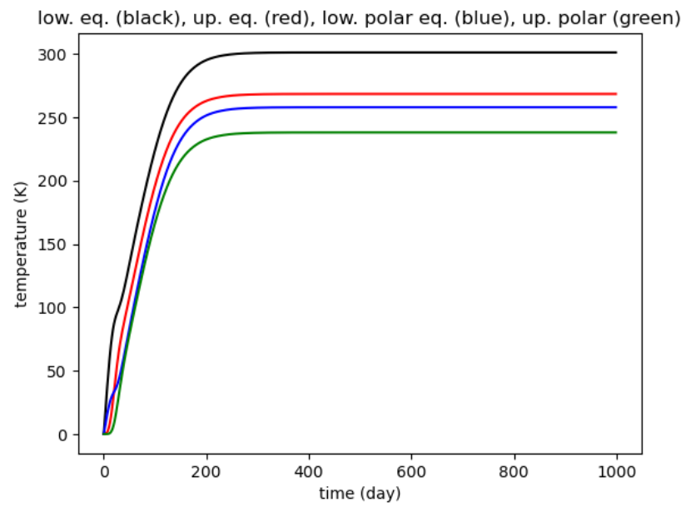

Slide 32
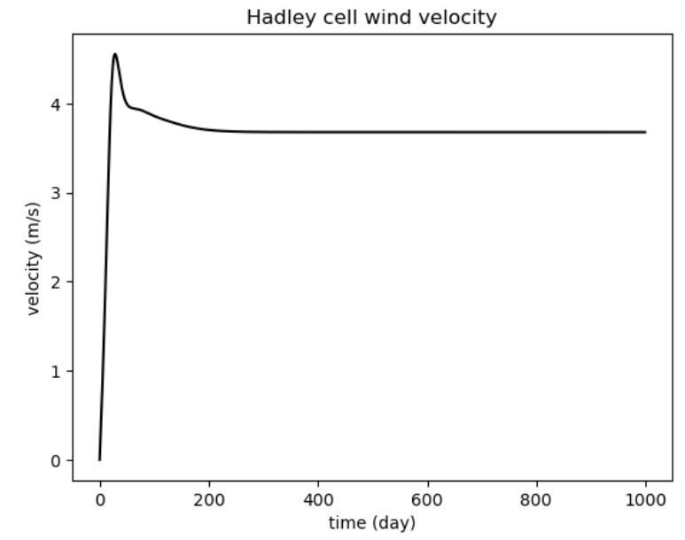

Slide 33
Physical Principle 7
seasons have a big affect on solar insolation
at high latitudes but not so much at low latitudes

Slide 34
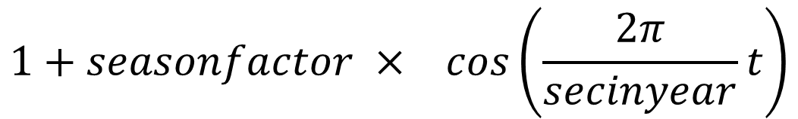
seasonal amplitude (polar solar flux only)
# seasonality
seasonfactor = 0.4;
secinyear = secinday*365.25;
seasonal period (one year)
solar insolation adjusted by multiplying by
$$1+seasonfactor × cos\left(\frac{2π}{secinyear}t\right)$$

Slide 35
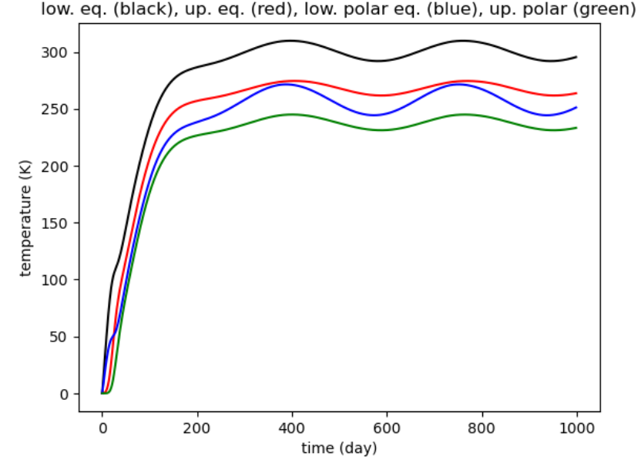

Slide 36
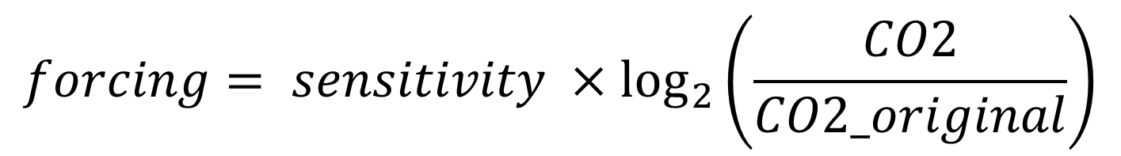
Physical Principle 8
increased IR absorption by anthropogenic CO2
is approximately equivalent to an increased solar constant
doubling of atmospheric CO2
is approximately equivalent to the solar constant increasing by
a sensitivity of 5 W/m²
out of 1351 W/m²
$$forcing= sensitivity ×\log_{2}\left(\frac{CO2}{CO2_original}\right)$$

Slide 37
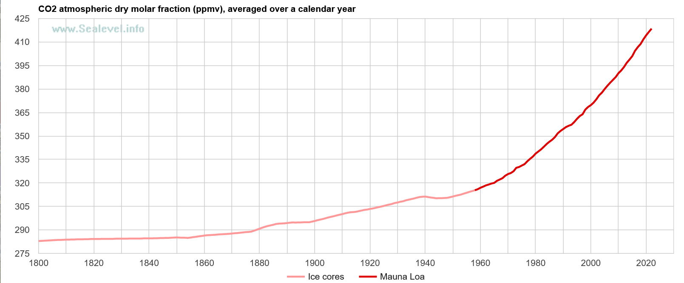
Physical Principle 9
burning of fossil fuels increase the CO2 in the atmosphere
315 in 1954
427
today

Slide 38
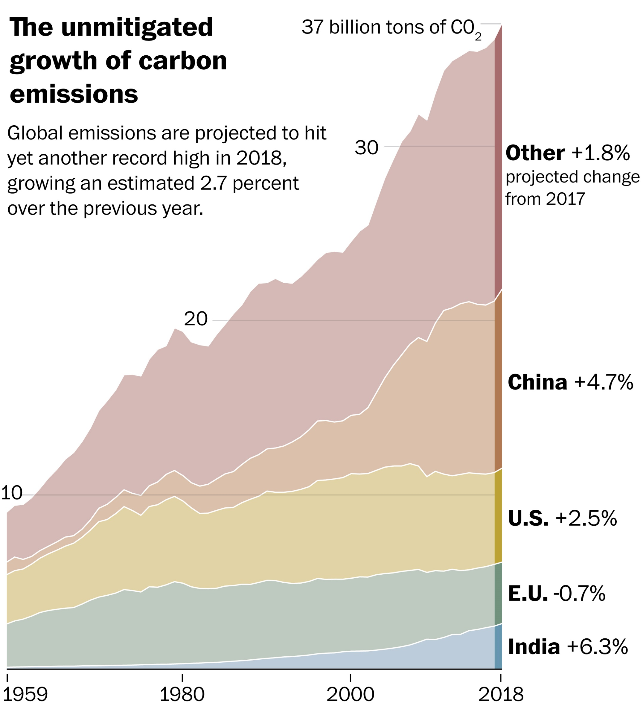


Slide 39
Keep track of CO2 by creating a fifth reservoir: CO2 in kg in the global almosphere
u[4] is CO2
M = 5;
# antropogenic C02 release
initialCO2 = 3341E12; # 3341 gigatonnes converted to kg (same as 427 ppm)
burning = 37E12 / secinyear; # 37 gigatonnes per year converted to kg/s
sensitivity = 5.0; # increase in solar constant for doubling of CO2

Slide 40
what to do
increase M to five
define burning and sensitivity;
inside myfun
add forcing to solar flux
add line that defines f[4] equal to rate of burning

Slide 41
def myfun( t, u ):
season = (1.0 + seasonfactor*cos((2*pi/secinyear)*t));
if( force ):
if( u[4] > 0 ):
forcing= sensitivity*log2(u[4]/initialCO2);
else:
forcing = 0.0;
else:
forcing = 0.0;
solarconstant = (sun+forcing) * daynite * (1.0-albedo); # average insolatiojn of earth's surface
f = np.zeros((M,));
T = u / (specificheat*masshalf); # temperature
DELTAT = 0.5 * ( T[0] + T[1] - T[2] - T[3] ); # mean gradient in temperature
wind = Hwind * DELTAT; # wind heat transport
f[0] = solarconstant*zone0 - stefanboltzman*(T[0]**p) + stefanboltzman*(T[1]**p) - wind*T[0] + wind*T[2];
f[1] = stefanboltzman*(T[0]**p) - 2.0*stefanboltzman*(T[1]**p) - wind*T[1] + wind*T[0];
f[2] = solarconstant*zone1*season - stefanboltzman*(T[2]**p) + stefanboltzman*(T[3]**p) - wind*T[2] + wind*T[3];
f[3] = stefanboltzman*(T[2]**p) - 2.0*stefanboltzman*(T[3]**p) - wind*T[3] + wind*T[1];
f[4] = burning;
return f;

Slide 42
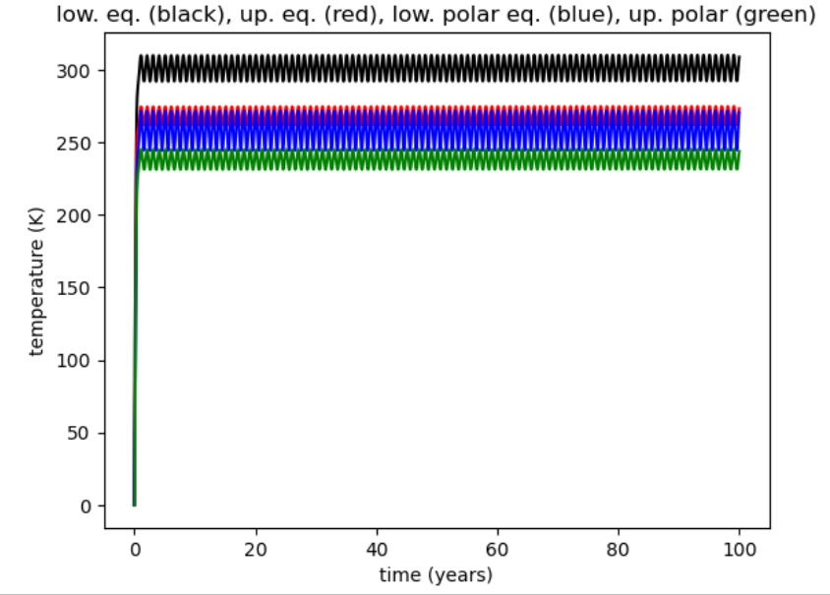

Slide 43
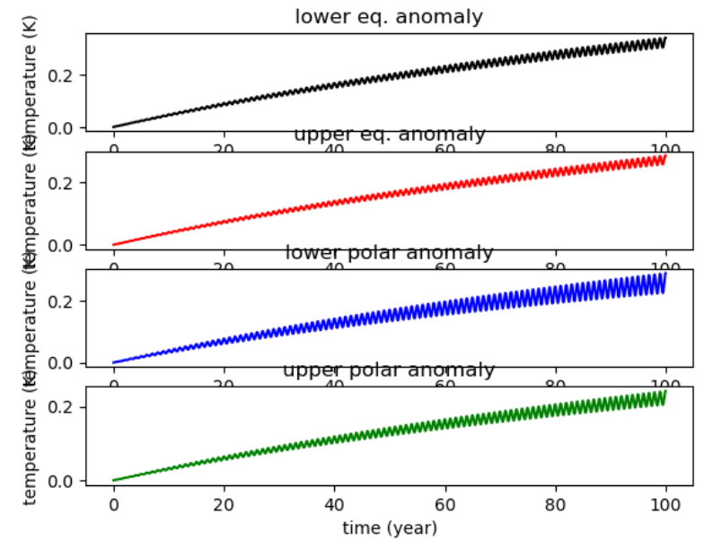
Plot anomaly
by differencing
two simulations
with and without
an effect
(easy to put IF
statement in code
to include / exclude effect)

Slide 44
Why the small oscillations?
Numerical
instability
of method?
Real behavior
representing
some oscillation
of heat between
reservoirs?

Slide 45
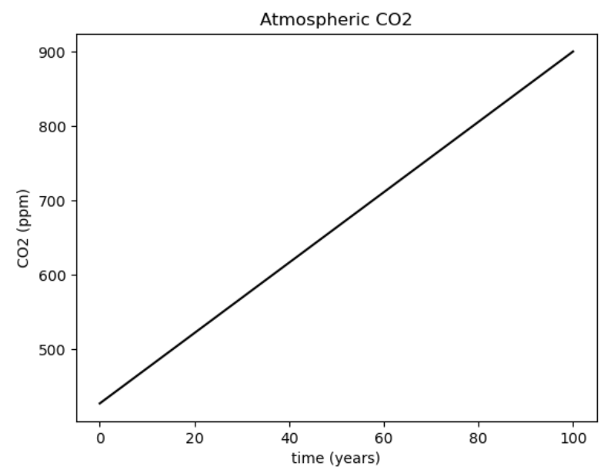

Slide 46
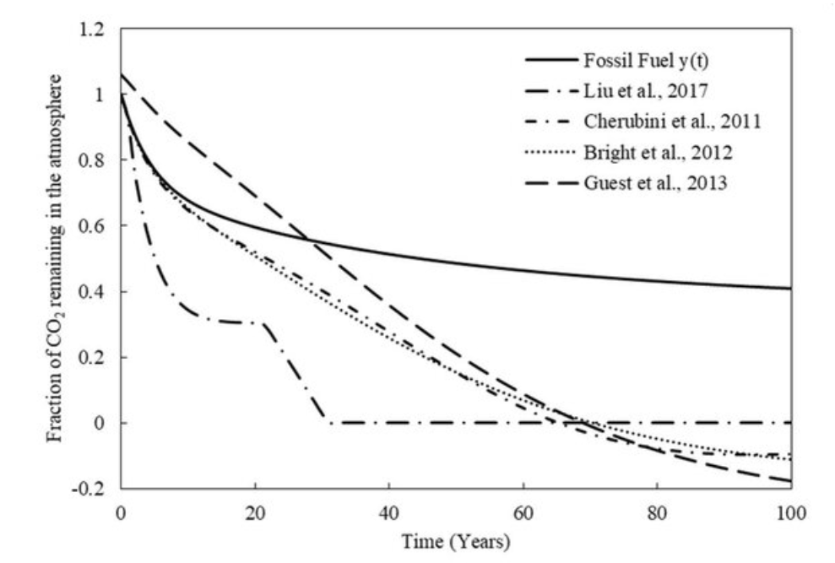
Physical Principle 10
excess CO2 is eventually absorbed by the Ocean (and biosphere) atmosphere
looks vaguely like
exponential decay
so rate of absorption
proportional to amount

Slide 47
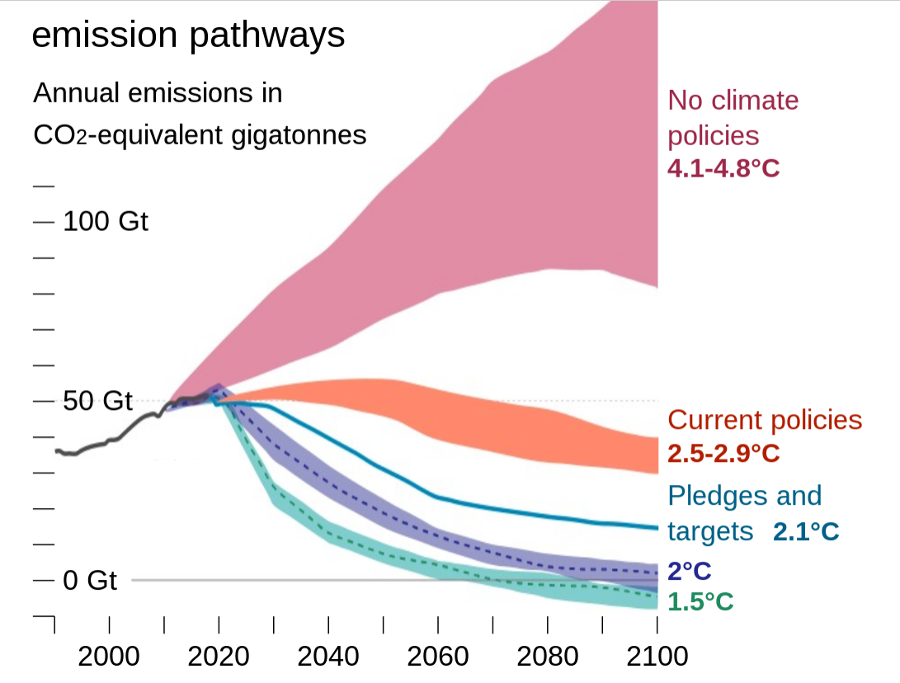
Physical Principle 11
it is possible that we might stop emitting CO2
suppose that we stop after Tstop

Slide 48
Tstopyear = 200.0; # no release after this time
Tstopsec = Tstopyear * secinyear;
# ocean uptake: rate depends on excess CO2
uptakerate= 1.0 / (200.0 * secinyear);
def myfun( t, u ):
… lines not hown here …
uptake = uptakerate*(u[4]-initialCO2);
if( uptake<0.0 ):
uptake=0.0;
f[4] = burning*(t<Tstopsec)- uptake;
return f;

Slide 49
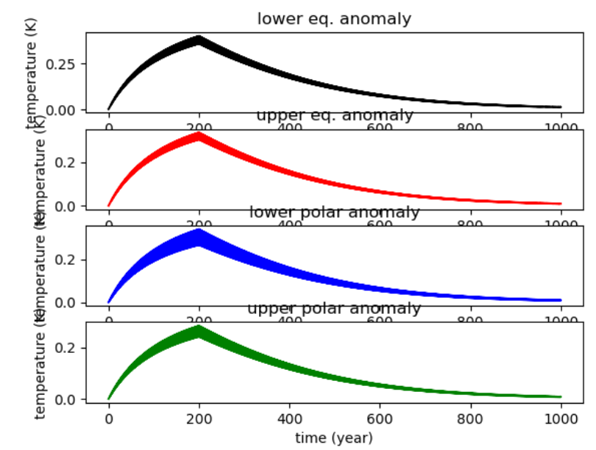

Slide 50
