Slide 1
2025 EESC W3400
Computational Earth Science
Lec 08: Cooling of the Solid Earth

Slide 2
today:
follow-up on seismic waves
cooling of the Earth

Slide 3
follow-up on seismic waves

Slide 4
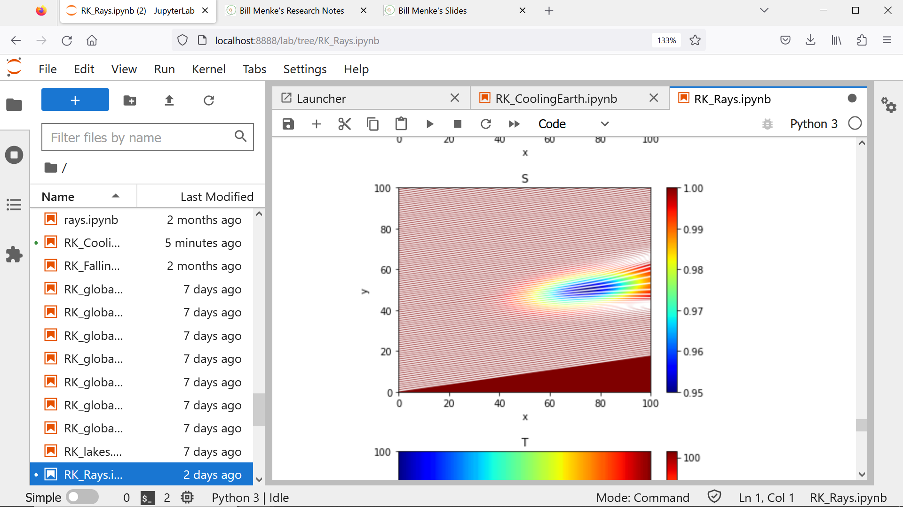
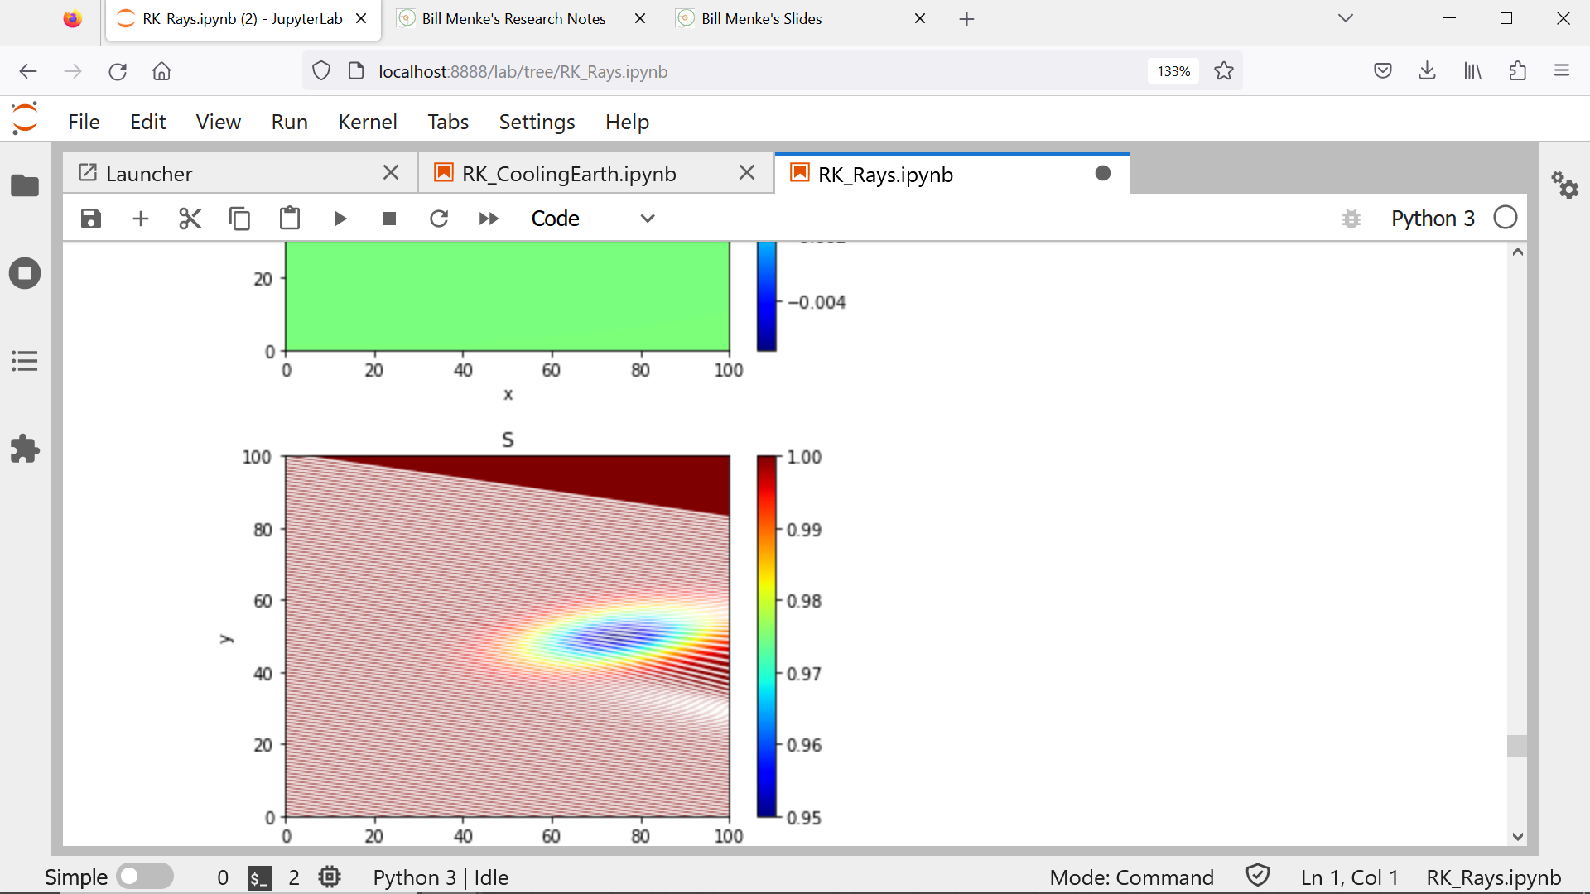
A
B

Slide 5
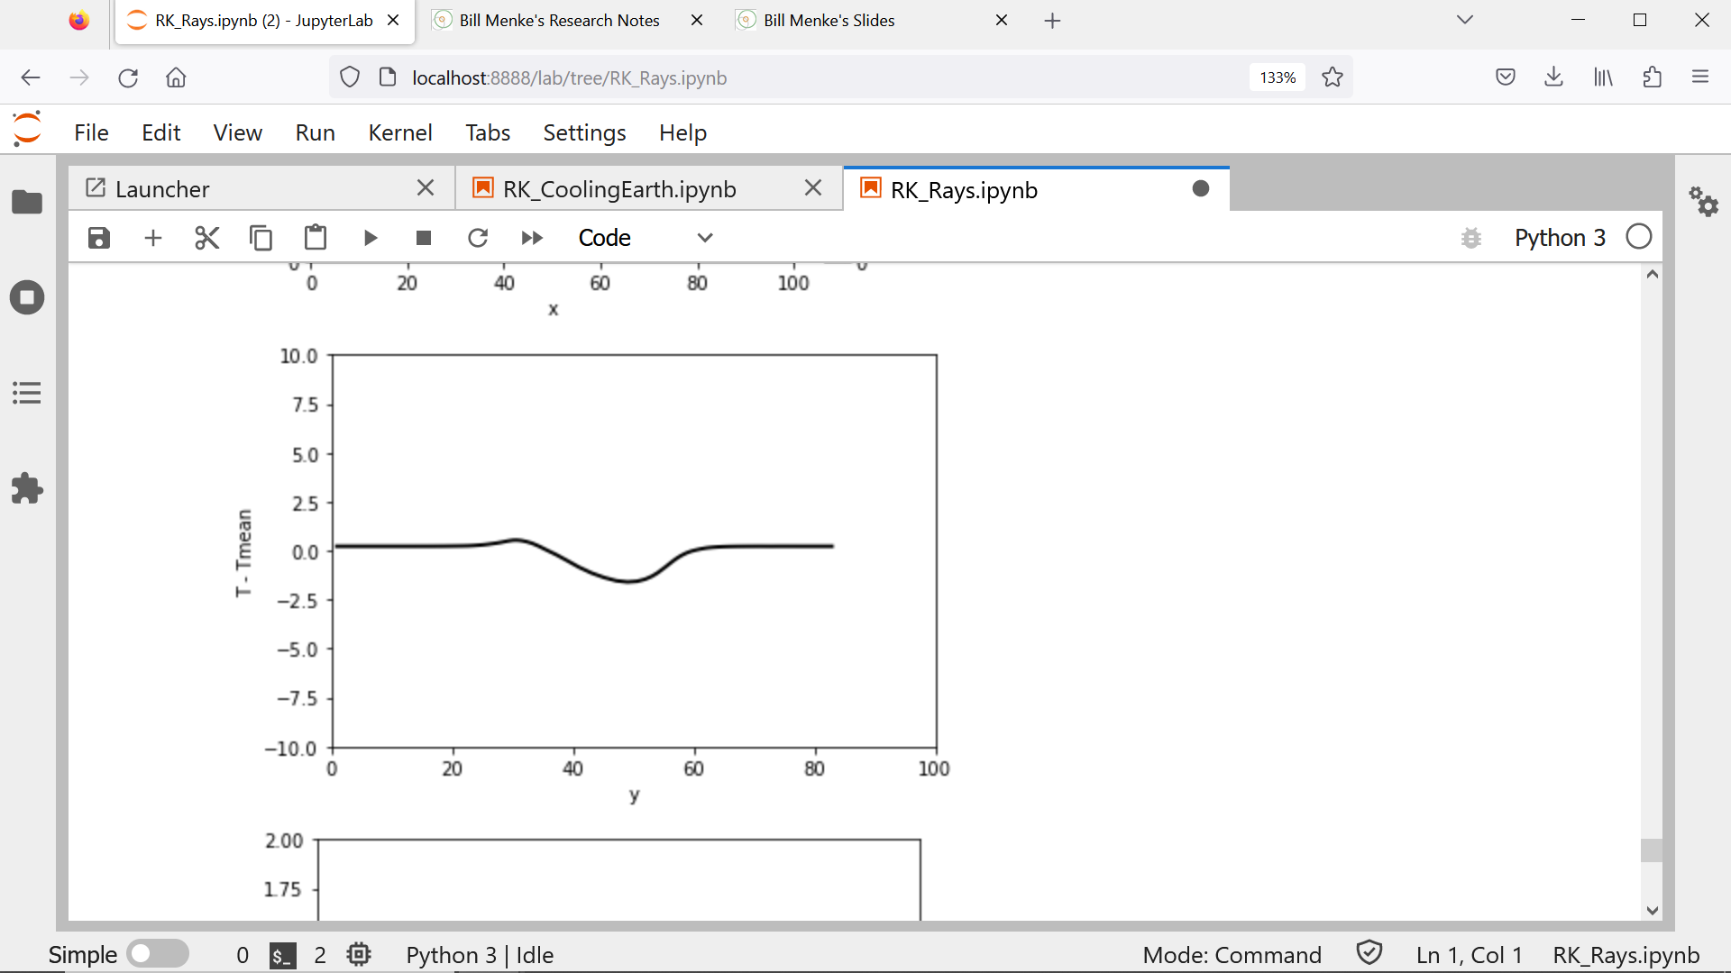
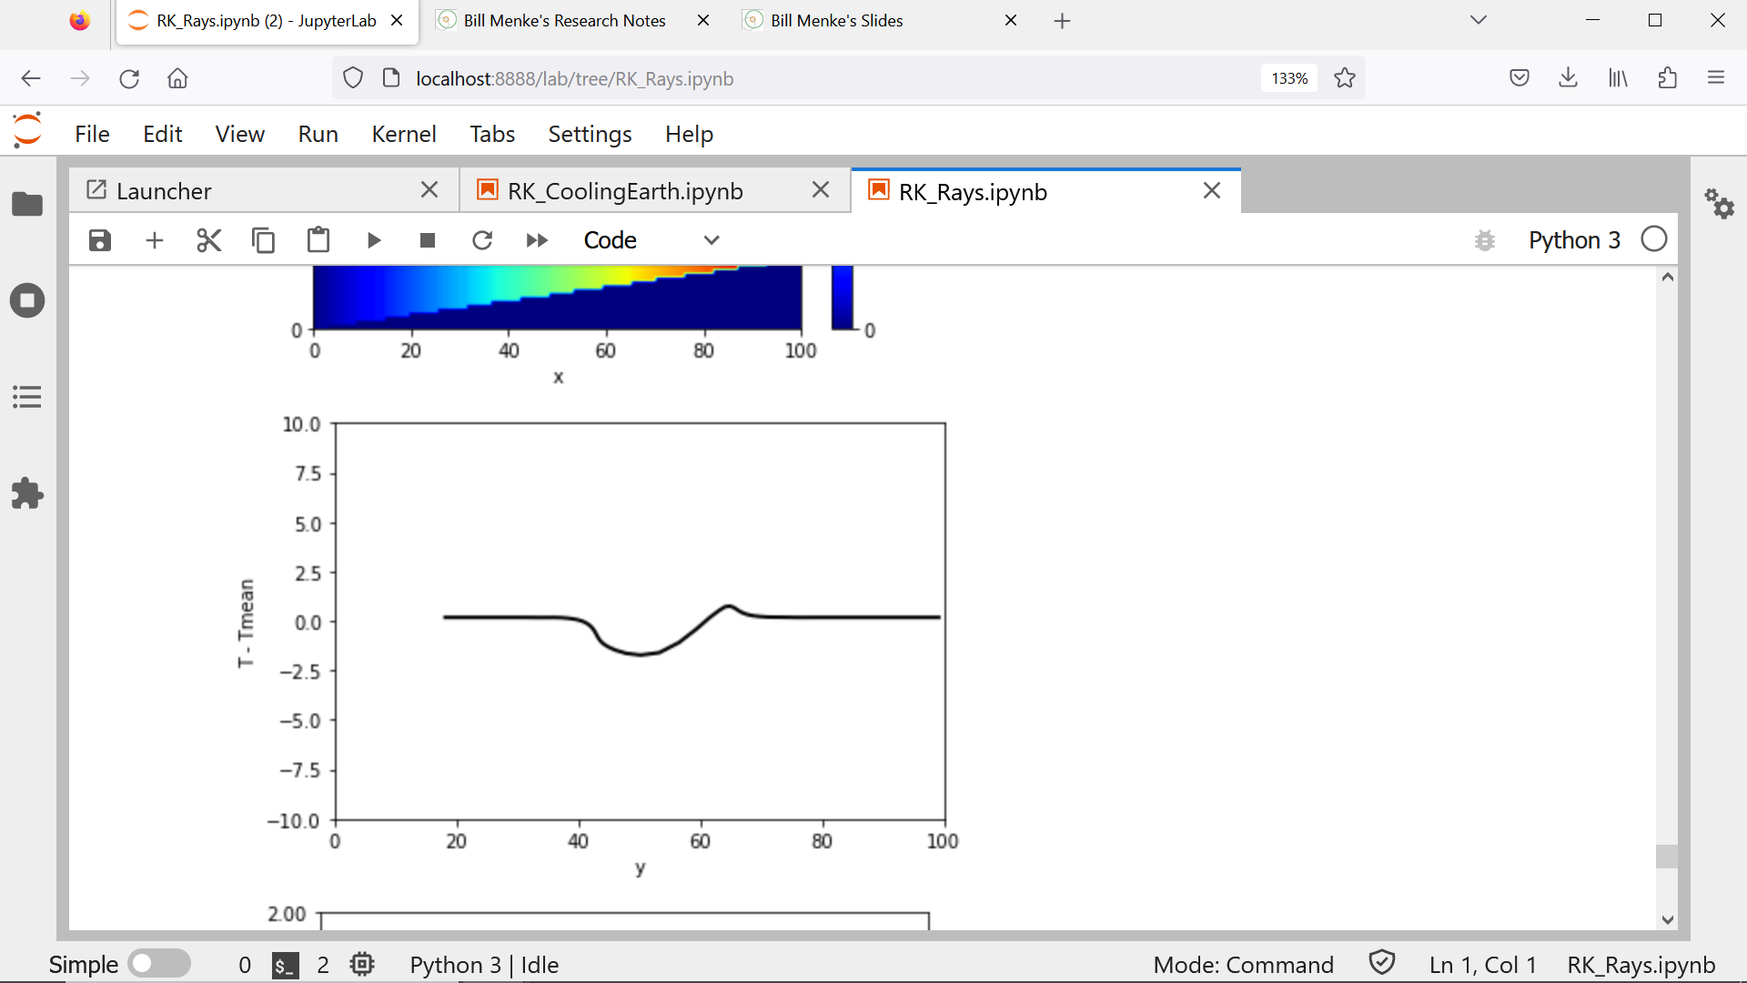
B
A

Slide 6
B
A
parallax
proportional to depth

Slide 7
wider flank
B
A

Slide 8
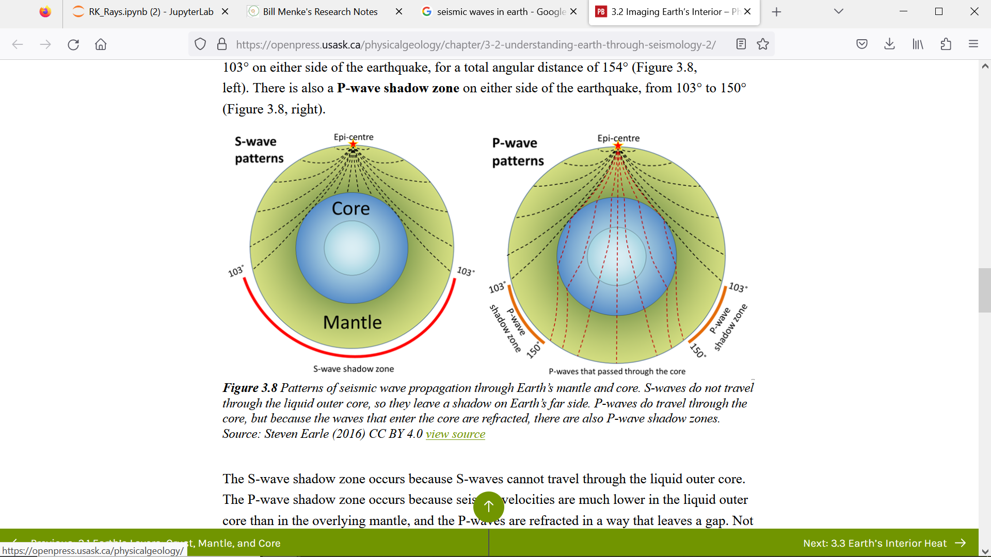
for a small region near the Earth’s
surface, rays are approximately tilted straight lines

Slide 9
for an earthquake on the
other side of the Earth,
they tilt the other way

Slide 10
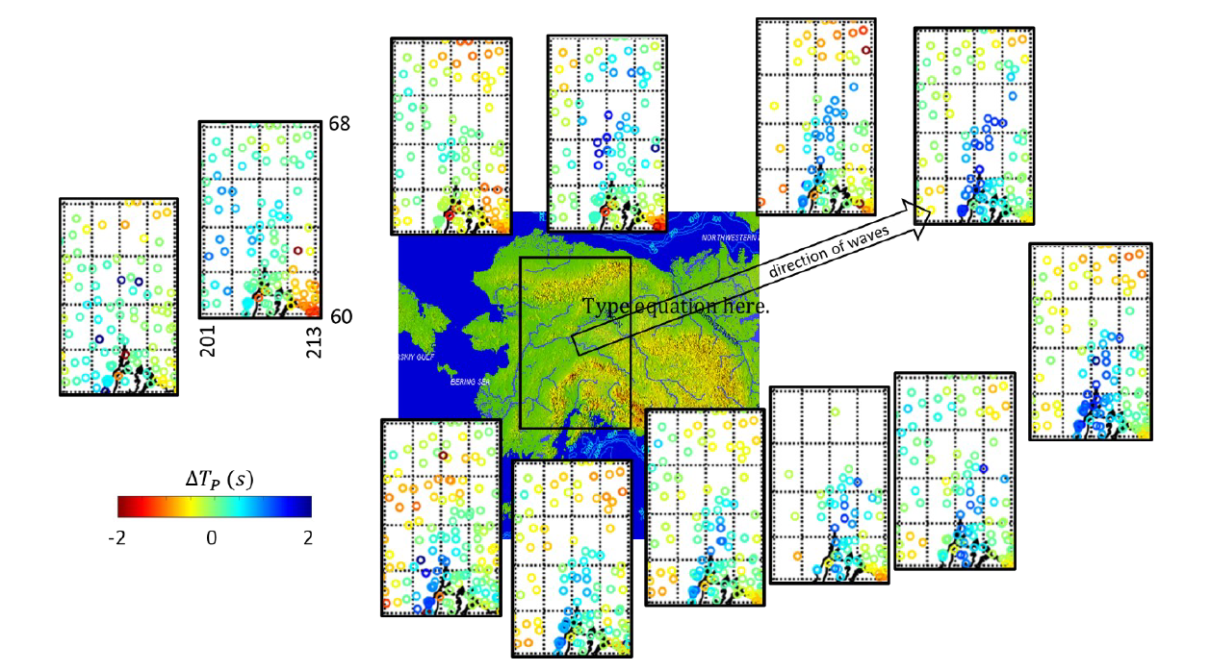
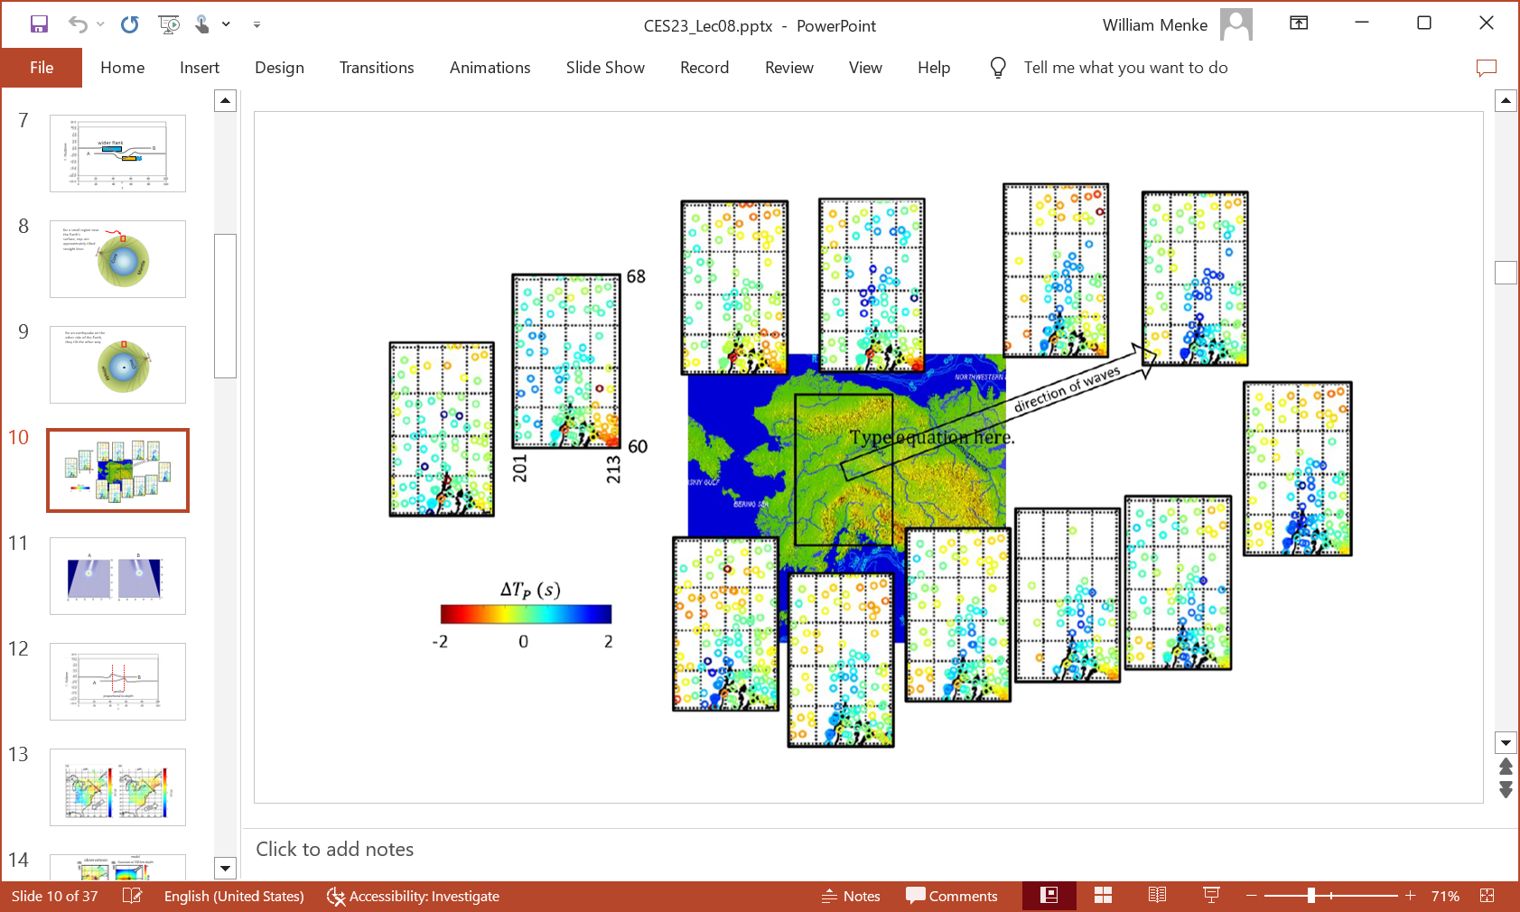

Slide 11
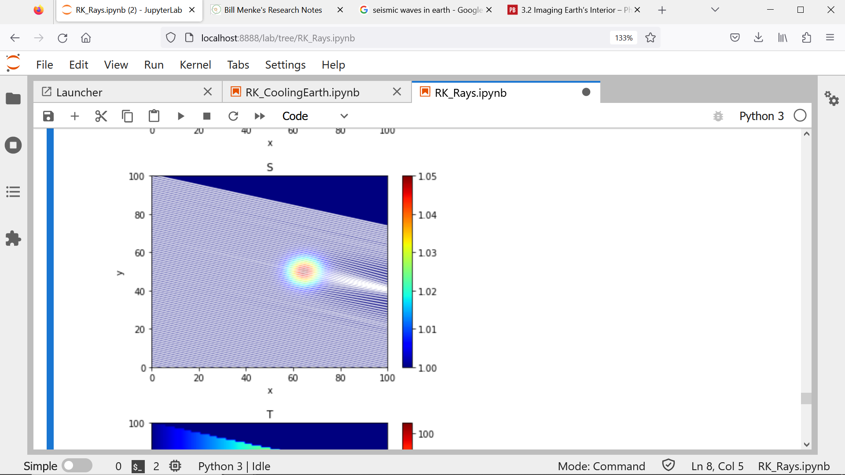
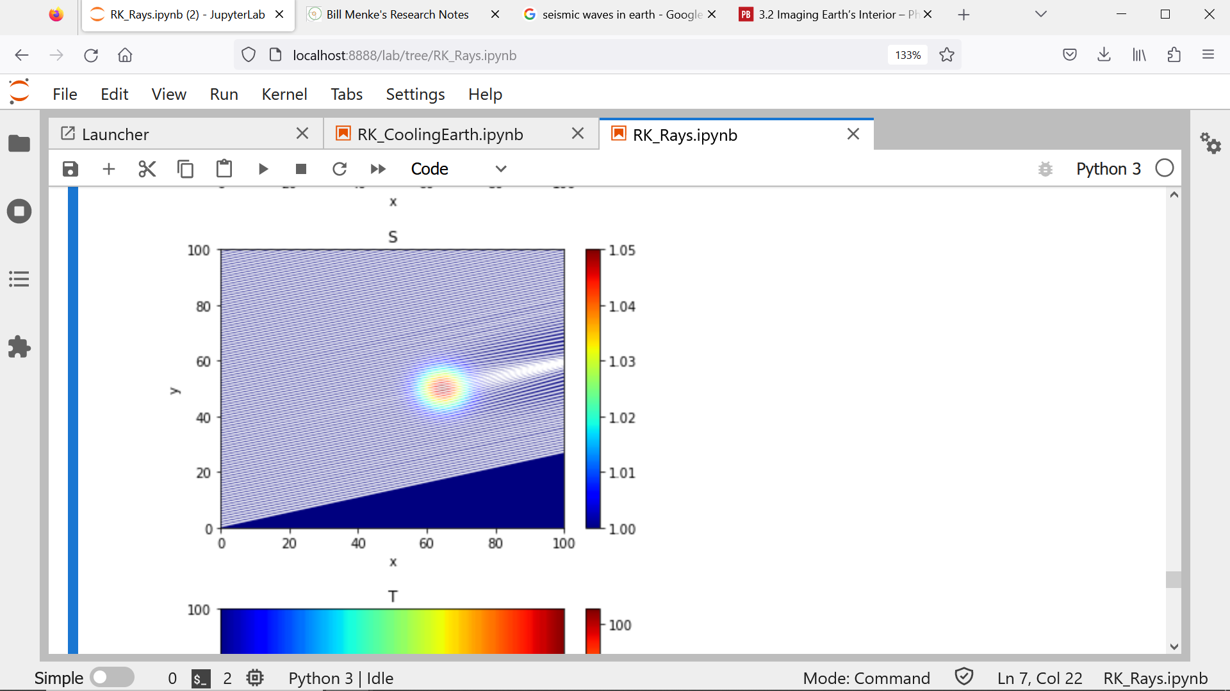
A
B

Slide 12
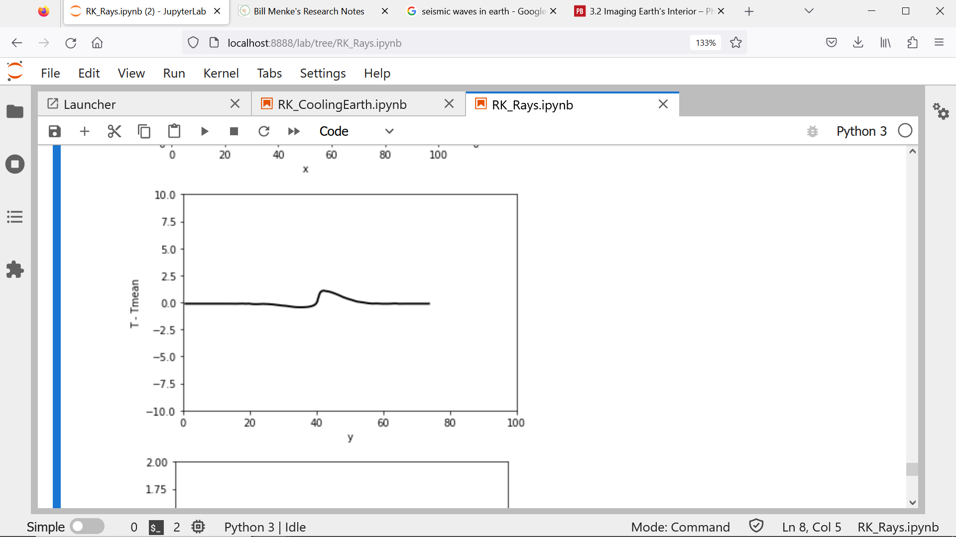
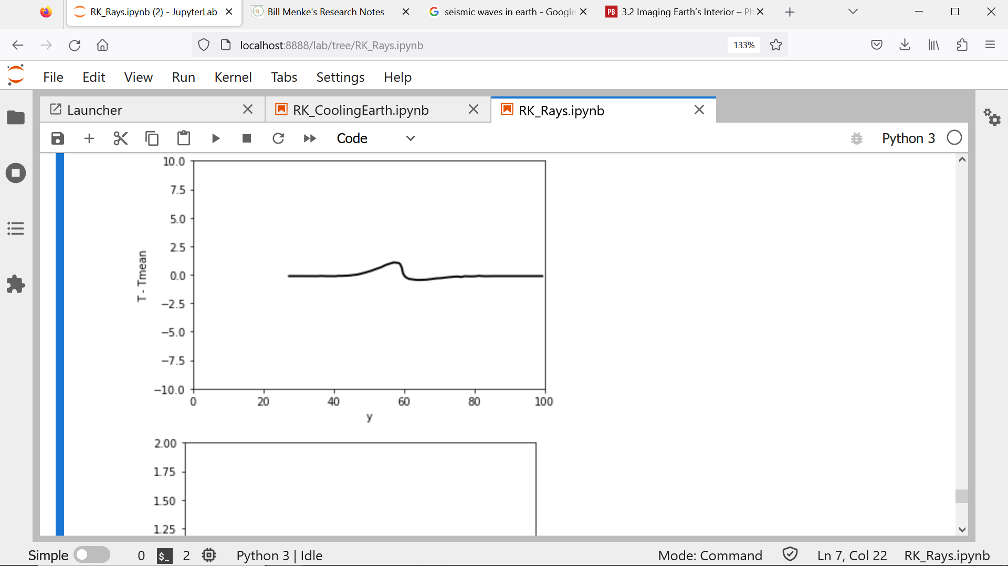
B
A
parallax
proportional to depth

Slide 13
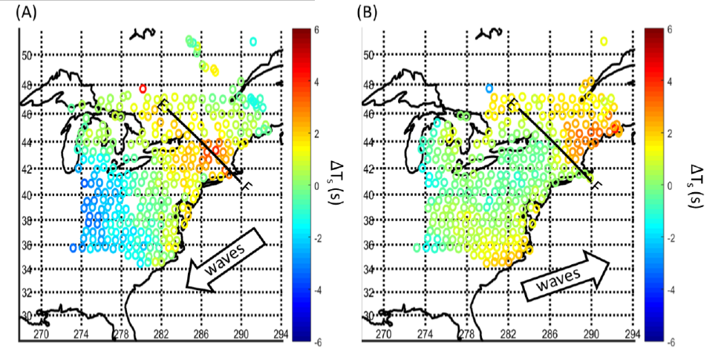

Slide 14
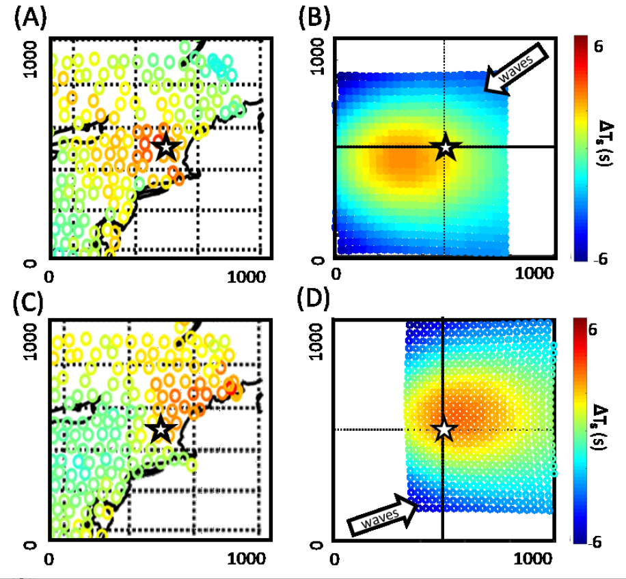
observations
model
Gaussian at 200 km depth
follow-up on seismic waves
follow-up on seismic waves

Slide 15
cooling of the earth

Slide 16
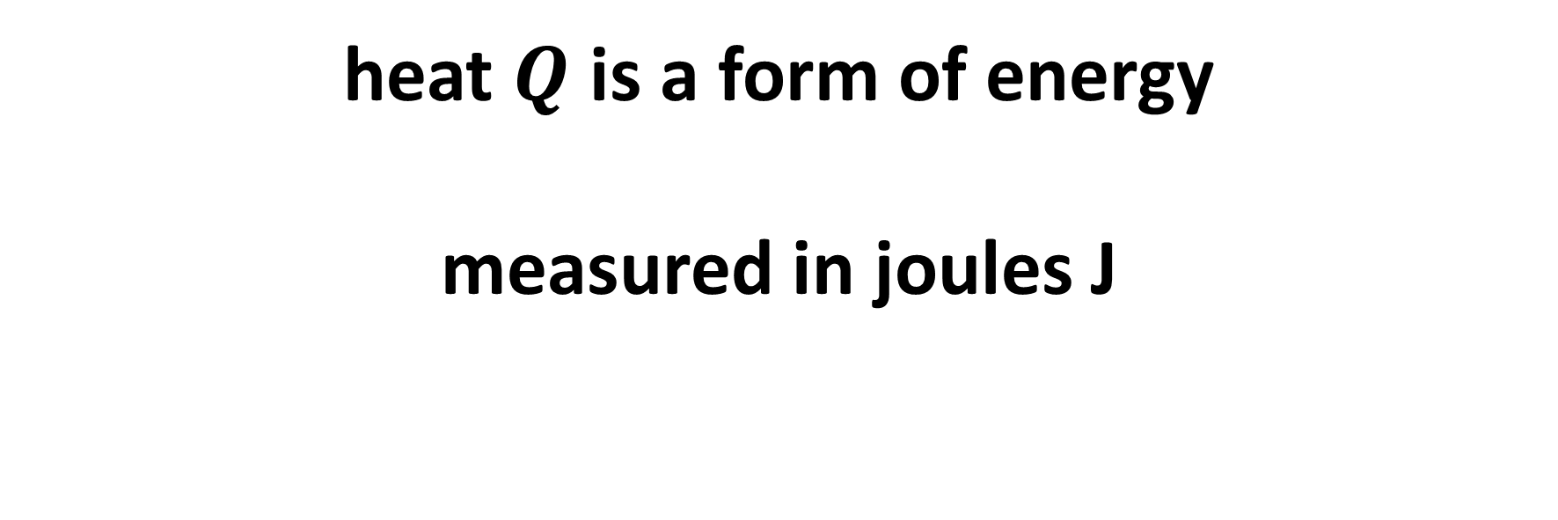
physical principal 1
heat $Q$is a form of energy
measured in joules J

Slide 17
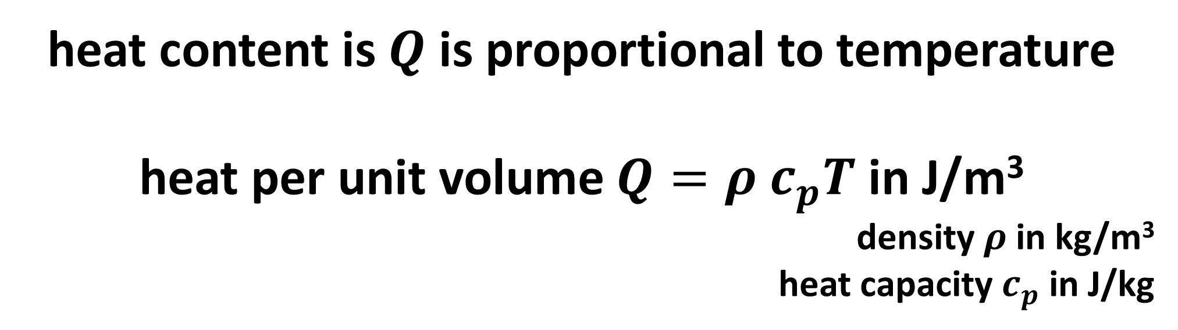


physical principal 2
heat content is $Q$ is proportional to temperature
heat per unit volume $Q=ρ c_{p}T$ in J/m³
density $ρ$ in kg/m³
heat capacity $c_{p}$ in J/kg
heat content = $ρc_{p}TV$ in J
volume $V$

Slide 18
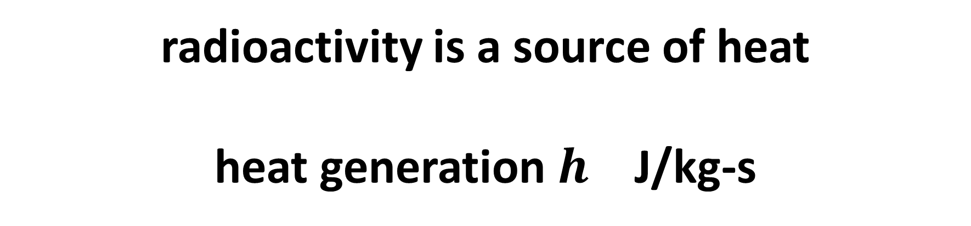

physical principal 4
radioactivity is a source of heat
heat generation $h$ J/kg-s
heat generation = $hρV$ J/s
volume $V$

Slide 19
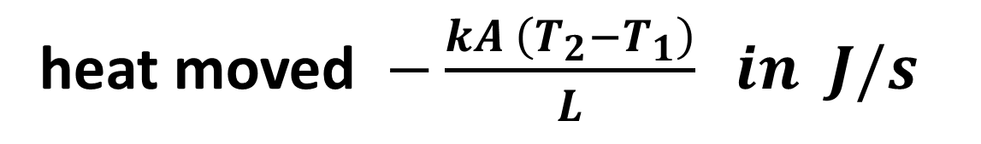
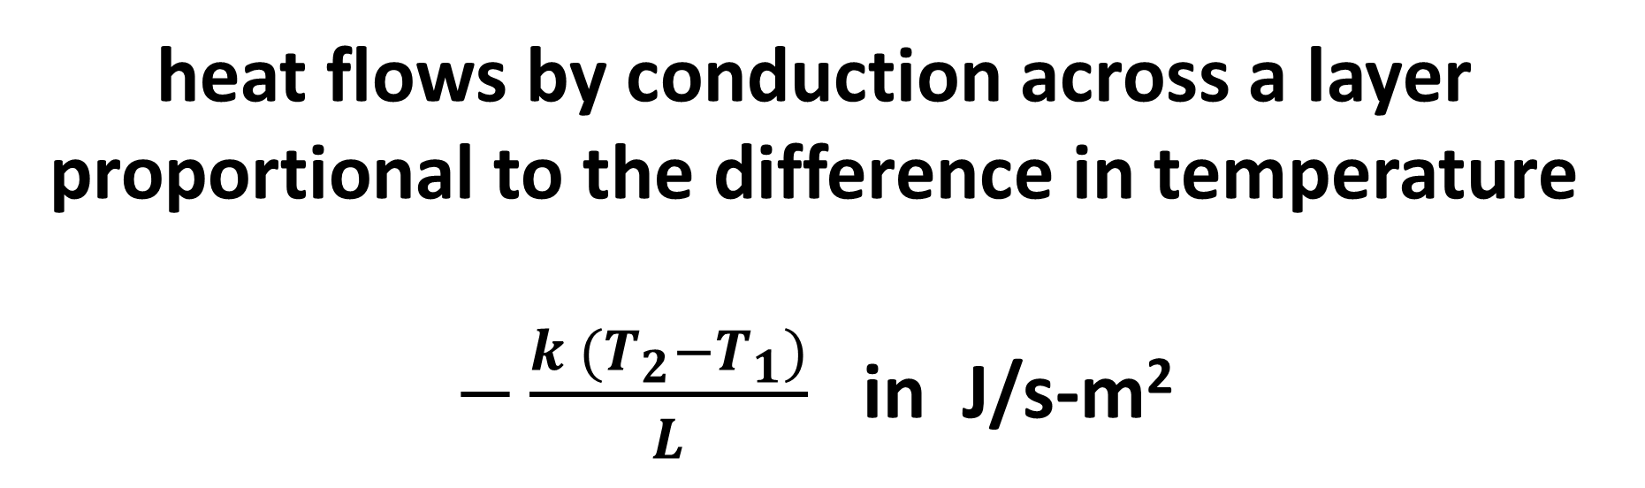
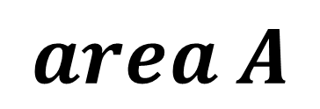
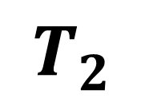
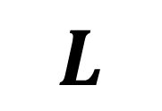
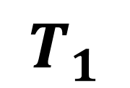

physical principal 5
heat flows by conduction across a layer proportional to the difference in temperature
$−\frac{k (T_{2}−T_{1})}{L}$ in J/s-m²
$$T_{2}$$
$$T_{1}$$
thermal conductivity $k \text{in} \text{J}\text{/}\text{s}\text{−}\text{K}\text{−}\text{m}$
$$area A$$
heat moved $−\frac{kA \left(T_{2}−T_{1}\right)}{L} in J/s$
$$L$$

Slide 20
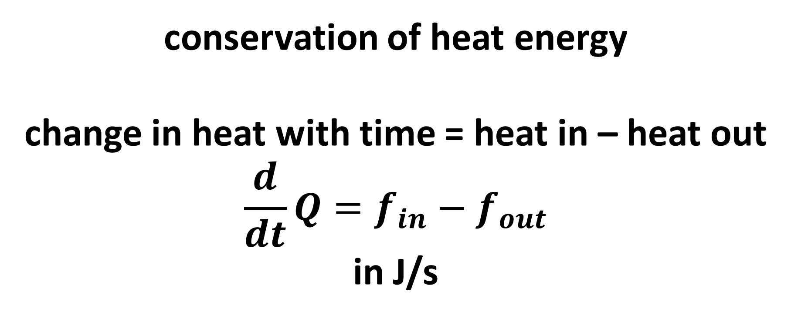
physical principal 6
conservation of heat energy
change in heat with time = heat in – heat out
$$\frac{d}{dt}Q=f_{in}−f_{out}$$
in J/s

Slide 21
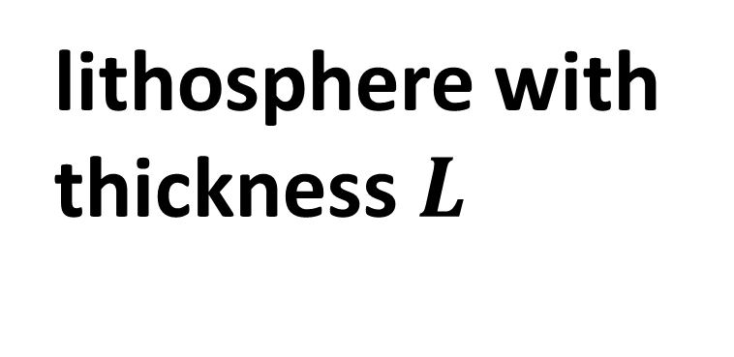

model of earth
lithosphere with thickness $L$
$$R$$
mantle
Ignore the core!

Slide 22

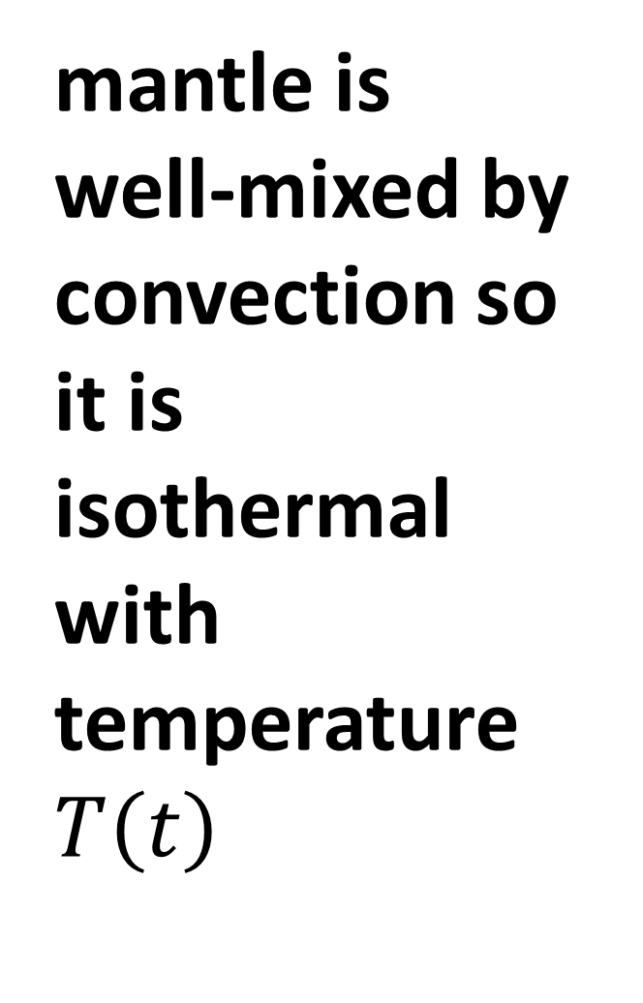
mantle is well-mixed by convection so it is isothermal with temperature$T\left(t\right)$
$$T\left(t\right)$$

Slide 23
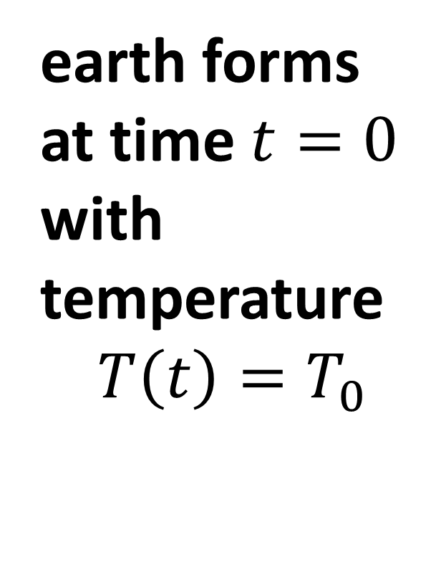
earth forms at time $t=0$ with temperature
$$T\left(t\right)=T_{0}$$
$$T\left(t\right)$$

Slide 24


$$T=0$$
lithosphere has negligible heat content,
surface temperature of 0
and conducts heat away
$$T\left(t\right)$$

Slide 25
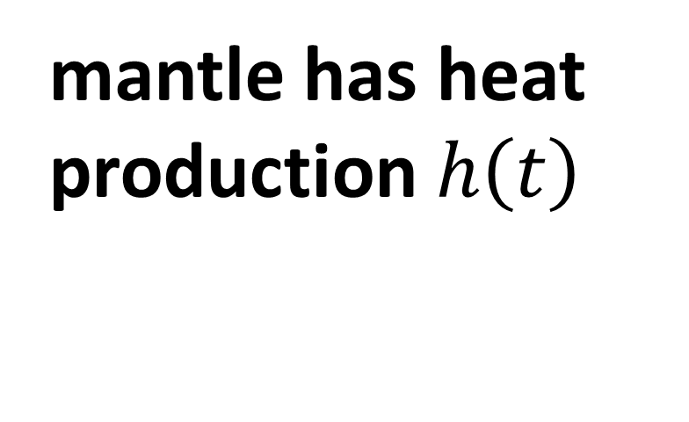

mantle has heat production $h\left(t\right)$
$$h\left(t\right)$$
mantle

Slide 26
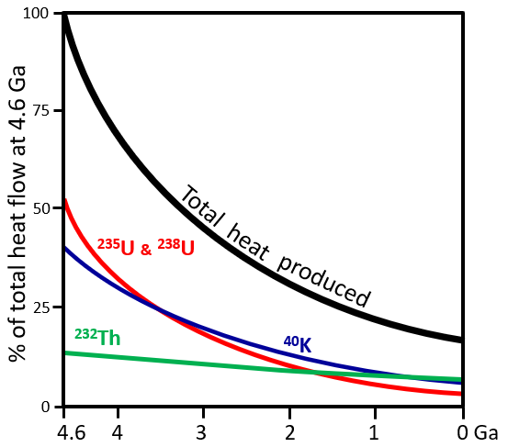
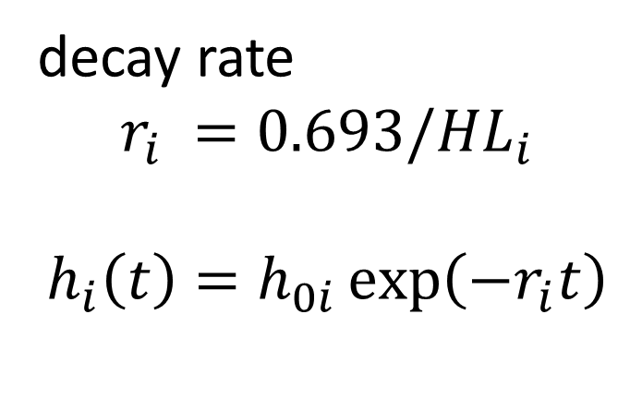
decay rate
$$r_{i} =0.693/{HL}_{i}$$
$$h_{i}\left(t\right)=h_{0i}\exp\left(−r_{i}t\right)$$

Slide 27
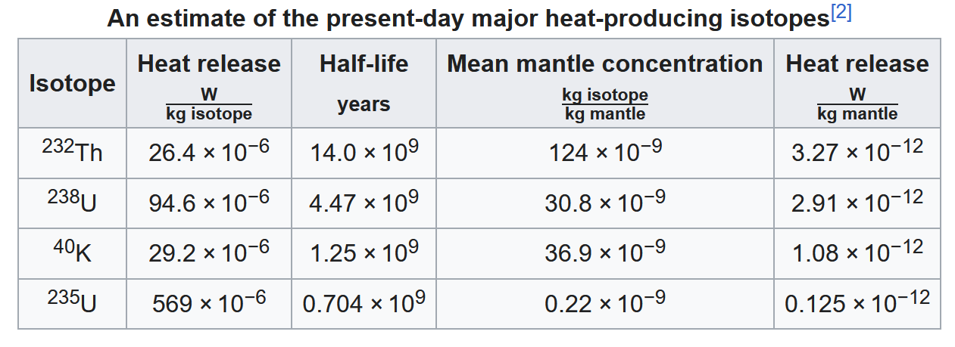
from Wikipedia

Slide 28
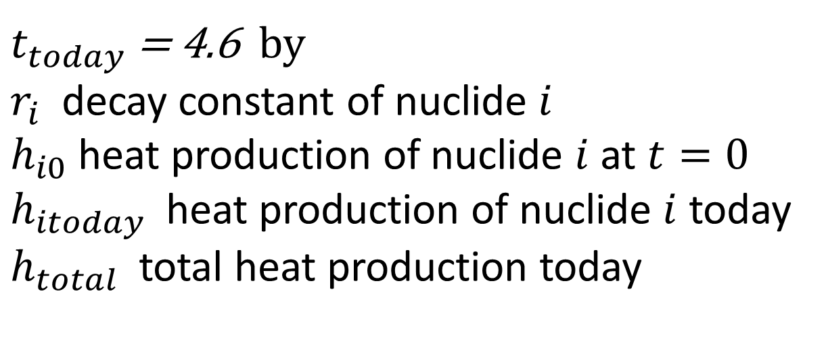
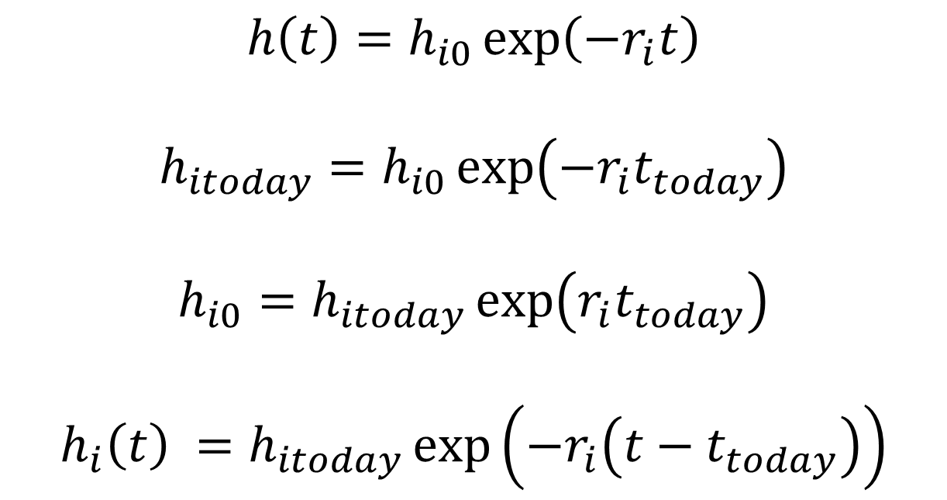
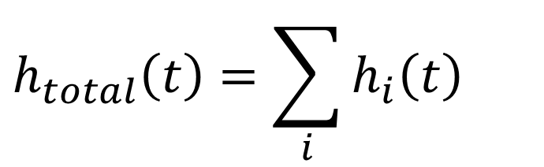
$t_{today}$ = 4.6 by
$r_{i}$ decay constant of nuclide $i$
$h_{i0}$ heat production of nuclide $i$ at $t=0$
$h_{itoday}$ heat production of nuclide $i$ today
$h_{total}$ total heat production today
$$h\left(t\right)=h_{i0}\exp\left(−r_{i}t\right)$$
$$h_{itoday}=h_{i0}\exp\left(−r_{i}t_{today}\right)$$
$$h_{i0}=h_{itoday}\exp\left(r_{i}t_{today}\right)$$
$$h_{i}\left(t\right) =h_{itoday}\exp\left(−r_{i}\left(t−t_{today}\right)\right)$$
$$h_{total}\left(t\right)=\sum_{i}{h_{i}\left(t\right)}$$

Slide 29
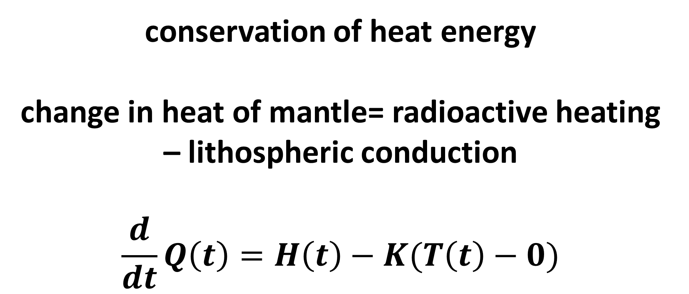
conservation of heat energy
change in heat of mantle= radioactive heating – lithospheric conduction
$$\frac{d}{dt}Q\left(t\right)=H\left(t\right)−K(T\left(t\right)−0)$$

Slide 30
conservation of heat energy
change in heat of mantle= radioactive heating – lithospheric conduction
$$\frac{d}{dt}Q\left(t\right)=H\left(t\right)−K(T\left(t\right)−0)$$
total
loss of heat
from lithosphere
total heat in mantle
total radioactive
heat production

Slide 31




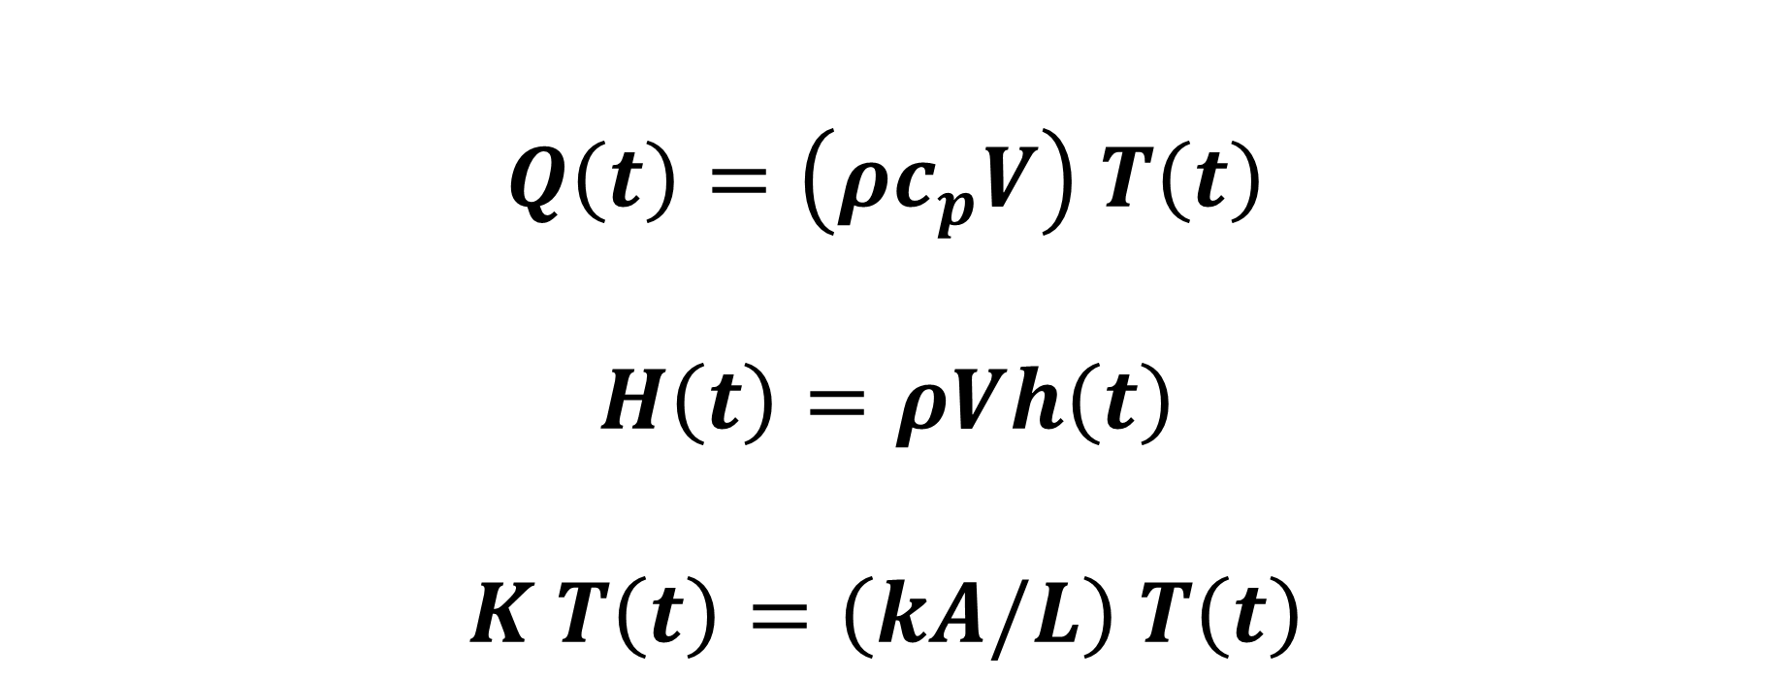
$$\frac{d}{dt}Q\left(t\right)=H\left(t\right)−K(T\left(t\right)−0)$$
$Q\left(t\right)=\left(ρc_{p}V\right)$ $T\left(t\right)$
$$H\left(t\right)=ρVh\left(t\right)$$
$K T\left(t\right)=\left(kA/L\right)$ $T\left(t\right)$
total heat in mantle
$$C$$
total radioactive
heat production
total
loss of heat
from lithosphere
$$K$$
$$\frac{d}{dt}T\left(t\right)=\left(H/C\right)−\left(K/C\right)T\left(t\right)$$

Slide 32
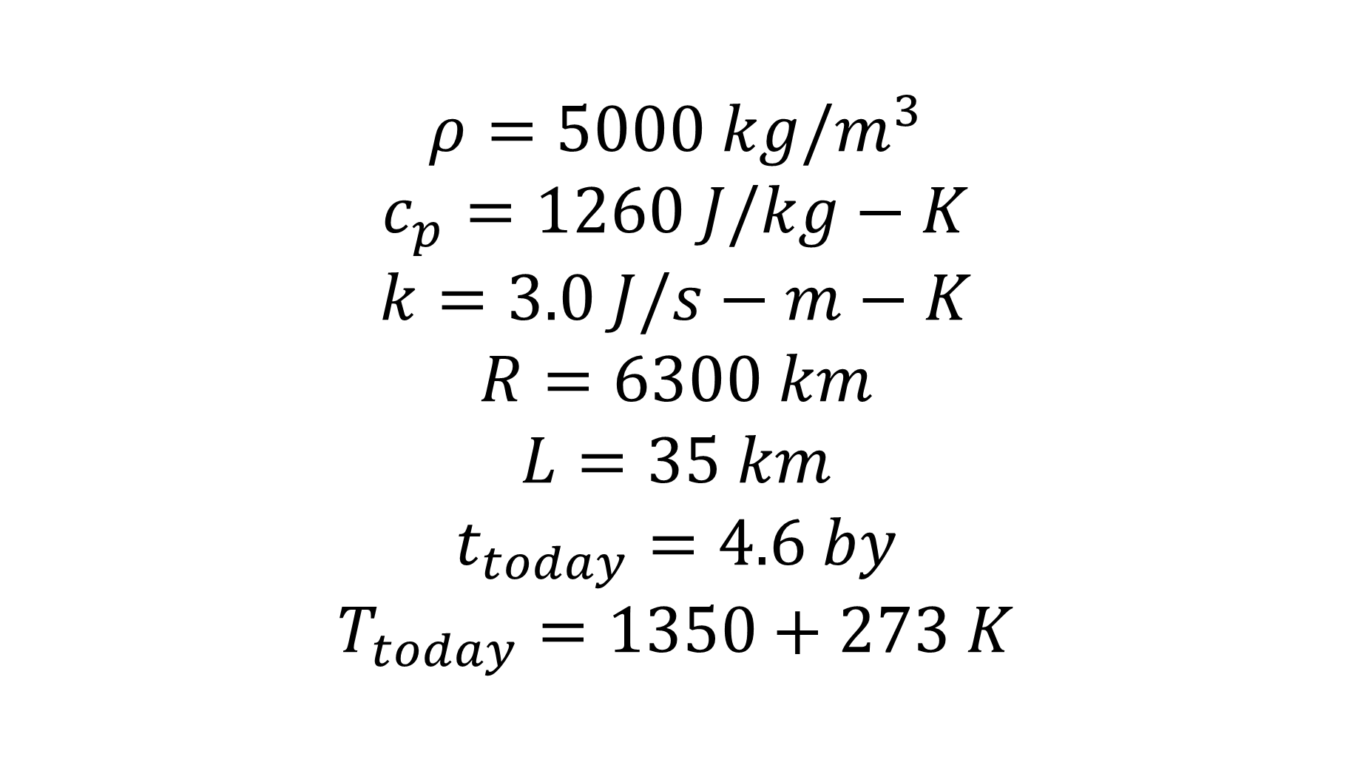
$$ρ=5000 kg/m^{3}$$
$$c_{p}=1260 J/kg−K$$
$$k=3.0 J/s−m−K$$
$$R=6300 km$$
$$L=35 km$$
$$t_{today}=4.6 by$$
$$T_{today}=1350+273 K$$

Slide 33
