Slide 1
2025 EESC W3400
Computational Earth Science
Lec 11: Periodicities and Fourier series

Slide 2
today:
smoothing with least squares
sine & cosine components with least squares

Slide 3
smoothing with least squares

Slide 4
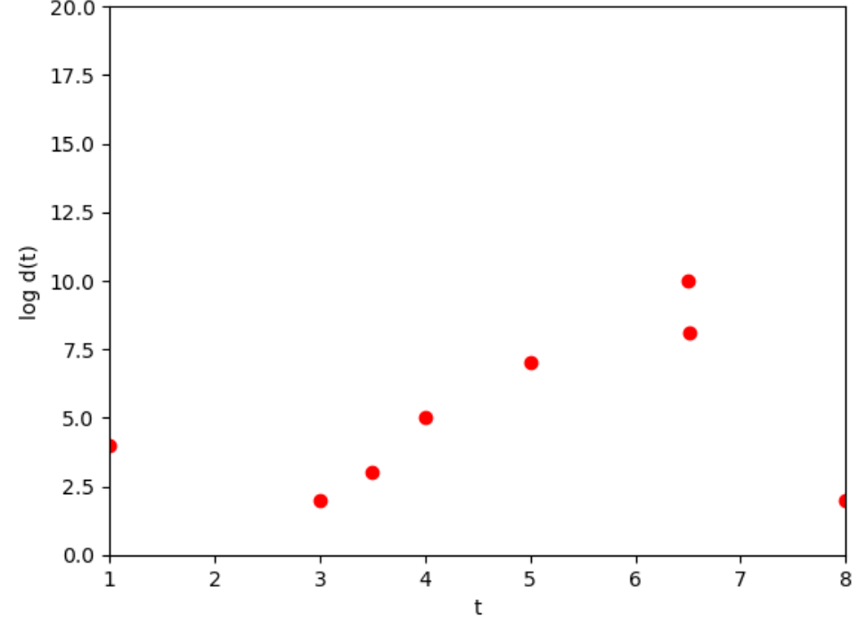
observed data (red)

Slide 5
goal is to find a smooth curve that approximately fits data
?

Slide 6


$$w$$
$$t_{0}$$

Slide 7
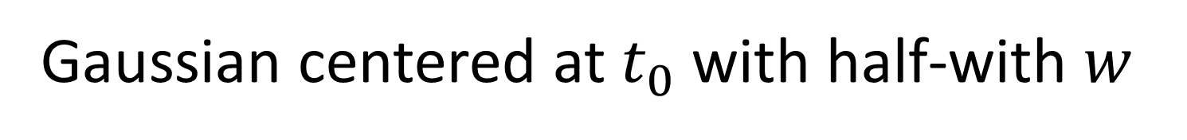
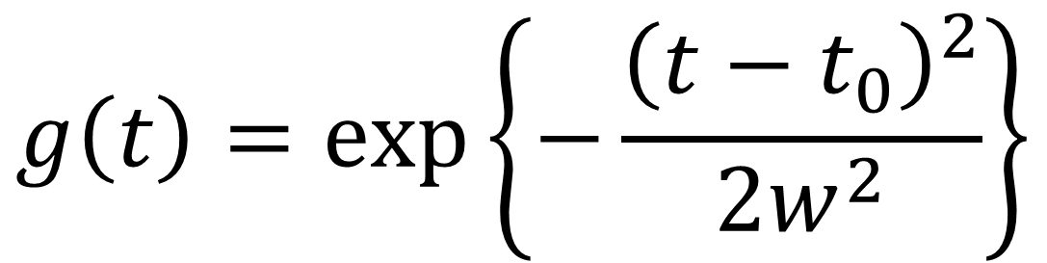
Gaussian centered at $t_{0}$ with half-with $w$
$$g\left(t\right)=\exp\left\{−\frac{{\left(t−t_{0}\right)}^{2}}{2w^{2}}\right\}$$

Slide 8
sets a scale length of
variation
$$w$$
center position
$$t_{0}$$

Slide 9
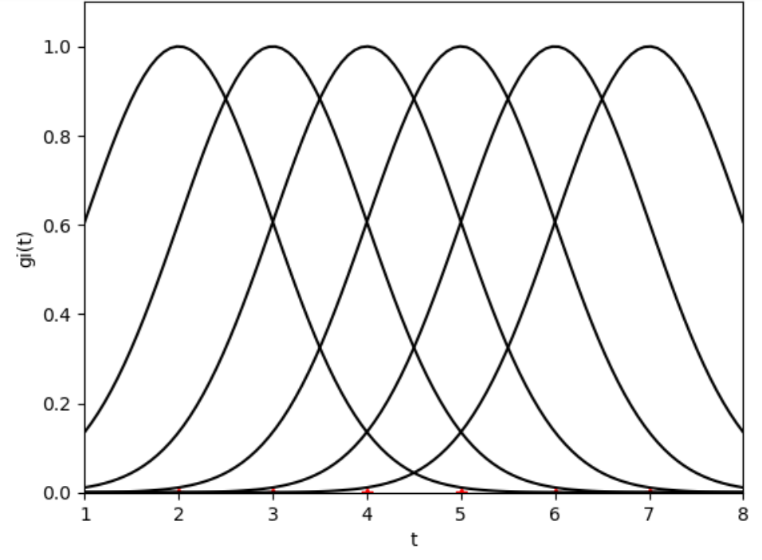
$$w$$
$$t_{0}$$

Slide 11
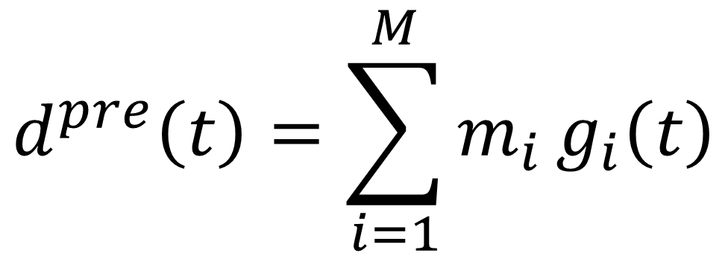
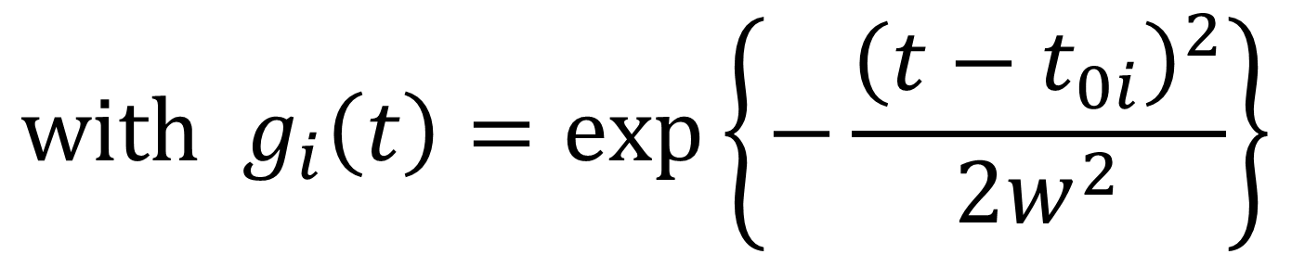
Model
$$d^{pre}\left(t\right)=\sum_{i=1}^{M}{m_{i}}g_{i}\left(t\right)$$
$$with g_{i}\left(t\right)=\exp\left\{−\frac{{\left(t−t_{0i}\right)}^{2}}{2w^{2}}\right\}$$

Slide 12

least-squares solution
$m^{est}={\left[G^{T}G\right]}^{−1}$ $G^{T}$ $d^{obs}$
$d^{pre}=G$ $m^{est}$
$$e=d^{obs}−d^{pre}$$
$E=e^{T}$ $e$
$$σ_{d}^{2}=E/\left(N−M\right)$$
$$C=σ_{d}^{2}{\left[G^{T}G\right]}^{−1}$$
$$σ_{m_{i}}=2 \sqrt{C_{ii}} (95\% confidence)$$
really only need these two lines

Slide 13
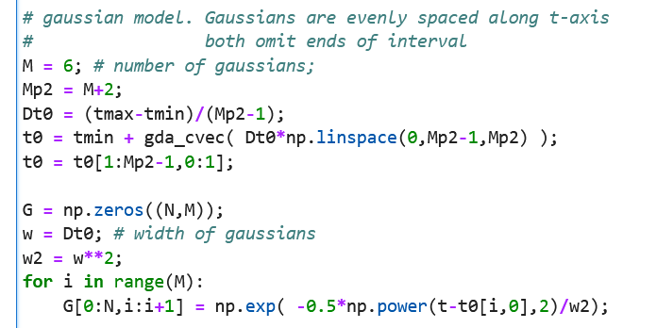
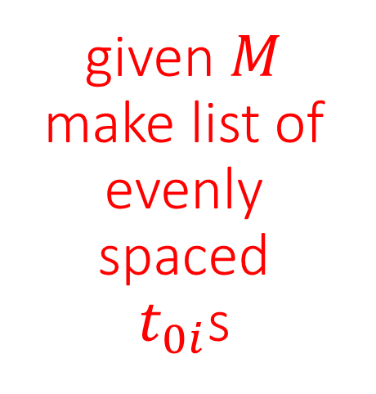
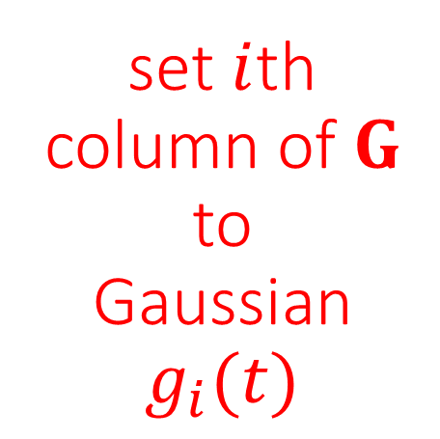
Hard part is to build G
given $M$ make list of evenly spaced
$t_{0i}$s
set $i$th column of $G$ to
Gaussian
$g_{i}(t)$

Slide 14
least-squares solution
$m^{est}={\left[G^{T}G\right]}^{−1}$ $G^{T}$ $d^{obs}$
$d^{pre}=G$ $m^{est}$
$$e=d^{obs}−d^{pre}$$
$E=e^{T}$ $e$
$$σ_{d}^{2}=E/\left(N−M\right)$$
$$C=σ_{d}^{2}{\left[G^{T}G\right]}^{−1}$$
$$σ_{m_{i}}=2 \sqrt{C_{ii}} (95\% confidence)$$
really only need these two lines

Slide 15
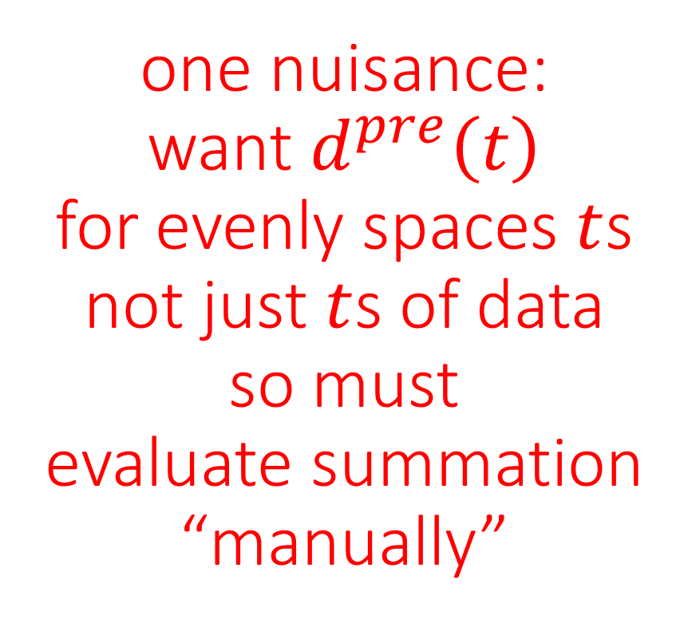
least-squares solution
$m^{est}={\left[G^{T}G\right]}^{−1}$ $G^{T}$ $d^{obs}$
$d^{pre}=G$ $m^{est}$
$$e=d^{obs}−d^{pre}$$
$E=e^{T}$ $e$
$$σ_{d}^{2}=E/\left(N−M\right)$$
$$C=σ_{d}^{2}{\left[G^{T}G\right]}^{−1}$$
$$σ_{m_{i}}=2 \sqrt{C_{ii}} (95\% confidence)$$
one nuisance:
want $d^{pre}\left(t\right)$
for evenly spaces $t$s
not just $t$s of data
so must
evaluate summation
“manually”

Slide 16
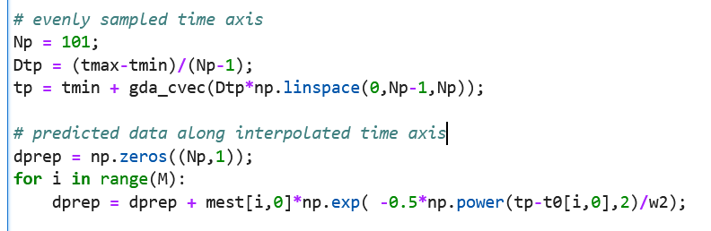

Slide 17
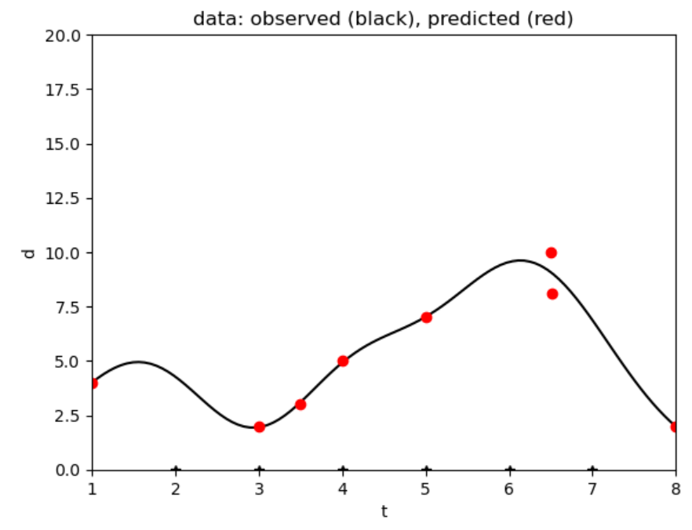
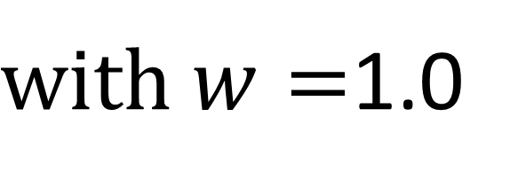
$with w=$1.0

Slide 18
sine & cosine components with least squares

Slide 19
importance of periodicities
Notes:
Need to be able to recognize when a periodicity is present, determine is period and its strength.

Slide 20
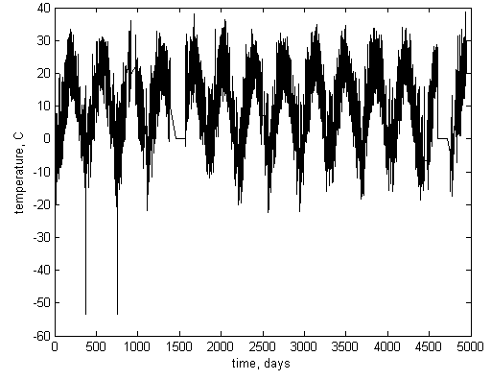
Air temperature
Black Rock Forest
365 days
1 year
Notes:
Black Rock Forest air temperature has a yearly periodicity with strength of ±20 degrees C …

Slide 21
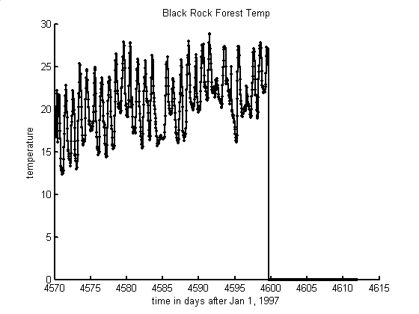
Air temperature
Black Rock Forest
1 day
time, days
Notes:
… and a daily periodicity with strength of ±5 degrees C …

Slide 22
temporal periodicities and their periods
astronomical
rotation
daily
revolution
yearly
other natural
ocean waves
a few seconds
anthropogenic
electric power
60 Hz
work week
7 days
Notes:
Ask the class to contribute others, such as (astronomical) ocean tides (12 hours, daily, monthly), precession of the equinox (26,000 years), sunspots (11 years) (other natural) heart beats (a few Hz), predator-prey oscillations (varies), (anthropogenic) work patterns (weekly), machinery (varies)

Slide 23
sinusoidal oscillation
f(t) = C cos{ 2π (t-t₀) / T }
amplitude, C
d(t)
period, T
time, t
delay, t₀
Notes:
Review the basic nomenclature

Slide 24
lingo
temporal
f(t) = C cos{ 2π t / T }
spatial
f(x) = C cos{ 2π x / λ }
amplitude, C
amplitude, C
period, T
wavelength, λ
frequency, f=1/T
-
angular frequency, ω=2 π /T
wavenumber, k=2 π / λ
f(t) = C cos(ωt)
f(x) = C cos(kx)
Notes:
temporal periodicities are described differently than spatial periodicities.

Slide 25
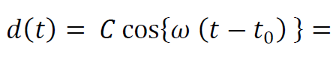
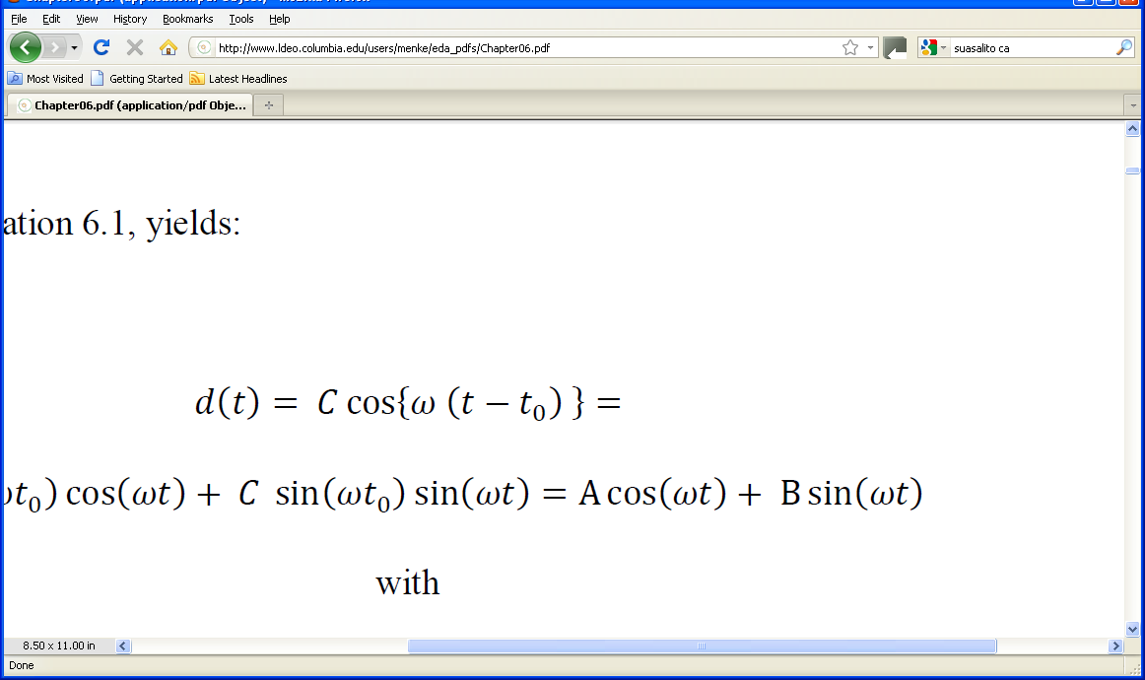
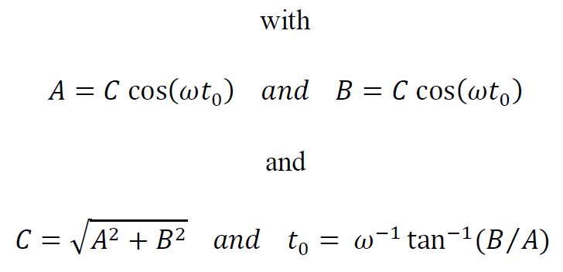
pairing sines and cosines to avoid using time delays
Notes:
Sines and cosines of the same frequency are always paired to avoid having to use explicit time shifts.

Slide 26
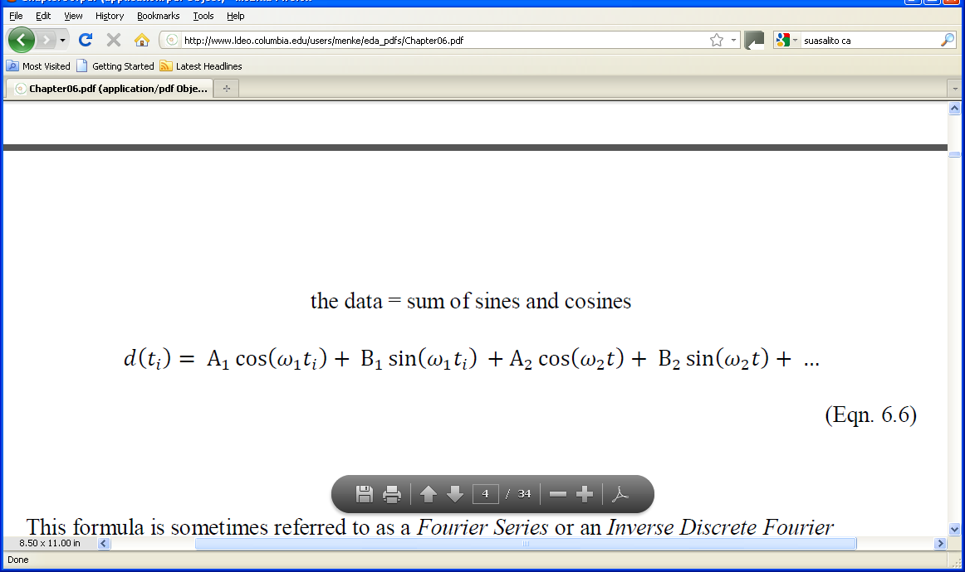
linear model containing nothing but sines and cosines
Notes:
Mention that this brings the discussion back techniques that they already understand, that is,
linear models and their solution by least squares.

Slide 27
A’s and B’s are model parameters
ω’s are known
Notes:
The A’s and B’s quantify the strength of a periodicity at a given frequency. They are the model parameters.
The ω‘s give the frequencies at which periodicities can occur.

Slide 28
two choices
values of frequencies?
total number of frequencies?

Slide 29
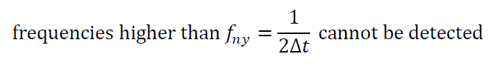
surprising fact about data evenly sampled in time (or space)
Nyquist frequency
Notes:
This is very important.

Slide 30
d₁ (t) = cos(ω₁t), with ω₁=2Δω
d₁(t)
time, t
d₂(t) = cos{ω₂t}, with ω₂=(2+N)Δω,
d₂(t)
time, t
Notes:
example of aliasing, two sinusoids, when sampled at the same, evenly spaced times (circles), produce identical patterns.

Slide 31
values of frequencies?
evenly spaced, f_{n} = (n-1)Δ f
minimum frequency of zero
maximum frequency of f _{ny}
total number of frequencies? N/2+1
number of model parameters, M
= number of data, N
Notes:
Mention that zero frequency just gets you a constant, because cos(0)=1 and sin(0)=0.

Slide 32
values of frequencies?
evenly spaced, f_{n} = (n-1)Δ f
minimum frequency of zero
maximum frequency of f _{ny}
total number of frequencies? N/2+1
number of model parameters, M
= number of data, N
As long as N is even
Notes:
Mention that zero frequency just gets you a constant, because cos(0)=1 and sin(0)=0.

Slide 33
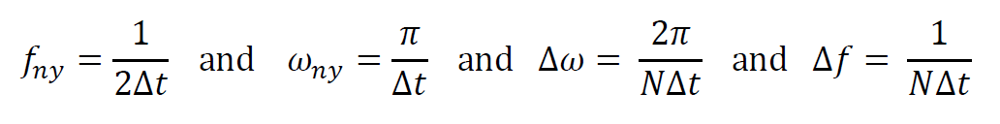
implies
Notes:
Second two formula are derived from first two by dividing by N/2.

Slide 34
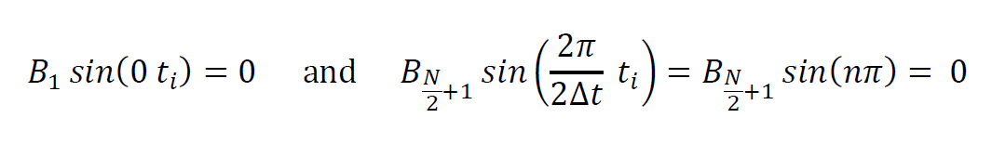
Number of Frequencies
why N/2+1 and not N/2 ?
first and last sine are omitted from the Fourier Series since they are identically zero:
Notes:
Emphasize that choice M=N (number of model parameters equal number of data) is motivated by desire to
use as many sines and cosines as possible without needing to add prior information.

Slide 35
cos(½NΔω t)
cos(0t)
cos(Δω t)
sin(Δωt)
cos(2Δω t)
sin(2Δω t)
Notes:
Idea behind a Fourier Series is that the data are a sum of these sinusoidal patterns.
Zero frequency is a constant. First non-zero frequency corresponds to one full
period over the length of the time series. Nyquist frequency is just a “cosine” that
oscillates from +1 to -1 every sample.

Slide 36
cos(½NΔω t)
cos(0t)
cos(Δω t)
sin(Δωt)
cos(2Δω t)
sin(2Δω t)
doesn’r really look much like a cosine
Notes:
Idea behind a Fourier Series is that the data are a sum of these sinusoidal patterns.
Zero frequency is a constant. First non-zero frequency corresponds to one full
period over the length of the time series. Nyquist frequency is just a “cosine” that
oscillates from +1 to -1 every sample.

Slide 37
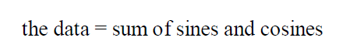
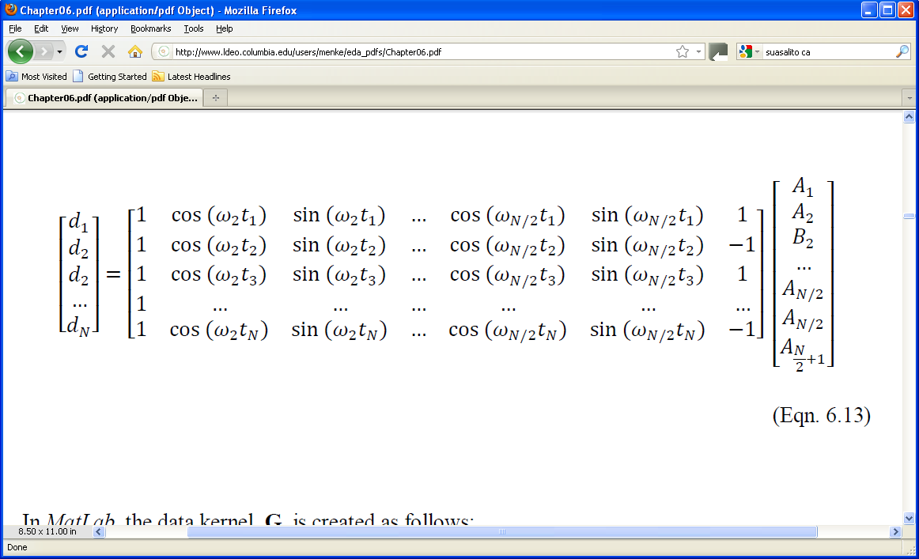
model containing only sines and cosines
“Discrete Fourier Series”
d = Gm
Notes:
Here we get back to the linear problem.

Slide 38
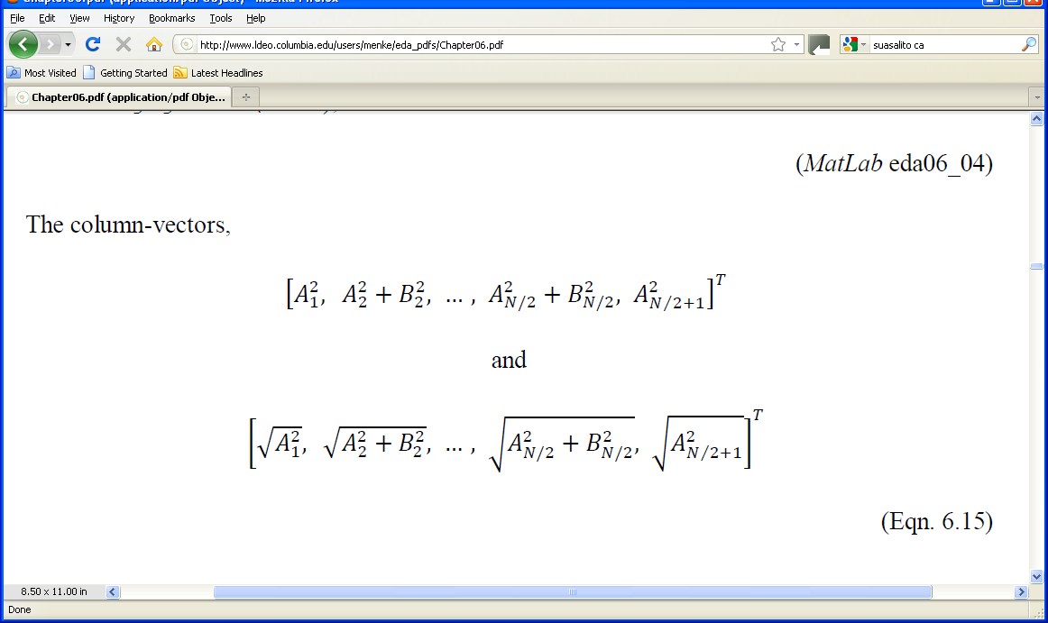
how to plot the model parameters?
A’s and B ’s
plot
against frequency
Notes:
Remind the class that A²+B²=C², the square of the amplitude of a time-shifted cosine.
This form emphasizes the overall amplitude of the oscillatory pattern, irrespective of its time-shift.

Slide 39
power spectral density
big at frequency ω when
when sine or cosine at the frequency
has a large coefficient

Slide 40
alternatively, plot
amplitude spectral density
Notes:
Plots of amplitude spectral density are useful if there are several peaks of different size, since the big
peak does not stand so high compared to power spectral density.

Slide 41
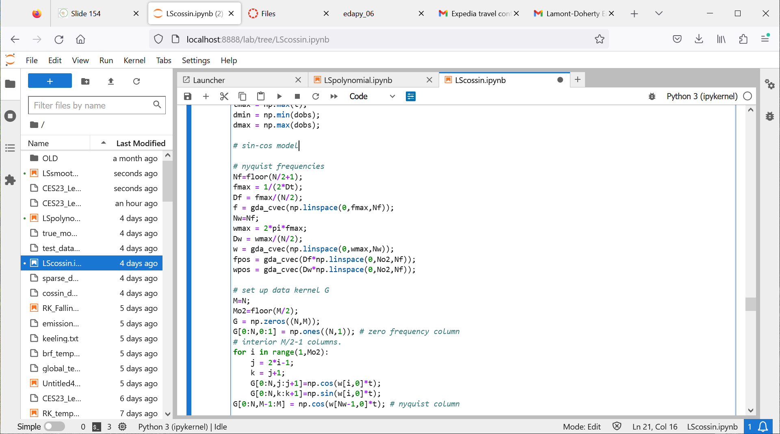

Slide 42

$$G$$

Slide 43
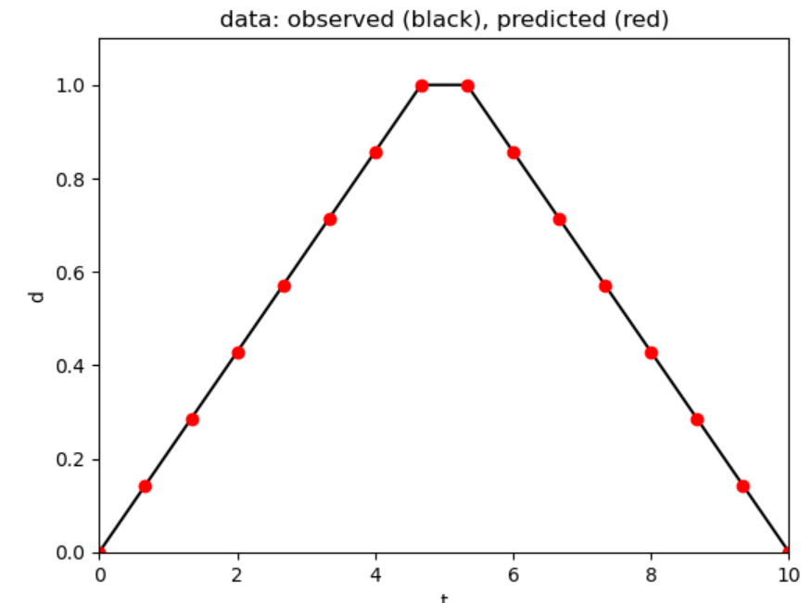

Slide 44
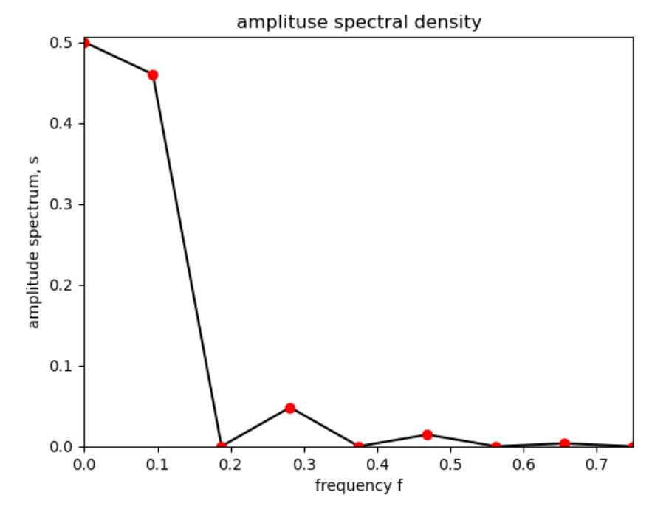

Slide 45
lots of power at low frequencies
every other frequency zero
due to symmetry of data about center of time interval

