Slide 1
2025 EESC W3400
Computational Earth Science
Lec 14: 2D FFT illustrated by propagating waves

Slide 2
Today
Use of the Fast Fourier Transform in Modeling

Slide 3
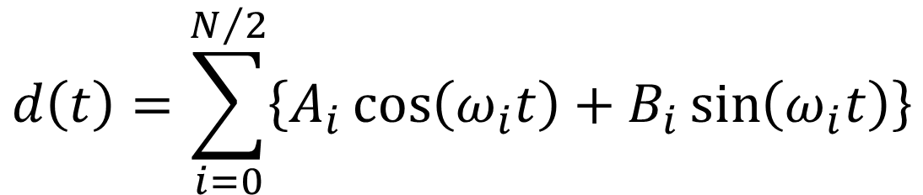
$$d\left(t\right)=\sum_{i=0}^{N/2}{\left\{A_{i}\cos\left(ω_{i}t\right)+B_{i}\sin\left(ω_{i}t\right)\right\}}$$
Notes:
Mention that this brings the discussion back techniques that they already understand, that is,
linear models and their solution by least squares.

Slide 4
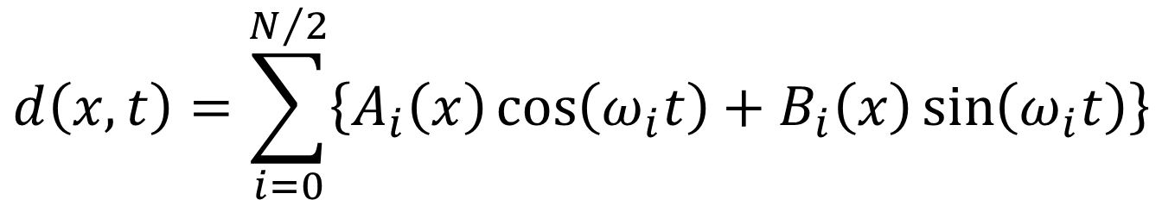
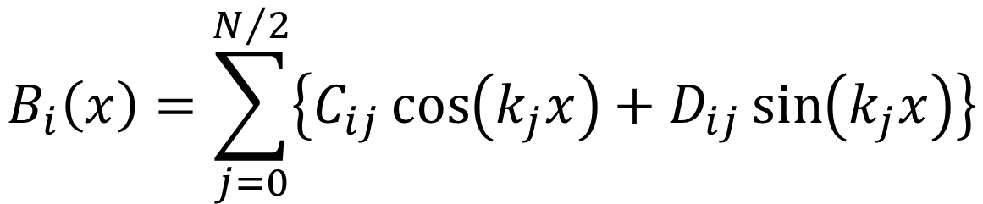
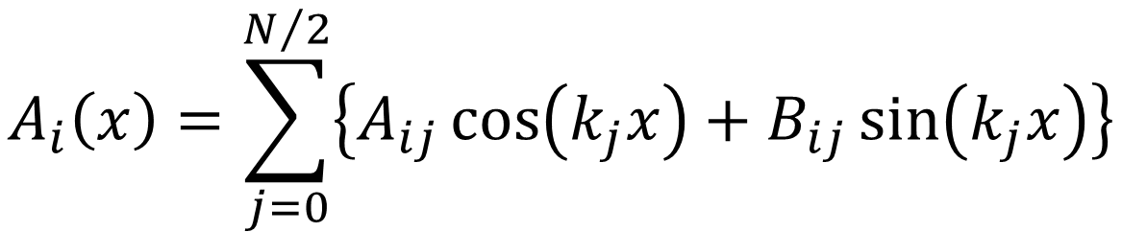
$$d\left(x,t\right)=\sum_{i=0}^{N/2}{\left\{A_{i}\left(x\right)\cos\left(ω_{i}t\right)+B_{i}\left(x\right)\sin\left(ω_{i}t\right)\right\}}$$
$$A_{i}\left(x\right)=\sum_{j=0}^{N/2}{\left\{A_{ij}\cos\left(k_{j}x\right)+B_{ij}\sin\left(k_{j}x\right)\right\}}$$
$$B_{i}\left(x\right)=\sum_{j=0}^{N/2}{\left\{C_{ij}\cos\left(k_{j}x\right)+D_{ij}\sin\left(k_{j}x\right)\right\}}$$
Notes:
Mention that this brings the discussion back techniques that they already understand, that is,
linear models and their solution by least squares.

Slide 5
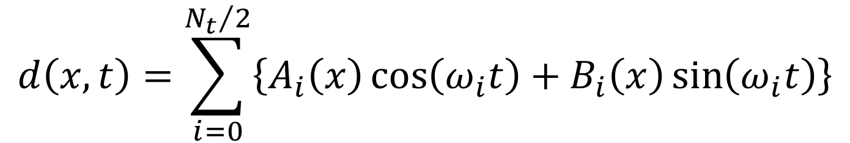
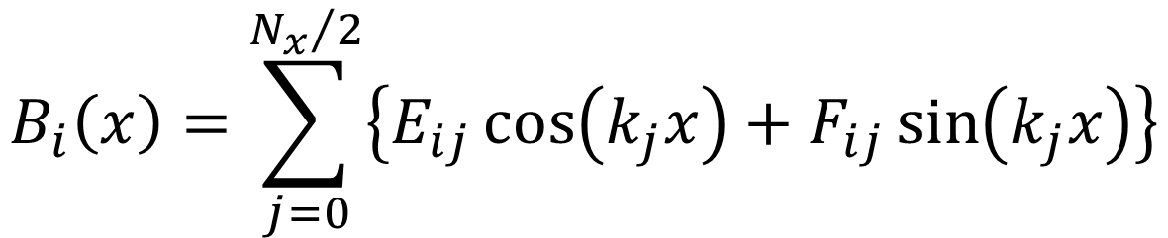
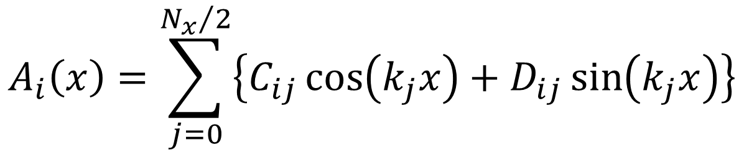
$$d\left(x,t\right)=\sum_{i=0}^{{N_{t}}/2}{\left\{A_{i}\left(x\right)\cos\left(ω_{i}t\right)+B_{i}\left(x\right)\sin\left(ω_{i}t\right)\right\}}$$
$$A_{i}\left(x\right)=\sum_{j=0}^{{N_{x}}/2}{\left\{C_{ij}\cos\left(k_{j}x\right)+D_{ij}\sin\left(k_{j}x\right)\right\}}$$
$$B_{i}\left(x\right)=\sum_{j=0}^{{N_{x}}/2}{\left\{E_{ij}\cos\left(k_{j}x\right)+F_{ij}\sin\left(k_{j}x\right)\right\}}$$
Notes:
Mention that this brings the discussion back techniques that they already understand, that is,
linear models and their solution by least squares.

Slide 6
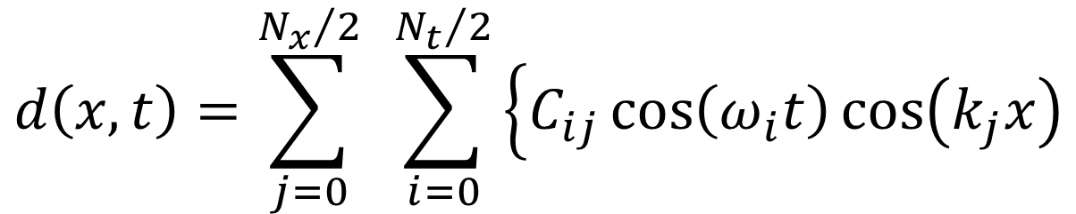



$$d\left(x,t\right)=\sum_{j=0}^{{N_{x}}/2}{ }\sum_{i=0}^{{N_{t}}/2}{\left\{C_{ij}\cos\left(ω_{i}t\right)\cos\left(k_{j}x\right)\right.}$$
$$+D_{ij}\cos\left(ω_{i}t\right)\sin\left(k_{j}x\right)$$
$$+E_{ij}\sin\left(ω_{i}t\right)\cos\left(k_{j}x\right)$$
$$\left.+F_{ij}\sin\left(ω_{i}t\right)\sin\left(k_{j}x\right)\right\}$$
Notes:
Mention that this brings the discussion back techniques that they already understand, that is,
linear models and their solution by least squares.

Slide 7
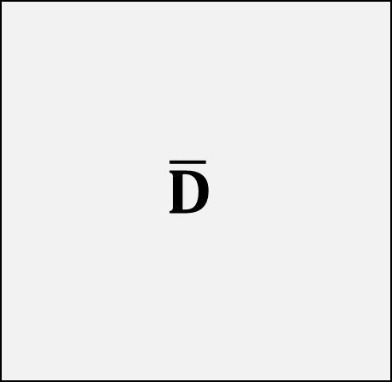
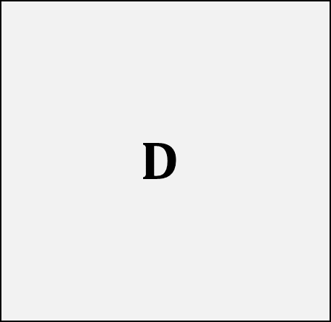



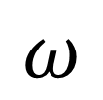

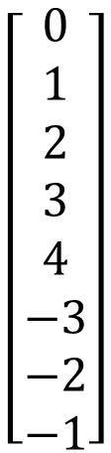
FFT2
Dbar = np.fft.fft2(D);
IFFT2
D = np.fft.ifft2(Dbar);
$$\left[\begin{matrix}0 \\ 1 \\ 2 \\ 3 \\ 4 \\ 5 \\ 6 \\ 7\end{matrix}\right]$$
$$D$$
$$\left[\begin{matrix}0 \\ 1 \\ 2 \\ 3 \\ 4 \\ −3 \\ −2 \\ −1\end{matrix}\right]$$
$$\overline{D}$$
$$x$$
$$k$$
$$\left[\begin{matrix}0 & 1 & 2 & 3 & 4 & 5 & 6 & 7\end{matrix}\right]$$
$$\left[\begin{matrix}0 & 1 & 2 & 3 & 4 & −3 & −2 & −1\end{matrix}\right]$$
$$t$$
$$ω$$
Notes:
Mention that this brings the discussion back techniques that they already understand, that is,
linear models and their solution by least squares.

Slide 8
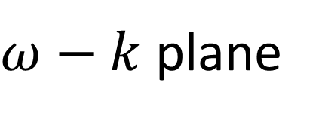






$ω−k$ plane
$$k$$
$$k_{ny}$$
$$ω$$
$${−ω}_{ny}$$
$$ω_{ny}$$
$${−k}_{ny}$$

Slide 9

$ω−k$ plane
$$k$$
$$k_{ny}$$
$$ω_{0},k_{0}$$
$$ω$$
$${−ω}_{ny}$$
$$ω_{ny}$$
$${−k}_{ny}$$

Slide 10

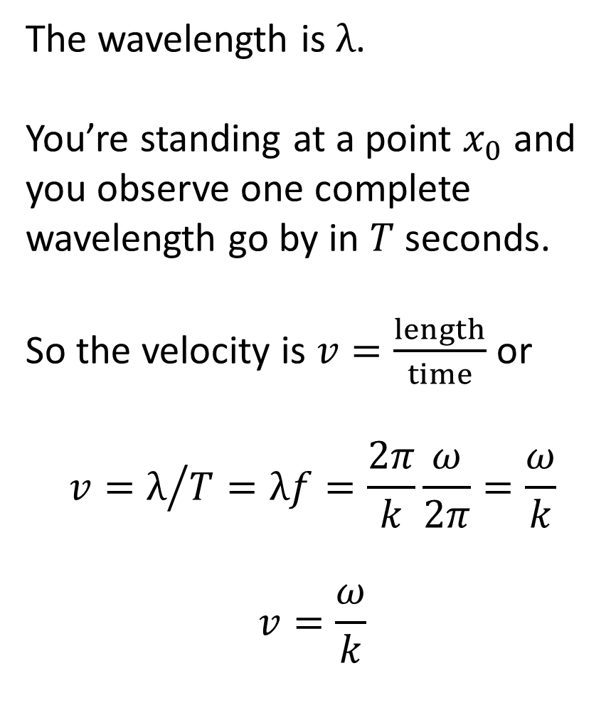




velocity = frequency times wavelength
The wavelength is $λ$.
You’re standing at a point $x_{0}$ and you observe one complete wavelength go by in $T$ seconds.
So the velocity is $v=\frac{length}{time}$ or
$$v=λ/{T=λf=\frac{2π}{k}\frac{ω}{2π}=\frac{ω}{k}}$$
$$v=\frac{ω}{k}$$
$$λ$$
$$x$$
$$x_{0}$$
$$T$$
$$x$$

Slide 11

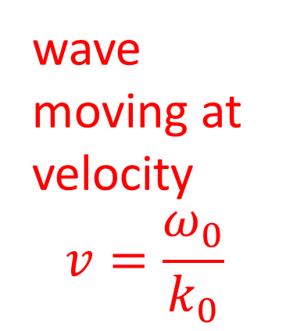
$ω−k$ plane
$$k$$
wave moving at velocity
$$v=\frac{ω_{0}}{k_{0}}$$
$$k_{ny}$$
$$\overline{u}\left(ω_{0},k_{0}\right)$$
$$ω$$
$${−ω}_{ny}$$
$$ω_{ny}$$
$${−k}_{ny}$$

Slide 12
$ω−k$ plane
$$k$$
$$k_{ny}$$
to get a real cosine wave you have to add this point
with the same
amplitude
$$\overline{u}\left(ω_{0},k_{0}\right)$$
$$ω$$
$${−ω}_{ny}$$
$$ω_{ny}$$
$${−k}_{ny}$$

Slide 13
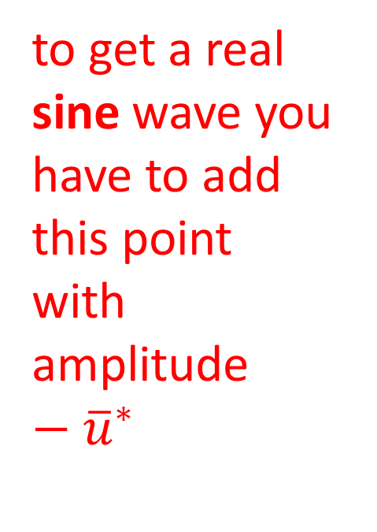
$ω−k$ plane
$$k$$
$$k_{ny}$$
to get a real sine wave you have to add this point
with amplitude $−{\overline{u}}^{∗}$
$$\overline{u}\left(ω_{0},k_{0}\right)$$
$$ω$$
$${−ω}_{ny}$$
$$ω_{ny}$$
$${−k}_{ny}$$

Slide 14

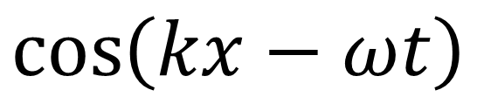

$$\left[\begin{matrix}0 \\ 1 \\ 2 \\ 3 \\ 4 \\ −3 \\ −2 \\ −1\end{matrix}\right]$$
$$\overline{D}$$
$$1$$
$$\cos\left(kx−ωt\right)$$
IFFT2
$$k$$
$$1$$
$$\left[\begin{matrix}0 & 1 & 2 & 3 & 4 & −3 & −2 & −1\end{matrix}\right]$$
$$ω$$
Notes:
Mention that this brings the discussion back techniques that they already understand, that is,
linear models and their solution by least squares.

Slide 15
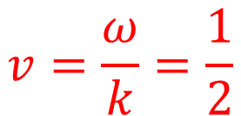
$$v=\frac{ω}{k}=\frac{1}{2}$$
$$\left[\begin{matrix}0 \\ 1 \\ 2 \\ 3 \\ 4 \\ −3 \\ −2 \\ −1\end{matrix}\right]$$
$$\overline{D}$$
$$1$$
$$\cos\left(kx−ωt\right)$$
IFFT2
$$k$$
$$1$$
$$\left[\begin{matrix}0 & 1 & 2 & 3 & 4 & −3 & −2 & −1\end{matrix}\right]$$
$$ω$$
Notes:
Mention that this brings the discussion back techniques that they already understand, that is,
linear models and their solution by least squares.

Slide 16
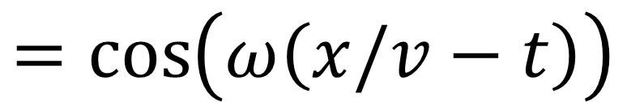
$$\left[\begin{matrix}0 \\ 1 \\ 2 \\ 3 \\ 4 \\ −3 \\ −2 \\ −1\end{matrix}\right]$$
$$\overline{D}$$
$$1$$
$$\cos\left(kx−ωt\right)$$
IFFT2
$$k$$
$$1$$
$$=cos\left(ω\left(x/v−t\right)\right)$$
$$\left[\begin{matrix}0 & 1 & 2 & 3 & 4 & −3 & −2 & −1\end{matrix}\right]$$
$$ω$$
Notes:
Mention that this brings the discussion back techniques that they already understand, that is,
linear models and their solution by least squares.

Slide 17
# sine wave
ut = np.zeros((Nt,Nx),dtype=complex);
iw=4;
ik=3;
v = w[iw,0]/k[ik,0];
ut[iw,ik] = complex(0.0,1.0);
ut[Nt-iw,Nx-ik] = np.conj(ut[iw,ik]);
# inverse fourier transform
u = np.fft.ifft2(ut);
u = np.real(u);

Slide 18
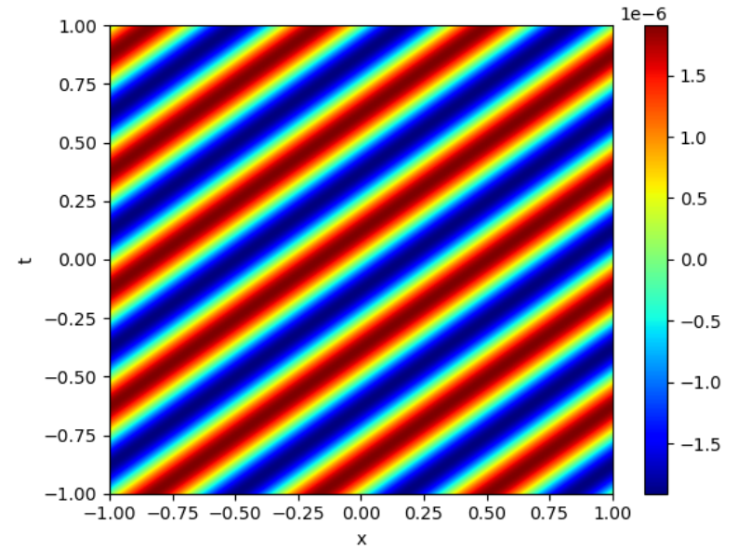

Slide 19
# can do any number of dimensions
ut = np.zeros((Nt,Nx,Ny),dtype=complex);
FFTn
Dbar = np.fft.fftn(D);
IFFTn
D = np.fft.ifftn(Dbar);
Notes:
Mention that this brings the discussion back techniques that they already understand, that is,
linear models and their solution by least squares.

Slide 20
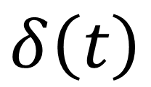



A useful fact
$$δ\left(t\right)$$
Impulse function $δ\left(t\right)$ ....
$$t$$
$$0$$

Slide 21
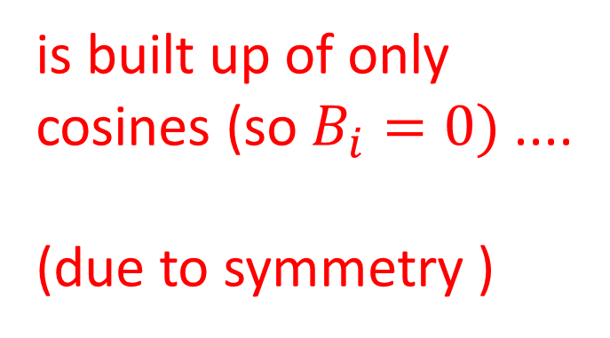
$$δ\left(t\right)$$
is built up of only
cosines (so $B_{i}=0)$....
(due to symmetry )
$$t$$
$$0$$

Slide 22
$$δ\left(t\right)$$
... and all the cosines have the same amplitude of 2
$$t$$
$$0$$

Slide 23
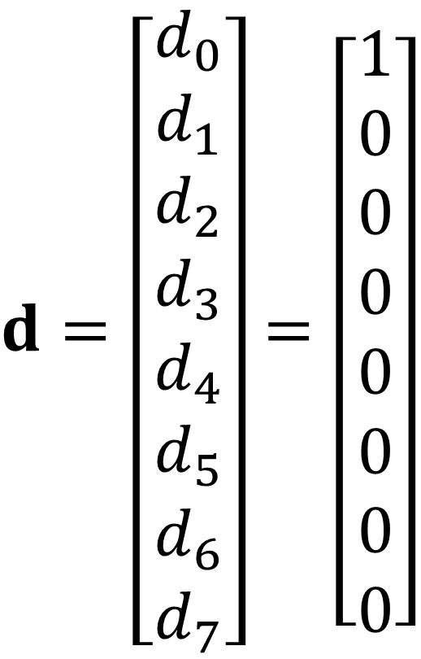
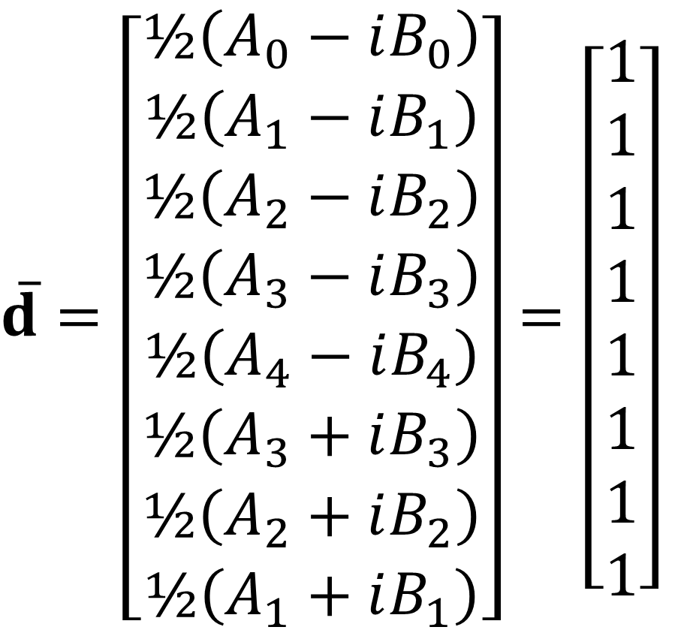
$\overline{d}=\left[\begin{matrix}½\left(A_{0}−iB_{0}\right) \\ ½\left(A_{1}−iB_{1}\right) \\ ½\left(A_{2}−iB_{2}\right) \\ ½\left(A_{3}−iB_{3}\right) \\ ½\left(A_{4}−iB_{4}\right) \\ ½\left(A_{3}+iB_{3}\right) \\ ½\left(A_{2}+iB_{2}\right) \\ ½\left(A_{1}+iB_{1}\right)\end{matrix}\right]$ $=\left[\begin{matrix}1 \\ 1 \\ 1 \\ 1 \\ 1 \\ 1 \\ 1 \\ 1\end{matrix}\right]$
$d=\left[\begin{matrix}d_{0} \\ d_{1} \\ d_{2} \\ d_{3} \\ d_{4} \\ d_{5} \\ d_{6} \\ d_{7}\end{matrix}\right]$ $=\left[\begin{matrix}1 \\ 0 \\ 0 \\ 0 \\ 0 \\ 0 \\ 0 \\ 0\end{matrix}\right]$

Slide 24

Using Fourier Transforms to model acoustic waves in $\left(x,y,t\right)$

Slide 25

acoustic wave equation
based on newton’s law
$$m a=f$$

Slide 26
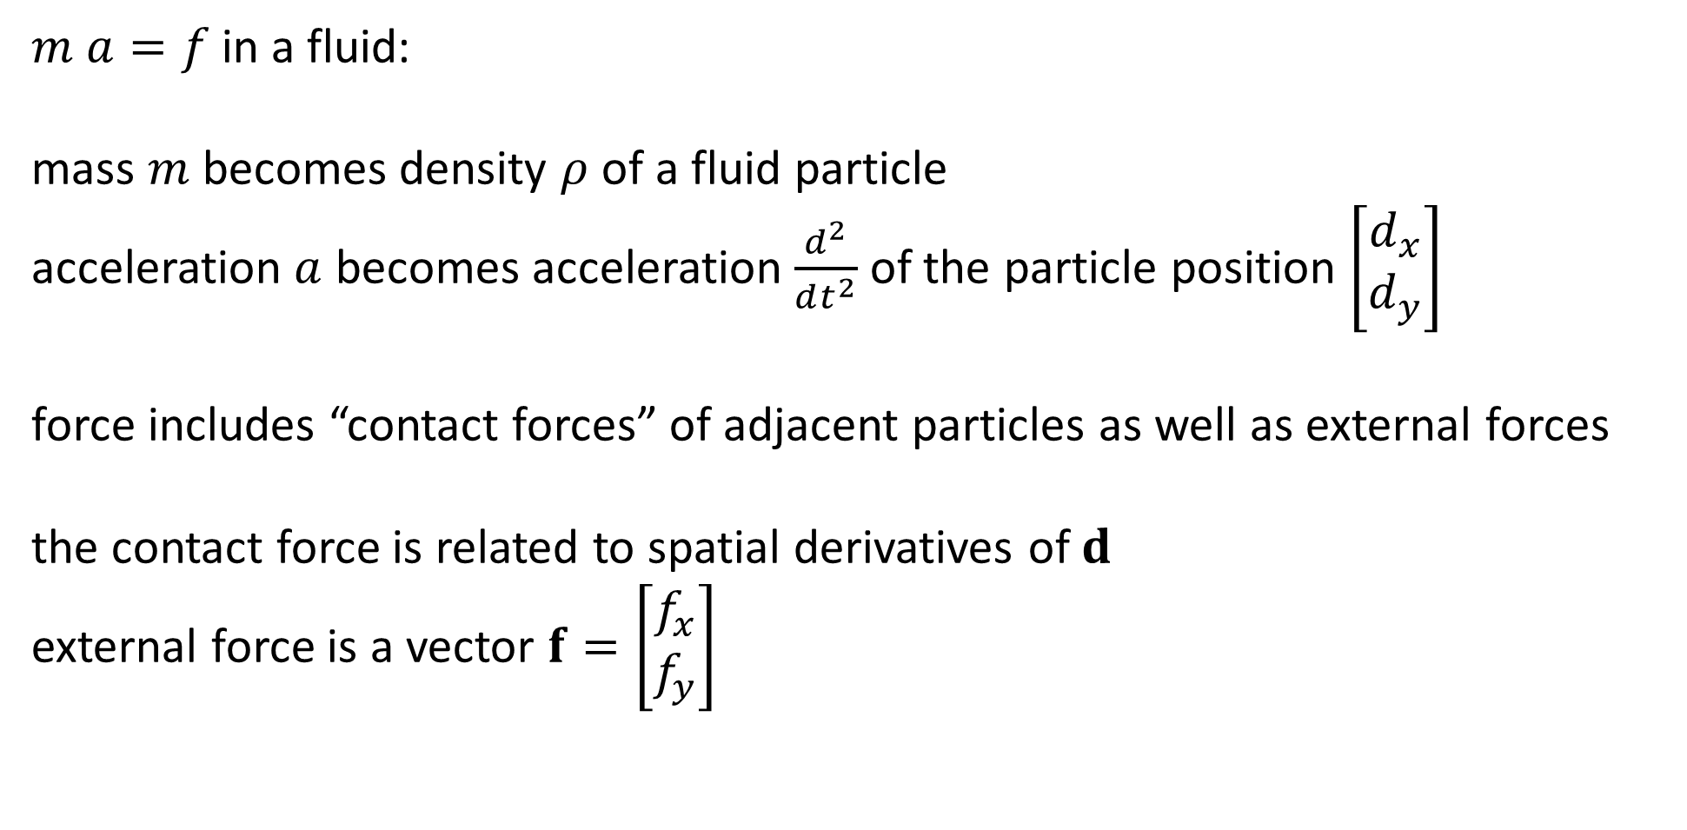
$m a=f$in a fluid:
mass $m$ becomes density $ρ$ of a fluid particle
acceleration $a$ becomes acceleration $\frac{d^{2}}{dt^{2}}$ of the particle position $\left[\begin{matrix}d_{x} \\ d_{y}\end{matrix}\right]$
force includes “contact forces” of adjacent particles as well as external forces
the contact force is related to spatial derivatives of $d$
external force is a vector $f=\left[\begin{matrix}f_{x} \\ f_{y}\end{matrix}\right]$

Slide 27

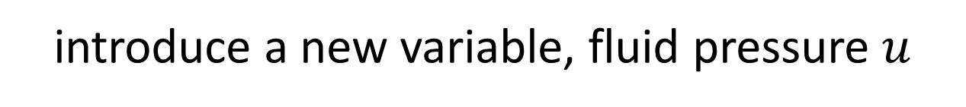
introduce a new variable, fluid pressure $u$
$$u=−κ\left(\frac{dd_{x}}{dx}+\frac{dd_{y}}{dy}\right)$$
pressure goes up as particles move towards one another
compressibility of the fluid $κ$

Slide 28
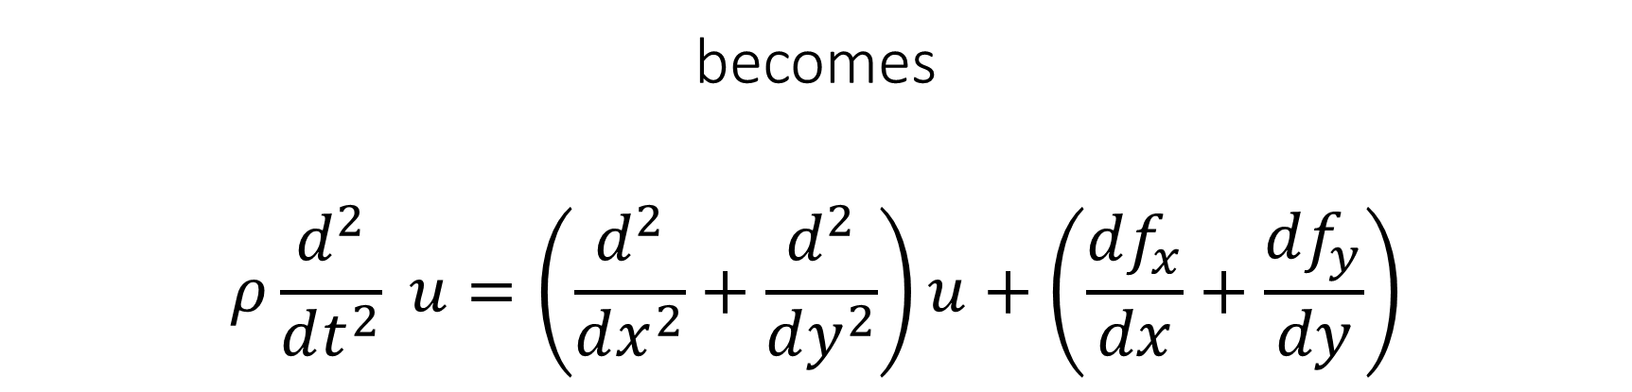

$$m a=f$$
becomes
$$ρ\frac{d^{2}}{dt^{2}} u=\left(\frac{d^{2}}{dx^{2}}+\frac{d^{2}}{dy^{2}}\right)u+\left(\frac{df_{x}}{dx}+\frac{df_{y}}{dy}\right)$$
acceleration
contact force
external force

Slide 29
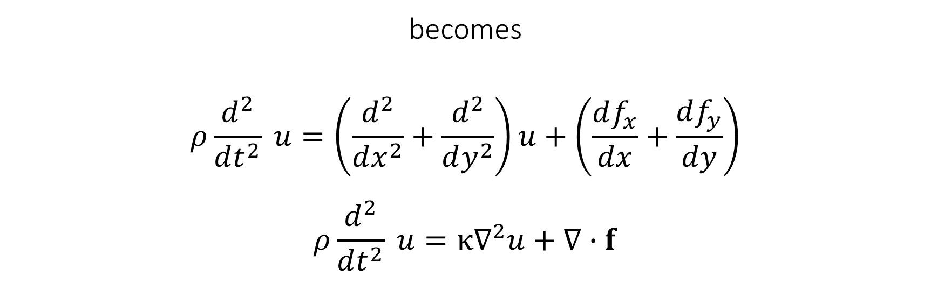
$$m a=f$$
becomes
$$ρ\frac{d^{2}}{dt^{2}} u=\left(\frac{d^{2}}{dx^{2}}+\frac{d^{2}}{dy^{2}}\right)u+\left(\frac{df_{x}}{dx}+\frac{df_{y}}{dy}\right)$$
$$ρ\frac{d^{2}}{dt^{2}} u=κ∇^{2}u+∇∙f$$

Slide 30

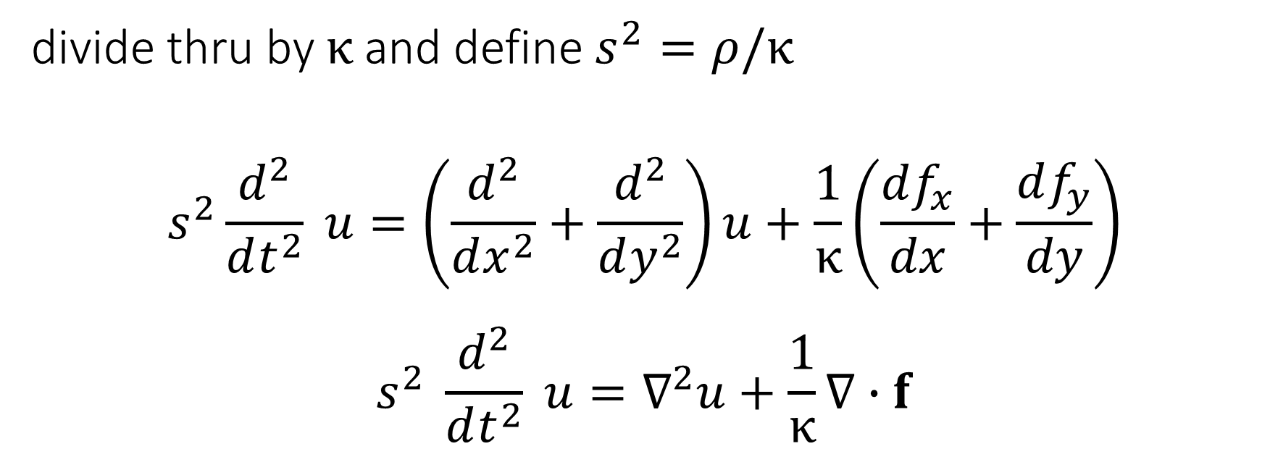

divide thru by $κ$ and define $s^{2}=ρ/κ$
$$s^{2}\frac{d^{2}}{dt^{2}} u=\left(\frac{d^{2}}{dx^{2}}+\frac{d^{2}}{dy^{2}}\right)u+\frac{1}{κ}\left(\frac{df_{x}}{dx}+\frac{df_{y}}{dy}\right)$$
$$s^{2} \frac{d^{2}}{dt^{2}} u=∇^{2}u+\frac{1}{κ}∇∙f$$
but we’ll assume $κ=1$ for simplicity
$s$ is slowness, by the way

Slide 31
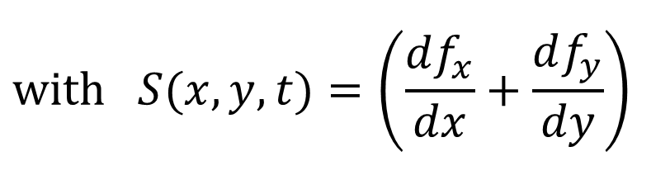
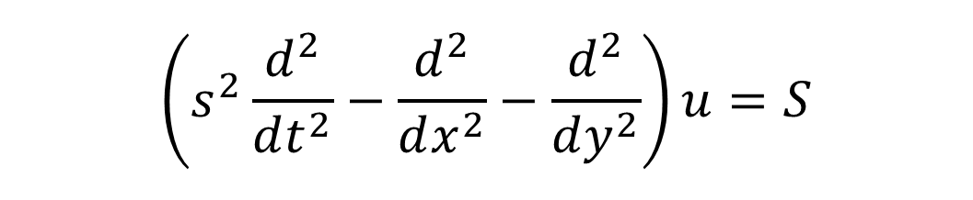
Acoustic wave equation
$$\left(s^{2}\frac{d^{2}}{dt^{2}}−\frac{d^{2}}{dx^{2}}−\frac{d^{2}}{dy^{2}}\right)u=S$$
$$with S(x,y,t)=\left(\frac{df_{x}}{dx}+\frac{df_{y}}{dy}\right)$$

Slide 32

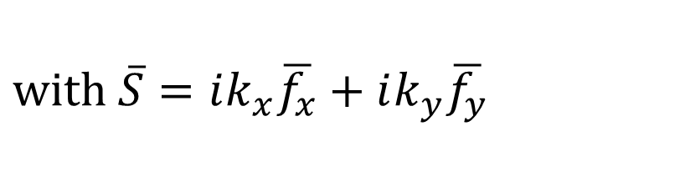
Acoustic wave equation
$$\left(s^{2}\frac{d^{2}}{dt^{2}}−\frac{d^{2}}{dx^{2}}−\frac{d^{2}}{dy^{2}}\right)u=S$$
$$with S(x,y,t)=\left(\frac{df_{x}}{dx}+\frac{df_{y}}{dy}\right)$$
It’s Fourier transform
$$\left({{−s}^{2}ω}^{2}+k_{x}^{2}−k_{x}^{2}\right) \overline{u}=\overline{S}$$
$$with \overline{S}=ik_{x}\overline{f_{x}}+ik_{y}\overline{f_{y}}$$

Slide 33
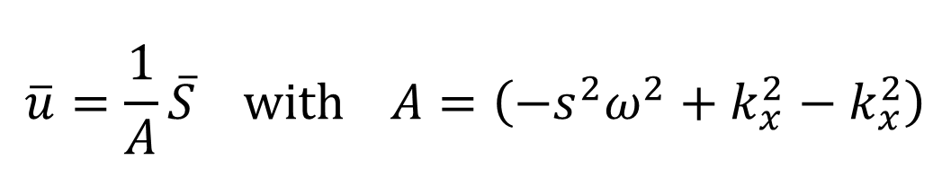
Acoustic wave equation
$$\left(s^{2}\frac{d^{2}}{dt^{2}}−\frac{d^{2}}{dx^{2}}−\frac{d^{2}}{dy^{2}}\right)u=S$$
$$with S(x,y,t)=\left(\frac{df_{x}}{dx}+\frac{df_{y}}{dy}\right)$$
It’s Fourier transform
$$\left({{−s}^{2}ω}^{2}+k_{x}^{2}−k_{x}^{2}\right) \overline{u}=\overline{S}$$
$$with \overline{S}=ik_{x}\overline{f_{x}}+ik_{y}\overline{f_{y}}$$
The transformed solution
$$\overline{u}=\frac{1}{A}\overline{S} with A=\left({{−s}^{2}ω}^{2}+k_{x}^{2}−k_{x}^{2}\right)$$

Slide 34

Acoustic wave equation
$$\left(s^{2}\frac{d^{2}}{dt^{2}}−\frac{d^{2}}{dx^{2}}−\frac{d^{2}}{dy^{2}}\right)u=S$$
$$with S(x,y,t)=\left(\frac{df_{x}}{dx}+\frac{df_{y}}{dy}\right)$$
It’s Fourier transform
$$\left({{−s}^{2}ω}^{2}+k_{x}^{2}−k_{x}^{2}\right) \overline{u}=\overline{S}$$
$$with \overline{S}=ik_{x}\overline{f_{x}}+ik_{y}\overline{f_{y}}$$
The transformed solution
$$\overline{u}=\frac{1}{A}\overline{S} with A=\left({{−s}^{2}ω}^{2}+k_{x}^{2}−k_{x}^{2}\right)$$
And then an inverse Fourier transform to get $u$

Slide 35
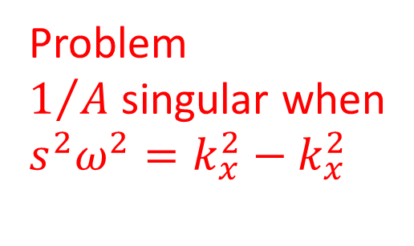
Acoustic wave equation
$$\left(s^{2}\frac{d^{2}}{dt^{2}}−\frac{d^{2}}{dx^{2}}−\frac{d^{2}}{dy^{2}}\right)u=S$$
$$with S(x,y,t)=\left(\frac{df_{x}}{dx}+\frac{df_{y}}{dy}\right)$$
It’s Fourier transform
$$\left({{−s}^{2}ω}^{2}+k_{x}^{2}−k_{x}^{2}\right) \overline{u}=\overline{S}$$
$$with \overline{S}=ik_{x}\overline{f_{x}}+ik_{y}\overline{f_{y}}$$
The transformed solution
$$\overline{u}=\frac{1}{A}\overline{S} with A=\left({{−s}^{2}ω}^{2}+k_{x}^{2}−k_{x}^{2}\right)$$
Problem
$1/A$ singular when
$${s^{2}ω}^{2}=k_{x}^{2}−k_{x}^{2}$$
And then an inverse Fourier transform to get $u$

Slide 36

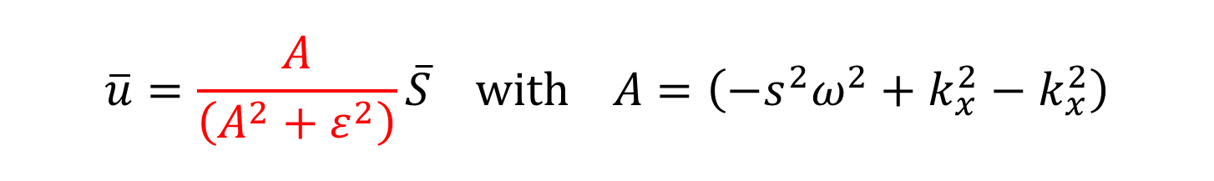
Acoustic wave equation
$$\left(s^{2}\frac{d^{2}}{dt^{2}}−\frac{d^{2}}{dx^{2}}−\frac{d^{2}}{dy^{2}}\right)u=S$$
$$with S(x,y,t)=\left(\frac{df_{x}}{dx}+\frac{df_{y}}{dy}\right)$$
It’s Fourier transform
$$\left({{−s}^{2}ω}^{2}+k_{x}^{2}−k_{x}^{2}\right) \overline{u}=\overline{S}$$
$$with \overline{S}=ik_{x}\overline{f_{x}}+ik_{y}\overline{f_{y}}$$
The transformed solution
$$\overline{u}=\frac{A}{\left(A^{2}+ε^{2}\right)}\overline{S} with A=\left({{−s}^{2}ω}^{2}+k_{x}^{2}−k_{x}^{2}\right)$$
Solution is to approximate with a non-singular fucntion
$${with ε^{2}≪A}^{2}$$
And then an inverse Fourier transform to get $u$

Slide 37

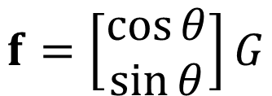

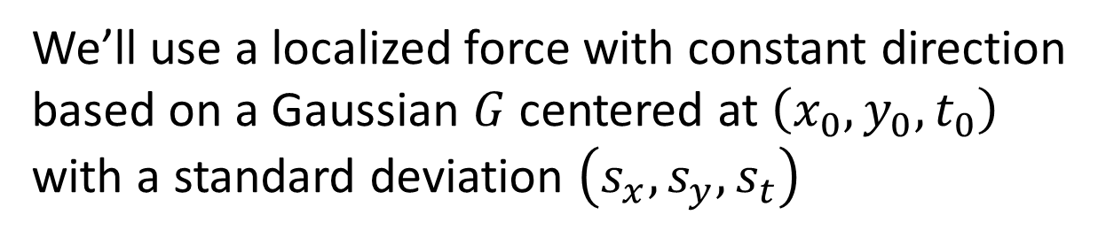



We’ll use a localized force with constant direction
based on a Gaussian $G$ centered at $\left(x_{0},y_{0},t_{0}\right)$
with a standard deviation $\left(s_{x},s_{y},s_{t}\right)$
$$x$$
$$θ$$
$$f$$
$$f=\left[\begin{matrix}\cos{θ} \\ \sin{θ}\end{matrix}\right]G$$
$$G$$
$$\left(x_{0},y_{0}\right)$$

Slide 38
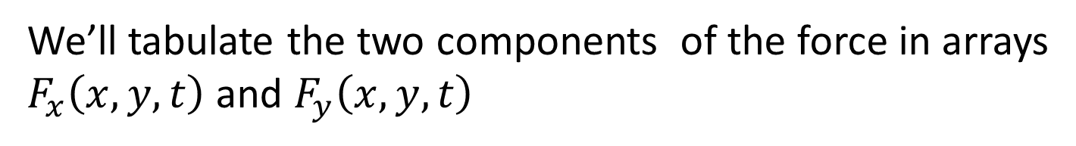
We’ll use a localized force with constant direction
based on a Gaussian $G$ centered at $\left(x_{0},y_{0},t_{0}\right)$
with a standard deviation $\left(s_{x},s_{y},s_{t}\right)$
$$x$$
$$θ$$
$$f$$
$$f=\left[\begin{matrix}\cos{θ} \\ \sin{θ}\end{matrix}\right]G$$
$$G$$
$$\left(x_{0},y_{0}\right)$$
We’ll tabulate the two components of the force in arrays
$F_{x}\left(x,y,t\right)$ and $F_{y}\left(x,y,t\right)$
and compute their Fourier transforms numerically

Slide 39
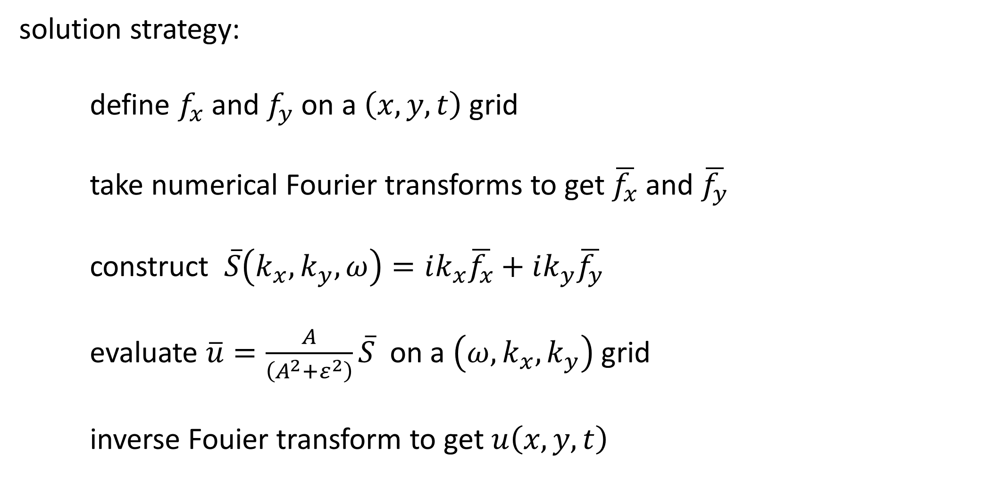
solution strategy:
define $f_{x}$ and $f_{y}$ on a $\left(x,y,t\right)$grid
take numerical Fourier transforms to get $\overline{f_{x}}$ and $\overline{f_{y}}$
construct $\overline{S}\left(k_{x},k_{y},ω\right)=ik_{x}\overline{f_{x}}+ik_{y}\overline{f_{y}}$
evaluate $\overline{u}=\frac{A}{\left(A^{2}+ε^{2}\right)}\overline{S}$ on a $\left(ω,k_{x},k_{y}\right)$ grid
inverse Fouier transform to get $u\left(x,y,t\right)$

Slide 40
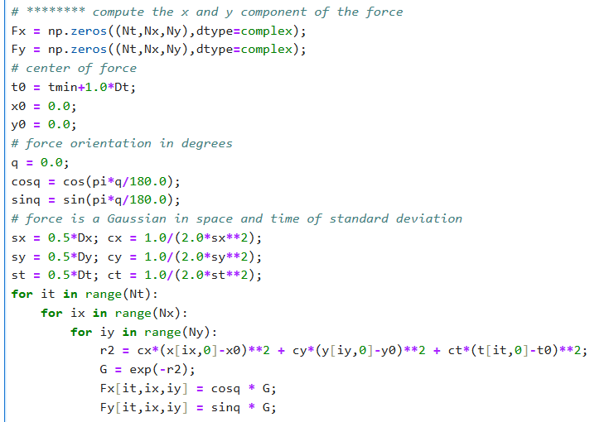
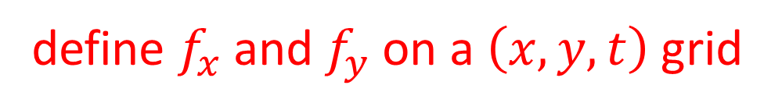
define $f_{x}$ and $f_{y}$ on a $\left(x,y,t\right)$grid

Slide 41
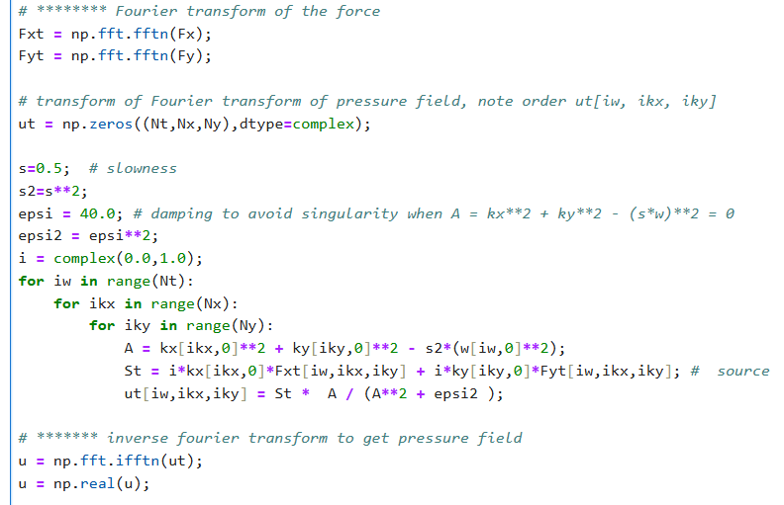

take numerical Fourier transforms to get $\overline{f_{x}}$ and $\overline{f_{y}}$
construct $\overline{S}\left(k_{x},k_{y},ω\right)=ik_{x}\overline{f_{x}}+ik_{y}\overline{f_{y}}$
evaluate $\overline{u}=\frac{A}{\left(A^{2}+ε^{2}\right)}\overline{S}$ on a $\left(ω,k_{x},k_{y}\right)$ grid
inverse Fouier transform to get $u\left(x,y,t\right)$

Slide 42
