Slide 1
2025 EESC W3400
Computational Earth Science
Lec 18: Vibrations of 1D finite bodies

Slide 2
Today
Vibrations of finite bodies
E.g. Organ pipe, bell, Earth
Similar to the Fourier Transform

Slide 3
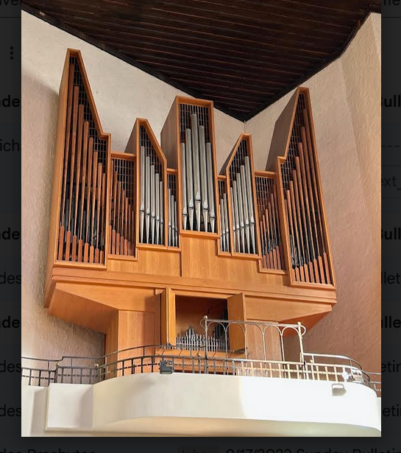

Slide 4
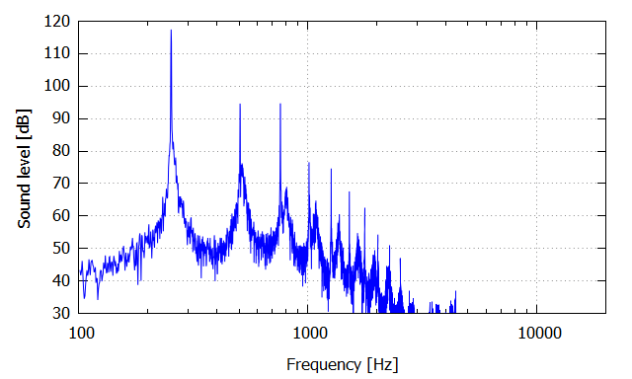
PSD of one continuously-played pipe

Slide 5
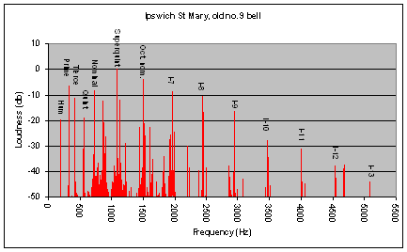
PSD of bell

Slide 6
PSD of ground motion at one observer on the earth’s surface after a very large earthquake

Slide 7
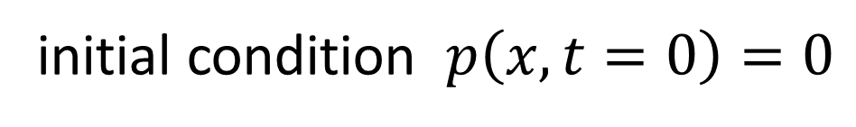
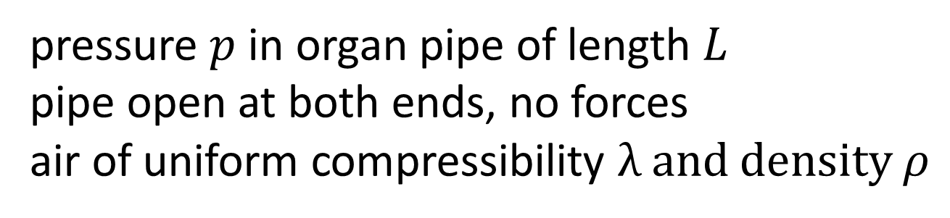




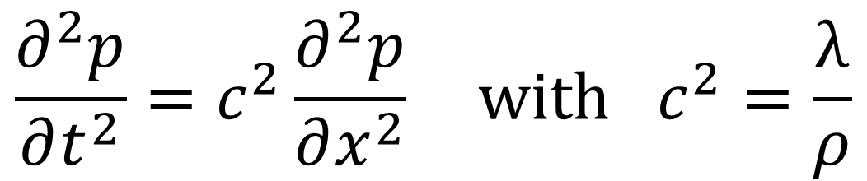

pressure $p$ in organ pipe of length $L$
pipe open at both ends, no forces
air of uniform compressibility λ and density $ρ$
$$x$$
$$0$$
$$L$$
$$p\left(x=0\right)=0$$
$$p\left(x=L\right)=0$$
$$\frac{∂^{2}p}{∂t^{2}}=c^{2}\frac{∂^{2}p}{∂x^{2}} with c^{2}=\frac{\text{λ}}{ρ}$$
initial condition $p\left(x,t=0\right)=0$

Slide 8
MODE
spatial pattern of pressure
with sinusoidal time variation

Slide 9
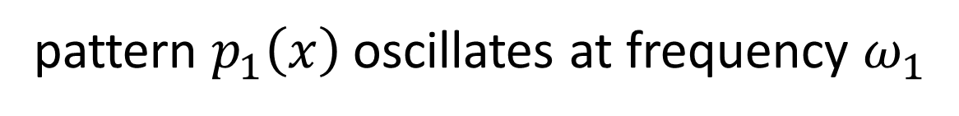


MODE
spatial pattern of pressure
with sinusoidal time variation
$$p\left(x,t\right)=p_{n}\left(x\right) \sin\left(ω_{n}t\right)$$
MODE
spatial pattern of pressure
with sinusoidal time variation
pattern $p_{1}\left(x\right)$ oscillates at frequency $ω_{1}$
pattern $p_{2}\left(x\right)$ oscillates at frequency $ω_{2}$
...

Slide 10
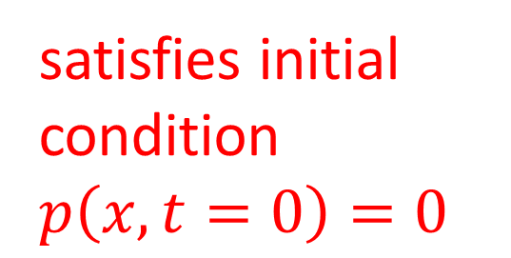
MODE
spatial pattern of pressure
with sinusoidal time variation
$$p\left(x,t\right)=p_{n}\left(x\right) \sin\left(ω_{n}t\right)$$
MODE
spatial pattern of pressure
with sinusoidal time variation
satisfies initial condition $p\left(x,t=0\right)=0$
pattern $p_{1}\left(x\right)$ oscillates at frequency $ω_{1}$
pattern $p_{2}\left(x\right)$ oscillates at frequency $ω_{2}$
...

Slide 11
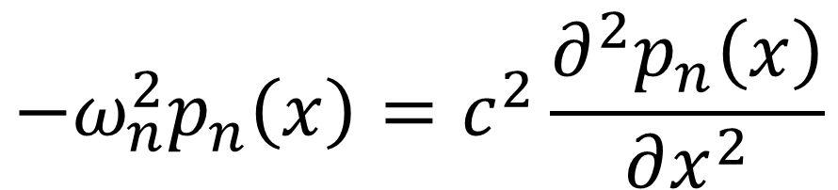

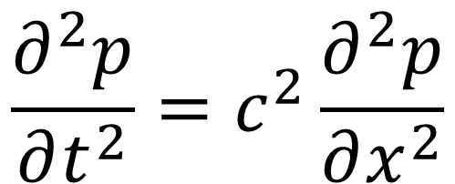
$$p\left(x,t\right)=p_{n}\left(x\right) \sin\left(ω_{n}t\right)$$
$$\frac{∂^{2}p}{∂t^{2}}=c^{2}\frac{∂^{2}p}{∂x^{2}}$$
$$−ω_{n}^{2}p_{n}\left(x\right)=c^{2}\frac{∂^{2}p_{n}\left(x\right)}{∂x^{2}}$$

Slide 12
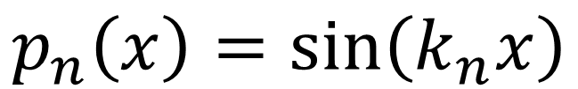
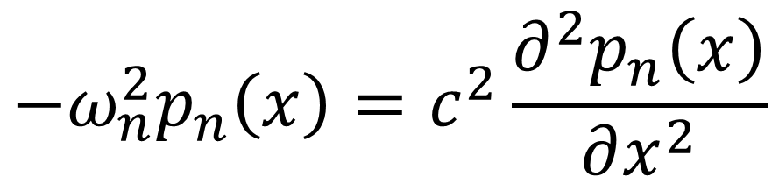
$$−ω_{n}^{2}p_{n}\left(x\right)=c^{2}\frac{∂^{2}p_{n}\left(x\right)}{∂x^{2}}$$
try
$$p_{n}\left(x\right)=\sin\left(k_{n}x\right)$$
$$−ω_{n}^{2}\sin\left(k_{n}x\right)=−c^{2}k_{n}^{2}\sin\left(k_{n}x\right)$$

Slide 13
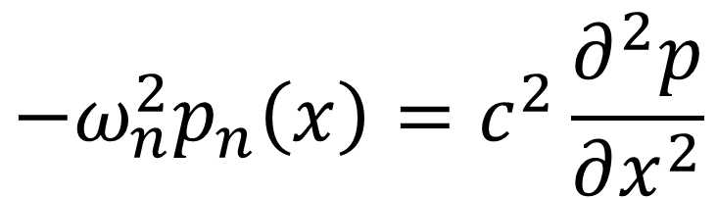
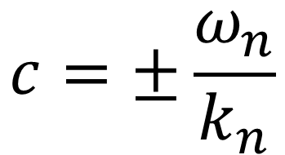
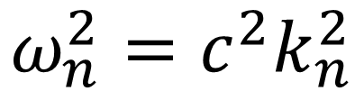
$$−ω_{n}^{2}p_{n}\left(x\right)=c^{2}\frac{∂^{2}p}{∂x^{2}}$$
try
$$p_{n}\left(x\right)=\sin\left(k_{n}x\right)$$
$$−ω_{n}^{2}\sin\left(k_{n}x\right)=−c^{2}k_{n}^{2}\sin\left(k_{n}x\right)$$
$$ω_{n}^{2}=c^{2}k_{n}^{2}$$
$$c=±\frac{ω_{n}}{k_{n}}$$

Slide 14
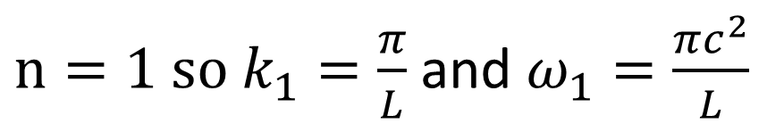




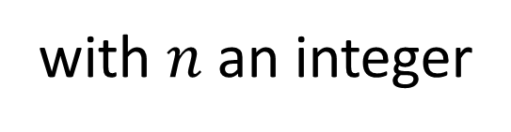

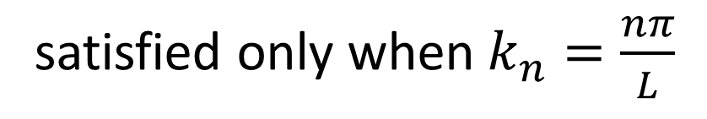

but what about the boundary conditions?
$$p_{n}\left(x=0\right)=\sin\left(k_{n}0\right)=0$$
always satisfied
$$p_{n} \left(x=L\right)=\sin\left(k_{n}L\right)=0$$
satisfied only when $k_{n}=\frac{nπ}{L}$
with $n$ an integer
$n=1 so k_{1}=\frac{π}{L}$ and $ω_{1}=\frac{πc^{2}}{L}$
$$p_{1}$$
$$x$$
$$0$$
$$L$$

Slide 15
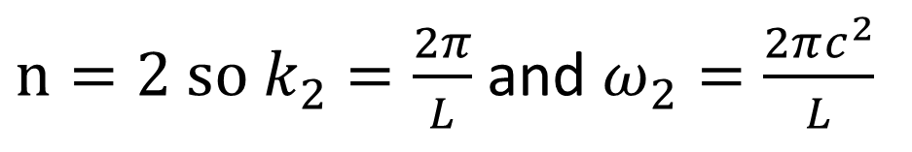

but what about the boundary conditions?
$$p_{n}\left(x=0\right)=\sin\left(k_{n}0\right)=0$$
always satisfied
$$p_{n} \left(x=L\right)=\sin\left(k_{n}L\right)=0$$
satisfied only when $k_{n}=\frac{nπ}{L}$
with $n$ an integer
$n=2 so k_{2}=\frac{2π}{L}$ and $ω_{2}=\frac{2πc^{2}}{L}$
$$p_{2}$$
$$x$$
$$0$$
$$L$$

Slide 16
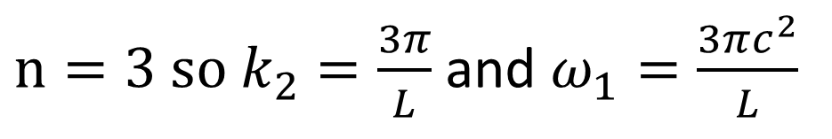

but what about the boundary conditions?
$$p_{n}\left(x=0\right)=\sin\left(k_{n}0\right)=0$$
always satisfied
$$p_{n} \left(x=L\right)=\sin\left(k_{n}L\right)=0$$
satisfied only when $k_{n}=\frac{nπ}{L}$
with $n$ an integer
$n=3 so k_{2}=\frac{3π}{L}$ and $ω_{1}=\frac{3πc^{2}}{L}$
$$p_{3}$$
$$x$$
$$0$$
$$L$$

Slide 17


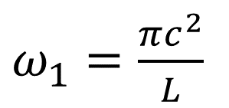
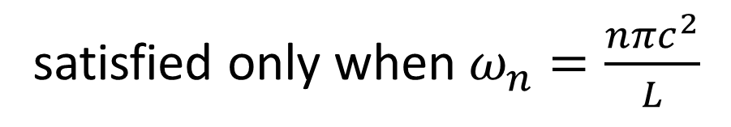
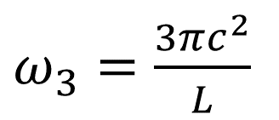




satisfied only when $ω_{n}=\frac{nπc^{2}}{L}$
$ω_{1}=\frac{πc^{2}}{L}$
$ω_{2}=\frac{2πc^{2}}{L}$
modal frequencies
evenly-spaced
$ω_{3}=\frac{3πc^{2}}{L}$
psd
...
$$ω$$
$$0$$
$$ω_{4}$$
$$ω_{1}$$
$$ω_{2}$$
$$ω_{3}$$

Slide 18
second overtone
third overtone
first overtone
fundamental
psd
...
$$ω$$
$$0$$
$$ω_{4}$$
$$ω_{1}$$
$$ω_{2}$$
$$ω_{3}$$

Slide 19
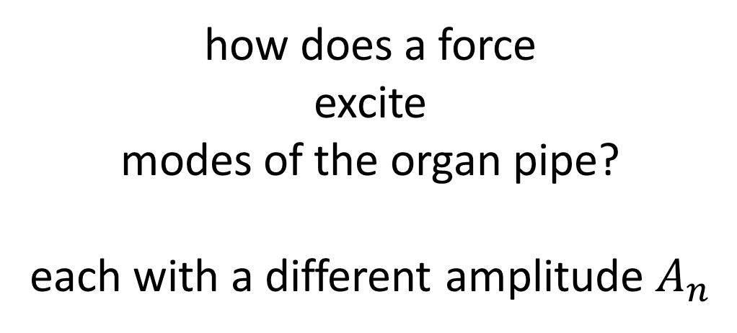
how does a force
excite
modes of the organ pipe?
each with a different amplitude $A_{n}$

Slide 20
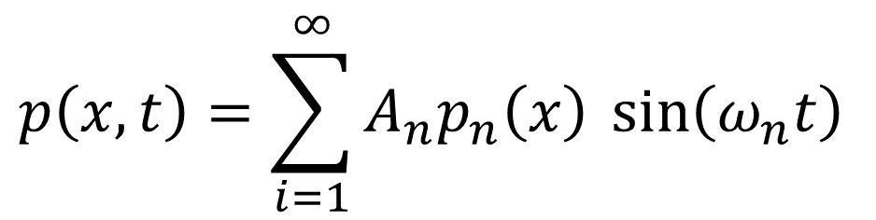
how does a force
excite
modes of the organ pipe?
each with a different amplitude $A_{n}$
$$p\left(x,t\right)=\sum_{i=1}^{∞}{A_{n}p_{n}\left(x\right) \sin\left(ω_{n}t\right)}$$

Slide 21




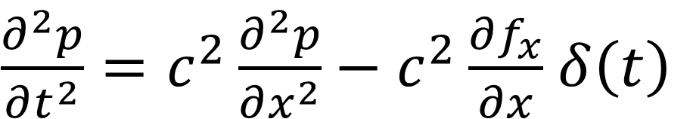
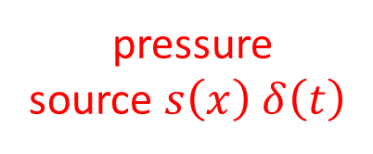
spatially impulsive force $f_{x}=δ\left(x−x_{0}\right)$ that’s also impulsive in time
$$f_{x}$$
$$x$$
$$0$$
$$x_{0}$$
$$L$$
$\frac{∂^{2}p}{∂t^{2}}=c^{2}\frac{∂^{2}p}{∂x^{2}}−c^{2}\frac{∂f_{x}}{∂x}$ $δ\left(t\right)$
equation with a source
pressure
source $s\left(x\right)$ $δ\left(t\right)$

Slide 22

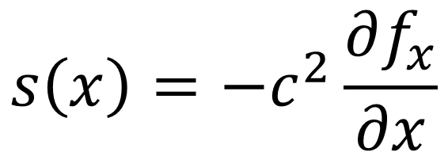

why is pressure source a derivative of the force?
$$−$$
$$+$$
$$x$$
$$0$$
$$x_{0}$$
$$L$$
force causes + pressure ahead, - behind
“dipolar”
$$s\left(x\right)=−c^{2}\frac{∂f_{x}}{∂x}$$

Slide 23
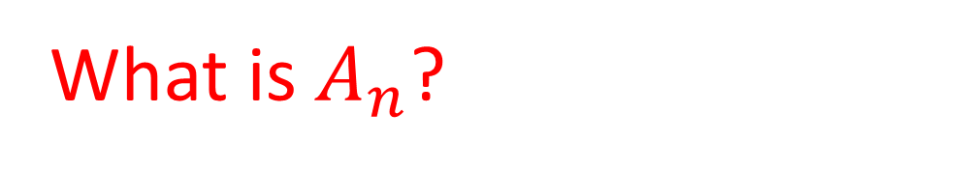
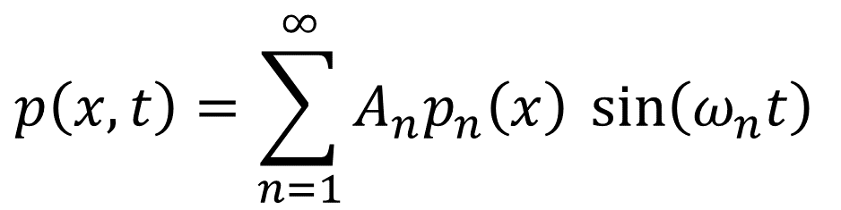
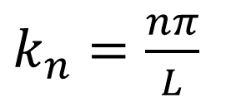
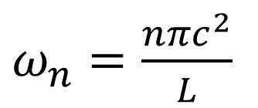
$$p\left(x,t\right)=\sum_{n=1}^{∞}{A_{n}p_{n}\left(x\right) \sin\left(ω_{n}t\right)}$$
$k_{n}=\frac{nπ}{L}$
$ω_{n}=\frac{nπc^{2}}{L}$
$$p_{n}\left(x\right)=\sin\left(k_{n}x\right)$$
What is $A_{n}$?

Slide 24
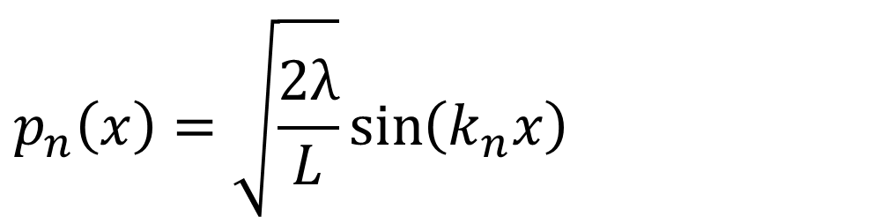
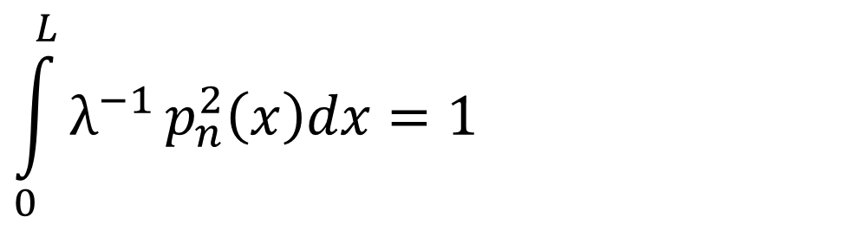
$$p\left(x,t\right)=\sum_{n=1}^{∞}{A_{n}p_{n}\left(x\right) \sin\left(ω_{n}t\right)}$$
$k_{n}=\frac{nπ}{L}$
$ω_{n}=\frac{nπc^{2}}{L}$
chosen so
$$\int_{0}^{L}{λ^{−1}}p_{n}^{2}\left(x\right)dx=1$$
$$p_{n}\left(x\right)=\sqrt{\frac{2λ}{L}}\sin\left(k_{n}x\right)$$

Slide 25
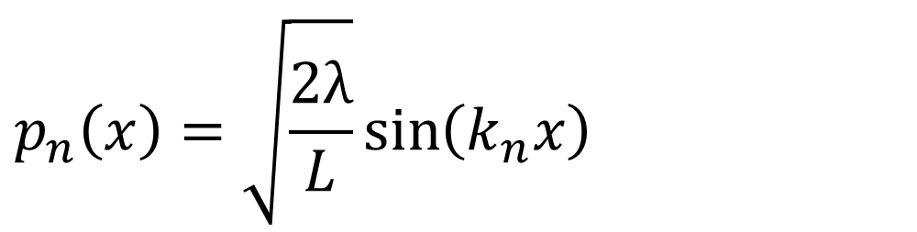
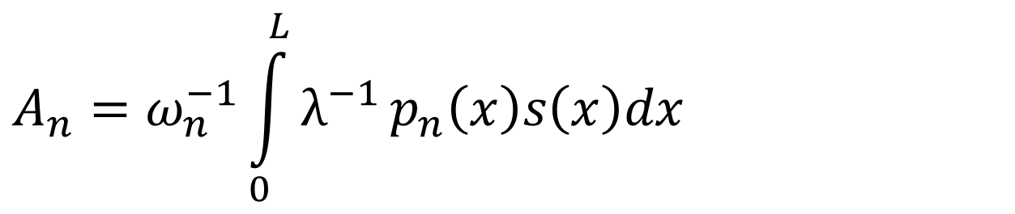
$$p\left(x,t\right)=\sum_{n=1}^{∞}{A_{n}p_{n}\left(x\right) \sin\left(ω_{n}t\right)}$$
$k_{n}=\frac{nπ}{L}$
$ω_{n}=\frac{nπc^{2}}{L}$
$$p_{n}\left(x\right)=\sqrt{\frac{2λ}{L}}\sin\left(k_{n}x\right)$$
$$A_{n}=ω_{n}^{−1}\int_{0}^{L}{λ^{−1}}p_{n}\left(x\right)s\left(x\right)dx$$

Slide 26
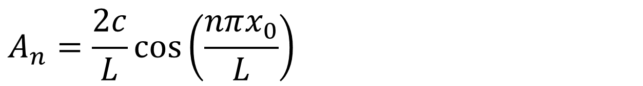

$$p\left(x,t\right)=\sum_{i=1}^{∞}{A_{n}p_{n}\left(x\right) \sin\left(ω_{n}t\right)}$$
$k_{n}=\frac{nπ}{L}$
$ω_{n}=\frac{nπc^{2}}{L}$
$$p_{n}\left(x\right)=\sqrt{\frac{2λ}{L}}\sin\left(k_{n}x\right)$$
$$A_{n}=\frac{2c}{L}\cos\left(\frac{nπx_{0}}{L}\right)$$

Slide 27
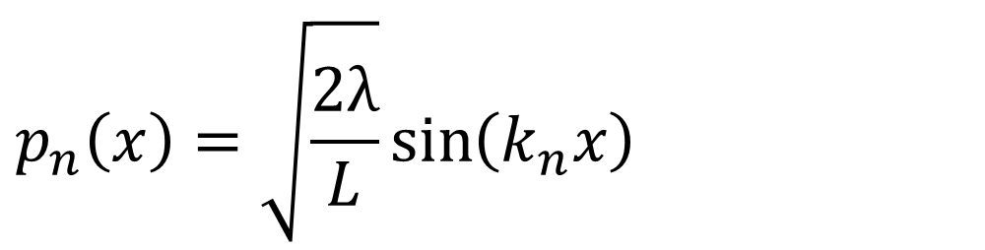
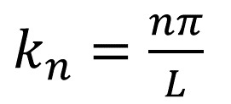

$$p\left(x,t\right)=\sum_{i=1}^{∞}{A_{n}p_{n}\left(x\right) \sin\left(ω_{n}t\right)}$$
$k_{n}=\frac{nπ}{L}$
$ω_{n}=\frac{nπc^{2}}{L}$
$$p_{n}\left(x\right)=\sqrt{\frac{2λ}{L}}\sin\left(k_{n}x\right)$$
code uses this version, because point source is not realistic
$$A_{n}=ω_{n}^{−1}\int_{0}^{L}{λ^{−1}}p_{n}\left(x\right)s\left(x\right)dx$$

Slide 28
# eigenfrequencies and eigenfunction of organ pipe
Nw = 100;
n = gda_cvec(np.linspace(1,Nw,Nw));
wn = n*pi*c/xmax;
pn = sqrt(2*lam/xmax) * np.sin( (pi/xmax)*np.matmul(x, n.T));
all modal shapes stored in a matrix pn[ix,n]

Slide 29



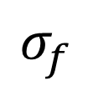


# force has a Gaussian shape
sf = 2.0;
sf2 = sf**2;
x0 = x[ix0,0];
f = (1.0/(sqrt(2*pi)*sf))*np.exp( -0.5*np.power(x-x0,2)/sf2 );
use small bell-shaped force instead of a point force
$$σ_{f}$$
$$f_{x}$$
$$x$$
$$0$$
$$L$$
$$x_{0}$$

Slide 30
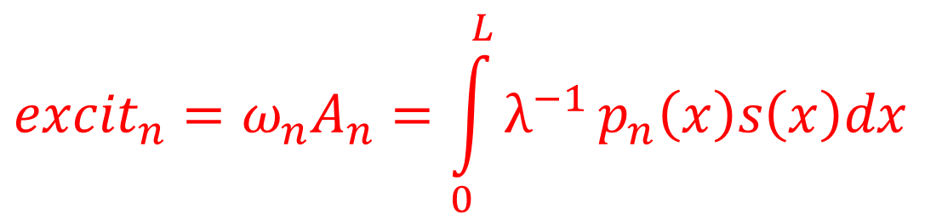
# excitation
excit = np.zeros((Nw,1));
for iw in range(Nw):
# excit = (1/lam) (integral) pn(x) f(s)
p = pn[0:Nx,iw:iw+1];
g = -c2 * np.matmul(D1,f);
excit[iw,0] = (1.0/lam) * Dx * np.sum( np.multiply(p,g) );
excitation of all modes stored in a vector
$${excit}_{n}=ω_{n}A_{n}=\int_{0}^{L}{λ^{−1}}p_{n}\left(x\right)s\left(x\right)dx$$
does the integral
by Reimann summation approximation

Slide 31


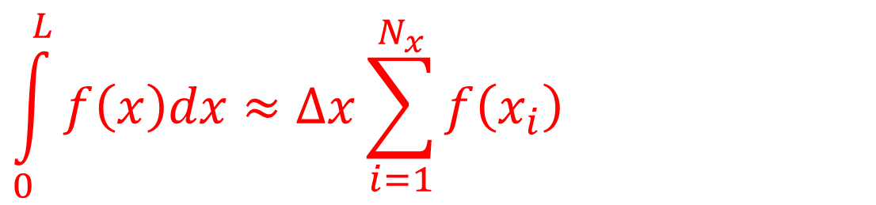




by Reimann summation approximation
$$\int_{0}^{L}{f\left(x\right)dx}≈∆x\sum_{i=1}^{N_{x}}{f\left(x_{i}\right)}$$
$$f\left(x\right)$$
$$≈$$
$$f\left(x\right)$$
$$x$$
$$x$$
$$0$$
$$L$$
$$0$$
$$L$$

Slide 32
by Reimann summation approximation
$$\int_{0}^{L}{f\left(x\right)dx}≈∆x\sum_{i=1}^{N_{x}}{f\left(x_{i}\right)}$$
= Dx * np.sum(f);

Slide 33
# excitation
excit = np.zeros((Nw,1));
for iw in range(Nw):
# excit = (1/lam) (integral) pn(x) f(s)
p = pn[0:Nx,iw:iw+1];
g = -c2 * np.matmul(D1,f);
excit[iw,0] = (1.0/lam) * Dx * np.sum( np.multiply(p,g) );
Reimann approximation

Slide 34
# compute pressure by performing mode sum
P = np.zeros((Nt,Nx));
for iw in range(Nw):
p = pn[0:Nx,iw:iw+1];
tfun = np.sin( wn[iw,0] * t );
P = P + (1.0/wn[iw,0]) * excit[iw,0] * np.matmul(tfun,p.T);
All times and positions calculated at once, P[t,x]
summation code relies very heavily on matrix math to improve speed

Slide 35
# compute pressure by performing mode sum
P = np.zeros((Nt,Nx));
for iw in range(Nw):
p = pn[0:Nx,iw:iw+1];
tfun = np.sin( wn[iw,0] * t );
P = P + (1.0/wn[iw,0]) * excit[iw,0] * np.matmul(tfun,p.T);
All times and positions calculated at once, P[t,x]
summation code relies very leavily on matrix math to improve speed
just 18 lines of code to do it all

Slide 36







Example
?
$$t$$
$$x$$
$$f_{x}$$
$$x$$
$$0$$
$$x_{0}$$
$$L$$

Slide 37
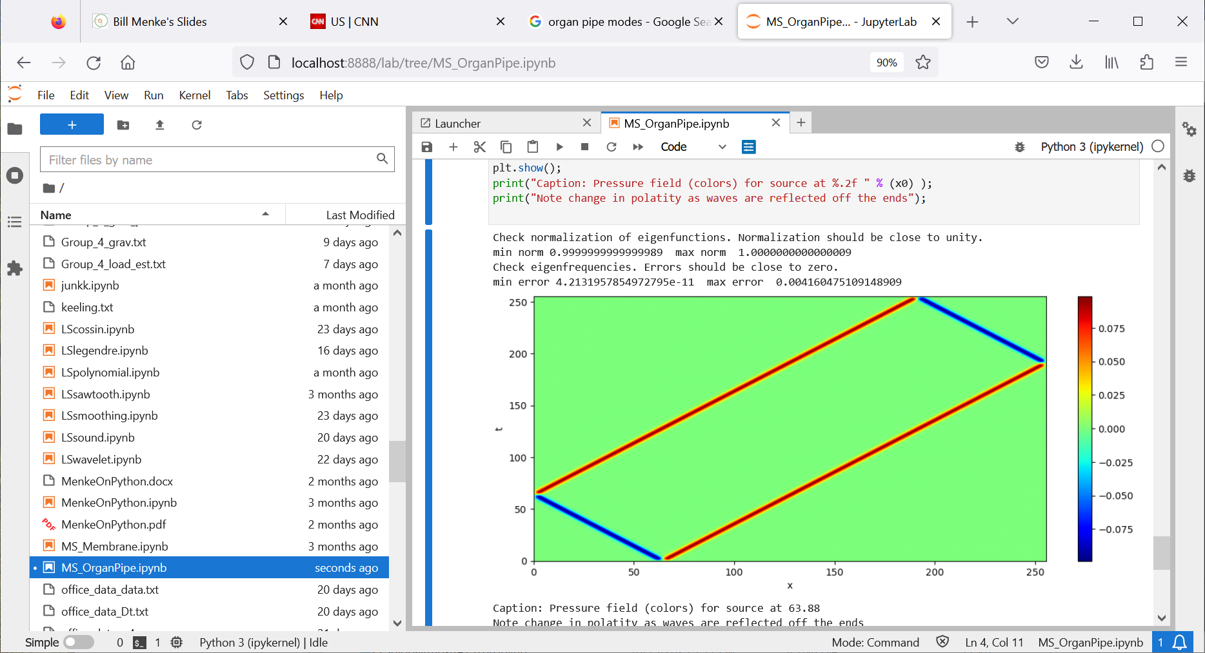



$$f_{x}$$
$$x$$
$$0$$
$$x_{0}$$
$$L$$

Slide 38
Where are the modes?
$$f_{x}$$
$$x$$
$$0$$
$$x_{0}$$
$$L$$

Slide 39
waves moving at velocity of c=1
50
50
$$f_{x}$$
$$x$$
$$0$$
$$x_{0}$$
$$L$$

Slide 40



dipolar near t=0
$$−$$
$$+$$
$$x$$
$$0$$
$$x_{0}$$
$$L$$

Slide 41
reflecting off the boundaries (and with a sign reversal)
$$f_{x}$$
$$x$$
$$0$$
$$x_{0}$$
$$L$$

Slide 42
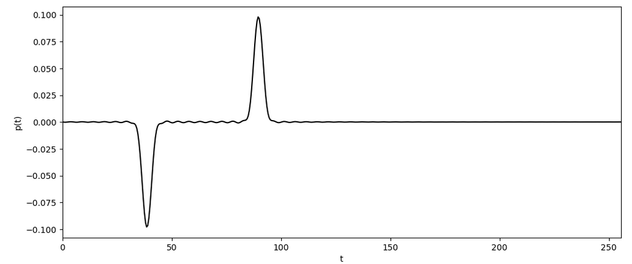
observer
pressure
time

Slide 43
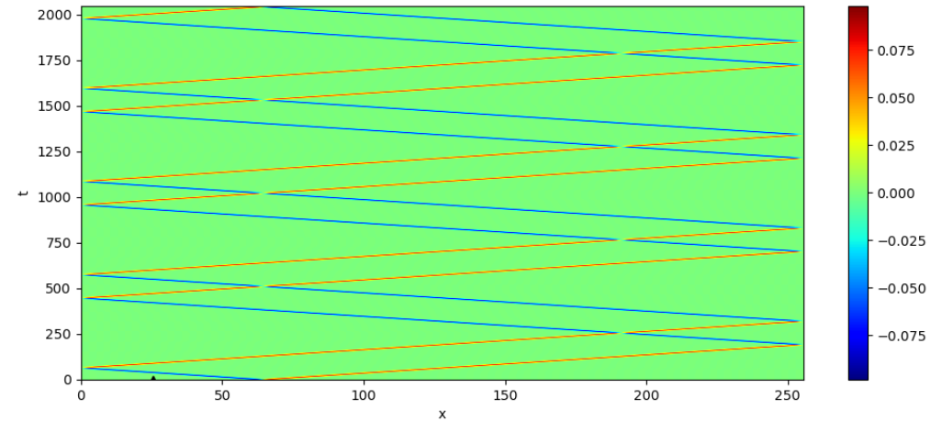
longer time

Slide 44
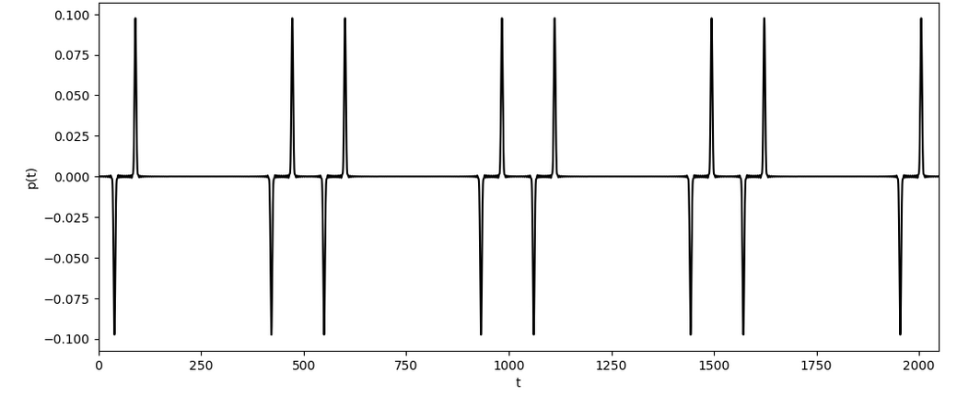
pressure
time

Slide 45
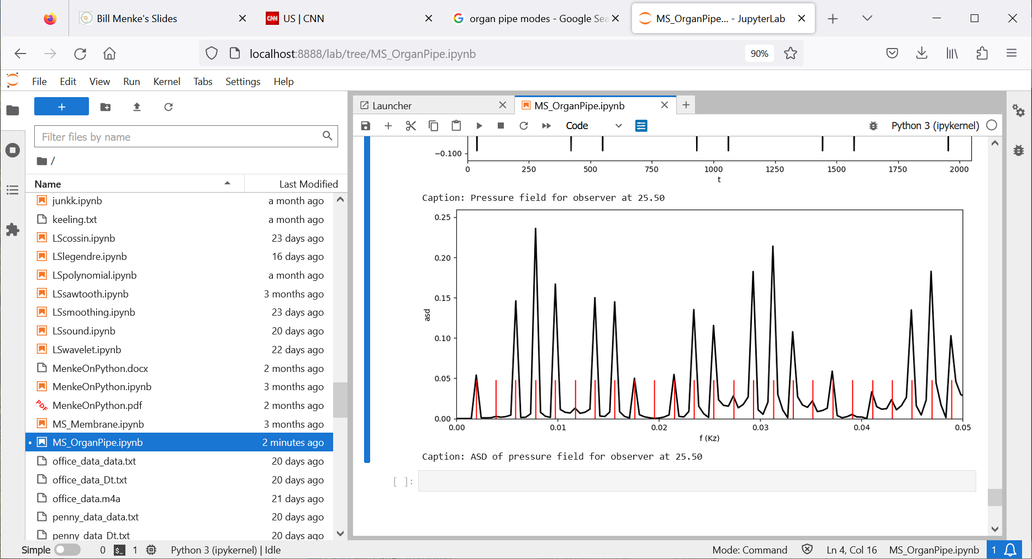
asd
frequency
modal
frequencies

Slide 46


$p_{4}$ strongly excited
asd
frequency
modal
frequencies
$p_{2}$ not excited

