Slide 1
2025 EESC W3400
Computational Earth Science
Lec 19: Vibration of 2D finite bodies

Slide 2
Today
More on
Vibrations of finite bodies
2D and 3D bodies

Slide 3
PSD of ground motion at one observer on the earth’s surface after a very large earthquake

Slide 4
MODE
spatial pattern of pressure
with sinusoidal time variation

Slide 5
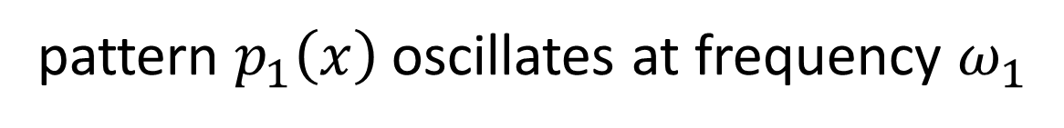


MODE
spatial pattern of pressure
with sinusoidal time variation
$$p\left(x,t\right)=p_{n}\left(x\right) \sin\left(ω_{n}t\right)$$
MODE
spatial pattern of pressure
with sinusoidal time variation
pattern $p_{1}\left(x\right)$ oscillates at frequency $ω_{1}$
pattern $p_{2}\left(x\right)$ oscillates at frequency $ω_{2}$
...

Slide 6
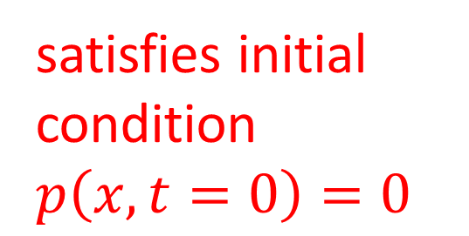
MODE
spatial pattern of pressure
with sinusoidal time variation
$$p\left(x,t\right)=p_{n}\left(x\right) \sin\left(ω_{n}t\right)$$
MODE
spatial pattern of pressure
with sinusoidal time variation
satisfies initial condition $p\left(x,t=0\right)=0$
pattern $p_{1}\left(x\right)$ oscillates at frequency $ω_{1}$
pattern $p_{2}\left(x\right)$ oscillates at frequency $ω_{2}$
...

Slide 7






second overtone
third overtone
first overtone
fundamental
psd
...
$$ω$$
$$0$$
$$ω_{1}$$
$$ω_{2}$$
$$ω_{3}$$
$$ω_{4}$$

Slide 8

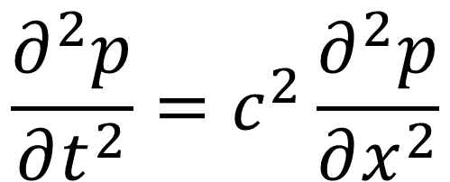
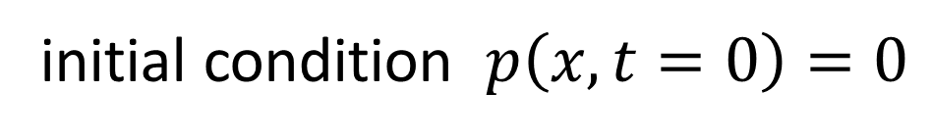




Last Lecture: 1D organ Pipe
$$x$$
$$0$$
$$L$$
$$p\left(x=0\right)=0$$
$$p\left(x=L\right)=0$$
$$\frac{∂^{2}p}{∂t^{2}}=c^{2}\frac{∂^{2}p}{∂x^{2}}$$
initial condition $p\left(x,t=0\right)=0$

Slide 9

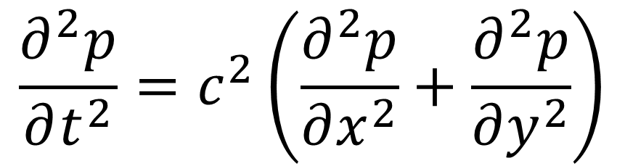
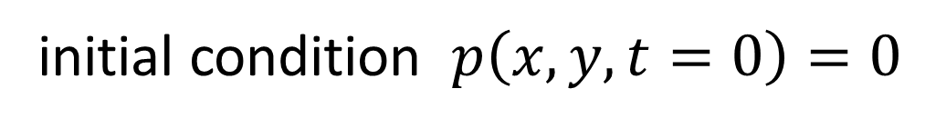






This Lecture: 2D square box
$$y$$
$$L$$
$$p\left(boundary\right)=0$$
$$0$$
$$x$$
$$0$$
$$L$$
$$\frac{∂^{2}p}{∂t^{2}}=c^{2}\left(\frac{∂^{2}p}{∂x^{2}}+\frac{∂^{2}p}{∂y^{2}}\right)$$
initial condition $p\left(x,y,t=0\right)=0$

Slide 10
$$p\left(x,t\right)=p_{n}\left(x\right)p_{m}\left(y\right)\sin\left(ω_{nm}t\right)$$
pattern in x
pattern in y
sinusoid in time t

Slide 11
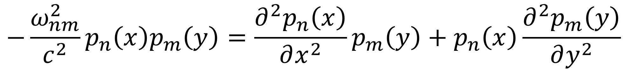
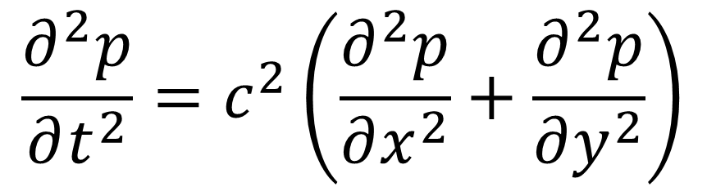
$$p\left(x,t\right)=p_{n}\left(x\right)p_{m}\left(y\right)\sin\left(ω_{nm}t\right)$$
$$\frac{∂^{2}p}{∂t^{2}}=c^{2}\left(\frac{∂^{2}p}{∂x^{2}}+\frac{∂^{2}p}{∂y^{2}}\right)$$
$$−\frac{ω_{nm}^{2}}{c^{2}}p_{n}\left(x\right)p_{m}\left(y\right)=\frac{∂^{2}p_{n}\left(x\right)}{∂x^{2}}p_{m}\left(y\right)+p_{n}\left(x\right)\frac{∂^{2}p_{m}\left(y\right)}{∂y^{2}}$$

Slide 12
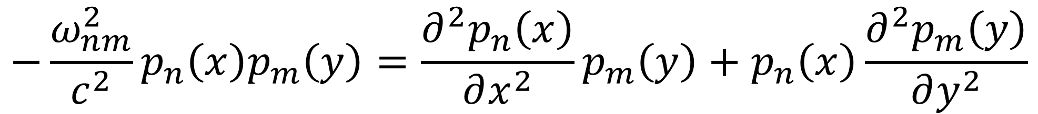

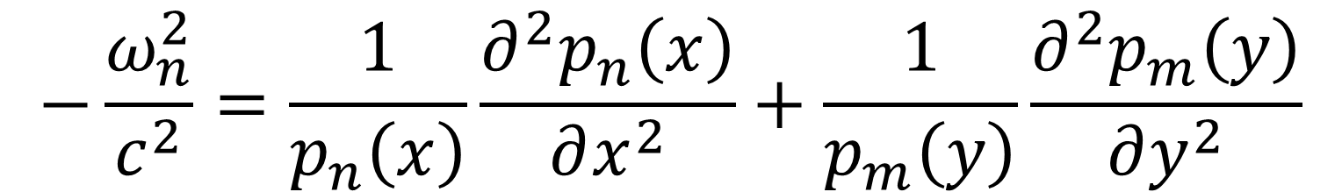
$$−\frac{ω_{nm}^{2}}{c^{2}}p_{n}\left(x\right)p_{m}\left(y\right)=\frac{∂^{2}p_{n}\left(x\right)}{∂x^{2}}p_{m}\left(y\right)+p_{n}\left(x\right)\frac{∂^{2}p_{m}\left(y\right)}{∂y^{2}}$$
divide by
$$p_{n}\left(x\right)p_{m}\left(y\right)$$
$$−\frac{ω_{n}^{2}}{c^{2}}=\frac{1}{p_{n}\left(x\right)}\frac{∂^{2}p_{n}\left(x\right)}{∂x^{2}}+\frac{1}{p_{m}\left(y\right)}\frac{∂^{2}p_{m}\left(y\right)}{∂y^{2}}$$

Slide 13
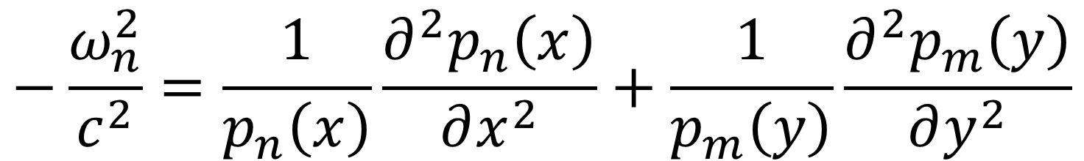
$$−\frac{ω_{nm}^{2}}{c^{2}}p_{n}\left(x\right)p_{m}\left(y\right)=\frac{∂^{2}p_{n}\left(x\right)}{∂x^{2}}p_{m}\left(y\right)+p_{n}\left(x\right)\frac{∂^{2}p_{m}\left(y\right)}{∂y^{2}}$$
divide by
$$p_{n}\left(x\right)p_{m}\left(y\right)$$
$$−\frac{ω_{n}^{2}}{c^{2}}=\frac{1}{p_{n}\left(x\right)}\frac{∂^{2}p_{n}\left(x\right)}{∂x^{2}}+\frac{1}{p_{m}\left(y\right)}\frac{∂^{2}p_{m}\left(y\right)}{∂y^{2}}$$
constant

Slide 14
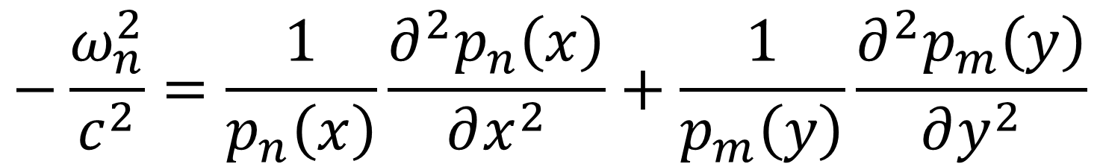
$$−\frac{ω_{nm}^{2}}{c^{2}}p_{n}\left(x\right)p_{m}\left(y\right)=\frac{∂^{2}p_{n}\left(x\right)}{∂x^{2}}p_{m}\left(y\right)+p_{n}\left(x\right)\frac{∂^{2}p_{m}\left(y\right)}{∂y^{2}}$$
divide by
$$p_{n}\left(x\right)p_{m}\left(y\right)$$
$$−\frac{ω_{n}^{2}}{c^{2}}=\frac{1}{p_{n}\left(x\right)}\frac{∂^{2}p_{n}\left(x\right)}{∂x^{2}}+\frac{1}{p_{m}\left(y\right)}\frac{∂^{2}p_{m}\left(y\right)}{∂y^{2}}$$
must be a constant, too
must be a constant, too
constant

Slide 15
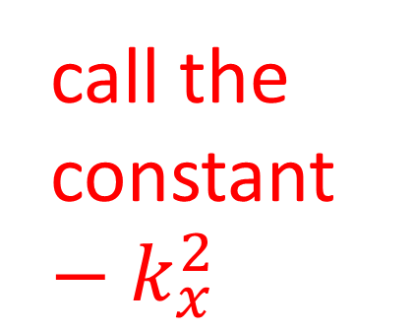
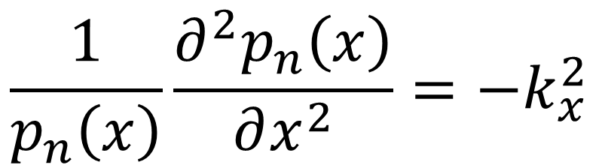
$$−\frac{ω_{nm}^{2}}{c^{2}}p_{n}\left(x\right)p_{m}\left(y\right)=\frac{∂^{2}p_{n}\left(x\right)}{∂x^{2}}p_{m}\left(y\right)+p_{n}\left(x\right)\frac{∂^{2}p_{m}\left(y\right)}{∂y^{2}}$$
divide by
$$p_{n}\left(x\right)p_{m}\left(y\right)$$
$$\frac{1}{p_{n}\left(x\right)}\frac{∂^{2}p_{n}\left(x\right)}{∂x^{2}}=−k_{x}^{2}$$
must be a constant, too
call the constant $−k_{x}^{2}$

Slide 16
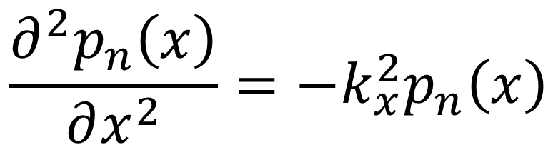
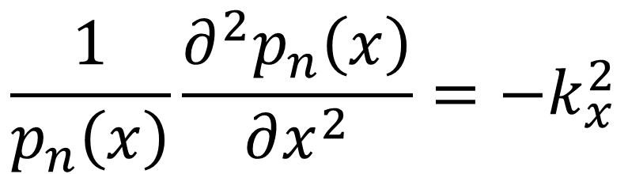
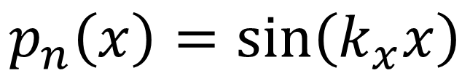
$$\frac{1}{p_{n}\left(x\right)}\frac{∂^{2}p_{n}\left(x\right)}{∂x^{2}}=−k_{x}^{2}$$
$$\frac{∂^{2}p_{n}\left(x\right)}{∂x^{2}}=−k_{x}^{2}p_{n}\left(x\right)$$
$$p_{n}\left(x\right)=sin\left(k_{x}x\right)$$

Slide 17
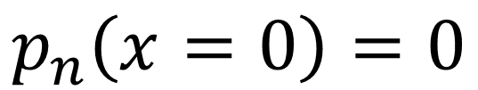
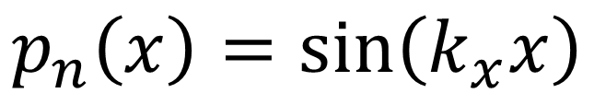

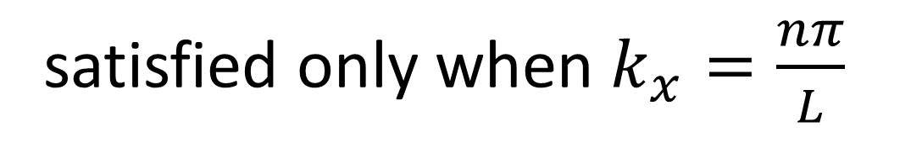
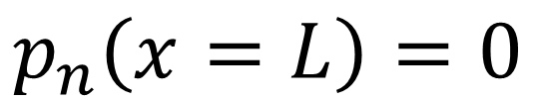
$$p_{n}\left(x\right)=sin\left(k_{x}x\right)$$
boundary conditions
$$p_{n}\left(x=0\right)=0$$
always satisfied
$$p_{n}\left(x=L\right)=0$$
satisfied only when $k_{x}=\frac{nπ}{L}$
and integer $n$

Slide 18
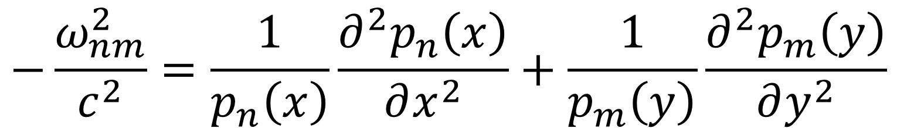
$$−\frac{ω_{nm}^{2}}{c^{2}}p_{n}\left(x\right)p_{m}\left(y\right)=\frac{∂^{2}p_{n}\left(x\right)}{∂x^{2}}p_{m}\left(y\right)+p_{n}\left(x\right)\frac{∂^{2}p_{m}\left(y\right)}{∂y^{2}}$$
divide by
$$p_{n}\left(x\right)p_{m}\left(y\right)$$
$$−\frac{ω_{nm}^{2}}{c^{2}}=\frac{1}{p_{n}\left(x\right)}\frac{∂^{2}p_{n}\left(x\right)}{∂x^{2}}+\frac{1}{p_{m}\left(y\right)}\frac{∂^{2}p_{m}\left(y\right)}{∂y^{2}}$$
must be a constant, too
must be a constant, too
constant

Slide 19
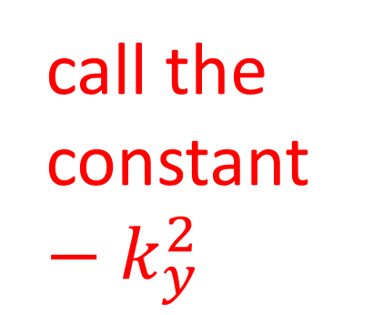
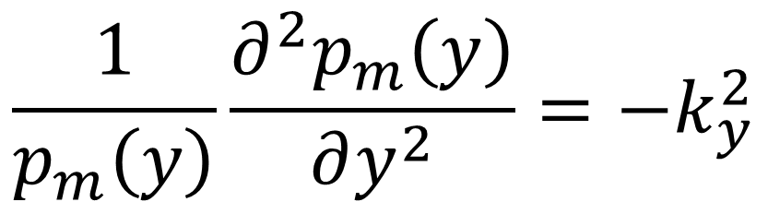
$$−\frac{ω_{nm}^{2}}{c^{2}}p_{n}\left(x\right)p_{m}\left(y\right)=\frac{∂^{2}p_{n}\left(x\right)}{∂x^{2}}p_{m}\left(y\right)+p_{n}\left(x\right)\frac{∂^{2}p_{m}\left(y\right)}{∂y^{2}}$$
divide by
$$p_{n}\left(x\right)p_{m}\left(y\right)$$
$$\frac{1}{p_{m}\left(y\right)}\frac{∂^{2}p_{m}\left(y\right)}{∂y^{2}}=−k_{y}^{2}$$
must be a constant, too
call the constant $−k_{y}^{2}$

Slide 20
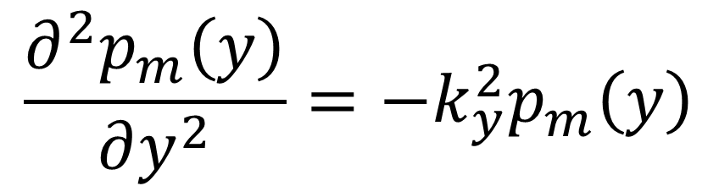
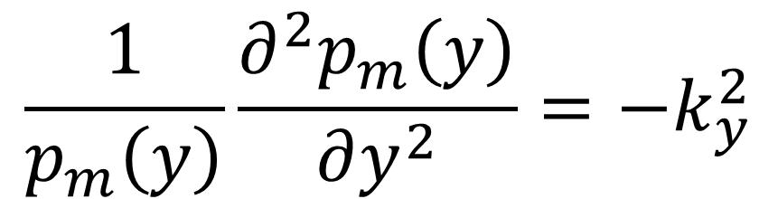
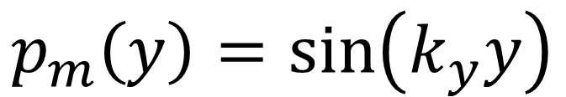
$$\frac{1}{p_{m}\left(y\right)}\frac{∂^{2}p_{m}\left(y\right)}{∂y^{2}}=−k_{y}^{2}$$
$$\frac{∂^{2}p_{m}\left(y\right)}{∂y^{2}}=−k_{y}^{2}p_{m}\left(y\right)$$
$$p_{m}\left(y\right)=sin\left(k_{y}y\right)$$

Slide 21
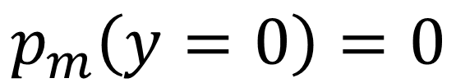
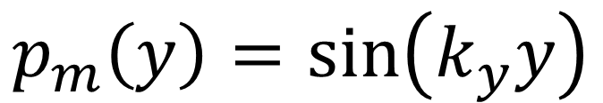

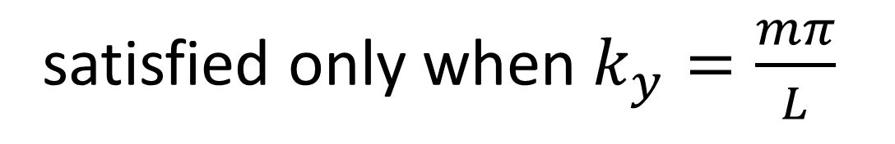
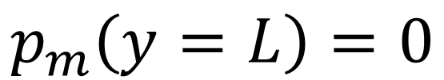
$$p_{m}\left(y\right)=sin\left(k_{y}y\right)$$
boundary conditions
$$p_{m}\left(y=0\right)=0$$
always satisfied
$$p_{m}\left(y=L\right)=0$$
satisfied only when $k_{y}=\frac{mπ}{L}$
and integer $m$

Slide 22
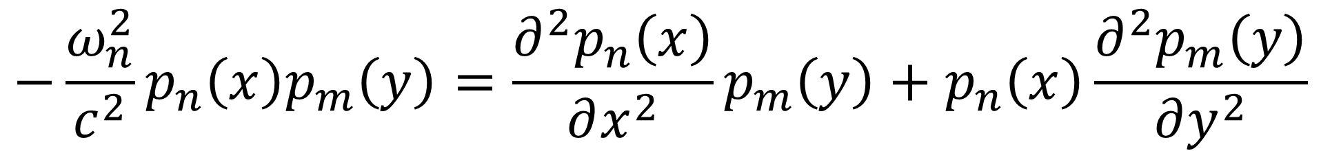


$$−\frac{ω_{n}^{2}}{c^{2}}p_{n}\left(x\right)p_{m}\left(y\right)=\frac{∂^{2}p_{n}\left(x\right)}{∂x^{2}}p_{m}\left(y\right)+p_{n}\left(x\right)\frac{∂^{2}p_{m}\left(y\right)}{∂y^{2}}$$
divide by
$$p_{n}\left(x\right)p_{m}\left(y\right)$$
$$−\frac{ω_{nm}^{2}}{c^{2}}=\frac{1}{p_{n}\left(x\right)}\frac{∂^{2}p_{n}\left(x\right)}{∂x^{2}}+\frac{1}{p_{m}\left(y\right)}\frac{∂^{2}p_{m}\left(y\right)}{∂y^{2}}$$
$$−k_{x}^{2}$$
$$−k_{y}^{2}$$

Slide 23
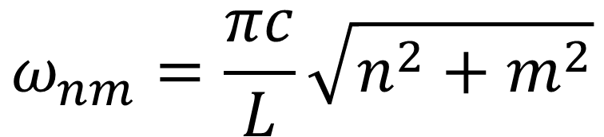
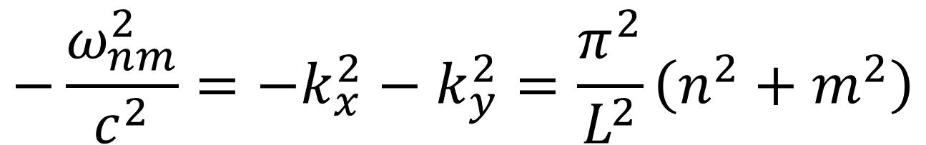
$$−\frac{ω_{nm}^{2}}{c^{2}}=−k_{x}^{2}−k_{y}^{2}=\frac{π^{2}}{L^{2}}\left(n^{2}+m^{2}\right)$$
$$ω_{nm}=\frac{πc}{L}\sqrt{n^{2}+m^{2}}$$

Slide 24
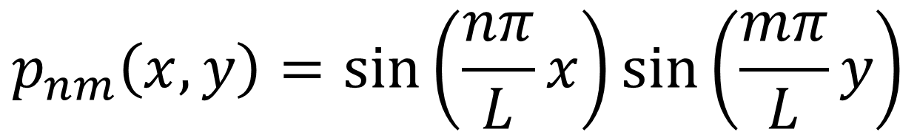
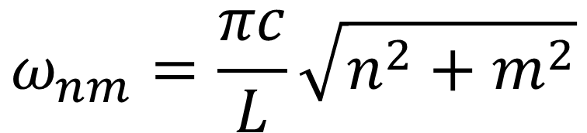
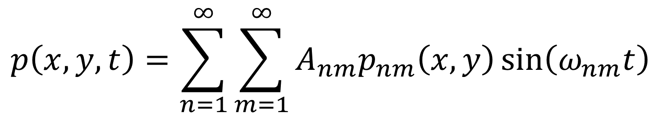
modal frequencies
$$ω_{nm}=\frac{πc}{L}\sqrt{n^{2}+m^{2}}$$
$$p_{nm}\left(x,y\right)=sin\left(\frac{nπ}{L}x\right)sin\left(\frac{mπ}{L}y\right)$$
modes
pressure
$$p\left(x,y,t\right)=\sum_{n=1}^{∞}{\sum_{m=1}^{∞}{{A_{nm}p}_{nm}\left(x,y\right)\sin\left(ω_{nm}t\right)}}$$

Slide 25
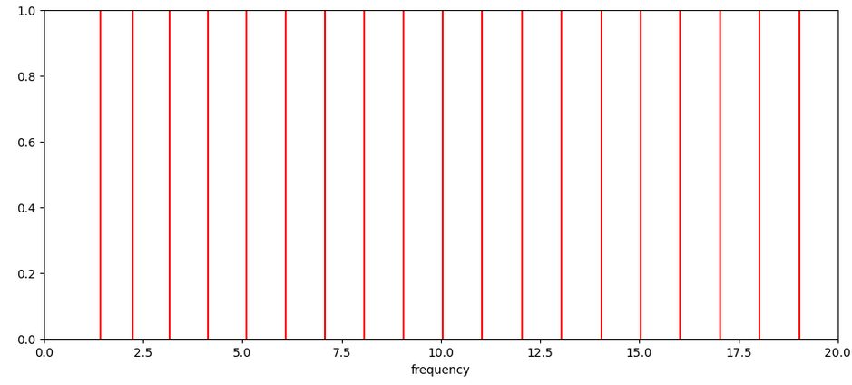
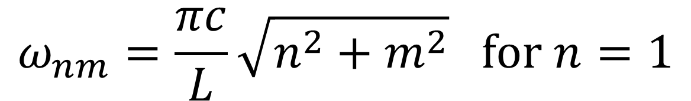
$$ω_{nm}=\frac{πc}{L}\sqrt{n^{2}+m^{2}} for n=1$$

Slide 26
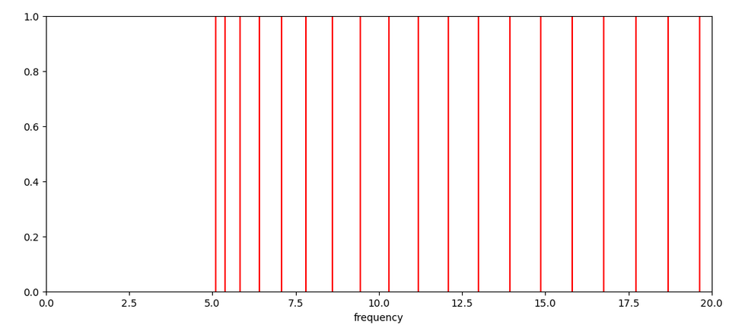
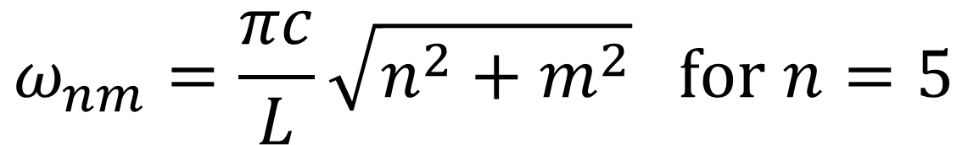
$$ω_{nm}=\frac{πc}{L}\sqrt{n^{2}+m^{2}} for n=5$$

Slide 27
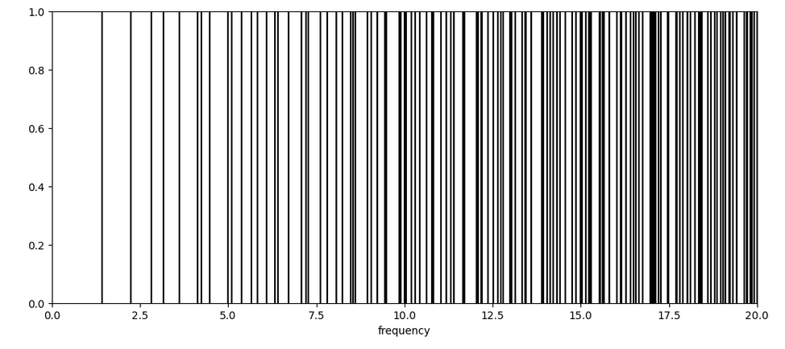
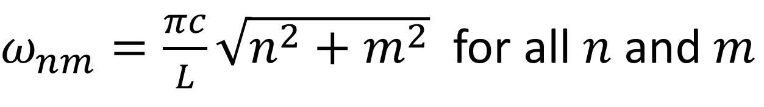
$ω_{nm}=\frac{πc}{L}\sqrt{n^{2}+m^{2}}$ for all $n$ and $m$

Slide 28

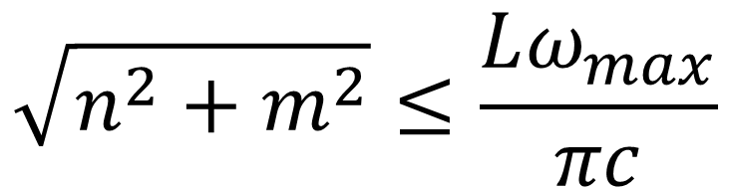

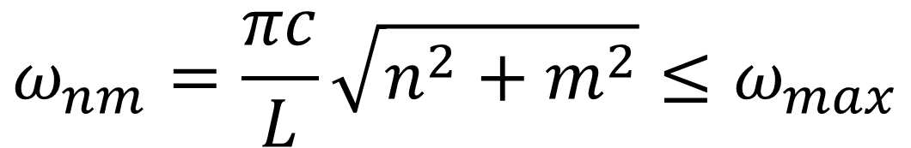

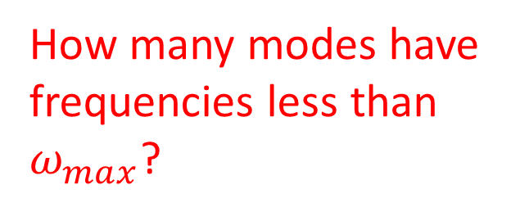

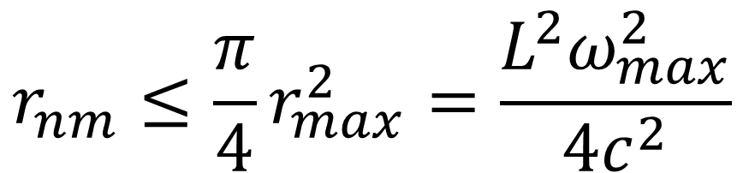
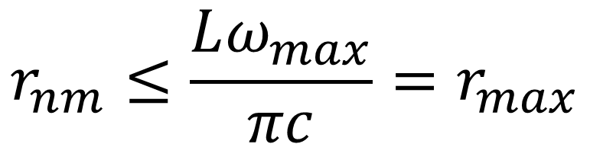

$$ω_{nm}=\frac{πc}{L}\sqrt{n^{2}+m^{2}}≤ω_{max}$$
How many modes have frequencies less than $ω_{max}$?
$$\sqrt{n^{2}+m^{2}}≤\frac{Lω_{max}}{πc}$$
$$m$$
$$r_{nm}≤\frac{Lω_{max}}{πc}=r_{max}$$
$$r_{nm}≤\frac{π}{4}r_{max}^{2}=\frac{L^{2}ω_{max}^{2}}{4c^{2}}$$
$$0$$
$$r_{max}$$
$$n$$
$$0$$

Slide 29



$\frac{L^{2}ω_{max}^{2}}{4c^{2}}$ modes
modes < 1 Hz for “flat Earth”
$\frac{{\left(6×{10}^{6}\right)}^{2}π^{2}\left(1 \right)}{{\left(1×{10}^{4}\right)}^{2}}$ modes
$\frac{3.6×{10}^{14} }{1×{10}^{8}}$ = $3.6×{10}^{6}$ modes

Slide 30

modes < 1 Hz for “cube Earth”
$$billions$$

Slide 31














Two different modes
$$y$$
$$y$$
$$L$$
$$L$$
$$0$$
$$x$$
$$0$$
$$x$$
$$0$$
$$L$$
$$0$$
$$L$$
$$p_{12}\left(x,y\right)$$
$$p_{21}\left(x,y\right)$$

Slide 32



two modes with the same frequency ... “degenerate”
$$y$$
$$y$$
$$L$$
$$L$$
$$0$$
$$x$$
$$0$$
$$x$$
$$0$$
$$L$$
$$0$$
$$L$$
$$p_{12}\left(x,y\right)$$
$$p_{21}\left(x,y\right)$$
$$ω_{12}=\frac{πc}{L}\sqrt{1+4}=\frac{πc}{L}\sqrt{4+1}=ω_{21}$$

Slide 33

how does a force
excite
modes of the square?
each with a different amplitude $A_{nm}$

Slide 34



Same as organ pipe, except 2D
$$\int_{0}^{L}{\int_{0}^{L}{{λ^{−1}p}_{nm}^{2}\left(x,y\right)dxdy}}=1$$
with mode normalized so
$$A_{nm}=ω_{nm}^{−1}\int_{0}^{L}{\int_{0}^{L}{λ^{−1}p_{nm}\left(x,y\right)s\left(x,y\right)dxdy}}$$
$$s\left(x\right)=−c^{2}\left(\frac{∂f_{x}}{∂x}+\frac{∂f_{y}}{∂y}\right)$$

Slide 35


Slide 36


force in x direction, 2500 modes in sum
$$x$$
$$y$$

Slide 37
The code
Step 1: Frequencies
Step 2: Modes
Step 3: Force
Step 4: Source
Step 5: Excitation
Step 6: Mode Sum

Slide 38

The code
Goal: $ω_{nm}$ in matrix wnm[n,m]
Step 1: Frequencies
Step 2: Modes
Step 3: Force
Step 4: Source
Step 5: Excitation
Step 6: Mode Sum

Slide 39

$$ω_{nm}=\frac{πc}{L}\sqrt{n^{2}+m^{2}}≤ω_{max}$$
How many frequencies? 50 by 50
Nw = 50;

Slide 40
$$ω_{nm}=\frac{πc}{L}\sqrt{n^{2}+m^{2}}≤ω_{max}$$
Nw = 50;
n = gda_cvec( np.linspace(1,Nw,Nw) );
what a pain! modes start at n=1 but Python arrays at zero. So make a vector that starts at 1
n = [1, 2, 3, ...]

Slide 41
$$ω_{nm}=\frac{πc}{L}\sqrt{n^{2}+m^{2}}≤ω_{max}$$
Nw = 50;
n = gda_cvec( np.linspace(1,Nw,Nw) );
wnm = np.zeros((Nw,Nw));
empty matrix wmn[n,m]

Slide 42
$$ω_{nm}=\frac{πc}{L}\sqrt{n^{2}+m^{2}}≤ω_{max}$$
Nw = 50;
n = gda_cvec( np.linspace(1,Nw,Nw) );
wnm = np.zeros((Nw,Nw));
for iw in range(Nw):
for jw in range(Nw):
wnm[iw,jw] = pi*c*sqrt((n[iw,0]/xmax)**2+(n[jw,0]/ymax)**2);
vector n = [1, 2, 3, ...]
frequencies in an array wmn[n,m]

Slide 43
$$ω_{nm}=\frac{πc}{L}\sqrt{n^{2}+m^{2}}≤ω_{max}$$
Nw = 50;
n = gda_cvec( np.linspace(1,Nw,Nw) );
wnm = np.zeros((Nw,Nw));
for iw in range(Nw):
for jw in range(Nw):
outer loop iw = 0, 1, 2, 3 ... 49
inner loop jw = 0, 1, 2, 3 ... 49
frequencies in an array wmn[n,m]

Slide 44
$$ω_{nm}=\frac{πc}{L}\sqrt{n^{2}+m^{2}}≤ω_{max}$$
Nw = 50;
n = gda_cvec( np.linspace(1,Nw,Nw) );
wnm = np.zeros((Nw,Nw));
for iw in range(Nw):
for jw in range(Nw):
wnm[iw,jw] = pi*c*sqrt((n[iw,0]/xmax)**2+(n[jw,0]/ymax)**2);
set matrix wmn[n,m] to $\frac{πc}{L}\sqrt{n^{2}+m^{2}}$
element by element

Slide 45

The code
Step 1: Frequencies
Step 2: Modes
Step 3: Force
Step 4: Source
Step 5: Excitation
Step 6: Mode Sum
Goal: $p_{nm}\left(x,y\right) in two matrices$
pn[x,n] and pm[y,m]
Takes too much memory to make one 4D array p[x,y,n,m]

Slide 46


$$p_{nm}\left(x,y\right)=sin\left(\frac{nπ}{L}x\right)sin\left(\frac{mπ}{L}y\right)$$
pn = sqrt(2*lam/xmax) * np.sin( (pi/xmax)*np.matmul(x, n.T) );
outer product
$\frac{π}{L}\left[\begin{matrix}x_{0} \\ x_{1} \\ x_{2} \\ ⋮ \\ x_{max}\end{matrix}\right]\left[\begin{matrix}1 & 2 & 3 & 4 & 5\end{matrix}\right]=\frac{π}{L}\left[\begin{matrix}x_{0}1 & ⋯ & x_{0}N_{w} \\ ⋮ & ⋱ & ⋮ \\ x_{max}1 & ⋯ & x_{0}N_{w}\end{matrix}\right]$

Slide 47

$$p_{nm}\left(x,y\right)=sin\left(\frac{nπ}{L}x\right)sin\left(\frac{mπ}{L}y\right)$$
pn = sqrt(2*lam/xmax) * np.sin( (pi/xmax)*np.matmul(x, n.T) );
elementwise sine
$\sin\left(\frac{π}{L}\left[\begin{matrix}x_{0}1 & ⋯ & x_{0}N_{w} \\ ⋮ & ⋱ & ⋮ \\ x_{max}1 & ⋯ & x_{0}N_{w}\end{matrix}\right]\right)$

Slide 48
$$p_{nm}\left(x,y\right)=sin\left(\frac{nπ}{L}x\right)sin\left(\frac{mπ}{L}y\right)$$
pn = sqrt(2*lam/xmax) * np.sin( (pi/xmax)*np.matmul(x, n.T) );
correct normalization
pm = sqrt(2*lam/xmax) * np.sin( (pi/ymax)*np.matmul(y, n.T) );
same for pm[iy]

Slide 49


$$f\left(x,y\right)=\left[\begin{matrix}f_{x} \\ f_{x}\end{matrix}\right]=G_{x}\left(x\right)G_{y}\left(y\right)\left[\begin{matrix}\cos\left(θ\right) \\ \sin\left(θ\right)\end{matrix}\right]$$
Goals:
force $f$has constant orientation given by $θ$
spatial pattern is a 2D Gaussian built from two 1D Gaussians
narrow Gaussians work better than a “point force”
vectors Gx[Nx,1] and Gy[Ny,1]

Slide 50


$$S\left(x,y\right)=−c^{2}\left({\frac{d}{dx}f}_{x}+{\frac{d}{dy}f}_{y}\right)=$$
$$=−c^{2}\left(\cos\left(θ\right)\frac{dG_{x}}{dx}G_{y}+\sin\left(θ\right)G_{x}\frac{dG_{y}}{dx}\right)$$
Goals:
source related to divergence of force
compute derivatives numerically with finite differences
array Sxy[Nx,Ny]

Slide 51


$$G_{x}=exp\left(−\frac{1}{2}\frac{{\left(x−x_{0}\right)}^{2}}{s_{x}^{2}}\right)$$
sfx = 2.0;
sfx2 = sfx**2;
sfy = 2.0;
sfy2 = sfy**2;
x0 = xmax/2.0;
y0 = ymax/2.0;
$$G_{y}=exp\left(−\frac{1}{2}\frac{{\left(y−y_{0}\right)}^{2}}{s_{y}^{2}}\right)$$
half-widths sfx and sfy of Gaussian
peak positions x0 and y0 of Gaussian

Slide 52

sfx = 2.0;
sfx2 = sfx**2;
sfy = 2.0;
sfy2 = sfy**2;
x0 = xmax/2.0;
y0 = ymax/2.0;
Gx = (1.0/(sqrt(2*pi)*sfx)) * np.exp( -0.5*np.power(x-x0,2)/sfx2 );
$$G_{x}\left(x\right)=\frac{1}{\sqrt{2π}s_{x}}exp\left(−\frac{1}{2}\frac{{\left(x−x_{0}\right)}^{2}}{s_{x}^{2}}\right)$$

Slide 53

sfx = 2.0;
sfx2 = sfx**2;
sfy = 2.0;
sfy2 = sfy**2;
x0 = xmax/2.0;
y0 = ymax/2.0;
Gx = (1.0/(sqrt(2*pi)*sfx)) * np.exp( -0.5*np.power(x-x0,2)/sfx2 );
vector as input
vector as output
$$G_{x}\left(x\right)=\frac{1}{\sqrt{2π}s_{x}}exp\left(−\frac{1}{2}\frac{{\left(x−x_{0}\right)}^{2}}{s_{x}^{2}}\right)$$

Slide 54

sfx = 2.0;
sfx2 = sfx**2;
sfy = 2.0;
sfy2 = sfy**2;
x0 = xmax/2.0;
y0 = ymax/2.0;
Gx = (1.0/(sqrt(2*pi)*sfx)) * np.exp( -0.5*np.power(x-x0,2)/sfx2 );
Gy = (1.0/(sqrt(2*pi)*sfy)) * np.exp( -0.5*np.power(y-y0,2)/sfy2 );
$$G_{y}\left(y\right)=\frac{1}{\sqrt{2π}s_{y}}exp\left(−\frac{1}{2}\frac{{\left(y−y_{0}\right)}^{2}}{s_{y}^{2}}\right)$$

Slide 55


The code
$$S\left(x,y\right)=−c^{2}\left(\cos\left(θ\right)\frac{dG_{x}}{dx}G_{y}+\sin\left(θ\right)G_{x}\frac{dG_{y}}{dx}\right)$$
Step 1: Frequencies
Step 2: Modes
Step 3: Force
Step 4: Source
Step 5: Excitation
Step 6: Mode Sum
Goal: S$\left(x,y\right)$
as array
Sxy[Nx,Ny]

Slide 56



$s\left(x,y\right)=$ $−c^{2}\cos\left(θ\right)\frac{∂G_{x}}{∂x}G_{y}$ $−c^{2}\sin\left(θ\right)G_{x}\frac{∂G_{y}}{∂y}$
Gxx = -c2 * cos(q) * np.matmul(D1/Dx,Gx);
multiplication by D1/Dx approximates a derivative
$D^{\left(1\right)}=\left[\begin{matrix}−1 & 1 & 0 & ⋯ & 0 \\ 0 & −1 & 1 & ⋯ & − \\ ⋯ & ⋯ & ⋯ & ⋯ & ⋯ \\ 0 & 0 & 0 & −1 & 1\end{matrix}\right]$
$\frac{1}{∆x}D^{\left(1\right)}\left[\begin{matrix}f_{0} \\ f_{1} \\ ⋮ \\ f_{N_{x}}\end{matrix}\right]=\frac{1}{∆x}\left[\begin{matrix}f_{1}−f_{0} \\ f_{2}−f_{1} \\ ⋮ \\ f_{N_{x}}−f_{N_{x}−1}\end{matrix}\right]$

Slide 57
$s\left(x,y\right)=$ $−c^{2}\cos\left(θ\right)\frac{∂G_{x}}{∂x}G_{y}$ $−c^{2}\sin\left(θ\right)G_{x}\frac{∂G_{y}}{∂y}$
Gxx = -c2 * cos(q) * np.matmul(D1/Dx,Gx);
Gyy = -c2 * sin(q) * np.matmul(D1/Dy,Gy);

Slide 58
Gxx = -c2 * cos(q) * np.matmul(D1/Dx,Gx);
Gyy = -c2 * sin(q) * np.matmul(D1/Dy,Gy);
another outer product
Sxy = np.matmul(Gxx,Gy.T)+np.matmul(Gx,Gyy.T);

Slide 59

The code
Step 1: Frequencies
Step 2: Modes
Step 3: Force
Step 4: Source
Step 5: Excitation
Step 6: Mode Sum
Goal:
as array
$${excit}_{nm}={ω_{nm}^{ }A}_{nm}$$
excit[n,m]

Slide 60

$${excit}_{nm}={ω_{nm}^{ }A}_{nm}=λ^{−1}\int_{0}^{L}{\int_{0}^{L}{p_{nm}\left(x,y\right)s\left(x,y\right)dxdy}}$$
excit = np.zeros((Nw,Nw));
empty matrix excit[n,m]

Slide 61
$${excit}_{nm}={ω_{nm}^{ }A}_{nm}=λ^{−1}\int_{0}^{L}{\int_{0}^{L}{p_{nm}\left(x,y\right)s\left(x,y\right)dxdy}}$$
excit = np.zeros((Nw,Nw));
for iw in range(Nw):
px = pn[0:Nx,iw:iw+1];
for jw in range(Nw):
py = pm[0:Ny,jw:jw+1];
outer loop over n: [1, 2, 3, ... Nw]
inner loop over m: [1, 2, 3, ... Nw]

Slide 62
$${excit}_{nm}={ω_{nm}^{ }A}_{nm}=λ^{−1}\int_{0}^{L}{\int_{0}^{L}{p_{nm}\left(x,y\right)s\left(x,y\right)dxdy}}$$
excit = np.zeros((Nw,Nw));
for iw in range(Nw):
px = pn[0:Nx,iw:iw+1];
for jw in range(Nw):
py = pm[0:Ny,jw:jw+1];
pn(x) for this n:
pm(y) for this m:
(transferring stuff to vectors adds a little to execution time, but greatly reduces changes of a coding error)

Slide 63

$${excit}_{nm}={ω_{nm}^{ }A}_{nm}=λ^{−1}\int_{0}^{L}{\int_{0}^{L}{p_{nm}\left(x,y\right)s\left(x,y\right)dxdy}}$$
excit = np.zeros((Nw,Nw));
for iw in range(Nw):
px = pn[0:Nx,iw:iw+1];
for jw in range(Nw):
py = pm[0:Ny,jw:jw+1];
pxy = np.matmul(px,py.T);
outer product creates matrix containing $p_{nm}\left(x,y\right)$
(for one pair of n, m)

Slide 64

$${excit}_{nm}={ω_{nm}^{ }A}_{nm}=λ^{−1}\int_{0}^{L}{\int_{0}^{L}{p_{nm}\left(x,y\right)s\left(x,y\right)dxdy}}$$
excit = np.zeros((Nw,Nw));
for iw in range(Nw):
px = pn[0:Nx,iw:iw+1];
for jw in range(Nw):
py = pm[0:Ny,jw:jw+1];
pxy = np.matmul(px,py.T);
excit[iw,jw]=(1.0/lam)*(Dx*Dy)*np.sum( np.multiply(pxy,gxy));
element-wise multiply creates product
(a matrix)
$$p_{nm}\left(x,y\right)s\left(x,y\right)$$

Slide 65

$${excit}_{nm}={ω_{nm}^{ }A}_{nm}=λ^{−1}\int_{0}^{L}{\int_{0}^{L}{p_{nm}\left(x,y\right)s\left(x,y\right)dxdy}}$$
excit = np.zeros((Nw,Nw));
for iw in range(Nw):
px = pn[0:Nx,iw:iw+1];
for jw in range(Nw):
py = pm[0:Ny,jw:jw+1];
pxy = np.matmul(px,py.T);
excit[iw,jw]=(1.0/lam)*(Dx*Dy)*np.sum( np.multiply(pxy,gxy));
sum approximated 2D integral
$$∆x∆y\sum_{i}{\sum_{j}{a_{ij}}}=\int_{0}^{L}{\int_{0}^{L}{a\left(x,y\right)dxdy}}$$
nested sums not necessary in Python

Slide 66
$${excit}_{nm}={ω_{nm}^{ }A}_{nm}=λ^{−1}\int_{0}^{L}{\int_{0}^{L}{p_{nm}\left(x,y\right)s\left(x,y\right)dxdy}}$$
excit = np.zeros((Nw,Nw));
for iw in range(Nw):
px = pn[0:Nx,iw:iw+1];
for jw in range(Nw):
py = pm[0:Ny,jw:jw+1];
pxy = np.matmul(px,py.T);
excit[iw,jw]=(1.0/lam)*(Dx*Dy)*np.sum( np.multiply(pxy,gxy));
results stored in excit[] matrix

Slide 67

The code
Step 1: Frequencies
Step 2: Modes
Step 3: Force
Step 4: Source
Step 5: Excitation
Step 6: Mode Sum
Goal:
perform the mode sum for one time $t_{0}$and put the results in a matrix
P[x,y]

Slide 68


t0 = 3.0*itime;
$$p\left(x,y,t\right)=\sum_{n=1}^{∞}{\sum_{m=1}^{∞}{{A_{nm}p}_{nm}\left(x,y\right)\sin\left(ω_{nm}t\right)}}$$
decide on time $t_{0}$
does a 2D summation

Slide 69
t0 = 3.0*itime;
P = np.zeros((Nx,Ny));
$$p\left(x,y,t\right)=\sum_{n=1}^{∞}{\sum_{m=1}^{∞}{{A_{nm}p}_{nm}\left(x,y\right)\sin\left(ω_{nm}t\right)}}$$
create empty matrix P[x,y]

Slide 70
t0 = 3.0*itime;
P = np.zeros((Nx,Ny));
for iw in range(Nw):
px = pn[0:Nx,iw:iw+1];
for jw in range(Nw):
py = pm[0:Ny,jw:jw+1];
outer loop over n: [1, 2, 3, ... Nw]
inner loop over m: [1, 2, 3, ... Nw]

Slide 71
t0 = 3.0*itime;
P = np.zeros((Nx,Ny));
for iw in range(Nw):
px = pn[0:Nx,iw:iw+1];
for jw in range(Nw):
py = pm[0:Ny,jw:jw+1];
pn(x) for this n:
pm(y) for this m:

Slide 72

t0 = 3.0*itime;
P = np.zeros((Nx,Ny));
for iw in range(Nw):
px = pn[0:Nx,iw:iw+1];
for jw in range(Nw):
py = pm[0:Ny,jw:jw+1];
pxy = np.matmul(px,py.T);
$$p\left(x,y,t\right)=\sum_{n=1}^{∞}{\sum_{m=1}^{∞}{{A_{nm}p}_{nm}\left(x,y\right)\sin\left(ω_{nm}t\right)}}$$
outer product to compute $p_{nm}\left(x,y\right)$
as array pxy[x,y]
for single pair of (n,m)

Slide 73

t0 = 3.0*itime;
P = np.zeros((Nx,Ny));
for iw in range(Nw):
px = pn[0:Nx,iw:iw+1];
for jw in range(Nw):
py = pm[0:Ny,jw:jw+1];
pxy = np.matmul(px,py.T);
tfun = np.sin( wnm[iw,jw] * t0 );
$$p\left(x,y,t\right)=\sum_{n=1}^{∞}{\sum_{m=1}^{∞}{{A_{nm}p}_{nm}\left(x,y\right)\sin\left(ω_{nm}t\right)}}$$
time function $\sin\left(ω_{nm}t\right)$ for one time $t_{0}$

Slide 74
t0 = 3.0*itime;
P = np.zeros((Nx,Ny));
for iw in range(Nw):
px = pn[0:Nx,iw:iw+1];
for jw in range(Nw):
py = pm[0:Ny,jw:jw+1];
pxy = np.matmul(px,py.T);
tfun = np.sin( wnm[iw,jw] * t0 );
P = P + (1.0/wnm[iw,jw]) * excit[iw,jw] * pxy * tfun;
$$p\left(x,y,t\right)=\sum_{n=1}^{∞}{\sum_{m=1}^{∞}{{A_{nm}p}_{nm}\left(x,y\right)\sin\left(ω_{nm}t\right)}}$$
“stack” result for this (n,m)
into matrix P[x,y]
with P = P + something
syntax

Slide 75

Some observations
- I avoid arrays with >2 dimensions
(too complicated, too much memory)
- I like the outer product
- I like breaking the process into clear steps
even though some steps could be combined
- I like making vectors and matrices of intermediate
results, even though they could be avoided
- if you look at the code, you will see that I also
include “test calculations” to make sure
results are sensible (e.g. $p_{nm}\left(x,y\right)$ correctly
normalized).

Slide 76
In code development
- CPU-time & Memory efficiency is not necessarily
a virtue
- How many times are you planning to run the code?
- What matters is speed in writing the code
and ensuring that the code is correct

