Slide 1
2025 EESC W3400
Computational Earth Science
Lec 20: Finite difference method illustrated with
2D time-independent conductive heat flow

Slide 2
Today
New (and fairly technical) Stuff
Finite Difference Method for Solving Dynamical Problems

Slide 3
As you will see
the idea is simple
but the bookkeeping is very complex

Slide 4
Today
all
Lecture
Thursday
all in-class projects
so be sure to attend

Slide 5
Example of
Temperature variation in heat-conducting solid
in the equilibrium approximation
(meaning no time dependence)

Slide 6

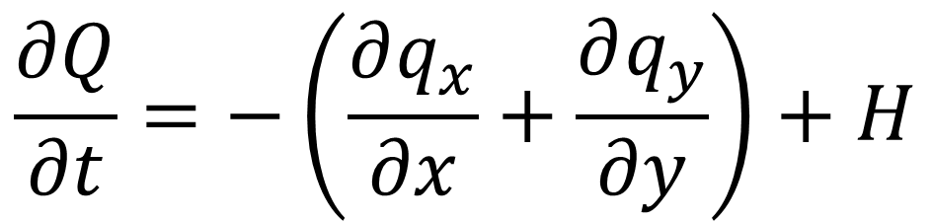
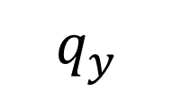

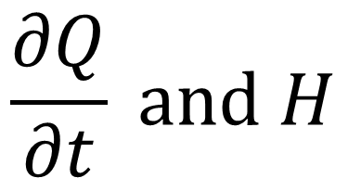
Conservation of heat energy $Q$
$$\frac{∂Q}{∂t}=−\left(\frac{∂q_{x}}{∂x}+\frac{∂q_{y}}{∂y}\right)+H$$
$$q_{x}$$
$$\frac{∂Q}{∂t} and H$$
increase in heat
net flux in
heat source
$$q_{y}$$

Slide 7
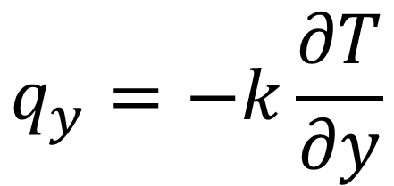
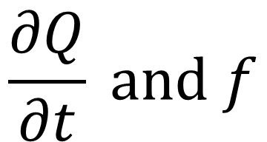
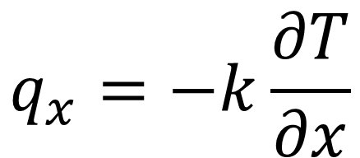
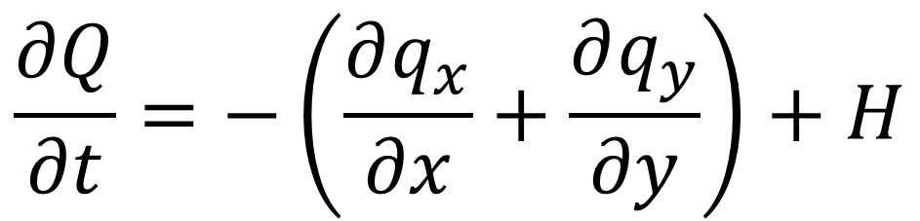
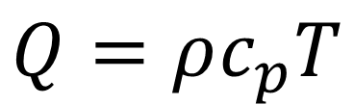
$$\frac{∂Q}{∂t}=−\left(\frac{∂q_{x}}{∂x}+\frac{∂q_{y}}{∂y}\right)+H$$
$$q_{x}$$
$$\frac{∂Q}{∂t} and f$$
$$Q=ρc_{p}T$$
heat proportional to temperature
$$q_{x}=−k\frac{∂T}{∂x}$$
$$q_{y}$$
heat flows from hot to cold
$$q_{y}=−k\frac{∂T}{∂y}$$

Slide 8
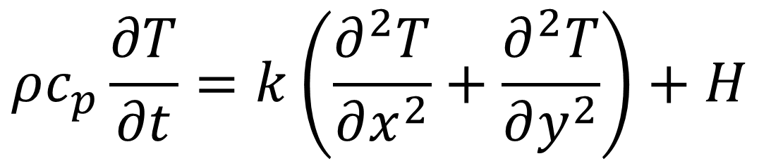
$$\frac{∂Q}{∂t}=−\left(\frac{∂q_{x}}{∂x}+\frac{∂q_{y}}{∂y}\right)+H$$
$$Q=ρc_{p}T$$
$$q_{x}=−k\frac{∂T}{∂x}$$
$$ρc_{p}\frac{∂T}{∂t}=k\left(\frac{∂^{2}T}{∂x^{2}}+\frac{∂^{2}T}{∂y^{2}}\right)+H$$
$$q_{y}=−k\frac{∂T}{∂y}$$

Slide 9
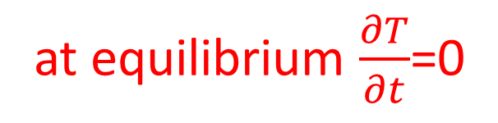
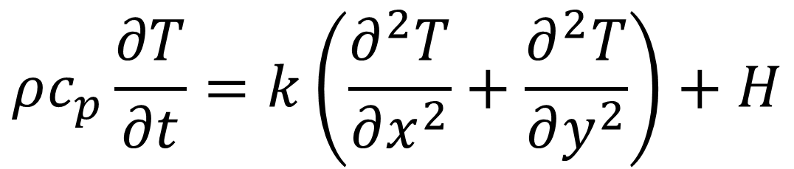
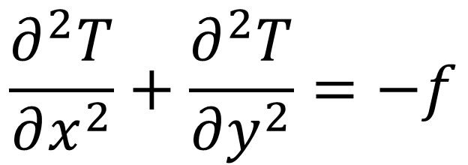

$$ρc_{p}\frac{∂T}{∂t}=k\left(\frac{∂^{2}T}{∂x^{2}}+\frac{∂^{2}T}{∂y^{2}}\right)+H$$
at equilibrium $\frac{∂T}{∂t}$=0
$$f=H/k$$
$$\frac{∂^{2}T}{∂x^{2}}+\frac{∂^{2}T}{∂y^{2}}=−f$$

Slide 10





boundary $T=T_{top}$
Inside
$$\frac{∂^{2}T}{∂x^{2}}+\frac{∂^{2}T}{∂y^{2}}=−f$$
boundary $T=T_{rig}$
boundary $T=T_{lef}$
boundary $T=T_{bot}$

Slide 11




at every boundary point $T$ is specified
at every inside point
equation is satisfied
at every boundary point $T$ is specified
at every boundary point $T$ is specified
at every boundary point $T$ is specified

Slide 12
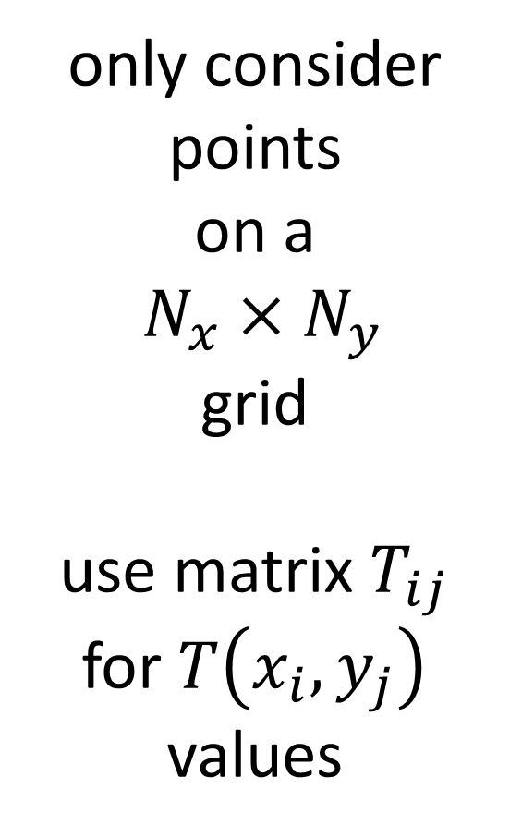
only consider
points
on a
$N_{x}×N_{y}$
grid
use matrix $T_{ij}$
for $T\left(x_{i},y_{j}\right)$
values

Slide 13
obey top BC
obey left BC
obey right BC
obey bottom BC
obey equation

Slide 14







$$x$$
obey top BC
$$T_{00}=T_{top}$$
$$T_{10}=T_{top}$$
$$T_{20}=T_{top}$$
$$y$$
$$⋮$$
$$N_{x}$$
equations

Slide 15




$$x$$
obey left BC
$$T_{00}=T_{left}$$
$$T_{01}=T_{left}$$
$$T_{11}=T_{left}$$
$$y$$
$$⋮$$
$$N_{y}−2$$
equations

Slide 16
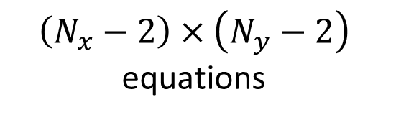

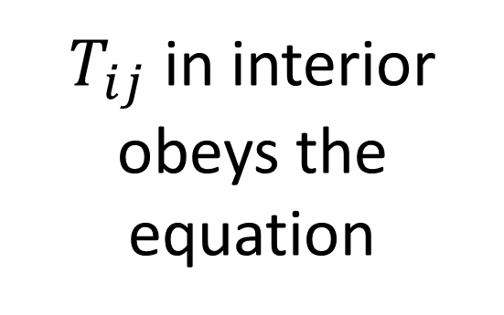


$$i$$
$$x$$
obey equation
$$j$$
$T_{ij}$ in interior obeys the equation
$$y$$
$$T_{ij}= ?$$
$$\left(N_{x}−2\right)×\left(N_{y}−2\right)$$
equations

Slide 17
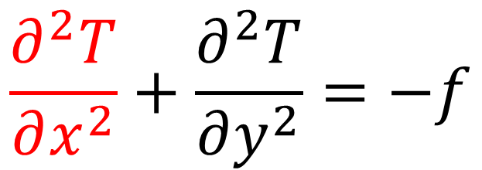




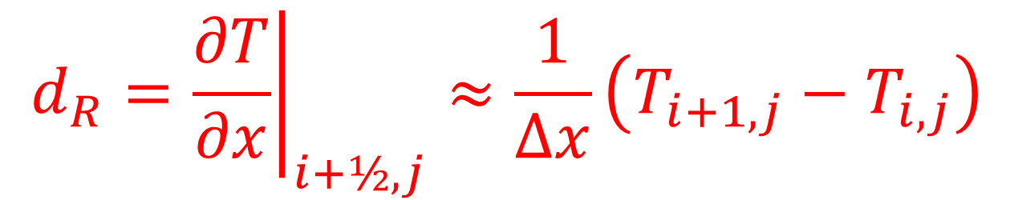
$$\frac{∂^{2}T}{∂x^{2}}+\frac{∂^{2}T}{∂y^{2}}=−f$$
at $\left(x_{i},y_{j}\right)$
$$i$$
$$i+1$$
$$d_{R}={\left.\frac{∂T}{∂x}\right|}_{i+½,j}≈\frac{1}{∆x}\left(T_{i+1,j}−T_{i,j}\right)$$
$$j$$

Slide 18

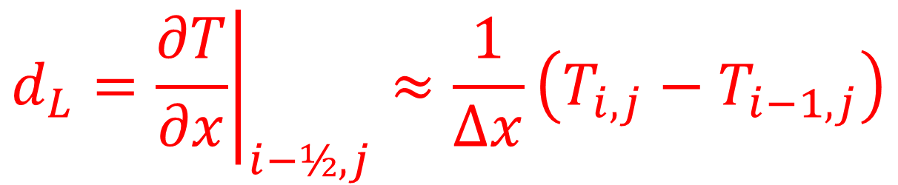
$$\frac{∂^{2}T}{∂x^{2}}+\frac{∂^{2}T}{∂y^{2}}=−f$$
at $\left(x_{i},y_{j}\right)$
$$i−1$$
$$i$$
$$d_{R}={\left.\frac{∂T}{∂x}\right|}_{i+½,j}≈\frac{1}{∆x}\left(T_{i+1,j}−T_{i,j}\right)$$
$$j$$
$$d_{L}={\left.\frac{∂T}{∂x}\right|}_{i−½,j}≈\frac{1}{∆x}\left(T_{i,j}−T_{i−1,j}\right)$$

Slide 19
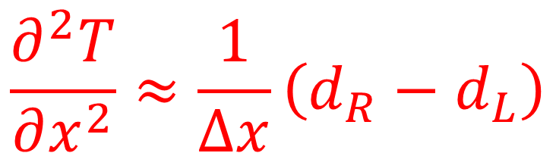
$$\frac{∂^{2}T}{∂x^{2}}+\frac{∂^{2}T}{∂y^{2}}=−f$$
at $\left(x_{i},y_{j}\right)$
$$i$$
$$d_{R}={\left.\frac{∂T}{∂x}\right|}_{i+½,j}≈\frac{1}{∆x}\left(T_{i+1,j}−T_{i,j}\right)$$
$$j$$
$$d_{L}={\left.\frac{∂T}{∂x}\right|}_{i−½,j}≈\frac{1}{∆x}\left(T_{i,j}−T_{i−1,j}\right)$$
$$\frac{∂^{2}T}{∂x^{2}}≈\frac{1}{∆x}\left(d_{R}−d_{L}\right)$$

Slide 20
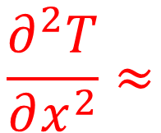
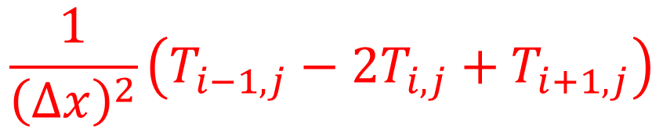
$$\frac{∂^{2}T}{∂x^{2}}+\frac{∂^{2}T}{∂y^{2}}=−f$$
at $\left(x_{i},y_{j}\right)$
$$\frac{∂^{2}T}{∂x^{2}}≈$$
$$\frac{1}{{\left(∆x\right)}^{2}}\left(T_{i−1,j}−2T_{i,j}+T_{i+1,j}\right)$$

Slide 21
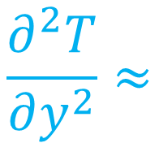
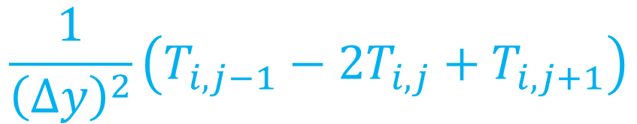
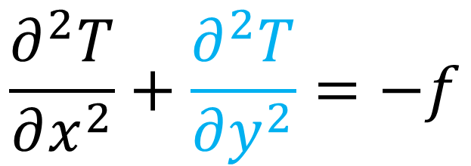
$$\frac{∂^{2}T}{∂x^{2}}+\frac{∂^{2}T}{∂y^{2}}=−f$$
at $\left(x_{i},y_{j}\right)$
$$\frac{∂^{2}T}{∂y^{2}}≈$$
$$\frac{1}{{\left(∆y\right)}^{2}}\left(T_{i,j−1}−2T_{i,j}+T_{i,j+1}\right)$$

Slide 22

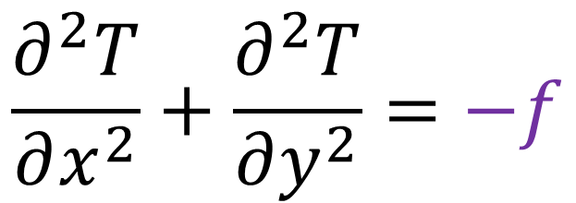
$$\frac{∂^{2}T}{∂x^{2}}+\frac{∂^{2}T}{∂y^{2}}=−f$$
at $\left(x_{i},y_{j}\right)$
$$=−f_{ij}$$

Slide 23
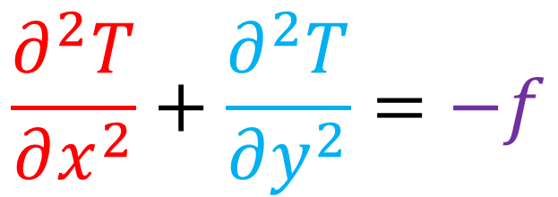
$$\frac{∂^{2}T}{∂x^{2}}+\frac{∂^{2}T}{∂y^{2}}=−f$$
at $\left(x_{i},y_{j}\right)$
$$\frac{1}{{\left(∆x\right)}^{2}}\left(T_{i−1,j}−2T_{i,j}+T_{i+1,j}\right)+ \frac{1}{{\left(∆y\right)}^{2}}\left(T_{i,j−1}−2T_{i,j}+T_{i,j+1}\right)=−f_{ij}$$
$$\left(\frac{T_{i−1,j}}{{\left(∆x\right)}^{2}}−\frac{2T_{i,j}}{{\left(∆x\right)}^{2}}+\frac{T_{i+1,j}}{{\left(∆x\right)}^{2}}\right)+ \left(\frac{T_{i,j−1}}{{\left(∆y\right)}^{2}}−\frac{2T_{i,j}}{{\left(∆y\right)}^{2}}+\frac{T_{i,j+1}}{{\left(∆y\right)}^{2}}\right)=−f_{ij}$$
$$\frac{T_{i−1,j}}{{\left(∆x\right)}^{2}}+\frac{T_{i+1,j}}{{\left(∆x\right)}^{2}}−\left(\frac{2}{{\left(∆x\right)}^{2}}+\frac{2}{{\left(∆y\right)}^{2}}\right)T_{i,j}+\frac{T_{i,j−1}}{{\left(∆y\right)}^{2}}+\frac{T_{i,j+1}}{{\left(∆y\right)}^{2}}=−f_{ij}$$

Slide 24
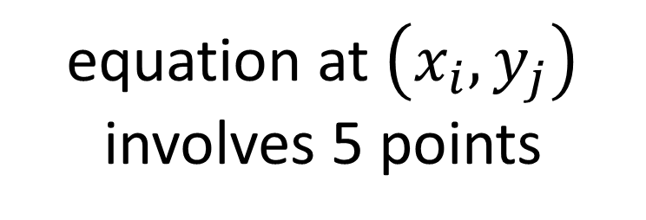


$$\frac{∂^{2}T}{∂x^{2}}+\frac{∂^{2}T}{∂y^{2}}=−f$$
at $\left(x_{i},y_{j}\right)$
$$i$$
equation at $\left(x_{i},y_{j}\right)$ involves 5 points
$$j$$
$$\frac{T_{i−1,j}}{{\left(∆x\right)}^{2}}+\frac{T_{i+1,j}}{{\left(∆x\right)}^{2}}−\left(\frac{2}{{\left(∆x\right)}^{2}}+\frac{2}{{\left(∆y\right)}^{2}}\right)T_{i,j}+\frac{T_{i,j−1}}{{\left(∆y\right)}^{2}}+\frac{T_{i,j+1}}{{\left(∆y\right)}^{2}}=−f_{ij}$$

Slide 25

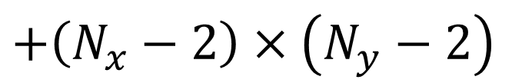
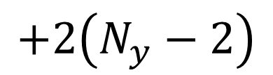
number of unknown Temperature values: $M=N_{x}×N_{y}$
number of equations
top & bottom
$${2N}_{x}$$
$$+2\left(N_{y}−2\right)$$
left and right
$+\left(N_{x}−2\right)$ $×\left(N_{y}−2\right)$
interior

Slide 26
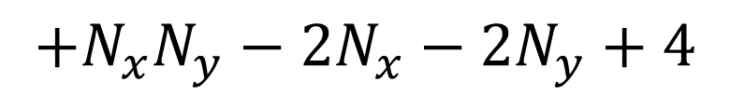
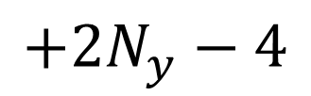

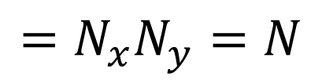
number of unknown Temperature values: $M=N_{x}×N_{y}$
number of equations
$${2N}_{x}$$
top & bottom
$${2N}_{x}$$
$$+2\left(N_{y}−2\right)$$
$$+2N_{y}−4$$
left and right
$+\left(N_{x}−2\right)$ $×\left(N_{y}−2\right)$
$$+N_{x}N_{y}−2N_{x}−2N_{y}+4$$
interior
$$=N_{x}N_{y}=N$$

Slide 27
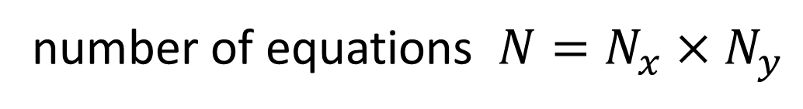
number of unknown Temperature values: $M=N_{x}×N_{y}$
number of equations $N=N_{x}×N_{y}$
number of unknown equal number of equations $N=M$
suggests problem is solvable

Slide 28
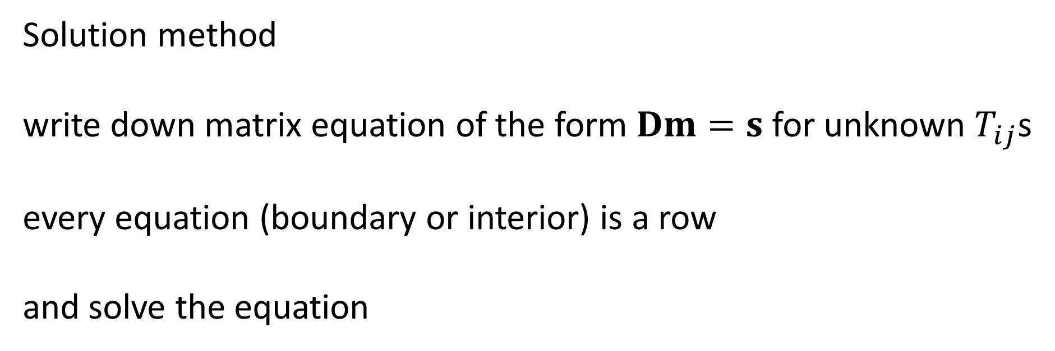
Solution method
write down matrix equation of the form $Dm=s$ for unknown $T_{ij}$s
every equation (boundary or interior) is a row
and solve the equation

Slide 29
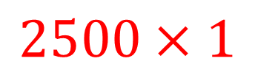
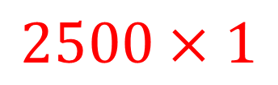
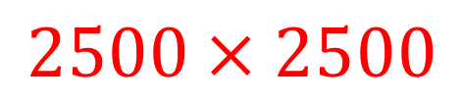
Example
$N_{x}=50 N_{y}=50$ $N=M=2500$
$$D m = s$$
$$2500×2500$$
$$2500×1$$
$$2500×1$$

Slide 30


Unknown $m$s are temperatures
$$2500 temperatures$$

Slide 31



Top Boundary has fifty points
$$50 rows$$
$$0$$
$$2500 temperatures$$

Slide 32




Bottom Boundary has fifty points
$$50 rows$$
$$0$$
$$50 rows$$
$$0$$
$$2500 temperatures$$

Slide 33




Left Boundary has 48 points
$$50 rows$$
$$0$$
$$50 rows$$
$$0$$
$$48 rows$$
$$0$$
$$2500 temperatures$$

Slide 34




Right Boundary has 48 points
$$50 rows$$
$$0$$
$$50 rows$$
$$0$$
$$0$$
$$48 rows$$
$$2500 temperatures$$
$$0$$
$$48 rows$$

Slide 35






Interior has $48×48=2304$ points
$$50 rows$$
$$0$$
$$50 rows$$
$$0$$
$$0$$
$$48 rows$$
$$2500 temperatures$$
$$0$$
$$48 rows$$
$$f$$
$$2,304 rows$$

Slide 36
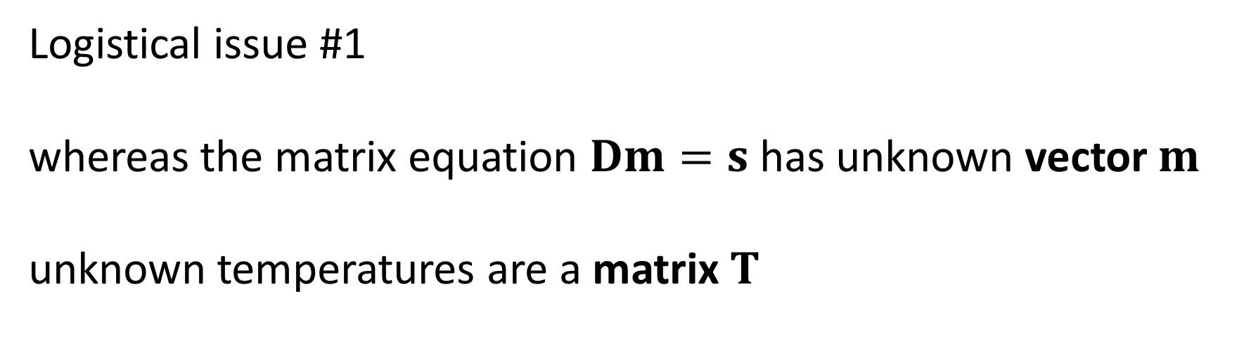
Logistical issue #1
whereas the matrix equation $Dm=s$ has unknown vector $m$
unknown temperatures are a matrix $T$

Slide 37
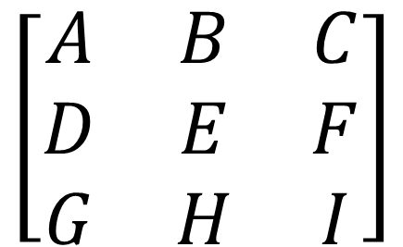
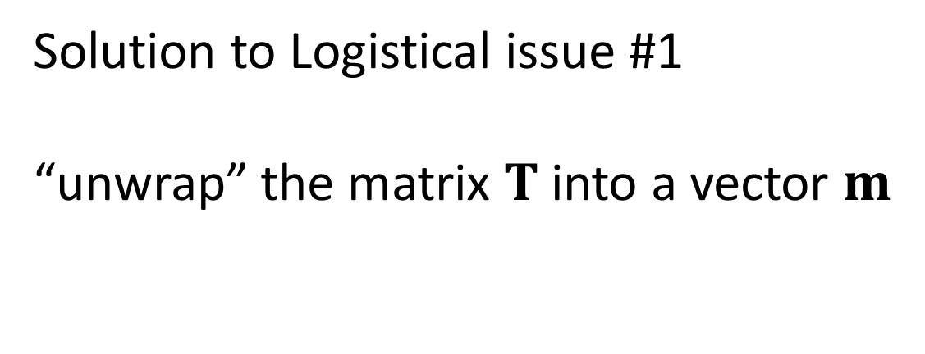

$$\left[\begin{matrix}A \\ B \\ C \\ D \\ E \\ F \\ G \\ H \\ I\end{matrix}\right]$$
Solution to Logistical issue #1
“unwrap” the matrix $T$ into a vector $m$
$$\left[\begin{matrix}A & B & C \\ D & E & F \\ G & H & I\end{matrix}\right]$$

Slide 38

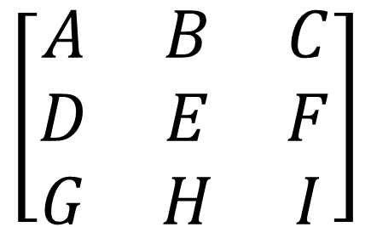
$$\left[\begin{matrix}A \\ B \\ C \\ D \\ E \\ F \\ G \\ H \\ I\end{matrix}\right]$$
$$\left[\begin{matrix}A & B & C \\ D & E & F \\ G & H & I\end{matrix}\right]$$
creates quite a bookkeeping problem!

Slide 39

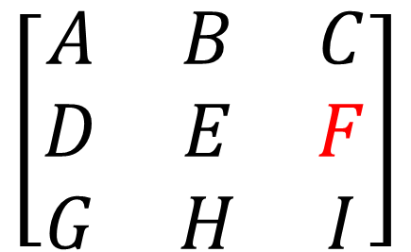



$$j$$
$$\left[\begin{matrix}A \\ B \\ C \\ D \\ E \\ F \\ G \\ H \\ I\end{matrix}\right]$$
$$\left[\begin{matrix}A & B & C \\ D & E & F \\ G & H & I\end{matrix}\right]$$
simplified by “lookup tables”
i=iofk[k,0];
j=jofk[k,0];
k=kofij[i,j];
$$i$$
creates quite a bookkeeping problem!
$$k$$

Slide 40
# lookup tables translate between matrix (i,j)
# and vector ordering k
M= Lx*Ly;
iofk = np.zeros((M,1),dtype=int);
jofk = np.zeros((M,1),dtype=int);
kofij = np.zeros((Lx,Ly),dtype=int);
k=0;
for ix in range(Lx):
for iy in range(Ly):
iofk[k,0]=ix;
jofk[k,0]=iy;
kofij[ix,iy]=k;
k=k+1;

Slide 41
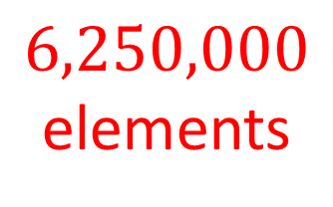


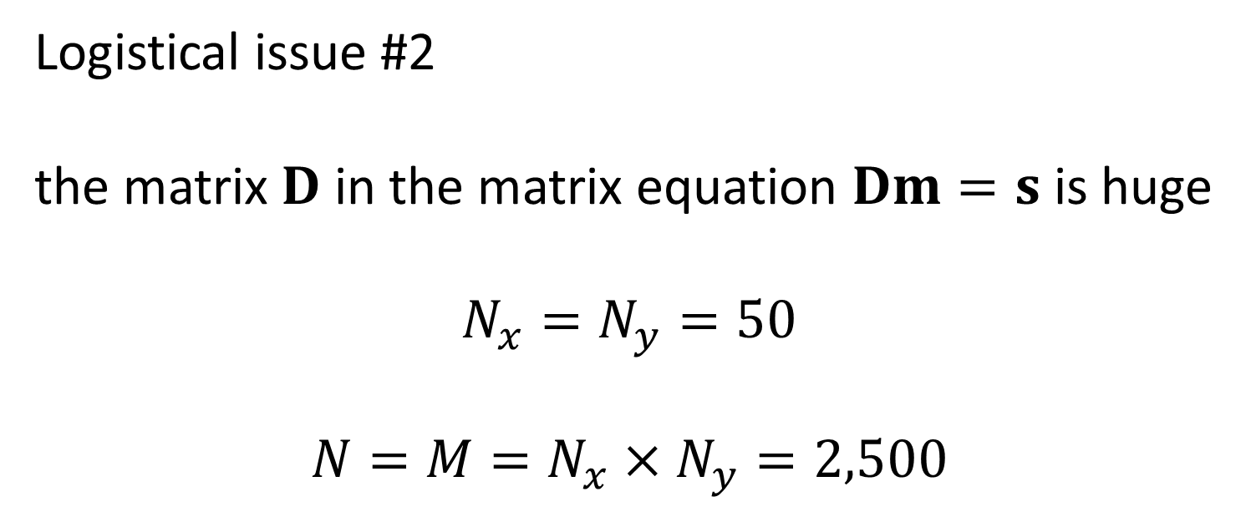



Logistical issue #2
the matrix $D$ in the matrix equation $Dm=s$ is huge
$$N_{x}=N_{y}=50$$
$$N=M=N_{x}×N_{y}=2,500$$
$$j$$
$$2,500$$
$$D$$
$$6,250,000$$
elements
$$2,500$$
$$i$$

Slide 42
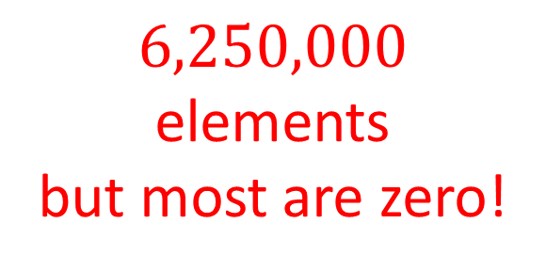
Logistical issue #2
the matrix $D$ in the matrix equation $Dm=s$ is huge
$$N_{x}=N_{y}=50$$
$$N=M=N_{x}×N_{y}=2,500$$
$$j$$
$$2,500$$
$$D$$
$$6,250,000$$
elements
but most are zero!
$$2,500$$
$$i$$

Slide 43
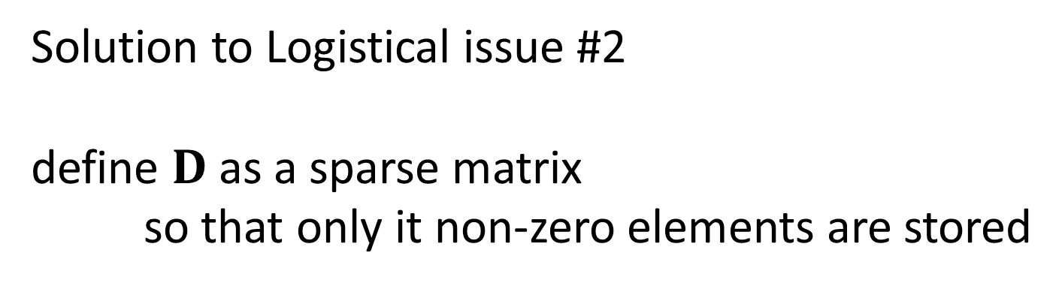
Solution to Logistical issue #2
define $D$ as a sparse matrix
so that only it non-zero elements are stored
$$j$$
fortunately
most of them are zero
in our case,
no more than 5 per row
$$2,500$$
$$D$$
$$2,500$$
$$i$$

Slide 44
Steps to making a sparse matrix D
create three vectors Dr, Dc and Dv to hold the row-index, column-index, and value of non-zero elements of D
(2) For each non-zero elements of D,
set one row of Dr, Dc and Dv
(3) Call a Python method that creates the sparse matrix

Slide 45


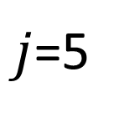











$j$=5
$$D_{r}$$
$$D_{c}$$
$$D_{v}$$
$$⋮$$
$$⋮$$
$$⋮$$
$$i=4$$
$$6.5$$
4
5
$$6.5$$
$$D$$
$$⋮$$
$$⋮$$
$$⋮$$

Slide 46






196 boundary points
one “1” per row
$$D_{r}$$
$$D_{c}$$
$$D_{v}$$
$$⋯1 ⋯$$
$$1$$
196 rows
196 rows
$$⋮$$
$$1$$

Slide 47










2304 interior points
four “1” and one “-4” per row
$$D_{r}$$
$$D_{c}$$
$$D_{v}$$
$$⋯1 ⋯$$
$$1$$
196 rows
196 rows
$$⋮$$
$$1$$
$$1⋯1⋯−4⋯1⋯1$$
$$1$$
$$⋮$$
11,520 rows
11,520 rows
$$−4$$
$$⋮$$
$$1$$

Slide 48
create the three vectors
Pmax = 100000;
maximum number of non-zero elements

Slide 49
Pmax = 100000;
Dr = np.zeros((Pmax,1),dtype=int);
Dc = np.zeros((Pmax,1),dtype=int);
row and column vectors must be integer

Slide 50
Pmax = 100000;
Dr = np.zeros((Pmax,1),dtype=int);
Dc = np.zeros((Pmax,1),dtype=int);
Dv = np.zeros((Pmax,1));
value vector

Slide 51

Pmax = 100000;
Dr = np.zeros((Pmax,1),dtype=int);
Dc = np.zeros((Pmax,1),dtype=int);
Dv = np.zeros((Pmax,1));
s = np.zeros((M,1));
RHS vector of $Dm=s$

Slide 52
(2) For each non-zero elements of D, set one row of Dr, Dc and Dv
counter for the rows of D
every point in grid is a different row
nr=0;

Slide 53
nr=0;
ne=0;
counter for the non-zero elements of D

Slide 54
nr=0;
ne=0;
mel=0; mer=0; meb=0; met=0; mi=0;
counters for the number of left, right, bottom, top and interior points

Slide 55
nr=0;
ne=0;
mel=0; mer=0; meb=0; met=0; mi=0;
for ix in range(Lx):
for iy in range(Ly):
loop over all the grid points
[code here to set the elements of one row
at a time of D]

Slide 56
# left boundary point
if( (ix==0) and (iy>0) and (iy<(Ly-1))):
test whether this (ix,iy) in on the left boundary

Slide 57
# left boundary point
if( (ix==0) and (iy>0) and (iy<(Ly-1))):
k=kofij[ix,iy];
convert (ix,iy) of D into a k of m

Slide 58
# left boundary point
if( (ix==0) and (iy>0) and (iy<(Ly-1))):
k=kofij[ix,iy];
mel=mel+1;
this is a left element, so increment the
left-element counter

Slide 59
# left boundary point
if( (ix==0) and (iy>0) and (iy<(Ly-1))):
k=kofij[ix,iy];
mel=mel+1;
Dr[ne,0] = nr;
Dc[ne,0] = k;
Dv[ne,0] = 1.0;
Define this non-zero element
row of D
col of D
value of D

Slide 60
# left boundary point
if( (ix==0) and (iy>0) and (iy<(Ly-1))):
k=kofij[ix,iy];
mel=mel+1;
Dr[ne,0] = nr;
Dc[ne,0] = k;
Dv[ne,0] = 1.0;
ne=ne+1;
increment the element counter

Slide 61
# left boundary point
if( (ix==0) and (iy>0) and (iy<(Ly-1))):
k=kofij[ix,iy];
mel=mel+1;
Dr[ne,0] = nr;
Dc[ne,0] = k;
Dv[ne,0] = 1.0;
ne=ne+1;
s[k,0]=ExLeft[iy-1,0];
set the RHS vector

Slide 62
# left boundary point
if( (ix==0) and (iy>0) and (iy<(Ly-1))):
k=kofij[ix,iy];
mel=mel+1;
Dr[ne,0] = nr;
Dc[ne,0] = k;
Dv[ne,0] = 1.0;
ne=ne+1;
s[k,0]=ExLeft[iy-1,0];
nr=nr+1;
we are done with the row of D,
so increment the row-counter

Slide 63
# else is an interior point
else:
I have skipped the other boundaries
the is the code for the interior where the differential equation is solved

Slide 64
# else is an interior point
else:
k00=kofij[ix-1,iy-1]; # interior
k01=kofij[ix-1,iy];
k02=kofij[ix-1,iy+1];
k10=kofij[ix,iy-1];
k11=kofij[ix,iy];
k12=kofij[ix,iy+1];
k20=kofij[ix+1,iy-1];
k21=kofij[ix+1,iy];
k22=kofij[ix+1,iy+1];
ks of the 9 points centered on this (ix,iy).
k of (ix,iy) is k11
in my notation

Slide 65
# else is an interior point
else:
k00=kofij[ix-1,iy-1]; # interior
k01=kofij[ix-1,iy];
k02=kofij[ix-1,iy+1];
k10=kofij[ix,iy-1];
k11=kofij[ix,iy];
k12=kofij[ix,iy+1];
k20=kofij[ix+1,iy-1];
k21=kofij[ix+1,iy];
k22=kofij[ix+1,iy+1];
mi=mi+1;
increment the interior-point counter

Slide 66
$$\frac{T_{i−1,j}}{{\left(∆x\right)}^{2}}+\frac{T_{i+1,j}}{{\left(∆x\right)}^{2}}−\left(\frac{2}{{\left(∆x\right)}^{2}}+\frac{2}{{\left(∆y\right)}^{2}}\right)T_{i,j}+\frac{T_{i,j−1}}{{\left(∆y\right)}^{2}}+\frac{T_{i,j+1}}{{\left(∆y\right)}^{2}}=−f_{ij}$$
# Term 1
Dr[ne,0] = nr;
Dc[ne,0] = k01;
Dv[ne,0] = Dxr2;
ne=ne+1;

Slide 67
$$\frac{T_{i−1,j}}{{\left(∆x\right)}^{2}}+\frac{T_{i+1,j}}{{\left(∆x\right)}^{2}}−\left(\frac{2}{{\left(∆x\right)}^{2}}+\frac{2}{{\left(∆y\right)}^{2}}\right)T_{i,j}+\frac{T_{i,j−1}}{{\left(∆y\right)}^{2}}+\frac{T_{i,j+1}}{{\left(∆y\right)}^{2}}=−f_{ij}$$
# Term 2
Dr[ne,0] = nr;
Dc[ne,0] = k21;
Dv[ne,0] = Dxr2;
ne=ne+1;

Slide 68
$$\frac{T_{i−1,j}}{{\left(∆x\right)}^{2}}+\frac{T_{i+1,j}}{{\left(∆x\right)}^{2}}−\left(\frac{2}{{\left(∆x\right)}^{2}}+\frac{2}{{\left(∆y\right)}^{2}}\right)T_{i,j}+\frac{T_{i,j−1}}{{\left(∆y\right)}^{2}}+\frac{T_{i,j+1}}{{\left(∆y\right)}^{2}}=−f_{ij}$$
# Term 3
Dr[ne,0] = nr;
Dc[ne,0] = k11;
Dv[ne,0] = -2.0*Dxr2 -2.0*Dyr2;
ne=ne+1;

Slide 69
$$\frac{T_{i−1,j}}{{\left(∆x\right)}^{2}}+\frac{T_{i+1,j}}{{\left(∆x\right)}^{2}}−\left(\frac{2}{{\left(∆x\right)}^{2}}+\frac{2}{{\left(∆y\right)}^{2}}\right)T_{i,j}+\frac{T_{i,j−1}}{{\left(∆y\right)}^{2}}+\frac{T_{i,j+1}}{{\left(∆y\right)}^{2}}=−f_{ij}$$
# Term 4
Dr[ne,0] = nr;
Dc[ne,0] = k10;
Dv[ne,0] = Dyr2;
ne=ne+1;

Slide 70
$$\frac{T_{i−1,j}}{{\left(∆x\right)}^{2}}+\frac{T_{i+1,j}}{{\left(∆x\right)}^{2}}−\left(\frac{2}{{\left(∆x\right)}^{2}}+\frac{2}{{\left(∆y\right)}^{2}}\right)T_{i,j}+\frac{T_{i,j−1}}{{\left(∆y\right)}^{2}}+\frac{T_{i,j+1}}{{\left(∆y\right)}^{2}}=−f_{ij}$$
# Term 5
Dr[ne,0] = nr;
Dc[ne,0] = k12;
Dv[ne,0] = Dyr2;
ne=ne+1;

Slide 71
$$\frac{T_{i−1,j}}{{\left(∆x\right)}^{2}}+\frac{T_{i+1,j}}{{\left(∆x\right)}^{2}}−\left(\frac{2}{{\left(∆x\right)}^{2}}+\frac{2}{{\left(∆y\right)}^{2}}\right)T_{i,j}+\frac{T_{i,j−1}}{{\left(∆y\right)}^{2}}+\frac{T_{i,j+1}}{{\left(∆y\right)}^{2}}=−f_{ij}$$
# RHS
s[k11,0]=-f[ix,iy];

Slide 72
$$\frac{T_{i−1,j}}{{\left(∆x\right)}^{2}}+\frac{T_{i+1,j}}{{\left(∆x\right)}^{2}}−\left(\frac{2}{{\left(∆x\right)}^{2}}+\frac{2}{{\left(∆y\right)}^{2}}\right)T_{i,j}+\frac{T_{i,j−1}}{{\left(∆y\right)}^{2}}+\frac{T_{i,j+1}}{{\left(∆y\right)}^{2}}=−f_{ij}$$
# RHS
s[k11,0]=-f[ix,iy];
nr=nr+1;
done with the row

Slide 73
(3) Call a Python method that creates the sparse matrix
Dsparse=sparse.coo_matrix((Dv[0:ne,0:1].ravel(), (Dr[0:ne,0:1].ravel(),Dc[0:ne,0:1].ravel())),shape=(M,M)).tocsr();
del Dv; del Dr; del Dc;
construct sparse D
delete Dr Dc Dv
which are big and no longer needed

Slide 74
solve matrix equation
mest = gda_cvec(las.spsolve(Dsparse,s.ravel()));
put solution in matrix form
T = np.zeros((Lx,Ly));
for k in range(M):
i = iofk[k,0];
j = jofk[k,0];
T[i,j] = mest[k,0];
and we’re done!
(except for plotting)

Slide 75
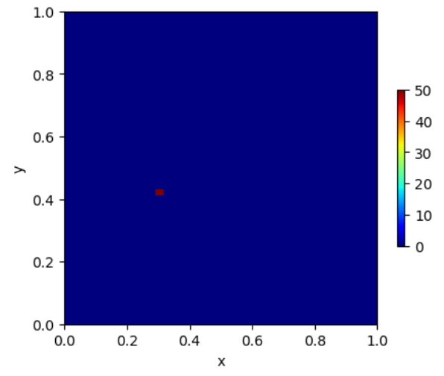
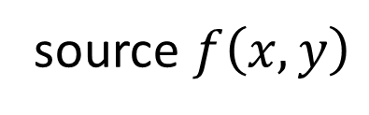
source $f\left(x,y\right)$

Slide 76

color-coded geometry

Slide 77

temperature

Slide 78
as usual
the hard part is the
BOOKKEEPING

