Slide 1
2025 EESC W3400
Computational Earth Science
Lec 22: Writing a FD code illustrated with 1D+time heat flow equation

Slide 2
Today
Finite Difference Method for Solving
Dynamic Heat Conduction Problem
a.k.a. the Diffusion Equation

Slide 3
Today
I will lead you through writing a FD code
assuming small problem that doesn’t need sparse matrices

Slide 4






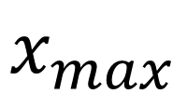

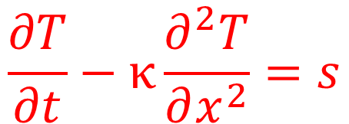

Goal: Find temperature, $T\left(x,t\right)$ for
$$t_{max}$$
$$0$$
$$T=0$$
$$t$$
$$source$$
$$s\left(x,t\right)$$
$$T=0$$
$$x_{max}$$
$$x$$
$$T=0$$
$$\frac{∂T}{∂t}−κ\frac{∂^{2}T}{∂x^{2}}=s$$
satisfied in the interior

Slide 5






Finite Difference grid
$$∆t$$
$$0$$
$$N_{t}−1$$
$$t$$
$$0$$
$$∆x$$
$$N_{x}−1$$
$$x$$
$$\frac{∂T}{∂t}−κ\frac{∂^{2}T}{∂x^{2}}=s$$
satisfied in the interior

Slide 6

initial condition
$$0$$
$$t$$
$$1× T\left(x,t=0\right)=0$$
$$x$$

Slide 7
boundary condition
$$1×T\left(x=0,∆t≤t≤t_{max}\right)=0$$
$$0$$
$$t$$
$$x$$
$$1×T\left(x=x_{max},∆t≤t≤t_{max}\right)=0$$

Slide 8
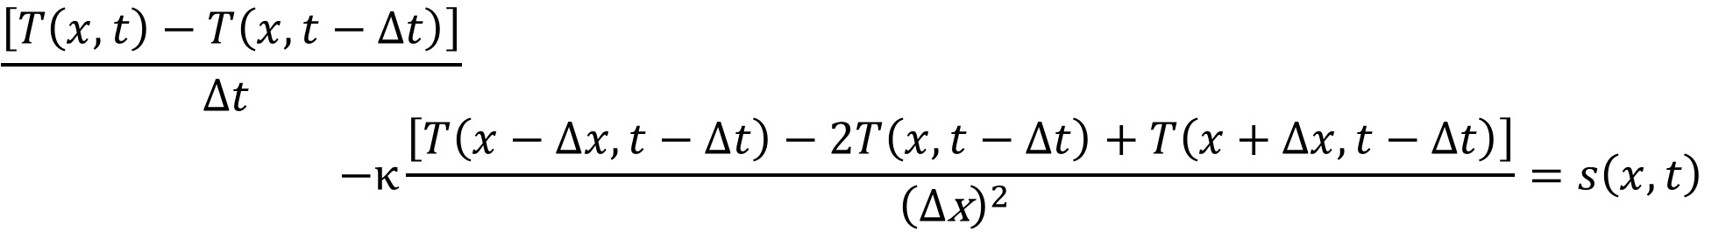
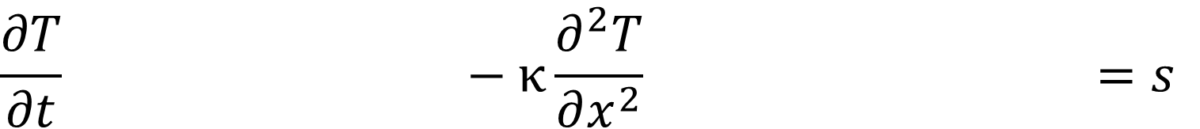
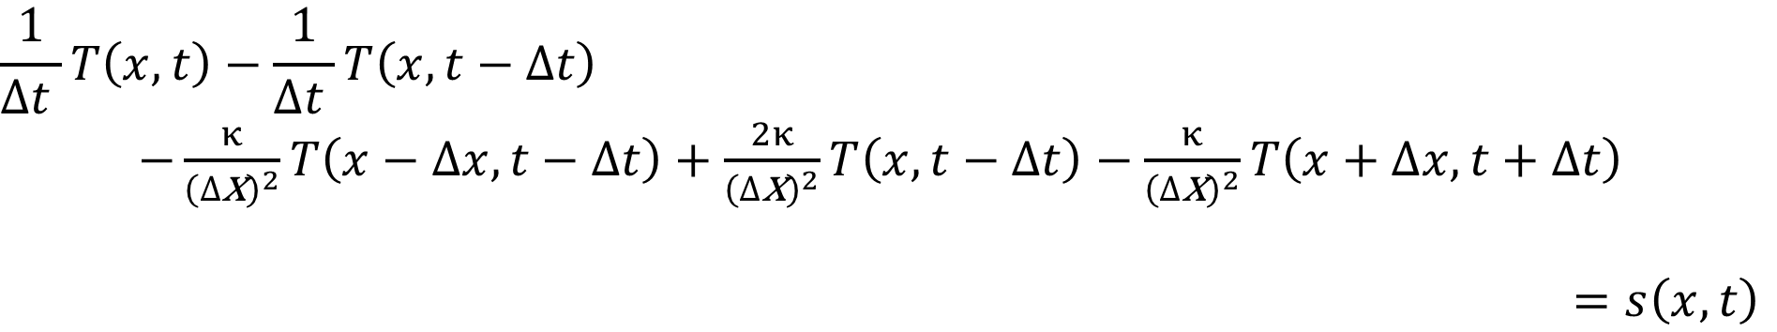
interior
$$\frac{∂T}{∂t} −κ\frac{∂^{2}T}{∂x^{2}} =s$$
$$\frac{\left[T\left(x,t\right)−T\left(x,t−∆t\right)\right]}{∆t }$$
$$−κ\frac{\left[T\left(x−∆x,t−∆t\right)−2T\left(x,t−∆t\right)+T\left(x+∆x,t−∆t\right)\right]}{{\left(∆\text{x}\right)}^{2} }=s\left(x,t\right)$$
$$\frac{1}{∆t }T\left(x,t\right)−\frac{1}{∆t }T\left(x,t−∆t\right)$$
$−\frac{κ}{{\left(∆\text{x}\right)}^{2}}T\left(x−∆x,t−∆t\right)+\frac{2κ}{{\left(∆\text{x}\right)}^{2}}T\left(x,t−∆t\right)−\frac{κ}{{\left(∆\text{x}\right)}^{2}}T\left(x+∆x,t+∆t\right)$
$=s\left(x,t\right)$

Slide 9
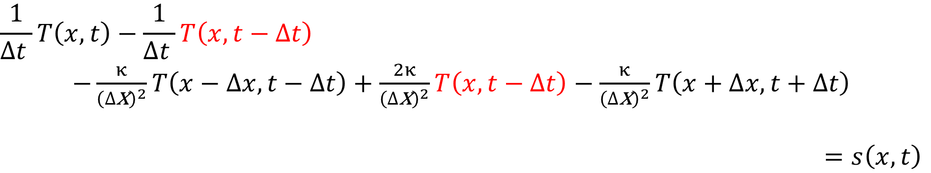
interior
$$\frac{∂T}{∂t} −κ\frac{∂^{2}T}{∂x^{2}} =s$$
$$\frac{\left[T\left(x,t\right)−T\left(x,t−∆t\right)\right]}{∆t }$$
$$−κ\frac{\left[T\left(x−∆x,t−∆t\right)−2T\left(x,t−∆t\right)+T\left(x+∆x,t−∆t\right)\right]}{{\left(∆\text{x}\right)}^{2} }=s\left(x,t\right)$$
$$\frac{1}{∆t }T\left(x,t\right)−\frac{1}{∆t }T\left(x,t−∆t\right)$$
$−\frac{κ}{{\left(∆\text{x}\right)}^{2}}T\left(x−∆x,t−∆t\right)+\frac{2κ}{{\left(∆\text{x}\right)}^{2}}T\left(x,t−∆t\right)−\frac{κ}{{\left(∆\text{x}\right)}^{2}}T\left(x+∆x,t+∆t\right)$
$=s\left(x,t\right)$

Slide 10
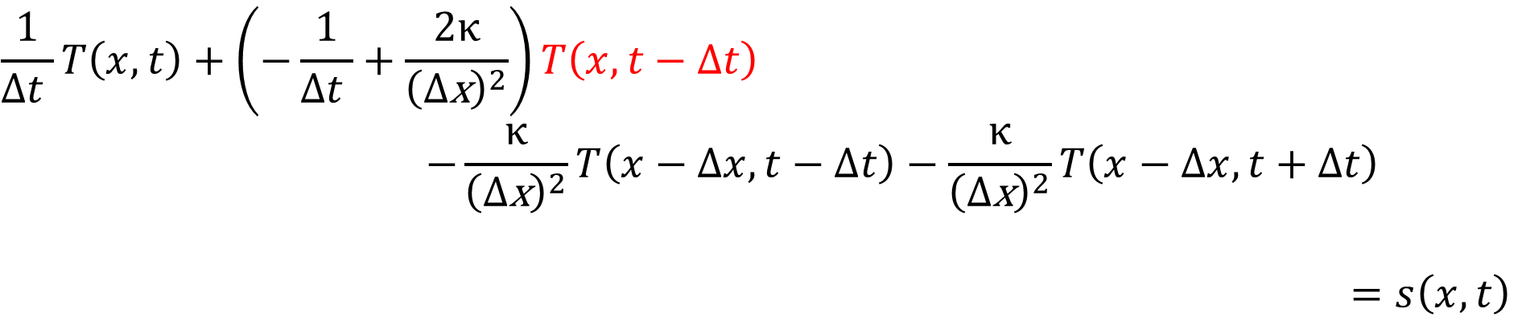
interior
$$\frac{1}{∆t }T\left(x,t\right)+\left(−\frac{1}{∆t }+\frac{2κ}{{\left(∆\text{x}\right)}^{2}}\right)T\left(x,t−∆t\right)$$
$$−\frac{κ}{{\left(∆\text{x}\right)}^{2}}T\left(x−∆x,t−∆t\right)−\frac{κ}{{\left(∆\text{x}\right)}^{2}}T\left(x−∆x,t+∆t\right)$$
$=s\left(x,t\right)$

Slide 11






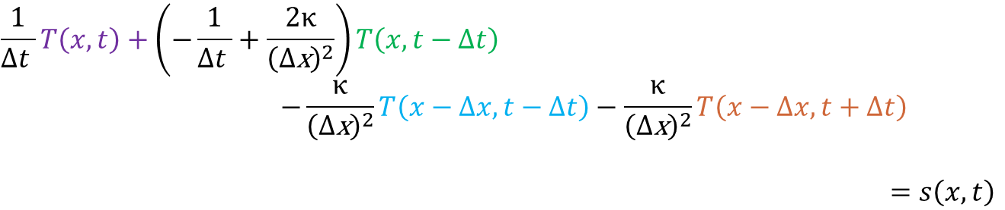


interior
$$∆t$$
$$0$$
$$N_{t}−1$$
$$t$$
$$0$$
every interior equation involves 4 points
$$∆x$$
$$N_{x}−1$$
$$x$$
$$\frac{1}{∆t }T\left(x,t\right)+\left(−\frac{1}{∆t }+\frac{2κ}{{\left(∆\text{x}\right)}^{2}}\right)T\left(x,t−∆t\right)$$
$$−\frac{κ}{{\left(∆\text{x}\right)}^{2}}T\left(x−∆x,t−∆t\right)−\frac{κ}{{\left(∆\text{x}\right)}^{2}}T\left(x−∆x,t+∆t\right)$$
$=s\left(x,t\right)$

Slide 12
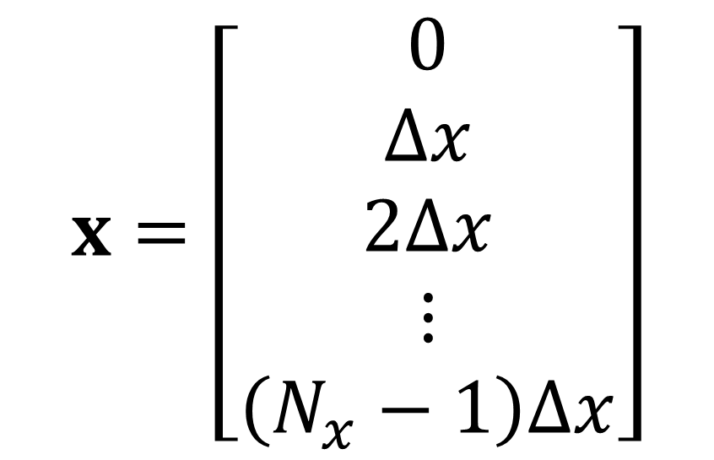
Step 1: define x axis
$$x=\left[\begin{matrix}0 \\ ∆x \\ 2∆x \\ ⋮ \\ \left(N_{x}−1\right)∆x\end{matrix}\right]$$

Slide 13
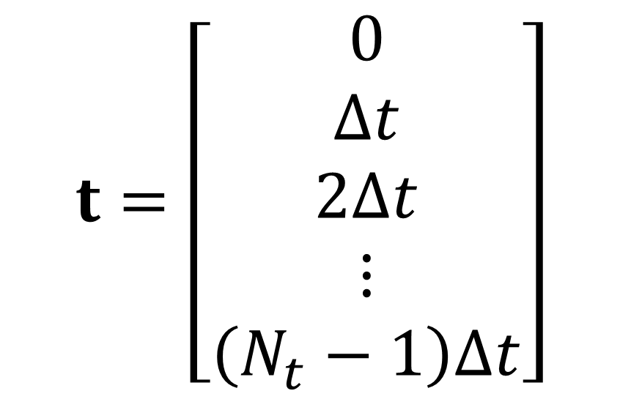
Step 2: define t axis
$$t=\left[\begin{matrix}0 \\ ∆t \\ 2∆t \\ ⋮ \\ \left(N_{t}−1\right)∆t\end{matrix}\right]$$

Slide 14
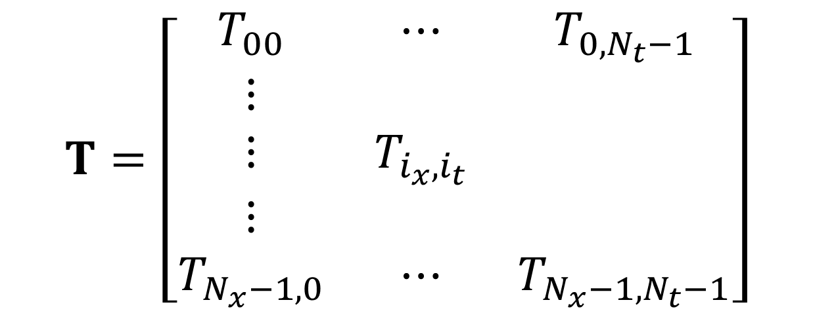
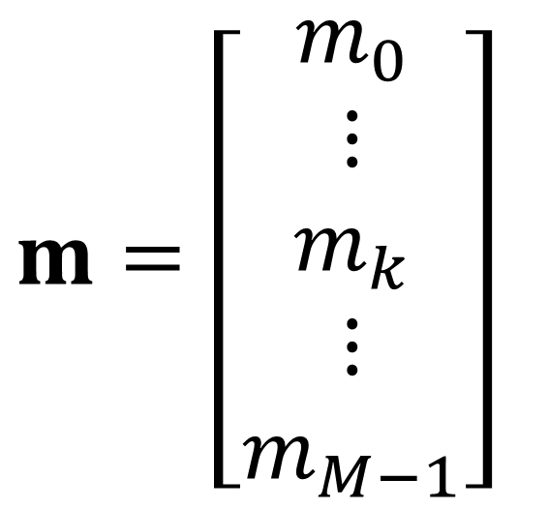

Step 3: make tables to unwrap temperature matrix to vector
$$T=\left[\begin{matrix}T_{00} & ⋯ & T_{{0,N}_{t}−1} \\ ⋮ & & \\ ⋮ & T_{i_{x}{,i}_{t}} & \\ ⋮ & & \\ T_{N_{x}−1,0} & ⋯ & T_{N_{x}−1,N_{t}−1}\end{matrix}\right]$$
$$m=\left[\begin{matrix}m_{0} \\ ⋮ \\ m_{k} \\ ⋮ \\ m_{M−1}\end{matrix}\right]$$
$$M=N_{x}×N_{t}$$

Slide 15
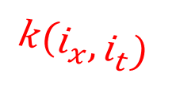
Step 3: make tables to unwrap temperature matrix to vector
$$T=\left[\begin{matrix}T_{00} & ⋯ & T_{{0,N}_{t}−1} \\ ⋮ & & \\ ⋮ & T_{i_{x}{,i}_{t}} & \\ ⋮ & & \\ T_{N_{x}−1,0} & ⋯ & T_{N_{x}−1,N_{t}−1}\end{matrix}\right]$$
$$m=\left[\begin{matrix}m_{0} \\ ⋮ \\ m_{k} \\ ⋮ \\ m_{M−1}\end{matrix}\right]$$
$$k\left(i_{x},i_{t}\right)$$

Slide 16
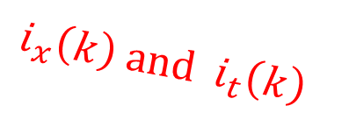
Step 3: make tables to unwrap temperature matrix to vector
$$T=\left[\begin{matrix}T_{00} & ⋯ & T_{{0,N}_{t}−1} \\ ⋮ & & \\ ⋮ & T_{i_{x}{,i}_{t}} & \\ ⋮ & & \\ T_{N_{x}−1,0} & ⋯ & T_{N_{x}−1,N_{t}−1}\end{matrix}\right]$$
$$m=\left[\begin{matrix}m_{0} \\ ⋮ \\ m_{k} \\ ⋮ \\ m_{M−1}\end{matrix}\right]$$
$$i_{x}\left(k\right){ and i}_{t}\left(k\right)$$

Slide 17






Steps 4, 5, 6 and 7: set up $D$ and $rhs$ for $Dm=rhs$
initial condition
$$0$$
left boundary condition
$$0$$
rt boundary condition
$$0$$
interior equation
$$s$$
$$D$$
$$rhs$$

Slide 18
Step 4: initial conditions
initial condition
$$0$$
$$D$$
$$rhs$$

Slide 19
Step 5: boundary conditions
left boundary condition
$$0$$
rt boundary condition
$$0$$
$$D$$
$$rhs$$

Slide 20

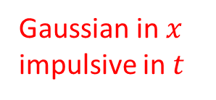

Steps 6: construct source $s$
Gaussian in $x$
impulsive in $t$
$$s$$
$$D$$
$$rhs$$

Slide 21
Step 7: interior equation
interior equation
$$s$$
$$D$$
$$rhs$$

Slide 22

Step 8: solve equation $Dm=rhs$ for $m$
$$rhs$$

Slide 23

Step 9: construct $T$ given $m$
$$T=\left[\begin{matrix}T_{00} & ⋯ & T_{{0,N}_{t}−1} \\ ⋮ & & \\ ⋮ & T_{i_{x}{,i}_{t}} & \\ ⋮ & & \\ T_{N_{x}−1,0} & ⋯ & T_{N_{x}−1,N_{t}−1}\end{matrix}\right]$$
$$m=\left[\begin{matrix}m_{0} \\ ⋮ \\ m_{k} \\ ⋮ \\ m_{M−1}\end{matrix}\right]$$
$$i_{x}\left(k\right){ and i}_{t}\left(k\right)$$

Slide 24
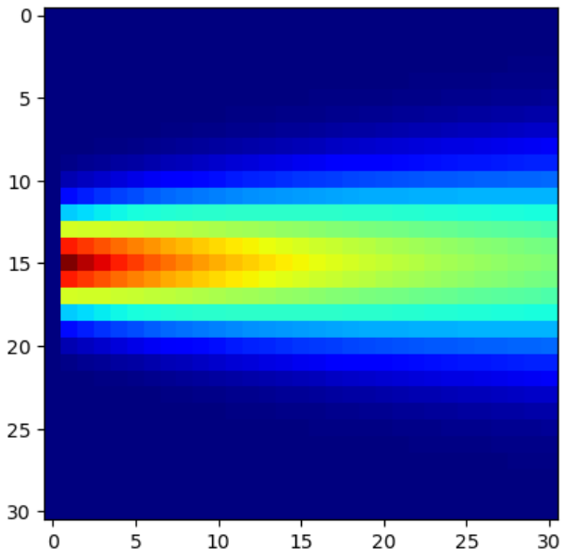

Step 10: plot $T$

Slide 25
trick is to build code incrementally
step-by-step
and test steps along the way

Slide 26
so let’s give it a shot
bring up jupyter lab and load Lec22_stub

