Slide 1
2025 EESC W3400
Computational Earth Science
Lec 25: Writing a least squares code illustrated with planar fit problem

Slide 2
Today
A little coding practice
so bring up jupyter lab on your computers

Slide 3


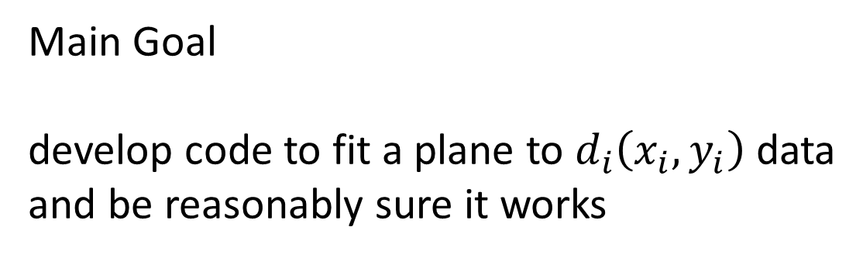



Main Goal
develop code to fit a plane to $d_{i}\left(x_{i},y_{i}\right)$ data
and be reasonably sure it works
$$y$$
$$d_{i}$$
$$x_{i}$$
$$x$$
$$y_{i}$$
Secondary Goal
develop code to create a test data

Slide 4
might be useful
in understanding
topography
Main Goal
develop code to fit a plane to $d_{i}\left(x_{i},y_{i}\right)$ data
and be reasonably sure it works
$$y$$
$$d_{i}$$
$$x_{i}$$
$$x$$
$$y_{i}$$
Secondary Goal
develop code to create a test data

Slide 5
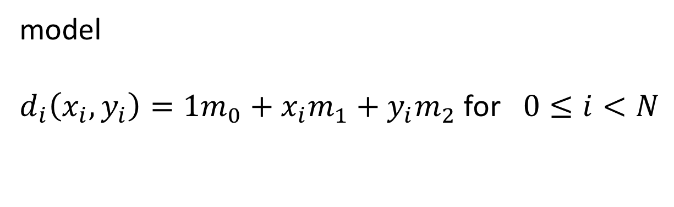
model
$d_{i}\left(x_{i},y_{i}\right)=1m_{0}+x_{i}m_{1}+y_{i}m_{2}$ for $0≤i<N$

Slide 6
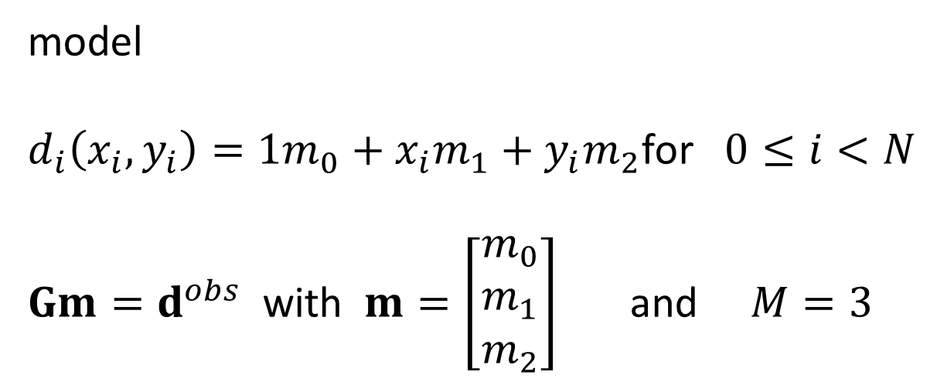
model
$d_{i}\left(x_{i},y_{i}\right)=1m_{0}+x_{i}m_{1}+y_{i}m_{2}$for $0≤i<N$
$Gm=d^{obs}$ with $m=\left[\begin{matrix}m_{0} \\ m_{1} \\ m_{2}\end{matrix}\right]$ and $M=3$

Slide 7
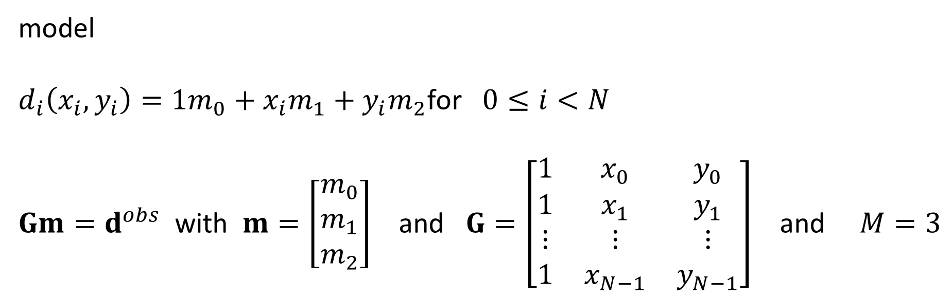
model
$d_{i}\left(x_{i},y_{i}\right)=1m_{0}+x_{i}m_{1}+y_{i}m_{2}$for $0≤i<N$
$Gm=d^{obs}$ with $m=\left[\begin{matrix}m_{0} \\ m_{1} \\ m_{2}\end{matrix}\right]$ and $G=\left[\begin{matrix}1 & x_{0} & y_{0} \\ 1 & x_{1} & y_{1} \\ ⋮ & ⋮ & ⋮ \\ 1 & x_{N−1} & y_{N−1}\end{matrix}\right]$ and $M=3$

Slide 8
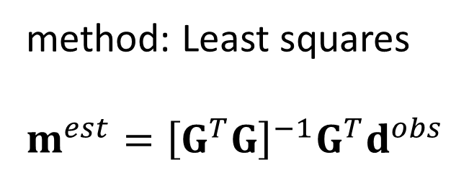
method: Least squares
$$m^{est}={\left[G^{T}G\right]}^{−1}G^{T}d^{obs}$$
estimated solution

Slide 9

method: Least squares
$$m^{est}={\left[G^{T}G\right]}^{−1}G^{T}d^{obs}$$
$$d^{pre}=Gm^{est}$$
predicted data

Slide 10
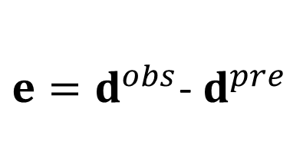
method: Least squares
$$m^{est}={\left[G^{T}G\right]}^{−1}G^{T}d^{obs}$$
$$d^{pre}=Gm^{est}$$
$e=d^{obs}$- $d^{pre}$
error of fit

Slide 11
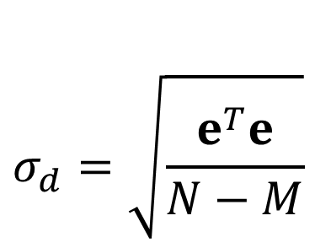
method: Least squares
$$m^{est}={\left[G^{T}G\right]}^{−1}G^{T}d^{obs}$$
$$d^{pre}=Gm^{est}$$
$e=d^{obs}$- $d^{pre}$
$$σ_{d}=\sqrt{\frac{e^{T}e}{N−M}}$$
estimate of error in data

Slide 12

method: Least squares
$$m^{est}={\left[G^{T}G\right]}^{−1}G^{T}d^{obs}$$
$$d^{pre}=Gm^{est}$$
$e=d^{obs}$- $d^{pre}$
$$σ_{d}=\sqrt{\frac{e^{T}e}{N−M}}$$
$$C_{m}=σ_{d}^{2}{\left[G^{T}G\right]}^{−1}$$
covariance of model parameters

Slide 13
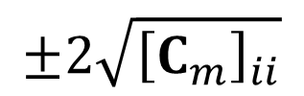
method: Least squares
$$m^{est}={\left[G^{T}G\right]}^{−1}G^{T}d^{obs}$$
$$d^{pre}=Gm^{est}$$
$e=d^{obs}$- $d^{pre}$
$$σ_{d}=\sqrt{\frac{e^{T}e}{N−M}}$$
$$C_{m}=σ_{d}^{2}{\left[G^{T}G\right]}^{−1}$$
$$±2\sqrt{{\left[C_{m}\right]}_{ii}}$$
95% confidence limits of estimate model parameters

Slide 14





Secondary Goal: develop code to create a test data
define x axis
define y axis
choose
$$m^{true}$$
and write them out
evaluate
$$D^{true}$$
on an (x,y) grid (for plotting purposed)
add random noise to $D^{true}$ to simulate observations $D^{obs}$
randomly select some $D^{obs}$ as observations $d^{obs}$
write $d^{obs}$ to a file
plot $D^{obs}$ as image and superimpose data points

Slide 15




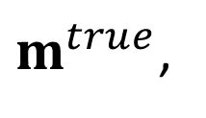


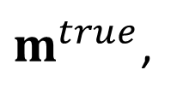

Primary Goal: estimate
$$m^{true}$$
and its confidence
read data from file
make $G$
apply least squares formulas to get
$m^{true}$,
$$σ_{d}$$
and confidence
write out
$m^{true}$,
$$σ_{d}$$
and confidence
define x axis
define y axis
evaluate
$$D^{pre}$$
on an (x,y) grid (for plotting purposed)
plot
$$D^{pre}$$
as image
overlay $d^{obs}$

Slide 16
Code Tidbits
read file
D = np.genfromtxt(myfile, delimiter="\t");
Nrows, Ncols = np.shape(D);
write file
myfile = "planedata.txt";
np.savetxt(myfile,np.concatenate((xobs,yobs,dobs),axis=1),delimiter="\t");
plot image
mycmap = matplotlib.colormaps['jet'];
plt.imshow(Dobs.T,cmap=mycmap,vmin=0.0,vmax=50.0);
random integers
ixr = np.random.randint(low=0, high=Nx, size=(Nr,1) );
iyr = np.random.randint(low=0, high=Ny, size=(Nr,1) );
plot colored dots
plt.scatter(xobs,yobs,c=dobs,cmap=mycmap,vmin=0.0,vmax=50.0,edgecolors=[0,0,0]);

