Slide 1
Group project 01: A close look at a glacier
Goals:
For you to learn to recognize a glacier using satellite and terrain maps
and get a sense for its geographical setting
and its scale

Slide 2
Part A (Illustrated in the first two slides)
Using Google Maps and PowerPoint
Pick a glacier near your assigned coordinate.
Make co-registered satellite and terrain maps that include the entire glacier including snowfields
Annotate the name of the mountain range (or other place-name)
Make readable metric distance scale.
Outline glacier in red.
Outline top of glacial valley in blue.
Annotate name (if any) and elevation (in meters) of a nearby mountain peak.
Annotate elevation (in meters) of snowfields and terminus
Add large arrow (yellow) annotated with (rough) length of glacier and direction of flow.
Part B (illustrated with third slide)
Make zoomed-in satellite of glacial terminus
Make readable metric distance scale.
Outline glacier in red.
Outline exit stream (if any) in blue.
Annotate river (if any) and sea into which meltwater from glacier flows.
Part C (Illustrated with Photo pulled off the web)
Find a photo of the glacier (or some other glacier close to it).
POST TO COURSEWORKS AS A PPTX
with a filename
GroupProject01_XX
where XX sis your group number

Slide 3
Group Assignment Locations
46.1597, 10.5370
35.9341, 75.6299
31.9636, 77.7554
-46.8579, -73.8274
-51.1296, -73.3558
48.7506, -113.7278
59.9640, -140.6138
62.8564, -150.6221
73.1360, -79.2326
80.4844, -59.7907
63.5600, -19.2998
30.2599, 93.7377

Slide 4
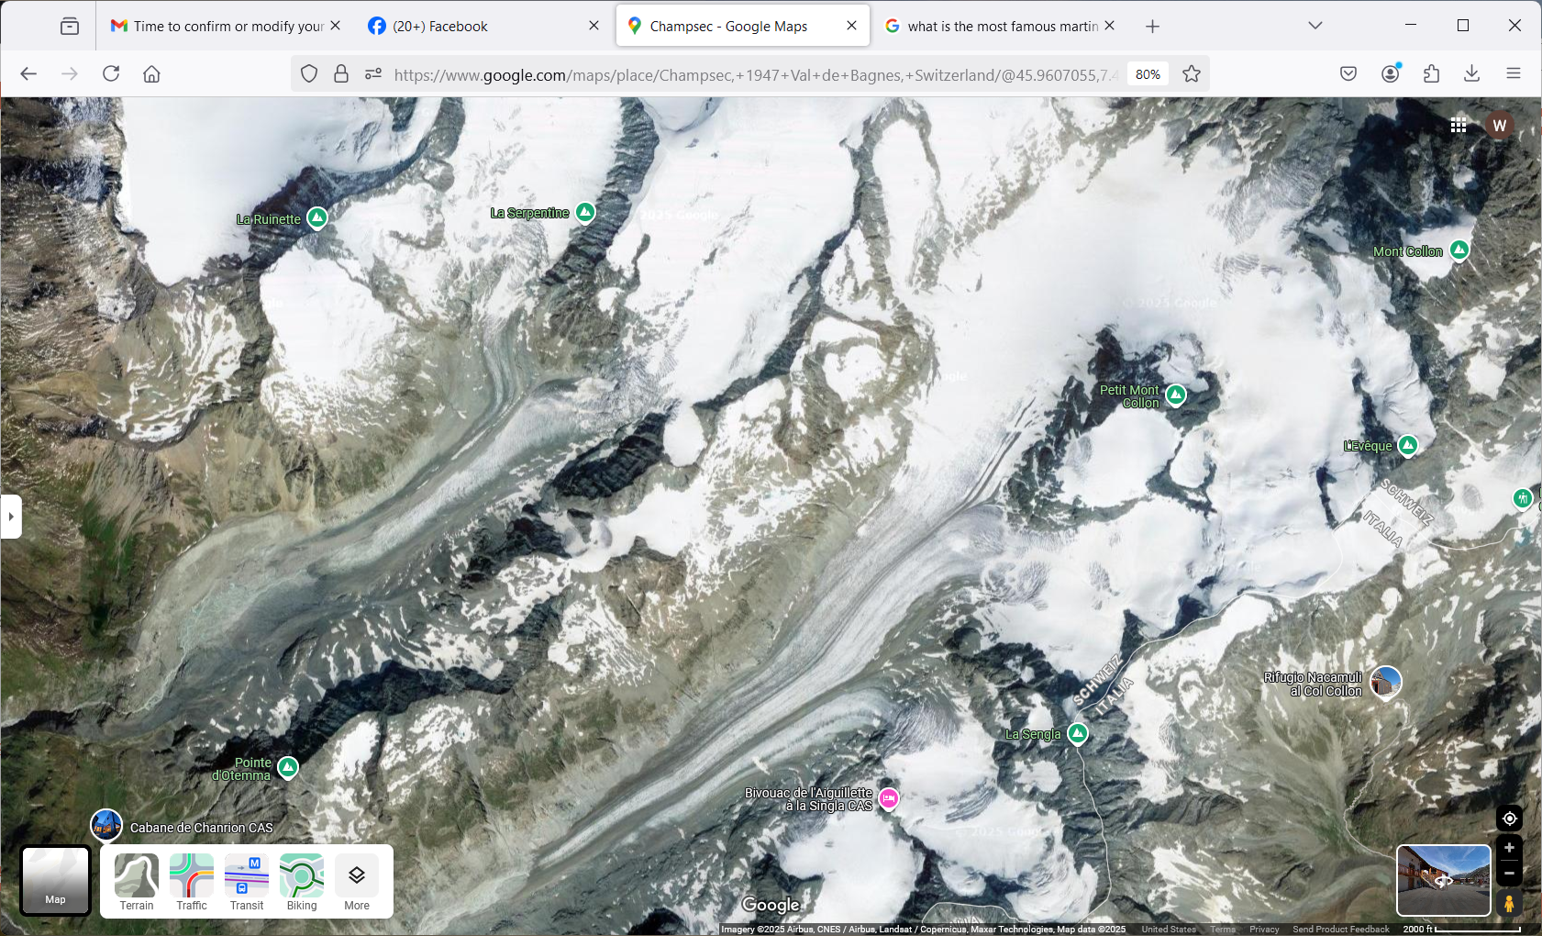
The Alps
3,100 m
6.9 km
Petit Mont Collon
3,555 m
Glacier d’Otemma
2600 m
1 km

Slide 5
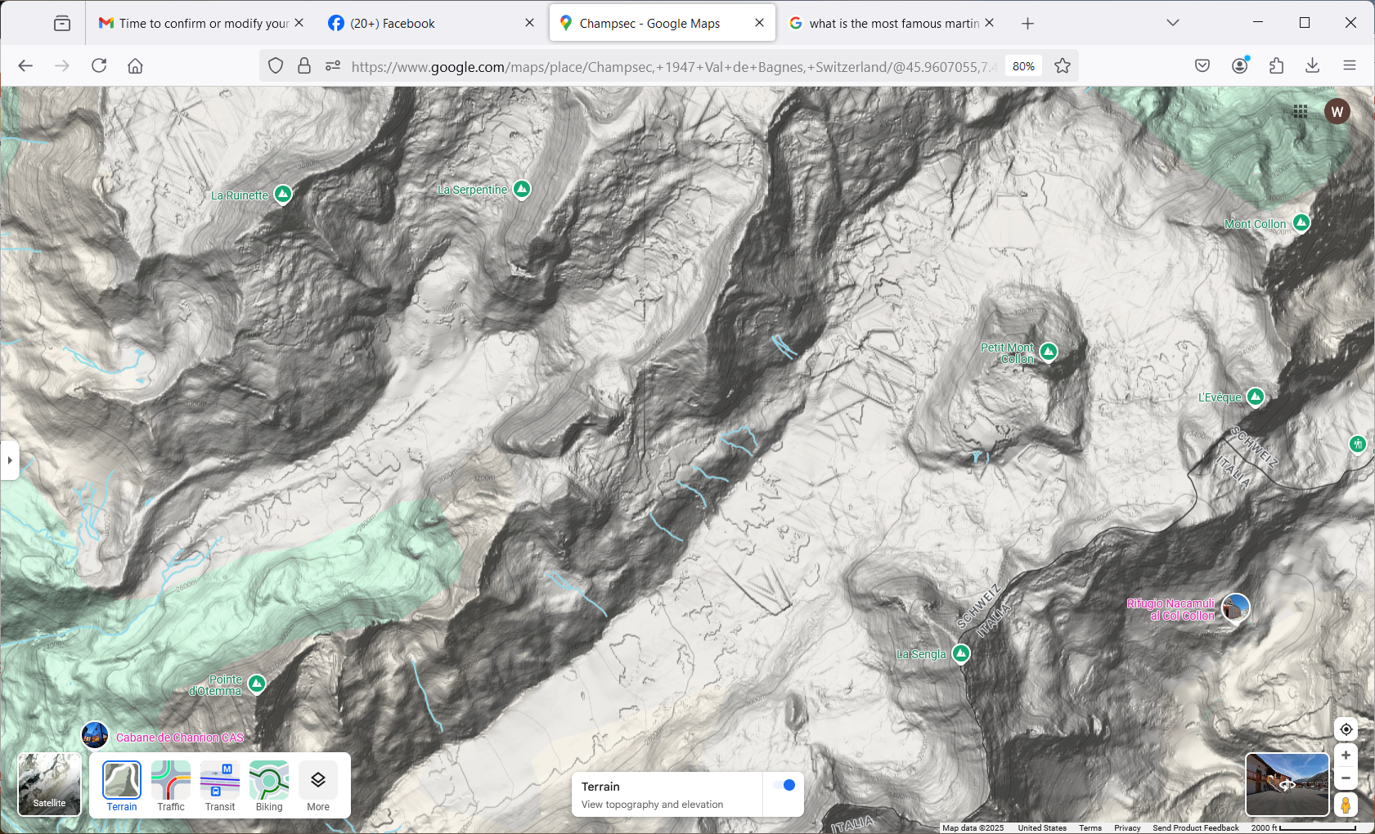
The Alps
3,100 m
6.9 km
Petit Mont Collon
3,555 m
Glacier d’Otemma
2600 m
1 km

Slide 6
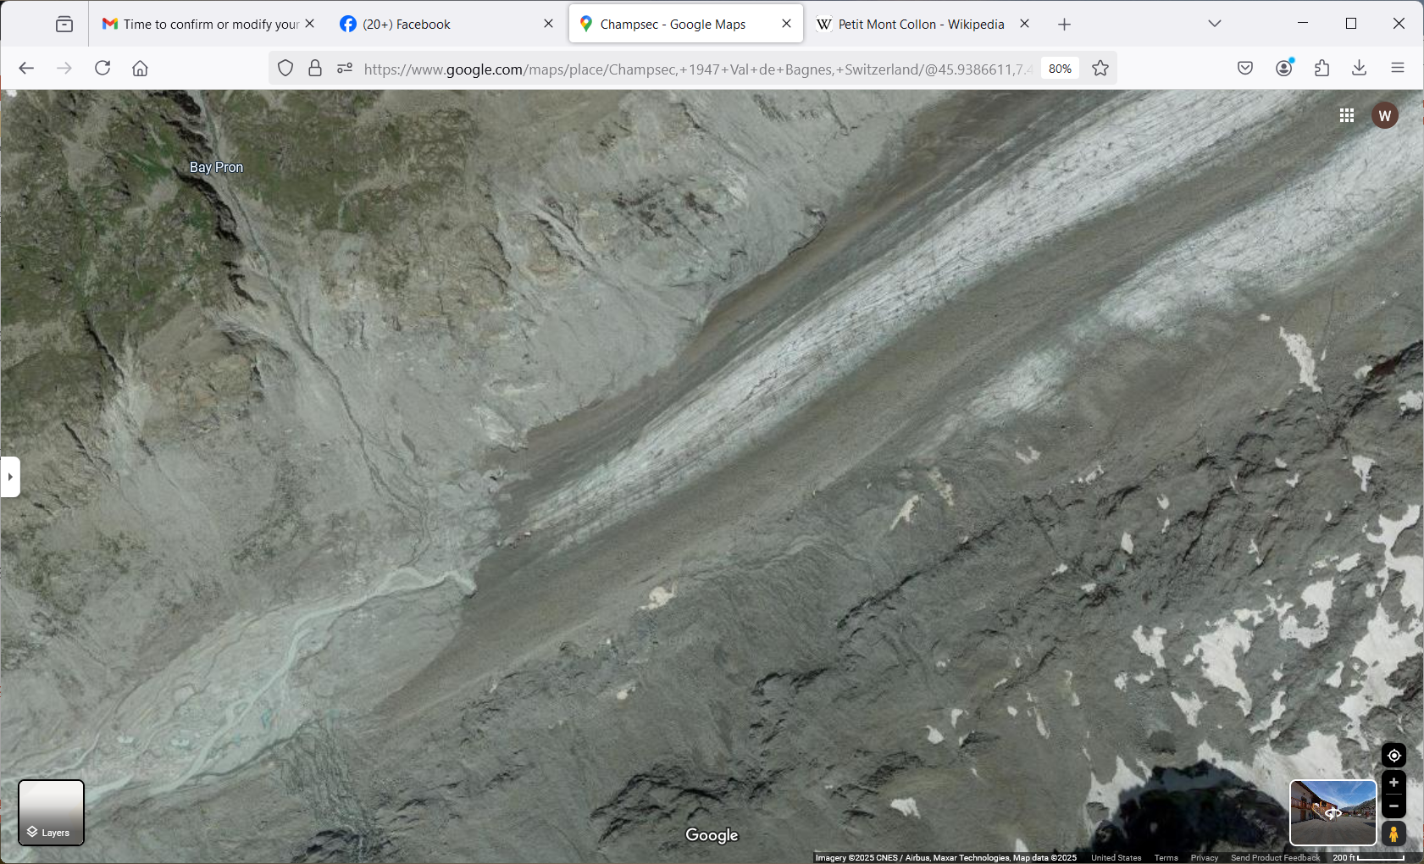
Glacier d’Otemma
To the Rhône River and Mediterranean Sea
60 m

Slide 7
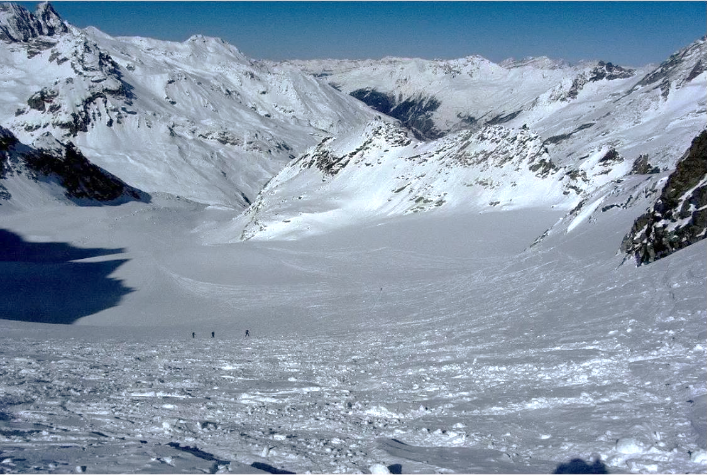
Glacier d’Otemma

