Slide 1
Group Project 3
Looking at medial moraines –
- line of rocks being transported by a glacier

Slide 2
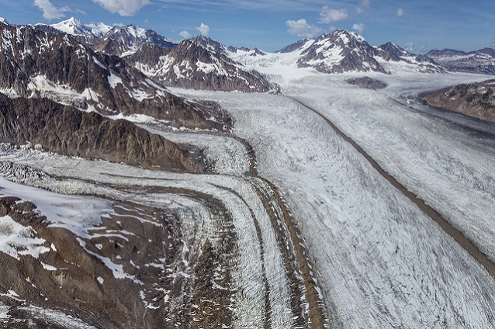

Slide 3
source
region
source
region
source
region
lateral Moraine
Medial Moraine
source
region
Medial Moraine
Medial Moraine
lateral Moraine
Medial Moraine

Slide 4
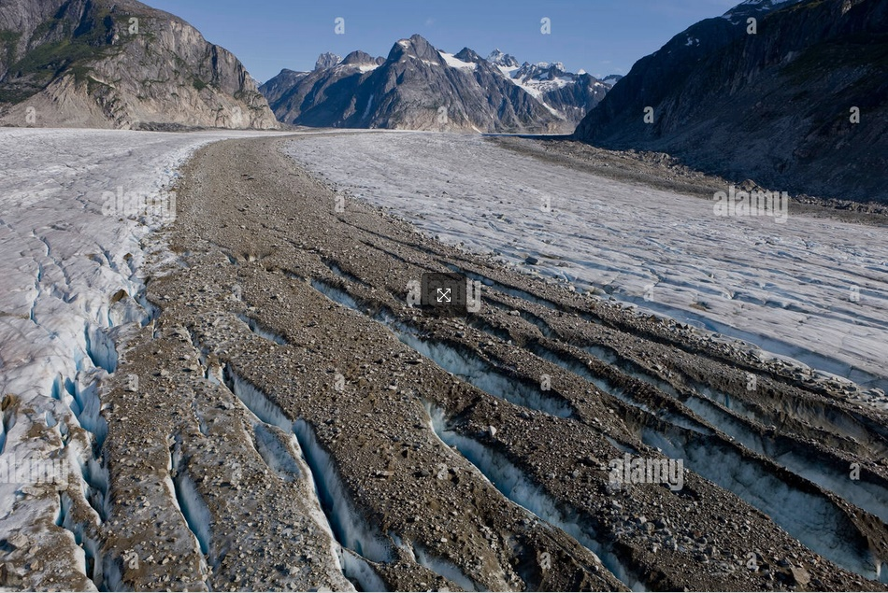
Medial Moraine

Slide 5
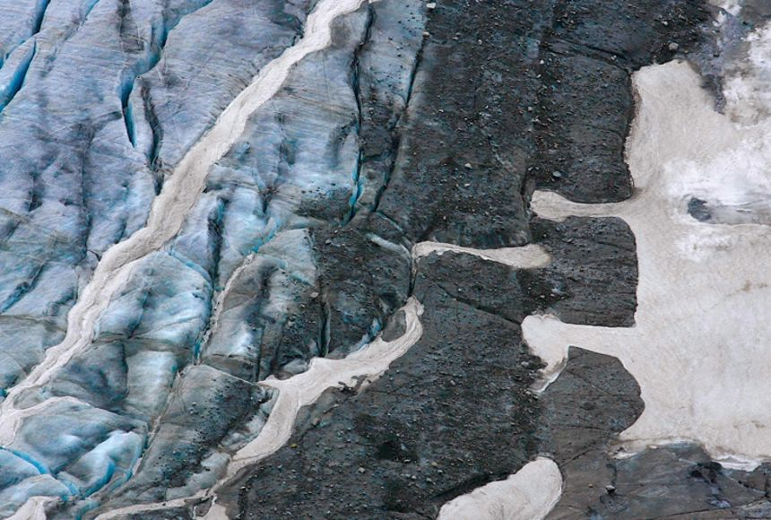
Medial Moraine

Slide 6
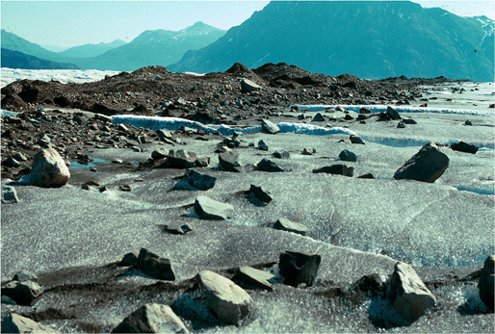
Medial Moraine

Slide 7
Group Project 3: Examining Medial Moraines and transport of Erratic Boulder
Goal: find the “winning” glacier in your assigned part of the world.
A winning glacier must have TWO medial moraines, and the length of the largest moraine plus the distance between the source regions of the two moraines must be as large as possible. That is, it must maximize
S = largest of two moraine (curvy) lengths + (straight-line) distance between two source regions
Make 3 slides as shown in the example
Google Terrain Map of your assigned part of the world with scale bar and arrow showing your winning glacier and annotated with name of the part of the world
Google Satellite Image of your winning glacier with scale bar and annotated with lat,lon of center of region (so we know where it its)
Same Google Satellite Image as in 2, overlain with curves depicting TWO medial moraines and annotated with (A) along-glacier length of each moraine, (B) straight-line distance between source region of two moraines, and the sum S (in km).
Use Google Maps to measure distances (as shown in the last two exemplary slides). Make screenshots for later verification.
Group Assignments: (1) Alps; (2) Alaska south of of 60.5N (3) Alaska N of 60.5N; (4) Andes between 45S and 47S; (5) Andes between 47S and 52S; (6) Himalayas and Tibet between 70E and 80E;

Slide 8
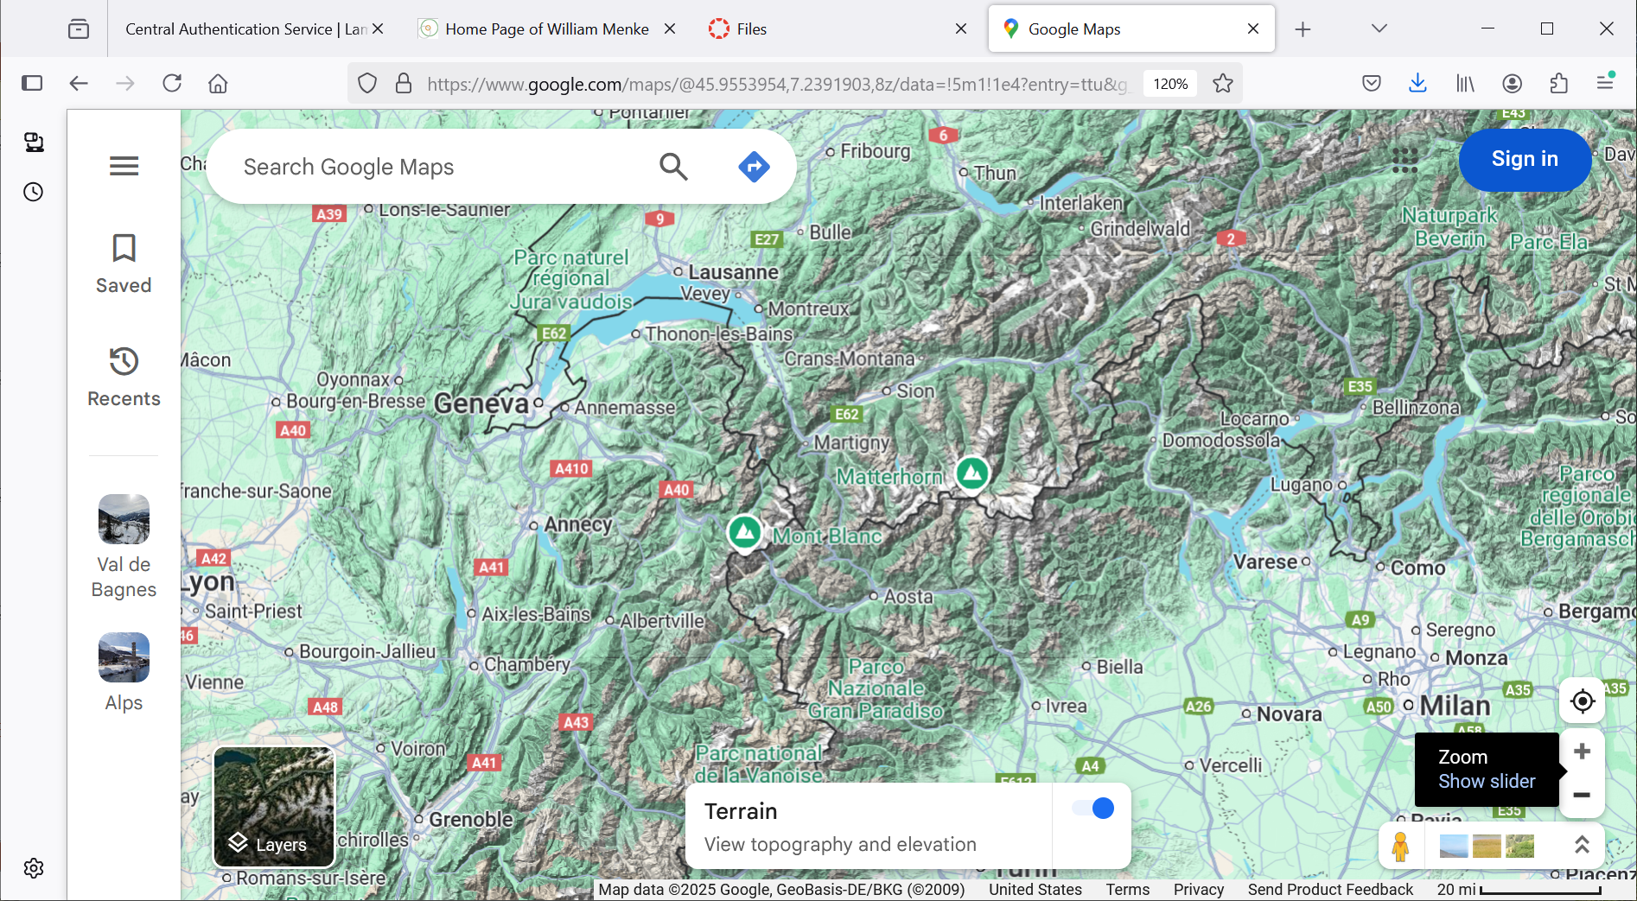
Slide 1: The Alps
20 mi = 12.42 km

Slide 9
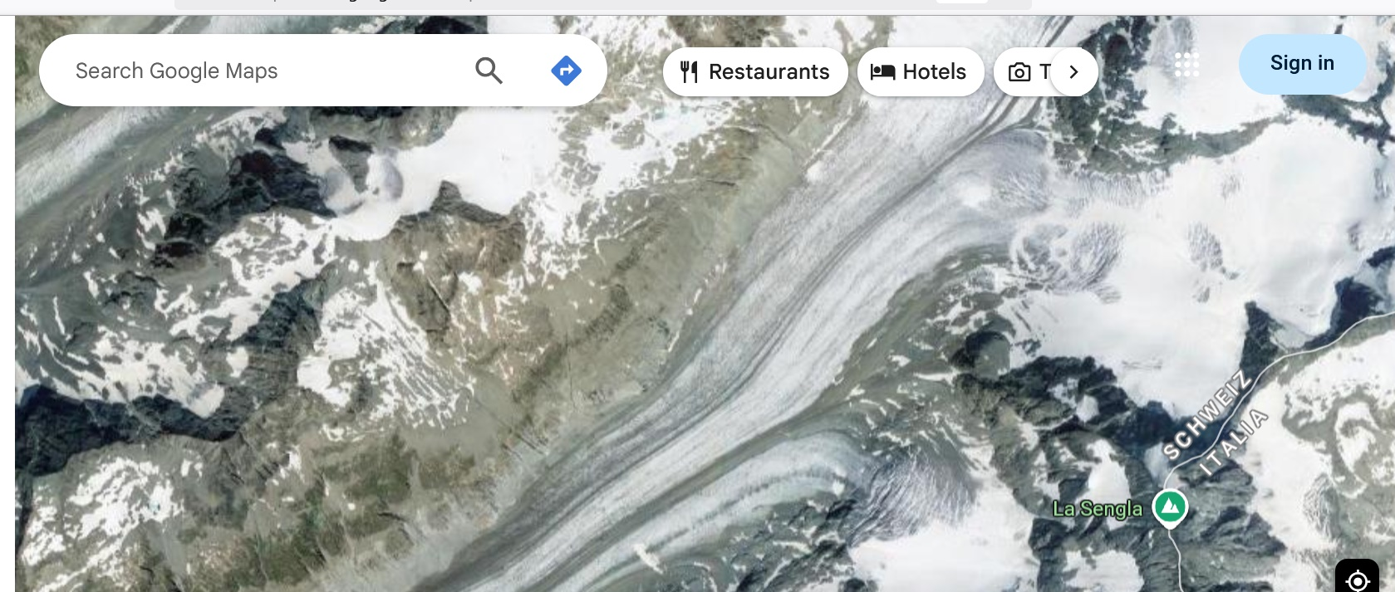
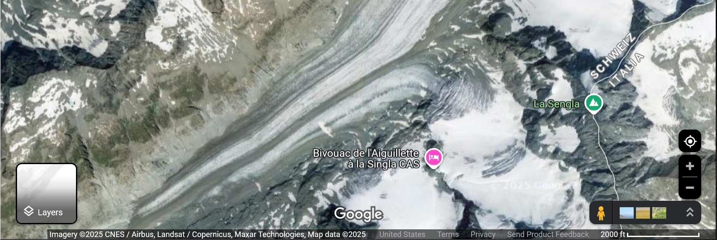
Slide 2: 45.957, 7.453
2000 ft = 0.61 km

Slide 10
Slide 3: S=4.28+1.73=6.01 km
1.73 km
4.28 km
1.52 km
2000 ft = 0.61 km

Slide 11
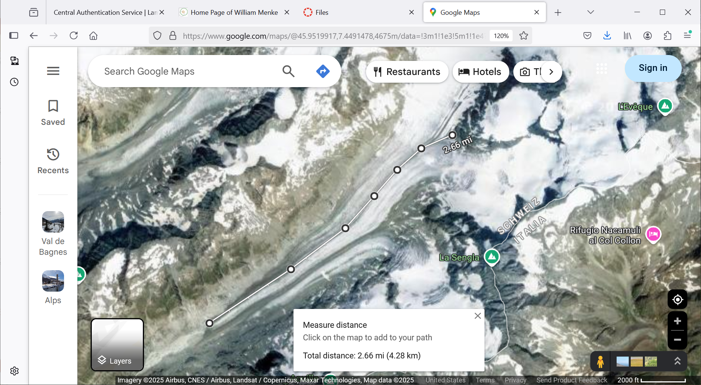

Slide 12
