Slide 1
Group Project 5
Staten Island Moraine

Slide 2
Group 1
Rocks from Moraine
The sample consists of a collection of pebbles taken from the moraine. The fine component was discarded but an attempt was made to preserve the relative abundance and size distribution of the coarse component.
Weight each rock, make a histogram of the weights and interpret the results. What is the most common weight range?
Sort the pebbles into rock type categories. Use lithologic names if you can. If you have no training in rock identification, sort them into categories based on their color and texture. Take a photo of the result.
Mage a histogram of total weights of each category. What category is the most plentiful?
Are big or small sizes over or under represented in any category?
Interpret the rock type of the most common category in the context of the distance that the major source of that rock type is from the moraine. See attached maps

Slide 3
Group 2
Rocks from Beach near Moraine
The sample consists of a collection of cobbles picked up from the from the beach near the moraine (and which presumably eroded out from the moraine). An effort was made to collect as many different rock types as possible.
Examine each rock and sort them into igneous, metamorphic and sedimentary groups, laid out on the table. Within each group, sort them into sub-groups depending upon similarity. Take a photo of your result.
Assisted by the Instructor/TA, determine the rock type of each cobble.
Match up as many rock with possible source areas (as given by the annotated geologic map). What is the most distant rock source from Staten Island?

Slide 4
Group 3
Size Distribution of Moraine Material
The sample consists of moraine material from Staten Island.
Weigh and record each piece of the sieve (its “tare weight”) for future reference. Re-stack the sieve, coarseness increasing upward.
Place the moraine sample in the uppermost sieve compartment. Examine it visually and describe it. Take a photo.
Put the cover on the sieve and shake it for a while until the size fractions separate. Take a photo of each size fraction.
Weigh each sieve and subtract the tare weight to get the weight of each size fraction. Make a histogram of the size fractions and interpret the results.

Slide 5
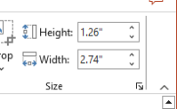
Group 4
Photos of Whole Moraine
Two wide-angle photos of the moraine are provided
Load photo GP05_04_01 into Photoshop. Measure the Photoshop size of the compass in the image using
and compute a proportionality ratio
$R=\frac{actual size}{Photoshop size}$
where the compass measures 52 by 77 millimeters. You can now measure any length in the photo using
$$actual size= R ×Photoshop size$$
Load photo GP05_04_02, which is a different part of the same moraine (buth with some overlap). Match up features to develop an approximate distance scale for that photo.
How tall is the moraine? What’s its overall color?

Slide 6
Group 4, con’t
Outline a few of the biggest boulders in the moraine and annotate the two images with their dimensions? Describe their color and shape.
Identify stratification of the moraine. Is it weak or developed? How thick are the layers? Are they of uniform or variable thickness? Are they flat lying or tilted. Do boulders (and other large stones) preferentially occur in some layers and not others,

Slide 7
Group 5
Close-up Photos of Moraine
One close-up photos of the moraine s provided
Load photo GP05_05_01 into Photoshop. Measure the Photoshop size of the compass in the image using
and compute a proportionality ratio
$R=\frac{actual size}{Photoshop size}$
where the compass measures 52 by 77 millimeters. You can now measure any length in the photo using
$$actual size= R ×Photoshop size$$
Pick a minimum pebble size so that the image contains 20-50 pebbles of that size or greater. Trace over all these pebbles with rotated ellipses
and record their length $L,$width $W$
and area $A=πR^{2}LW/4$. Use Excel.
4. What fraction of the total area is pebbles? You will need to estimate the total area of the photo, $A=R^{2}LW.$
5. Make a histogram of the pebble areas. Are big or small pebbles the most common?

Slide 8
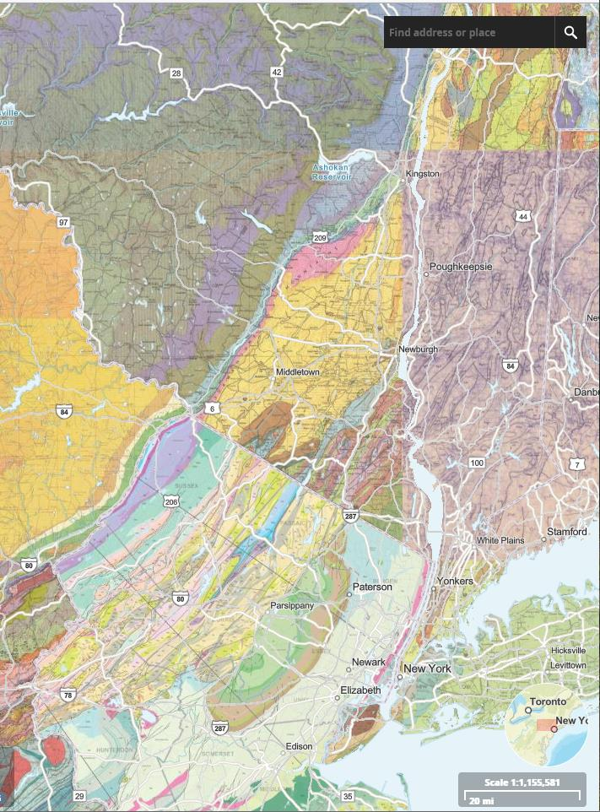

Slide 9
white quartzite
gneiss and granite
ourple quartzite
schist
sandstone and shale

