Slide 1
Group Project 7: Variations in ice sheet flow direction around Lake Ontario inferred from drumlin orientation
Examine your study region (listed in the next slide) and identify the drumlins.
How many drumlins are there per square km in the densest part of the field? Draw a 10 km by 10 km box, count them and divide by 100.
Infer the typical direction of ice flow based on the shape of the drumlins in the area. Identify only a single direction (not one for each drumlin) based on the shape of a few really well-shaped ones.
Pick 20-30 drumlins and measure their orientation according to the instructions below and plot you result on the radial diagram.
Identify other glacial geomorphological features (tunnel valleys, eskers, kettle lakes, etc.) in your study region and comment upon their significance.
6. How well does your flow direction agree with the ice flow map (attached).

Slide 2
Drumlin Fields in the general vicinity of Lake Ontario
G1. Ontario, Canada near Rice Lake
G2. Western New York State, near Marbletown and west of Route 14
G3. Western New York State, near Weedsport and east of Route 14
G4. Western New York State, near Wheatland Center and east of Route 14
(incidental discovery: what is near the intersections of Lacey Rd and Cameron Rd in Caledonia NY and what is it telling you?)
G5. Ontario, Canada near Flamborough
G6. Ontario, Canada near Madoc Junction and east of Route 14
(incidential discovery: what’s by Oak Lake?)

Slide 3
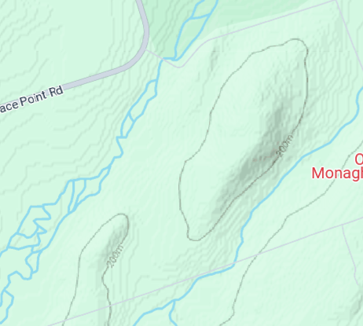
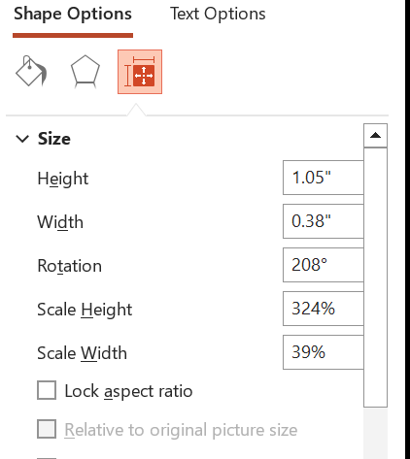
Measuring and plotting the direction of ice flow with PowerPoint
Step 1. Copy the map to Powerpoint.
Step 2. Select a upward-pointing arrow and draw it onto the map centered on the drumlin
Step 3. Rotate it CLOCKWISE until it aligns with ice sheet flow direction as deduced from the shape of the drumlin
Step 4. Read the rectangle’s rotation angle (in the 0-360 range) from the Formal Shape menu. You need to be careful that you’re not 180 degrees off with the angle. In this example, the downslope direction is N208E

Slide 4
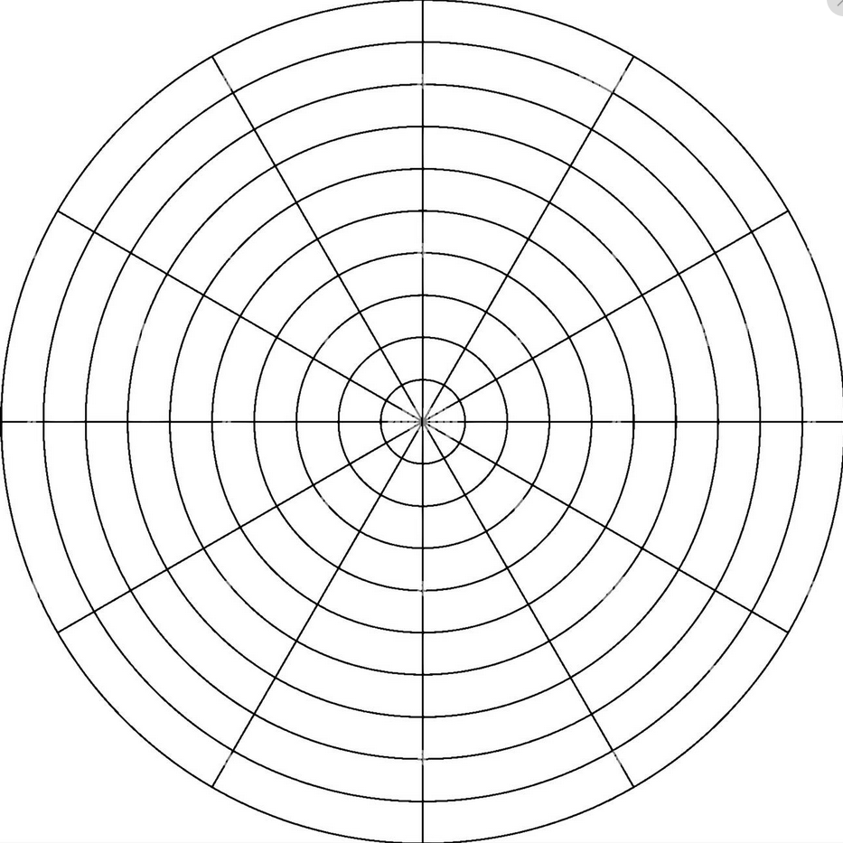
0
N
Step 5. Assess whether your measurement is good, very good or excellent. It helps to have a short written rubric that guides the assessment, so develop one that is informed by your actual observations of the drumlins in your study area.
Let’s say you assess a particular drumlin as “very good” (VG)..
330
30
300
60
W
270
G
VG
E
90
E
Step 6. Transfer it to the polar diagram with the correct angle and a length that reflects your quality assessment. Note that the rings increase in diameter from “G” to “E”. See the next two slides for a suggestion on how to do this efficiently.
120
240
210
150
180
S

Slide 5
The diagram is for one arrow. It should start out blank, so if it has a “previous arrow” in it, just delete that arrow.
Cut and paste the arrow from the map, move it so that its tail is at the center of this diagram, overlay it with a line-ending-with-an-arrow of the same angle but length reflecting quality, and then delete the original arrow.
0
N
330
30
300
60
W
270
G
VG
E
90
E
120
240
210
150
180
S

Slide 6
This diagram is for all the arrows
Now cut an paste each arrow here, so that you wind up with a diagram with many arrows on it.
0
N
330
30
300
60
W
270
G
VG
E
90
E
120
240
210
150
180
S

Slide 7
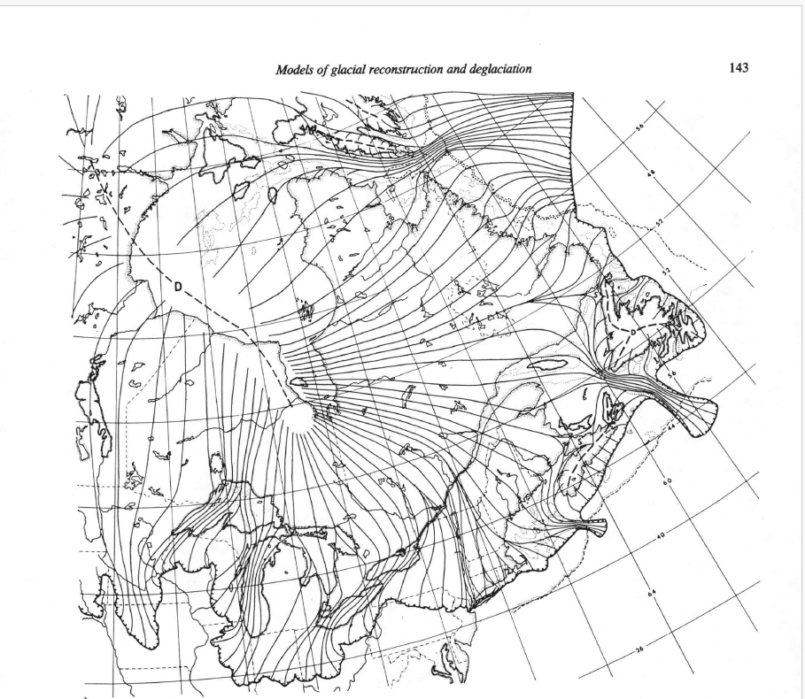
Gn study area
Step 7. Select and “group: your polar diagram and copy-and-paste it into the space shown below. Annotate the map with the red dot showing your study area (and update the “n” in the title, above). Make this the last slide in your Group Results file
Radial plot goes here
$18,000$ year ago

