Slide 1
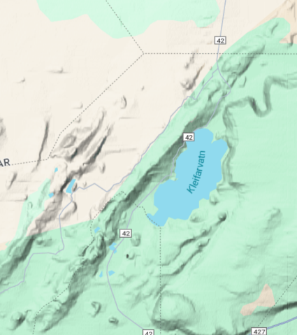
Group Project 8
Groups 1 through 4 are each assigned a different of Iceland
You will be examining both (1) hyaloclastite ridges and (2) hyaloclastite hills and table mountains.
Divide your group into two (possibly overlapping) sub-gr0ups for each.
The ridge subgroup will measure the apparent plate tectonic spreading direction using the orientation of the ridge.
Make a table with the lat/lon of the center of the ridge and the apparent spreading direction, measured in the 0-180 degree range. For instance, this ridge has
63.9329, -22.0080, 125.0 deg
Measure 20-30 ridges in your part of Iceland. Divide the measurements into about geographical clusters, average the apparent spreading direction for each and plot them as red, double-ended arrows on the attached map of Iceland.

Slide 2
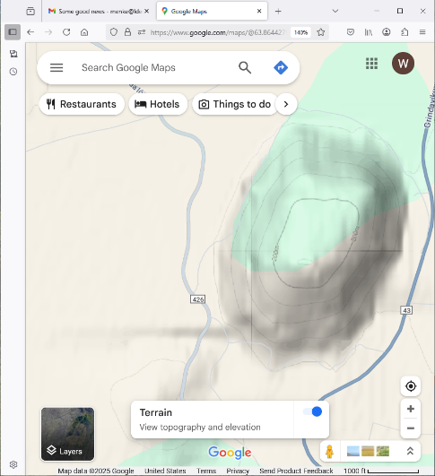
Beware that other geomorpological features, such as aretes, superficially resemble hyaloclastite ridges. o do you bet to avoid them.
The hill/table mountain subgroup will measure the lat/lon of the hill, its elevation and that of the surrounding land. Also assess whether there is evidence for the hill being a table mountain, for example its summit being very flat or having volcanic crater. Use H and T to distinguish. Finally, measure its distance in from the center of Iceland
63.8653, -22.4373, 240.0 m, 40.0 m, H, 184 km
Measure 20-30 hills broadly distributed in the study area, and then plot the data on the attached plot. An example is shown here
hill
1000
table mt
elev in m
top
base
distance from center in km
200

Slide 3
I urge using hills that have a simple shape and that are not too big (say diameter less than 20 km)
Center of Iceland: 64°46'56.9"N 18°18'01.3"W
Group 1: North of the center of Lake Askja
Group 2: South of the center of Lake Askja and east of the center of Lake Þórisvatn
Group 3: South of the center of Lake Askja, west of the center of Lake Þórisvatn, and east of the center of lake Þingvallavatn
Group 4: South of the center of Lake Askja, and west of the center of lake Þingvallavatn

Slide 4
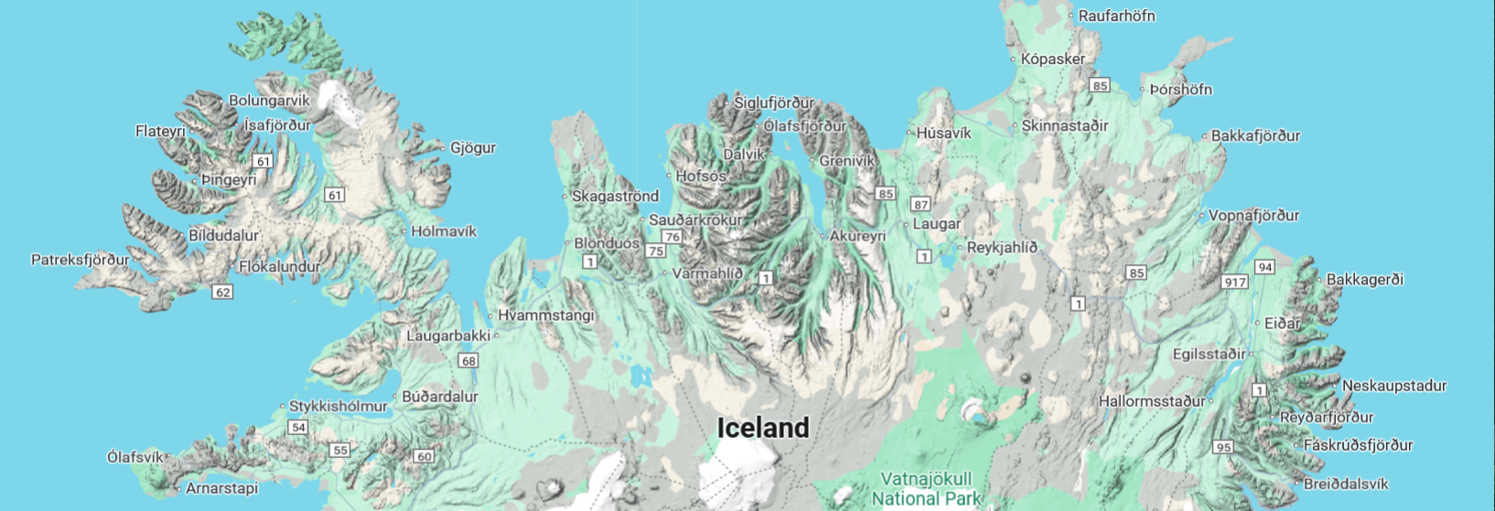
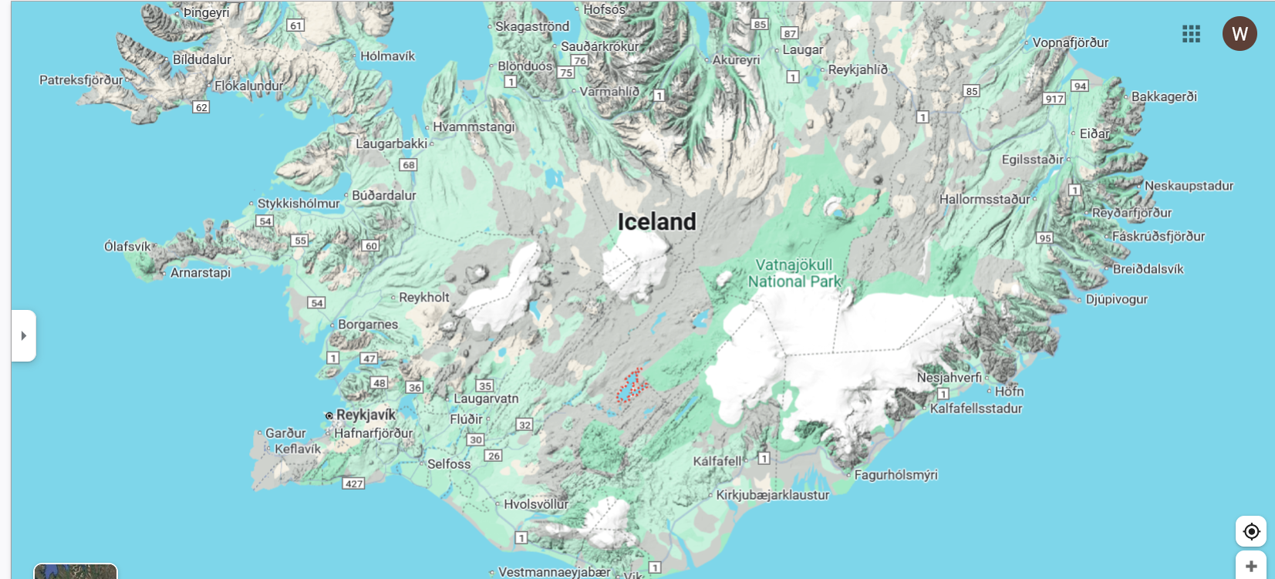
Don’t change the scale of this map

Slide 5
2000
Don’t change the scale of this plot
Key
top
1500
base
hill
table mt
elev in m
500
0
0
100
300
400
distance from center in km

