Slide 1
Group Project 10
We will use bathymetric maps to investigate
- what the post-Ice-Age coast looked like
- how fast the coastline moved (horizontally) during Meltwater Pulse 1A
- whether any present-day islands were previously attached to mainland
- whether any former islands were completely inundated
- what submarine features were impediments to along-the-coast travel
The four regions we will study are
Atlantic coast from New jersey to New Hampshire
Atlantic coast from Maine to Newfoundland
Florida-Bahamas-Yucatan
Doggerland
This project uses GeoMapApp, so please install it if you’ve not done so already. See
https://www.geomapapp.org/
The setup for this project is tedious, so follow the instructions closely.

Slide 2
Sea level at the end of the Ice Age at 16 k-years was about 120 meters, and rose to about 0 at about 7 years.
Use the sea level curve to estimate sea level at 1000 years intervals between 16 and 7 k-years. Note that Meltwater Pulse 1A is between 15 and 14 k-years.

Slide 3
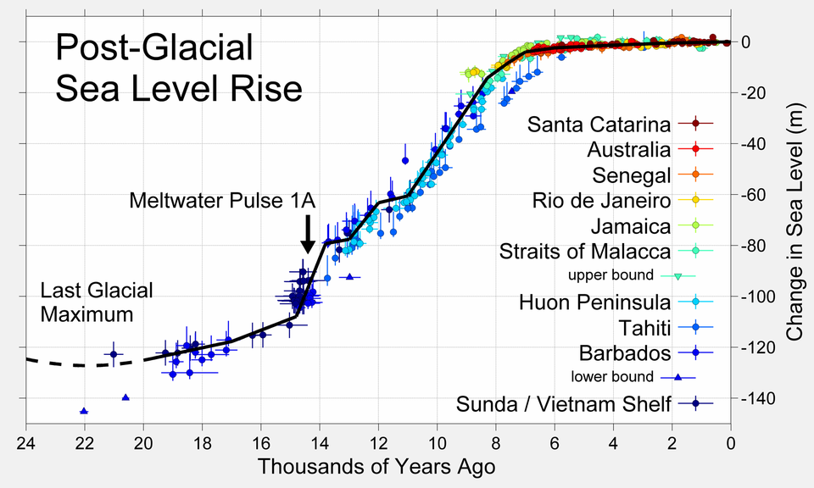
time | Sea level
16 | 120
15
14
13
12
11
10
9
8
7 | 0

Slide 4
Step 1. Launch GeoMapApp and Agree to the Terms and Conditions of use.
Step 2. A world map will appear. Using the hand and + and -, position and scale to show the shallow sea in and around your study area. In these instruction, I will use a site along the Alaskan Peninsula as an example. It’s important to choose the position carefully, because once you get going, you will not be changing it.
Step 3. From the Overlays Menu, select color scale.
Step 4. From the Overlays Menu, select distance scale
Step 5. Click on the distance profile tool . This forces a load of the bathymetric data. When the load is done, cancel the window that appears. The map should now look like this:

Slide 5
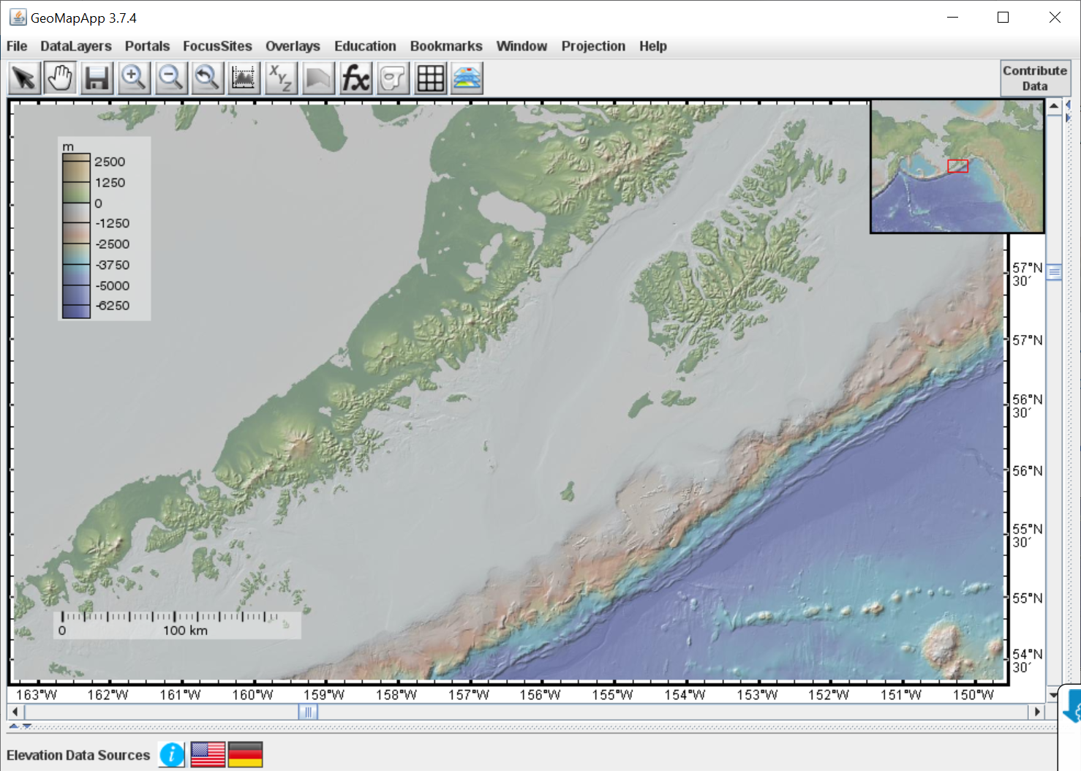

Slide 6
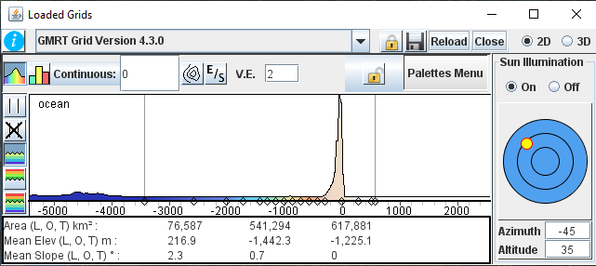
Step 6. Now select the Window/Loaded-Grids menu. This window should pop up.

Slide 7
Step 7. Click on the “Modify Ocean Pallette” button (red arrow). This will allow you to change move the vertical bars (blue arrows)

Slide 8
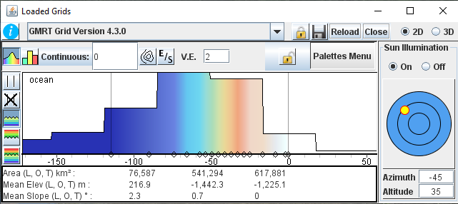
Step 8. Move the vertical bars to -120 and 0 meters. This will need to be done in several steps.

Slide 9
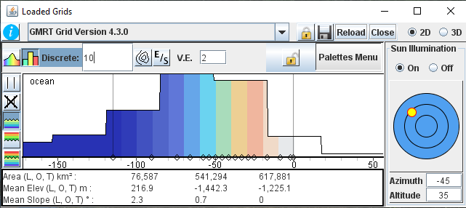
Step 9. Change the zero to 10 (red arrow)

Slide 10
Step 9. Click on the contour button (red arrow). A Modify Contours window will appear.

Slide 11
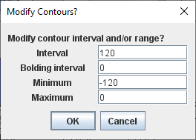
Step 1. Change the numbers to Interval 120, Bold interval 0, minimum -120, maximum 0 and hit OK
Contours should appear. Save a screenshot of the map.

Slide 12
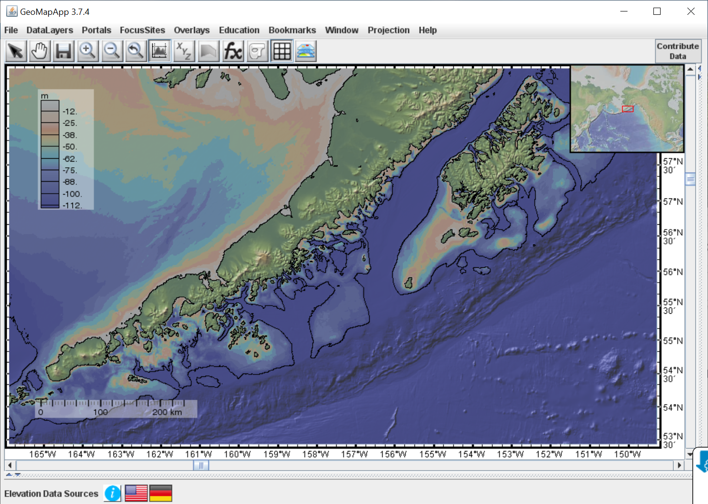
16 kyr
The -120 m contour marks the coastline at 16 k-years and the 0 m contour is the present-day coastline. Note I’ve annotated on the 16.

Slide 13
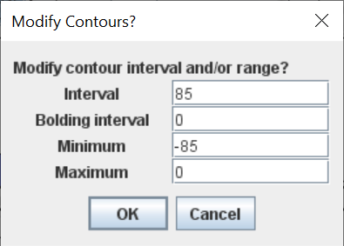
Step 11. Now do a sequence of maps, where you change BOTH the interval and the minimum contour to the value you determine from the sea level curve, and assemble them into a crude “movie” of sea level rising. Anotate the time onto each map, to keep track.
An 85 meter contour corresponds to
Step 12, Use the movie to address the questions in the first slide.

