Slide 1
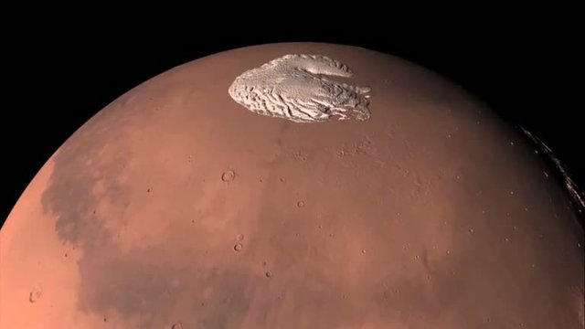
Group Project 12
The planet Mars, showing its northern Polar Cap
It has long been known that the planet Mars has polar caps, as they can be seen from Earth using a telescope. Since the late 20th Century, close-up photos from space craft in orbit around Mars have demonstrated that many features “look” glacial in origin. However, except for a very few patches of Mars sampled by rovers, identification of Martian features relies on satellite images, only, and is highly dependent on making analogies to glacial features on Earth. Furthermore, although some Martian geomorphology may be due to modern glaciation, others may be relics of past ice ages, and given that much of the Martian surface is covered with layers of dust, the ice of a modern glacier and the basal sediment that was once beneath a long-gone glacier may be hard to distinguish.
Each group has one (or sometimes, a few) satellite photos of Martian features that are “probably glacial”. Find at least one, but preferably three, Earth analogues with which they can be compared. Pay special attention to scale; a 100 km wide feature ought not be compared to one only 1 km wide. Describe the similarities and differences. Are you convinced the Martian feature has a glacial origin? State why or why not.

Slide 2
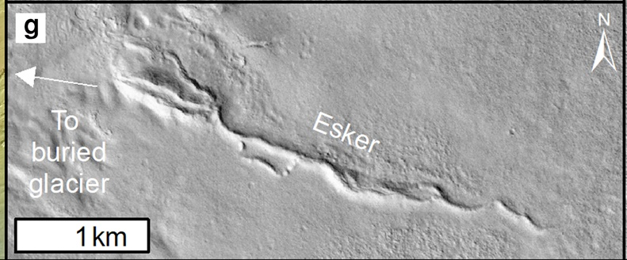
Group 1. Eskers

Slide 3
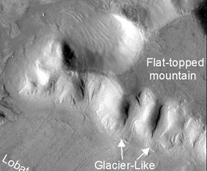
Group 2. Cirques and terminal morianes

Slide 4
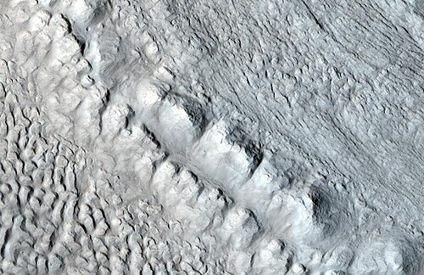
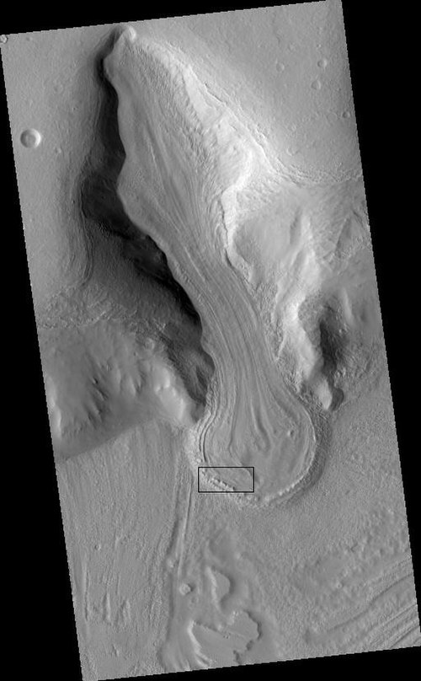
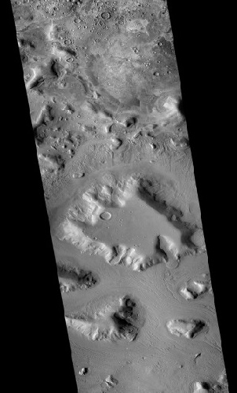
Group 3. Valley glacier, terminal
moraine and meltwater streambed
3 km
10 km

Slide 5
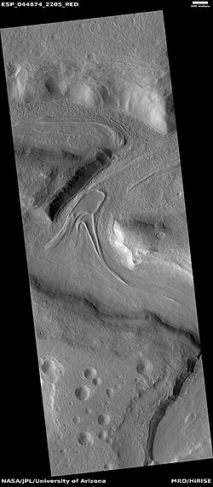
Group 4. Medial moraines from several connecting glaciers
500 m

Slide 6
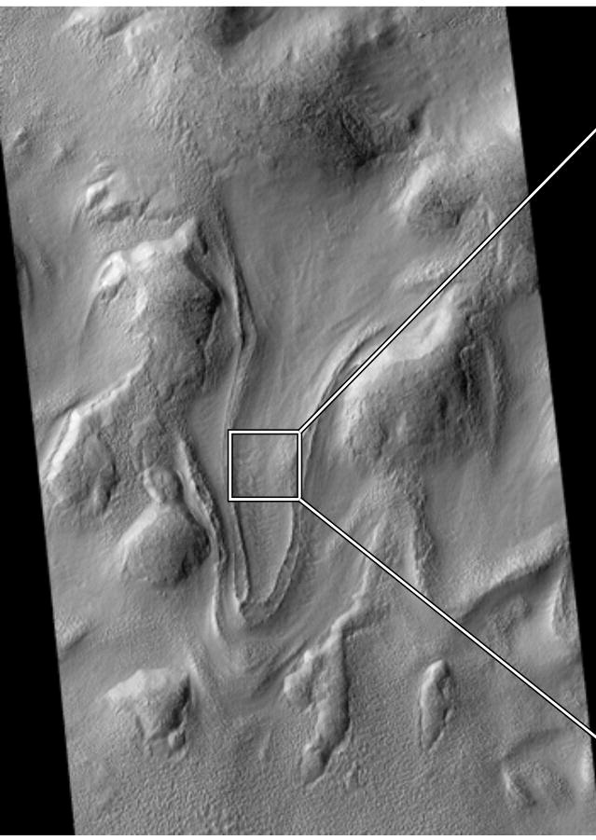
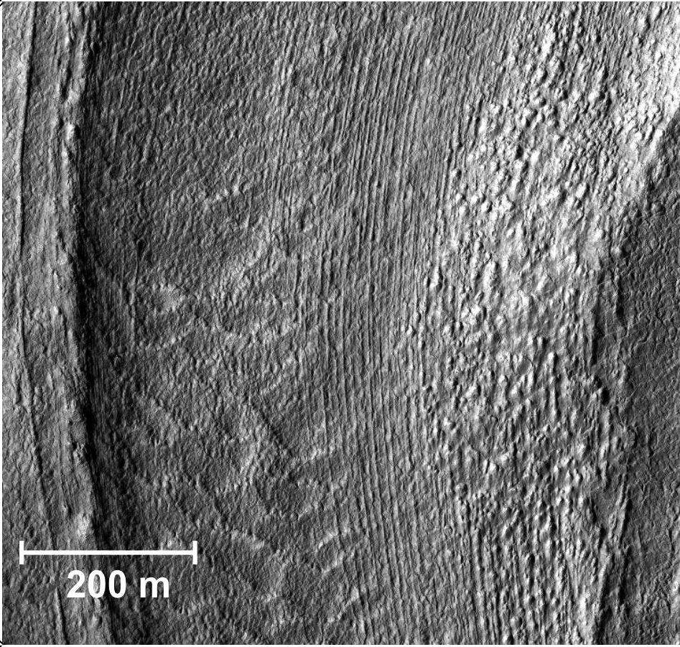
Group 5. Drumlins and
Mega-Scale Glacial Lineation

