Slide 1
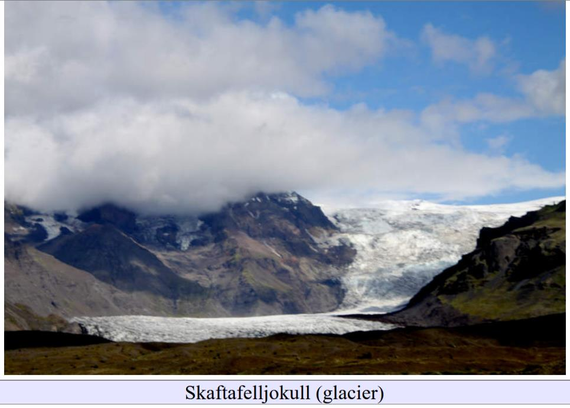
glacial geomorphology
Lecture 01

Slide 2
glacial geomorphology
glaciers
Earth
shape
how glaciers shape the earth

Slide 3
goals of the course for you to able to recognize signs of glaciation in the world’s landforms for you to be able to connect these landforms to the glacial processes that formed then for you to be able to make inferences about climate conditions in the past

Slide 4
goals of the course for you to able to recognize signs of glaciation in the world’s landforms for you to be able to connect these landforms to the glacial processes that formed them for you to be able to make inferences about climate conditions in the past
Anyone want to propose any additional goals?

Slide 5
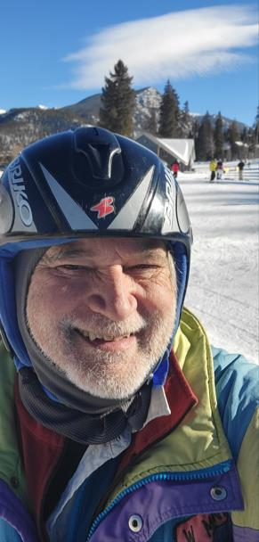
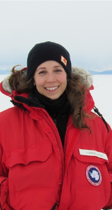
Teaching
Staff
Bill Menke, (he/him), Instructor
MENKE@LDEO.COLUMBIA.EDU
Caitlin Locke (she/her), T.A.
cd2477@columbia.edu

Slide 6
please review my policies on grading and other student matters www.ldeo.columbia.edu/~menke/www_users_menke/gradingpolicy.html

Slide 7
Format of Class Tuesdays: Lecture with some discussion Thursdays: In-class group projects

Slide 8
Format of Class Tuesdays: Lecture with some discussion Thursdays: In-class group projects
In Class Participation Required

Slide 9
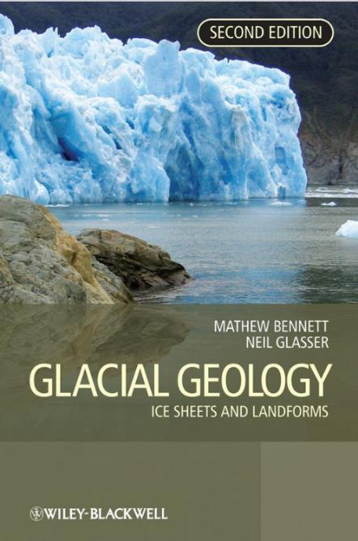
Weekly readings
from the textbook

Slide 10
Assessment Weekly: Individual Project Report (2/3 of grade) End of Term: Individual Term Paper Glacial Geomorphology of the [region] and its implications (1/3 of grade)

Slide 11
Assessment Weekly: Individual Project Report (2/3 of grade) End of Term: Individual Term Paper Glacial Geomorphology of the [region] and its implications (1/3 of grade)
Regions pre-approved by me; no duplicates allowed, FCFS
10 minute in class presentations April 29 – May 1
PDF posted to Courseworks by 11:59 PM May 16, 2025

Slide 12
Assessment Weekly: Individual Project Report (2/3 of grade) End of Term: Individual Term Paper Glacial Geomorphology of the [region] and its implications (1/3 of grade)
Rubric
on Courseworks
Rubric
on Courseworks

Slide 13
Collaboration Encouraged however collaborations must be declared and all submitted writing must be your own

Slide 14
Mostly a “qualitative” course But next Thursday (1/30) we will use Python-based glacial flow simulations. So please install Python on your Notebook computers (using instructions and with help of TA).

Slide 15
Why is Glacial Geomorphology Important?

Slide 16
Why is it important to you? lets make a list

Slide 17
The Discovery of the Ice Age

Slide 18
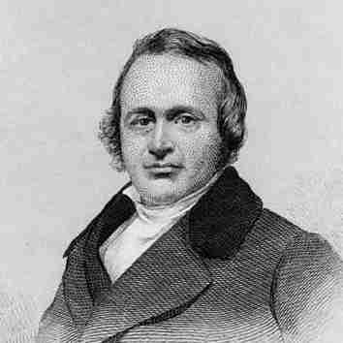
1837
Swiss naturalist Louis Agassis speaks at Swiss sachet of Natural Sciences. Replaces talk on fossil fishes with one proposing an 'ice age' in Europe and North America.
Louis Agassis

Slide 19
Who was US President in 1837?

Slide 20
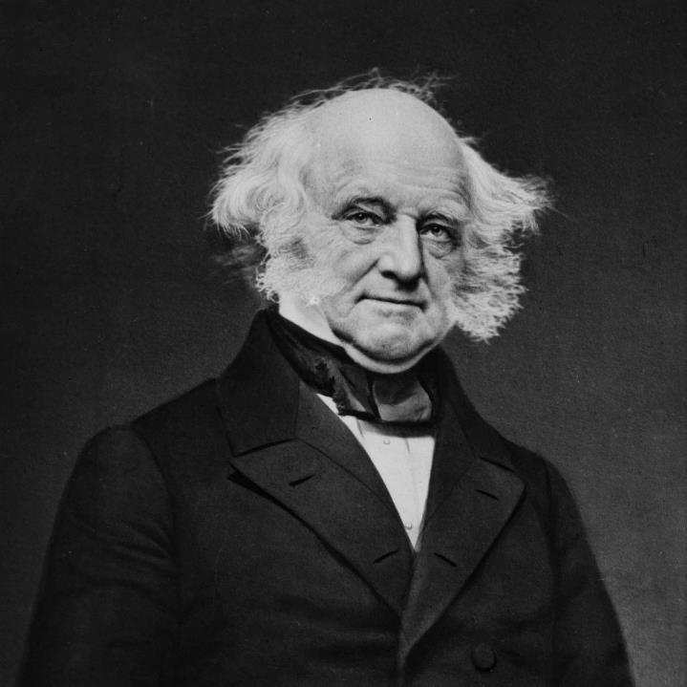
Martin Van Buren
8th President
of the
United States
“There is a power in public opinion in this country—and I thank God for it: for it is the most honest and best of all powers".

Slide 21
Why 1837 ?
What Precursory Knowledge was necessary ?
What Cultural Factors were important ?

Slide 22
Suppose you were living in 19th Century
London
Paris
Vienna
Rome
where would you go to see a glacier?

Slide 23
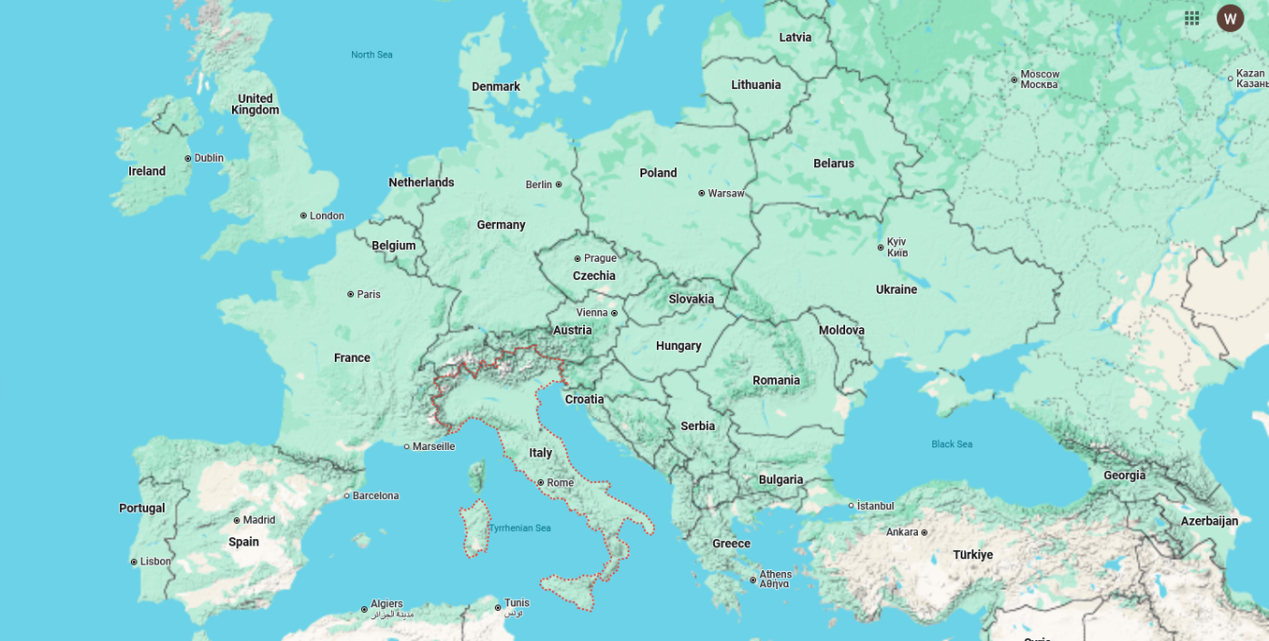
The Alps

Slide 24
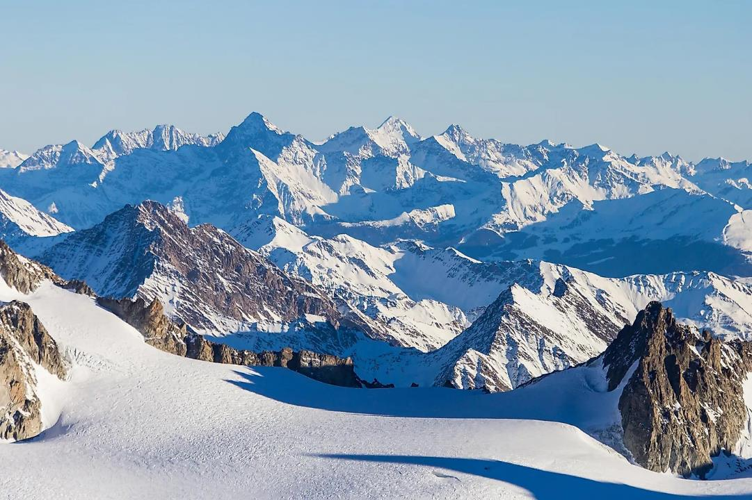
The Alps
here’s a glacier

Slide 25
and how long would the trip take?

Slide 26
and how safe would the trip be?

Slide 27
1815, Jean-Pierre Perraudin, Swiss Mountaineer. “Having long ago observed marks and scars occurring on hard rocks which do not weather, I finally decided, after going near the glaciers, that they had been made by the pressure or weight of these masses, at which I find traces as least as far as Champsec. This makes me think that glaciers filled in the past the entire Val de Bagnes, and I am ready to demonstrate this fact to incredulous people by the obvious proof of comparing these marks with those uncovered by glaciers at present.” 1815, Jean De Charpentier, Swiss naturalist. “Although Perraudin extended his glacier only [24 miles beyond its limit to Martigny], because he himself probably had never been beyond that town, and although I agreed with him on the improbability of transporting erratic boulders by water, I nevertheless found his hypothesis so extraordinary and even so extravagant that I considered it as not worth examining or even considering.“

Slide 28
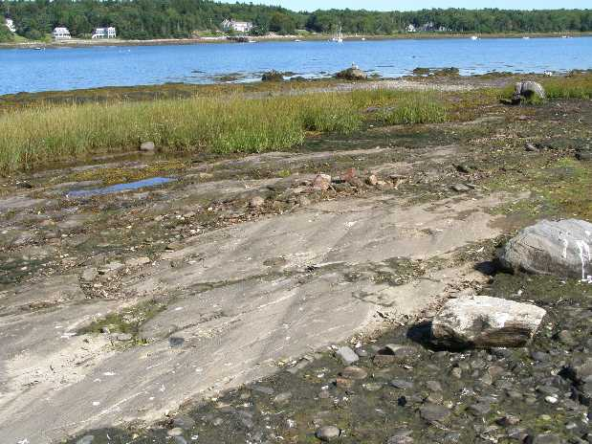

Slide 29
Grooves in slate bedrock
granite boulders

Slide 30
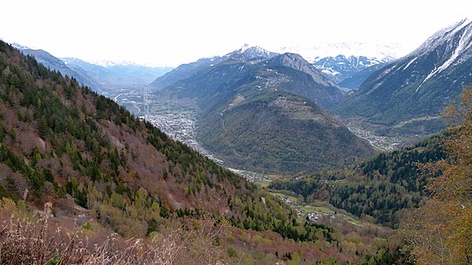
Val de Bagnes

Slide 31
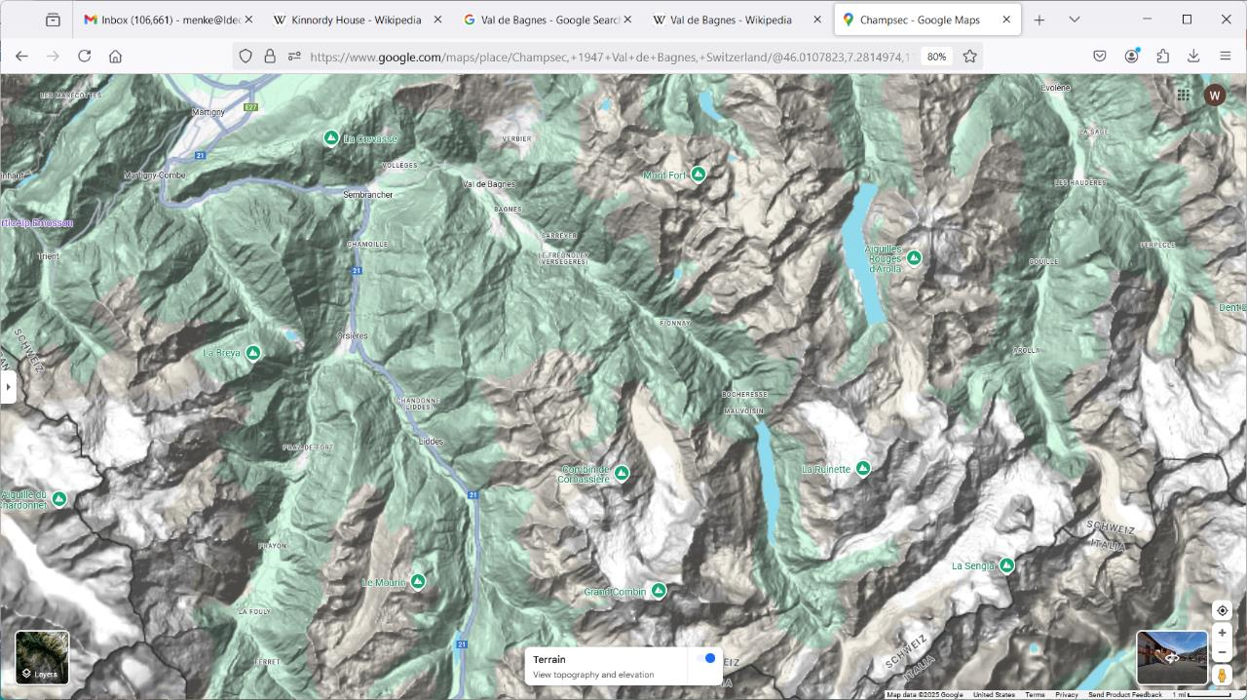
downstream
Val de Bagnes
Champsec
Glacier

Slide 33
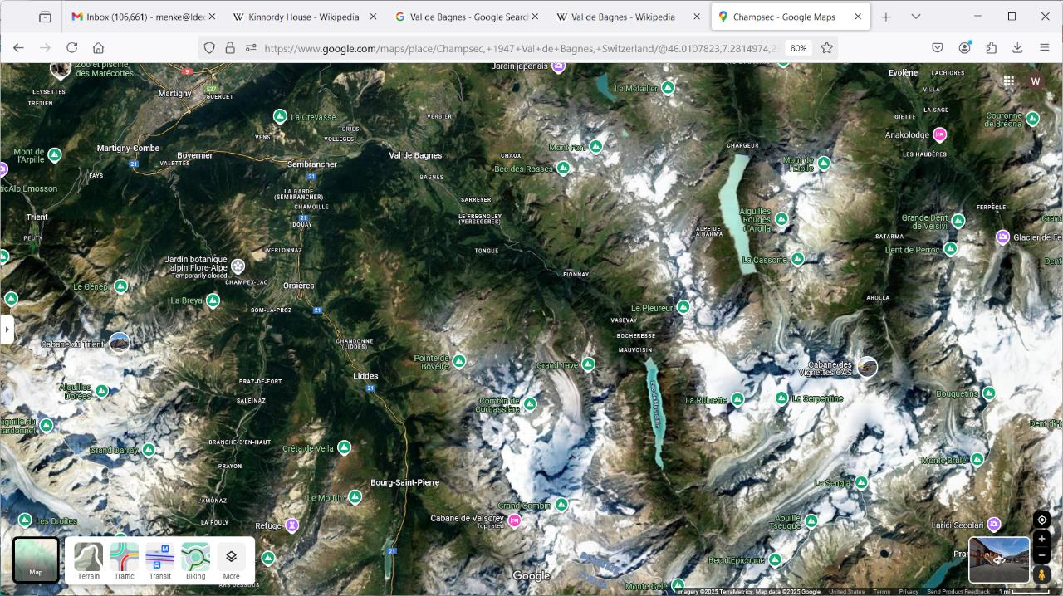

Slide 34
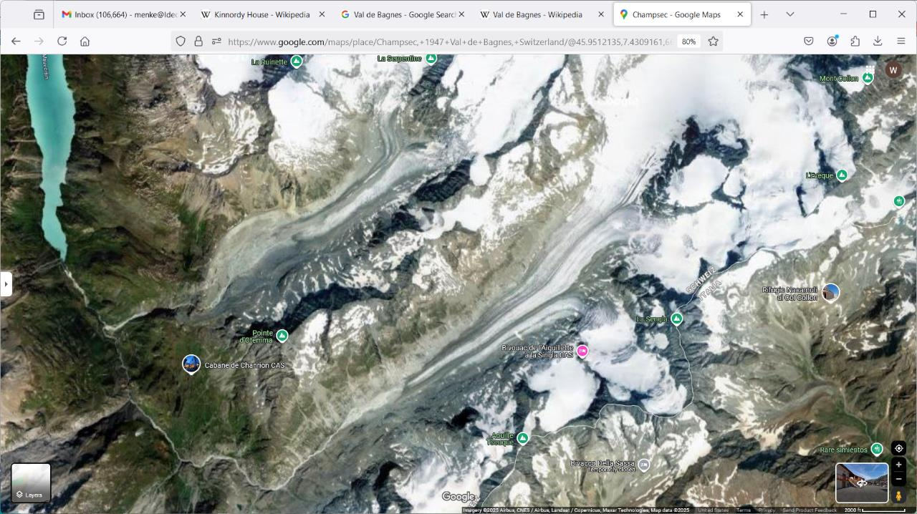

Slide 35
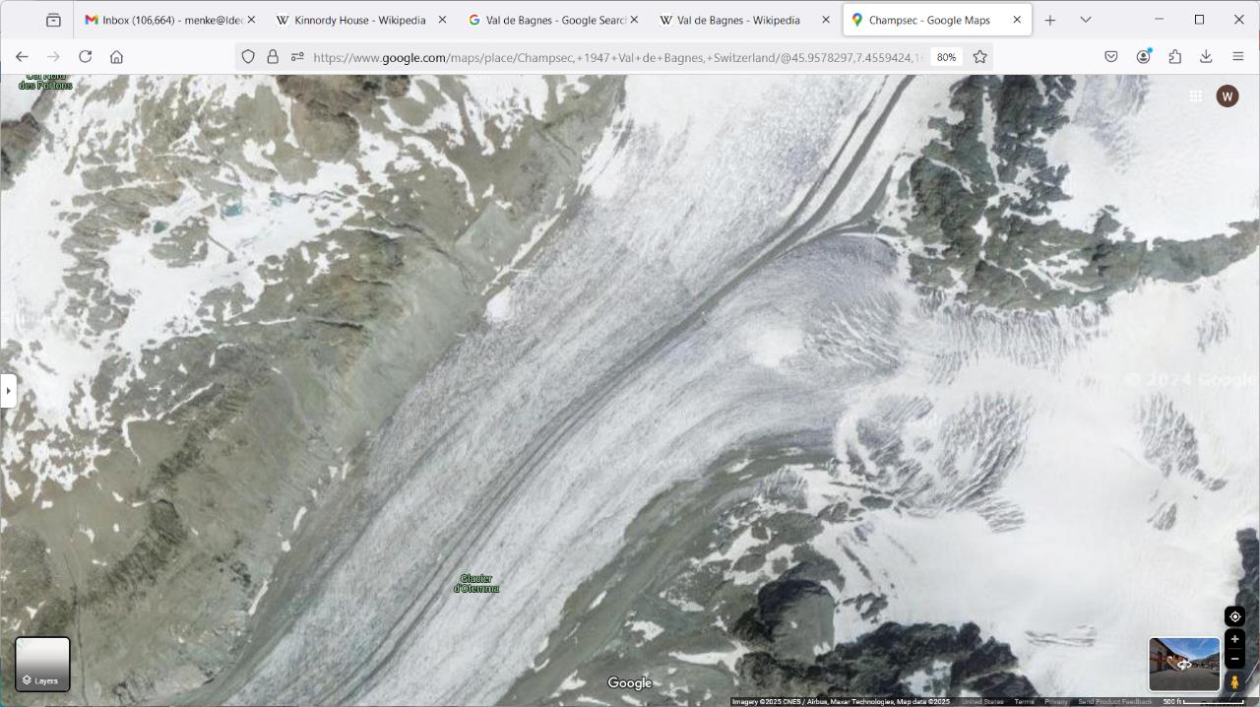
Glacier d’Otemma

Slide 37
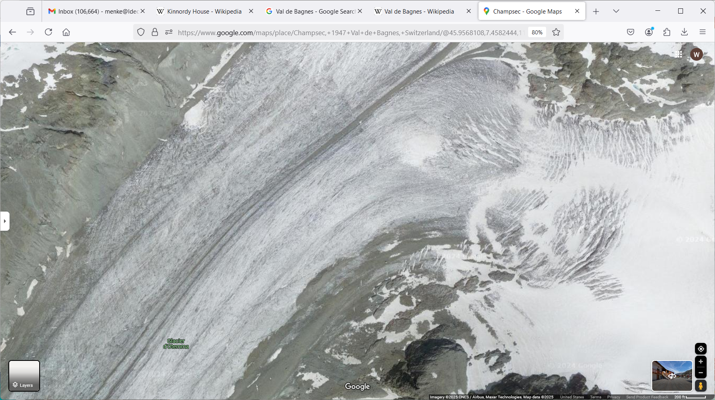

Slide 38
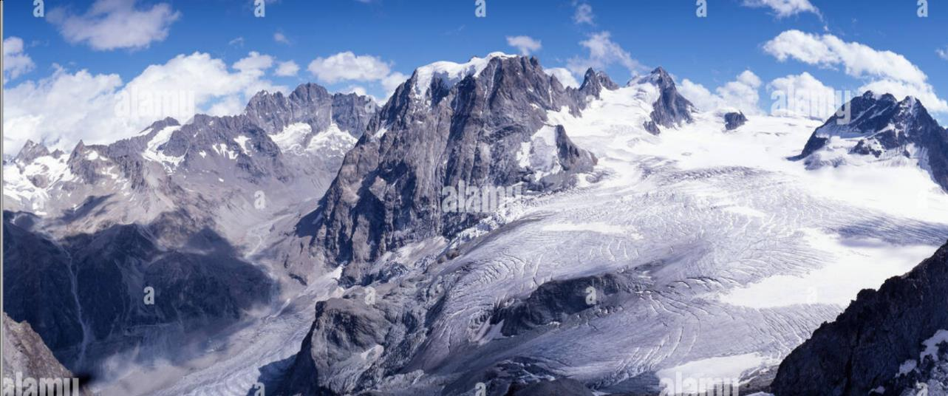

Slide 39
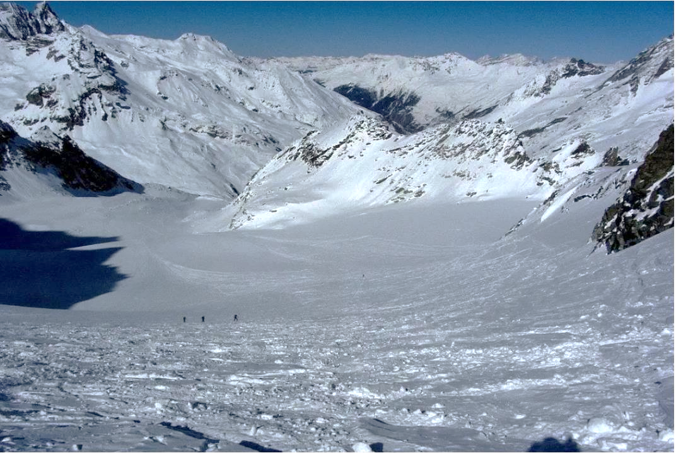

Slide 40
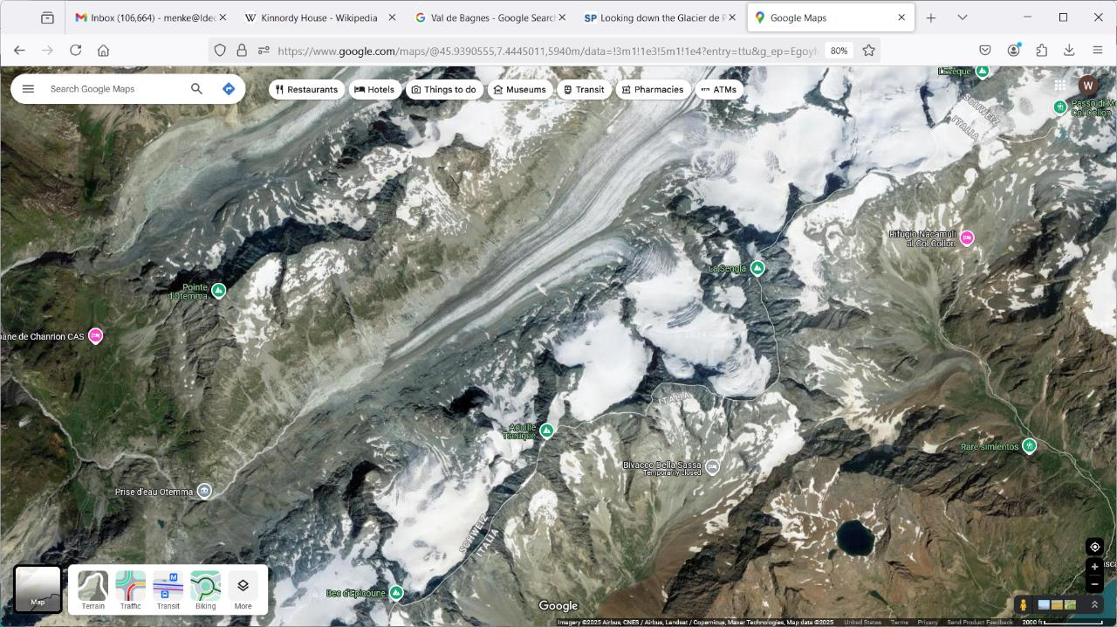
Evidence for the Ice Age here. Do you see it?

Slide 41
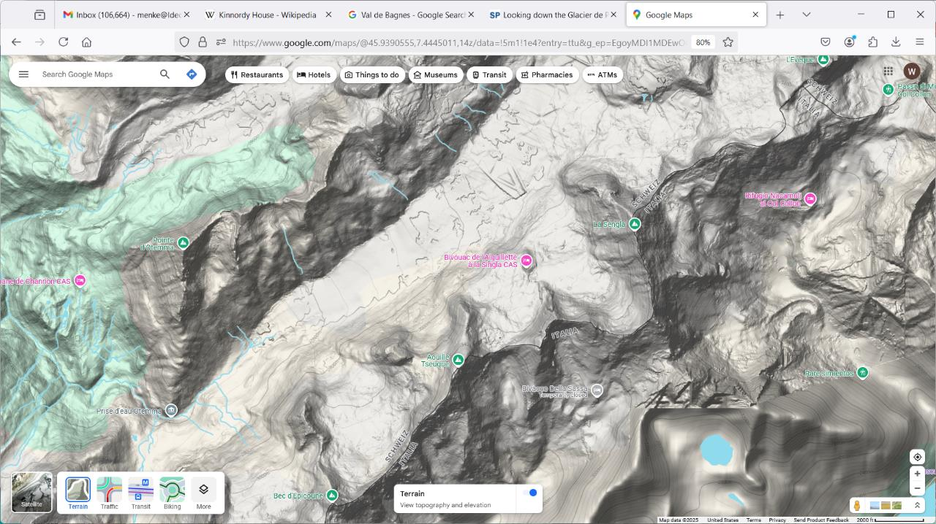
Evidence for the Ice Age here. Do you see it?

Slide 43
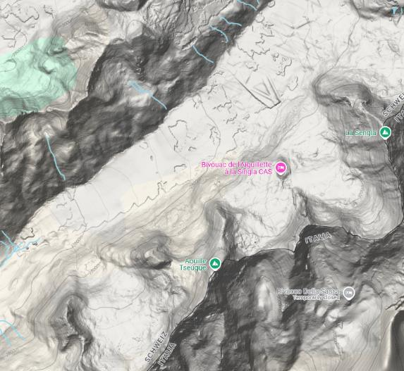
A
elevation
A
distance
B
B

Slide 44
A
Now
hanging
valley
elevation
glacier
flow out of screen
A
distance
B
B

Slide 45
A
During the Ice Age
glacier
elevation
A
distance
B
B

Slide 46
1821-1833, Ignace Venetz, highway engineer, studies glaciers, characterizes their movements.

Slide 47
Can you see a glacier move?
have you ever seen a glacier move?

Slide 48
time lapse of glacial movement
https://www.youtube.com/watch?v=hRhnLtFZxso

Slide 49
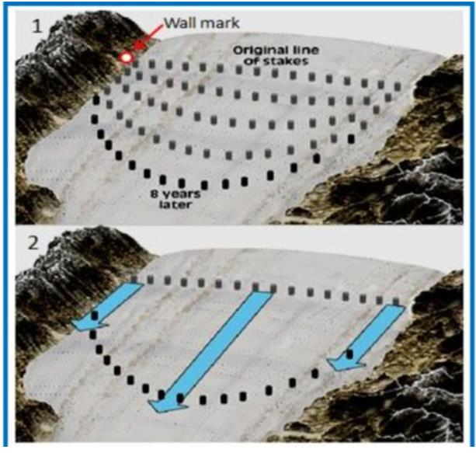
Venetz used a line of stakes

Slide 50
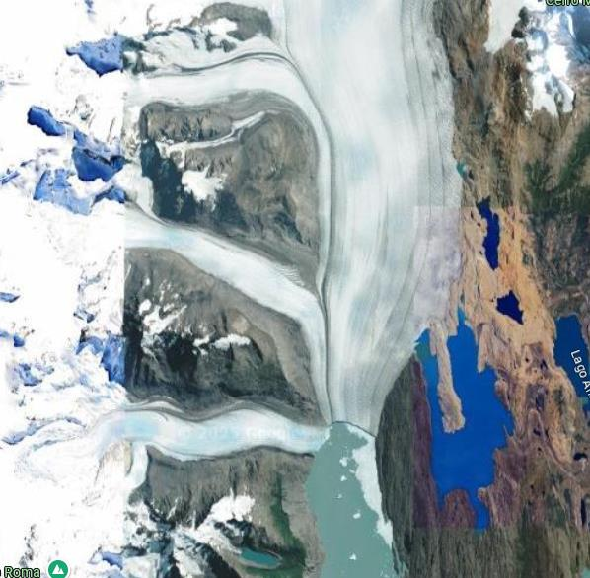
Indirect evidence of moving ice. What’s happening here?

Slide 51
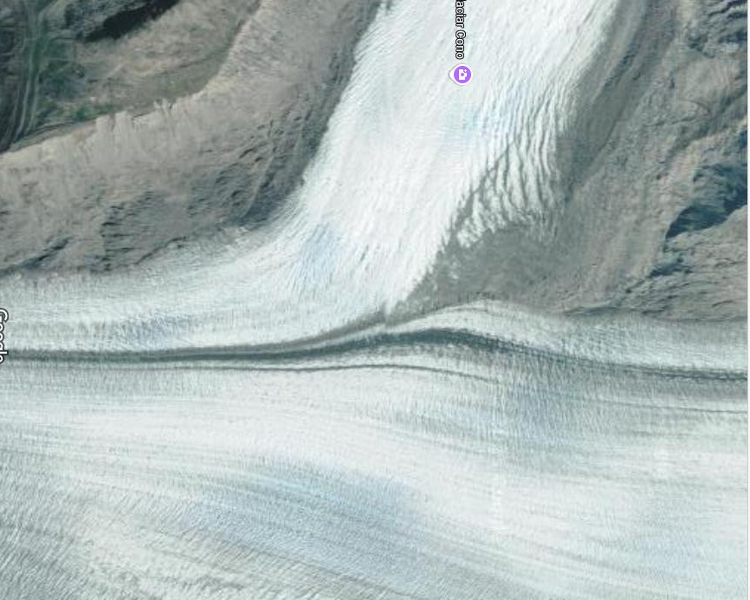
Close-up

Slide 52
1829, De Charpentier systematically characterizes evidence of glaciation. 1834, De Charpentier. Traveling through the valley of Hasli and Lungern, I met on the Brunig road a woodcutter from Meiringen. We talked and walked for a while. As I was examining a large boulder of Grimsel granite, lying next to the path, he said: 'There are many stones of that kind around here, but they come from far away, from the Grimsel, because they consist of Geisberger [granite] and the mountains of this vicinity are not made of it. When I asked him how he thought that these stones had reached their location, he answered without hesitation, 'The Grimsel glacier transported and deposited them on both sides of the valley, because that glacier extended in the past as far as the town of Bern, indeed water could not deposit them at such an elevation above the valley bottom, without filling the lakes. This good old man would never have dreamed that I was carrying in my pocket a manuscript in favor of his hypothesis. He was greatly astonished when he saw how pleased I was by his geological explanation, and when I gave him some money to drink to the memory of ancient Grimsel glacier and to the preservation of the the Brunig boulders.

Slide 53
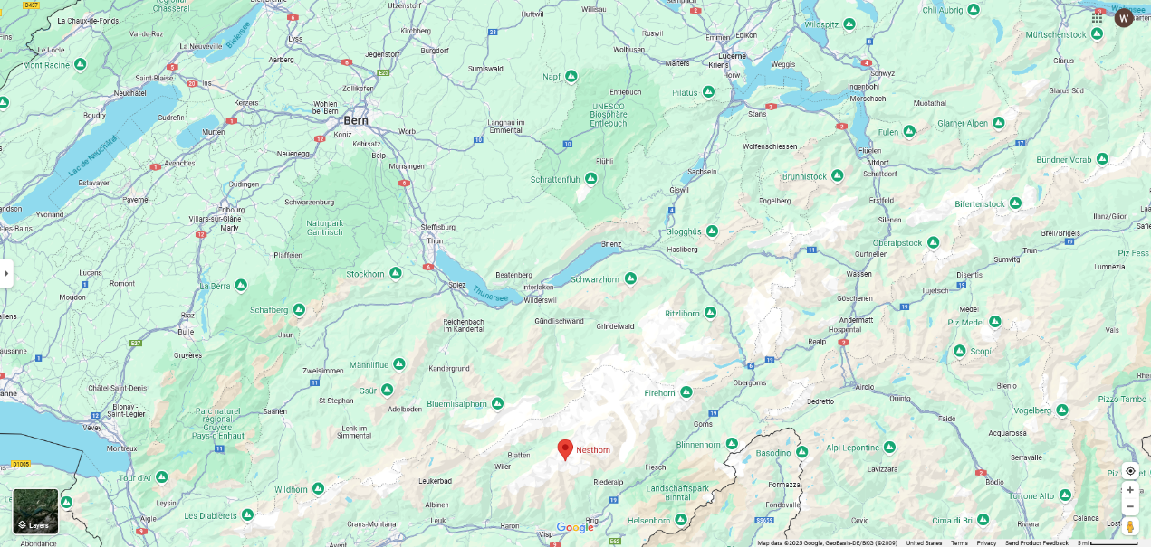
Bern
Lungern
Grimsell

Slide 54
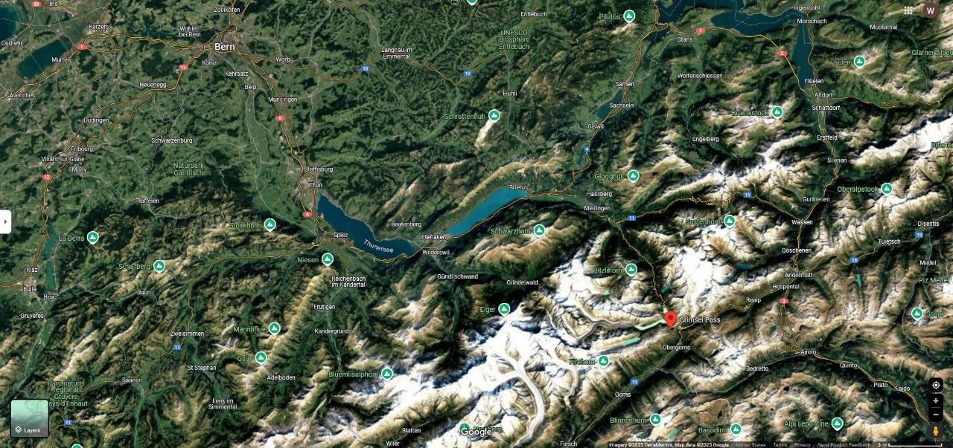
Bern
Lungern
Grimsell

Slide 55
Bern
Lungern
Grimsell

Slide 56
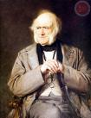
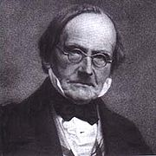
1833, Charles Lyell, English geologist & author of Principles of Geology. Recognition of 'erratic boulders' (or 'erratics') as geological enigma. Charles Lyell published ice rafting theory of erratics, transport occurred during Noah's flood. 1833, Rev. William Buckland, British geologist, recognizes a sea level problem with ice rafting theory. Where did all the water come from? 1834, Louis Agassiz hears de Charpentier's talk, but not impressed with it. 1836, Agassiz visits de Charpientier, ostensibly to study fossil fishes. Becomes acquainted with evidence of extensive past glaciation. 1837, Agassiz speaks at Swiss sachet of Natural Sciences. Replaces talk on fossil fishes with one proposing an 'ice age' in Europe and North America. Met with complete disbelief. 1838, Buckland visits Agassiz in Alps, sees glaciers, but is unconvinced that they were once larger.
Lyell
Buckland
Charpientier

Slide 57
1840, Agassiz published Study on Glaciers, which includes theory of the ice age 1840, Agassiz visits Buckland, shows him evidence of glaciation in England.

Slide 58
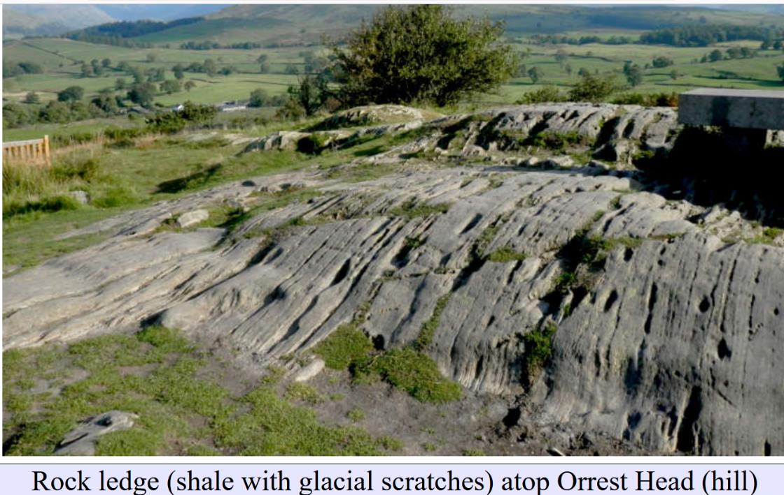

Slide 59
sedimentary layers
sedimentary layers

Slide 60
scratch
scratch
scratch
scratch
small gouge
scratch
scratch
large gouge

Slide 61
1840, Buckland convinces Lyell. “Lyell has adopted your theory in toto!! On my showing him a beautiful cluster of moraines within two miles of his father's house [in Scotland], he instantly accepted it, as solving a host of difficulties which have all his life embarrassed him.”

Slide 62
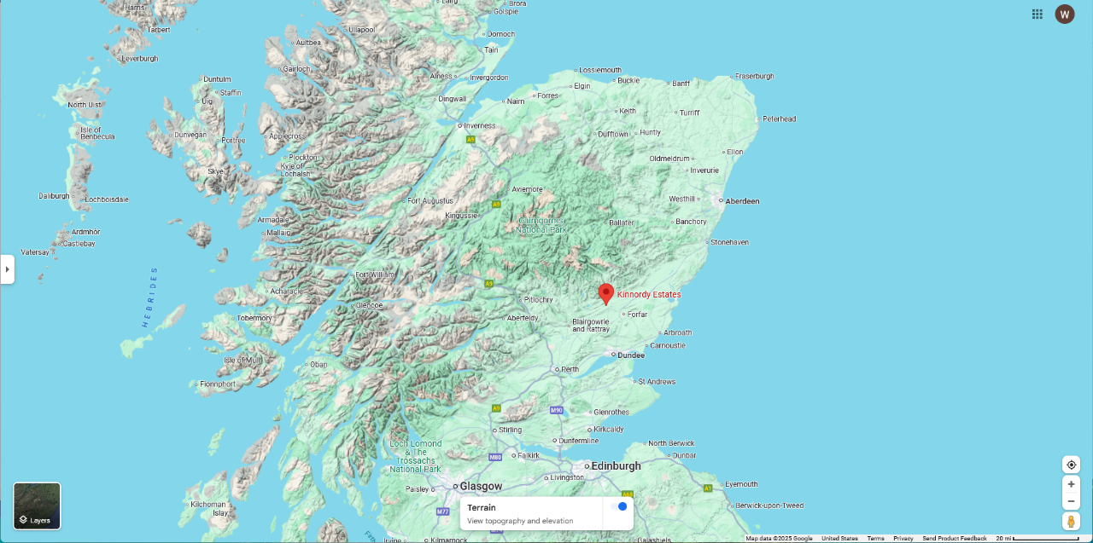
Lyell’s father’s house

Slide 63
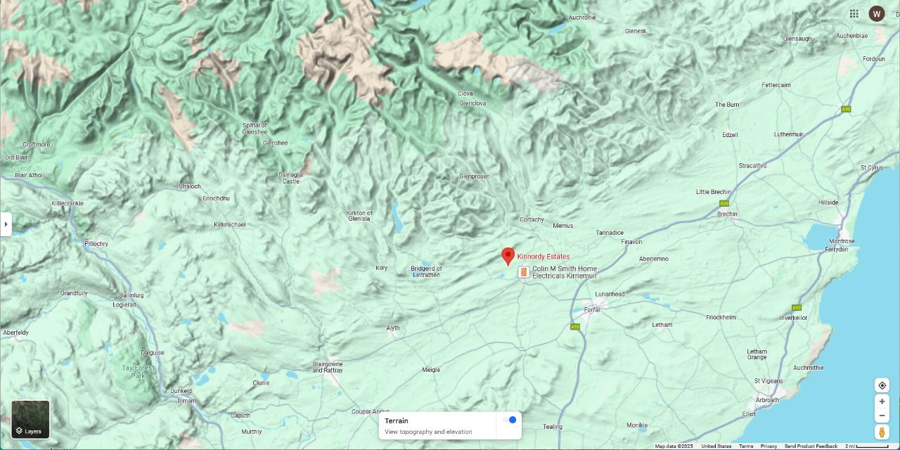
Lyell’s father’s house

Slide 65
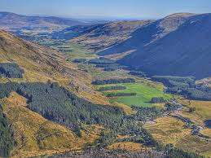

Slide 66
How well did Agassiz do in proving a Global Ice Age ?

Slide 67
What attributes does a Global Ice Age Have

Slide 68
Global Contemporaneous

Slide 69
What technologies were available in the 1840’s to address them?

Slide 70
Global … relatively easy Contemporaneous … much harder

Slide 71
1846, Agassiz visits North America: “I sprang on the shore [at Halifax] and started at a brisk pace for the heights above the landing.... I was met by the familiar signs, the polished surfaces, the furrows and scratches, the line engravings of the glacier ... and I became convinced that here also this great agent had been at work.”

Slide 72
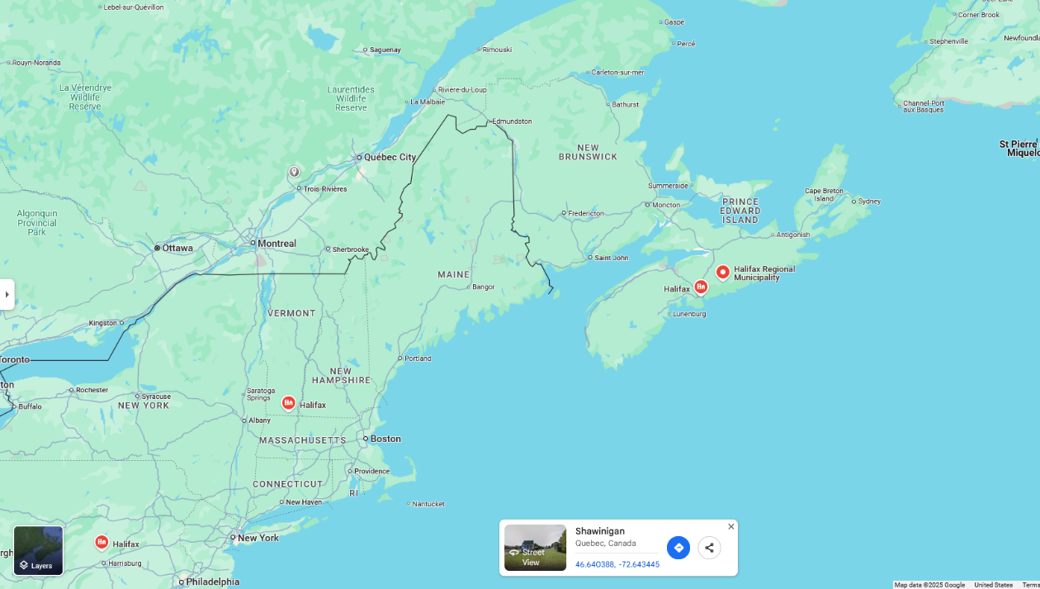
Halifax
New York

Slide 73
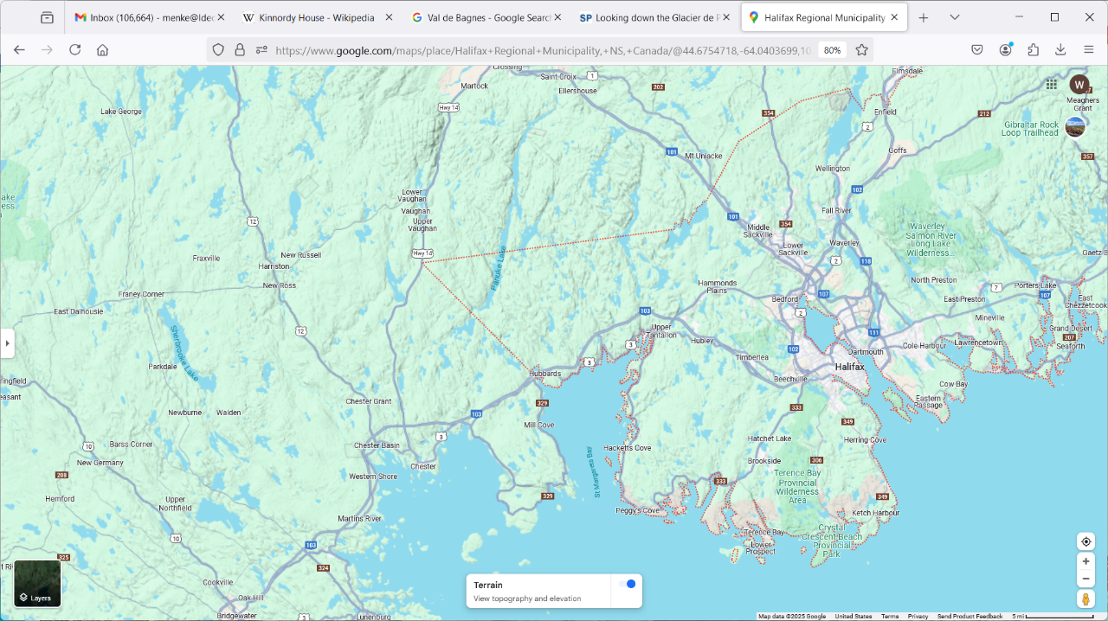
Halifax

Slide 75
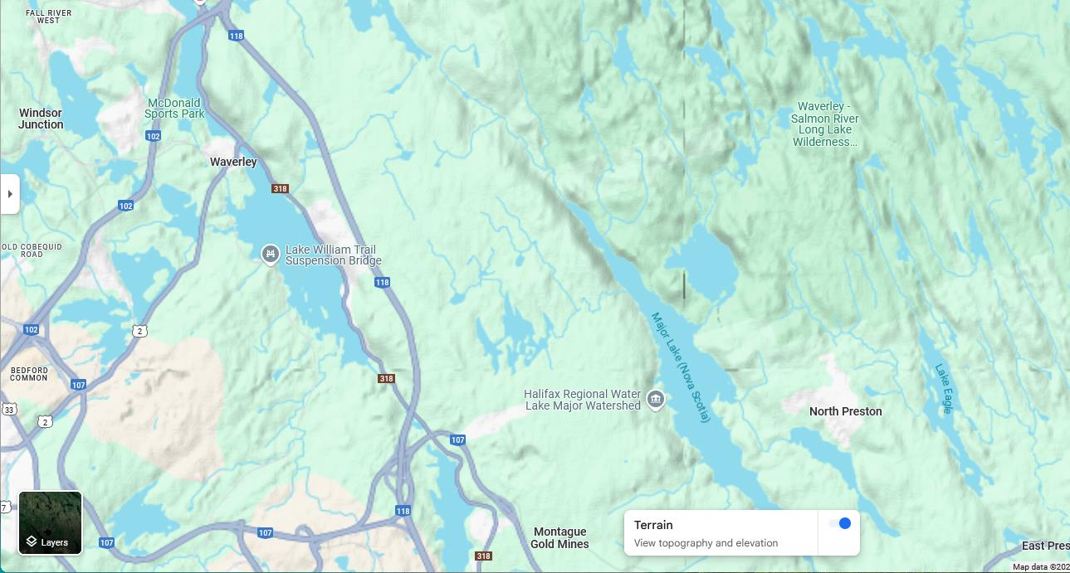

Slide 76
Glacial valley

Slide 77
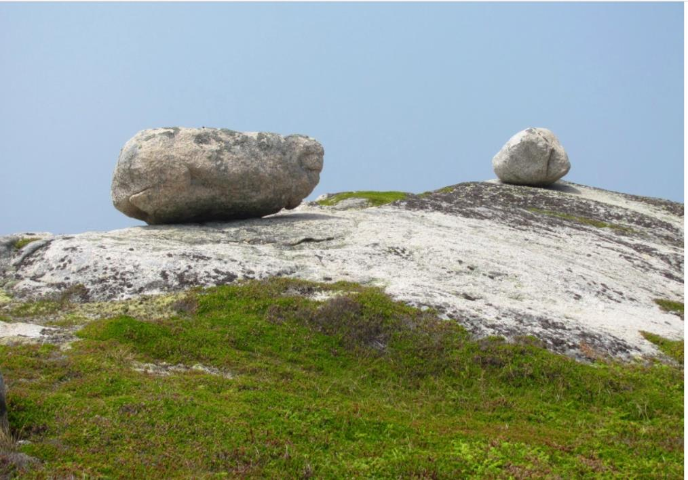

Slide 78
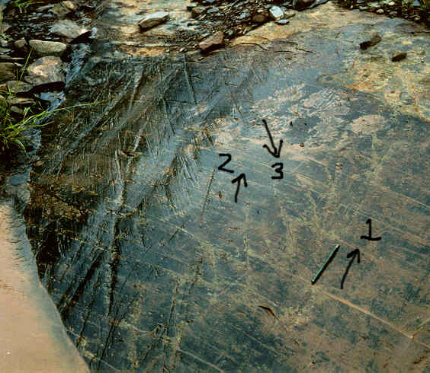

Slide 80
Global … relatively easy Contemporaneous … much harder
requires precise dating

Slide 81
Global … relatively easy Contemporaneous … much harder
Ice cores … just count annual ice layers

Slide 82
Global … relatively easy Contemporaneous … much harder
Ice cores … but you have to have a way of estimating the temperature when the ice formed

Slide 83
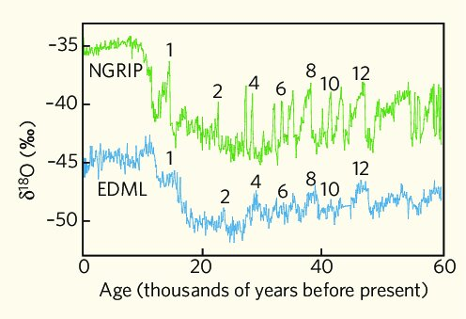
Greenland
Warmer
Antarctica
Today
Older

Slide 84
11.7 end of the Ice Age

