Slide 1
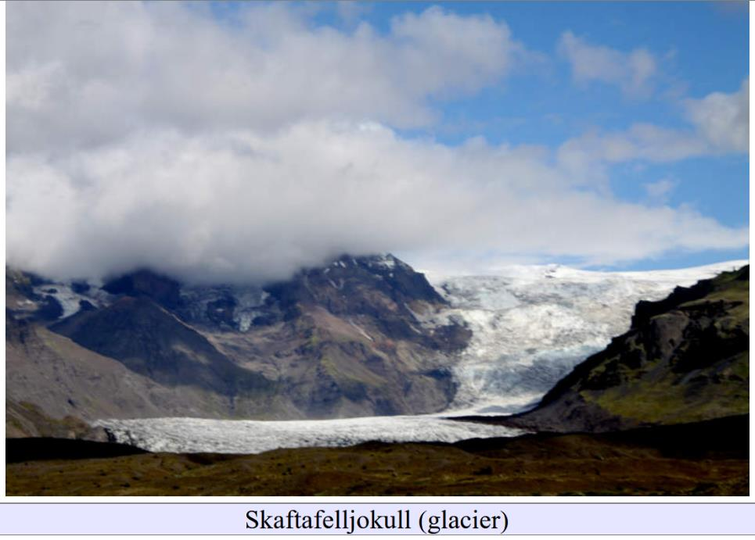
Glacial Movements
Lecture 02

Slide 2
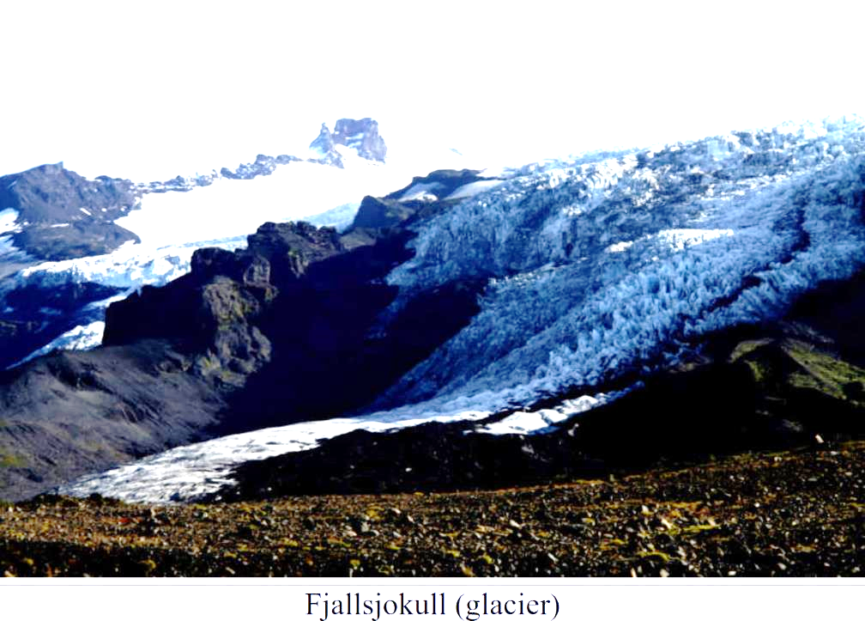
Glacier: Flowing mass of ice

Slide 3
Glacier: Flowing mass of ice

Slide 4
What force drives the flow?

Slide 5
Gravity

Slide 6
Force of Gravity
Ice
Force = density x
acceleration of gravity x
height x area
gravity

Slide 7
Force of Gravity
$$A$$
force = density x
acceleration of gravity x
height x area
$$ρ$$
$$z$$
$$f= ρgzA$$
gravity

Slide 8
Stress of Gravity
stress = force per unit area
$$A$$
Force = density x
acceleration of gravity x
height x area
$$ρ$$
$$z$$
$$\frac{f}{A}= ρgz$$
gravity

Slide 9
Stress of Gravity
stress = σ = force per unit area
$$A$$
Force = density x
acceleration of gravity x
height x area
$$ρ$$
$$z$$
$$σ=\frac{f}{A}= ρgz$$
gravity

Slide 10
Stress of Gravity
$$A$$
$$\frac{σ}{z}= ρg$$
$$ρ$$
$$z$$
$$ρ=917 kg/m^{3}$$
$$g=9.81 m/s^{2}$$
gravity
$$\frac{σ}{z}≈9000 pascal/m$$

Slide 11
Stress of Gravity
$$A$$
$$\frac{σ}{z}= ρg$$
$$ρ$$
$$z$$
gravity
$$\frac{σ}{z}≈9 kpa/m$$

Slide 12
frozen water bottle
$$z=0.2 m$$
$$σ≈9 ×0. 2 kpa≈2 kpa$$

Slide 13
What else besides gravity do you need for flow?

Slide 14
Sloping hillside
gravity
$$θ$$

Slide 15
$$θ$$
compressive stress of gravity
shear stress of gravity

Slide 16
$$θ$$
$$p=ρgz \cos{θ}$$
$$τ=ρgz \sin{θ}$$
drives flow

Slide 17
$$τ$$
shear stress increases
with depth in the glacier
steeper the slope
the faster the increase
$$z$$
high slope
low slope

Slide 18
shear stress
causes the ice to flow

Slide 19
flow
ice is moving
ice has a velocity
$$v$$
measured in m/s

Slide 20
Lab experiments
Glen flow law
shear stress
causes the ice to flow

Slide 21
$$τ$$
$$v$$
$$z$$
$$z$$
constant shear stresss
linearly increasing velocity

Slide 22
Lab experiments
Glen flow law
$$\frac{dv}{dz}=Aτ^{3}$$

Slide 23
Lab experiments
Glen flow law
$$\frac{dv}{dz}=Aτ^{3}$$
double the stress
velocity increase is eight times bigger

Slide 24
$$τ$$
$$v$$
$$z$$
$$z$$

Slide 25
$$τ$$
$$v$$
glaciers flow much faster on steep hill than shallow sloped
$$z$$
$$z$$

Slide 26
very idealized glacier of constant thickness $h$
very wide, so edges of glacial valley unimportant
on hill of constant slope
top has zero shear stress
bottom frozen to bed, so velocity is zero

Slide 27
$$τ$$
$$v$$
$$z$$
$$z$$
$$h$$

Slide 28
$$τ$$
$$v$$
top region
where
ice is moving
almost uniformly
$$z$$
$$z$$
bottom region
where
ice is “shearing”
$$h$$

Slide 29
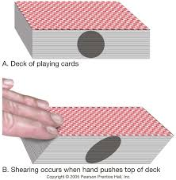
$$v$$
top region
where
ice is moving
almost uniformly
$$z$$
bottom region
where
ice is “shearing”
$$h$$

Slide 30
Glen flow law
$$\frac{dv}{dz}=Aτ^{3}$$
warm ice has an $A$ that is orders of magnitude bigger than cold ice

Slide 31
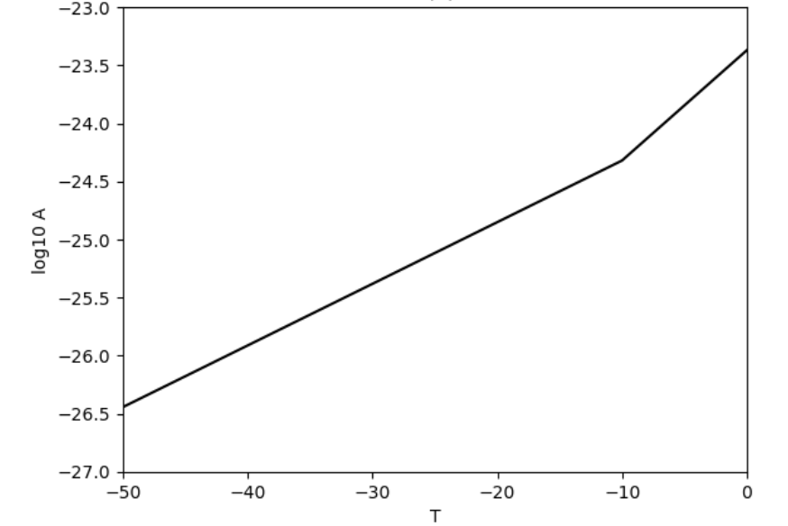
Bigger A
$$℃$$
warmer temperature

Slide 32
Glaciers behave differently
in different climates
Alps
East Antarctica
$$×30$$

Slide 33
Glaciers behaves differently
during the Ice Age
(when it was 11$℃$ colder)
$A$ was about three times smaller
$$×3$$
11$℃$

Slide 34
The geothermal gradient
global average
$$40℃/km$$
affects
ice velocity
$$×2.9$$
10$℃$
for 250 m thick glacier

Slide 35
Atmospheric lapse rate
important
$$×2.9$$
10$℃$
1 km elevation change

Slide 36
very idealized glacier of constant thickness $h$
very wide, so edges of glacial valley unimportant
on hill of constant slope
top has zero shear stress
bottom frozen to bed, so velocity is zero
slides on bed
not

Slide 37
basal sliding law not so well known
one simple law is the linear law
$$v_{basal}=Cτ$$

Slide 38
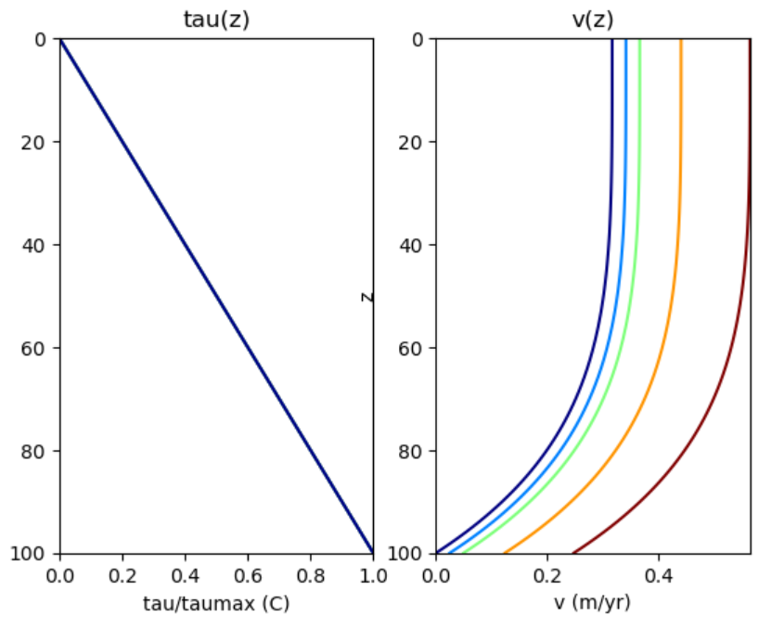
$$C=5×{10}^{14}$$
$$C=0$$
$$C={10}^{13}$$

Slide 39
Basal sliding
shifts the velocities
higher
increasing $C$

Slide 40
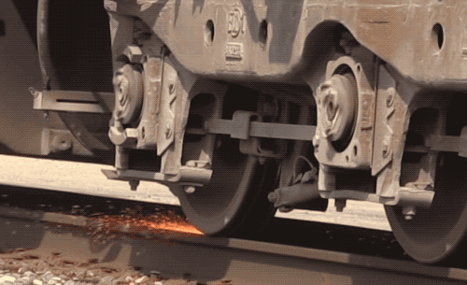
Sliding is a frictional process
that generates heat
and can lead to melting at the base of the glacier

Slide 41
Basal Thermal Regime
How close is the base of the glacier to melting?
Net basal heating: ice melts at base
Equilibrium
Net basal cooling: water freezes at base

Slide 42
Mass Balance
New snow added everywhere, but
Net addition of ice at high elevations
because cold temperatures suppress melting
Net loss of ice at low elevations
because warm temperatures facilitate melting

Slide 43
At equilibrium,
a glacier maintains a constant shape
because flow from higher to lower elevations is
is balanced
by addition of snow at higher elevations
and melting at lower elevations

Slide 44
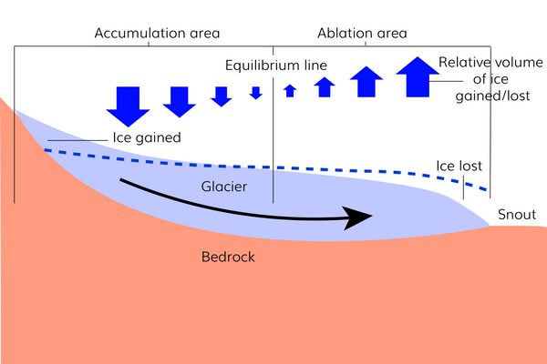

Slide 45
equilibrium is only an idealization
because
in reality many glaciers are either
advancing or retreating

Slide 46
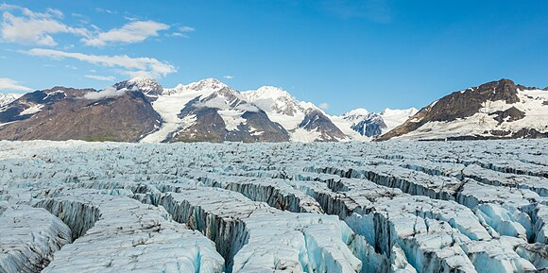
Crevasse: tension crack in surface of glacier

Slide 47
bad to fall into

Slide 48
bad to drive into

Slide 49
need extensional horizontal stress to open crevasse

Slide 50
case 1: Compressing glacier

Slide 51
case 1: Glacier thickens

Slide 52
case 2: Extending glacier

Slide 53
case 2: Extending glacier
Crevasses form

Slide 54
form when
horizontal stress
is tensional
(but their dynamics are not a subject of this class)
tension
tension
But for an analysis, see
https://www.ldeo.columbia.edu/~menke/www_users_menke/SED23/SED23_Lec26.pdf

Slide 55
meltwater
can deepen them

