Slide 1
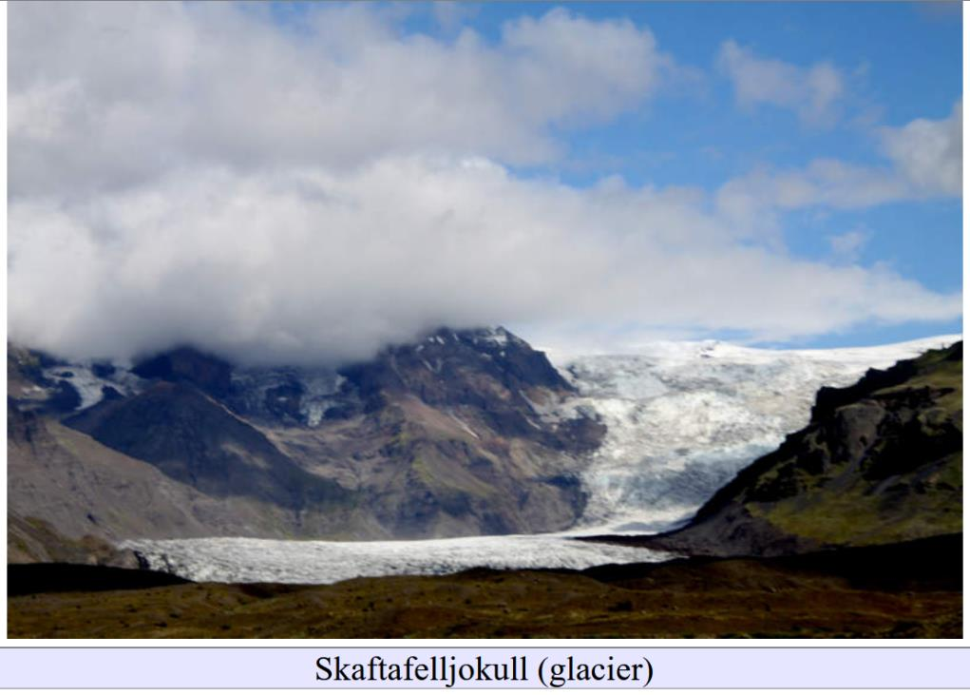
Large-scale erosional landforms
Lecture 3

Slide 2
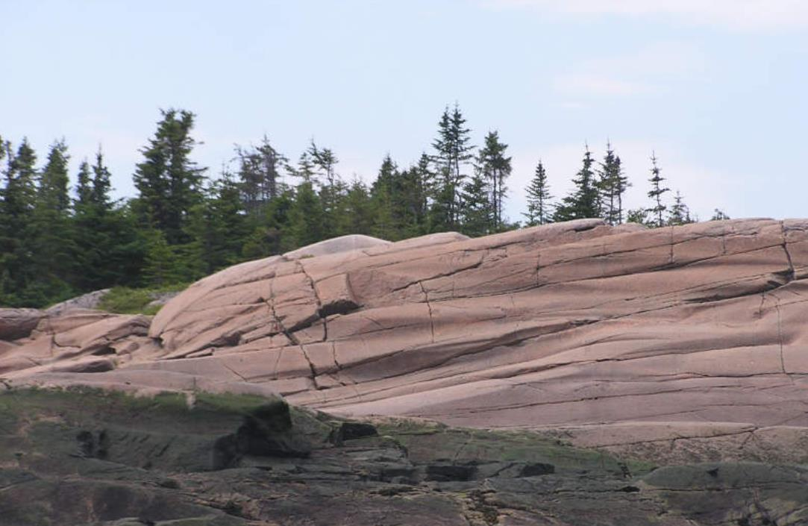

Slide 3
striations, grooves, furrows

Slide 4
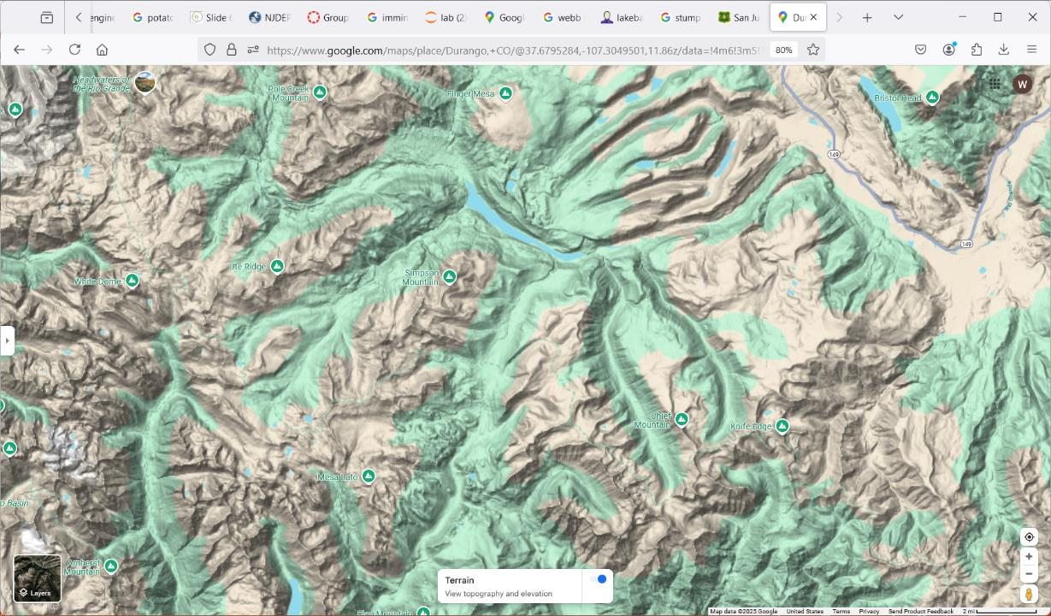
Somewhere in Colorado
3 km

Slide 5
3 km

Slide 6
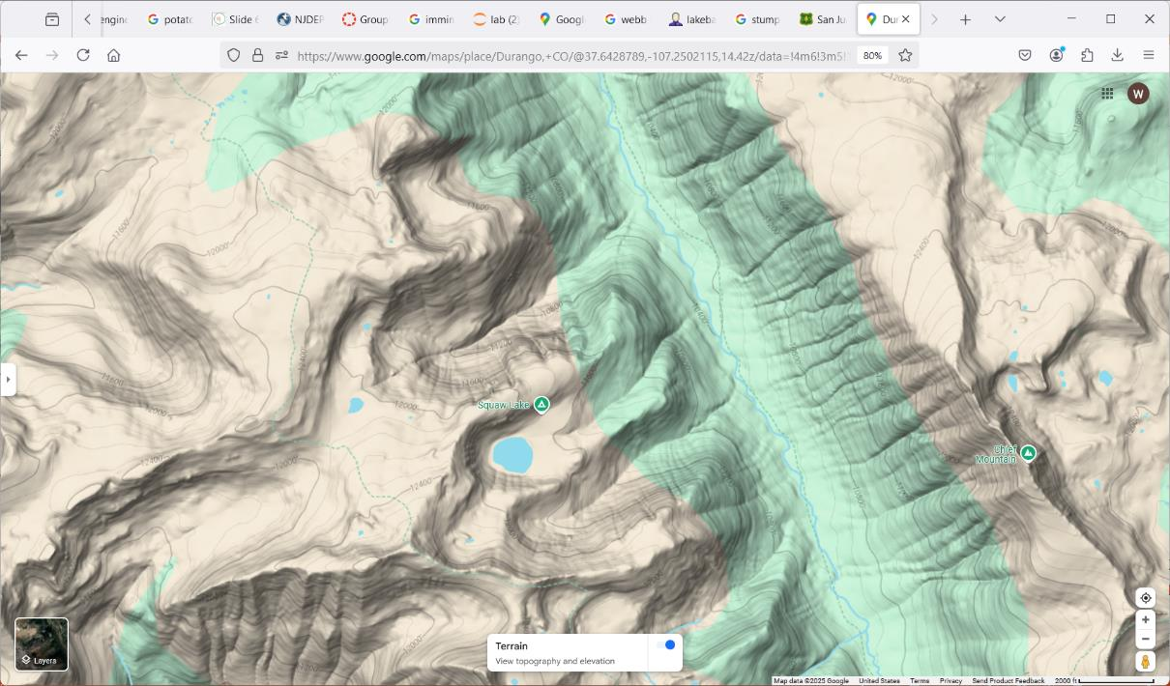
0.6 km

Slide 7
U-shaped valley
0.6 km

Slide 8
0.6 km

Slide 9
post-glacial streams
0.6 km

Slide 10
last 12,000 years
0.6 km

Slide 11
0.6 km

Slide 12
cirque
cirque
cirque
cirque
cirque
cirque
cirque
cirque
0.6 km

Slide 13
0.6 km

Slide 14
cirque stairway
0.6 km

Slide 15
0.6 km

Slide 16
tarn = cirque lake
cirque lake
cirque lake
cirque lake
0.6 km

Slide 17
0.6 km

Slide 18
arête
arête
arête
0.6 km

Slide 19
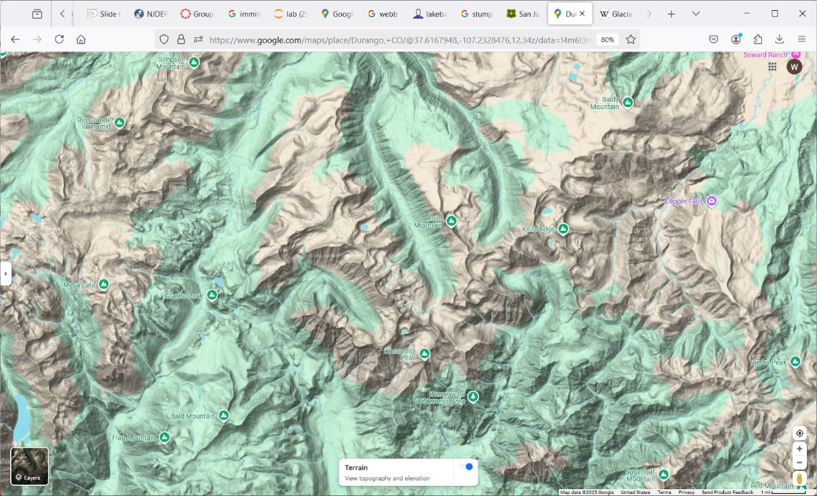
1.5 km

Slide 20
Somewhere in Colorado
1.5 km

Slide 21
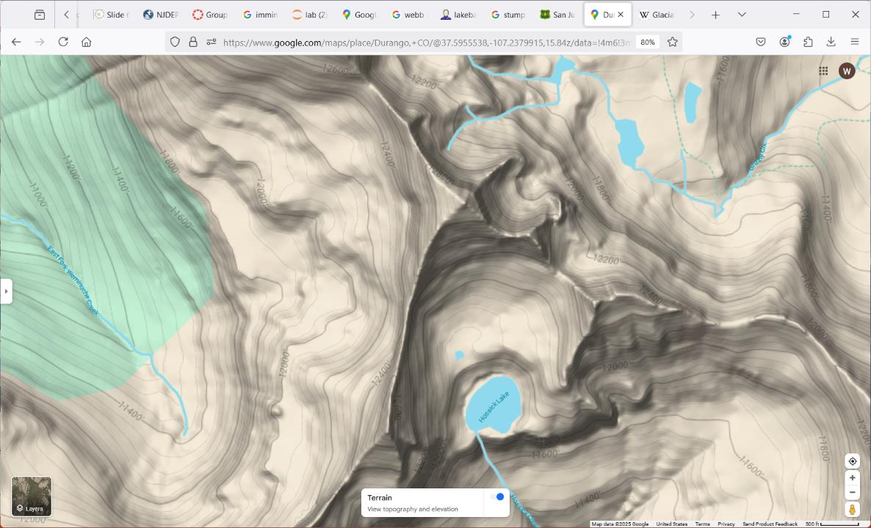

Slide 22
Cirques

Slide 23
Cirque lake

Slide 24
arêtes

Slide 25
horn
horn

Slide 26
striations, grooves, furrows
U-shaped valley
cirque (valley at head of glacier)
cirque stairway (nested cirques)
cirque lake (tarn)
arête (ridge between two cirques)
horn (peak between several cirques)

Slide 27
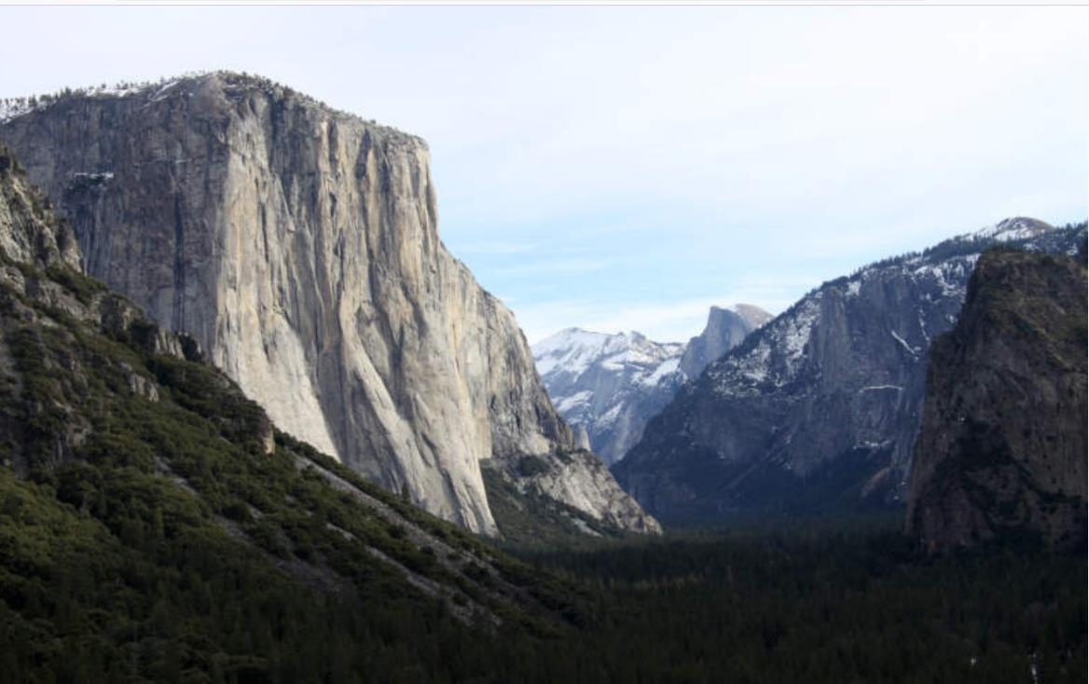

Slide 28
U-shaped valley

Slide 29
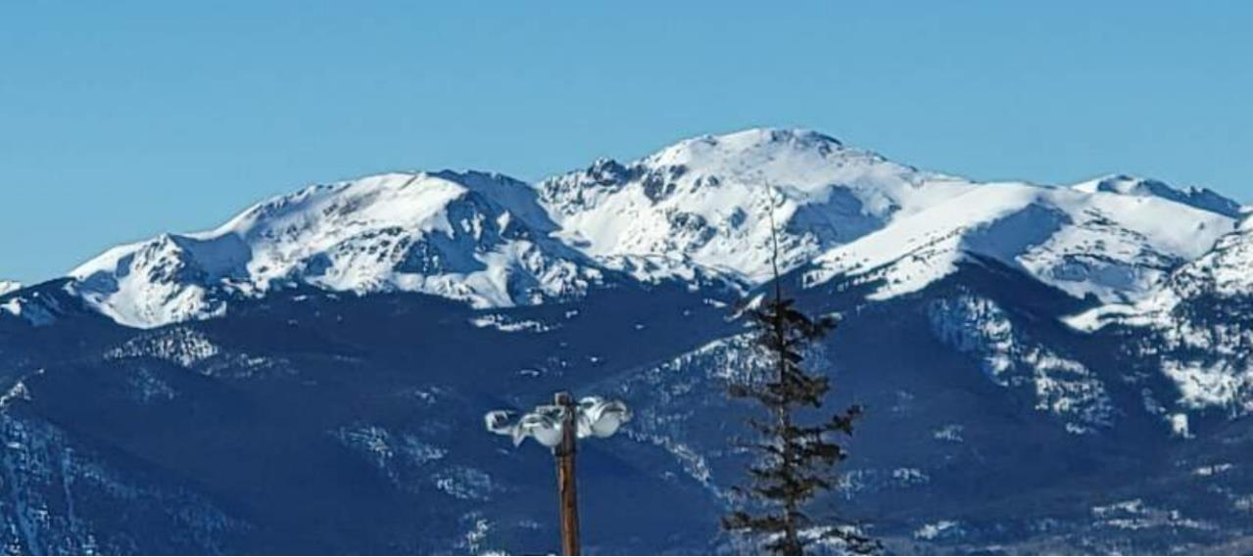

Slide 31
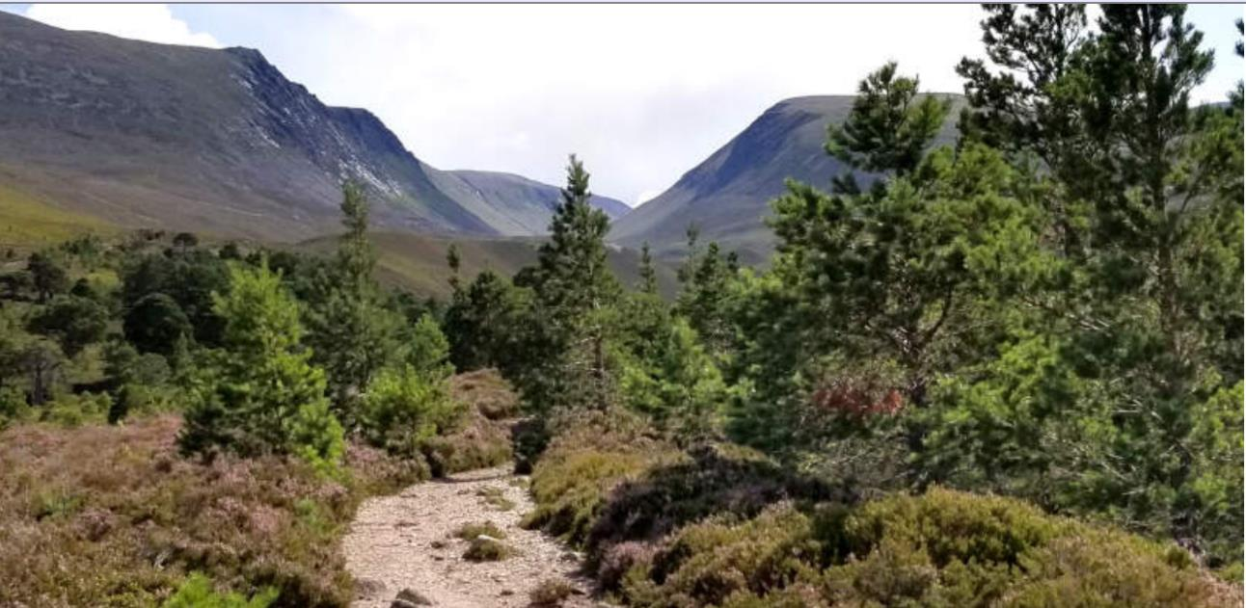

Slide 32
U-shaped valley

Slide 33
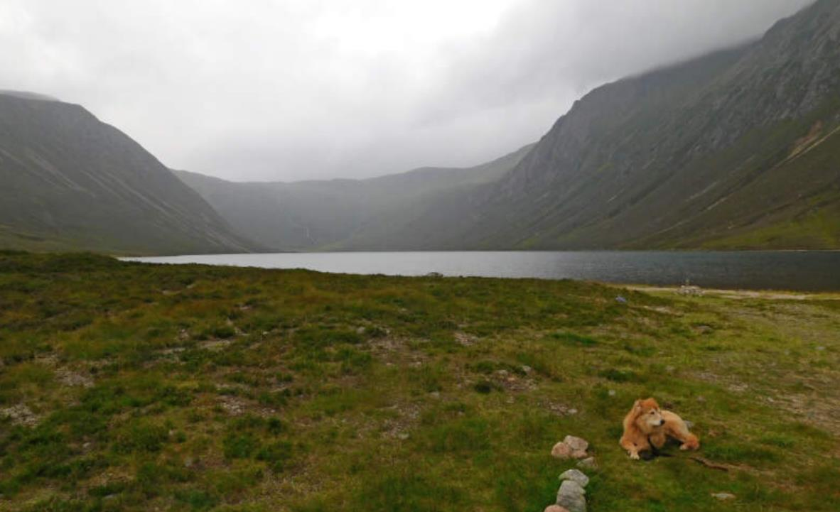

Slide 34
U-shaped valley

Slide 35
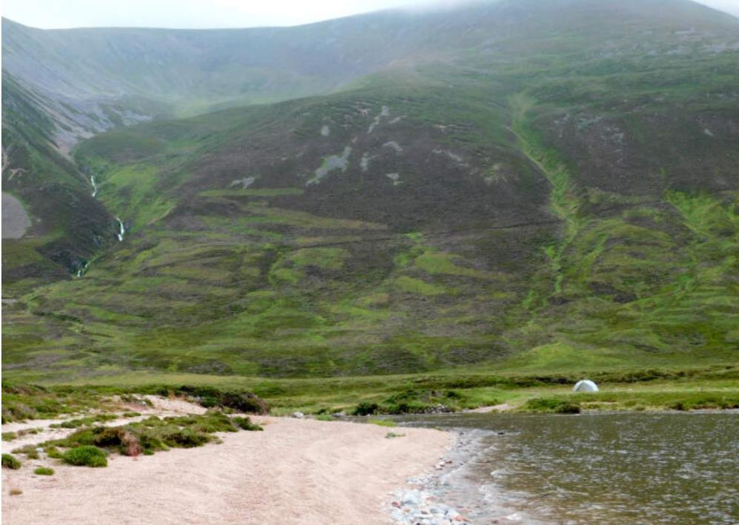

Slide 36
cirque

Slide 37
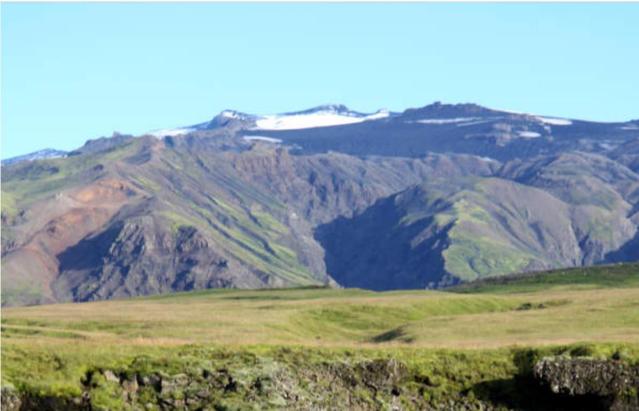

Slide 38
cirque
cirque

Slide 39
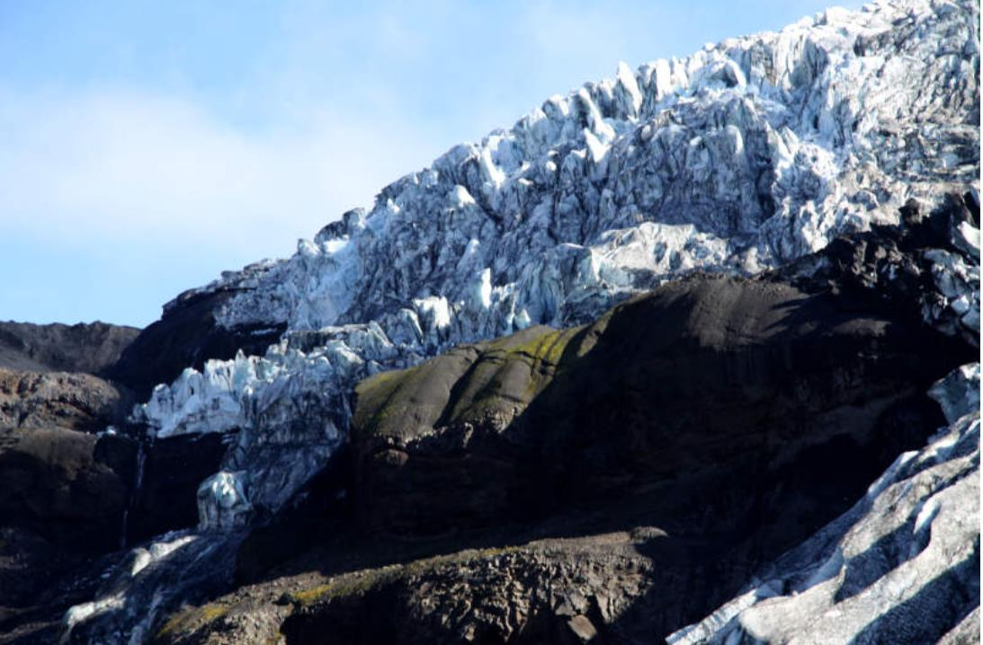

Slide 40
striations

Slide 41
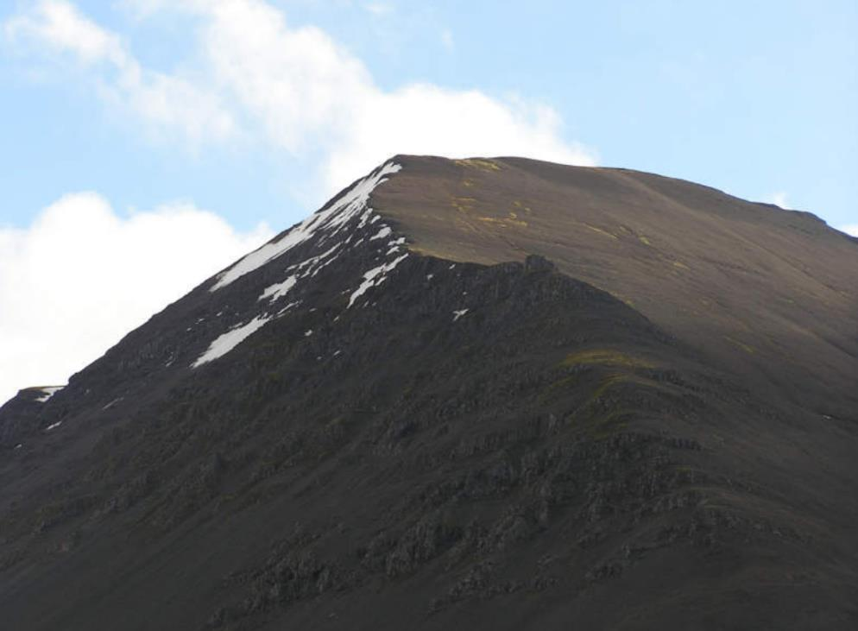

Slide 42
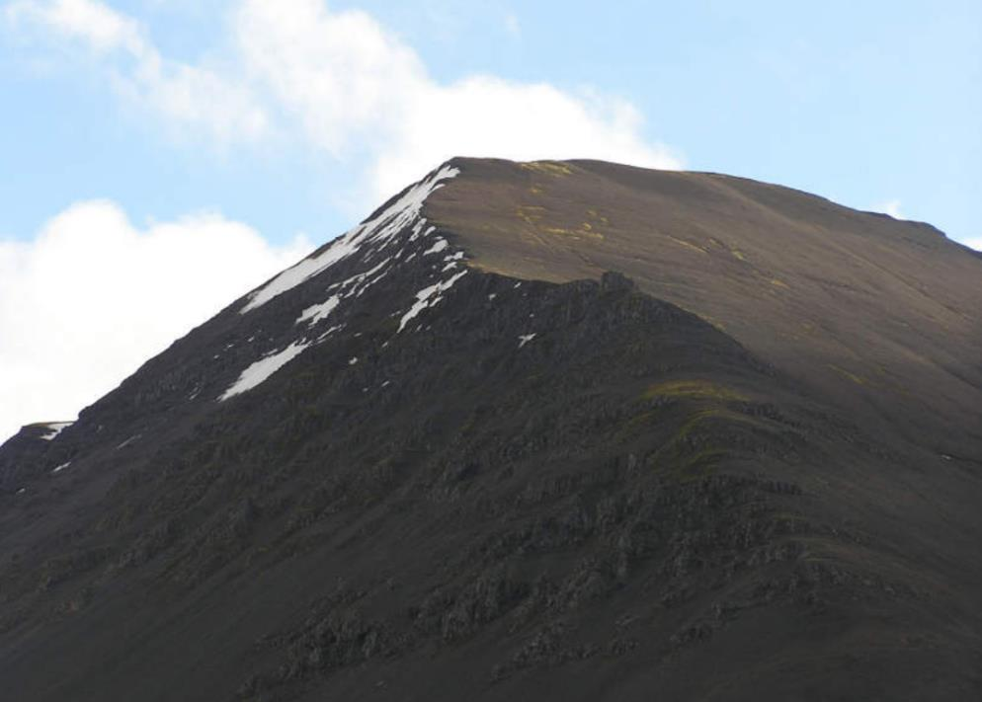
side of valley with striations

Slide 43
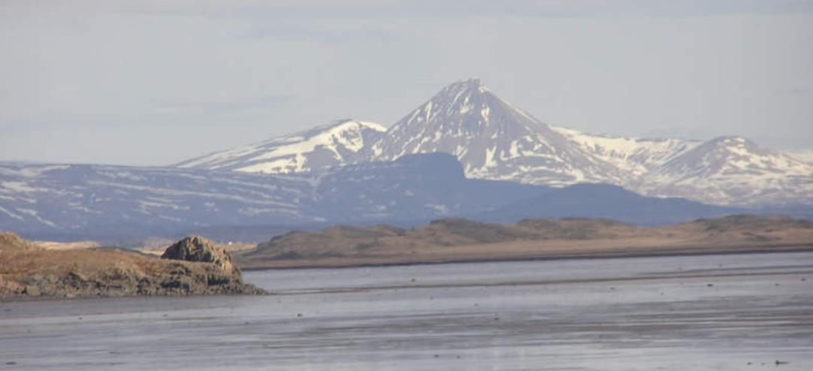

Slide 44
cirque

Slide 45
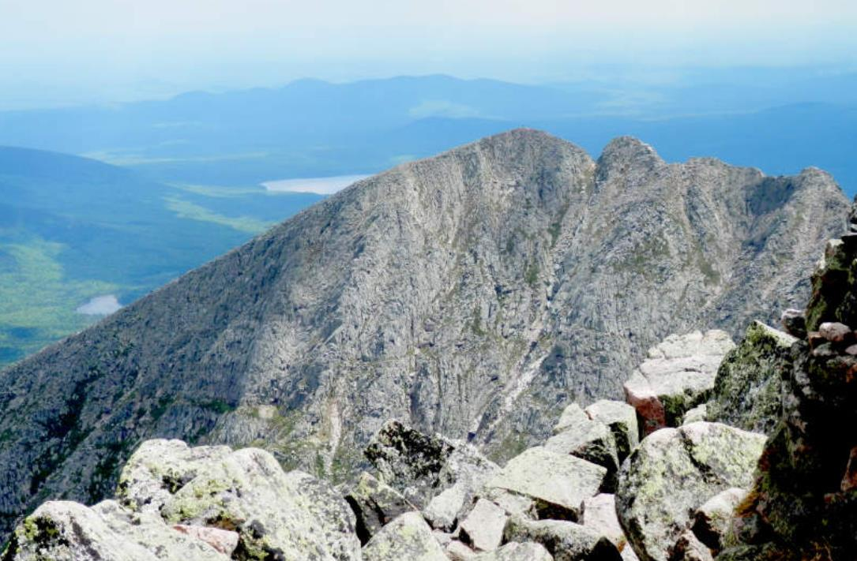

Slide 46
arête

Slide 47
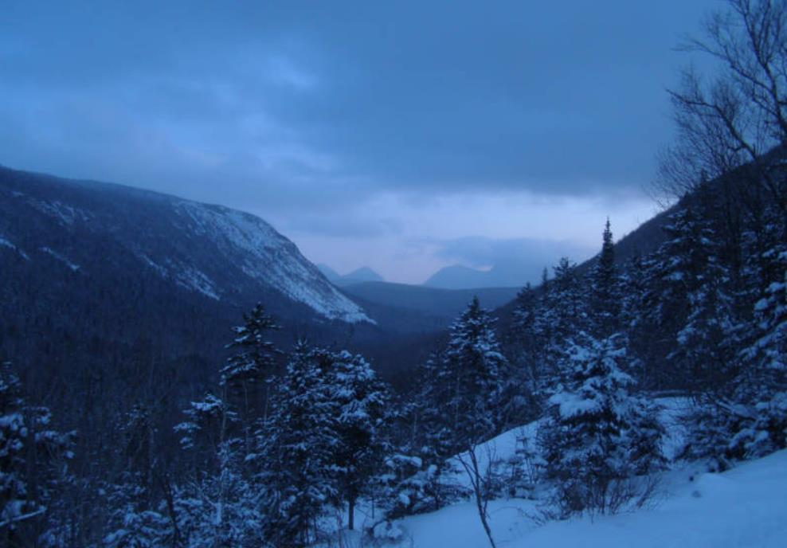

Slide 48
U-shaped valley

Slide 49
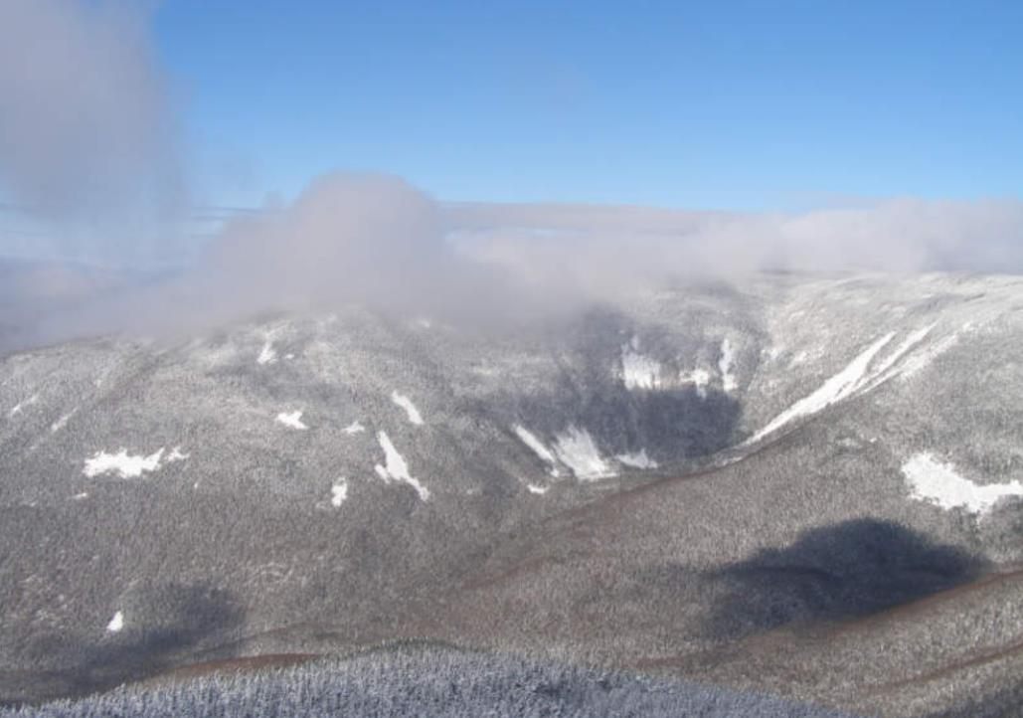

Slide 50
cirque

Slide 51
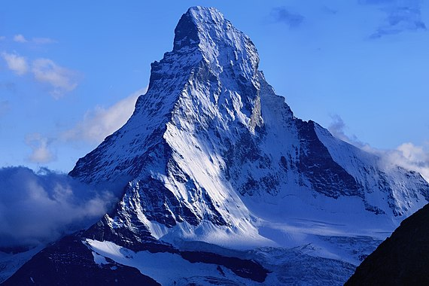

Slide 52
horn

Slide 53
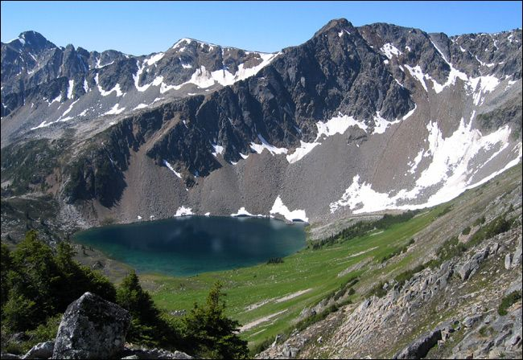

Slide 54
cirque lake

Slide 55
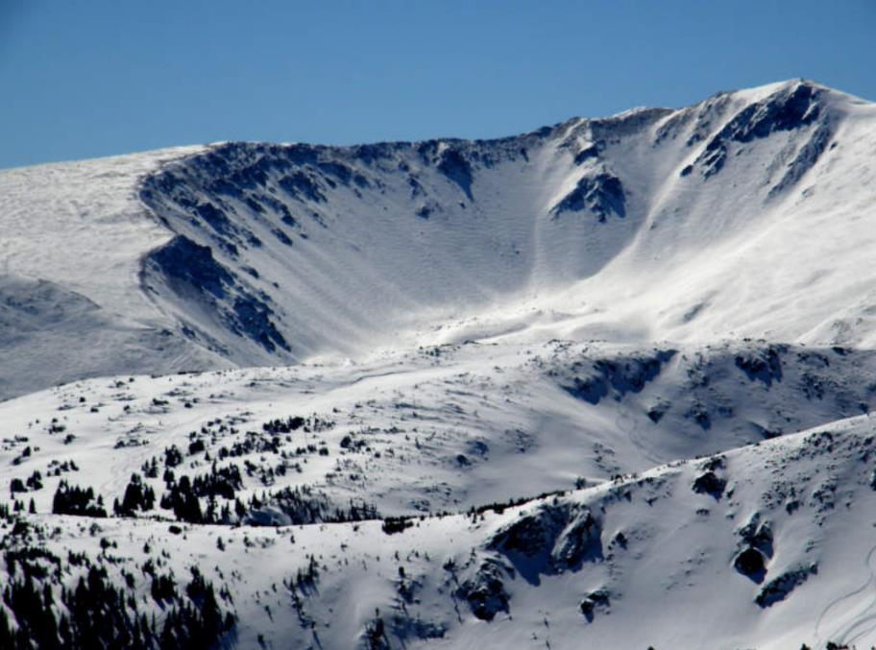

Slide 56
cirque

Slide 57
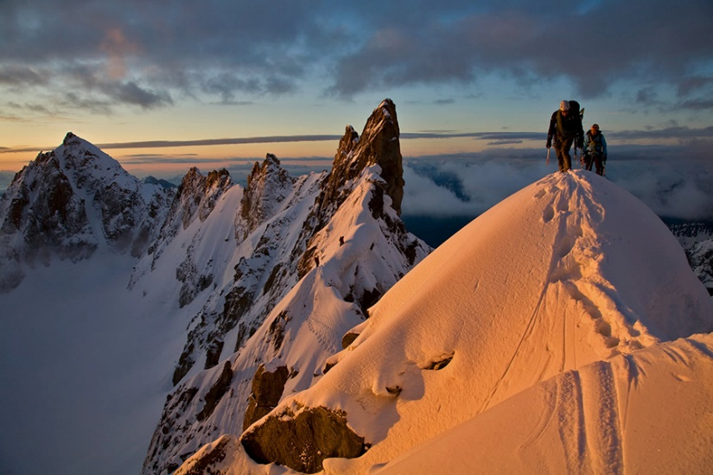

Slide 58
arête

Slide 59
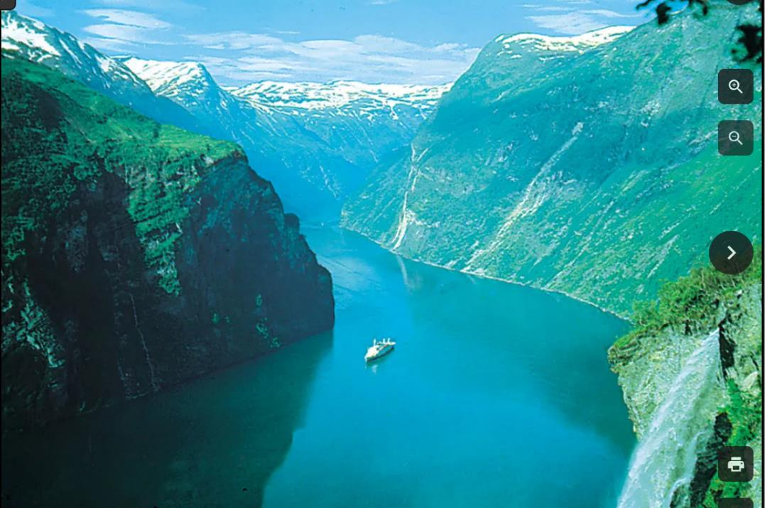

Slide 60
fjord = flooded
U-shaped valley

Slide 61
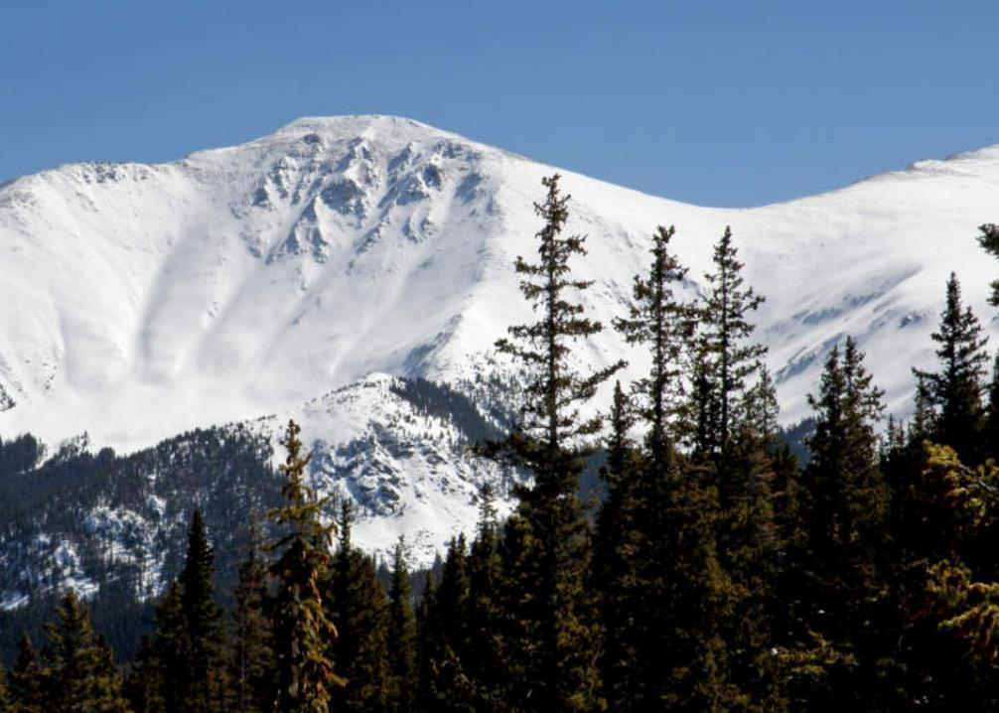

Slide 62
cirque

Slide 63
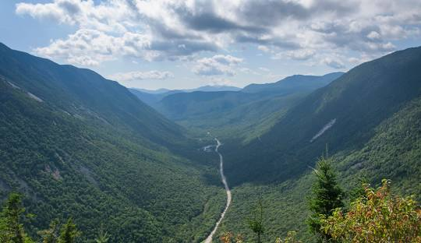

Slide 64
U-shaped valley

Slide 65
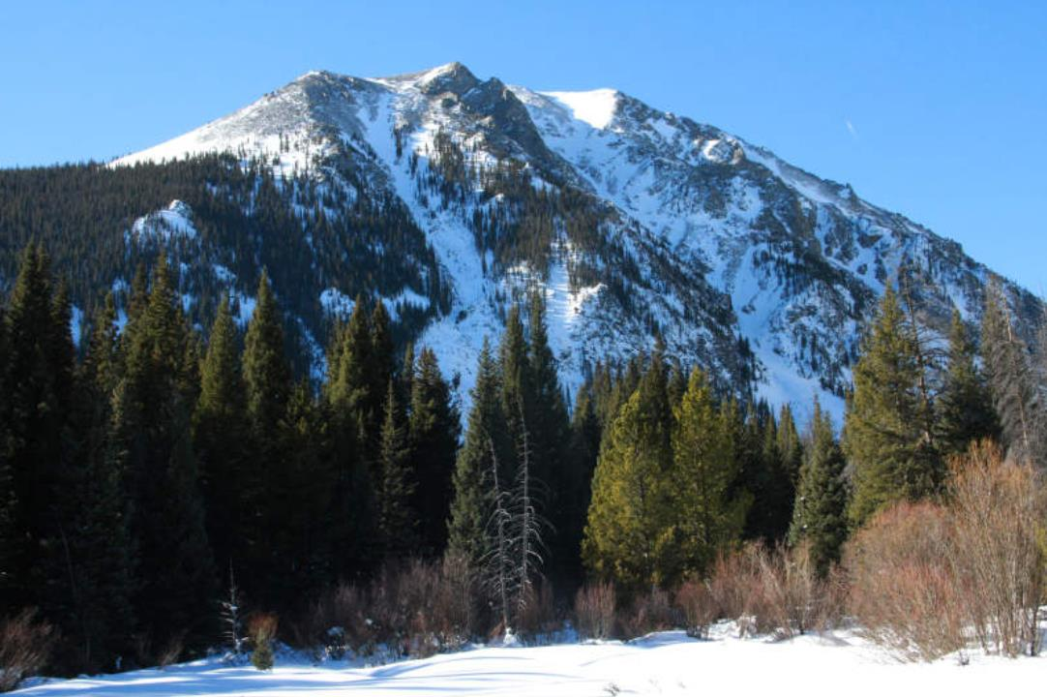

Slide 66
cirques

Slide 67
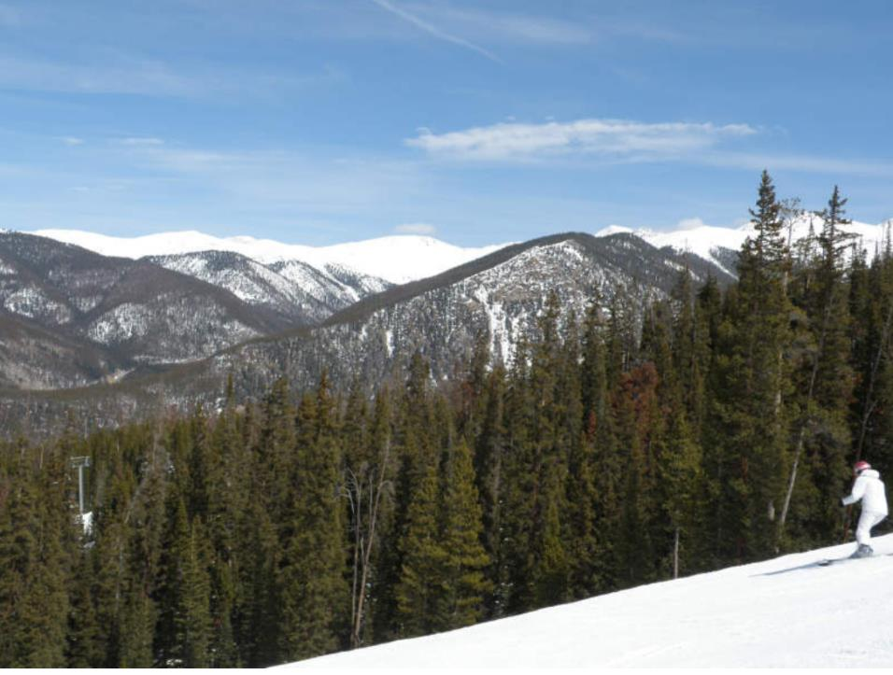

Slide 68
U-shaped valley
arête
U-shaped valley

Slide 69
Question:
How long do glaciers need to make this topography?

Slide 70
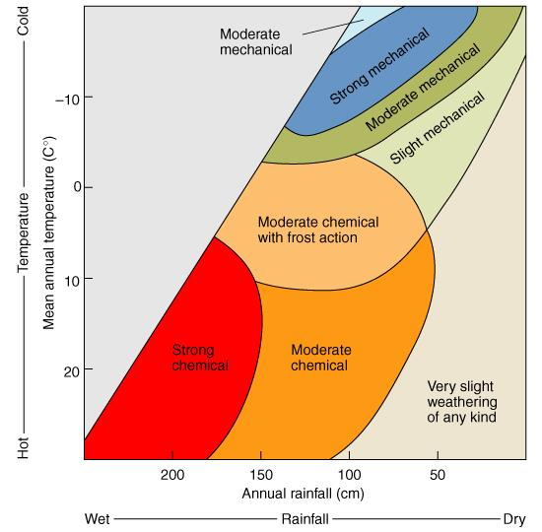
Weathering and Erosion

Slide 71
Weathering and Erosion
breaking down rock
transporting it way

Slide 72
Glaciation mainly mechanical weathering
Glaciation
breaking rock into
smaller and smaller
pieces (sediments)

Slide 73
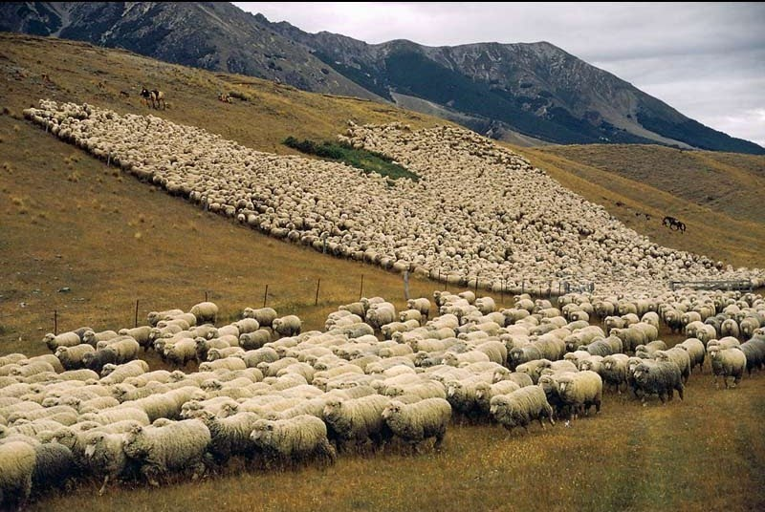
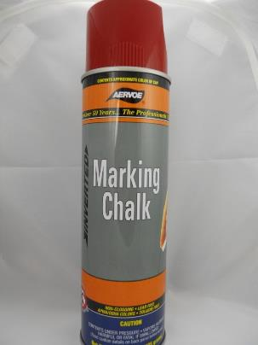
How to estimate number of sheep?

Slide 74
Steps
randomly select and mark 100 sheep with chalk
let them mix back into flock
randomly select a bunch sheep and determine fraction F marked
total sheep = 100 / F

Slide 75
Logic
If only two sheep are marked
then the herd is fifty times bigger
than the initial group of 100

Slide 76
¹⁰Be unstable with half-life of 1.6 ma, produced by cosmic rays hitting atmosphere
⁹Be stable, naturally occurs in rock at concentration of about 2.5 ppm

Slide 77
¹⁰Be unstable with half-life of 1.6 ma, produced by cosmic rays hitting atmosphere
marked sheep
⁹Be stable, naturally occurs in rock at concentration of about 2.5 ppm
unmarked sheep

Slide 78
Only ¹⁰Be,
known flux
measure
$$\frac{{}_{ }^{9}{Be}}{{}_{ }^{10}{Be}}$$
sediments
rocks
Only ⁹Be, unknown flux

Slide 79
Really only estimate the flux of ⁹Be,
so you must know ⁹Be concentration in rock
to determine the flux of sediments
Only ¹⁰Be,
known amount
measure
$$\frac{{}_{ }^{9}{Be}}{{}_{ }^{10}{Be}}$$
sediments
rocks
Only ⁹Be, unknown amount

Slide 80
Check method against
sediment flux estimated directly by measuring sediment
being transported by the river

Slide 81
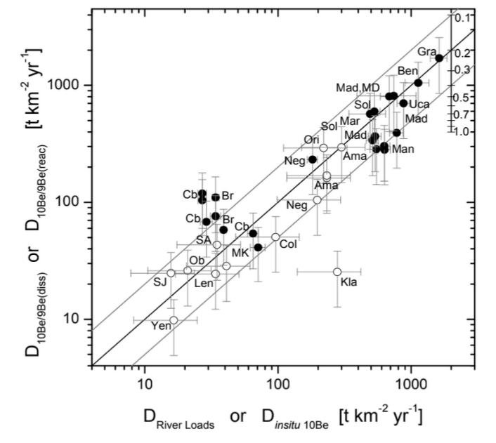
1 mm/yr is a large denudation rate
for rivers

Slide 82
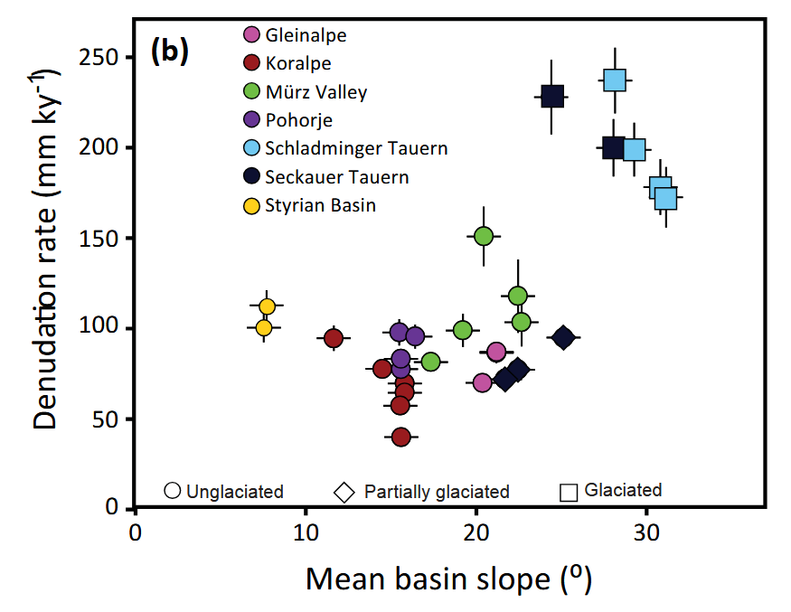

Slide 83
glaciated
0.25 mm/yr

Slide 84
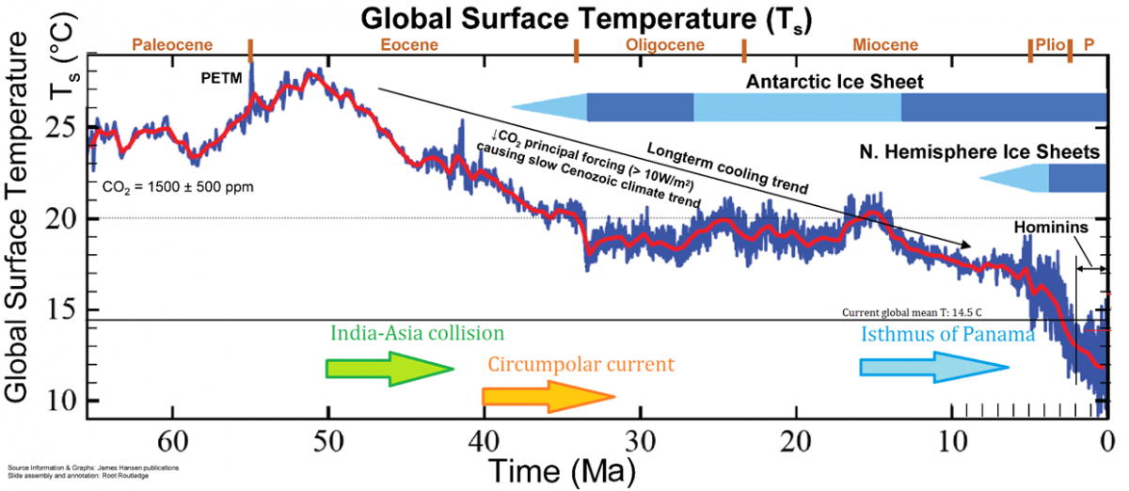
Ice Age starts
2.6 my ago

Slide 85
Average Erosion since start of Ice Age
2,600,000 years
0.25 mm/yr
650,000 mm
650 meters

Slide 86
Average Erosion since start of Ice Age
2,600,000 years
0.25 mm/yr
650,000 mm
650 meters
(but locally may be
smaller or larger)
4478 m
1078 m
3400 m

