Slide 1
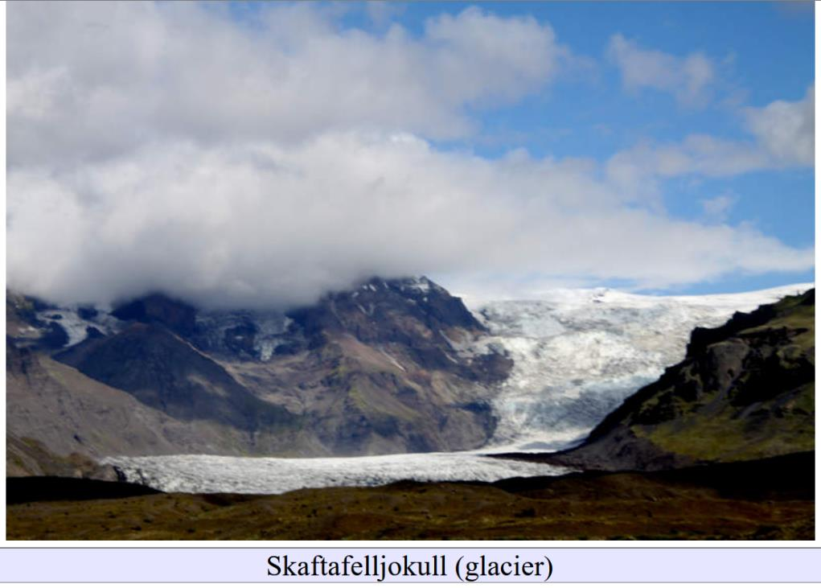
glacial hydrology
Lecture 4

Slide 2
heat from sunlight is the main reason a glacier melts
Solar “constant” $1370 Wm^{−2}$

Slide 3
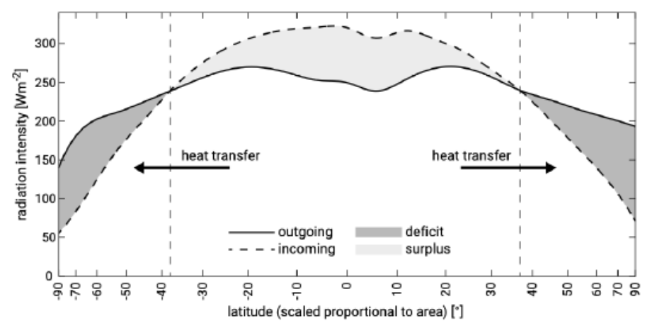
Incoming and outgoing solar radiation as a function of latitude

Slide 4
Incoming and outgoing solar radiation as a function of latitude
$$200 Wm^{−2}$$
$$45°$$

Slide 5
160 Wm⁻²
200 Wm⁻²
Albedo $0.8$
40 Wm⁻²
fraction of
light reflected
Snow

Slide 6
heat of fusion 334,000 J/kg
40 Wm⁻²
mass 917 kg/m³
Ice
heat to melt
334,000 x 917 = 314,500,000 J/m³
heat supplied 40 J/sm⁻²
time to melt =
314,500,000 /40=7,886,200 s/m
91 days to melt 1 meter of ice

Slide 7
What’s a typical amount of precipitation per year?

Slide 8
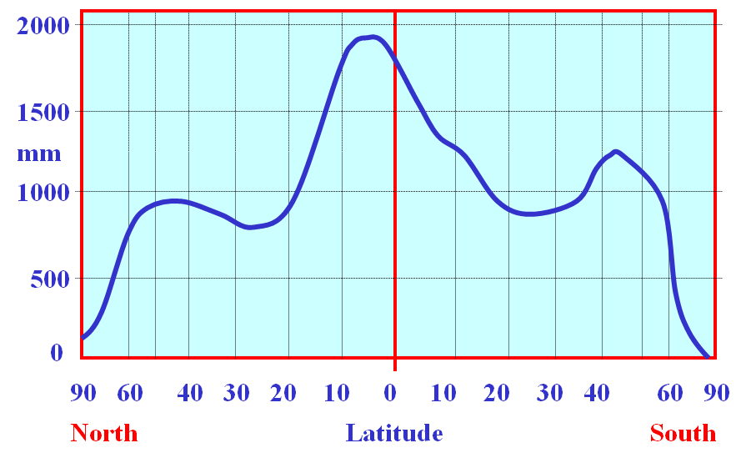

Slide 9
$$1 m$$
$$45°$$

Slide 10
heat of fusion 334,000 J/kg
40 Wm⁻²
mass 917 kg/m³
Ice
heat to melt 314,500,000 J/m³
heat supplied 40 J/sm⁻²
time to melt 7,886,200 s/m
91 days to melt 1 meter of ice
about the summer
about a year of ice

Slide 11
heat of fusion 334,000 J/kg
40 Wm⁻²
mass 917 kg/m³
Ice
heat to melt 314,500,000 J/m³
heat supplied 40 J/sm⁻²
time to melt 7,886,200 s/m
91 days to melt 1 meter of ice
about the summer
about a year of ice
if more than a year’s worth of ice melts in the summer, then the glacier melts away …

Slide 12
heat of fusion 334,000 J/kg
40 Wm⁻²
mass 917 kg/m³
Ice
heat to melt 314,500,000 J/m³
heat supplied 40 J/sm⁻²
time to melt 7,886,200 s/m
91 days to melt 1 meter of ice
may take longer, because some energy needed
to warm cold ice, some heat lost to cold air

Slide 13
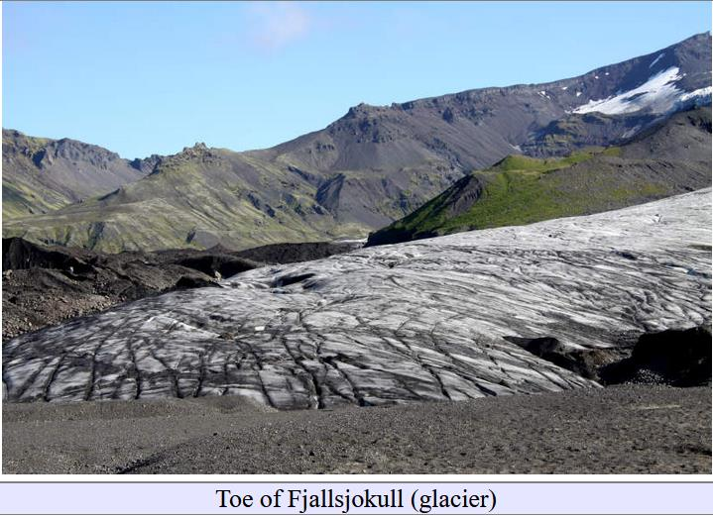

Slide 14
Why isn’t this glacier snowy white?

Slide 15
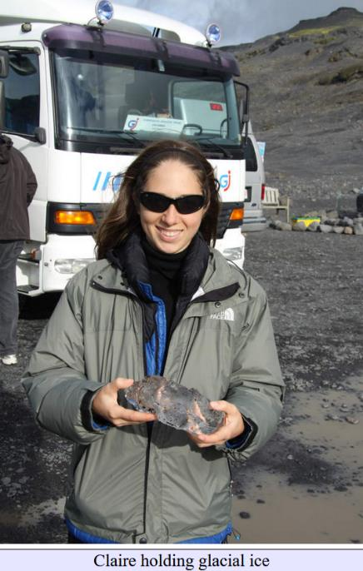
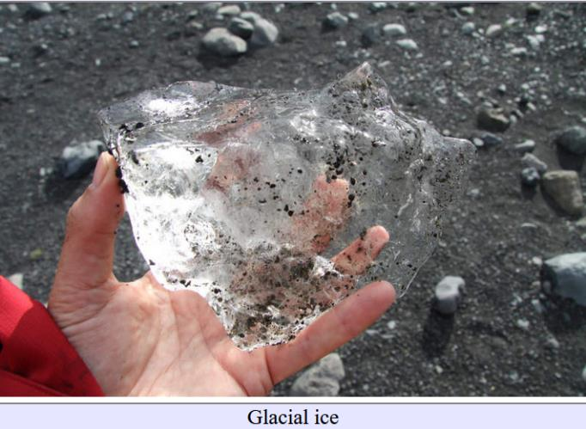

Slide 16
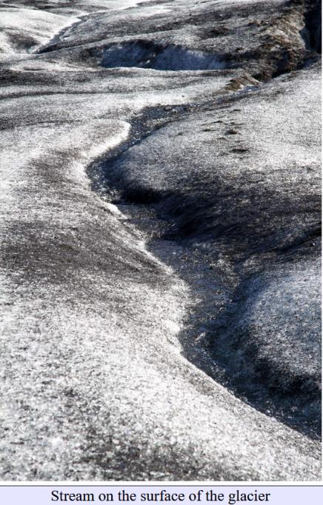
supraglacial stream
stream on top of the glacier

Slide 17
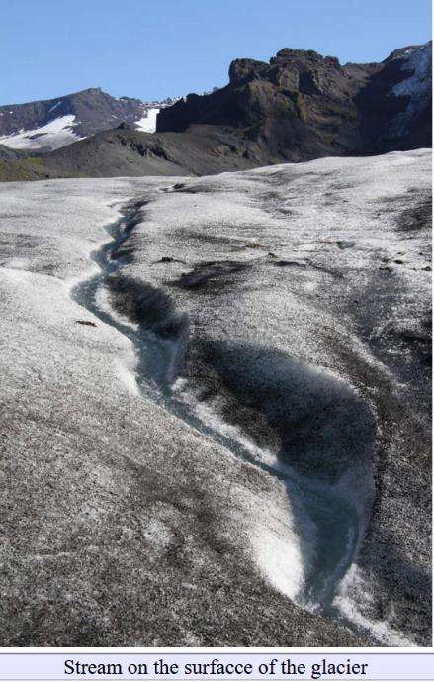
supraglacial stream

Slide 18
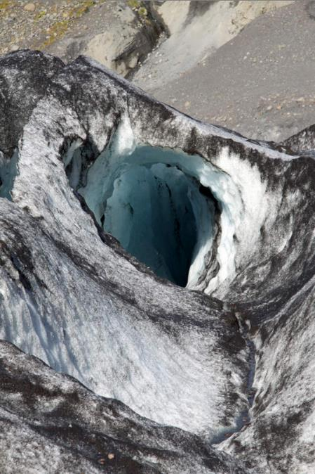
supraglacial stream
draining into
moulin
moulin (or glacier mill)
hole in ice into which
water drains
French word for “mill”

Slide 19
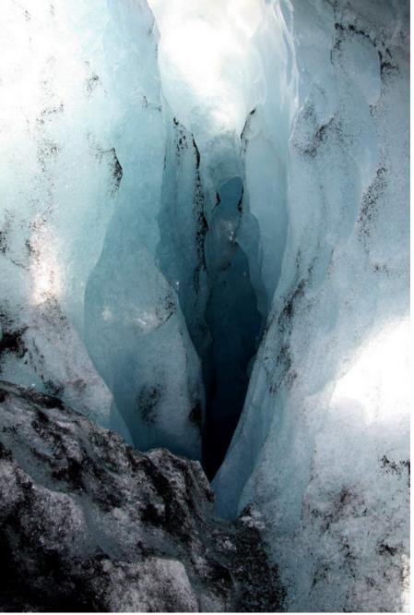
supraglacial stream
draining into
moulin

Slide 20
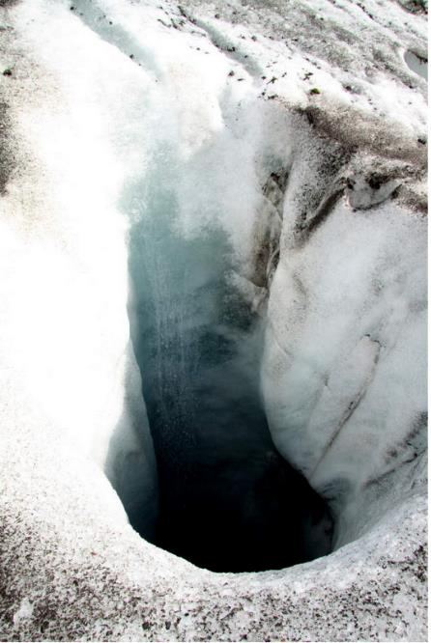
supraglacial stream
draining into
moulin

Slide 21
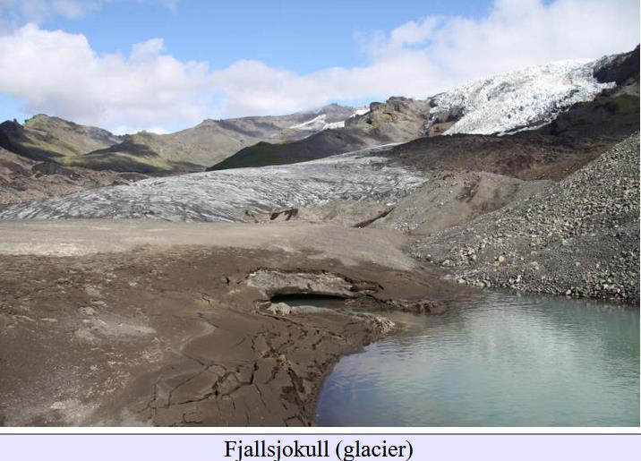

Slide 22
terminus of glacier
spring
moraine
lake

Slide 23
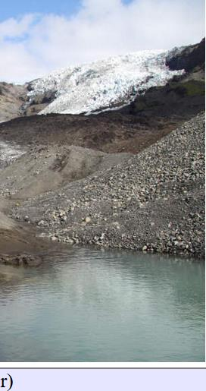
moraine
heap of gravel and rock
left when glacier melts
typically unsorted
types
lateral
medial
terminal
moraine
lake

Slide 24
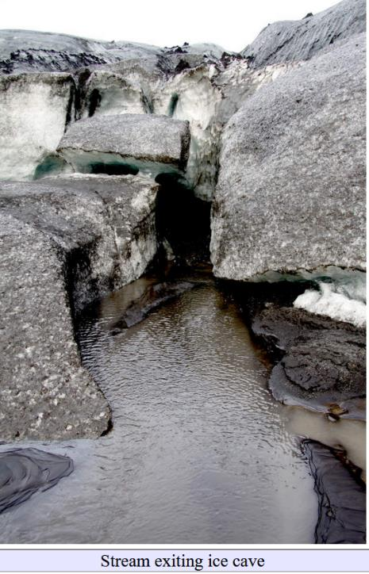

Slide 25
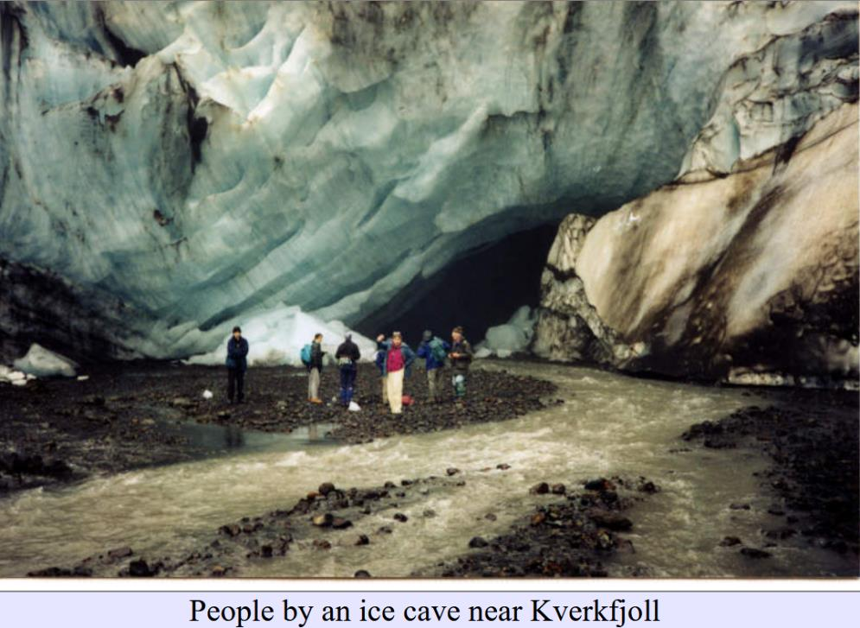

Slide 26
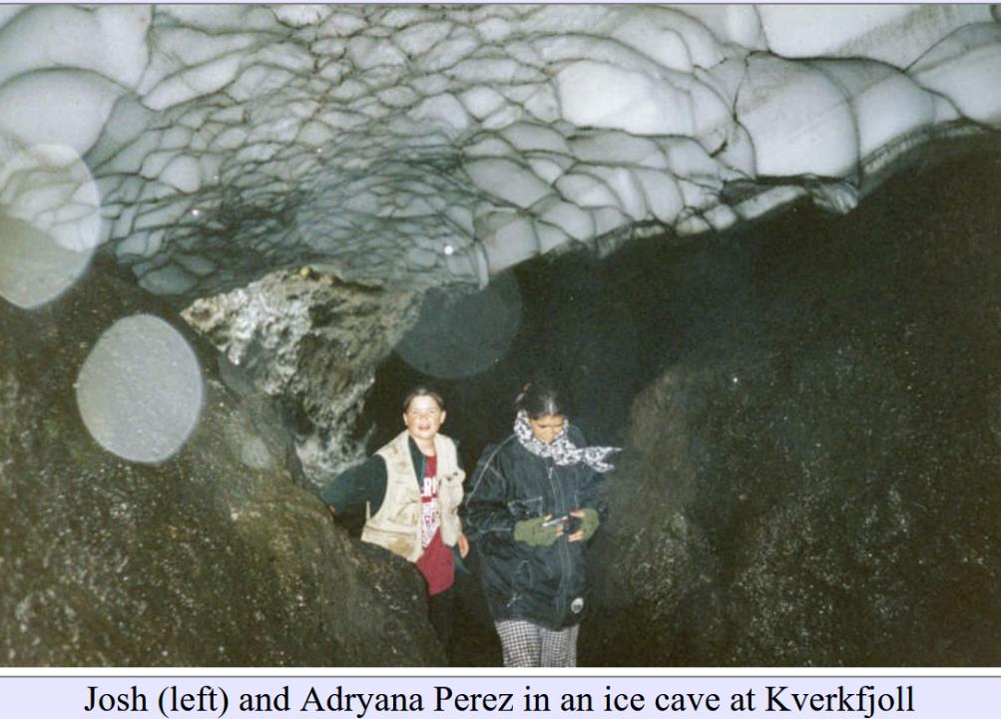

Slide 27
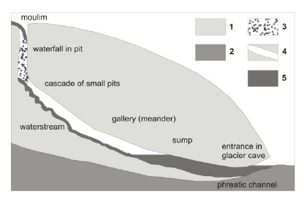

Slide 28
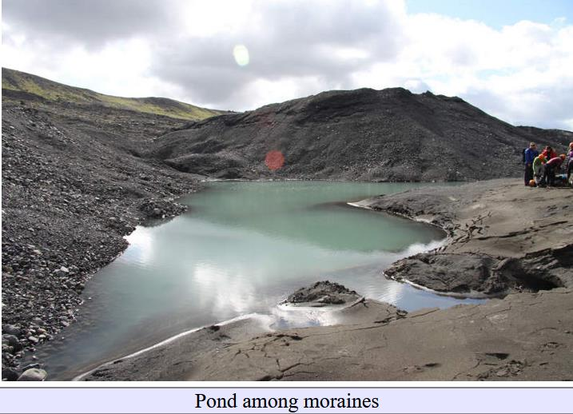

Slide 29
moraine
moraine
lake
sediment (outwash)

Slide 30
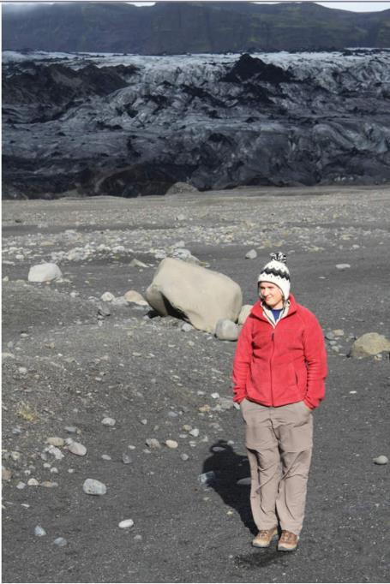

Slide 31
Glacial boulder
boulder transported by a glacier
Glacial erratic boulder
boulder of one rock type
transported by glacier
and left atop rock pavement
of a different rock type
terminus of glacier
glacial
boulder
Prof Menke*
* the other one

Slide 32
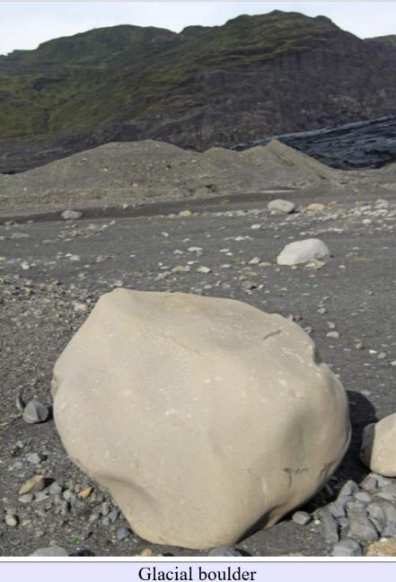
valley wall
moraine
boulder

Slide 33
Glacial boulder
sometimes have a
faceted shape

Slide 34
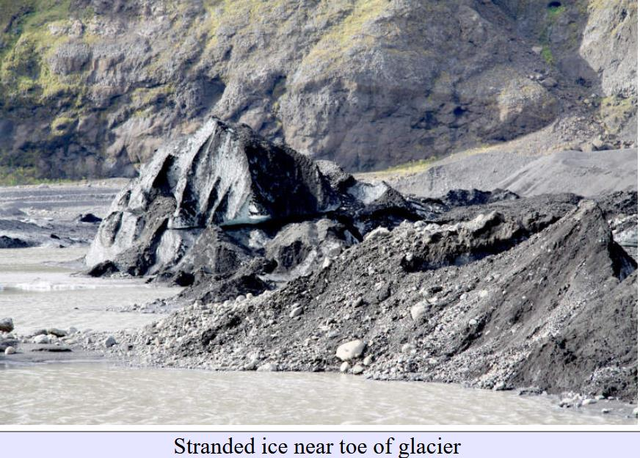

Slide 35
valley wall
ice
moraine
lake

Slide 36
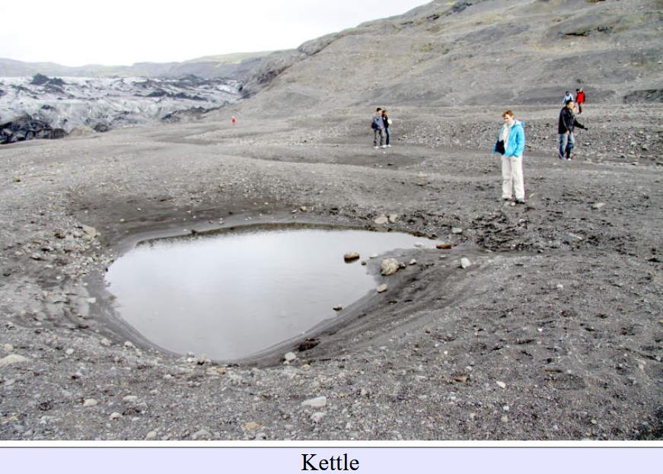

Slide 37
Kettle
pond formed when
stranded ice melts
and leaves a hole
terminus
pond
moraine

Slide 38
what made
these lines?

Slide 39
terraces
beaches
when
water
level in pond
was higher

Slide 40
what made
these lines?

Slide 41
they’re
terraces too
shoreline of a
now-defunct
lake

Slide 42
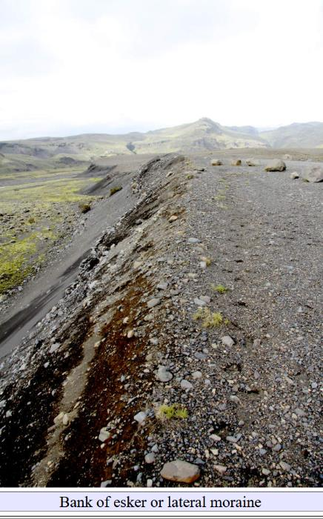

Slide 43
esker
sediment at bed of subglacial stream

Slide 44
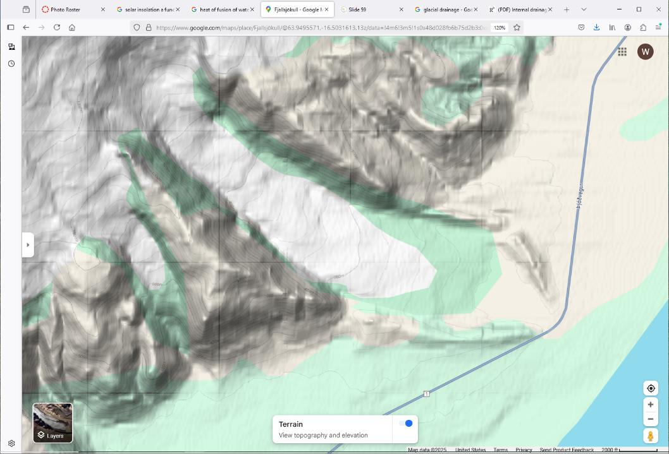
2000 ft

Slide 45
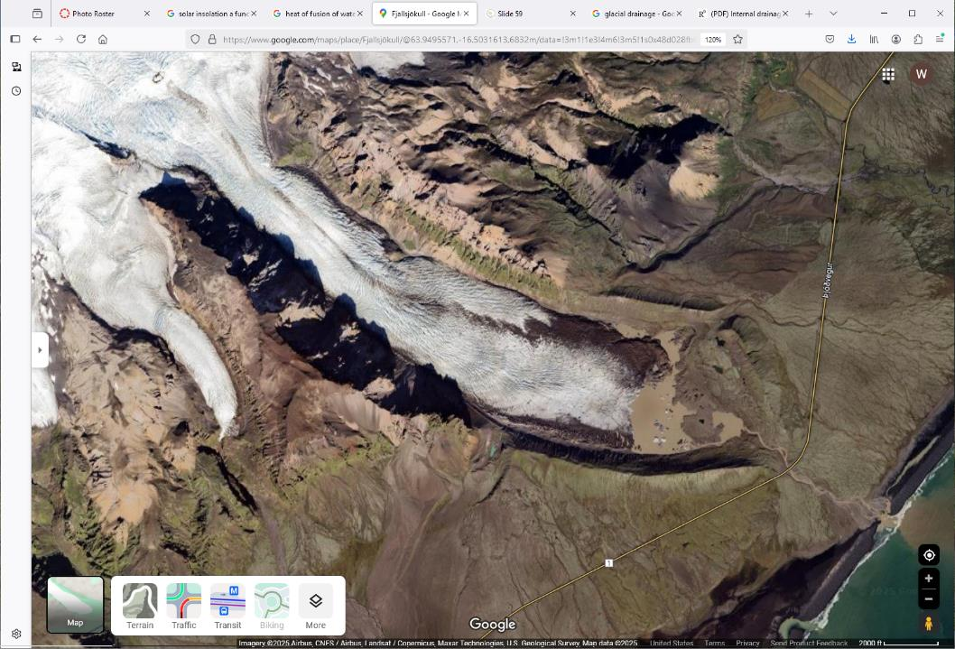
2000 ft

Slide 46
E
D
A
B
C
D
F
E
2000 ft

Slide 47
nunatak
valley wall
lateral moraine
medial moraine
valley wall
terminal
moraine
lateral moraine
2000 ft

Slide 48
nunatak
mountain peak protruding from glacier

Slide 49
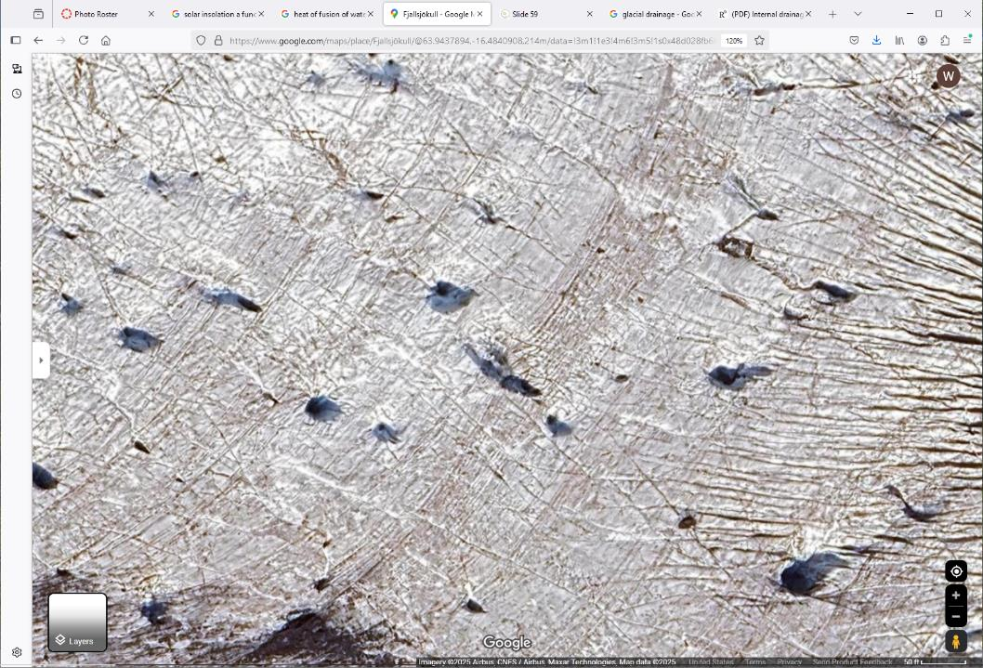

Slide 50
E
A
D
F
B
C
G
H
I

Slide 51
moulins
crevasses

Slide 52
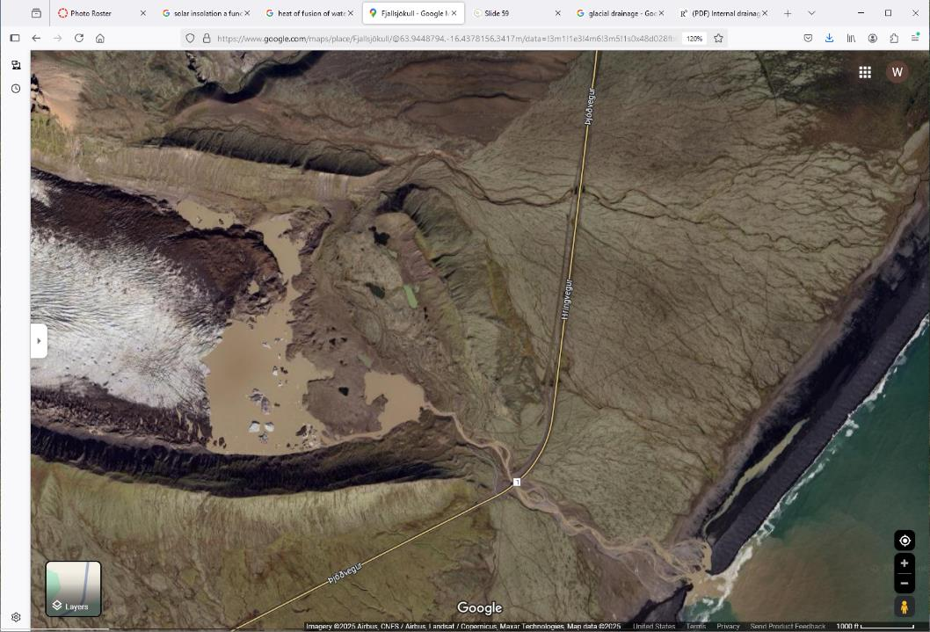
1000 ft

Slide 53
A
B
E
G
C
D
F
H
1000 ft

Slide 54
lateral moraine
terminal
moraine
glacier
outwash plain
moraine
lake
lateral moraine
braided stream
sea
1000 ft

Slide 55
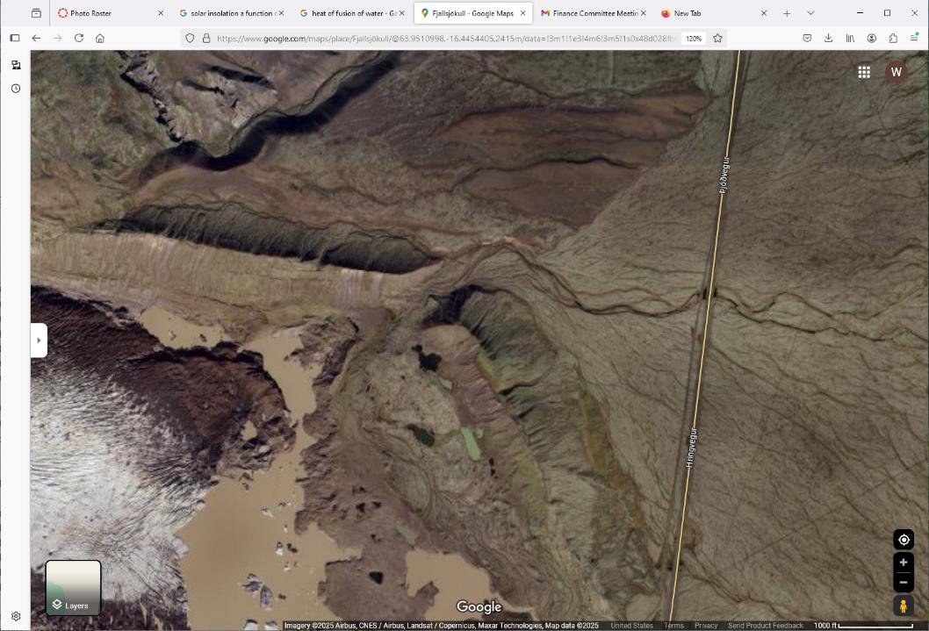
A
A
A
A

Slide 56
fossil stream bead

Slide 57
A

Slide 58
breach in moraine dam
when lake level was higher
fossil stream bead

Slide 59
A
B
2000 ft

Slide 60
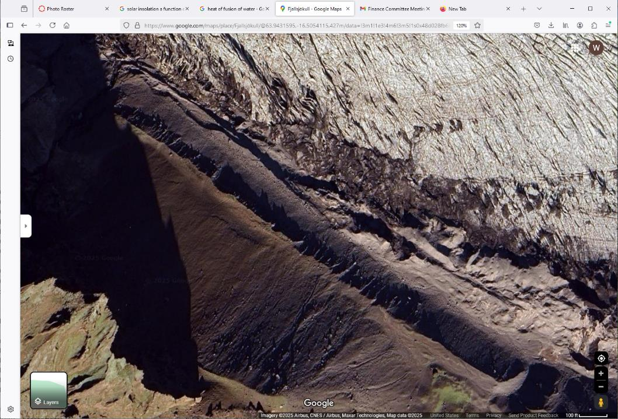

Slide 61
A
B
D
A
D
D
A
C

Slide 62
glacier
shadow of arete
lateral moraine
valley wall

Slide 63
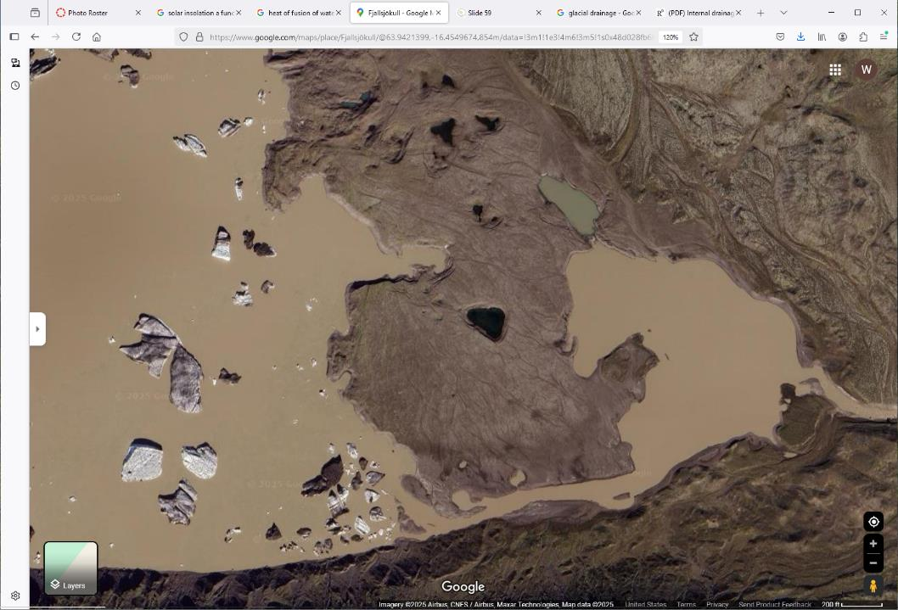
200 ft

Slide 64
F
A
E
B
D
G
B
B
200 ft
C

Slide 65
kettles
lake
kettle
outlet
stream
icebergs
outwash
moraine
200 ft

