Slide 1
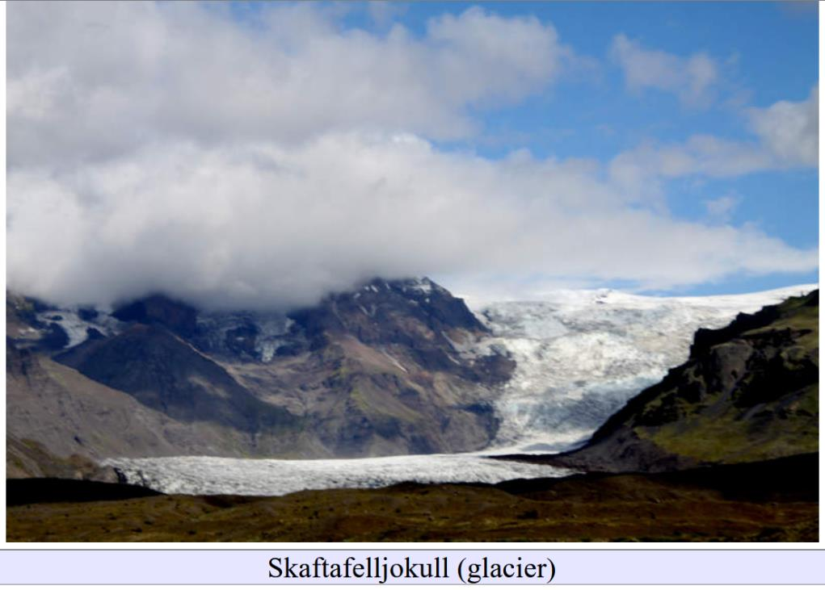
Moraines, Glacial Lakes and Floods of the Ice Age
Lecture 5

Slide 2
Some Glacial Landform I came across
on Social Media

Slide 3
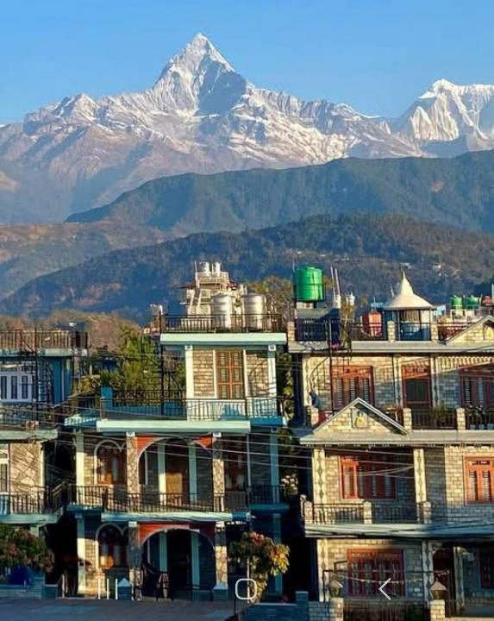
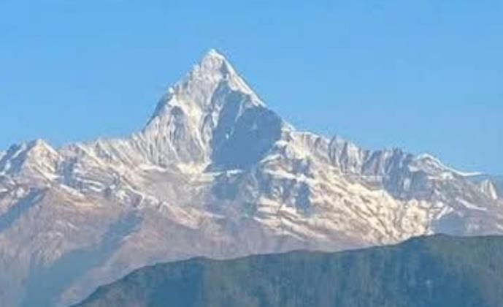

Slide 4
Horn

Slide 5
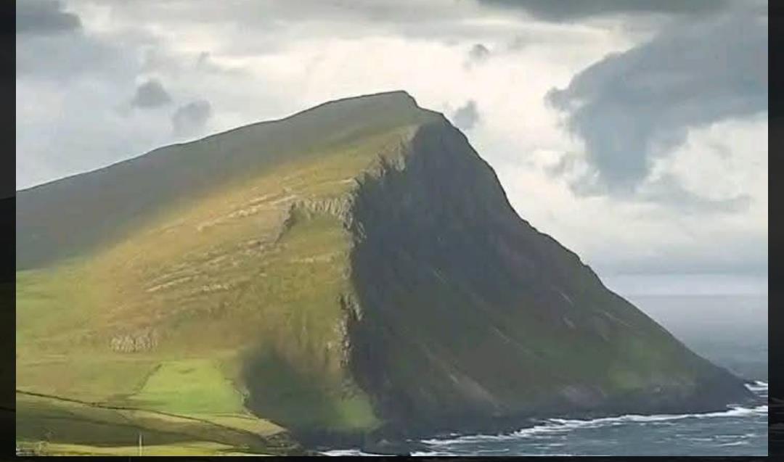

Slide 6
Glacially-smoothed surface with grooves

Slide 7
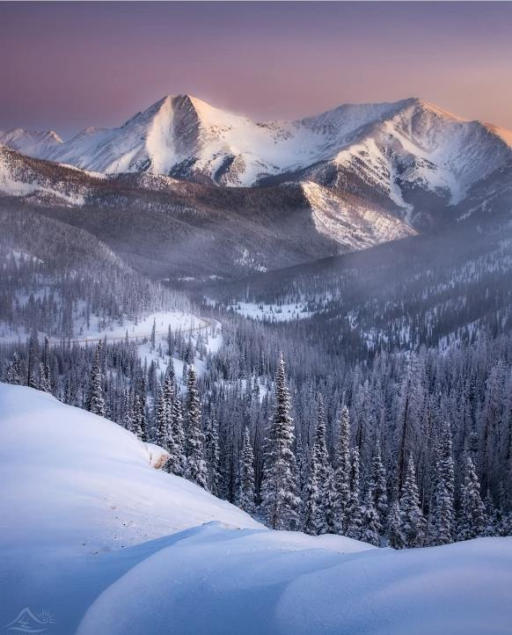
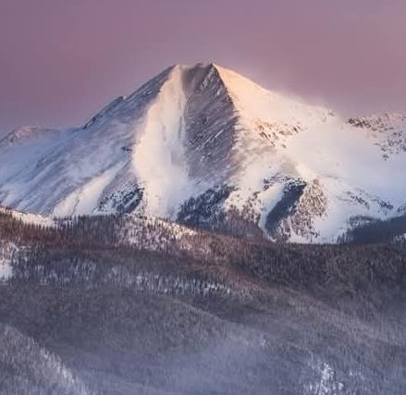

Slide 8
Cirque

Slide 9
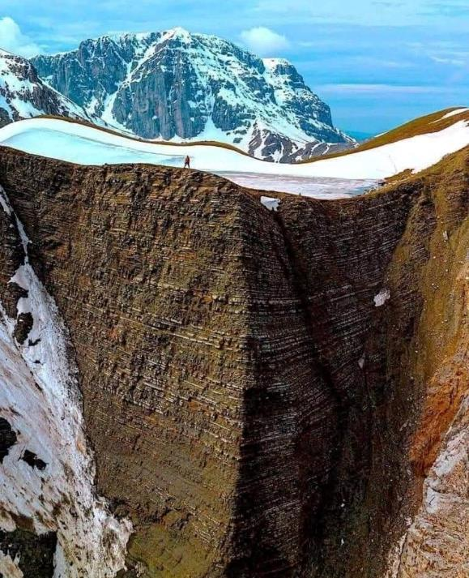
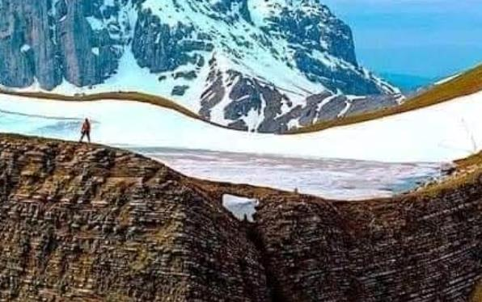

Slide 10
Cirque and Cirque Lake

Slide 11
Remnants of an Ice Age Subglacial River
in Harriman State Park, New York
(along the Menomine Trail Below Stockbridge Mountain Shelter)

Slide 12
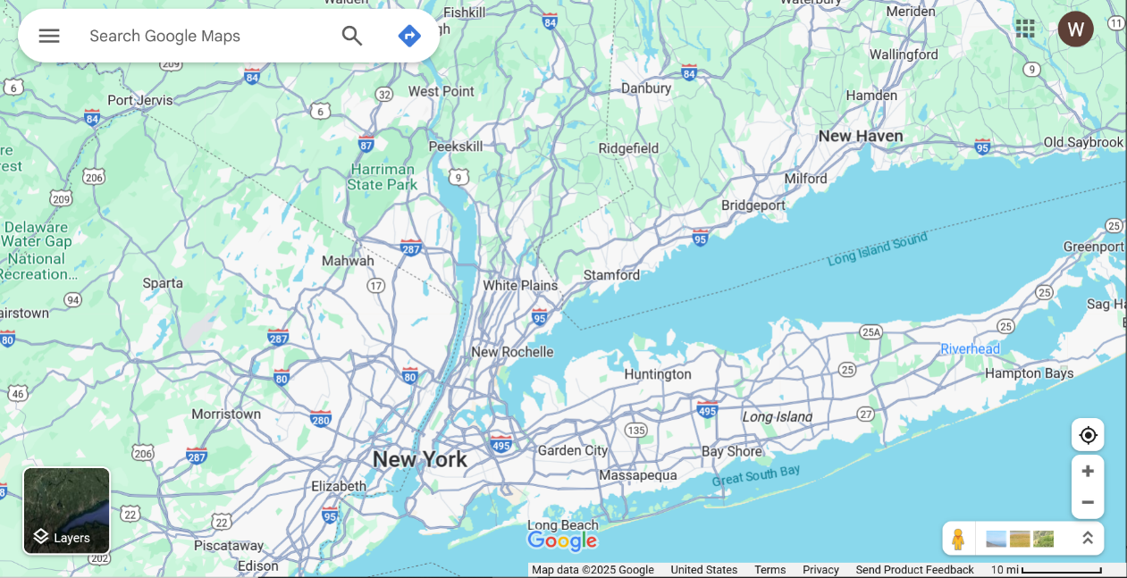
Harriman State Park
16 km

Slide 13
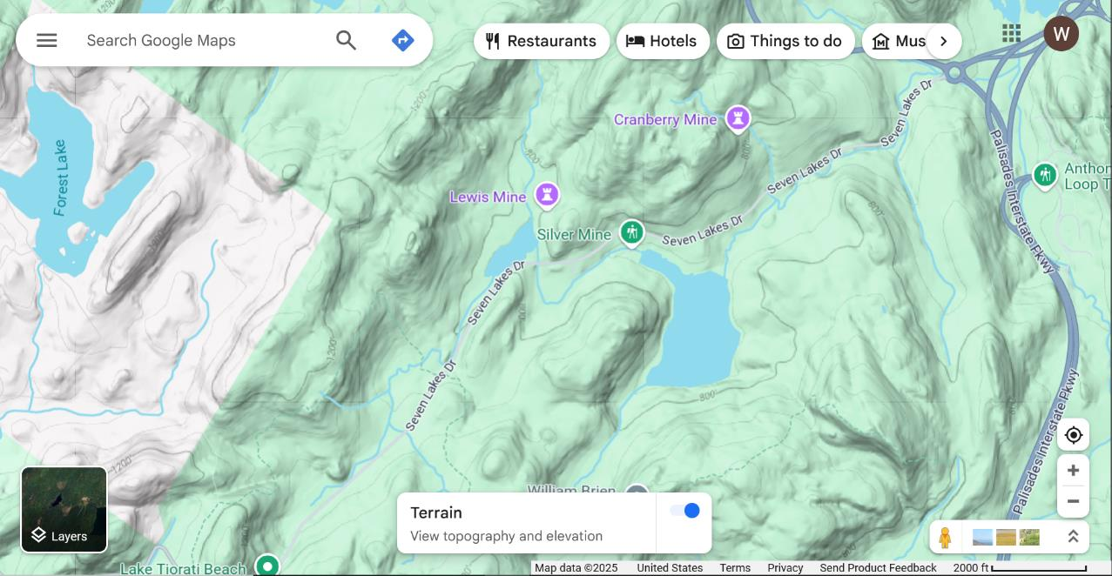

Slide 14
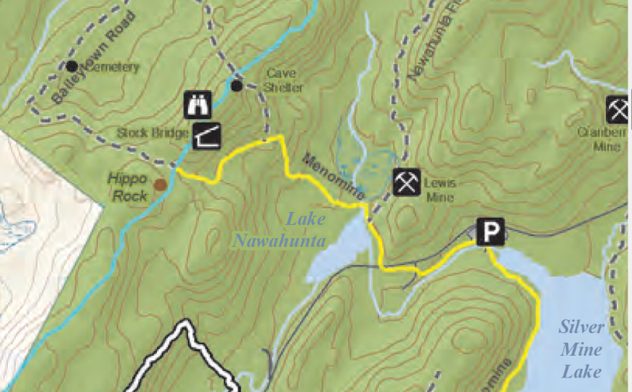
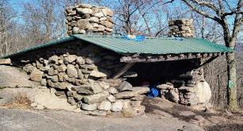
Long Path
Menomine Trail

Slide 15
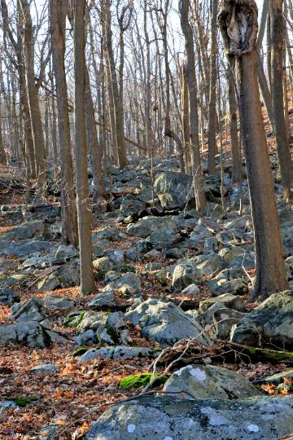
Boulders
North
Of
Trail

Slide 16
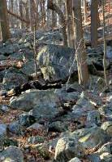
Some of the Boulders
Very Large

Slide 17
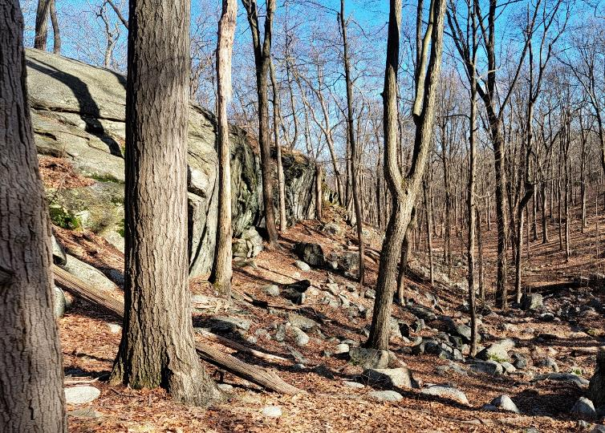
Cliff

Slide 18
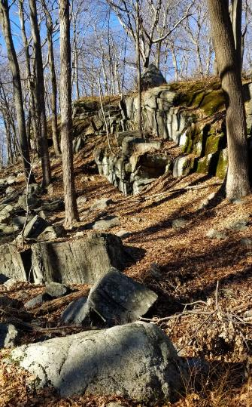
Some rocks below cliff
but probably not enough to account for the material that must have been removed to make the cliff

Slide 19
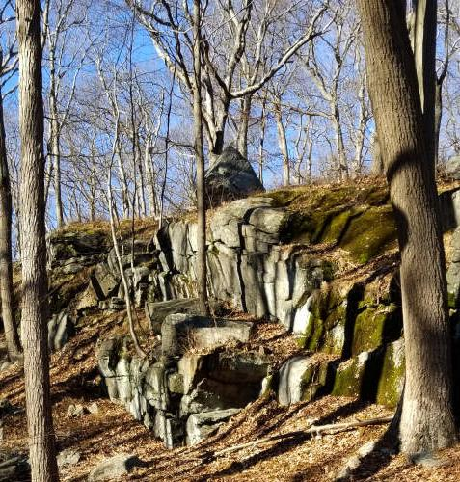
Boulder
Glacial Bounder perched on the top of the cliff

Slide 20
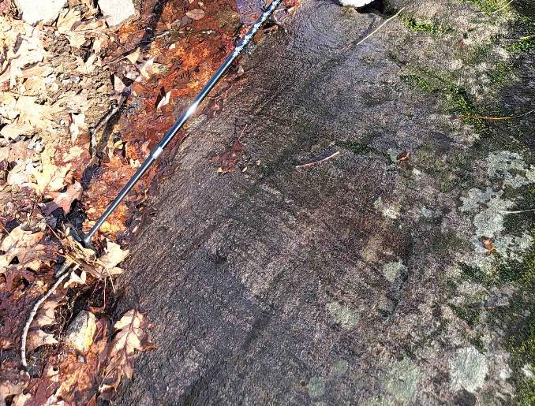
Striae Parallel to Cliff
Glacial Scratches along trail

Slide 21
Striae Parallel to Cliff
Striae
Glacial Scratches

Slide 22
Metamorphic banding
metamorphic banding of rock

Slide 23
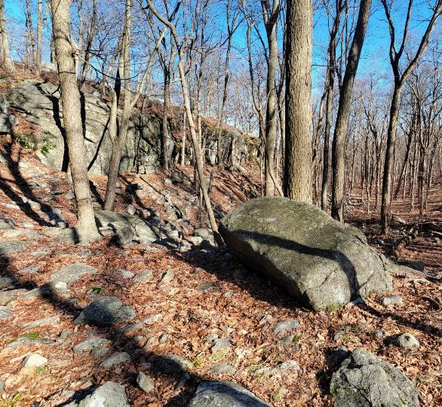
sudden drop off

Slide 24
site of waterfall?

Slide 25
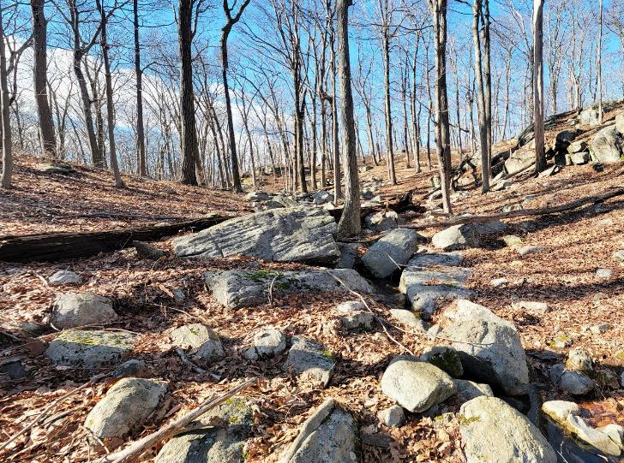
Stream
Above
Waterfall

Slide 26
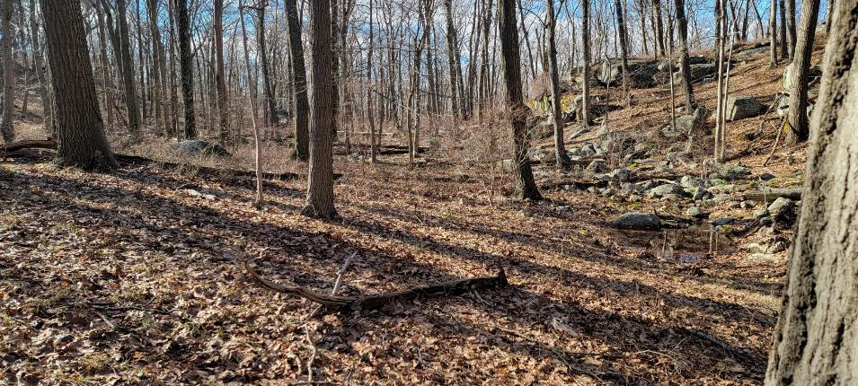
Tiny Watershed

Slide 27
ridge
Sill
perched boulder
cliff
Long Path
boulder field
scratches
Menomine Trail

Slide 28
Moulin
Subglacial
Waterfall
Subglacial River

Slide 29
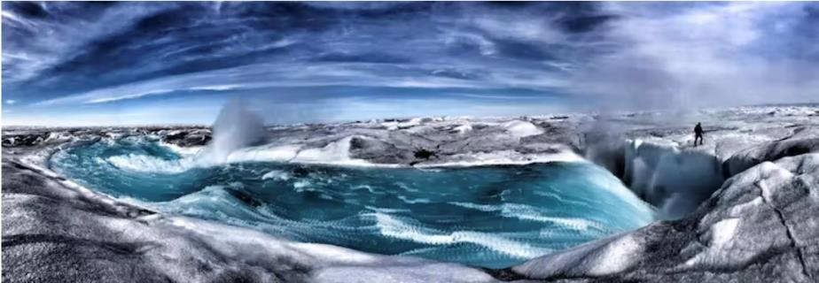
Moulin in Greenland

Slide 30
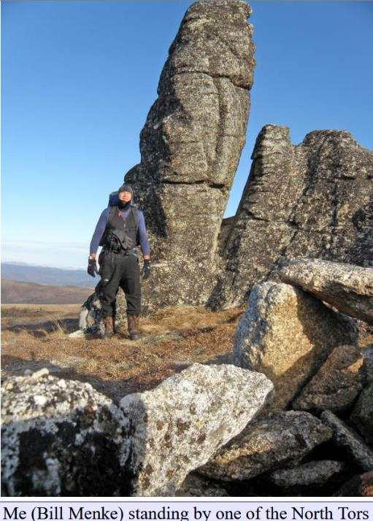
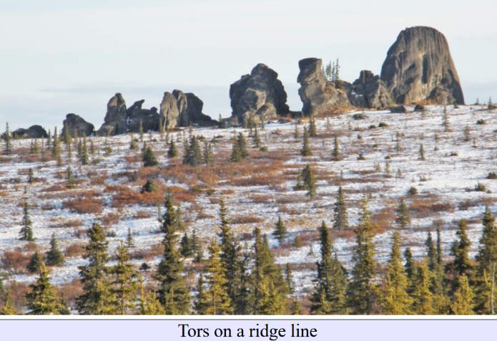
Granite Tors
near Fairbanks Alaska
Tor - Dutch for tower

Slide 31
Erosional, not glacial in origin
How come Ice Age glaciers did not sweep then away?

Slide 32
Younger than Ice Age
Erosional explanation wrong, actually glacial
Fairbanks not glaciated during Ice Age

Slide 33
What’s it take to make glaciers
Cold weather
and
____?______

Slide 34
What’s it take to make glaciers
Cold weather
and
precipitation

Slide 35
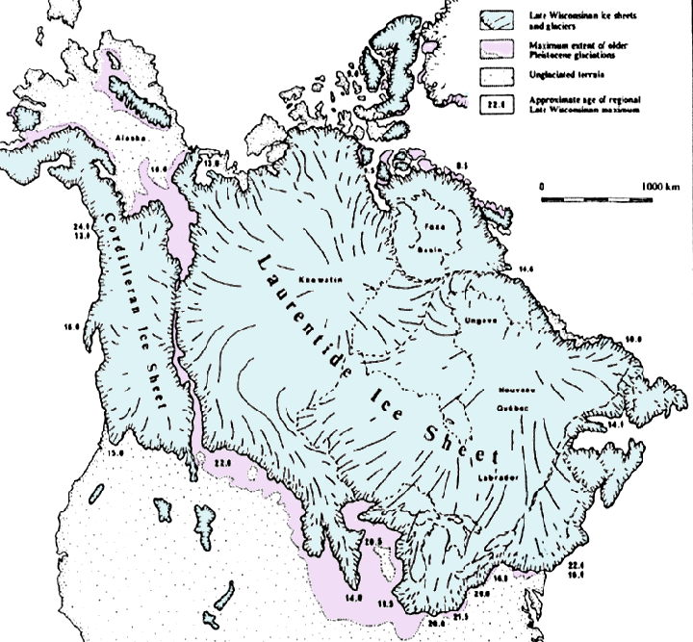

Slide 36
Fairbanks
Hudson Valley

Slide 37
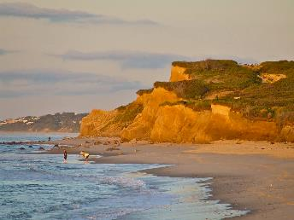

Slide 38
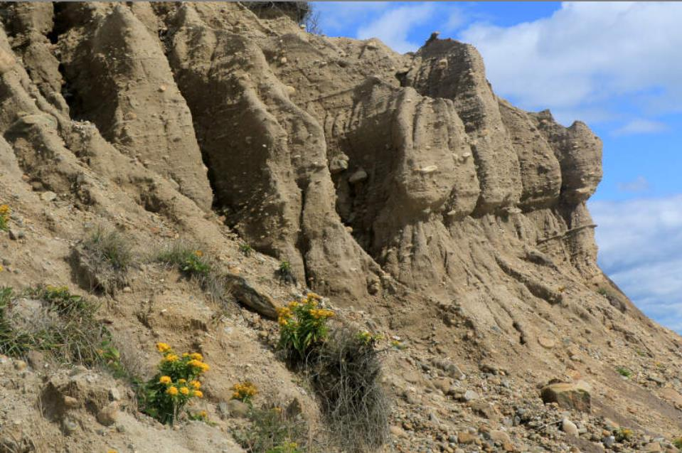
Cliffs at
Mountauk Point
New York

Slide 39
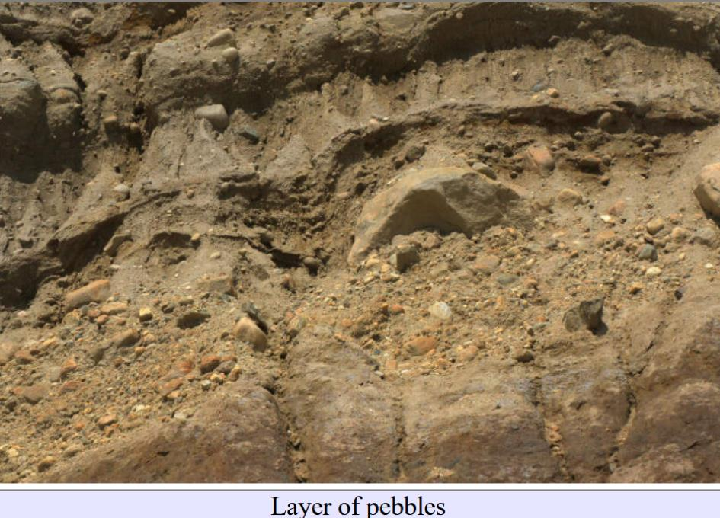
cliffs
composed
of
unconsolidated
sediment

Slide 40
Stratified,
so this is
“outwash”
and not
“till”

Slide 41
some layers
poorly sorted
and with big boulders

Slide 42
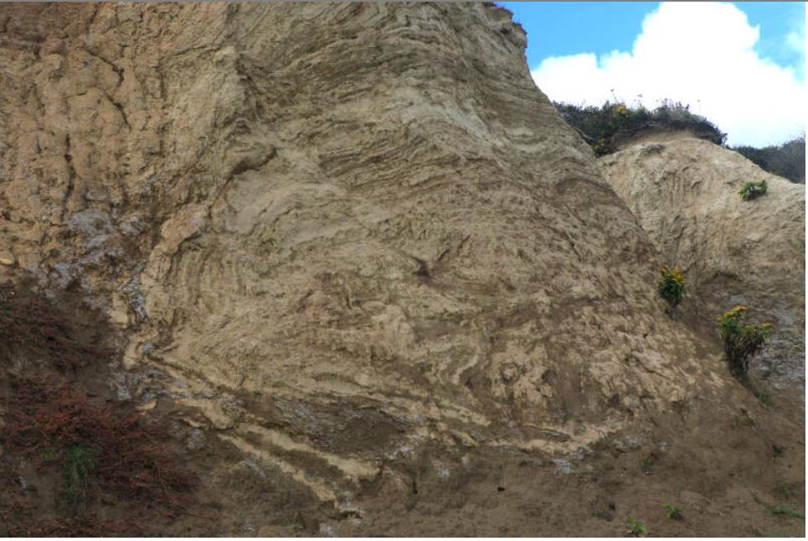

Slide 43
overturned
fold
bulldozing
by glacier

Slide 44
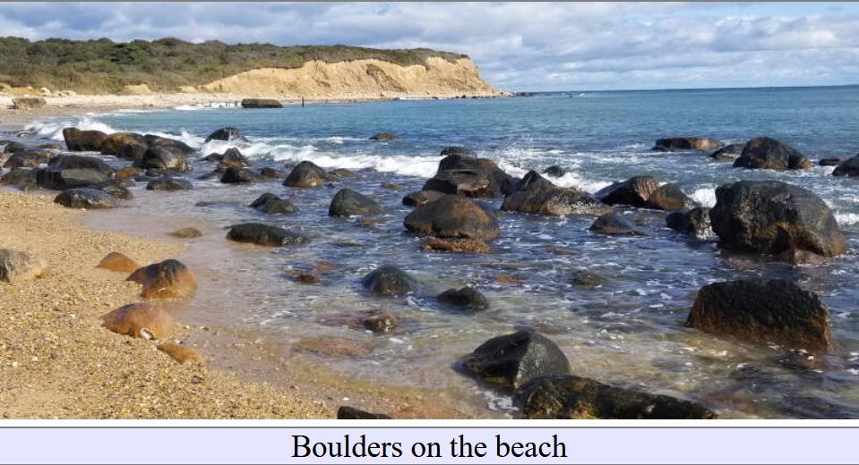
Many Glacial Boulders that have washed out of the cliff

Slide 45
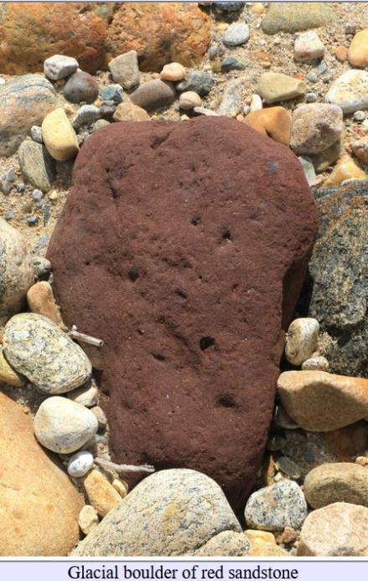

Slide 46
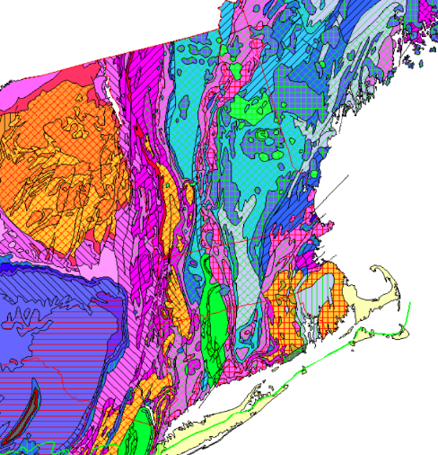
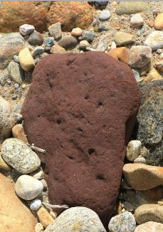
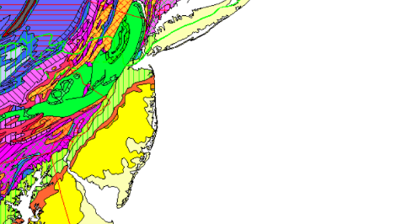
Red Sandstone
Montauk Pt

Slide 47
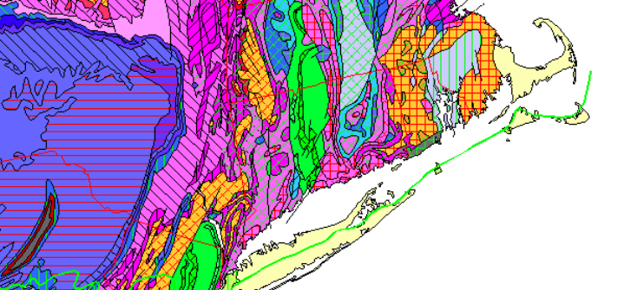
Montauk Pt
About 50 km

Slide 48
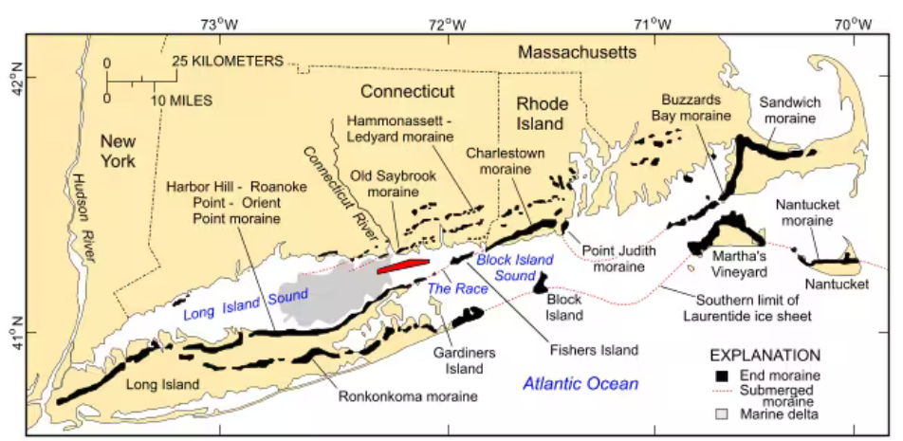

Slide 50
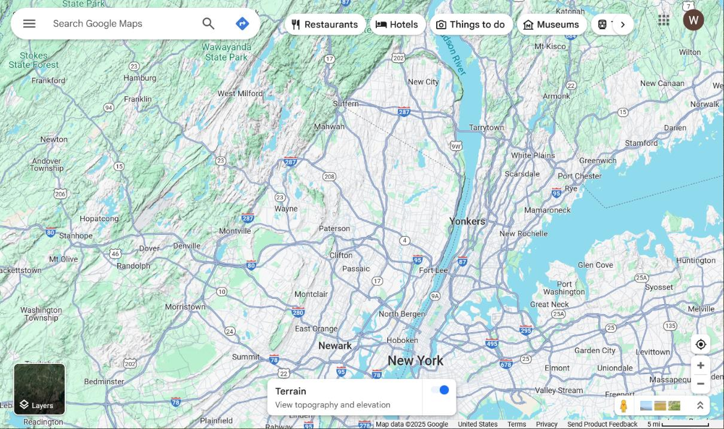
CU

Slide 52
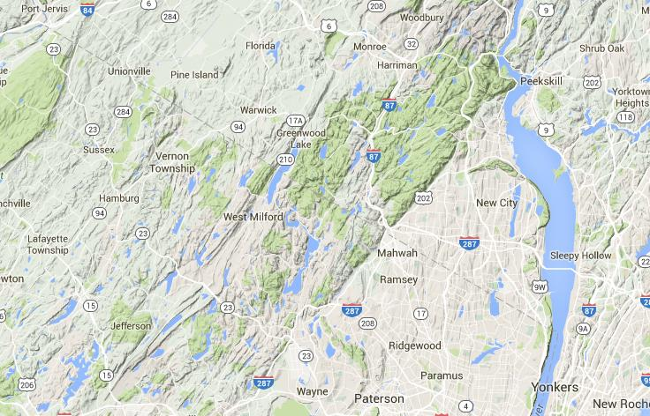
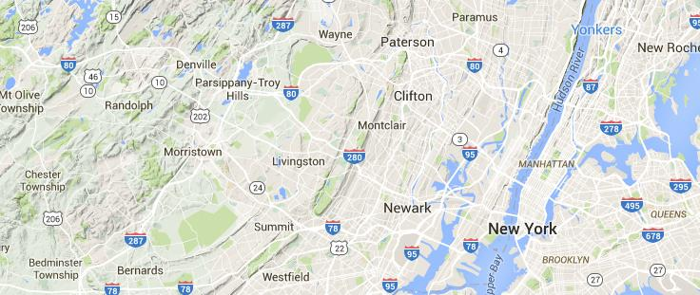
Hackensack River

Slide 53
High Tor
Lake Deforest

Slide 54
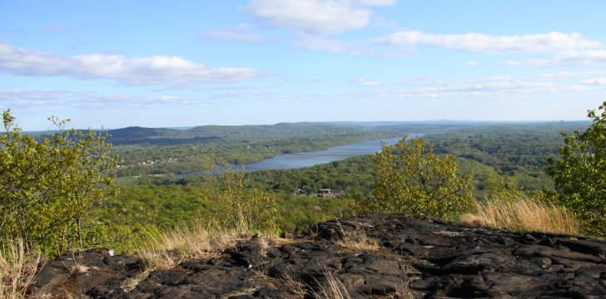
Lake Deforest

Slide 58
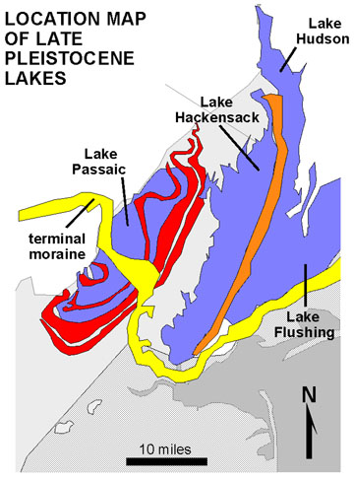

Slide 59
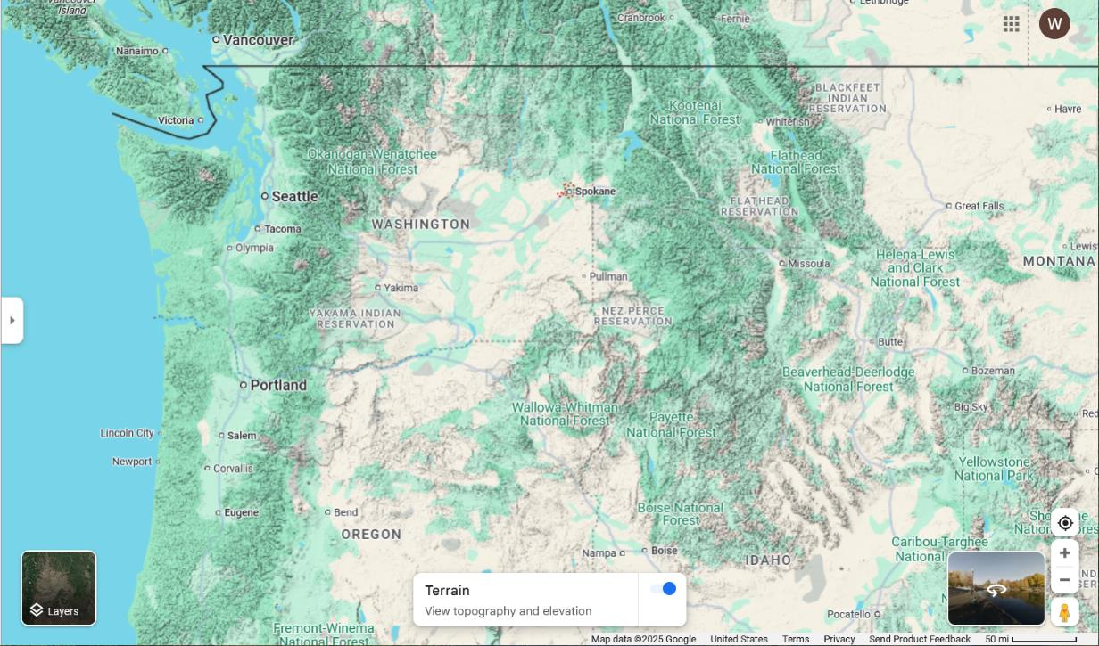
Spokane

Slide 60
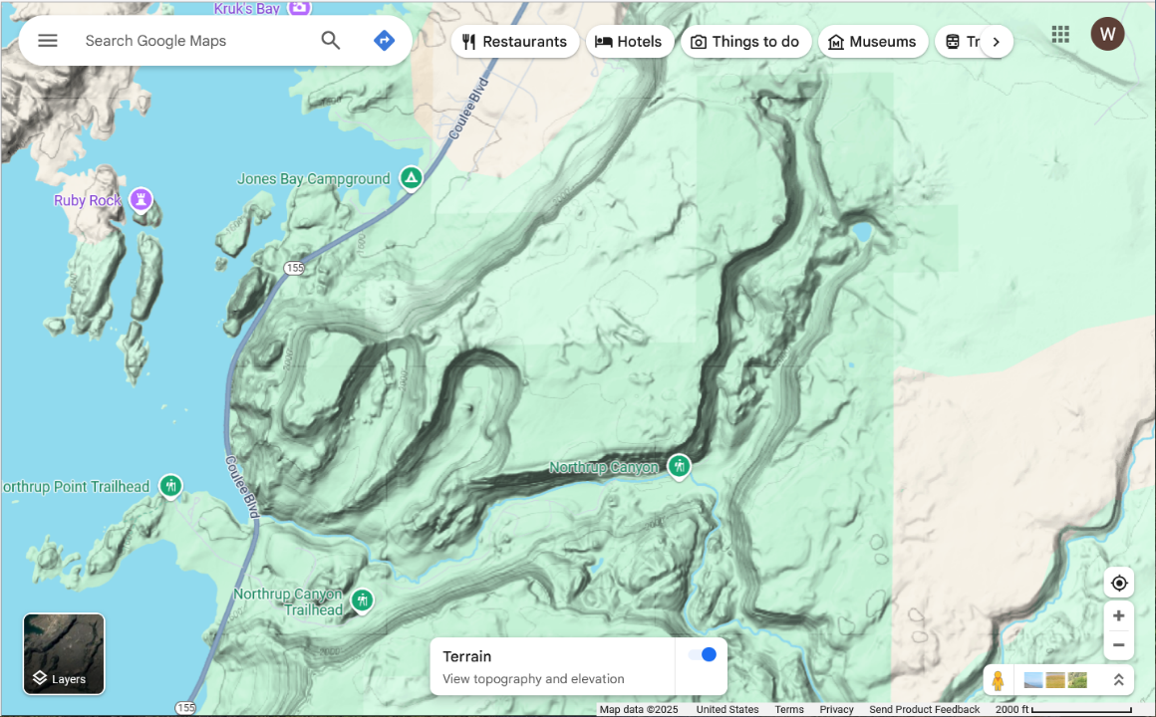
0.6 km

Slide 61
Northrup Lake
Northrup Canyon
0.6 km

Slide 62
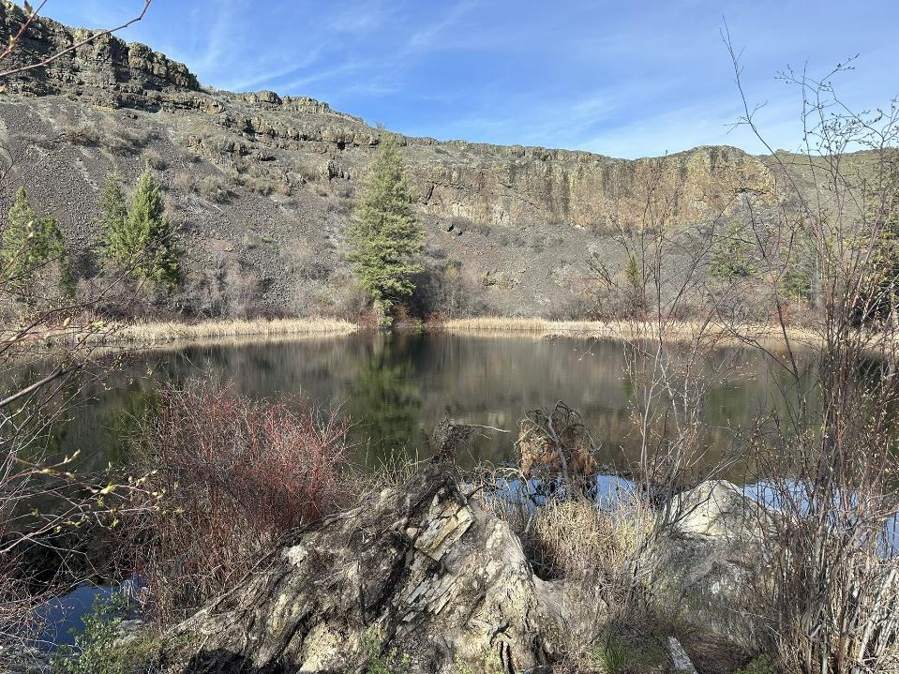

Slide 63
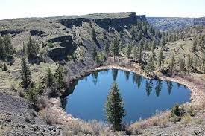

Slide 64
Although some features superficially look glacial
floor of valleys rougher
and more V-shaped than a typical glacial valley
cirque-like
rough
V-shaped
rough
0.6 km

Slide 65
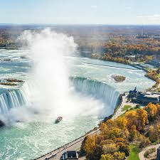
another way
to make a
cirque-like
valley
Niagara Falls,
New York

Slide 66
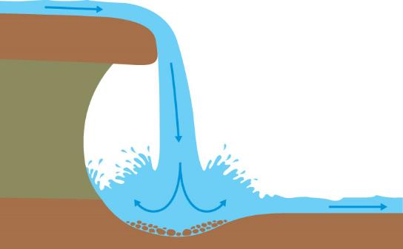
Northrup Lake
Plunge Pool

Slide 67
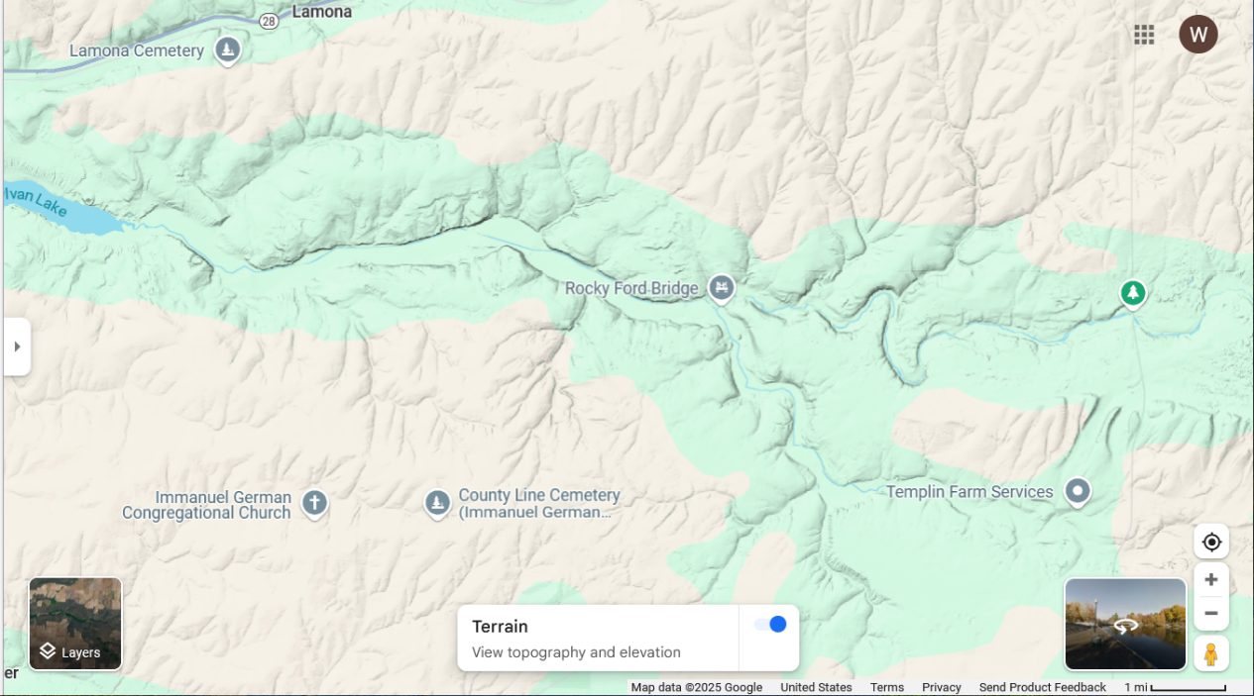
1.6 km

Slide 68
1.6 km

Slide 69
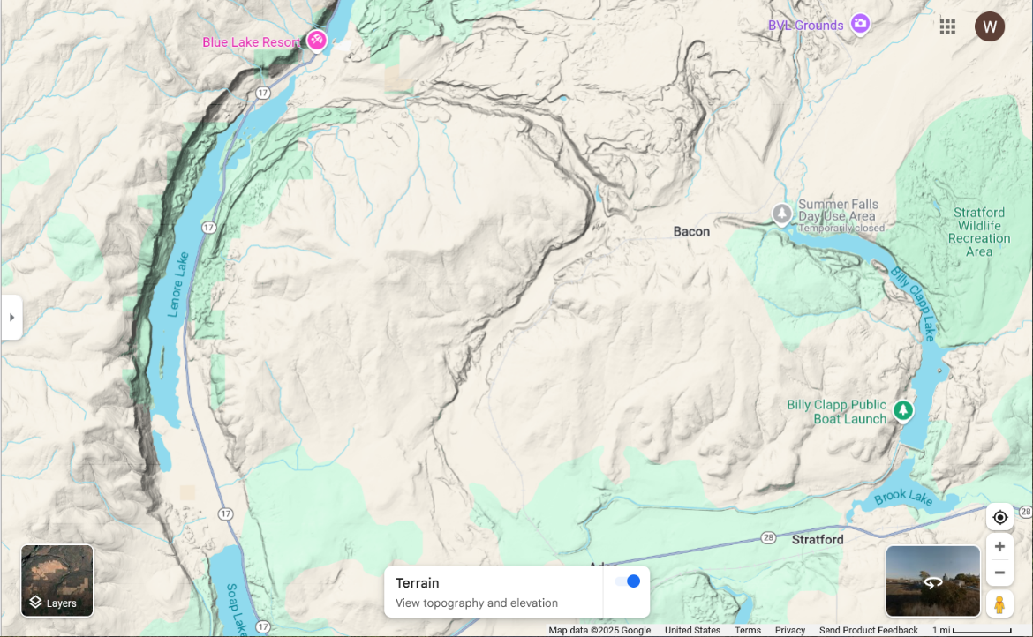
1.6 km

Slide 70
1.6 km

Slide 71
more
waterfalls?

Slide 72
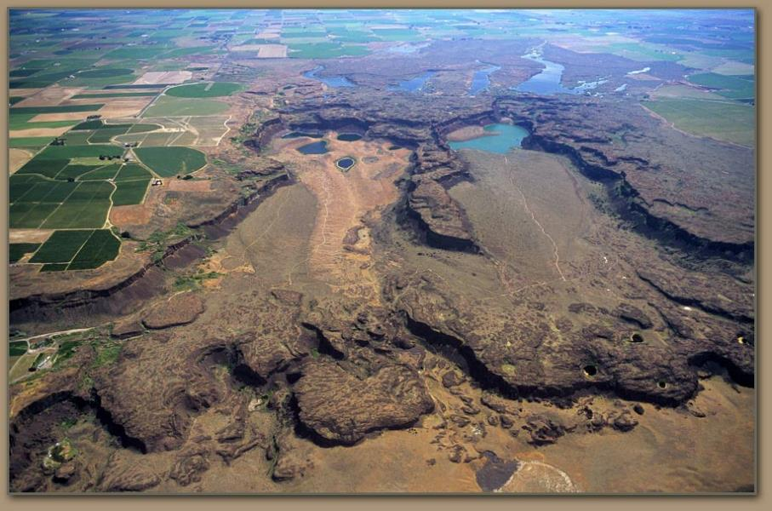
superficially cirque-like but much rougher than typical cirque

Slide 73
Cordilleran
Ice Sheet

Slide 74
Ice Dam
Glacial
Lake

Slide 75
Ice Dam
Lake
Spokane
Missoula

Slide 76
Clark Ford Idaho, site of Ice Dam

Slide 77
Glaciers
Lake
Flood
West
Bar

Slide 78
West
Bar
Columbia River
Wallula Gap
to the
Sea
to the Sea
Wallula
Gap
16 km

Slide 79
Wallula Gap
Wallula Gap
to the
Sea
to the Sea
16 km

Slide 80
Wallula Gap
Gap
to the
Sea
to the Sea
16 km
3.2 km

Slide 81
Wallula Gap

Slide 82
West Bar
3.2 km

Slide 83
Giant
Ripple
Marks
West Bar

Slide 85
Ice Dam
Glacial
Lake

