Slide 1
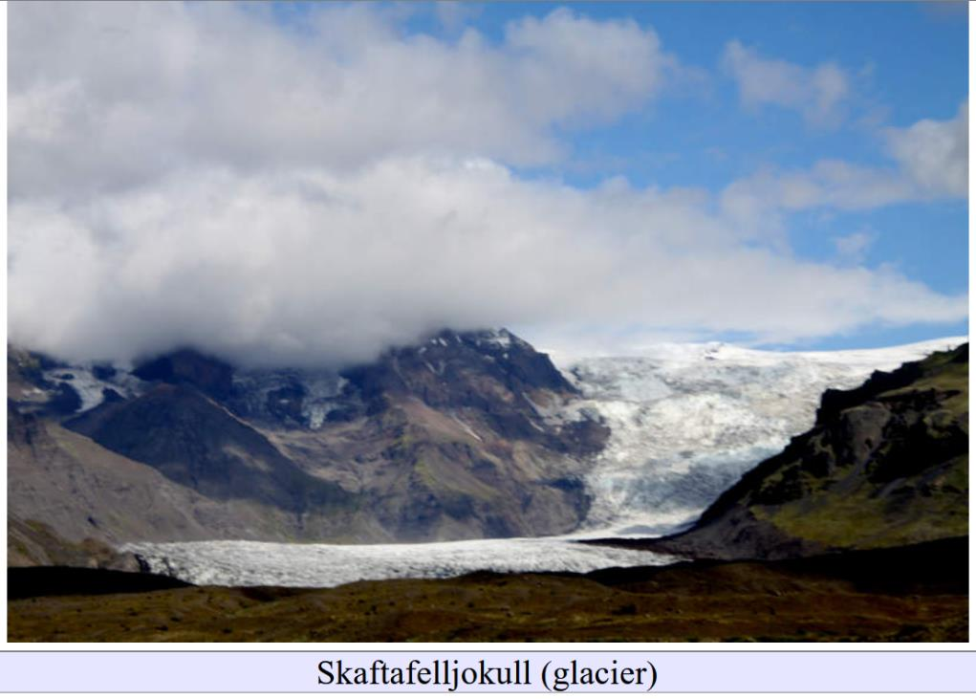
Erosional Glacial Features
Lecture 6

Slide 2
Part 0
Glacial Feature in Pics from Social Media

Slide 3
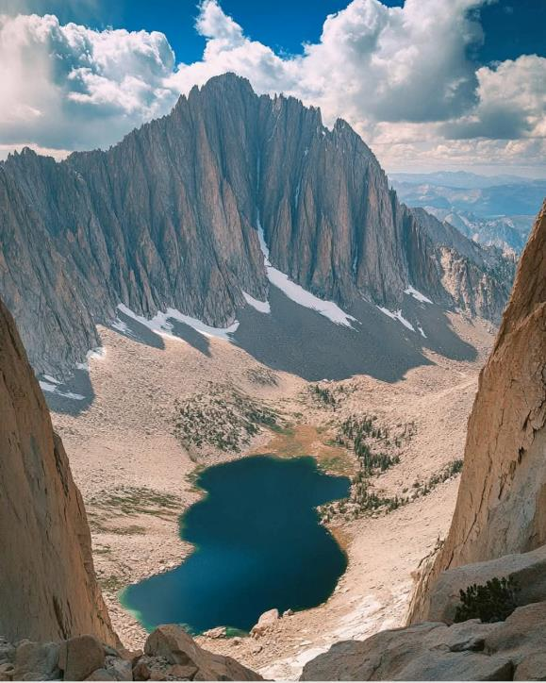
Glacial Valley
Arête
Moraine
Moraine Lake

Slide 4
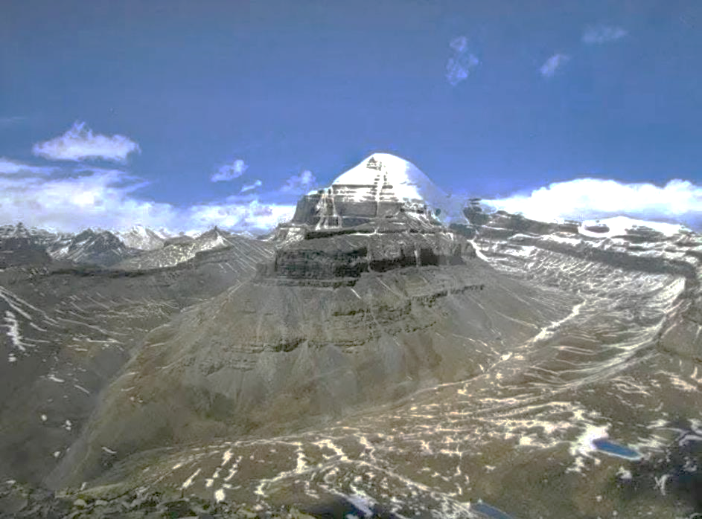
Two Glacial
Valleys
Arête
Horn

Slide 5
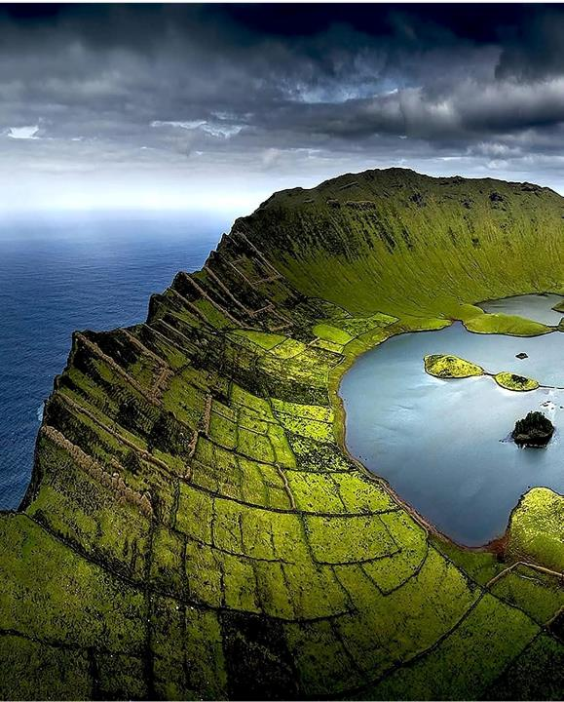
Watch It!
Crater
Crater Rim
Crater Lake

Slide 6
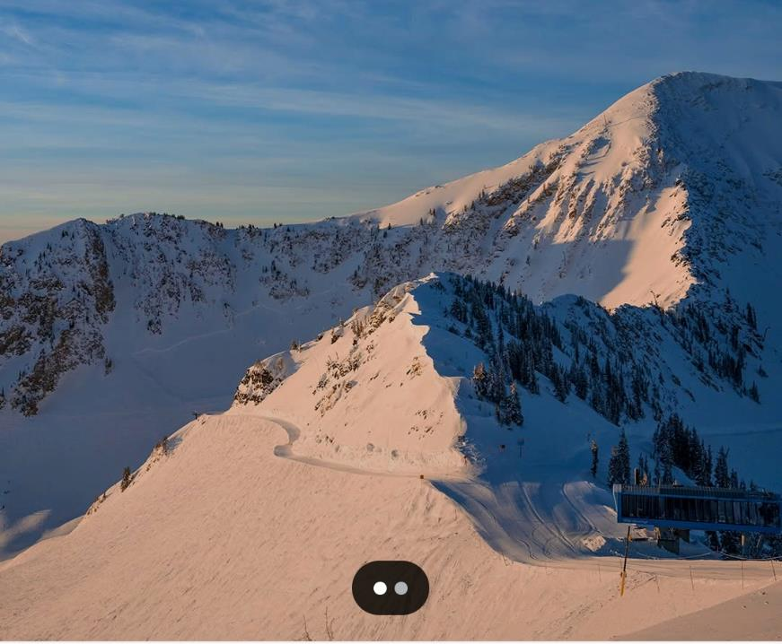
Cirque
Arête

Slide 7
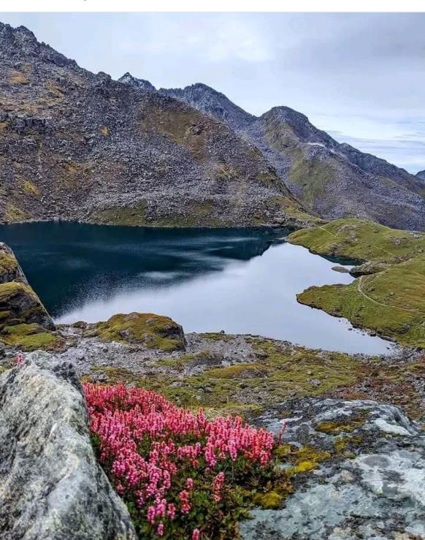
Cirque
Moraine
Moraine Lake

Slide 8
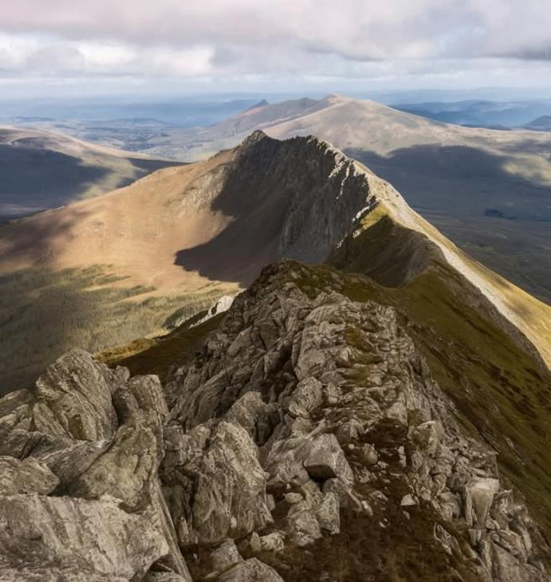
Cirque
Arête

Slide 9
Part 1
Mapping what’s beneath modern glaciers
“The Present is the Key to the Past”

Slide 10
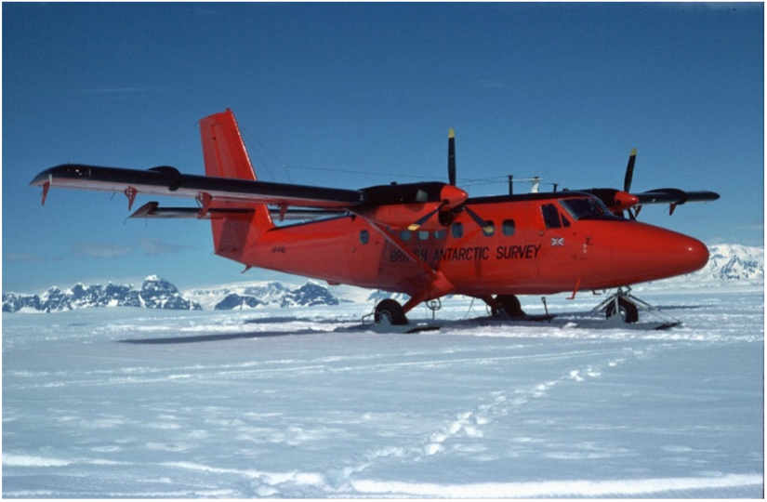

Slide 11
Radio Waves
Ice
Radio Waves
Bedrock

Slide 12
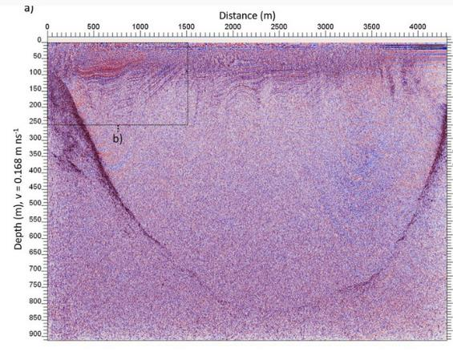
0
Ice
depth (m)
U-shaped Valley
Bedrock
900

Slide 13
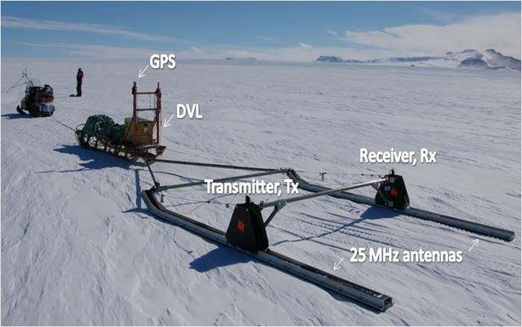

Slide 14
wavelength $\text{λ}$ of radio waves
$$c= \text{λ}\text{f}$$
$$\text{λ}= \frac{c}{f}=\frac{3×{10}^{8} ms^{−1}}{25×{10}^{6} s^{−1}}=1.2×{10}^{−3}m$$
about a millimeter

Slide 15
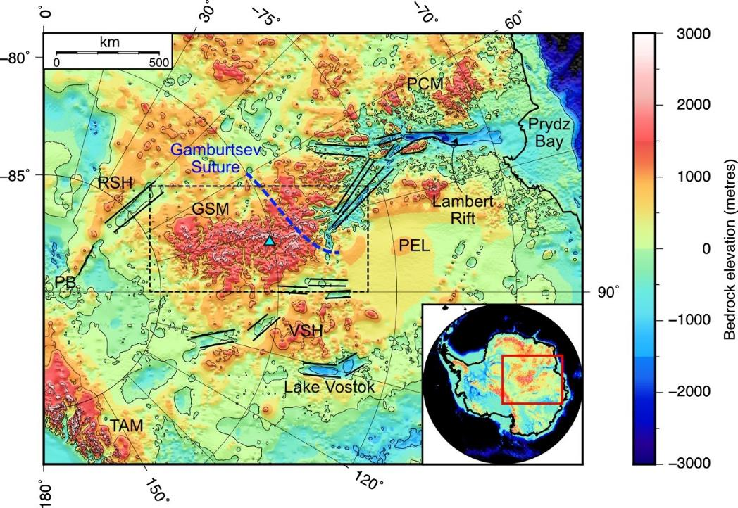

Slide 16
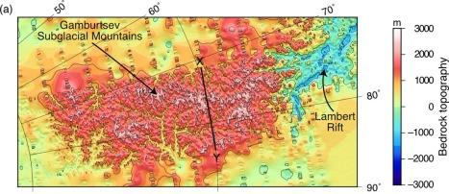

Slide 17
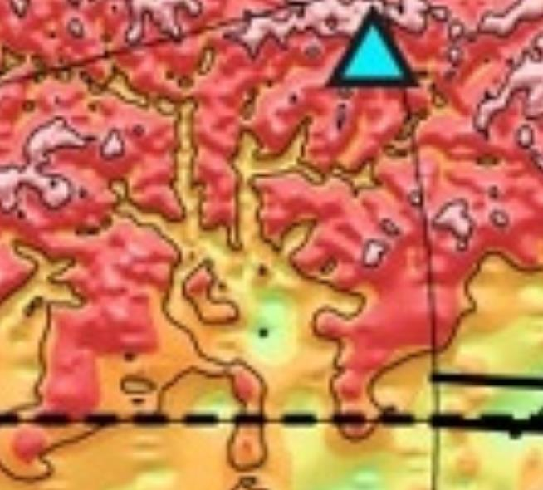

Slide 18
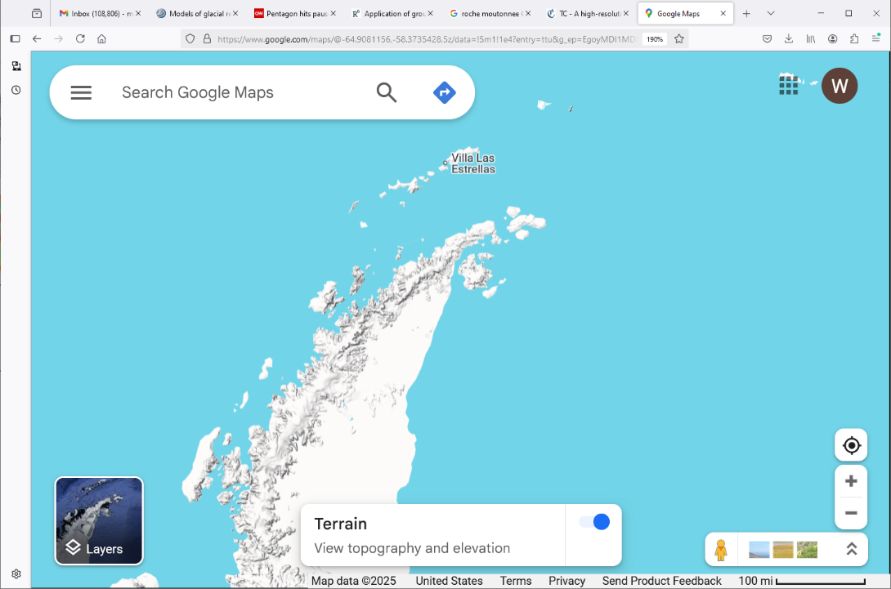

Slide 19
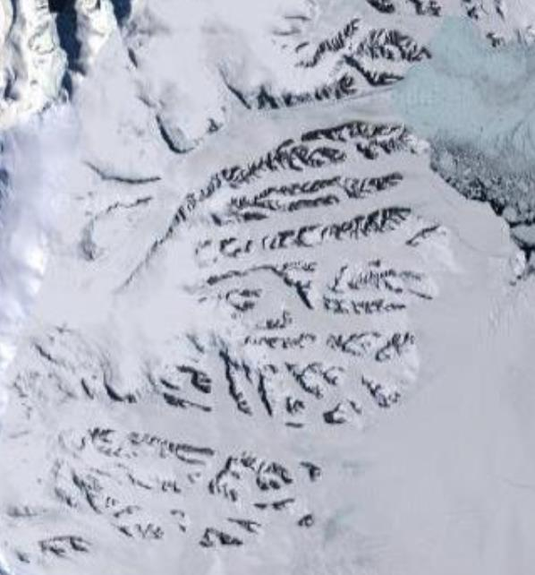

Slide 20
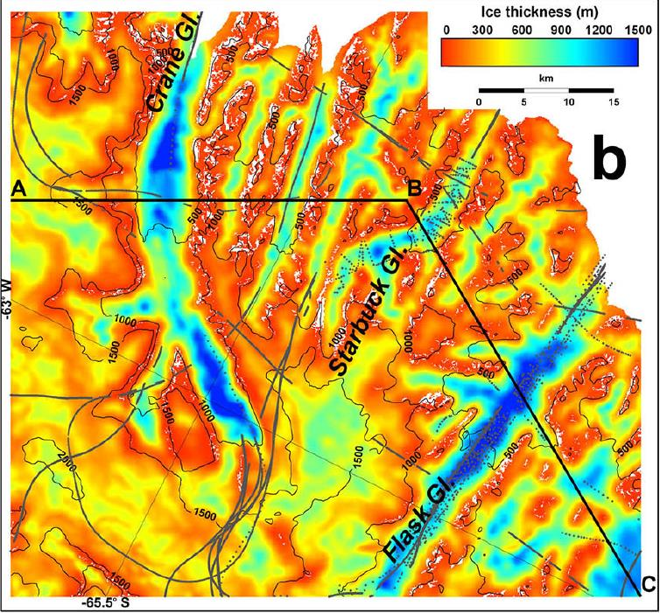

Slide 21
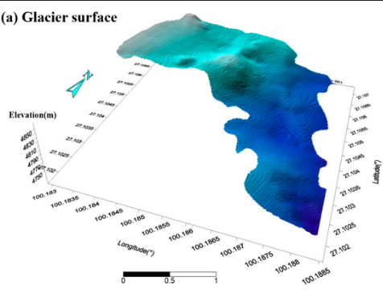
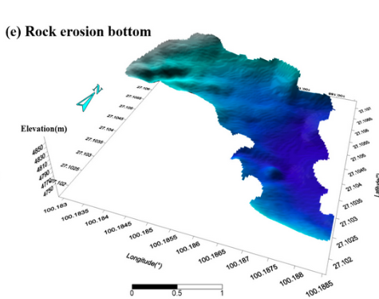

Slide 22
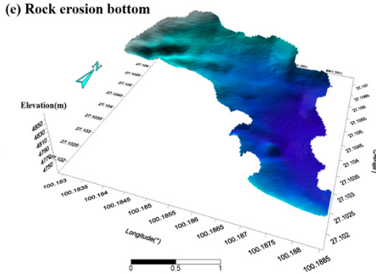

Slide 23
Part 2
Erosional Features Formed During Glacial Retreat

Slide 24
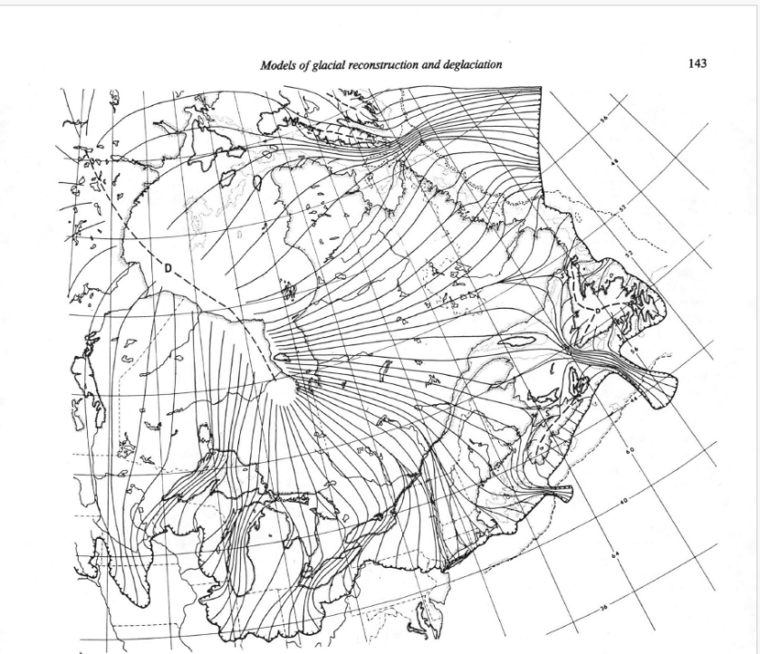
$18,000$ year ago

Slide 25
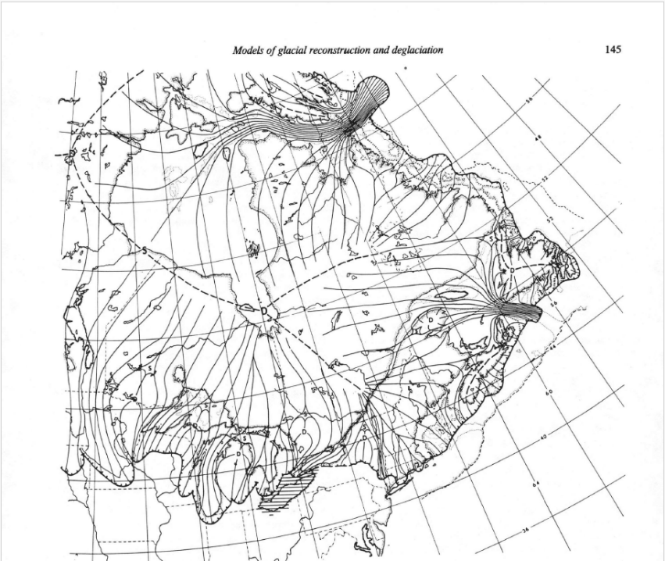
$16,000$ year ago

Slide 26
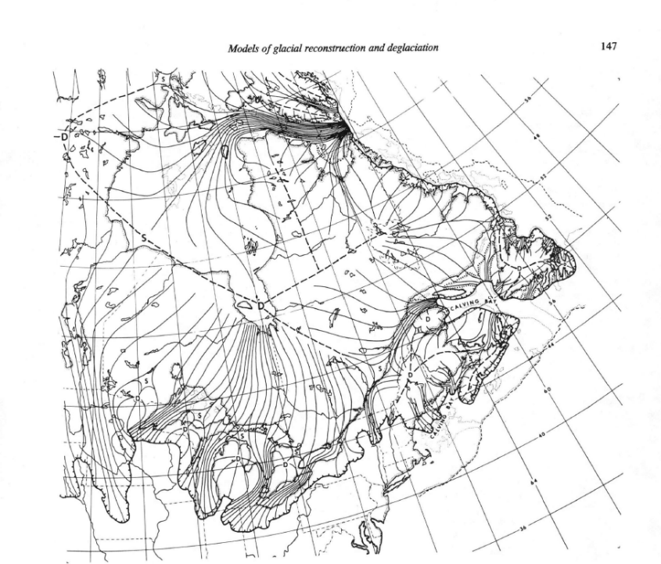
$14,000$ year ago

Slide 27
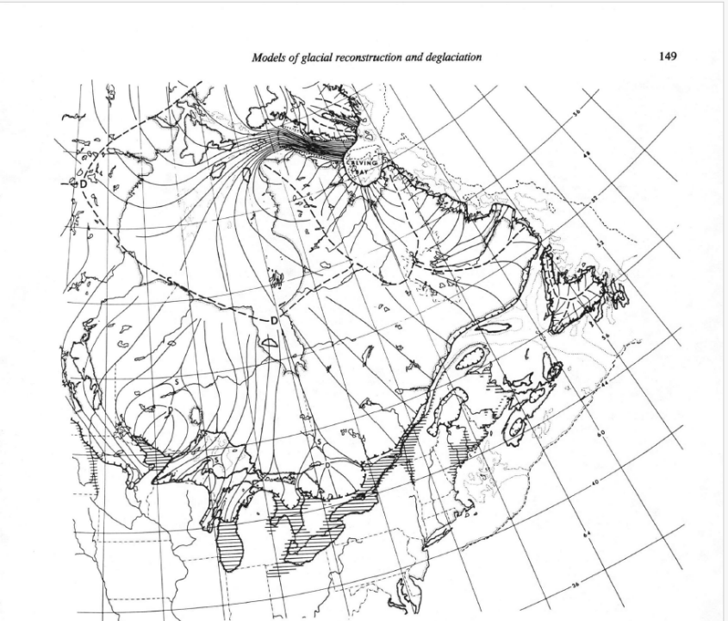
$12,000$ year ago

Slide 28
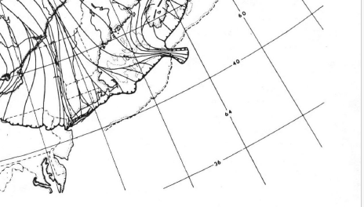
$18,000$ year ago

Slide 29
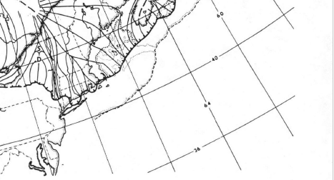
$16,000$ year ago

Slide 30
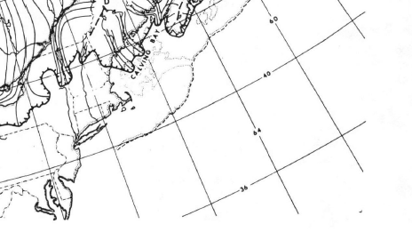
$14,000$ year ago

Slide 31
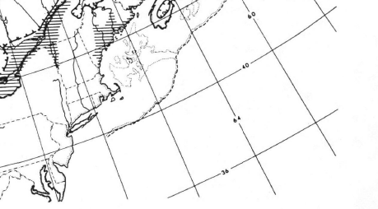
lake / marine
$12,000$ year ago

Slide 32
18,000 Ice Front at Ronkonkoma Moraine, Fast flow in Hudson Valley
steady retreat
12,000 has melted back to St Laurence River, large flooded regions

Slide 33
Finger
Lake
region
$16,000$ year ago

Slide 34
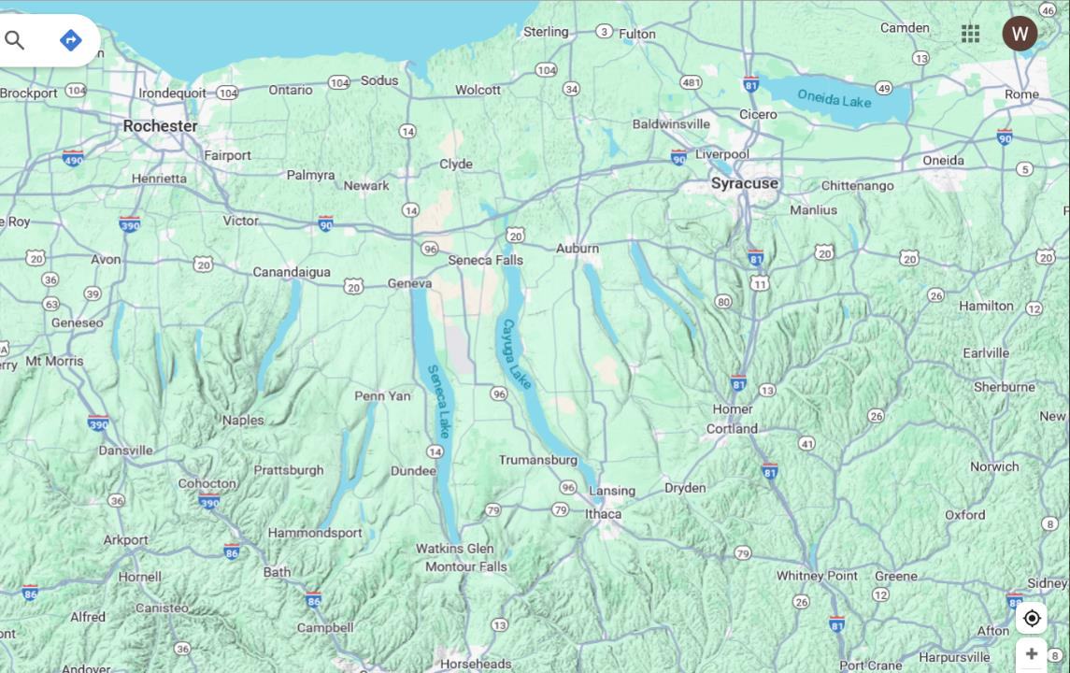

Slide 35
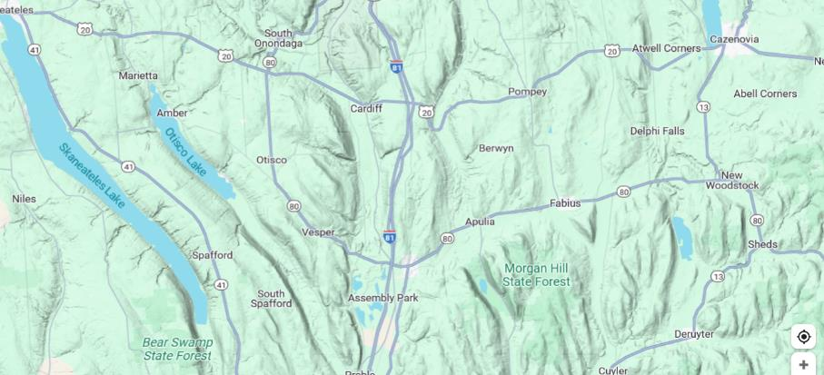
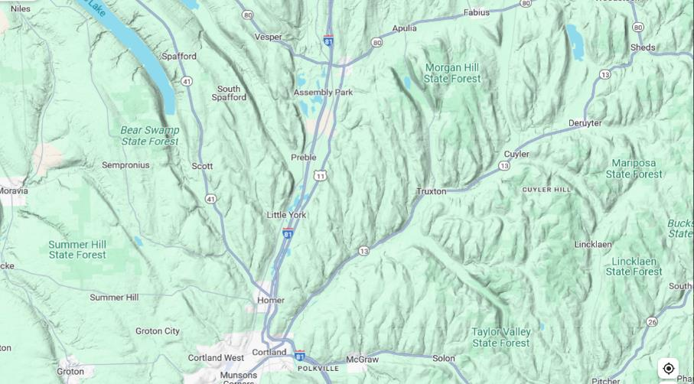
valleys bigger than modern lakes
not all are north-south

Slide 36
most valleys have no lakes
valleys bigger than modern lakes
not all are north-south

Slide 37
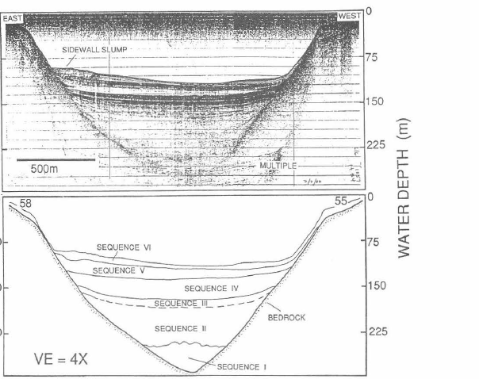
Lake Cayuga
seismic
echo sounding
indicates
valleys are
substantially
deeper than they appear and are filled with sediments

Slide 38
Tunnel Valley
Valley formed under the ice sheet when it its rapidly melting back
very broad infiltration of ice from surface melts
(lots of moulins)
flow of water along glacial bed, concentrated in large tunnels
erosion of bedrock beneath glacier
not known if flow is steady or sudden floods

Slide 39
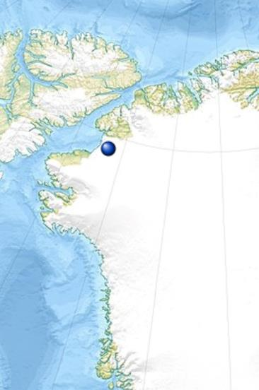
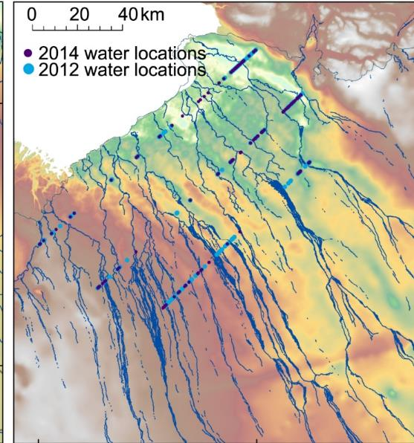
Modern tunnel valleys beneath
Humbolt Glacier, Greenland

Slide 40
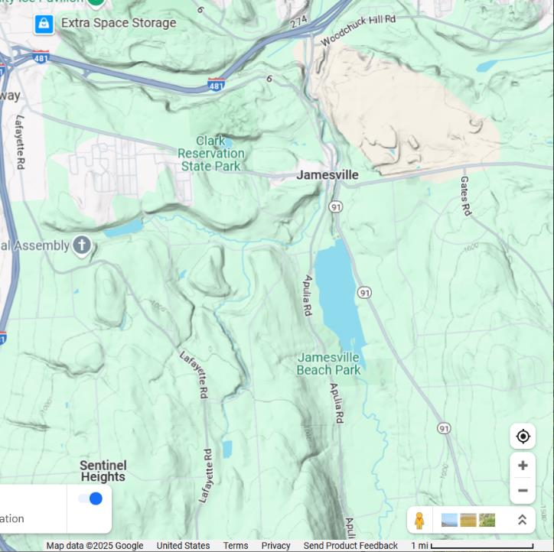
1.6 km

Slide 41
are the channels really subglacial
(below the glacier),
or might they be
proglacial
(in front of glacier)
?
1.6 km

Slide 42
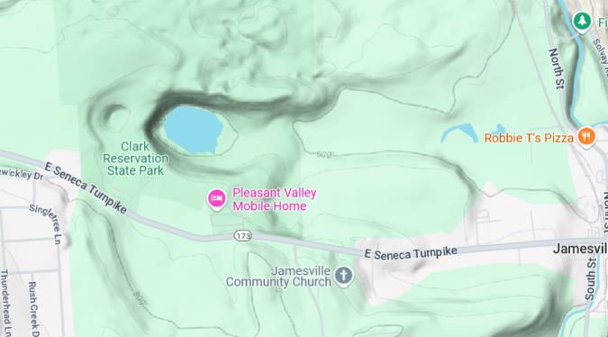
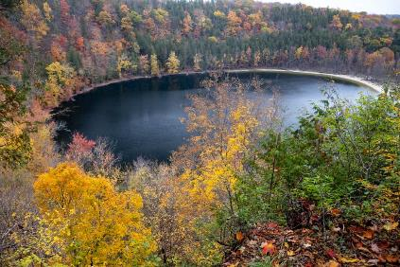
Plunge Pool
1.6 km

Slide 43
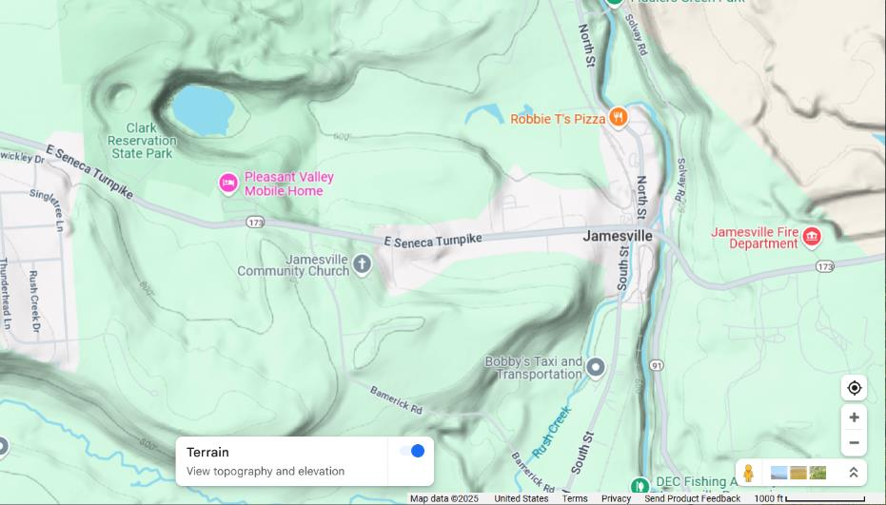
younger pool ?
older pool ?
older pool
presence of
two pools
suggestive
of change in
pathway
of subglacial
water flow
300 m

Slide 44
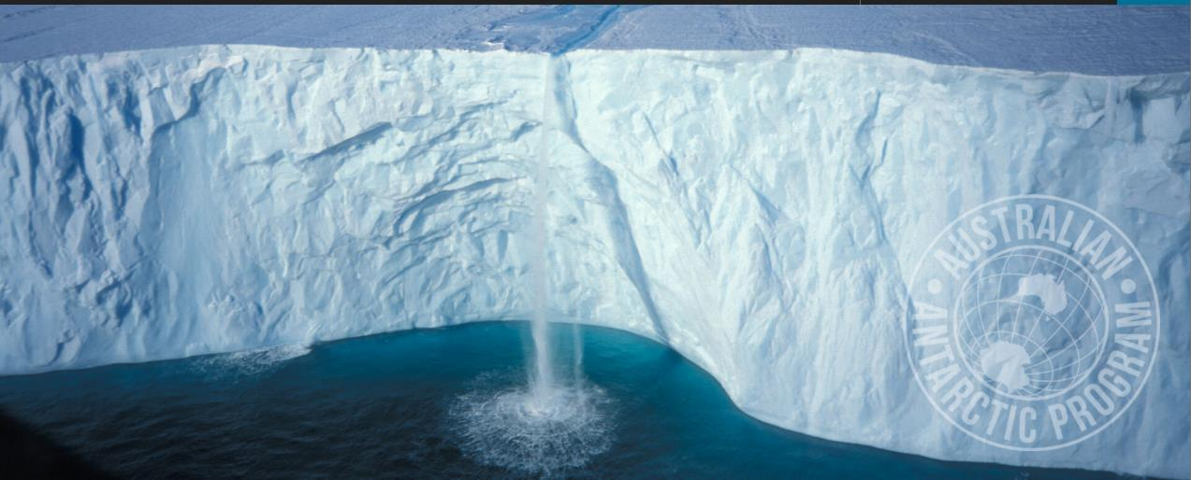
waterfall off of ice shelf in Antarctica

Slide 45
Pothole
swirling water causes stones to erode cylindrical holes in river bottom

Slide 46
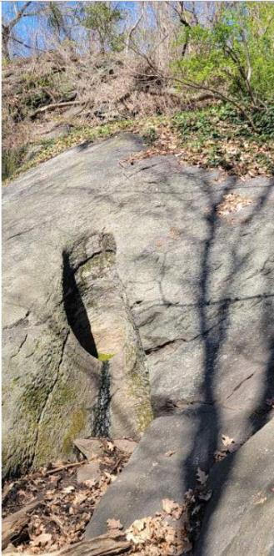
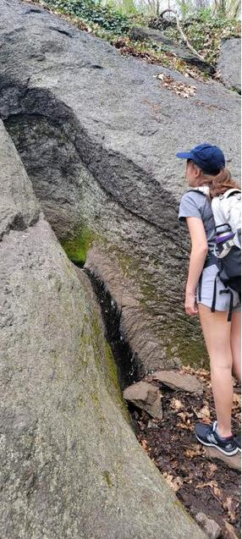
Glacial Pothole
(Inwood Park)
Pothole not near
present-day river
formed from
Ice Age meltwater

Slide 47
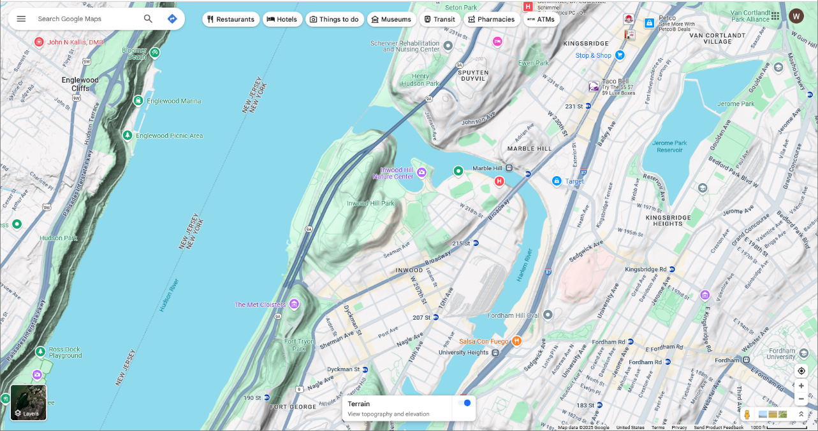
pothole
300 m

Slide 48
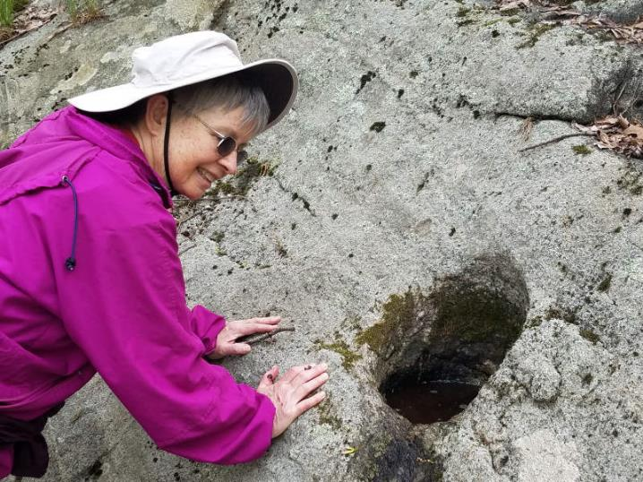
Glacial Pothole
near
Hurst
Trailhead
Harriman
State
Park)

Slide 49
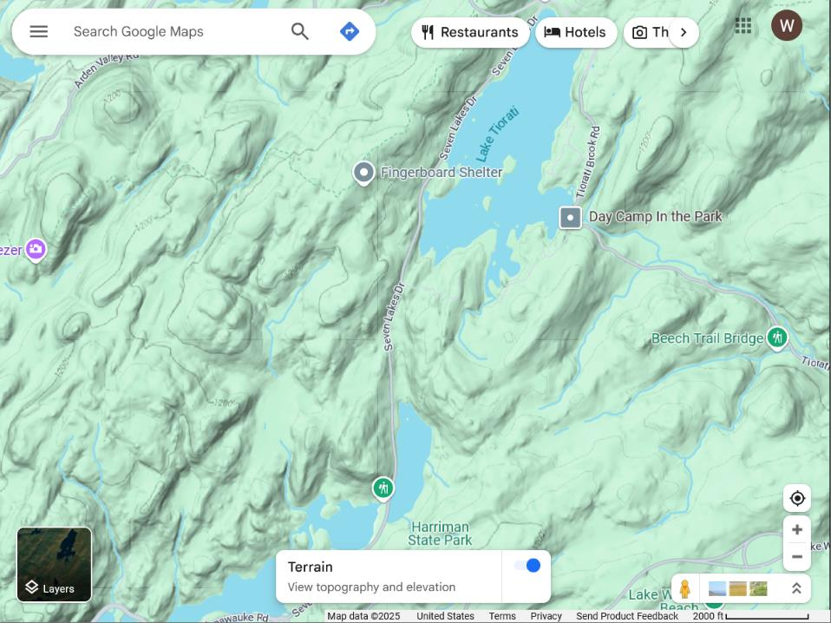
lake made by dam
pothole
600 m

Slide 50
lake made by dam
pothole
outflow channel?
600 m

Slide 51
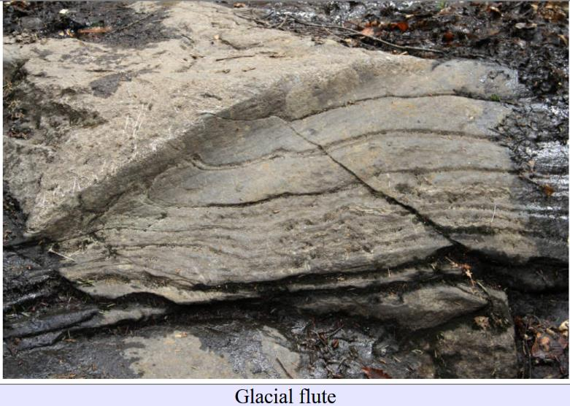
Glacial Flute

Slide 52
Glacial Flute
subglacial water may have played
a role in its formation
water flow

Slide 53
Glacial Flute
don’t confuse
metamorphic
banding
with
flutes

Slide 54
Part 3
Small-Scale Erosional Features

Slide 55
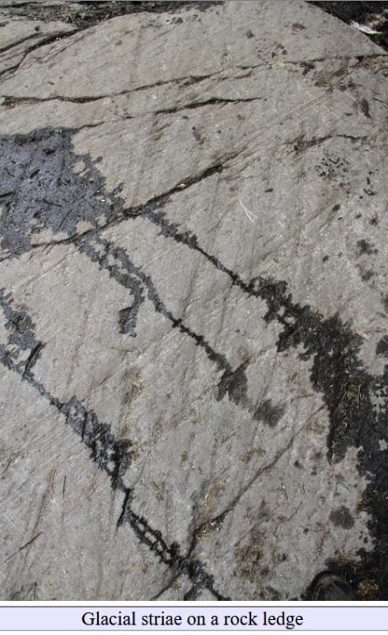
glacial scratches
“striae”

Slide 56
glacial scratches
“striae”

Slide 57
careful observation
needed to distinguish
striae
(on surface of rock)
from sedimentary layering
or metamorphic banding
(internal to the rock)

Slide 58
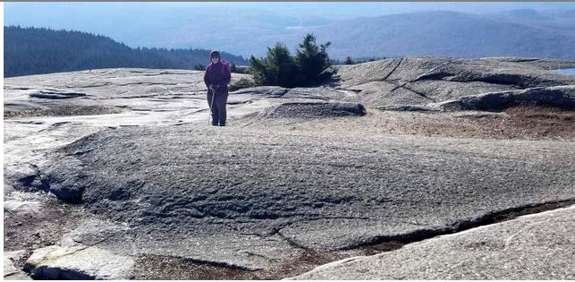
roche moutonnée with striae

Slide 59
steep
plucked
slope
gentle slope
striae
roche moutonnée with striae

Slide 60
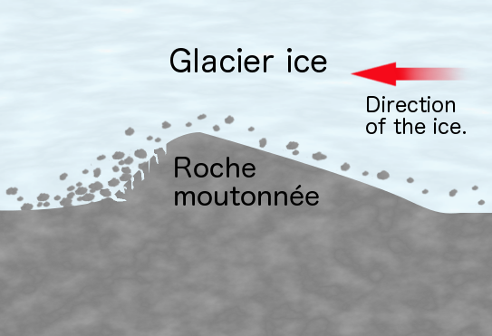
“plucking” or “quarrying” implies ice is in a freezing – not melting - regeim
Roche Moutonnée

Slide 61
steep slope
gentle slope
Ice flow direction
roche moutonnée with striae

Slide 62
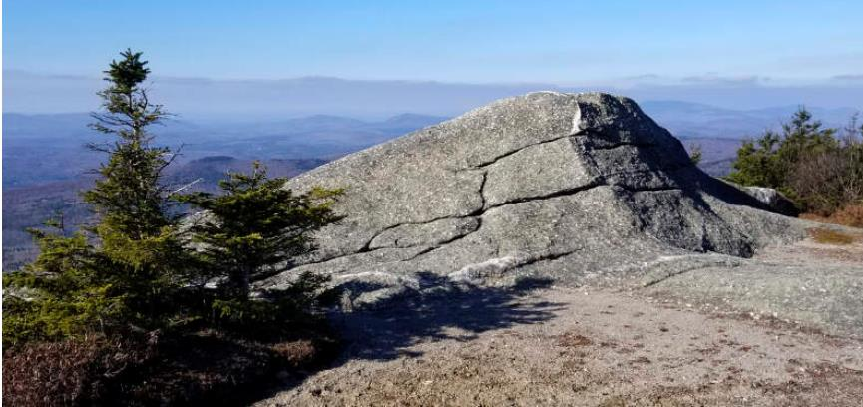
roche moutonnée

Slide 63
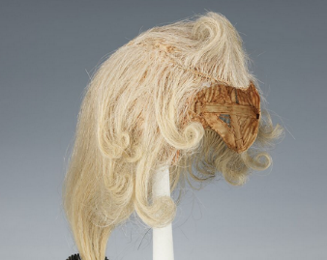
“Roche”
Rock in French
“Moutonnée”
Sheepskin in French
18th Century French Wig “The Moutonnée”

Slide 64
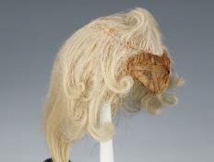
Dunning Trail near the Bowling Alley

Slide 65
Suffern Bear Mt Trail near Stone Memorial Shelter

Slide 66
Ramapo Dunderburg Trail at the Bald Rocks

Slide 67
Woods road north of Little Long Pond

Slide 68
a lot of plucked material from this roche moutonnée
was left nearby

Slide 69
giant roche moutonnées and glacially-plucked cliffs

Slide 70
An elongated, glacially-smoothed rock outcrop lacking plucking is called a
“whaleback”

Slide 71
An elongated, glacially-smoothed rock outcrop lacking plucking is called a
“whaleback”
3 km

Slide 72
Are these ridges big whalebacks?
An elongated, glacially-smoothed rock outcrop lacking plucking is called a
“whaleback”
3 km

Slide 73
Glacial Polish
glacier buffed the rock to a shine

Slide 74
Glacial Pavement
rock surface smoothed by ice

Slide 75
Glacial movement “sandpapers” rock pavement
Ice and Sand
Rock

Slide 76
How Thick was the Ice
near Manhattan?

Slide 77
Schunemunk Mountain
elevation
507 m

Slide 78
meta

Slide 79
purple quartzite with white pebbles
“pudding-
stone”

Slide 80
glacial
pavement with faint
striae

Slide 83
pebbles all cut flat
by glacial
polishing

Slide 84
pebbles all cut flat
by glacial
polishing

Slide 85
Englewoods Cliffs
elevation
102 m

Slide 87
Glacial Features in Morningside Park, too
elevation
36 m

Slide 88
Morningside Park
glacial pavement
striae

Slide 89
?
moraine
Eng Cl
Sch Mt
CU
500
elev in m
100
36
68
0
5
8
distance from CU in km

