Slide 1
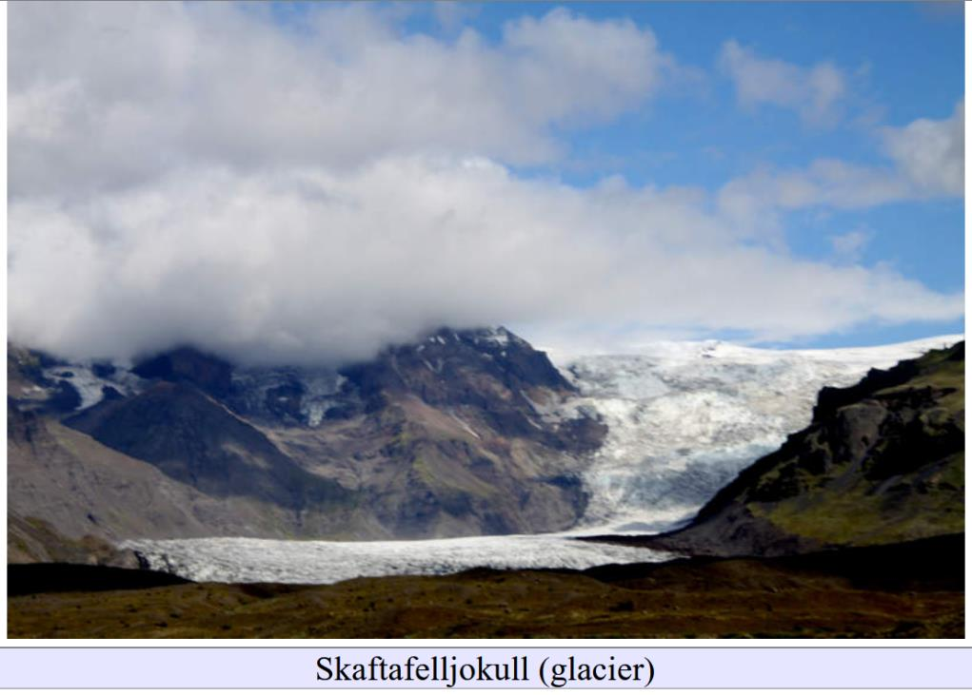
Depositional Glacial Features on Land
Lecture 7

Slide 2
Part 0
Glacial Feature in Pics from Social Media

Slide 3
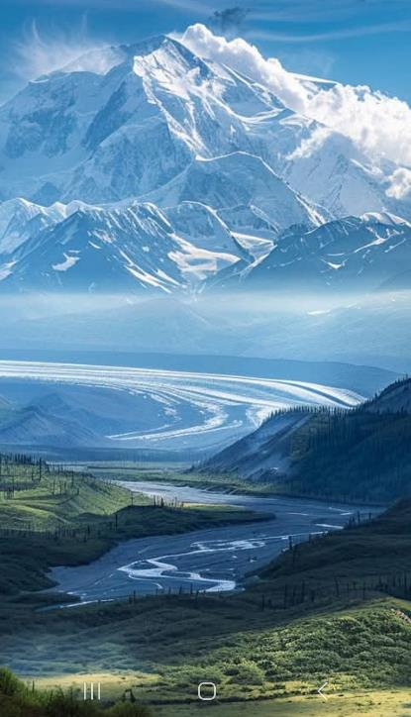
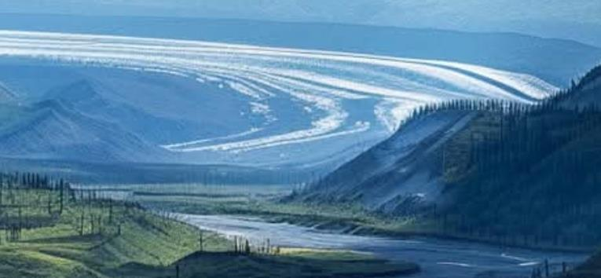

Slide 4
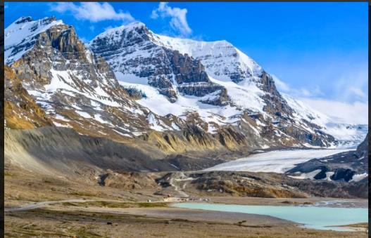
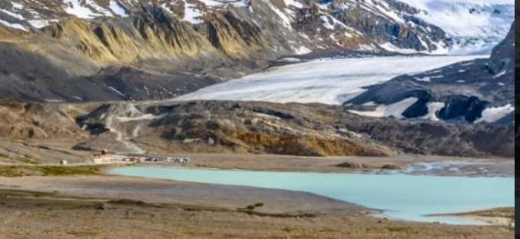

Slide 5
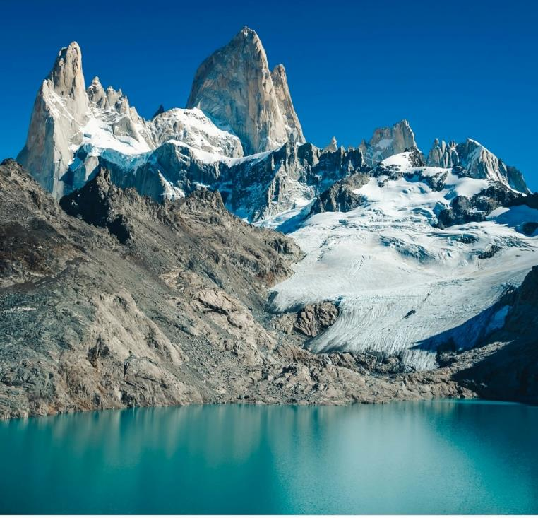

Slide 6
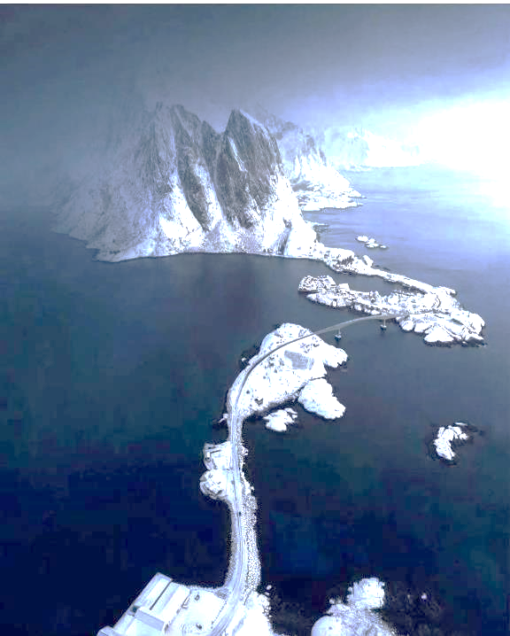

Slide 7
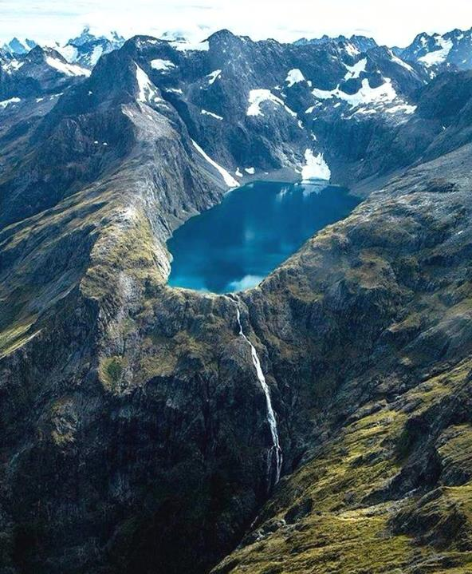
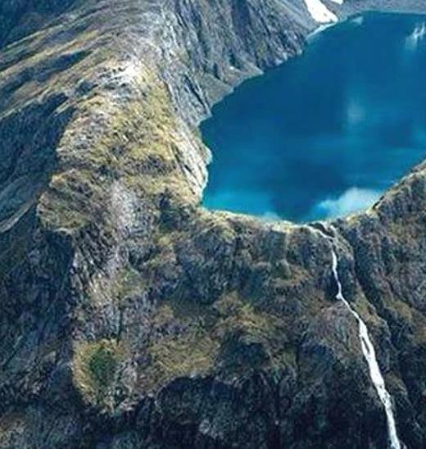

Slide 8
Part 1
10Be Exposure Dating

Slide 9
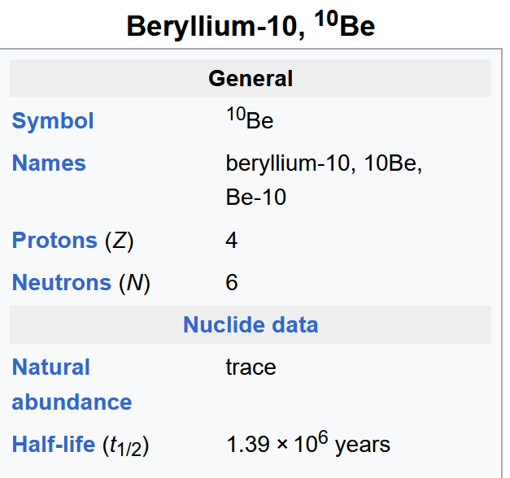
Long compared to end of Ice Age
Short compared to age of typical rocks

Slide 10
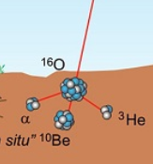
n
Produced by neutrons from cosmic rays
interacting with oxygen in rocks

Slide 11
production rate is
3.6 atoms per year per gram
in quartz

Slide 12
production rate
thought to be fairly constant
when averaged over hundreds of years

Slide 13
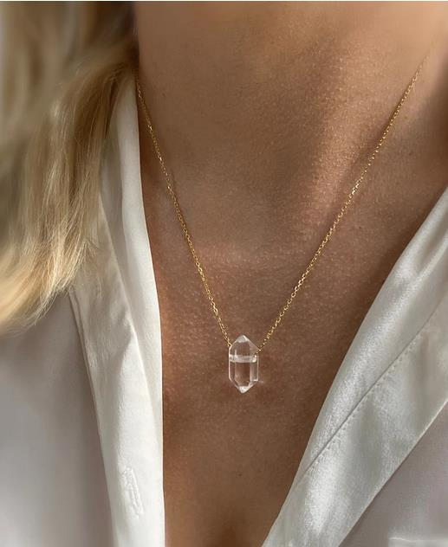
10 grams
432,000 atoms of ¹⁰Be
since end of Ice Age
mixed with
4x10²³ atoms of oxygen

Slide 14
penetration depth of neutrons into rock is a few centimeters

Slide 15
rock buried
more than a meter
for more than 10 million years has no ¹⁰Be
no production
and slow radioactive decay

Slide 16
rock quarried
by glacier

Slide 17
rock transported
by glacier

Slide 18
glacier melts
rock now exposed to cosmic rays
¹⁰Be starts to accumulate

Slide 19
sample rock,
measure ¹⁰Be,
infer exposure age

Slide 20
Part 2A
Using Erratic Boulders to date the end of the Ice Age

Slide 21
Part 2A
Erratic Boulders

Slide 22
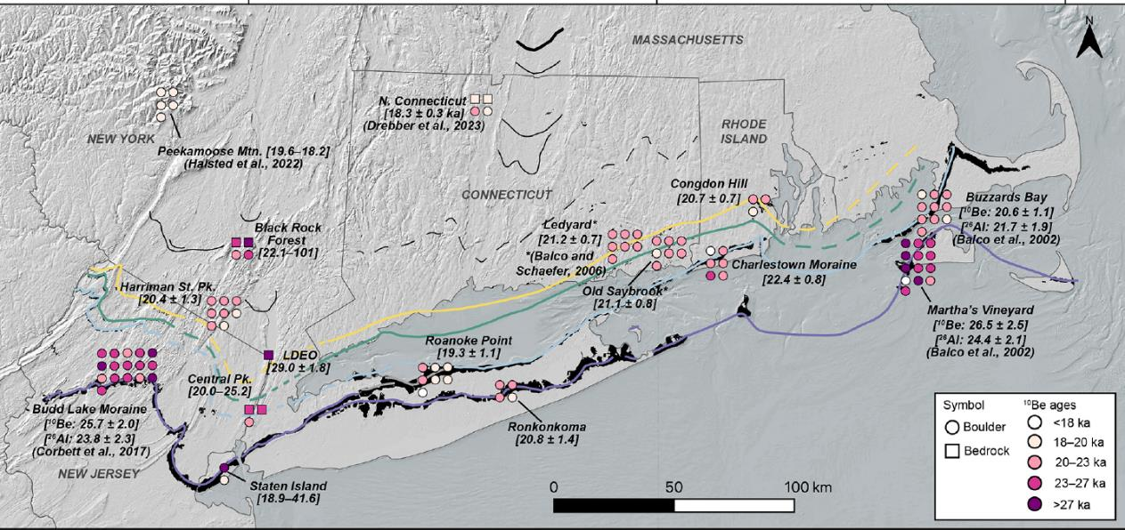

Slide 23
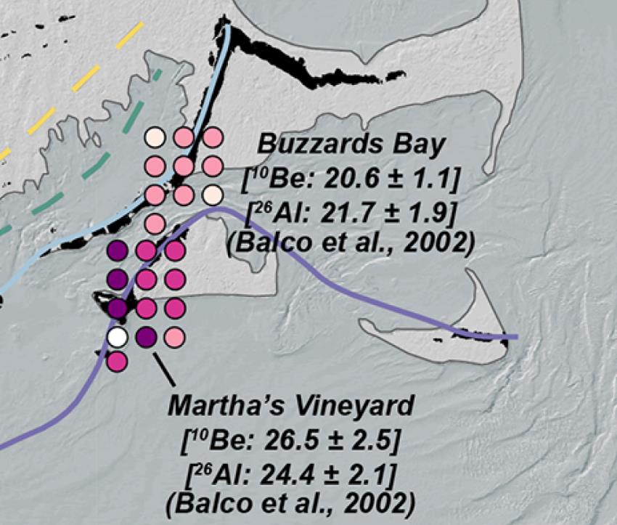
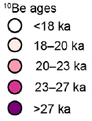

Slide 24
about
5,000 year age difference
between the two moraines

Slide 25
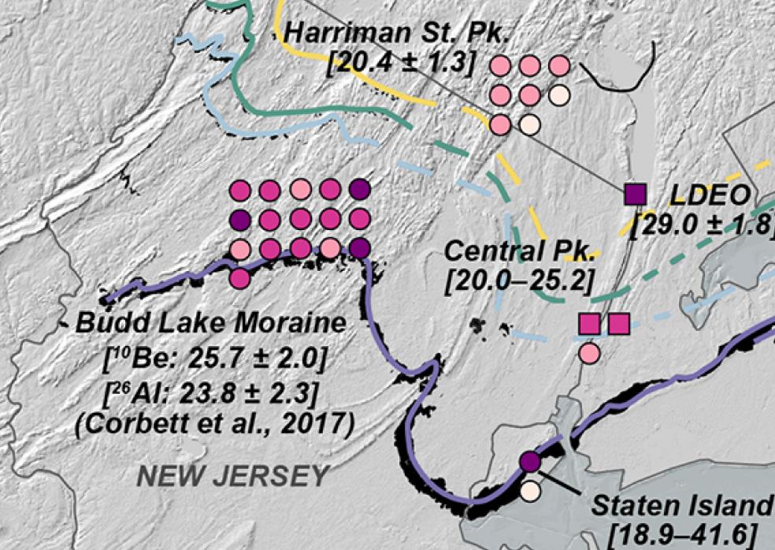

Slide 26
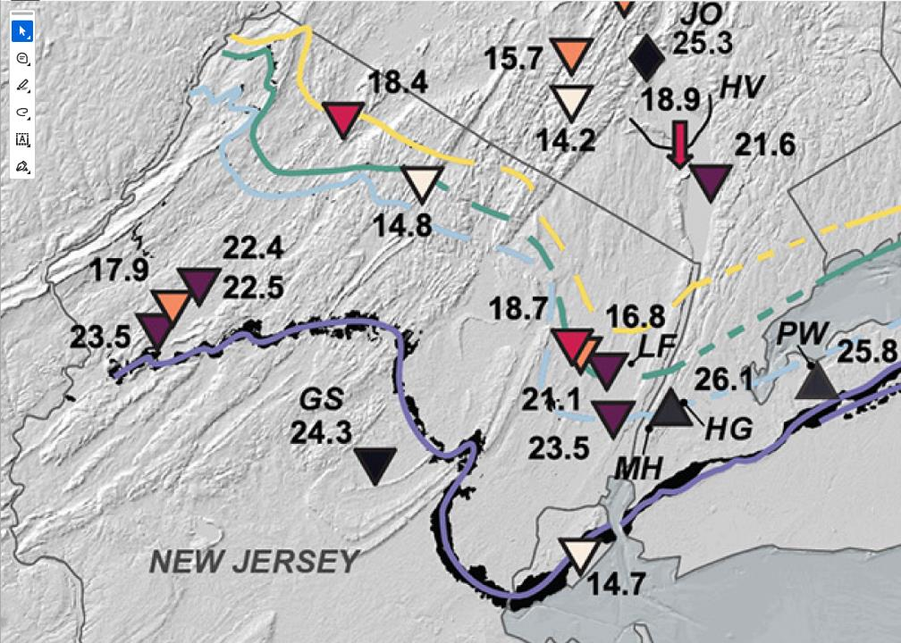
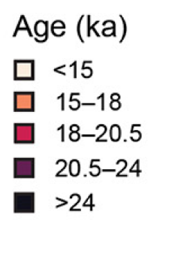
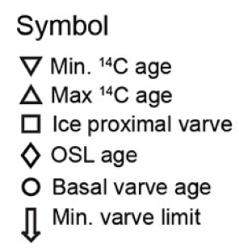

Slide 27
Core in Green Lake
Harriman State park

Slide 28
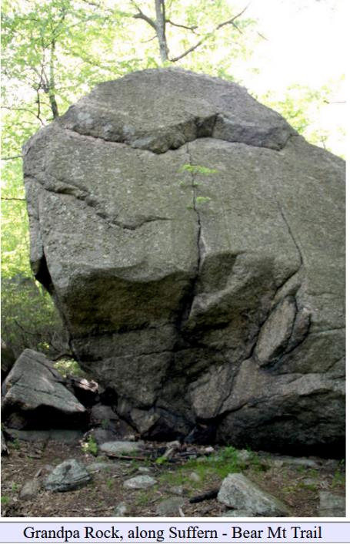
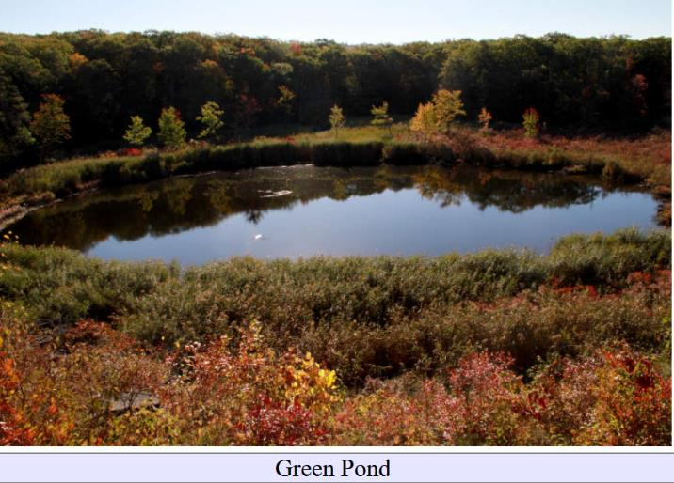

Slide 29
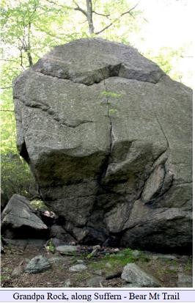
Unsolved mystery: why the big age difference?
0
10
C¹⁴ age of core bottom
20
exposure age of boulders
age, ka

Slide 30
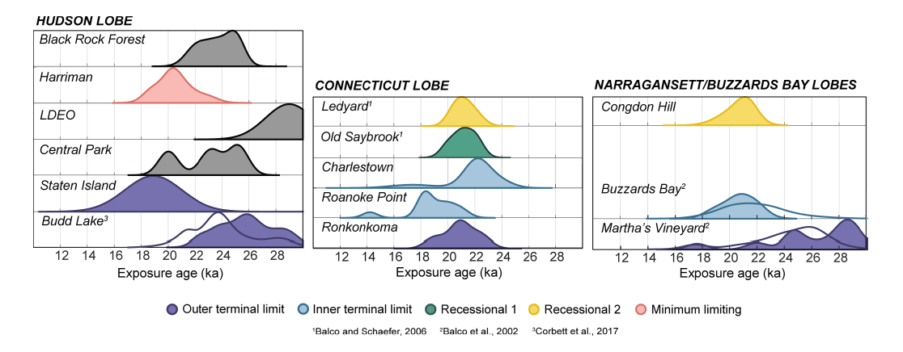

Slide 31
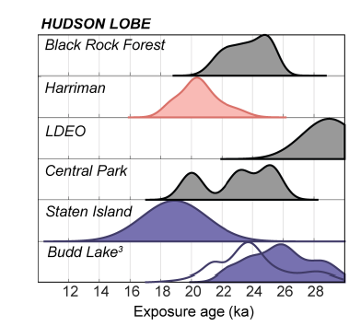

Slide 32
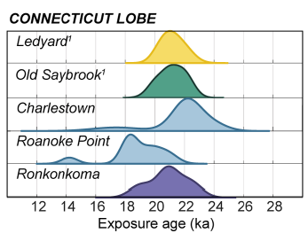

Slide 33
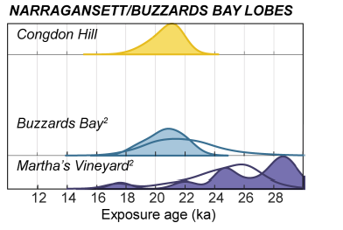

Slide 34
Part 2B
Using Erratic Boulders to Determine Ice Flow Directions

Slide 35
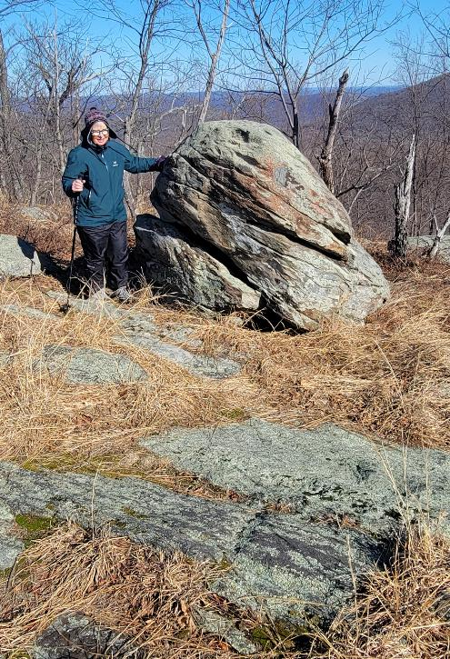
Erratic Boulder
Sandstone Boulder
Gneiss Ledge

Slide 36
Sandstone is a very common sedimentary rock
so lots of places sandstone could have come from

Slide 37
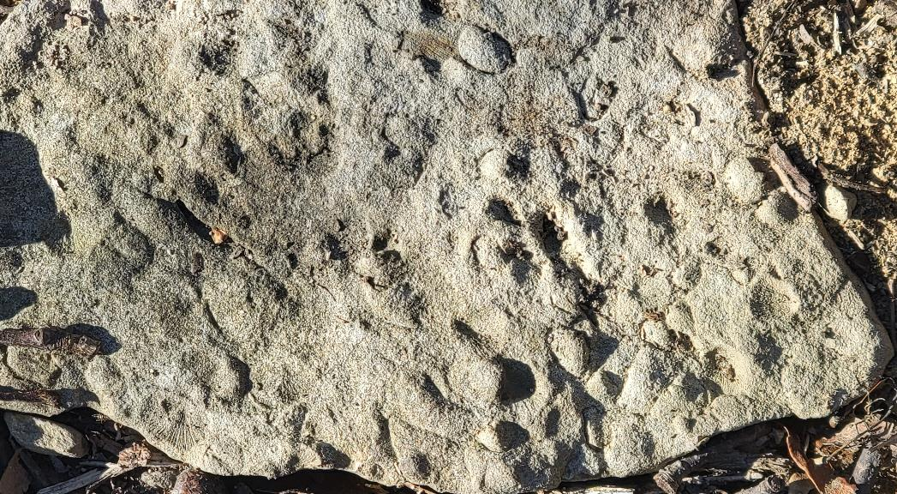

Slide 38
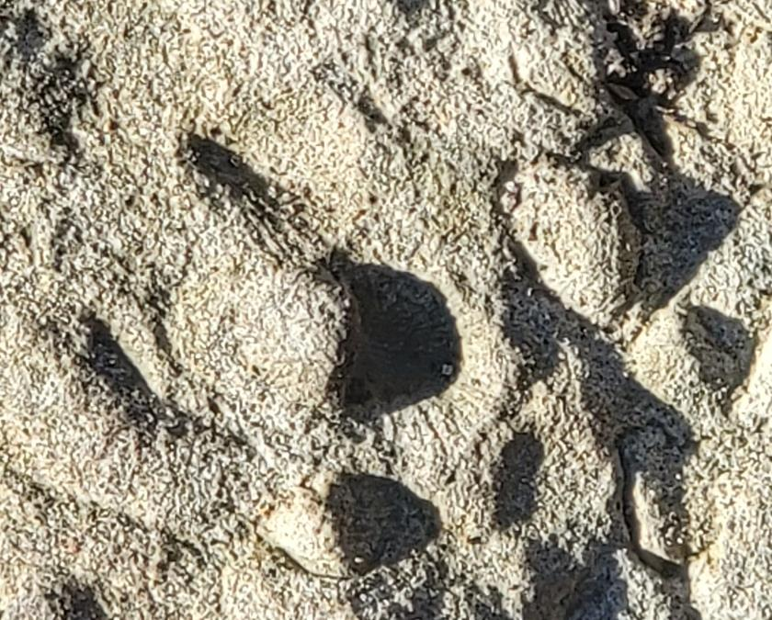
Fossil
imprints of
Brachiopod
shells
might help to reduce source possibilities

Slide 39
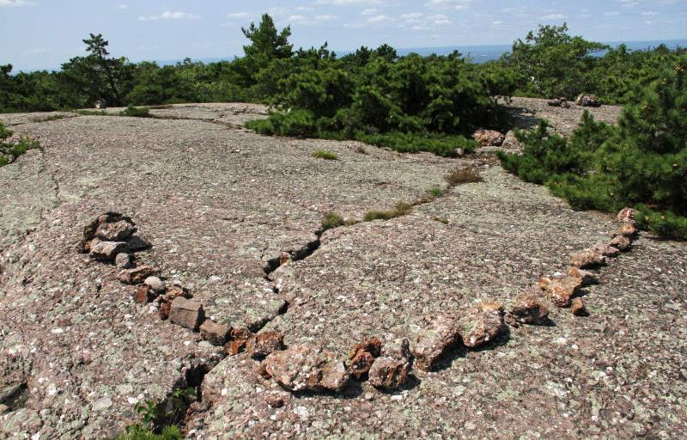
Puddingstone on Schunemunk Mountain
very recognizable

Slide 40
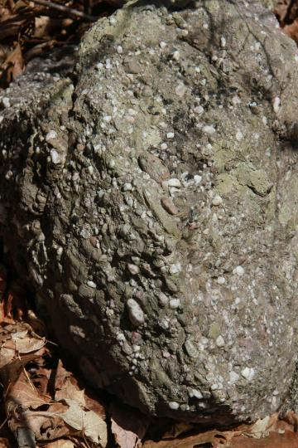
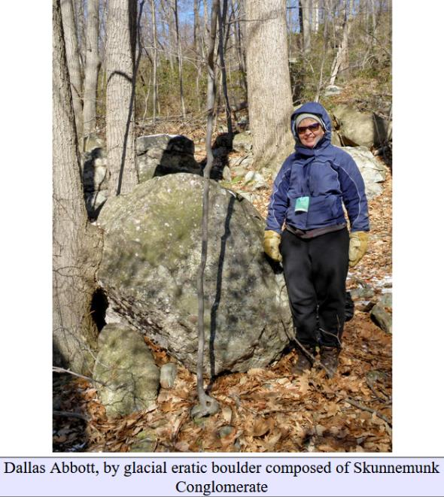

Slide 41
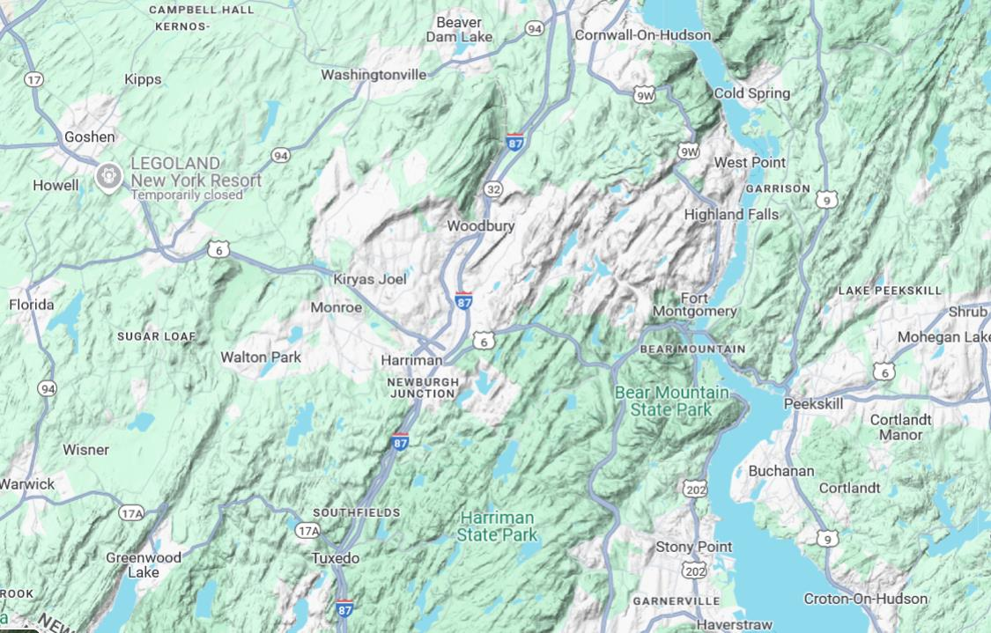
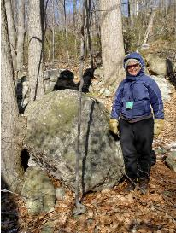
furthermore
source is more
localized

Slide 42
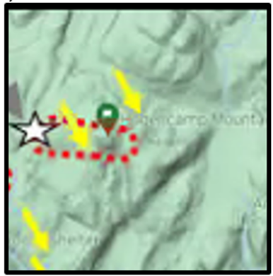
Consistent with striae data

Slide 43
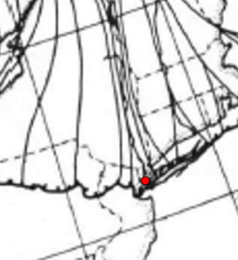
Not consistent with published flow streamlines

Slide 44
I don’t think I’ve ever come across Puddingstone erratics here
minimum angle
required

Slide 45
Part 3
Eskers
(subglacial stream beds)

Slide 46
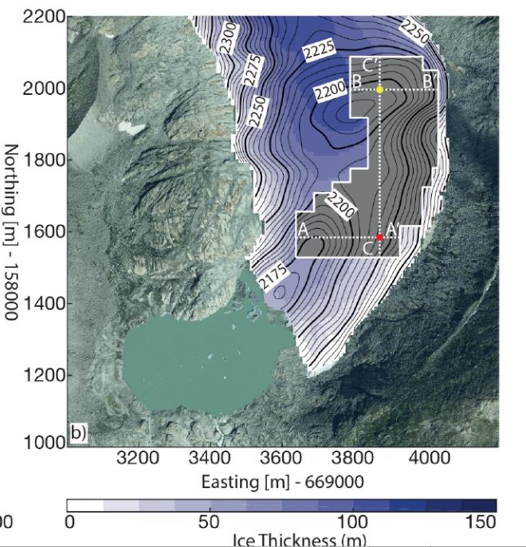
what do subglacial streams look like?

Slide 47
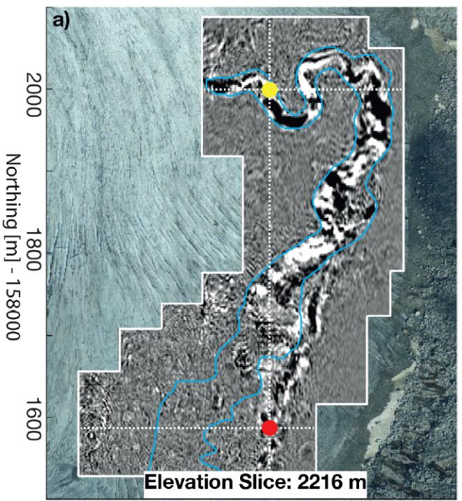
radar image of
englacial
/
subglacial
stream
englacial
=
within glacier
subglacial
=
beneath glacier

Slide 48
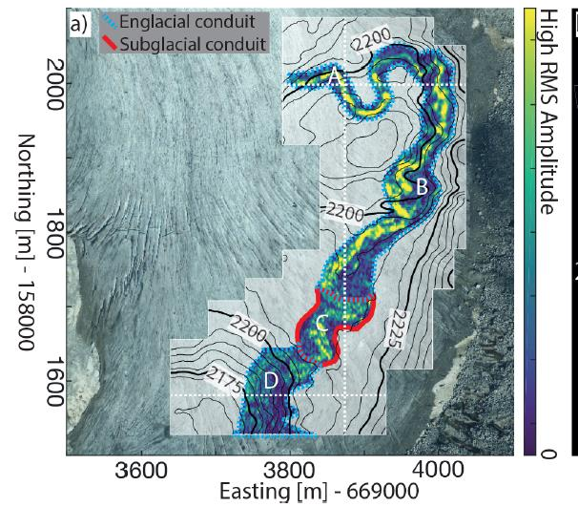
has
meandering
character

Slide 49
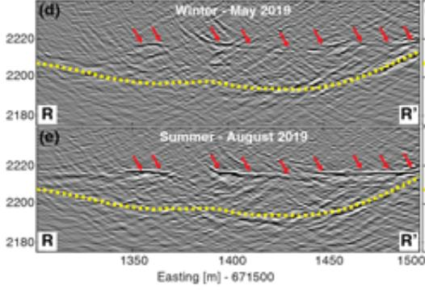
radar can image
seasonal changes
water
conduit
in glacier
(red arrows)
glacial bed
yellow

Slide 50
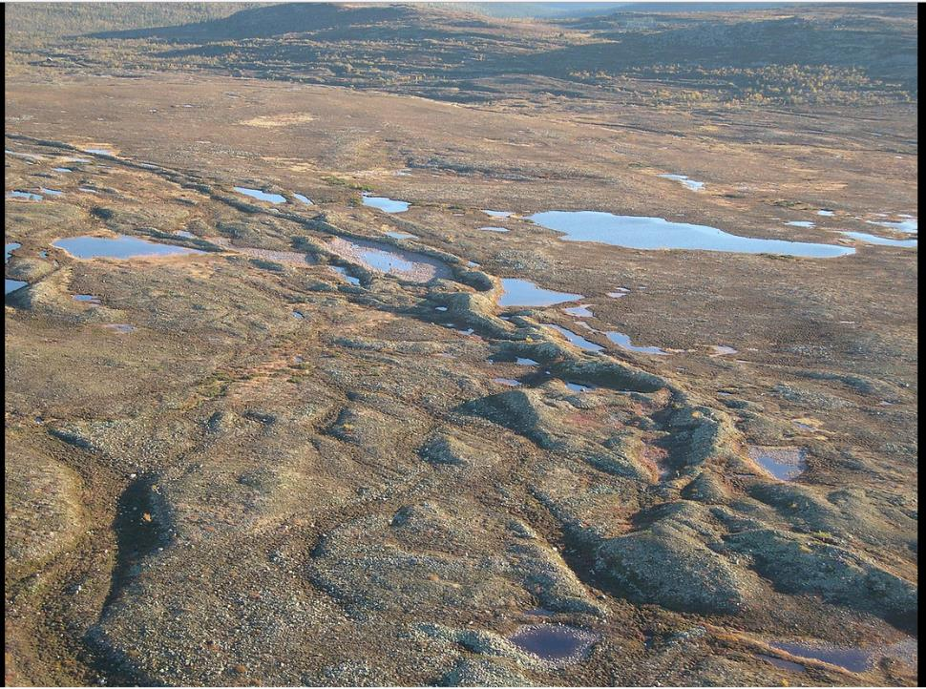

Slide 51
Esker
Esker
Esker
Esker

Slide 52
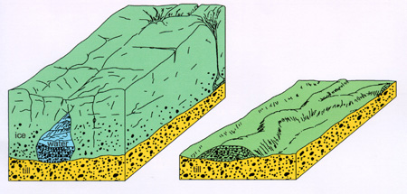
before
and after
glacier melts

Slide 53
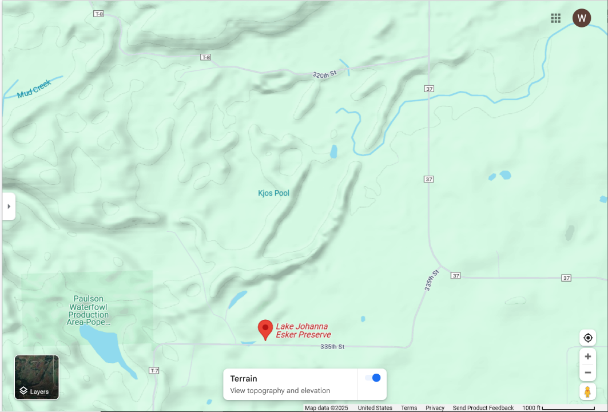

Slide 54
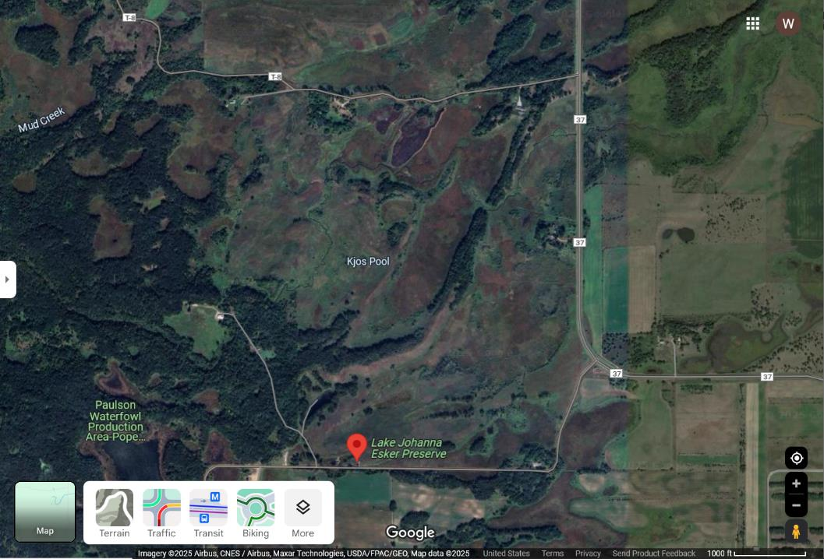

Slide 56
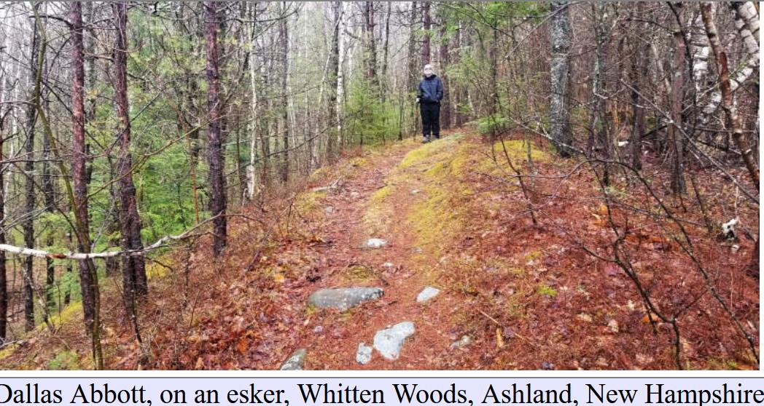

Slide 57
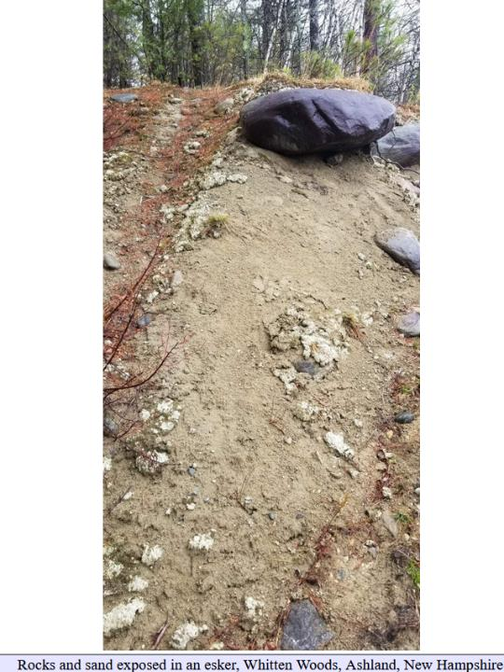
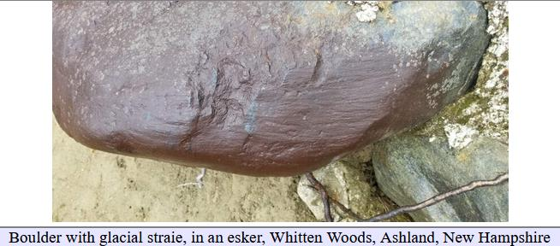
Esker composed of sand and gravel with occasional glacial boulders

Slide 58
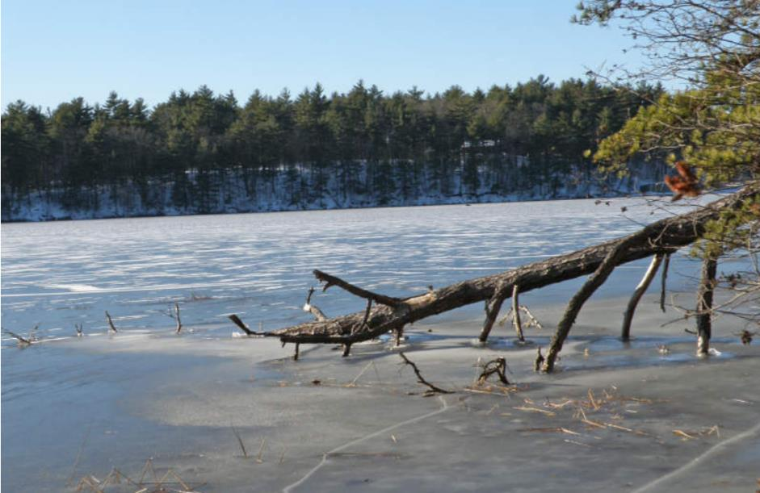
Esker, with a younger lake surrounding it

Slide 59
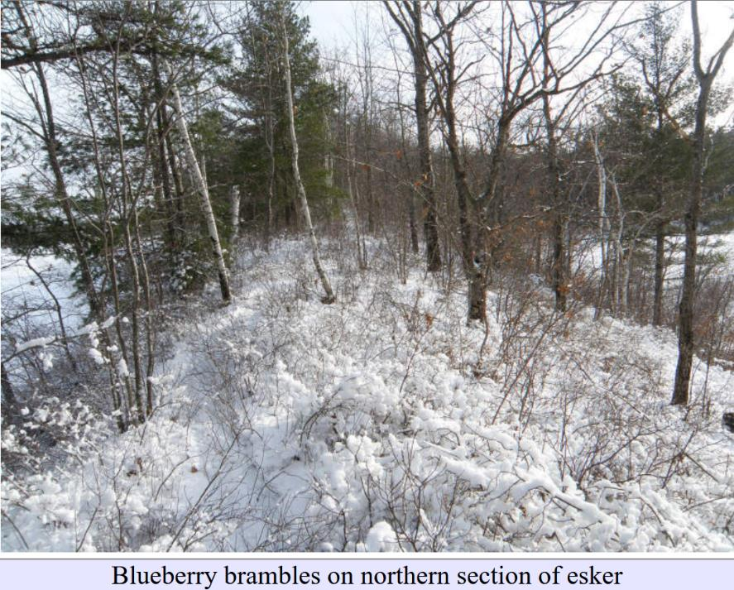

Slide 60
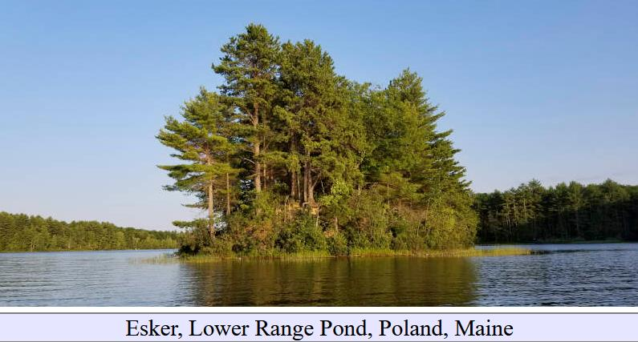

Slide 61
Poorly sorted sediment exposed
where Esker has been eroded

Slide 62
Eskers
confirmation an area was subglacial
indicator of direction of subglacial water flow

Slide 63
But beware: differential erosion can create features that mimic eskers

Slide 64
Part 3
Drumlins
(subglacial sediment hills)

Slide 66
Drumlins
shaped like
a roche moutonnette
BUT direction reversed!
flow

Slide 68
Drumlin

Slide 71
Diamict = poorly sorted sediment

Slide 77
Origin hypothesis 1:
Some sort of flow instability in a wet, viscous layer of till at the bottom of the glacier
Origin hypothesis 2:
Accumulation of sediment in originally
air- or water-filled cavities in the bottom of the glacier

Slide 78
Hypothesis 1:
glacier
wet, soft sediment
shear
shear
shear
shear
Bedrock or stiff sediment

Slide 79
Hypothesis 1:
glacier
shear
shear
shear
shear
viscous flow instability

Slide 80
Hypothesis 2:
glacier
wet, soft sediment
Bedrock or stiff sediment

Slide 81
Hypothesis 2:
glacier
wet, soft sediment
Bedrock or stiff sediment

Slide 82
Drumlins
confirmation an area was subglacial
indicator of direction of glacial flow

Slide 83
But beware: if you mistake them for a roche moutinnee you’ll reverse the glacial flow direction!
glacial flow
glacial flow
drumlin
roche moutinnee

