Slide 1
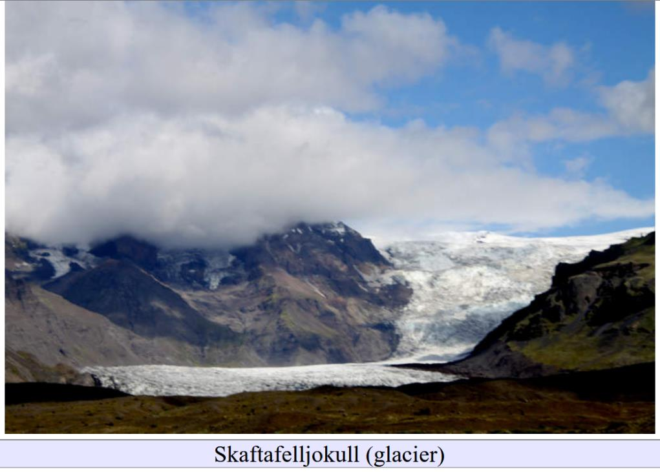
Glacio-Volcanic Landforms
Lecture 8

Slide 2
Part 1
Social Media Pics

Slide 3
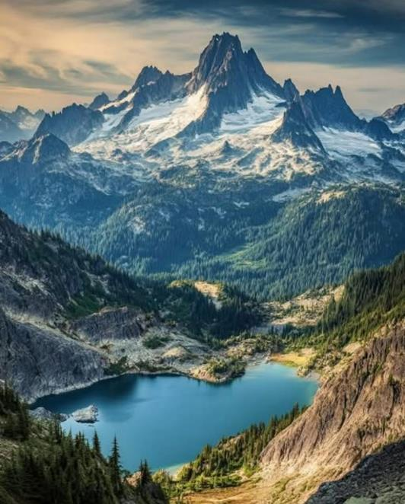
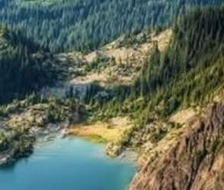
Glaciers (?) or snow fields
Cirques
Arêtes and Horns
dam probably not moraine
Cirque Lake

Slide 4
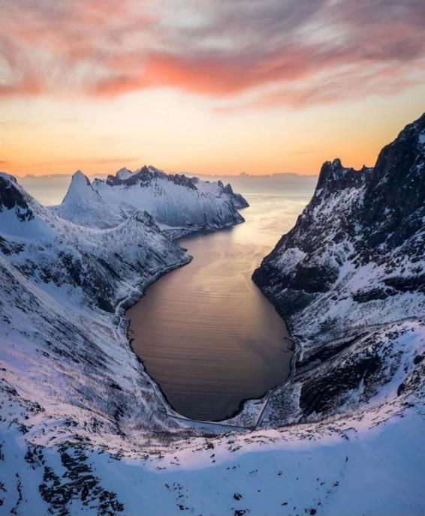
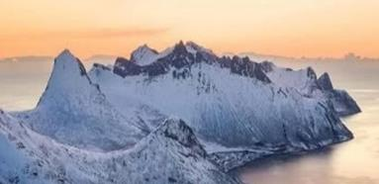
Cirque
Fjord
Arêtes
Horn

Slide 5
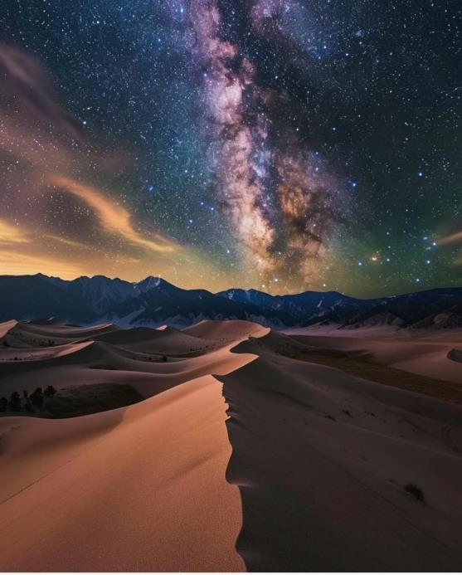
Not Glacial!
Not an Arête
What is it?

Slide 6
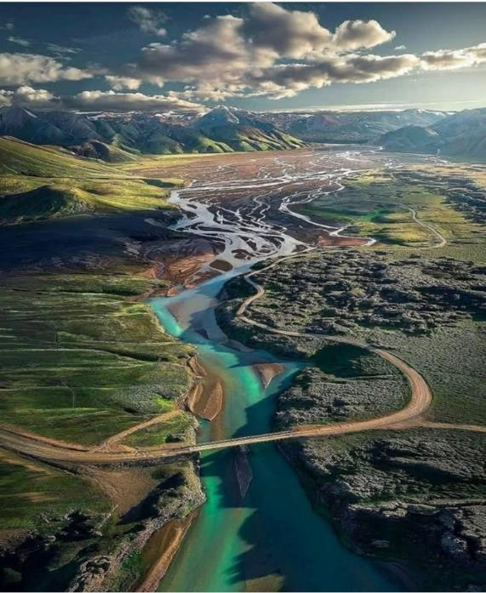
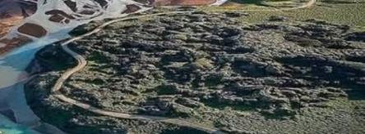
Glacial Valley
Braided Stream
What is hummocky terrain?

Slide 7
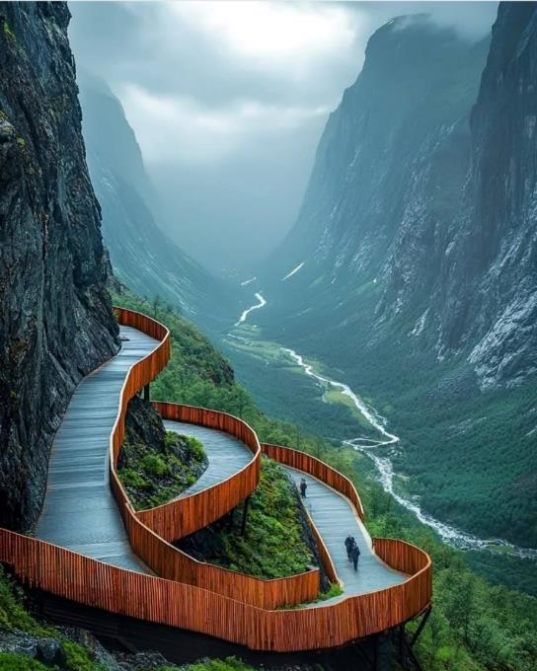
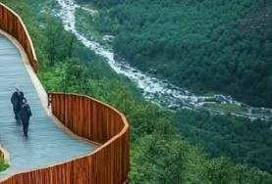
U-shaped Valley
Not particularly braided stream

Slide 8
Part 2
Hyaloclastite: Sub-glacial eruption material

Slide 9
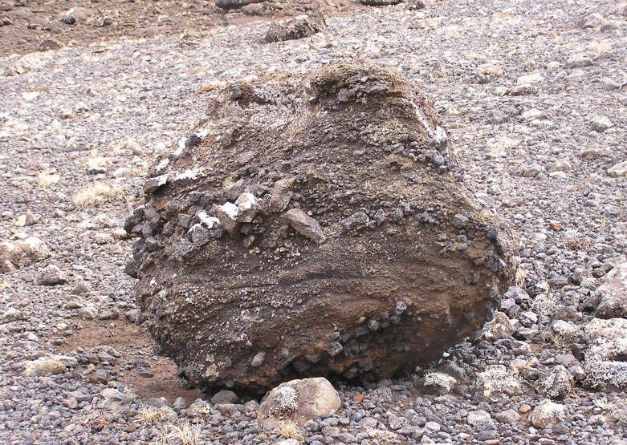
Hyaloclastite
basalt erupted under ice
angular clasts
weakly stratified
very altered
naturally cemented

Slide 10
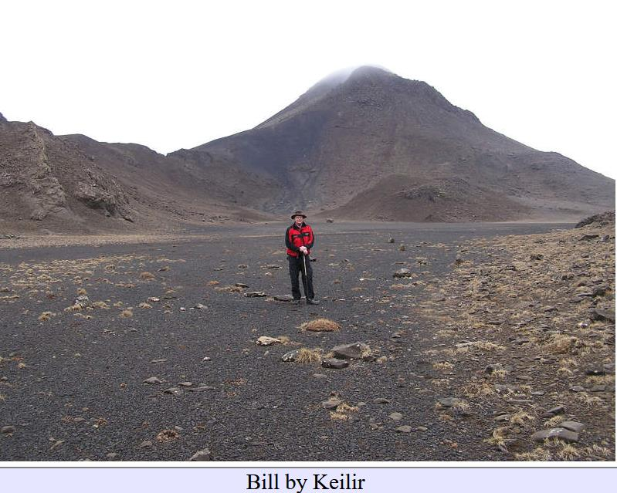
Hyaloclastite hill

Slide 11
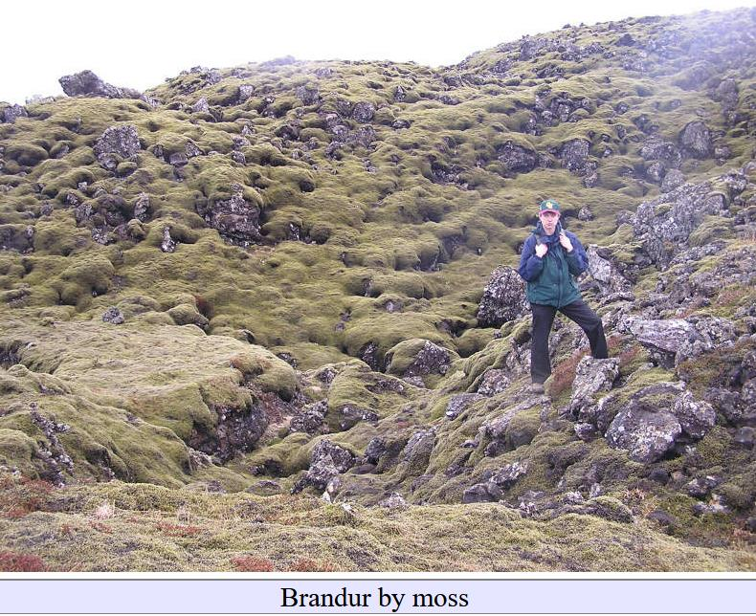
Sub-areal lava flow looks very different

Slide 12
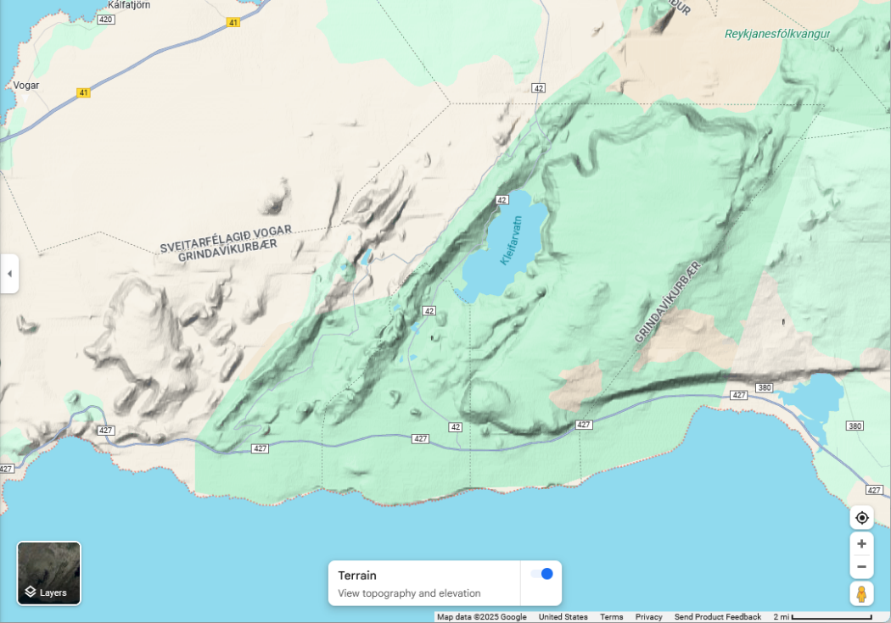
Keilir

Slide 13
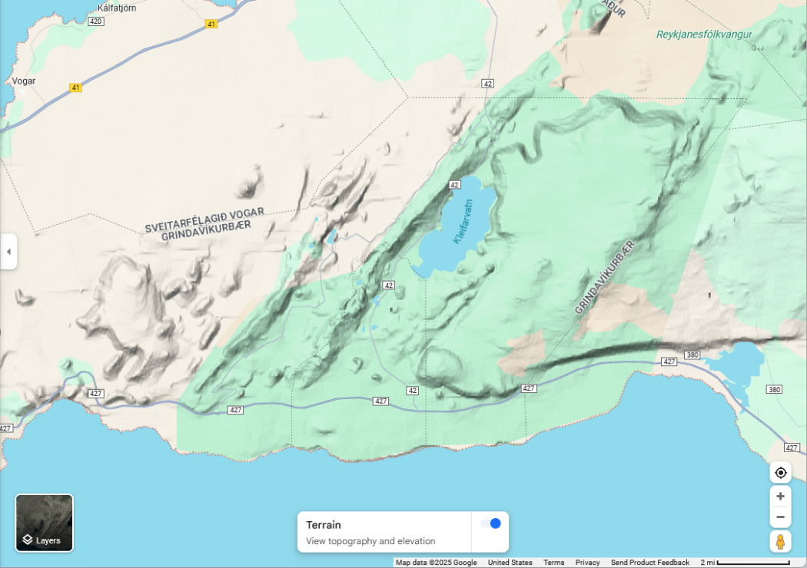
Keilir

Slide 14
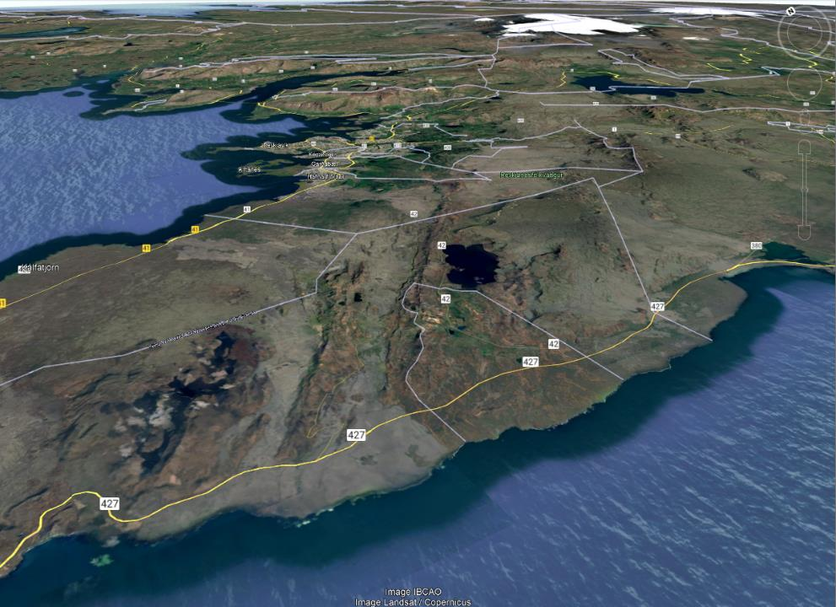
Hyaloclastite Ridges

Slide 15
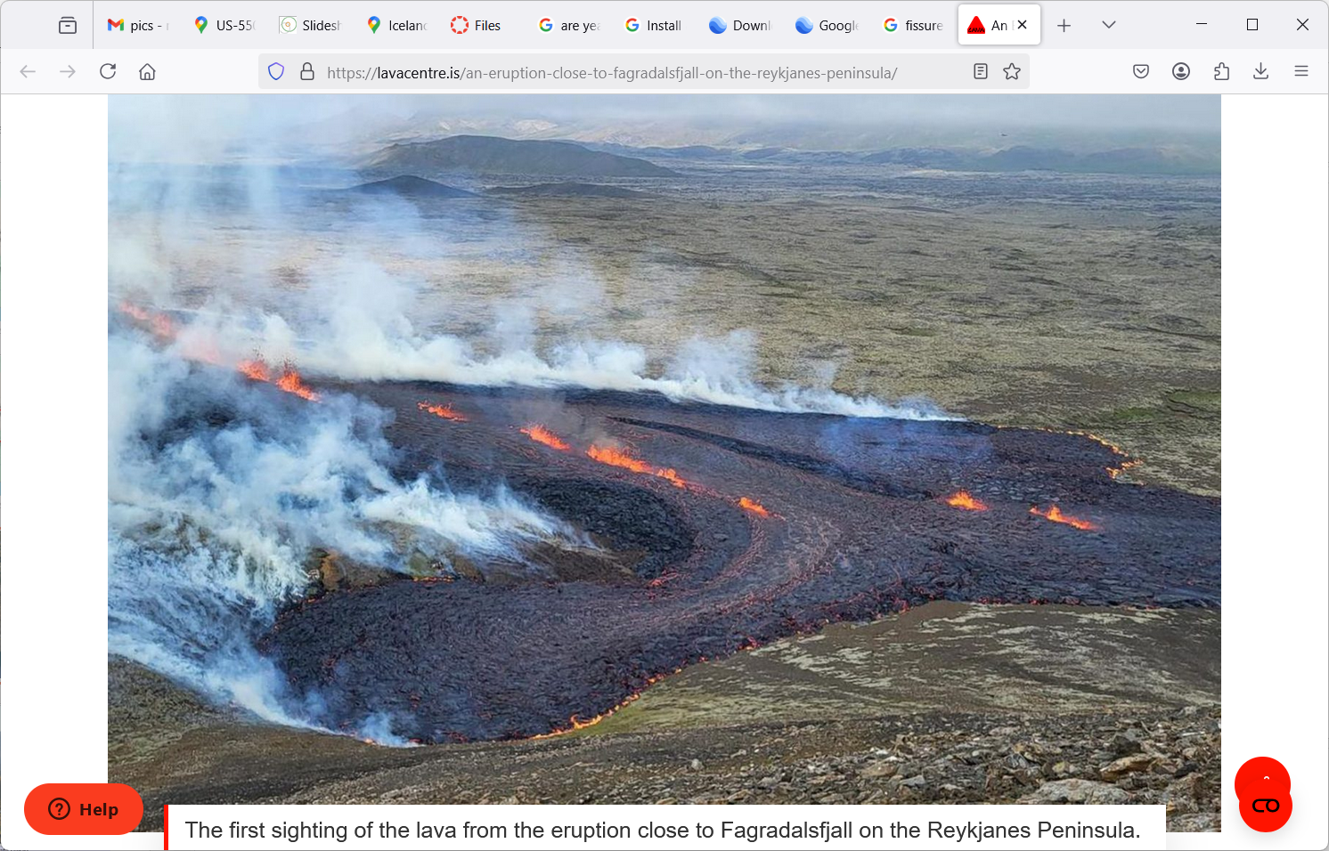
modern sub-areal fissure eruption

Slide 16
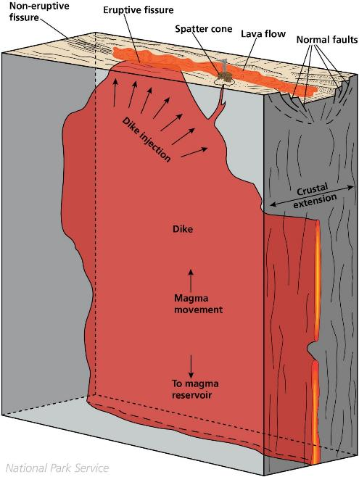
fissure eruption
top of lava-filled
vertical crack
opening direction is horizontal

Slide 17
Easy to judge opening diretion

Slide 18
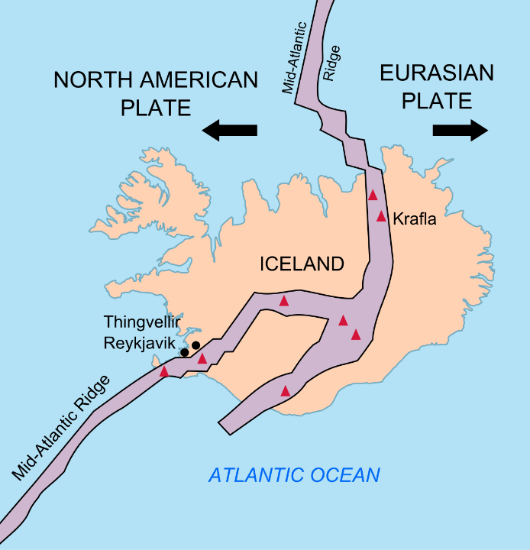
opening direction controlled by plate tectonic extension

Slide 19
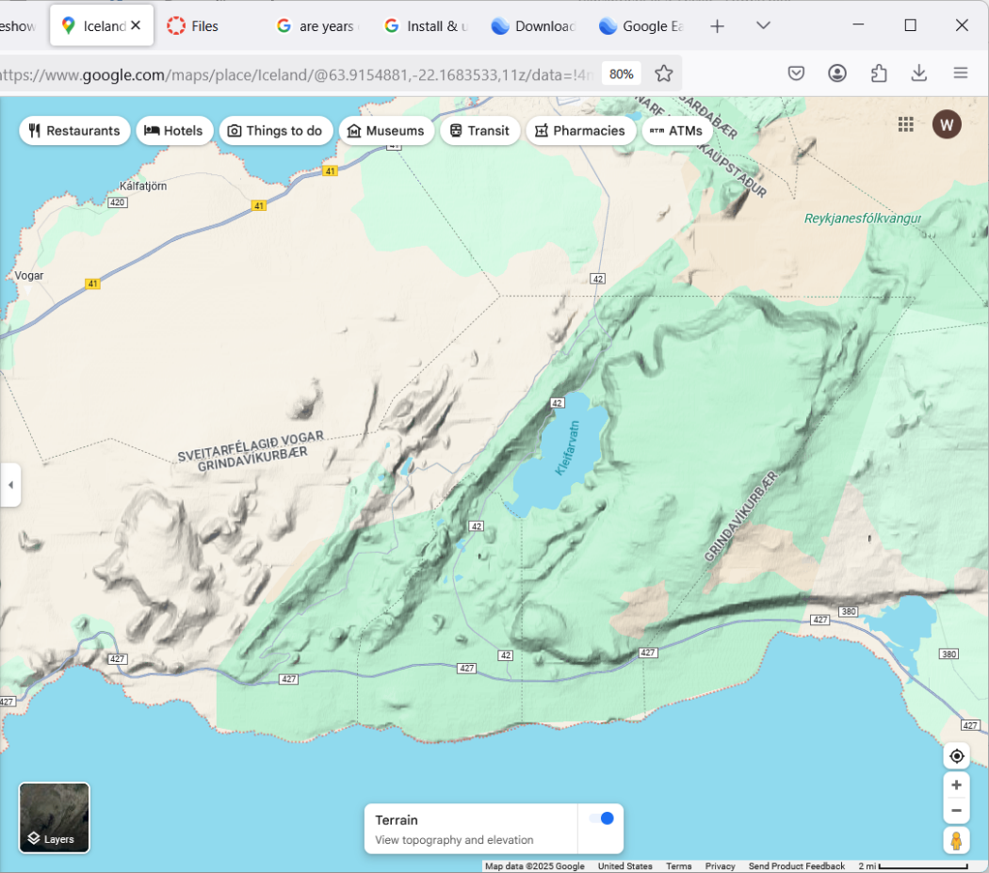
Thorbjorn - big subglacial eruption
fissure eruption relatively small

Slide 20
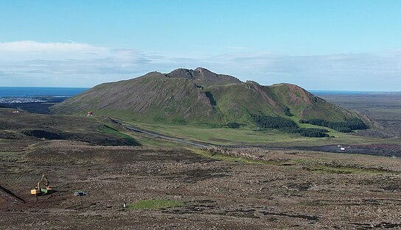
Thorbjorn (note that it is cut by fissures)

Slide 21
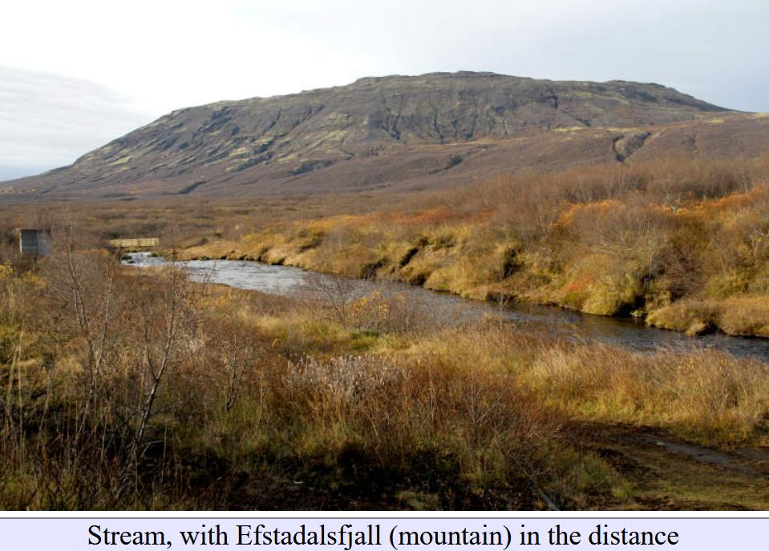
hyaloclastite ridges and hills common in iceland

Slide 22
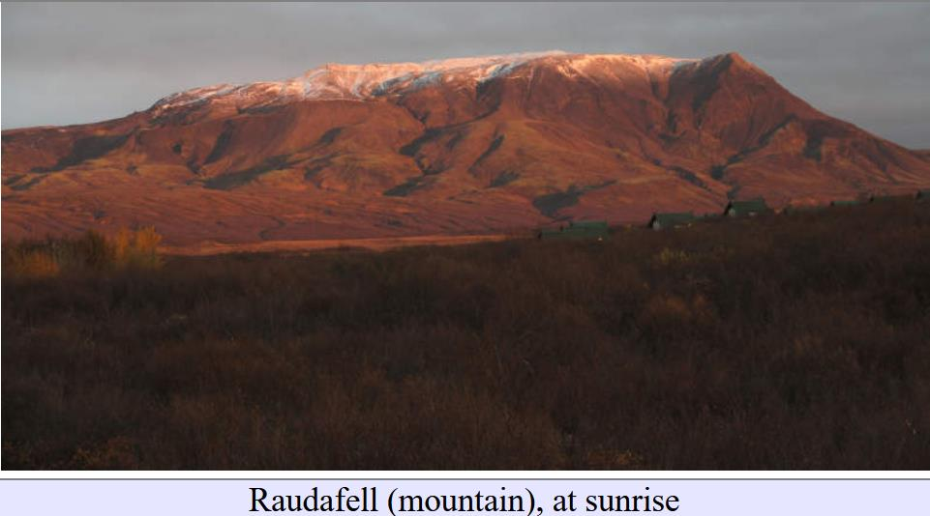

Slide 23
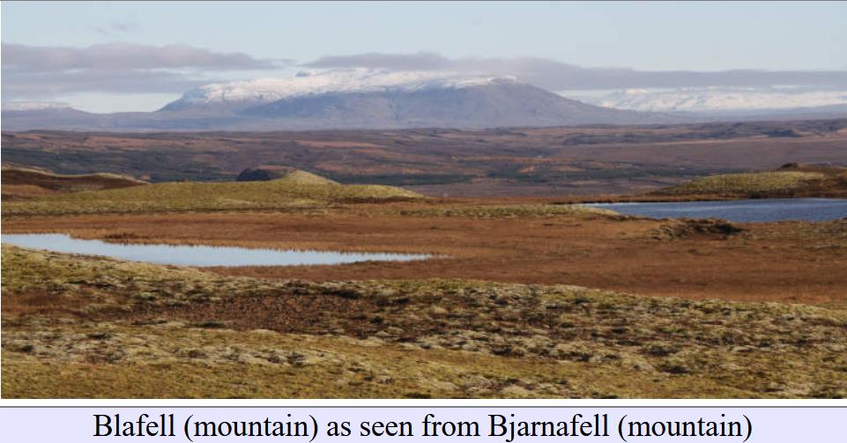

Slide 24
Part 3
Table Mountains

Slide 25
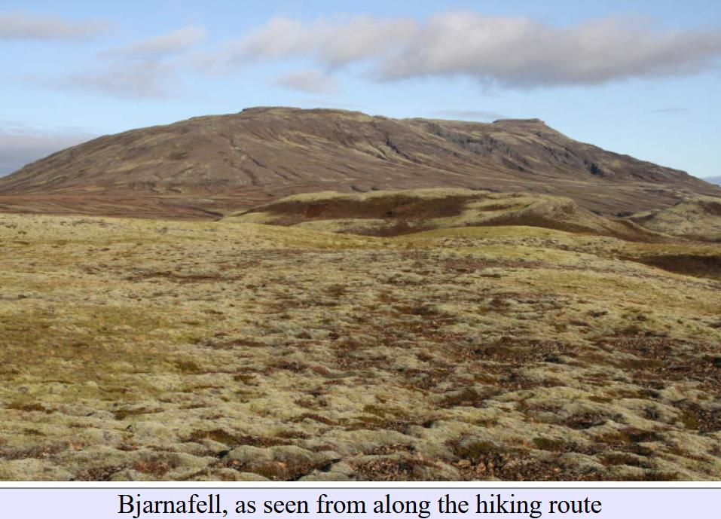

Slide 26
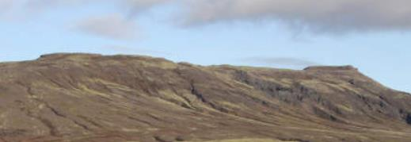
flat layers on top

Slide 27
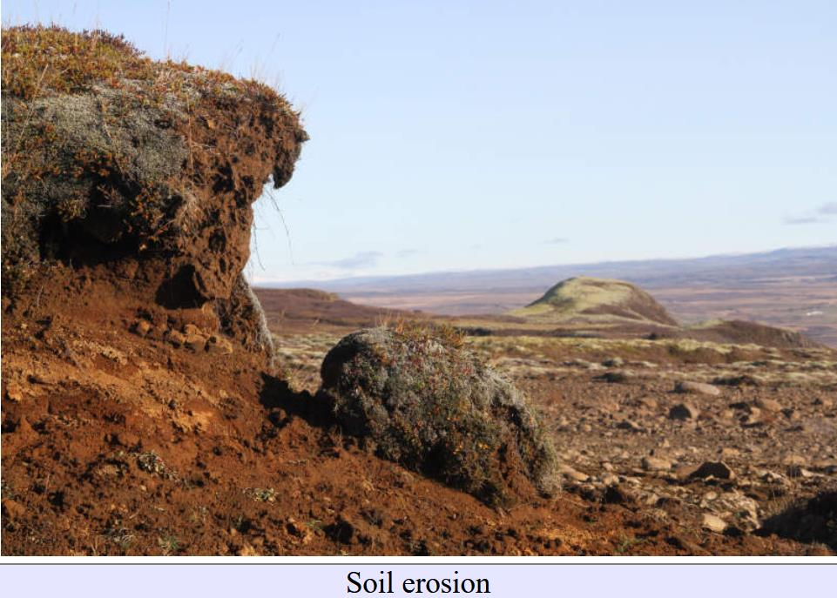
by the way, Iceland is the most ecologically-damaged country in Europe. Why?

Slide 28
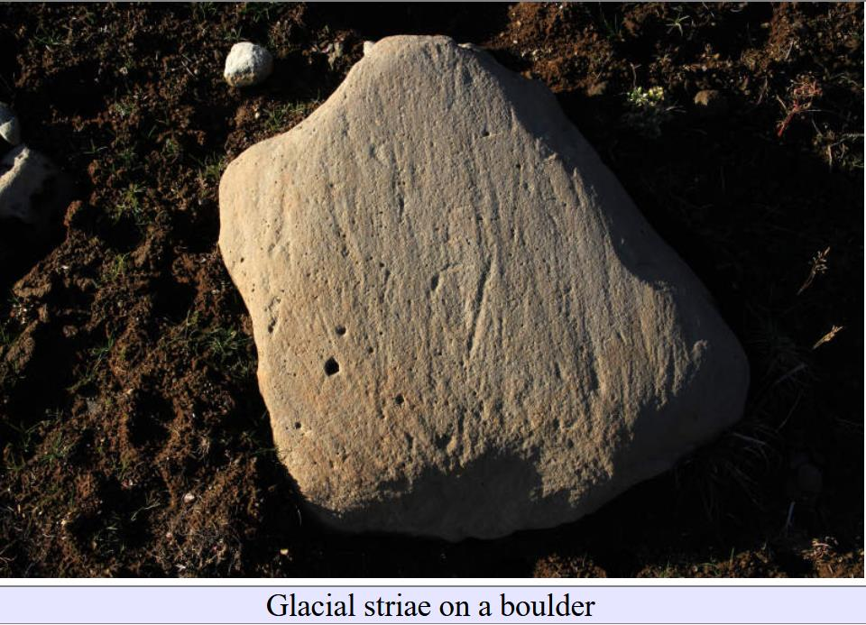

Slide 29
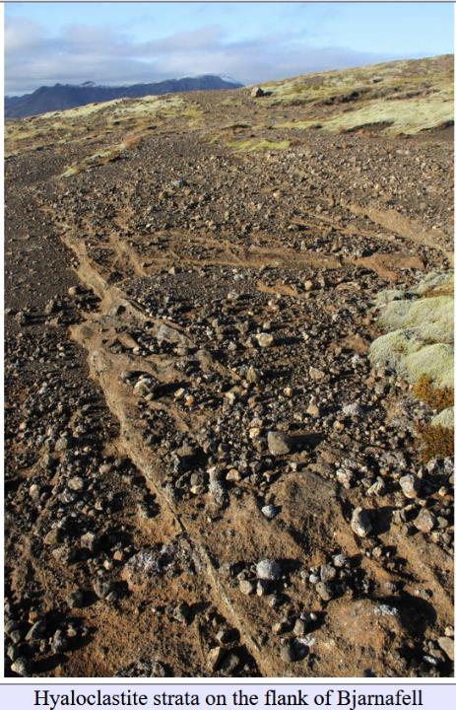

Slide 30
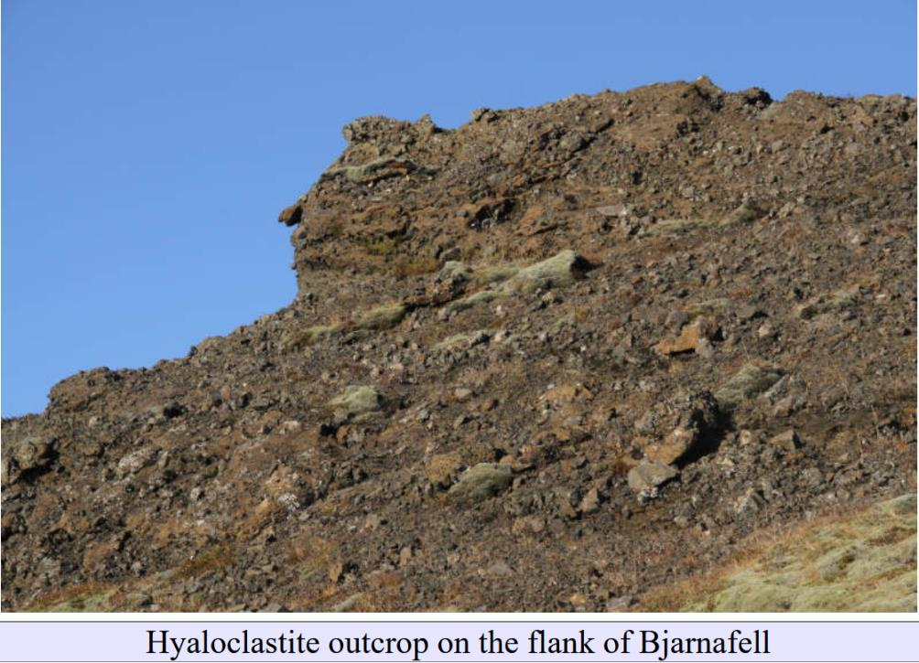

Slide 32
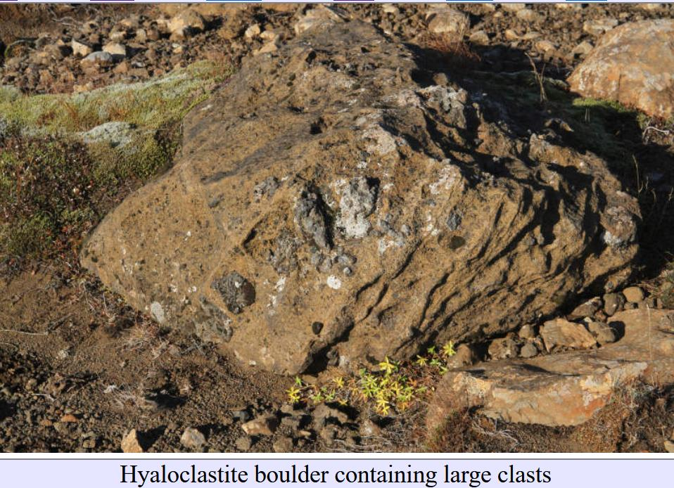

Slide 33
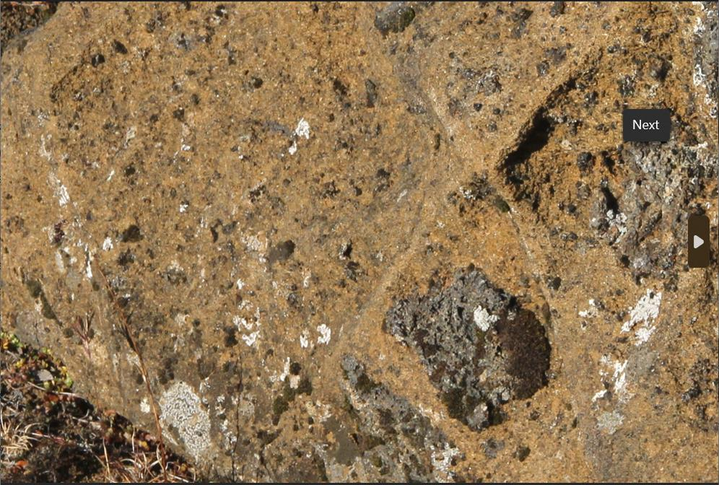

Slide 34
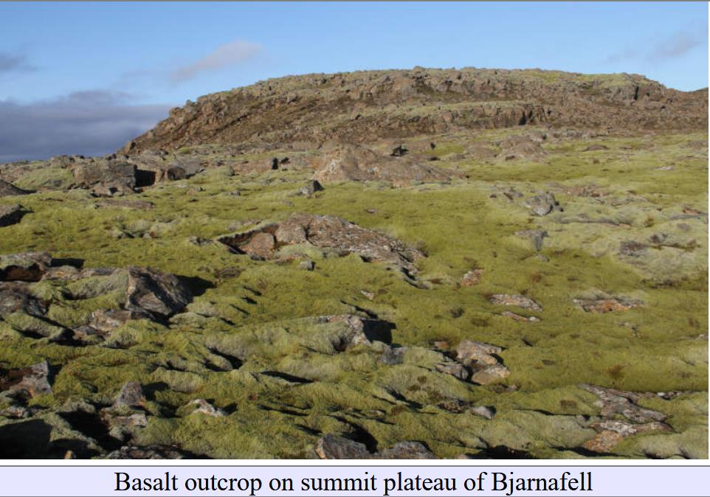

Slide 35
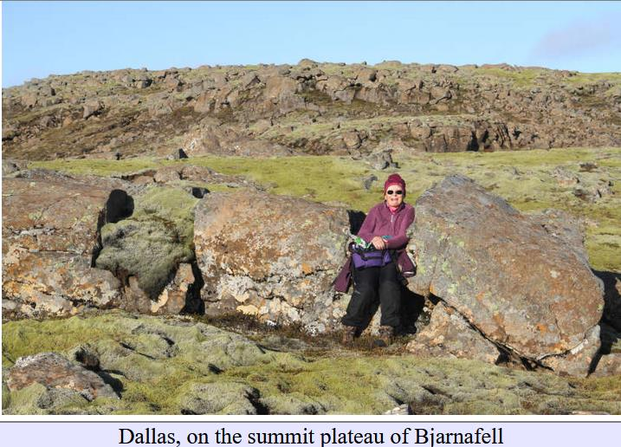

Slide 36
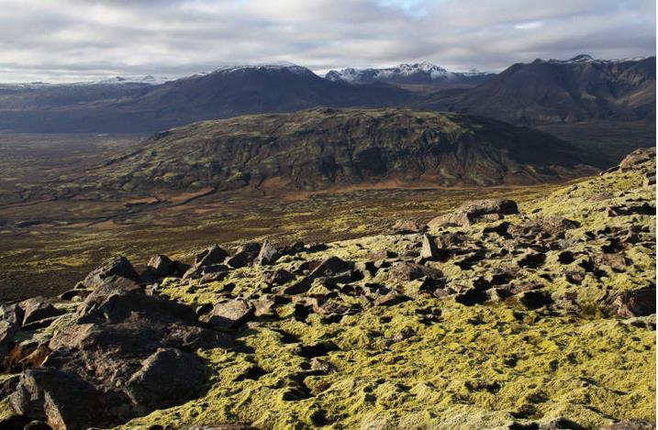

Slide 37
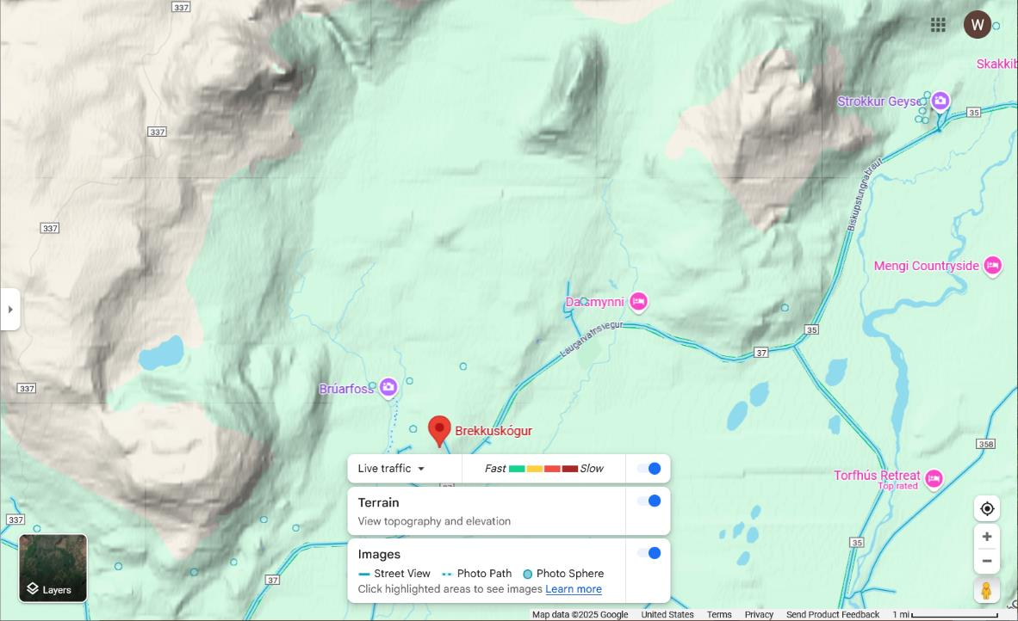
Hogenhofdi
Raudafell
Bjarnafell
only the tall hyaloclastite hills are capped with lava
Efstadalsfjall

Slide 38
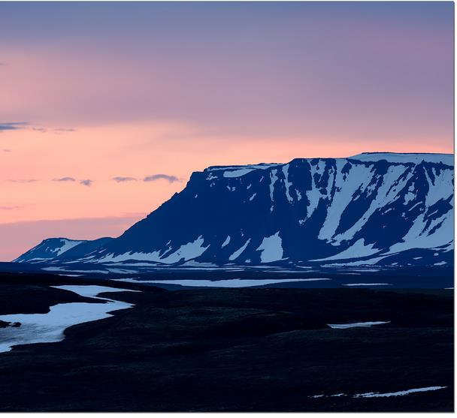
Gaesafjoll

Slide 39
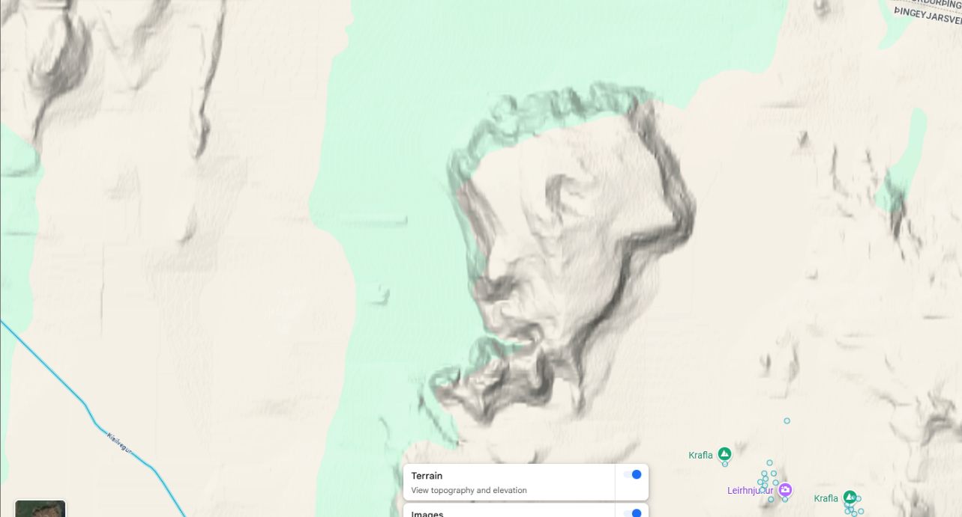
Gaesafjoll

Slide 40
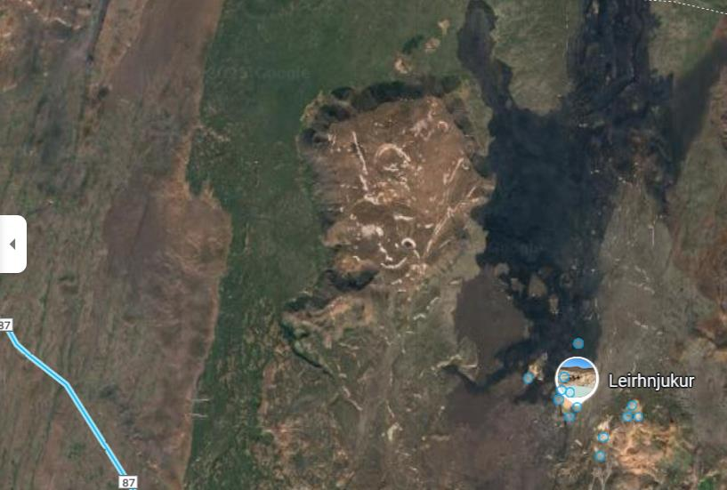

Slide 41
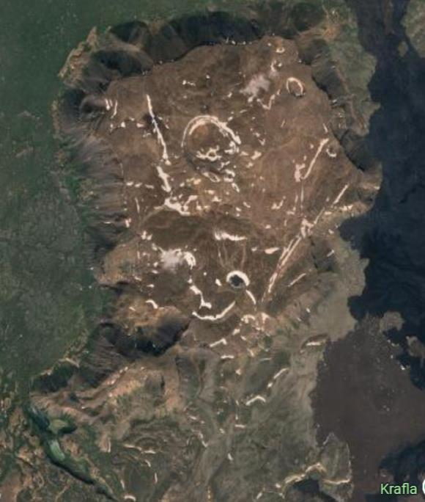
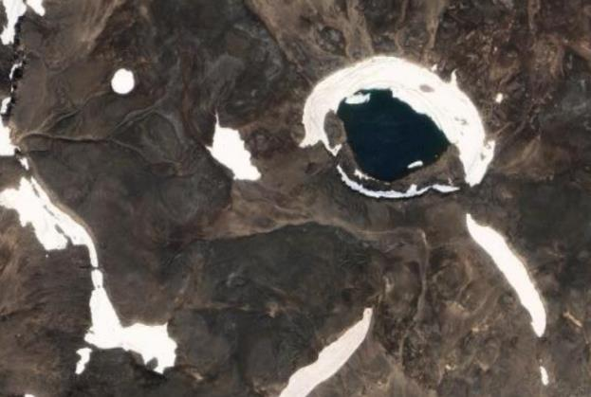
Volcanic Crater
Basalt at top

Slide 42
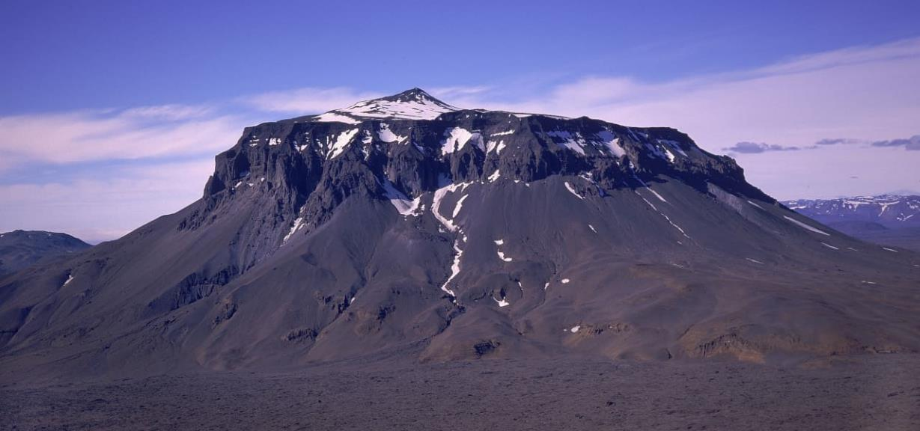
Herðubreið

Slide 43
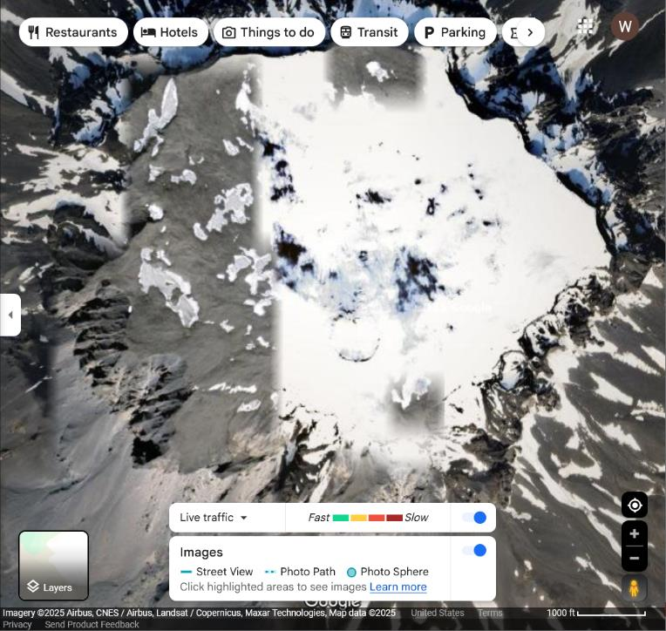
Volcanic Crater
Herðubreið

Slide 44
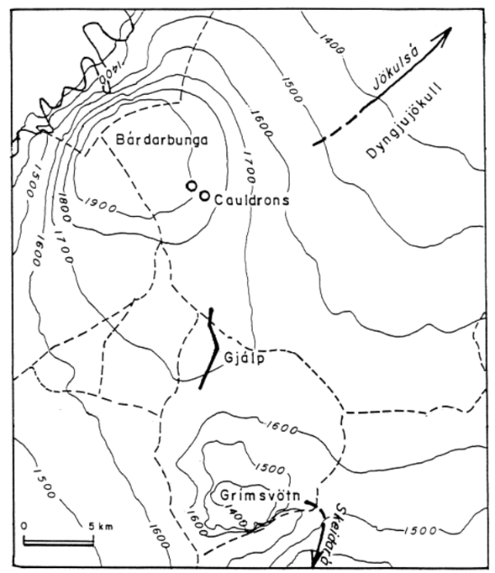
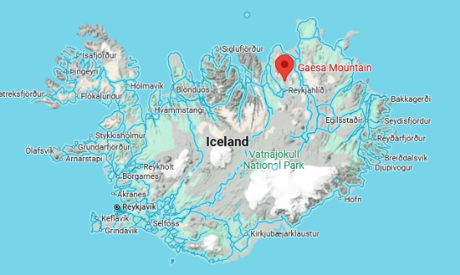
1996 subglacial eruption

Slide 45
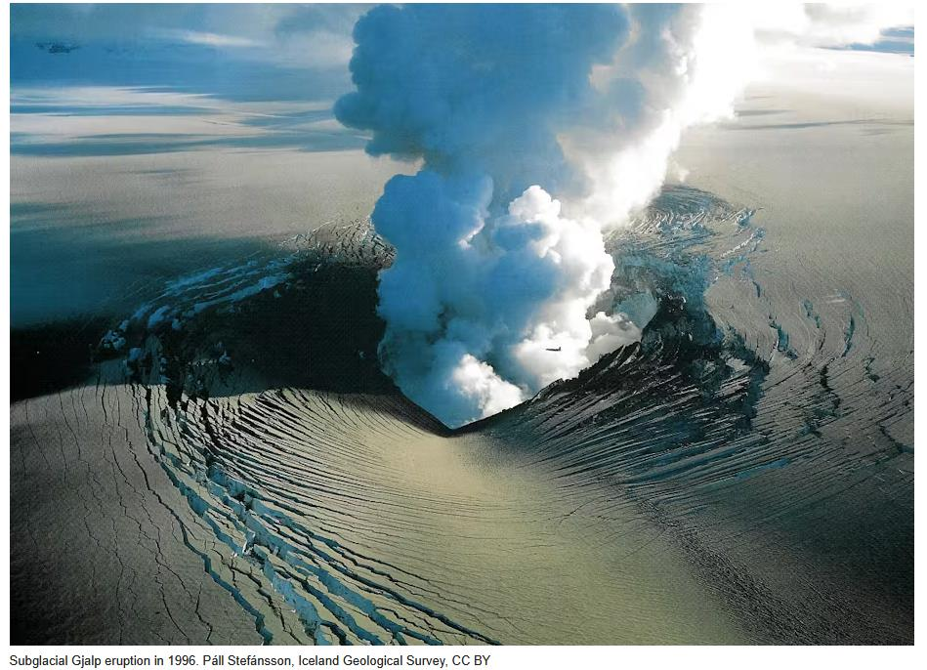
tephra-covered glacier

Slide 46
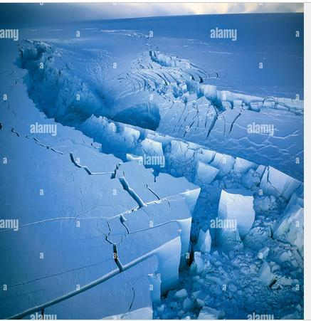
giant slot melted in ice

Slide 47
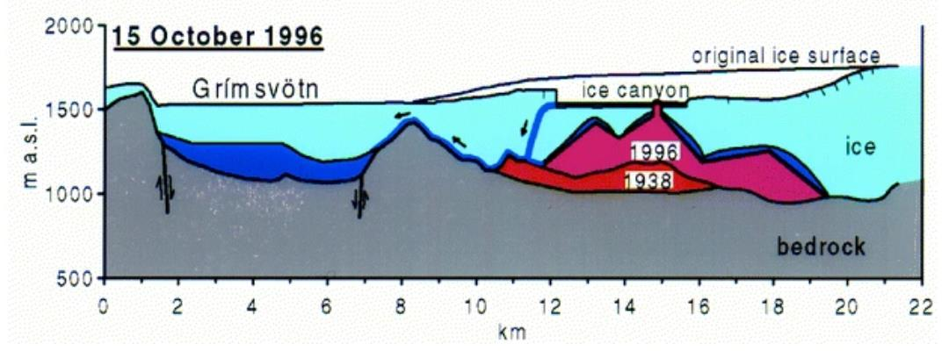

Slide 48
formation of table mountain
1
3
2
4
5

Slide 49
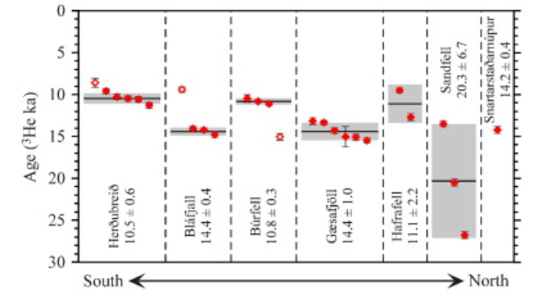
exposure ages of table mountains
north Iceland

Slide 50
height and exposure ages of table mountains
North Iceland
14,400 yrs
10,500 yrs

Slide 51
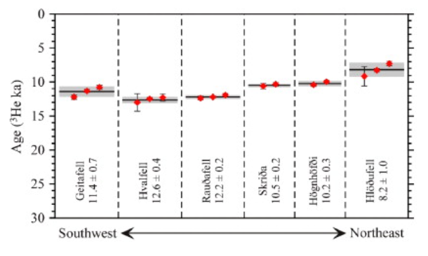
exposure ages of table mountains
south Iceland

Slide 52
height and exposure ages of table mountains
south Iceland
14,000 – 12,600 yrs

Slide 53
Volcanoes in West Antarctica

Slide 54
Volcanoes in West Antarctica
sub-areal
sub-glacial

Slide 55
Part 4
Glacial Rebound and accelerated volcanism

Slide 56
most table mountains date in the 10,000-15,000 yr range
south Iceland
north Iceland

Slide 58
Two things you need to know
(1) 1500 m of ice
depresses mantle
by 500 m
(2) mantle melts when
it upwells to make magma
ice
mantle
mantle
mantle

Slide 59
1500 m
Ice thickness
time
No Ice
Grow
Shrink
No Ice
100,000 years
5,000 yrs

Slide 60
ice 1/3 of density of mantle
500 m = 500,000 cm
subsidence
time
100,000 years
5,000 yrs

Slide 61
0.5 cm/yr
time
No Ice
100,000 years
subsidence rate
No Ice
5,000 yrs

Slide 62
0.5 cm/yr
time
mantle downwelling rate
No Ice
100,000 years
5,000 yrs

Slide 63
5,000 yrs
net rate
0.5 cm/yr
time
No Ice
100,000 years

Slide 64
suppose the mantle upwelling rate is 0.5 cm/yr
(a reasonable number)
subsidence cancels mantle upwelling for 100,000 yrs
no decompression melting of mantle occurs
no volcanism occurs
until the ice melts
then 100,000 years of volcanism
are compressed into 5,000 year

Slide 65
Part 5
Glacial subsidence and ancient shorelines

