Slide 1
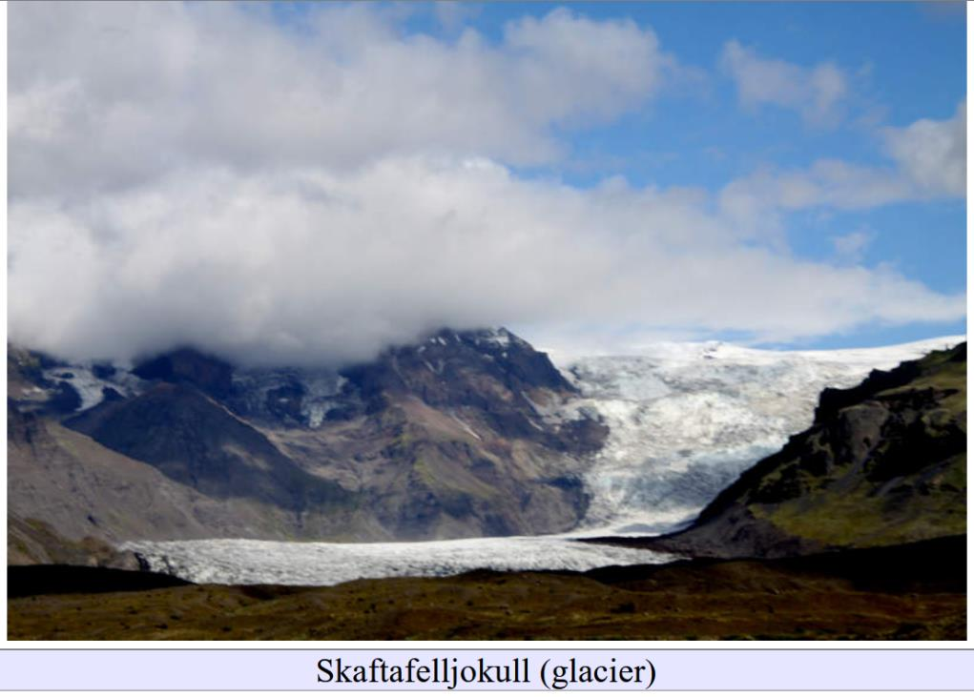
Submarine glacial geomorphology
Lecture 9

Slide 2
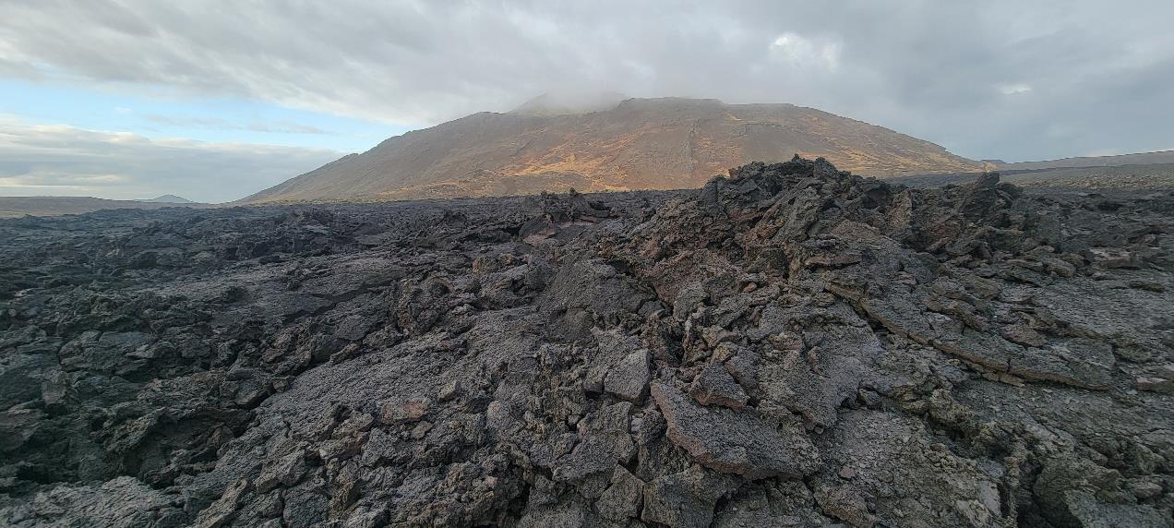
My spring break trip to Iceland
2024 lava flow near Thorbjorn (hyaloclastite hill)

Slide 3
Part 0: Social Media

Slide 4
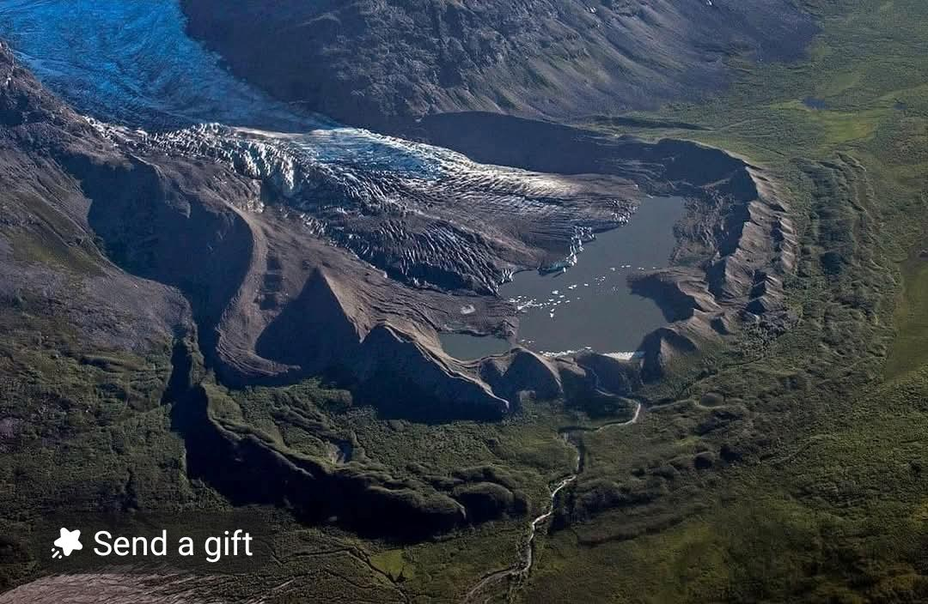
glacier, several terminal moraines, moraine lake, stream

Slide 5
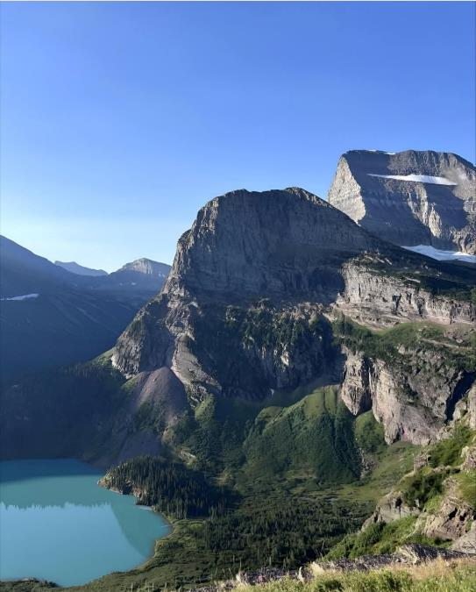
upper right:
definitely cirques, aretes
lower left
probably cirque with
cirque lake

Slide 6
background:
definitely glacier in cirque
aretes, horns
foreground
probably cirque with
moraine lake

Slide 7
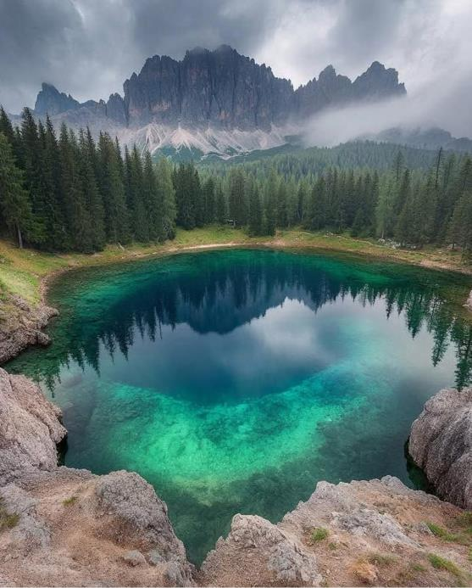
background:
arete ?
foreground
cirque with moraine lake ?
plunge pool?

Slide 8
sediment
basalt lava flow
North Table Mountain, Golden, Colorado
erosional “mesa”, not a table mountain
sediment sandstone, not hyaloclastite

Slide 9
Part 1: Icebergs

Slide 11
Filchner Ice Shelf
floating
Ice

Slide 12
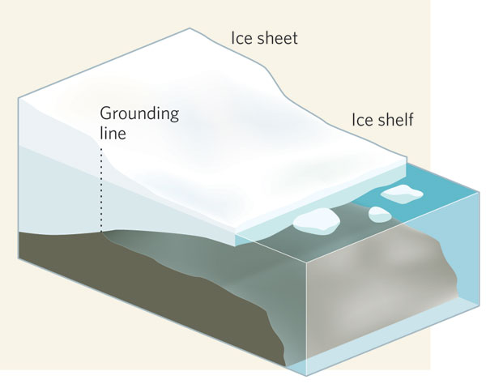

Slide 13
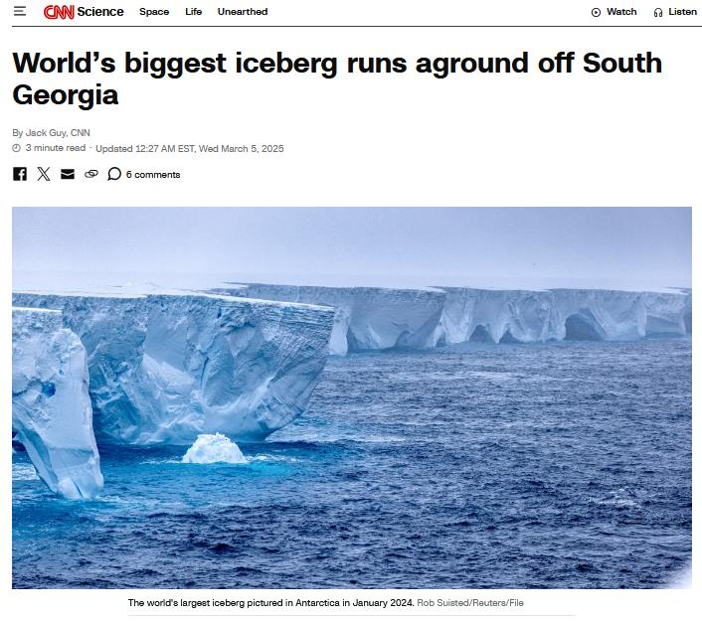
A23a broke off
Filchner
Ice Shelf
40 m
but only top 10% above water

Slide 14
Iceberg
40 m
360 m
400 m

Slide 15
2025
1986

Slide 16
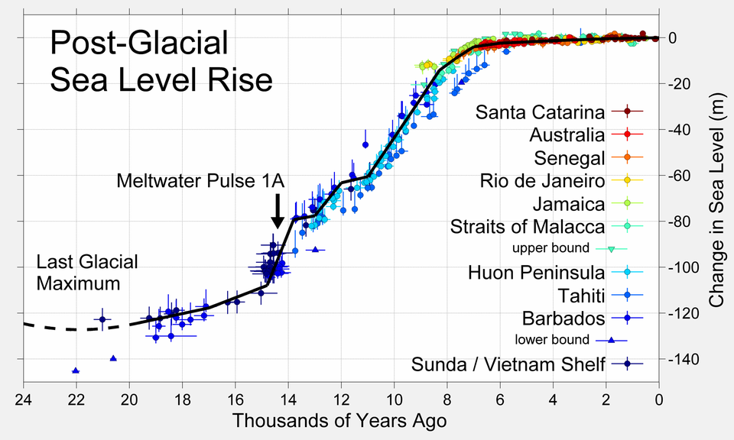
120 m

Slide 17
360 m + 120 m = 480 m
during the Ice Age
icebergs could run into the seafloor to depths that are now 500 m deep

Slide 18
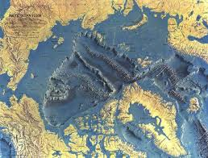
Lomonosov
Ridge

Slide 19
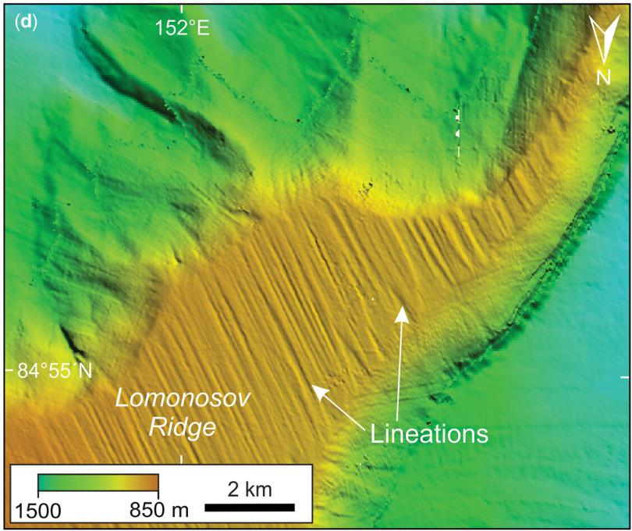

Slide 20
Part 2: Submarine glacial geomorphology

Slide 21
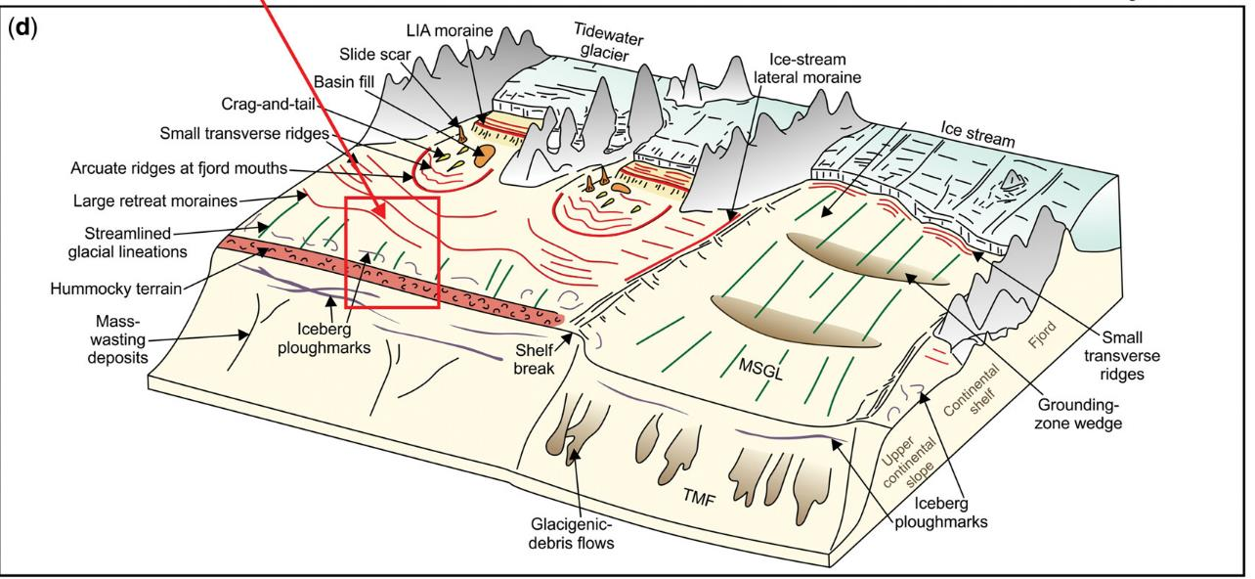

Slide 22
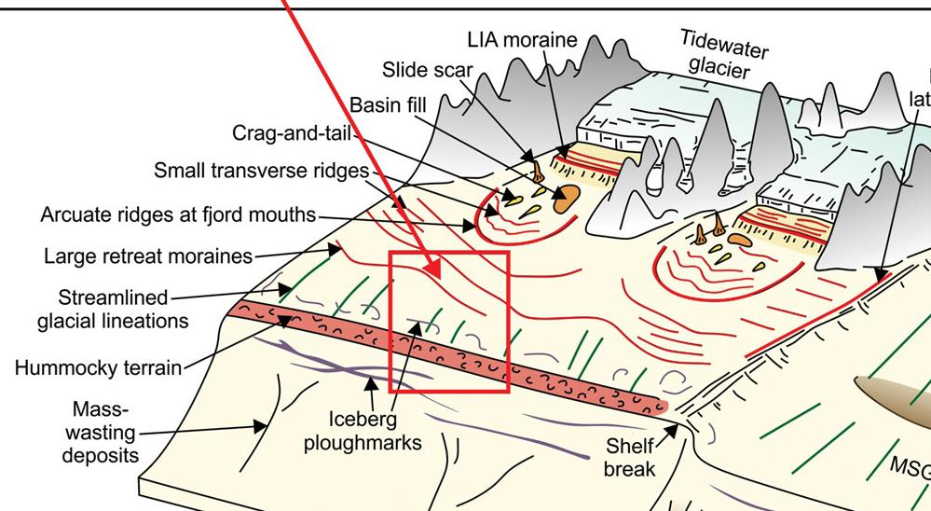
Tidewater
Glacier

Slide 23
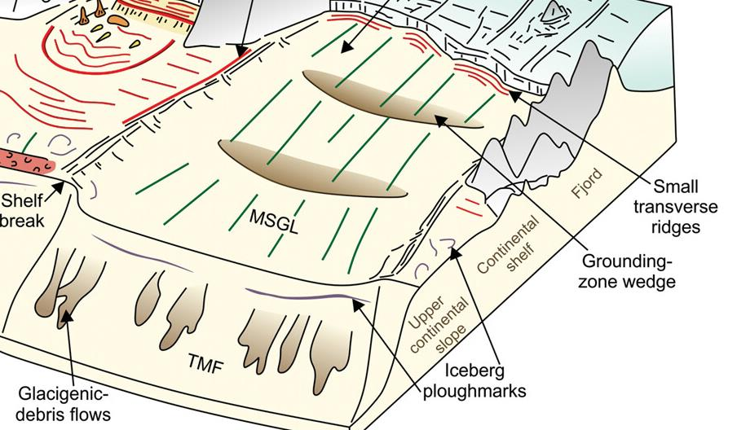
Ice Stream

Slide 24
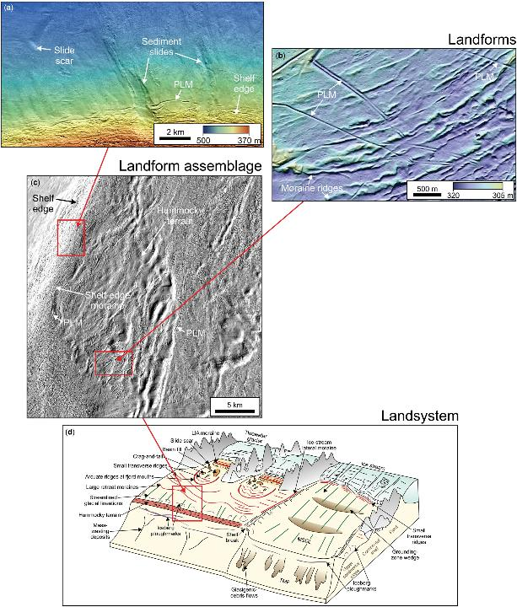

Slide 25
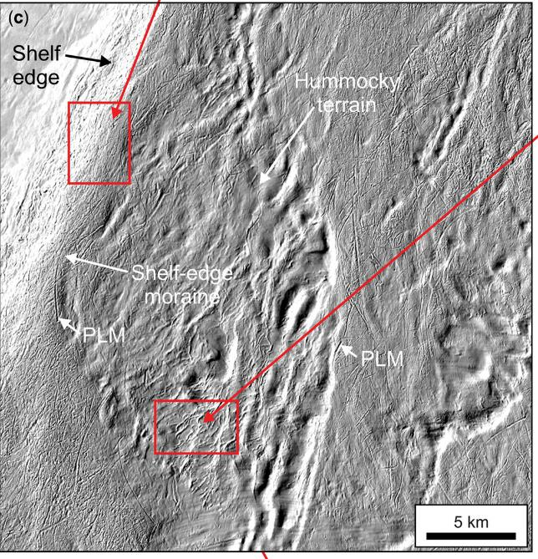
B
A

Slide 26
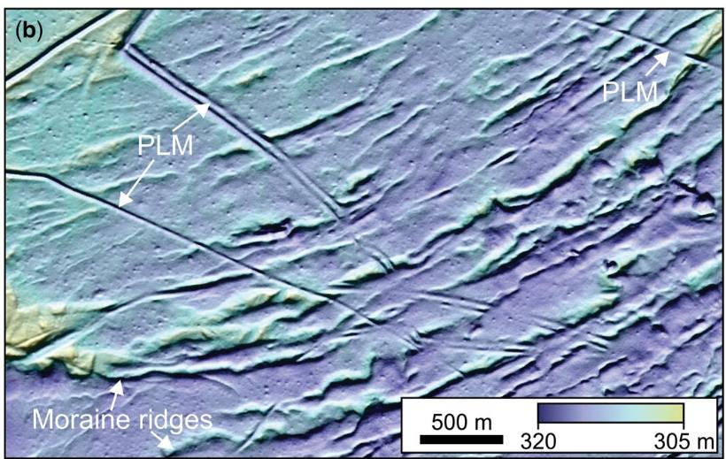
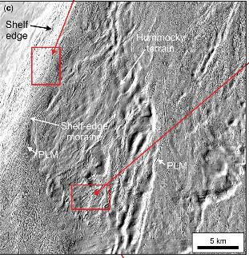
A
PLM= iceberg ploughmarks
A
law of superposition: ploughmarks later than moraine

Slide 27
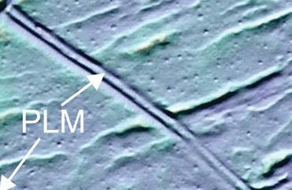
law of superposition: ploughmarks later than moraine
A
A

Slide 28
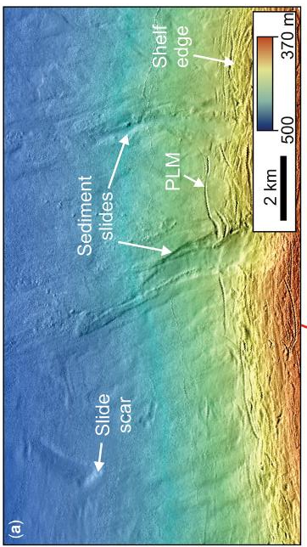
B
B

Slide 29
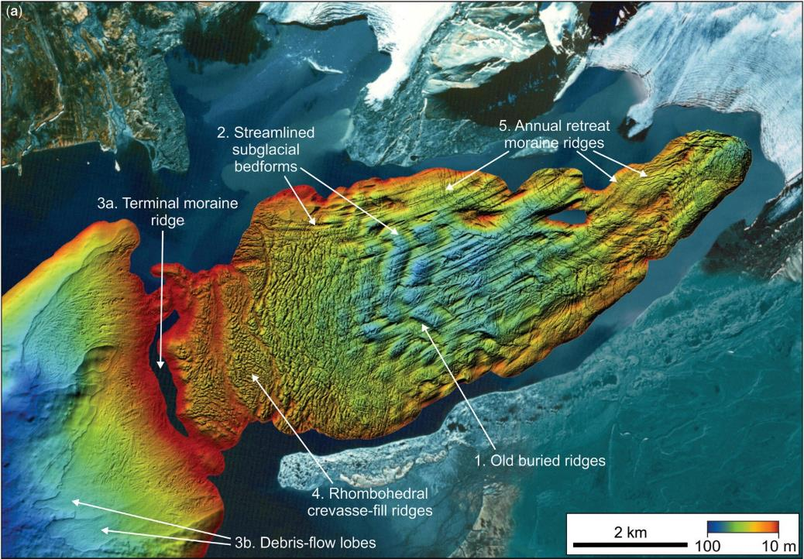

Slide 30
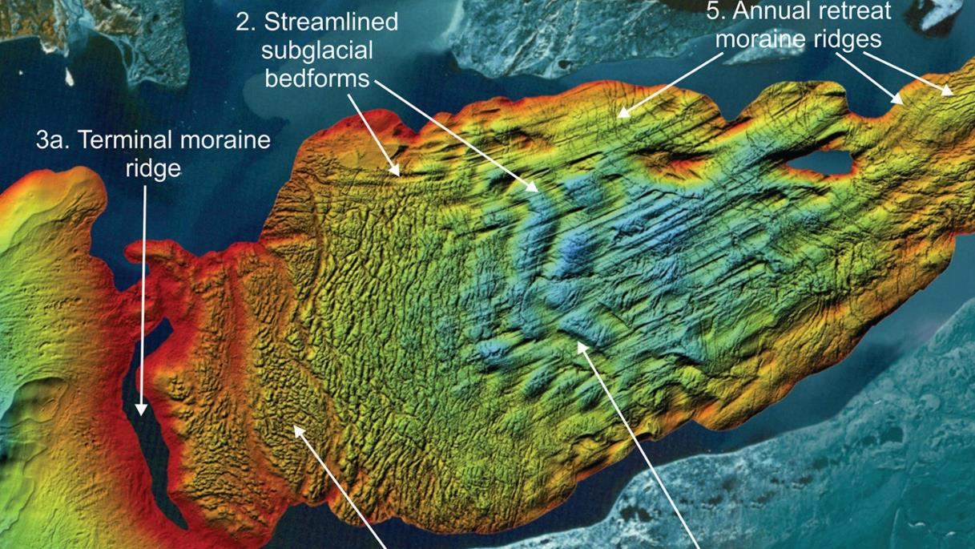

Slide 31
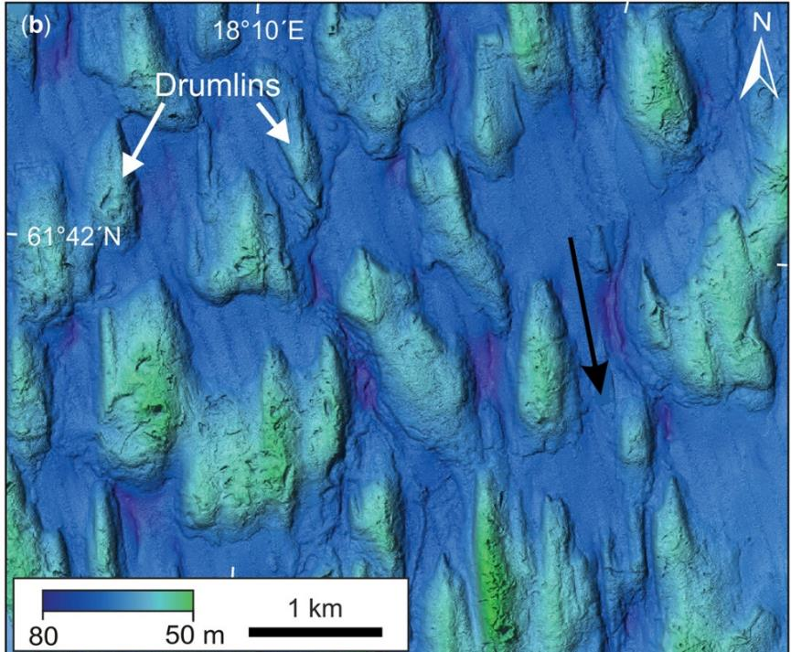

Slide 32
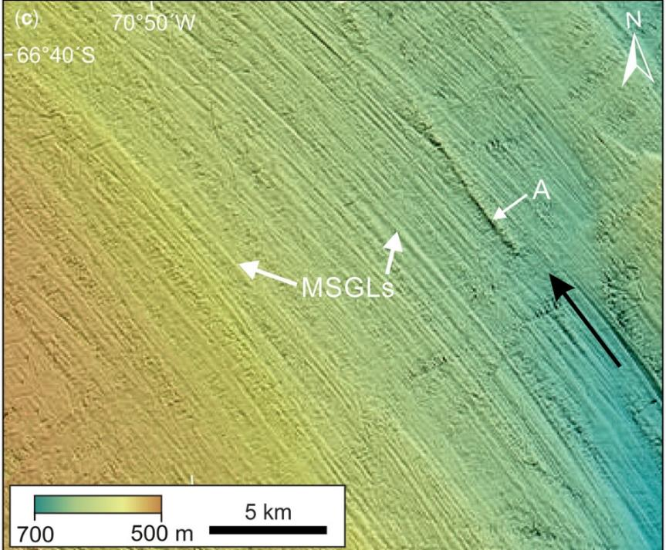
MSGL = mega-scale glacial lineations
long, skinny drumlins

Slide 33
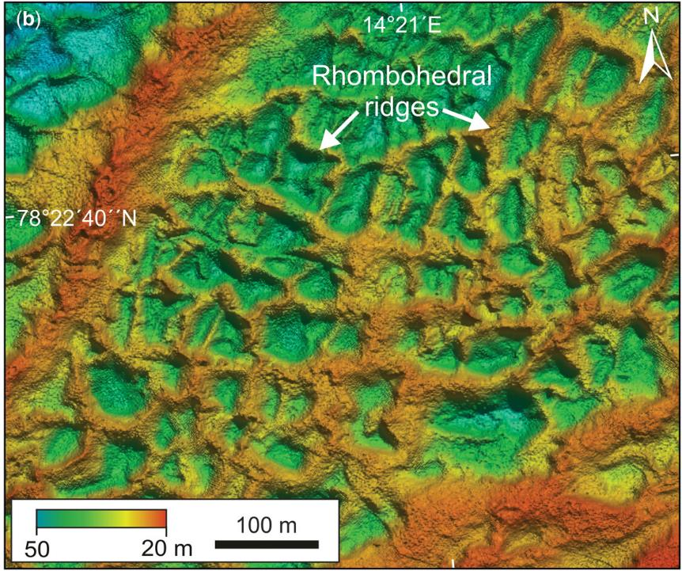
Rhombohedral ridges = from till in crevasses

Slide 34
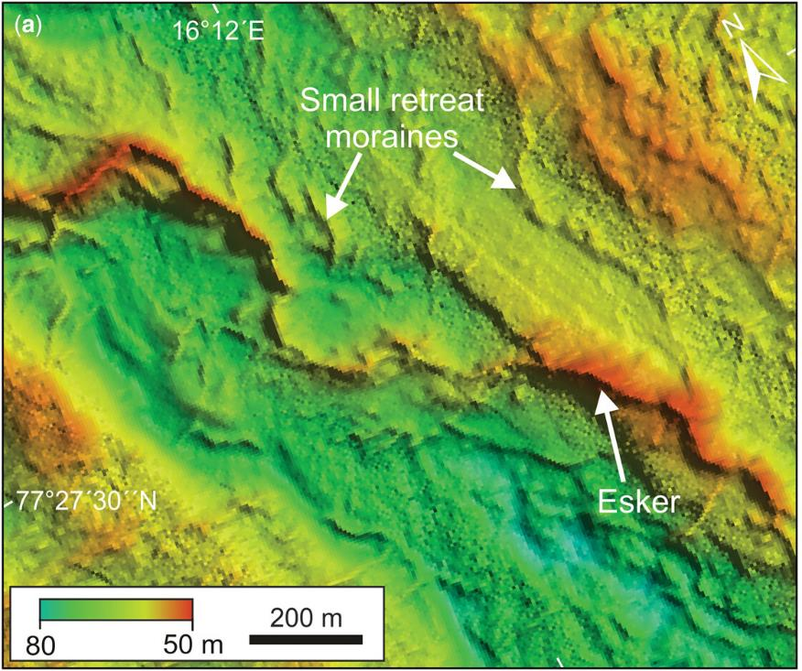
Esker

Slide 35
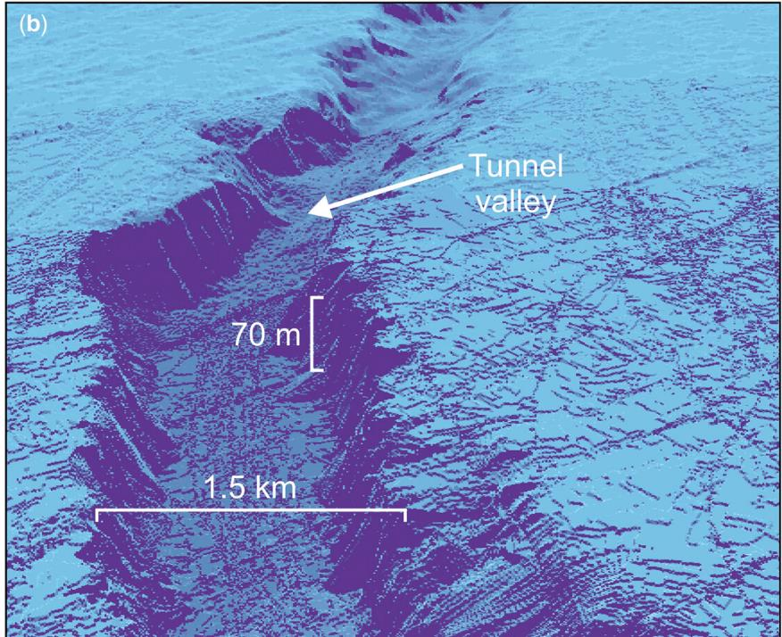
Tunnel Valley

Slide 36
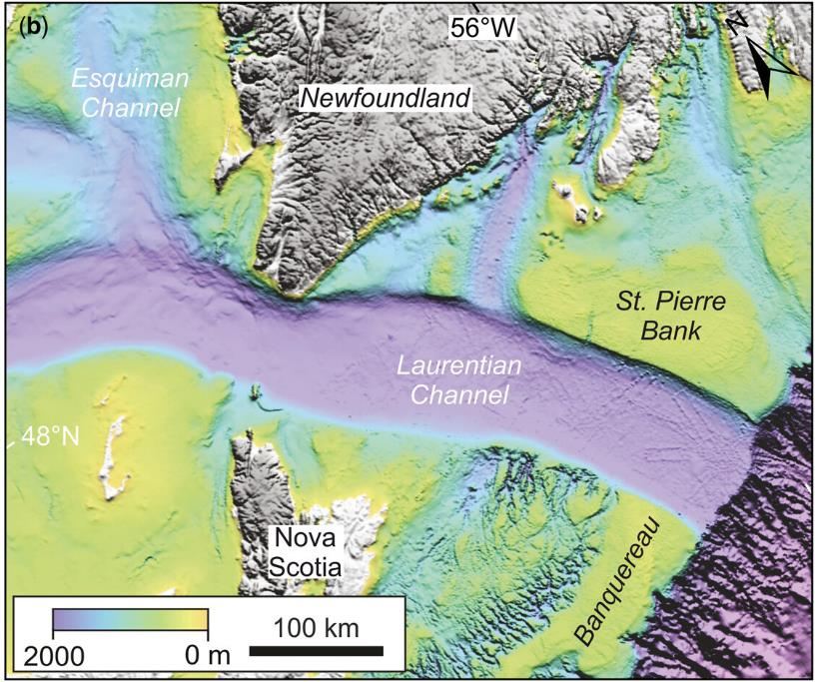
Fjord

Slide 37
Part 3: Iceberg ploughmarks

Slide 38
Atlas of Submarine Glacial Landforms

Slide 39
which way did it go?
Atlas of Submarine Glacial Landforms

Slide 40
Law of Superposition
Atlas of Submarine Glacial Landforms

Slide 41
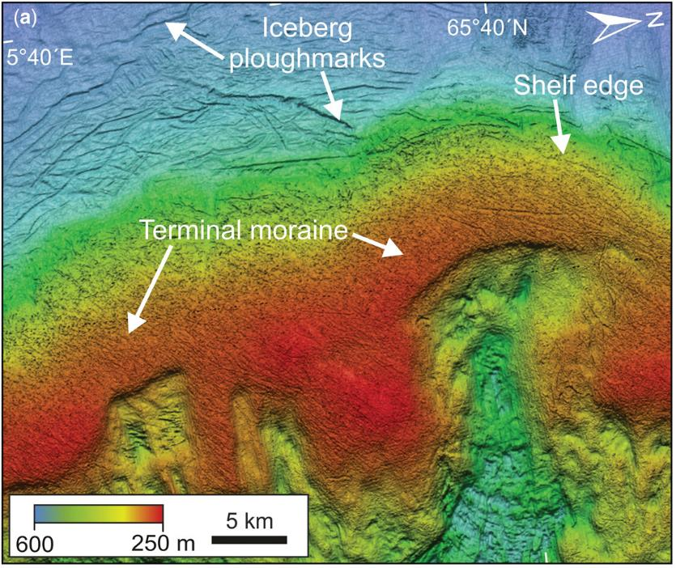

Slide 42
glacier was here

Slide 43
Moraine

Slide 44
Iceberg
Ploughmarks

Slide 45
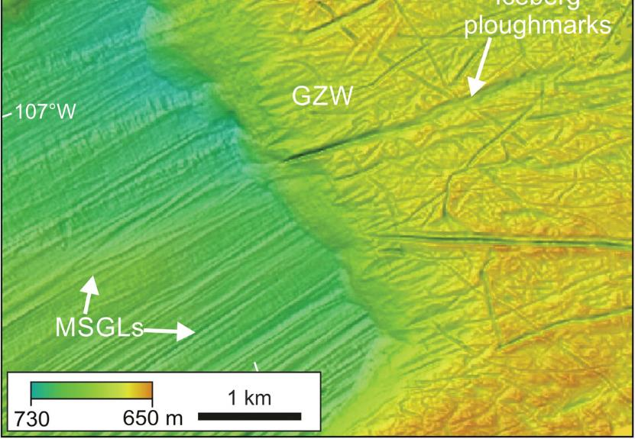

Slide 46
mega-scale
glacial lineations
(long, skinny drumlins)

Slide 47
grounding-zone wedge

Slide 48
iceberg
ploughmarks

Slide 49
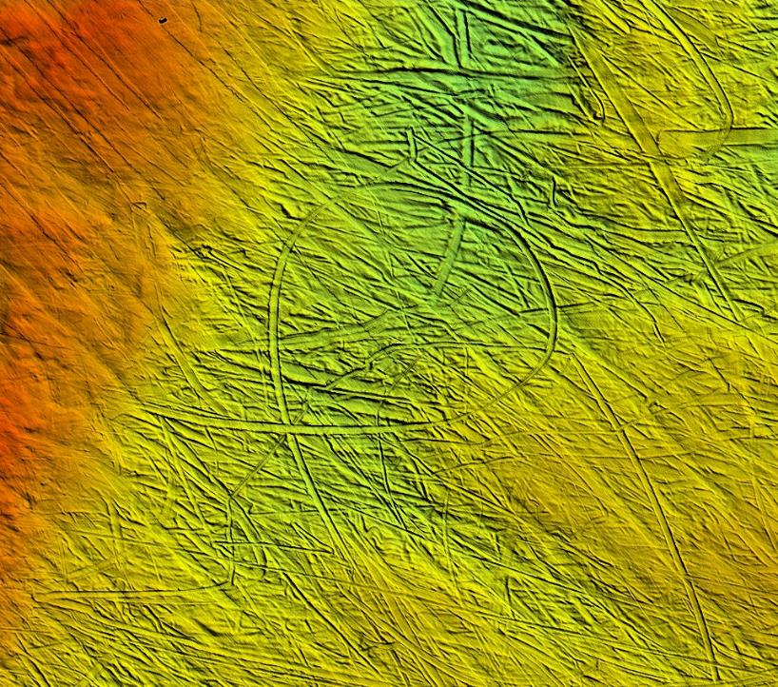

Slide 51
Part 4: Dropstones and Heinrich Layers

Slide 52
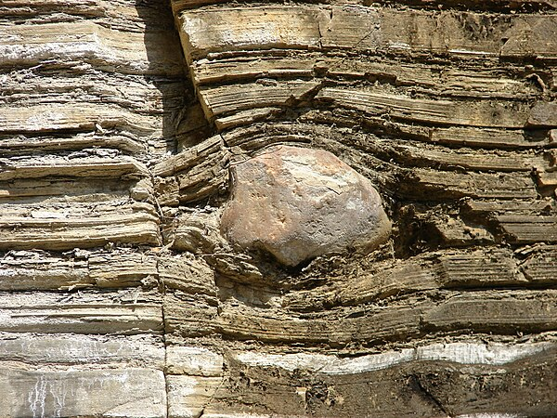
dropstone: melting iceberg dropped stone into otherwise well-stratified sediments

Slide 53
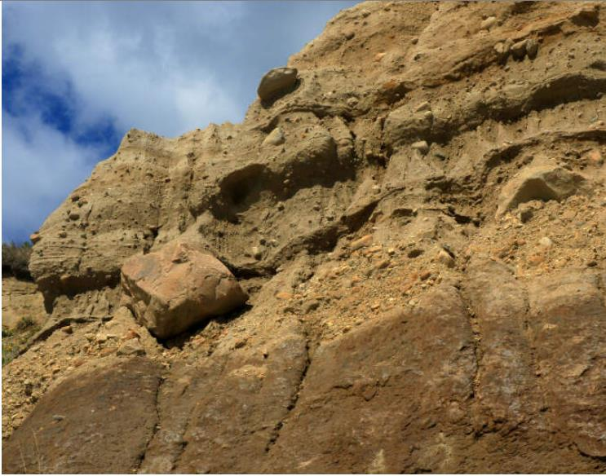
dropstone is not the same as a boulder in an outwash moraine, which could have been transported fluvially

Slide 54
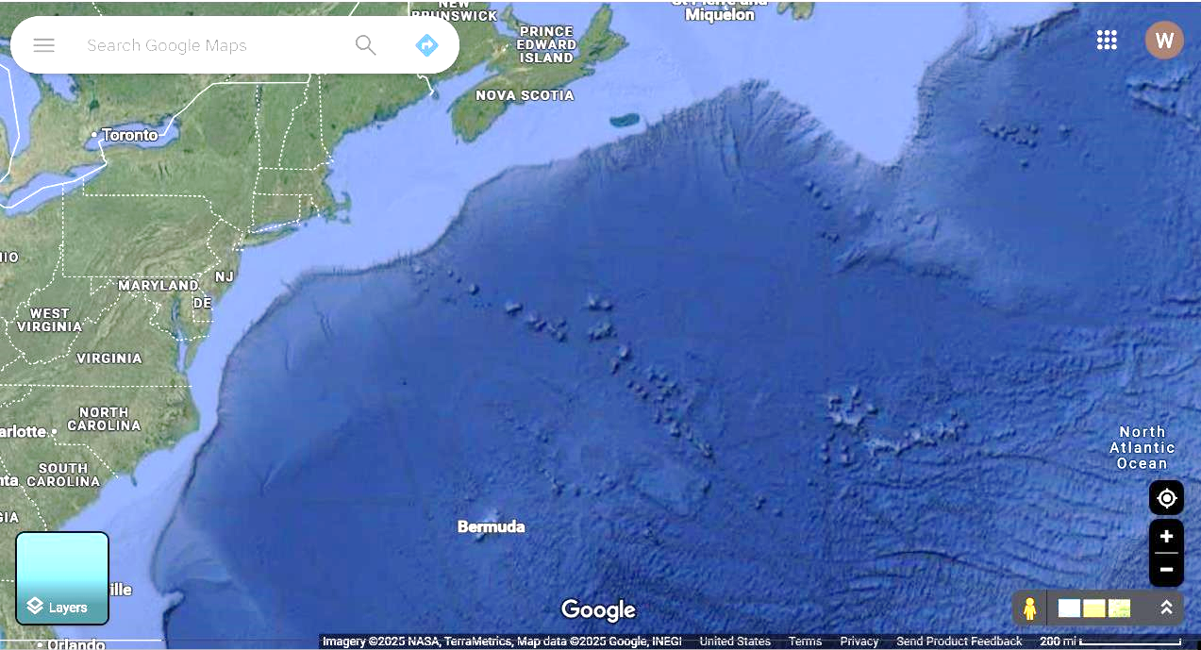
Corner Rise Seamounts basaltic lithology, so
easy to spot dropstones

Slide 55
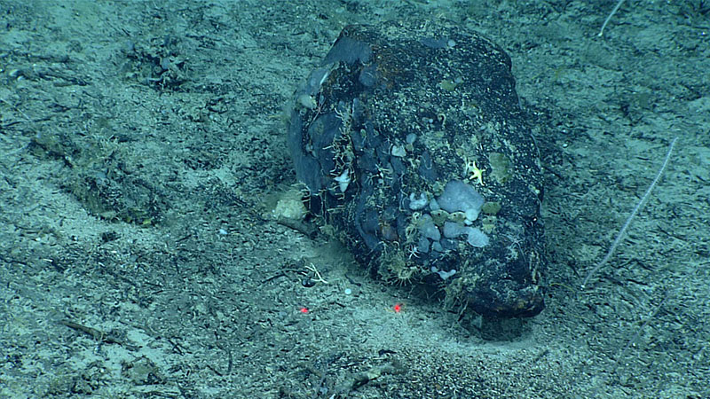
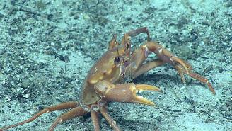

Slide 56
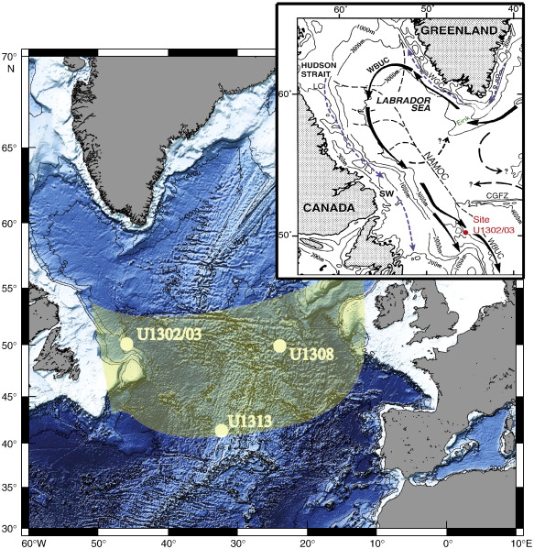
ODP Site U1308

Slide 57
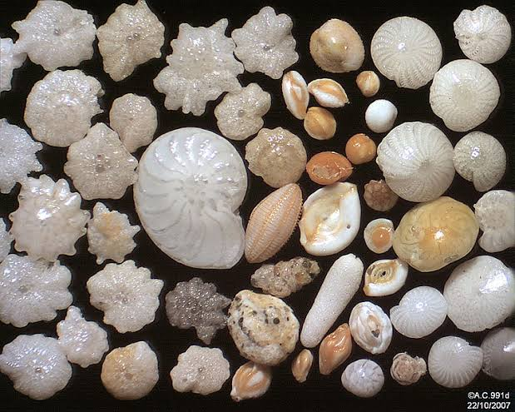
sediment
mostly foraminifera
plankton with
carbonate test (=shell)

Slide 58
Heinrich Event 1, ODP Site U1308A-1H-1
“lithic”
sediment
(sand grains
derived from
the continent)

Slide 59
concentration of lithic grains
time, ka

Slide 60
H1
concentration of lithic grains
time, ka

Slide 61
Bolling-Allerod (warming)
Younger Dryas (cold snap)
-30
Pleistocene
Greenland temp (degC)
Holocene
-45
20
10
0
20
time (ka)
H1

Slide 62
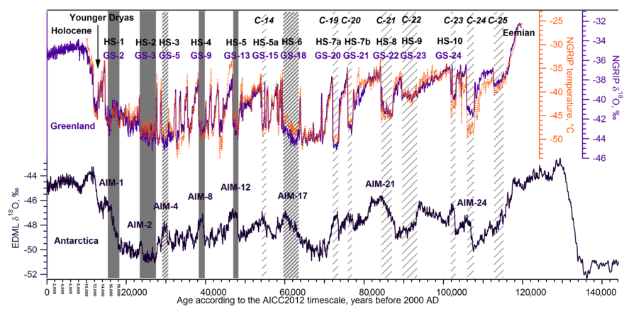

Slide 63
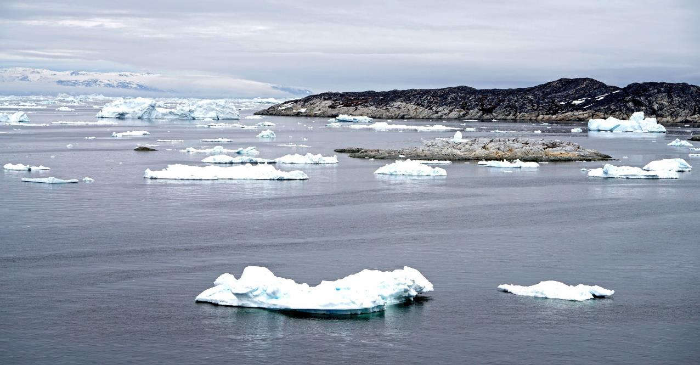
Modern surges of Icebergs

Slide 64
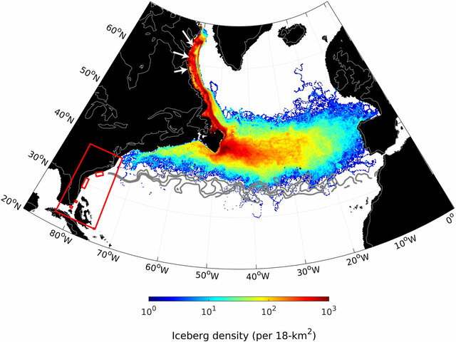
Simulation of Pleistocene Surge of Icebergs

Slide 65
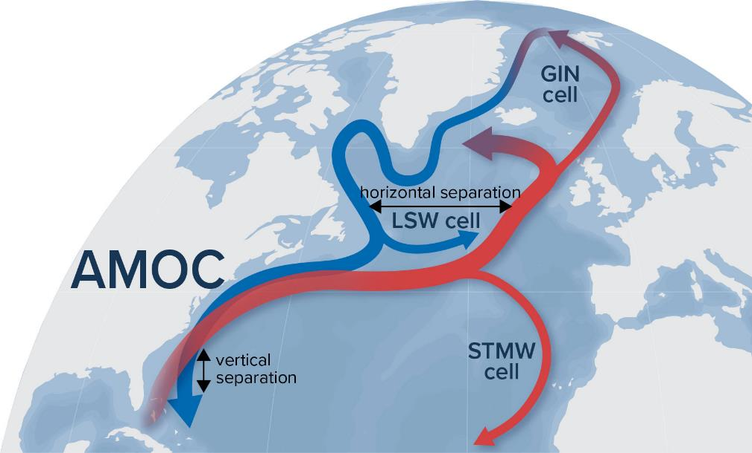
Low salinity of melting icebergs thought to have weakened the AMOC

Slide 66
Part 5: Submarine debris flows

Slide 67
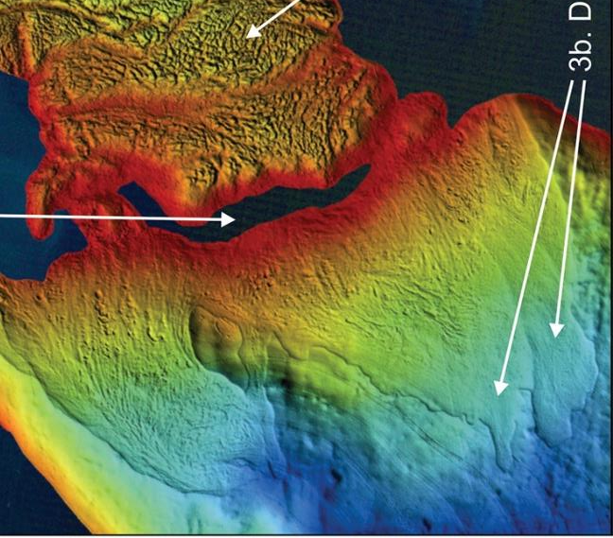
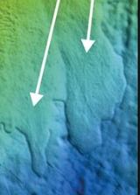
Debris Flows

Slide 68
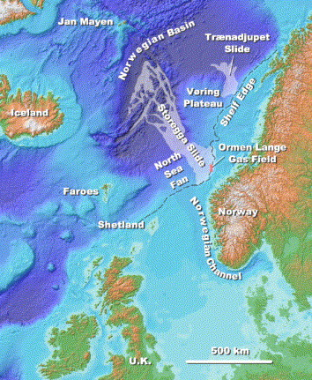
The three Storegga Slides,
approximately 6225–6170 BCE.

Slide 69
