Slide 1
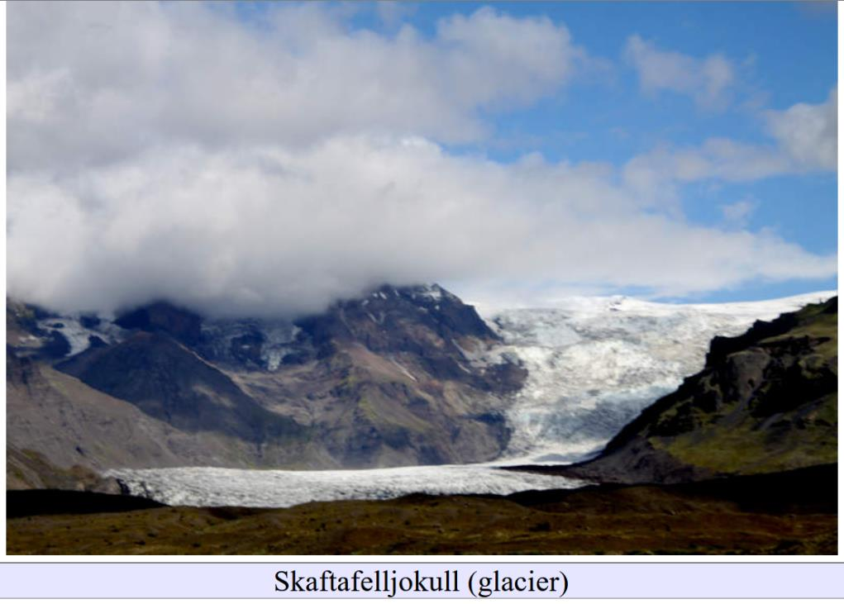
Varves, Loess and Biostratigraphy
Lecture 11

Slide 2
Part 0: Social Media

Slide 3
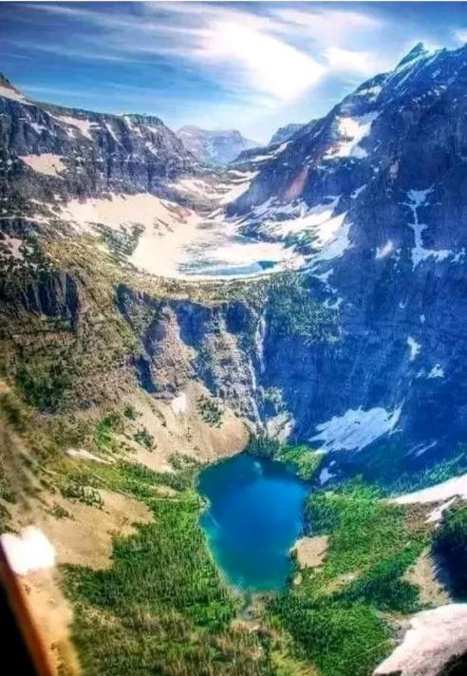

Slide 4
U shaped valley
two levels of cirques
cirque lakes
This terrain is glacial

Slide 5
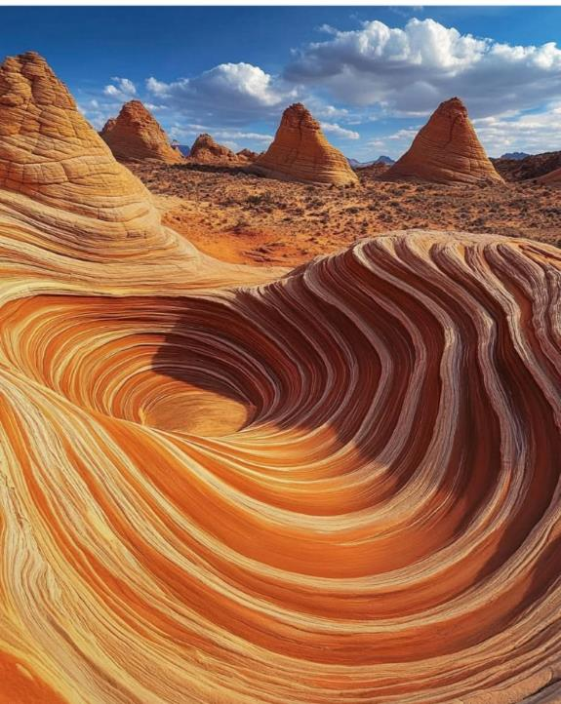
Could this be a cirque with horns in the distance?

Slide 6
Not triangular enough for horns, and no cirques below them
This terrain is not glacial

Slide 7
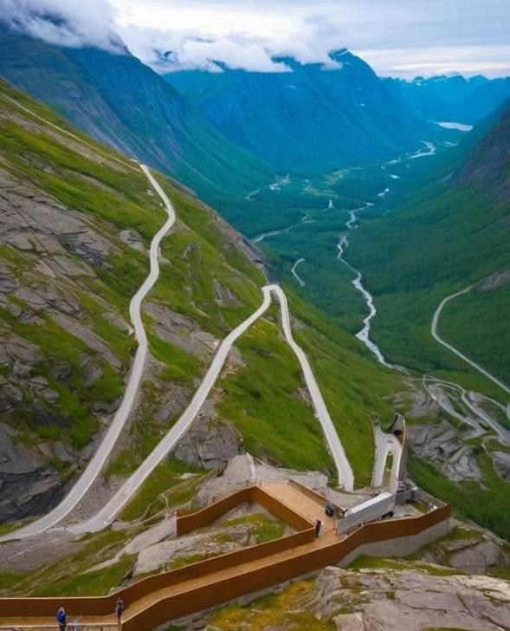
large U-shaped valley
stream at its bottom
lake in the distance
cool roadway ascending side of valley

Slide 8
large U-shaped valley
stream at its bottom
lake in the distance

Slide 9
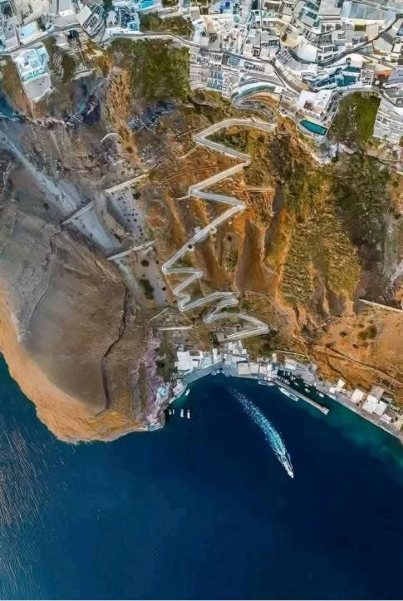
another steep cliff
cool roadway
water at the bottom

Slide 10
Lot’s of cliffs in the world
and not all of them glacial
nothing in the picture that
is especially glacial
anyone recognize the spot?

Slide 11
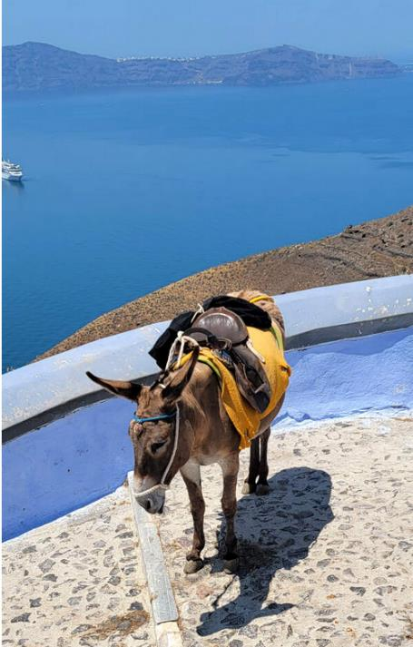
Santorini (Greece)
Volcanic Caldera
Not Glacial in origin

Slide 12
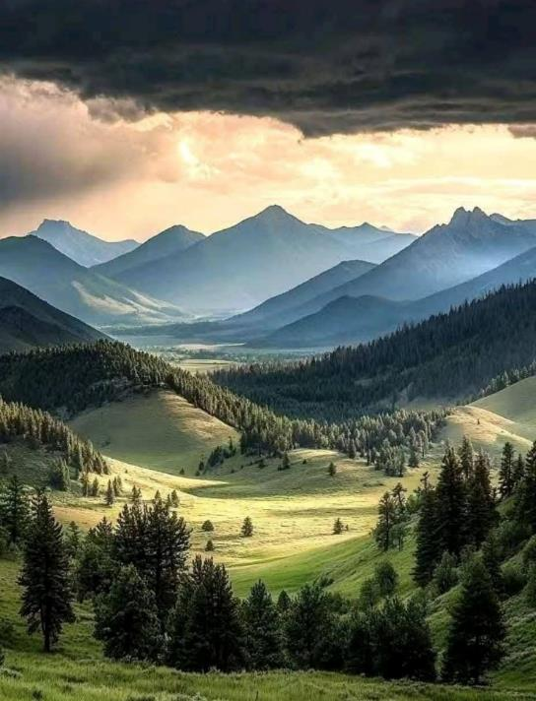
A big valley

Slide 13
Not especially U-shaped
Nothing strongly suggestive of a glacial origin

Slide 14
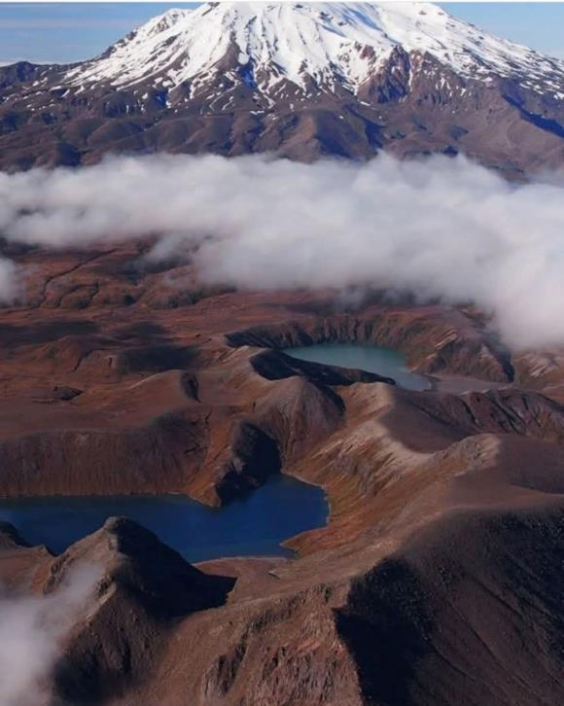
ponds in a hummocky area
with snowy mountain in distance

Slide 15
bowls could be cirques
but distant mountain looks very much like a volcano
so these are more likely volcanic craters with lakes in them

Slide 16
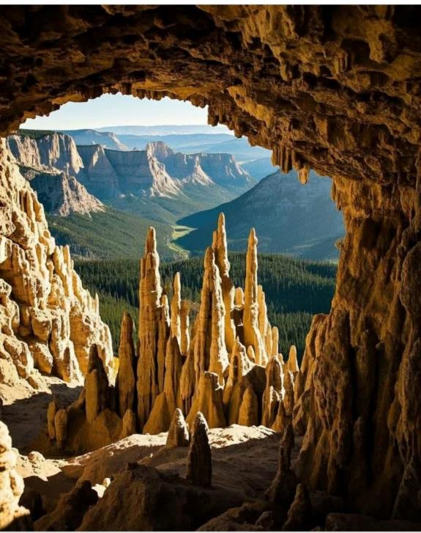
View looking our of a limestone cave with stalagmites
towards big valley in distance

Slide 17
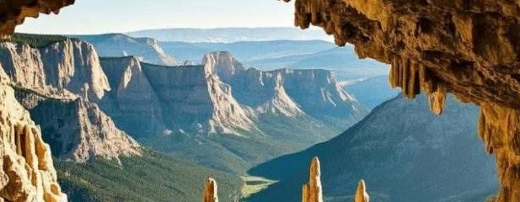
Enlargement.

Slide 18
wall of valley seems to have lots of aretes (yellow) and at least one cirque (red), so this area probably glacial. Valley is straight (arrow) with lots of flat faces. So this is probably glacial.

Slide 19
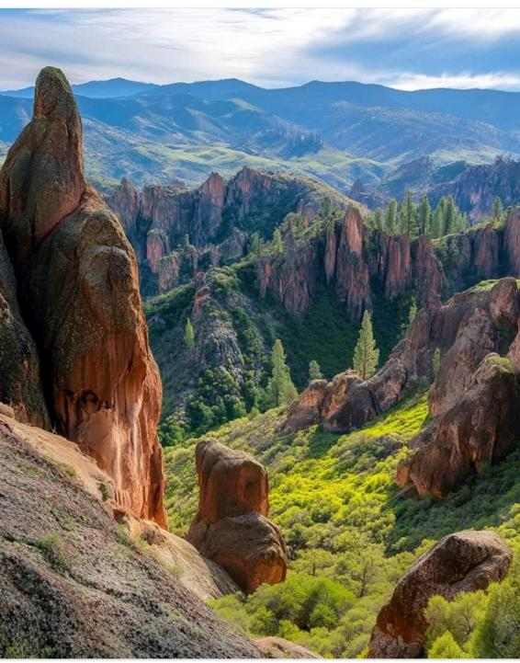
Hilly area with lots of pinnacles
Pinnacles not consistent with glacial action, which would knock them over
so not a glacial terrain

Slide 20
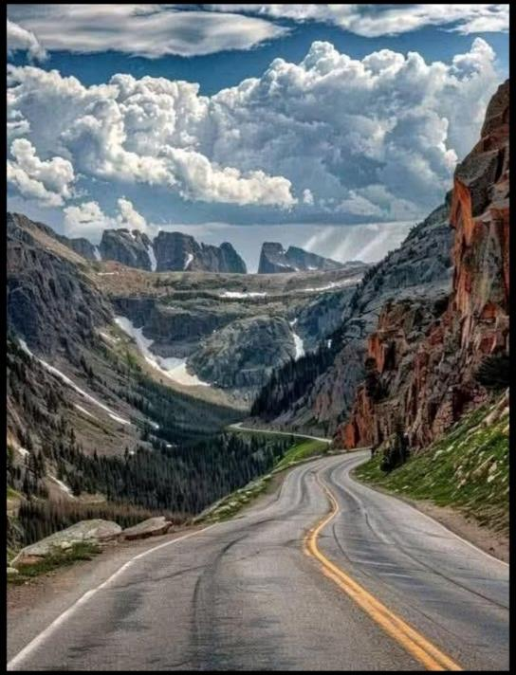
Mountains with notches
white ridge (or cloud?) in distance

Slide 21
Enlargement

Slide 22
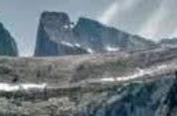
Arete and Cirques (red)
Likely glacial origin
White ridge looks pillowy (arrow) so probably a cloud

Slide 23
Part 1: Varve chronology
dating pro-glacial lakes
and
sea along the ice margin

Slide 24
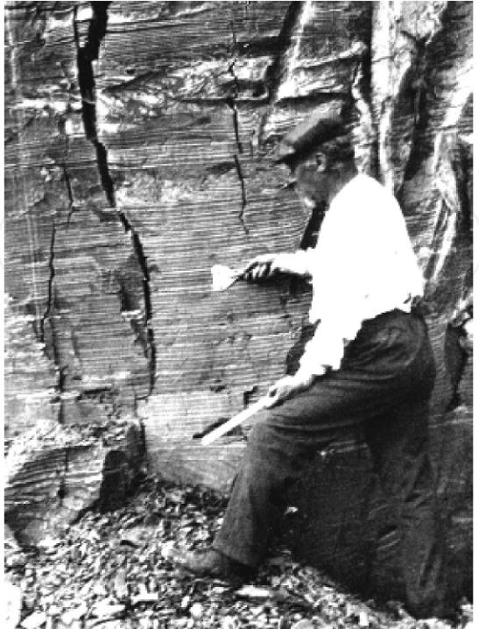
finely
layered (or “varved”)
silts and clays
varve derived from a Swedish word for “circle”, which is to say, “cycle”

Slide 25
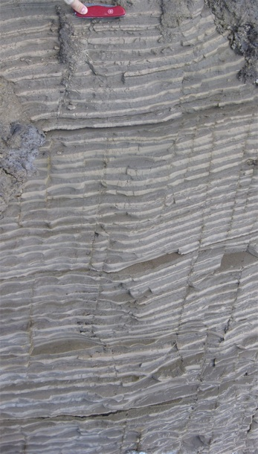
Annual cycles
1 yr
little biological activity to disturb layering

Slide 26
winter:
glacial melting suppressed
still water due to ice
sediment is dark colored
and fine grained
dark

Slide 27
summer:
glacial melting accelerated
more turbulent water
sediment is light colored
and coarse grained
light

Slide 28
winter: fine grained
summer: coarse grained

Slide 29
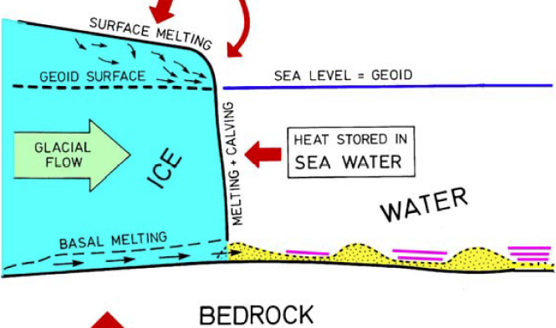
AIR
SEA
varves
varves
varves

Slide 30
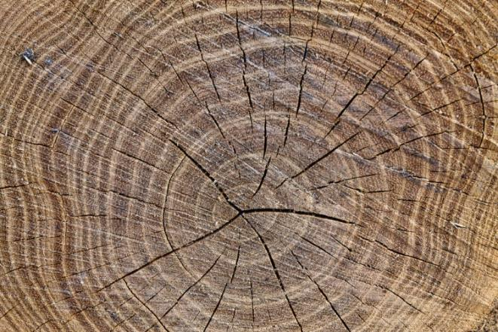
Varves can be counted like tree rings
thickness of rings
provides a way of
correlating varves
between different sites

Slide 31
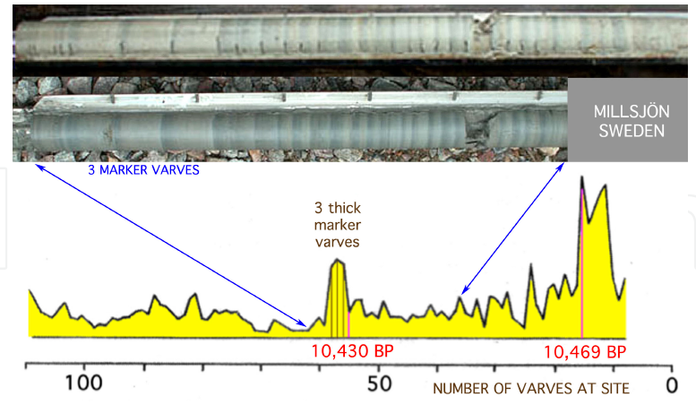
thickness

Slide 32
application 1.
The lowest varve at a site
dates that part of the lake floor
and is a proxy for the position of the glacier

Slide 33
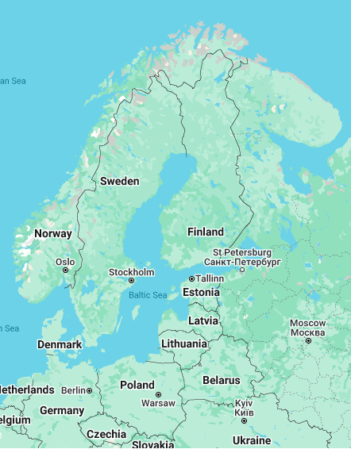
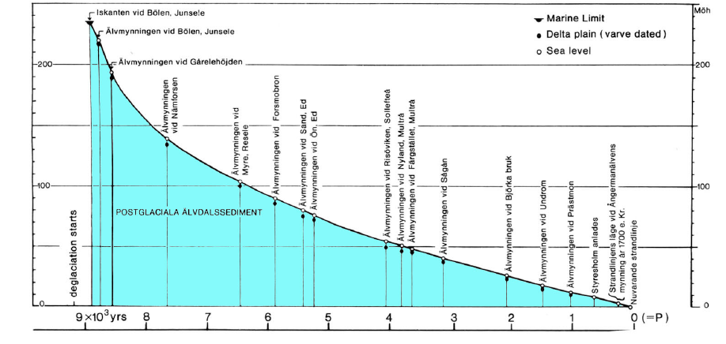
Baltic Sea shoreline of Sweeden

Slide 34
Baltic Sea shoreline
200
distance (km)
0
9
time (kyrs)
0

Slide 35
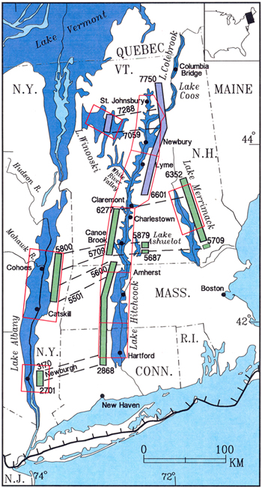
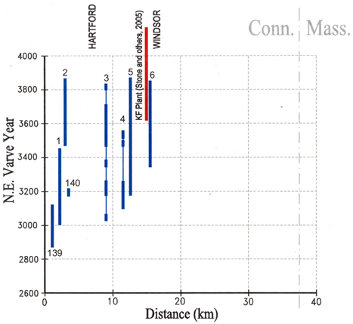
Connecticut
4000
3000

Slide 36
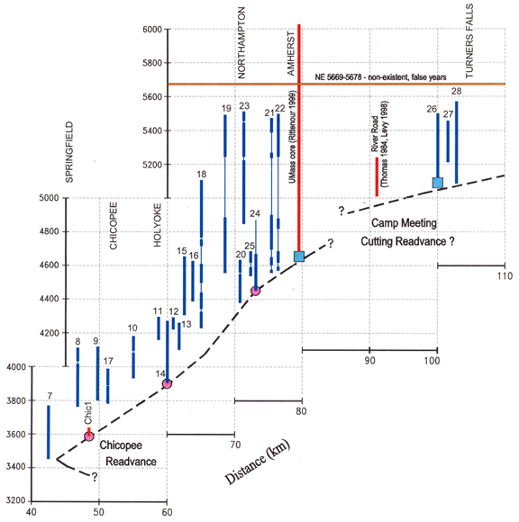
6000
Massachusetts
3200

Slide 37
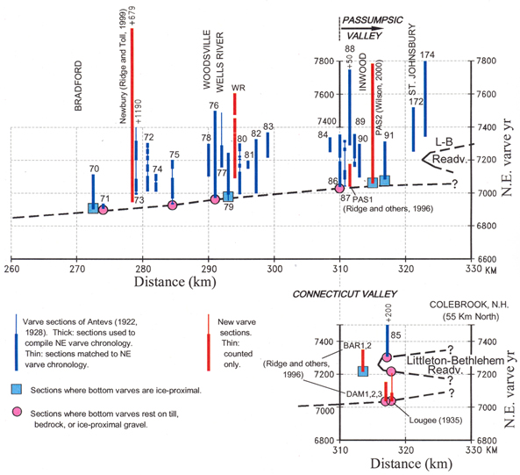
Northern VT/NH
7800
7000

Slide 38
application 2.
Date advance/retreat of glacier
till (or esker gravel) lying on top of a varved sequence

Slide 39
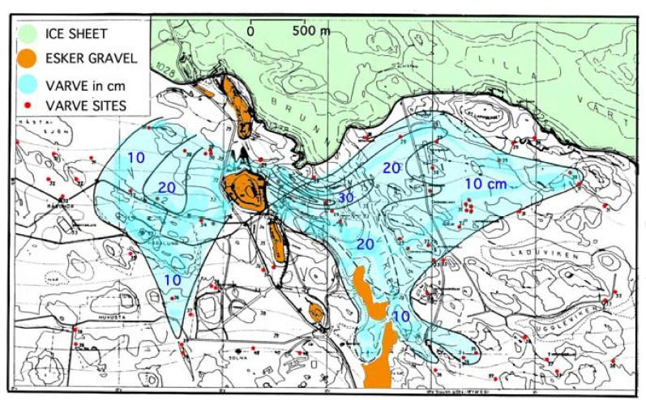
time = 10,385 BPE

Slide 40
application 3.
Date local events that left a record in the varved sediment
volcanic eruptions (through tephra)
very large earthquakes
(through disturbed layers)
lake drainage (through uncomformaties)
marine/freshwater transition
(through microfossils)

Slide 41
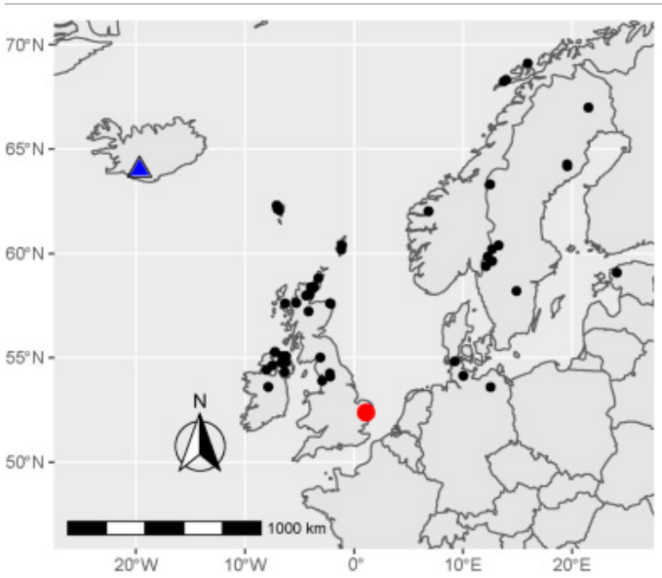
Iceland: triangle
tephra layers:
circles

Slide 42
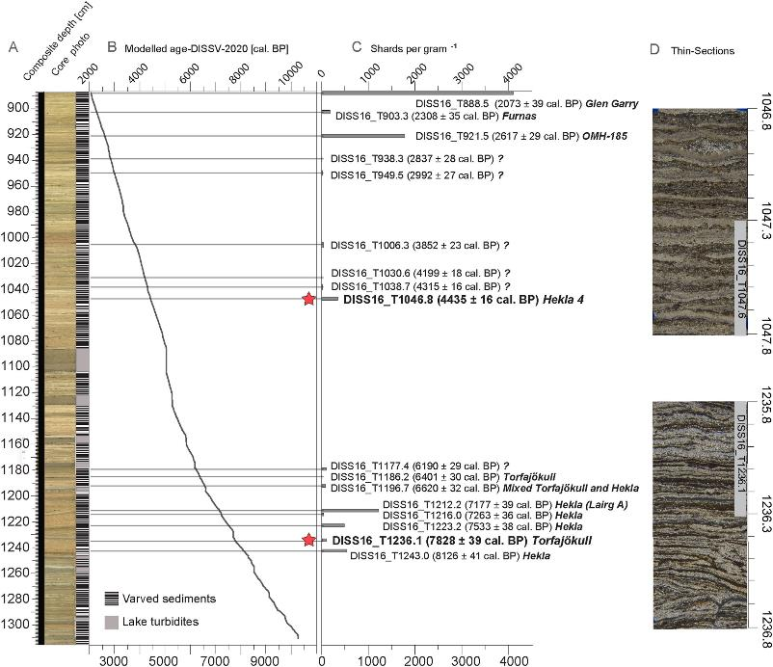
core in south Britain
(red circle in previous slide)
Hekla 4
Torfajökull

Slide 43
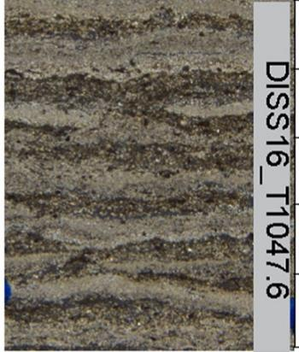
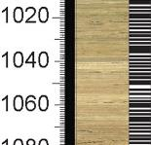
Hekla 4
1047.6

Slide 44
Part 2: North American Ice Margin and Biology

Slide 45
Manhattan
Long Island
New Jersey
Brooklyn
Staten
Island
Atlantic Ocean
New Jersey

Slide 46
Manhattan
Long Island
New Jersey
Brooklyn
Staten
Island
New Jersey
Atlantic Ocean

Slide 47
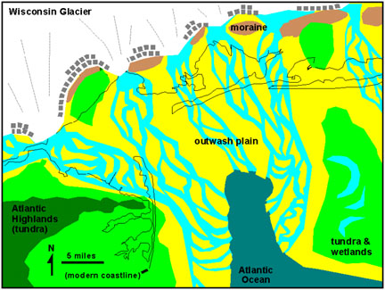
Manhattan
Long Island
New Jersey
Brooklyn
Staten
Island
New Jersey
Atlantic Ocean

Slide 48
Atlantic Ocean

Slide 49
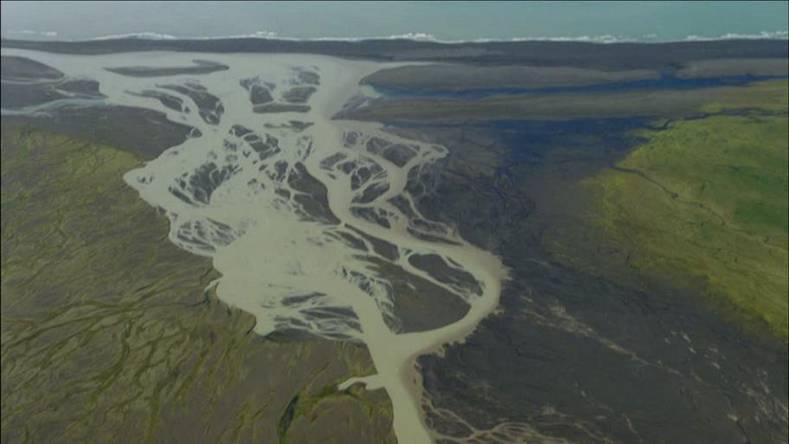
Outwash plain, Iceland

Slide 50
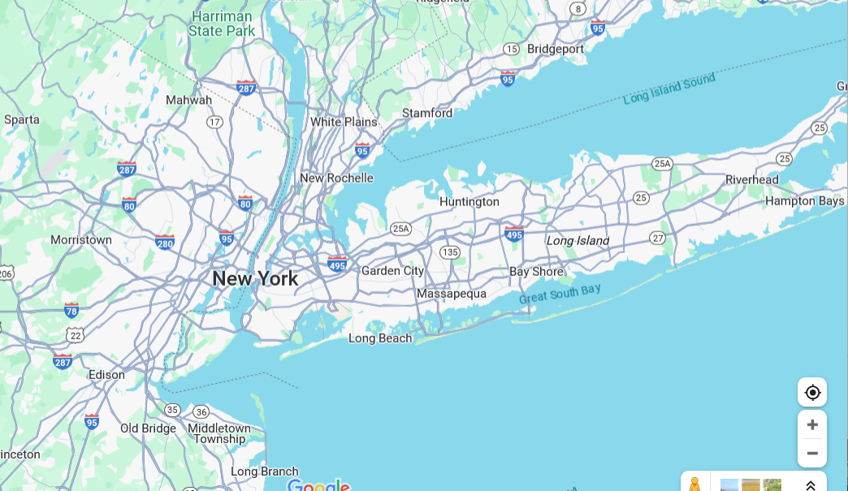
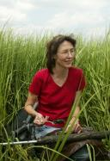
Alpine Swamp
Dr Peteet

Slide 51
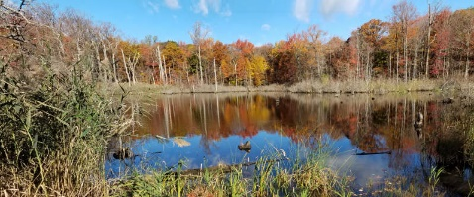
Alpine Swamp

Slide 52
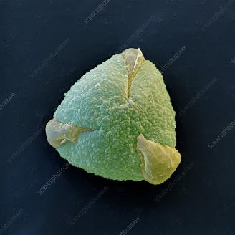
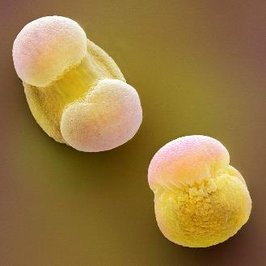
Pollen
Oak
Pine
Birch

Slide 53
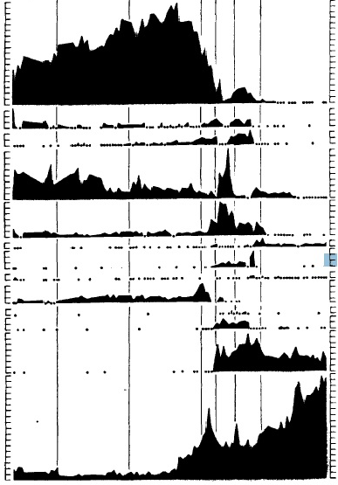
oak
ash
hop-hornbeam
adler
birch
hemlock
fir
spruce
pines
14000
today
Dorothy Peteet

Slide 54
oak
ash
hop-hornbeam
adler
birch
hemlock
fir
spruce
pines

Slide 55
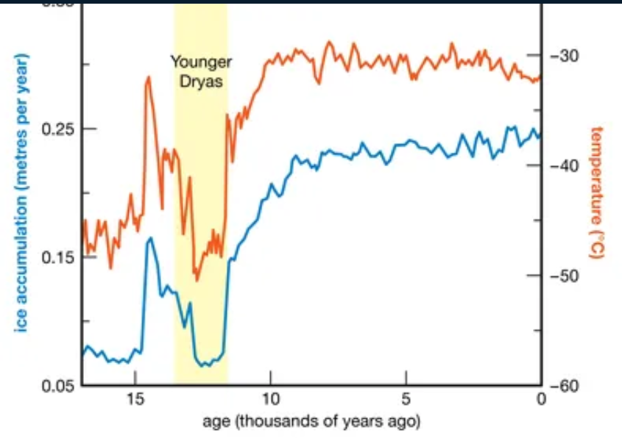

Slide 56
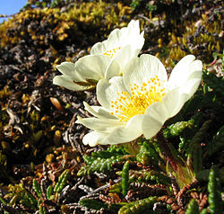
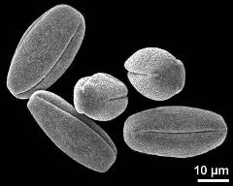
Dryas flower
pollen

Slide 57
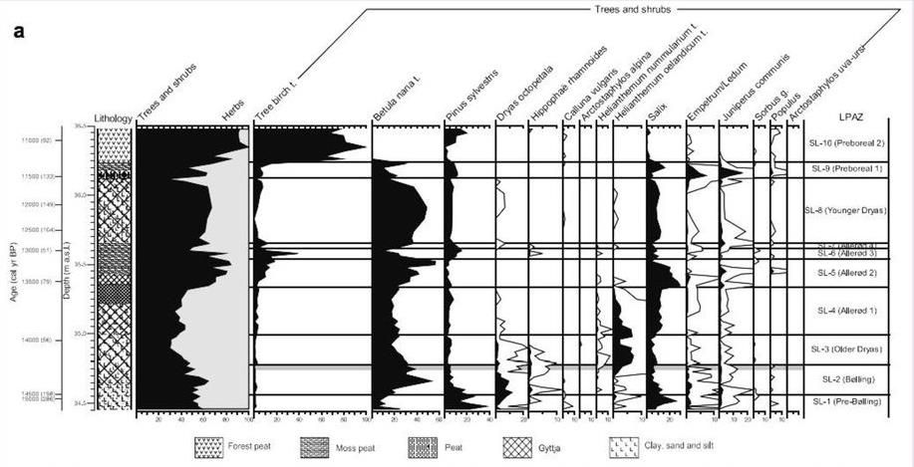
Dryas
11000
12000
Younger Dryas
13000
14000
15000
Site in Denmark

Slide 58
evolution of vegetation at Alpine Swamp
oak
ash
hop-hornbeam
adler
birch
hemlock
fir
spruce
pines
14000
today
Dorothy Peteet

Slide 59
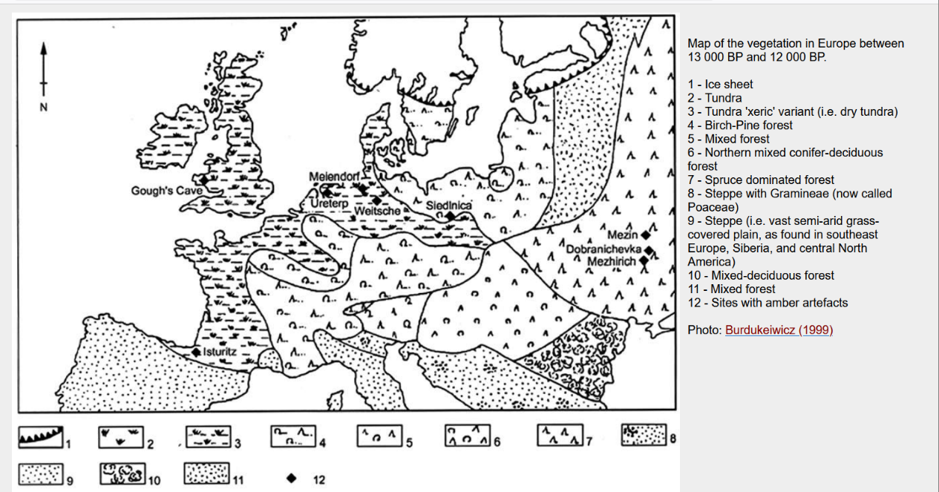

Slide 60
Part 3: Loess deposits

Slide 61
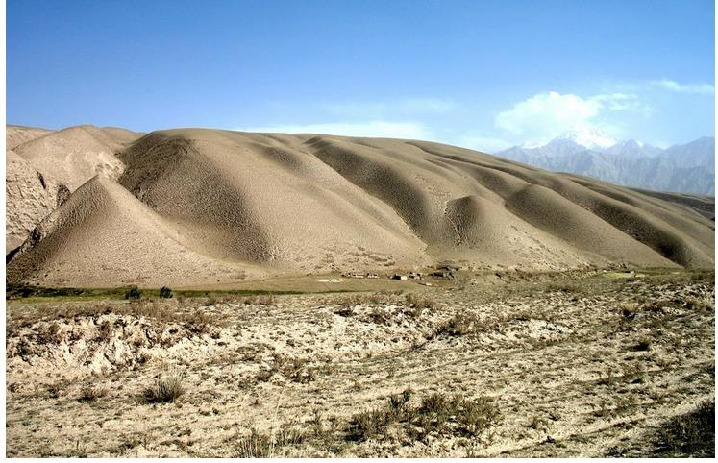
hill composed of loess

Slide 62
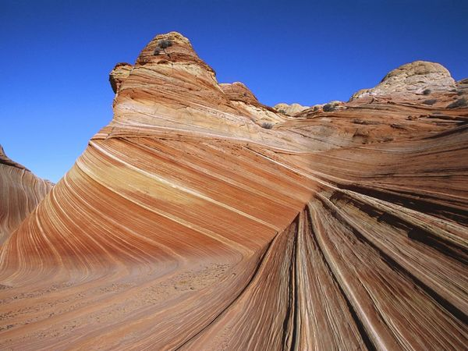
cross-stratified
dune deposit

Slide 63
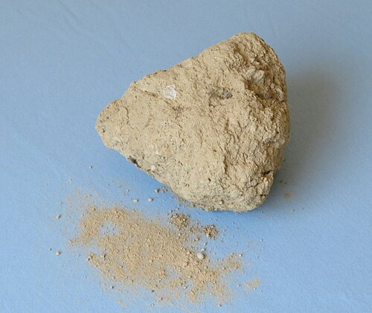
loess
Silt-sized
wind-deposited sediment

Slide 64
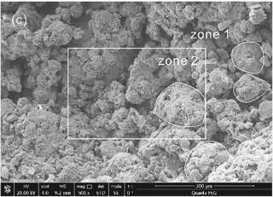
photomigrograph of loess
200 microns

Slide 65
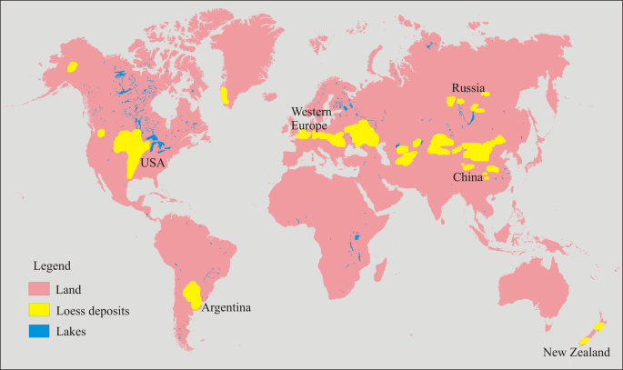

Slide 66
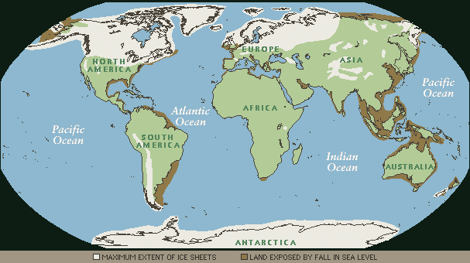

Slide 67
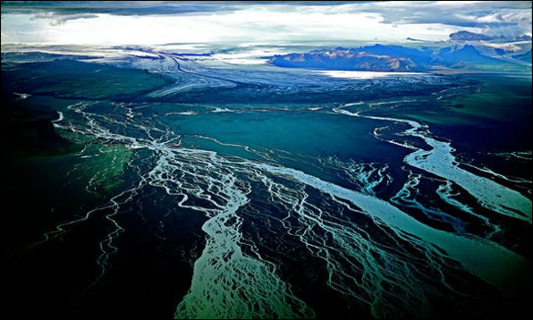
Glacial Outwash Plain with braided river

Slide 68
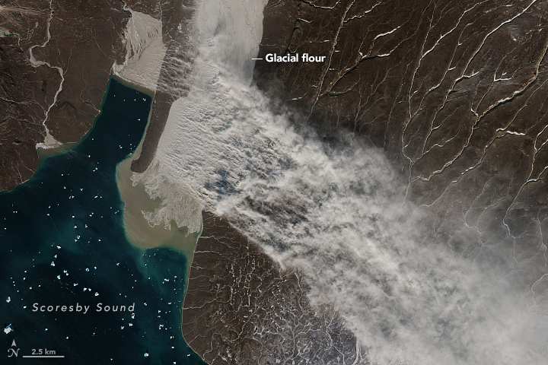
Dust blowing from dry bed of glacial outwash river

