Slide 1
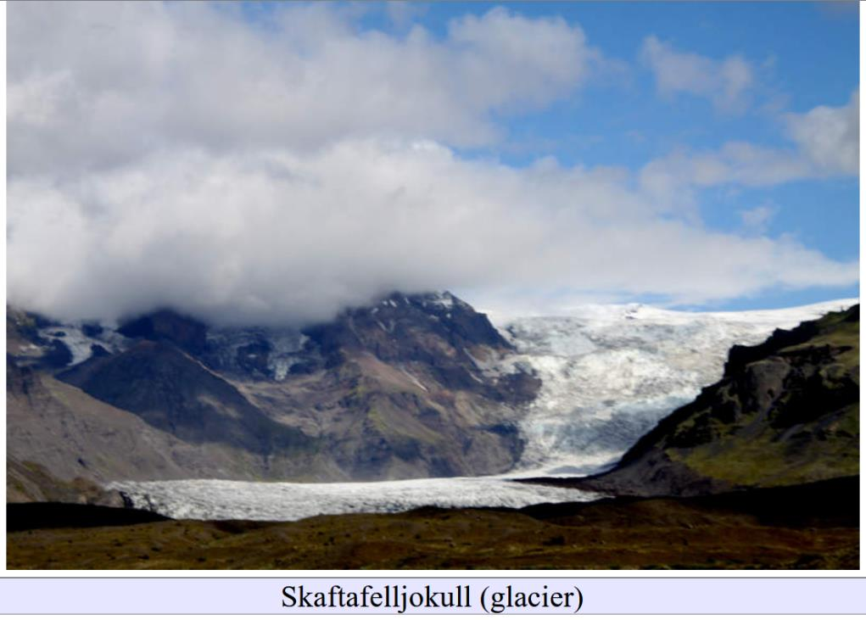
pre-Tertiary Ice Ages
Lecture 12

Slide 2
Part 0: Social Media

Slide 3
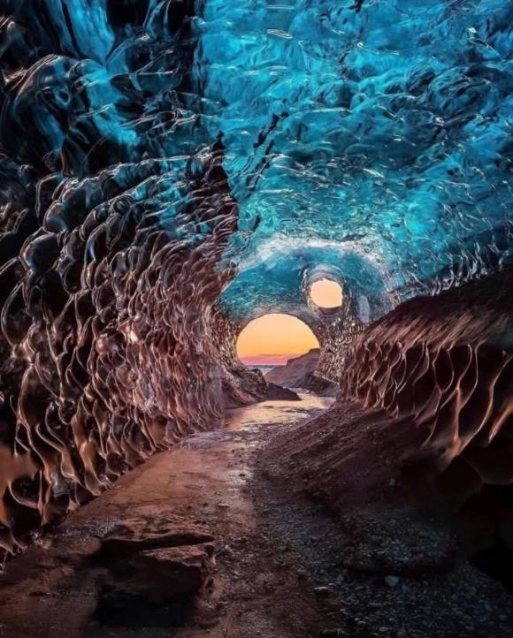
What is it?

Slide 4
Ice Cave
Nice view of the very dirty ice at the bottom of the glacier

Slide 5
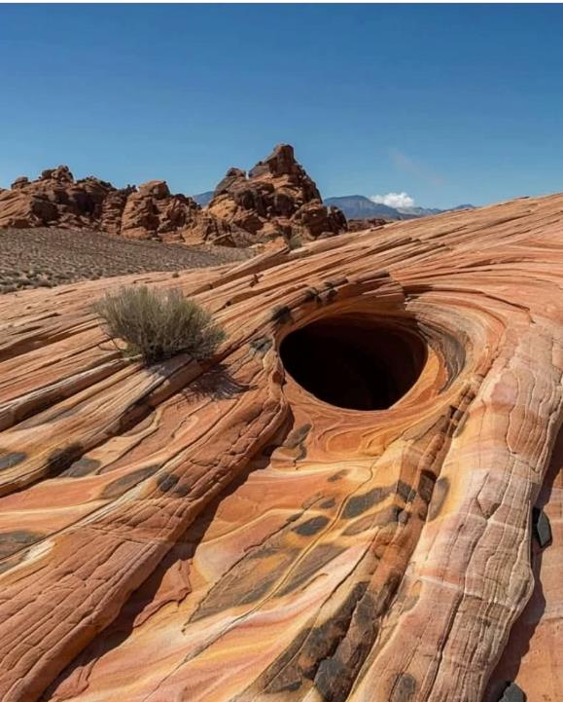

Slide 6
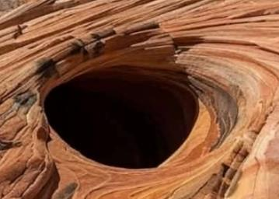
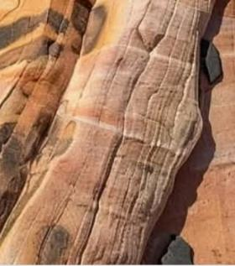
nothing
definitive
that pothole due to glacial
meltwater
definitely a pothole
superficially striae
but close examination
probably thru-going

Slide 7
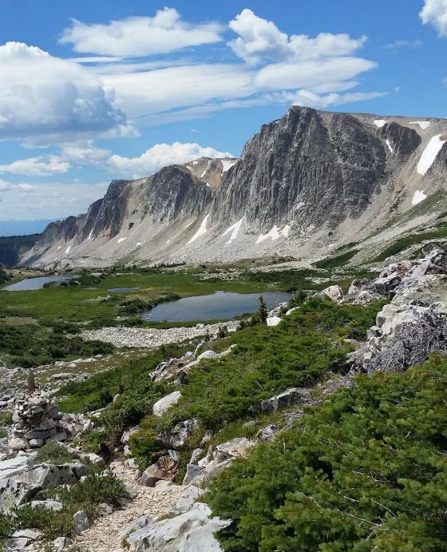
Big cliff,
but lots of processes can
make cliffs

Slide 8
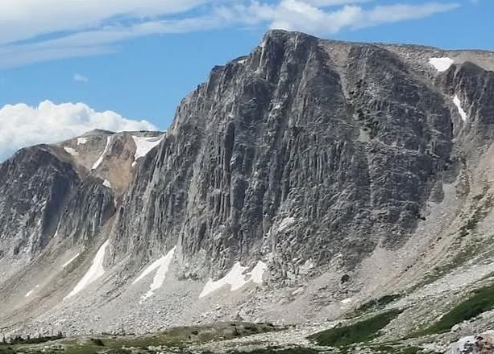
These may be
aretes
so might be glacial

Slide 9
These may be
aretes
so might be glacial

Slide 10
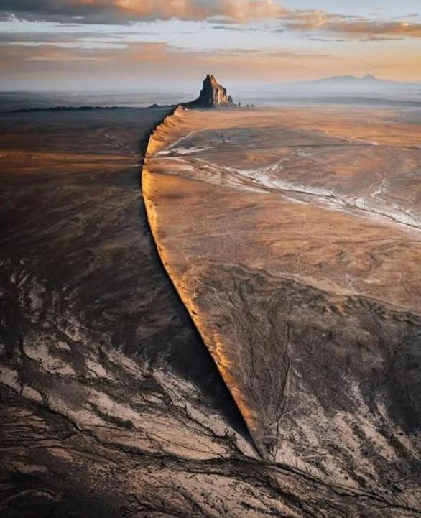
Could this be an esker?

Slide 11
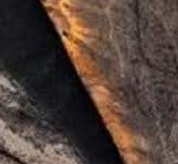
rather too straight
looks more like a layer of less-erodible rock protruding from the ground
not glacial

Slide 12
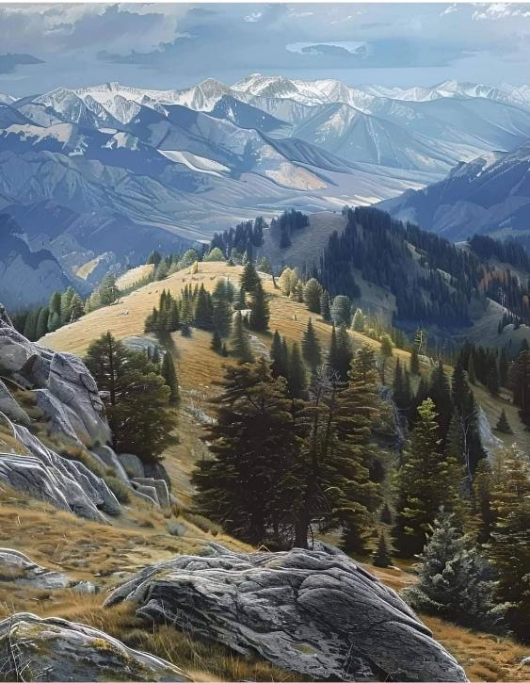

Slide 13
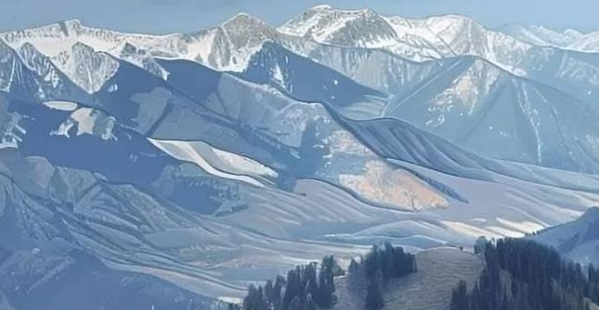
aretes on distant hills (red)
U-shaped valley
in distance may be glacial

Slide 14
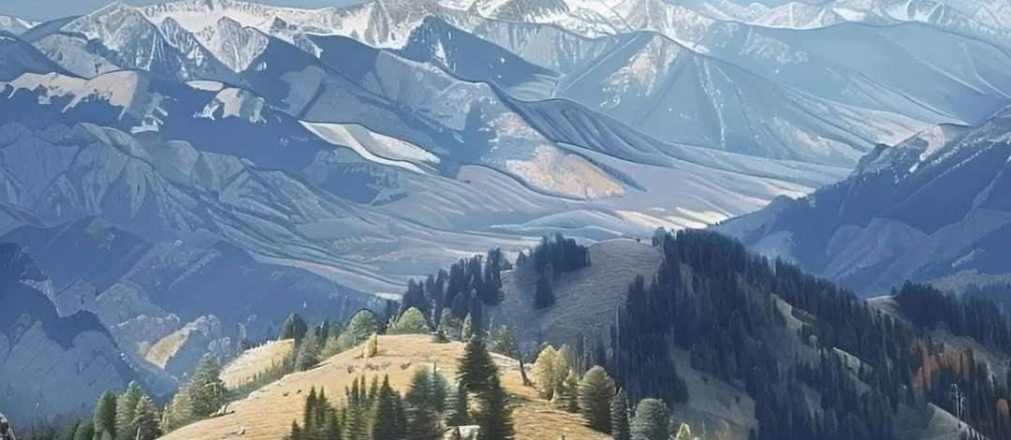
is this a moraine crossing the valley?

Slide 15
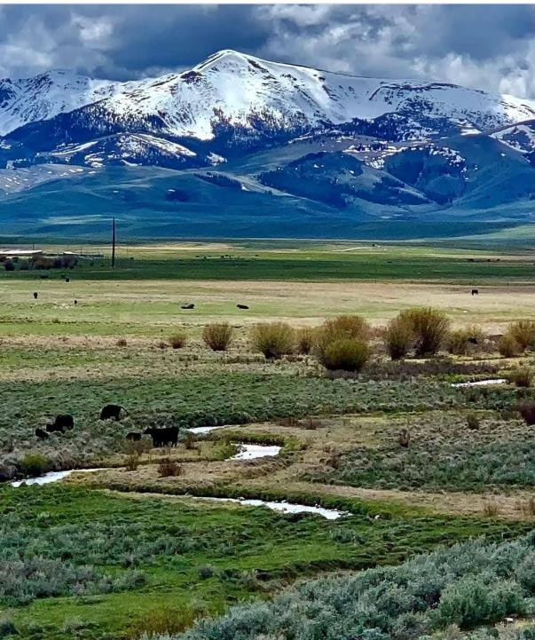

Slide 16
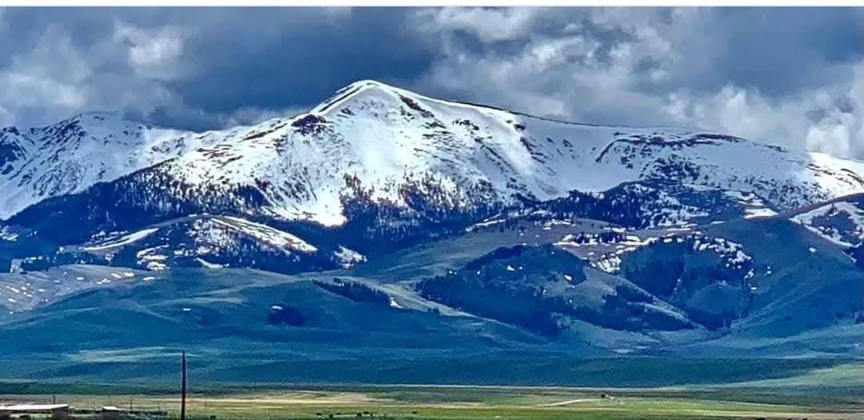
possible cirque and moraine

Slide 17
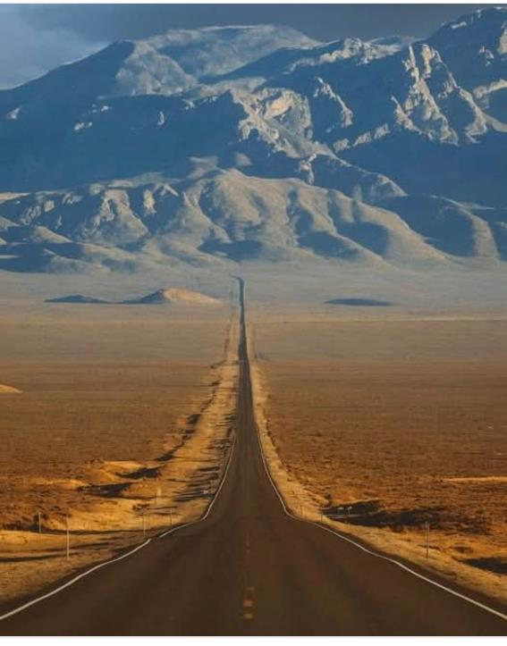
is that a
roche muttonette ?

Slide 18
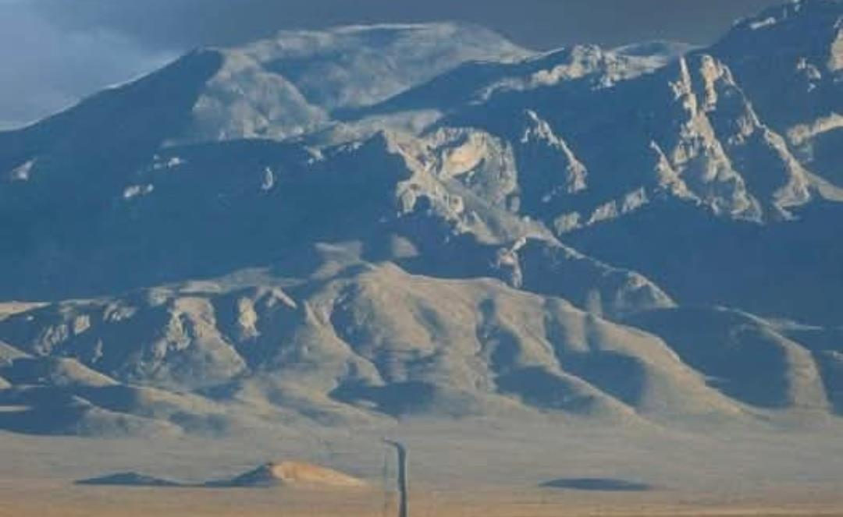
possible there’s a cirque in the mountains
so maybe ...

Slide 19
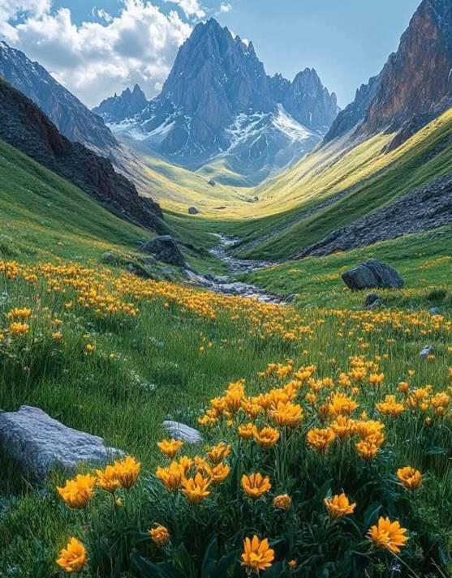

Slide 20
beautiful U-shaped valley (red)
with horn in distance (yellow)

Slide 21
Part 1: What glacial geology gets fossilized?

Slide 22
glacial striae?
granite

Slide 23
glacial striae
yes,
sediment protects
striae
then later erodes away
sediment
granite

Slide 24
sure,
but might be hard to differentiate from a conglomerate of other origin
(unless clasts have striae)
glacial till

Slide 25
glacial till?

Slide 26
sure,
but might be hard to differentiate from a conglomerate of other origin
(unless clasts have striae)
glacial till

Slide 27
drop-stone?

Slide 28
drop-stone?
yes

Slide 29
glacial boulder ?

Slide 30
glacial boulder
yes, it it might be hard to tell its glacial
(unless it has striae)

Slide 31
varves?
yes

Slide 32
U-shaped valley?

Slide 33
U-shaped valley
Possibly
but might be hard
to recognize it
unless the exposure
is very good
sediment
granite

Slide 34
Part 2: Factors influencing Earth’s temperature

Slide 35
Insolation
temperature warms so that outgoing infrared
equals incoming solar energy flux
$$f=σT^{4}$$
$$T=\sqrt[4]{f/σ}$$
current temperature: 255K

Slide 36
Albedo
sunlight reflected back to space does not contribute to surface warming
$$f=\left(1−α\right)f_{solar}$$
current albedo: 0.3

Slide 37
Greenhouse effect
Ground temperature $T_{g}$is warmer than top of atmosphere
$$T_{g}=\sqrt[4]{\left(1+n\right)} T$$
$n$ effective optical thickness of atmosphere currently about $n=2$

Slide 38
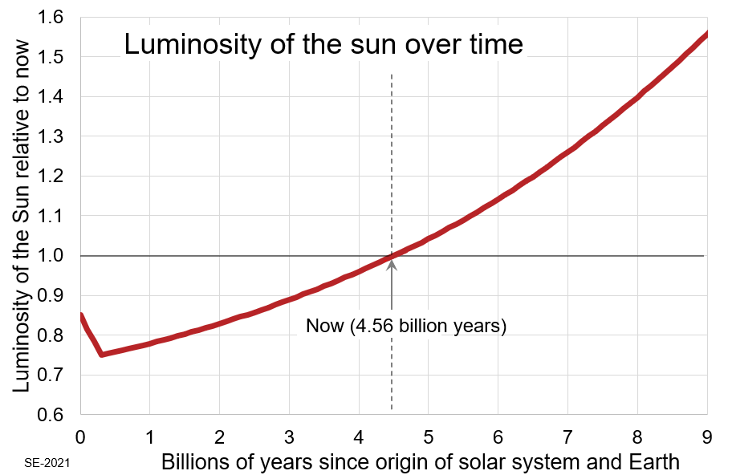
Insolation: The sun is getting brighter
$$f_{now}=σT_{now}^{4}$$
$$f_{A}=0.8f_{now}=σT_{A}^{4}$$
$$0.8={\left[\frac{T_{A}}{T_{now}}\right]}^{4}$$
$$T_{A}=\sqrt[4]{0.8}T_{now}$$
$$T_{A}=0.95 T_{now}$$
A
$$∆T=T_{A}−T_{A}=−12 K$$

Slide 39
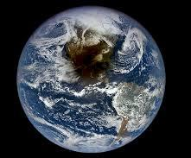
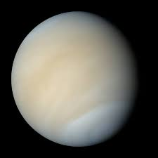
Albedo: We’re not sure
current albedo
0.3
$$\frac{(1−0.7)}{(1−0.3)}={\left[\frac{T_{A}}{T_{now}}\right]}^{4}$$
Earth
$$T_{A}=0.81 T_{now}$$
0.7
$$∆T=T_{A}−T_{A}=−51 K$$
Venus

Slide 40
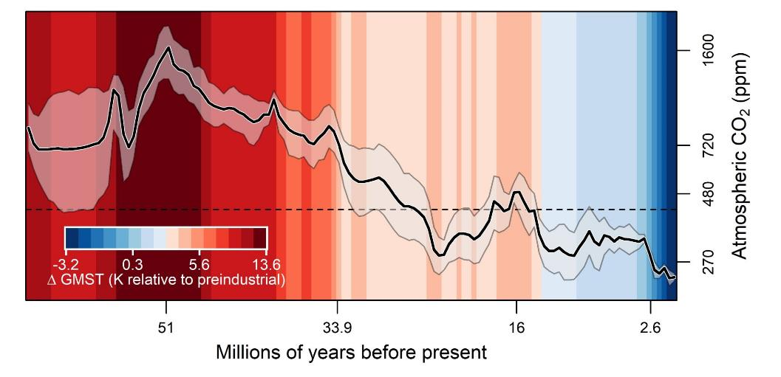
Greenhouse Gas: probably much more C02 early on
very good data for last 66 my

Slide 41
Greenhouse Gas: probably much more C02 early on
720
Antarctic glaciation

Slide 42
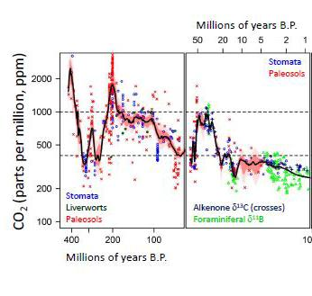
Greenhouse Gas: probably much more C02 early on
some measurements for last 400 my

Slide 43
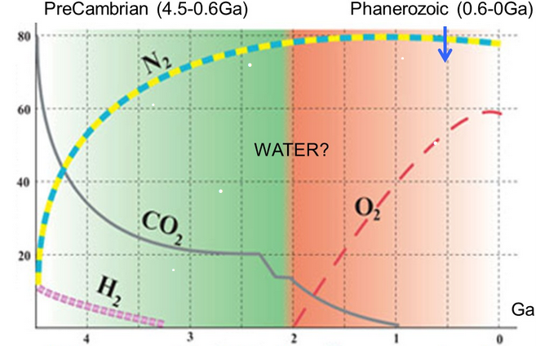
speculations for the early Earth

Slide 44
Venus-like
speculations for the early Earth

Slide 45
where did all the CO2 go
chemical weathering
limestone
subducted into the mantle
washed into the ocean

Slide 46
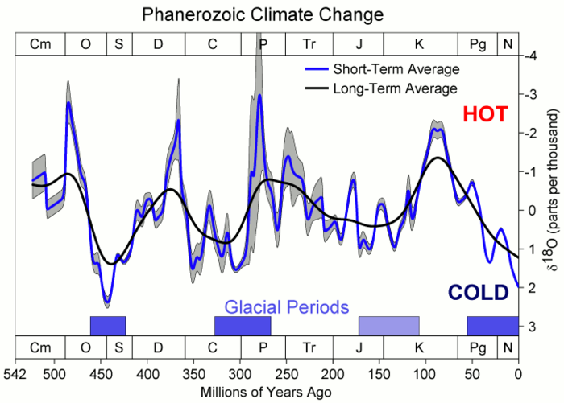
Temperature of the Earth during the last 500 my
no temperature scale
O18 proxy

Slide 47
Temperature of the Earth during the last 500 my
no temperature scale
O18 proxy
Late Paleozoic Ice Age

Slide 48
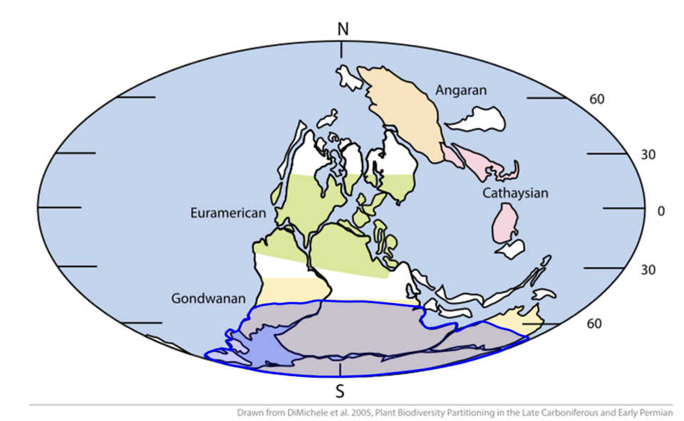
Plate tectonics matters at these time scales!
glaciated
300 ma

Slide 49
Boulder with striae (Saudi Arabia)
weathered out of a sandstone

Slide 50
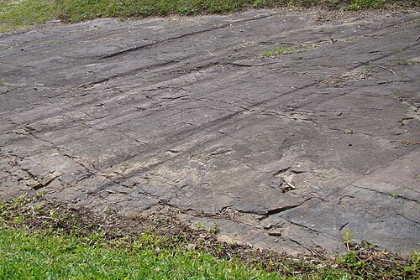
Striae
on bedrock
in Brazil

Slide 51
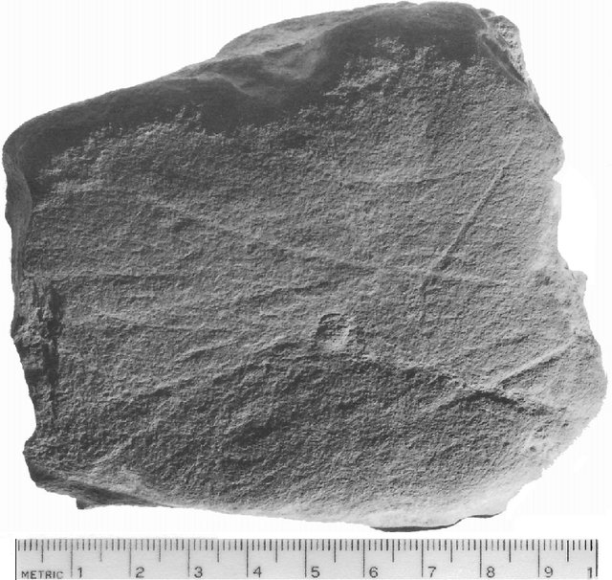
Striae on glacial
cobble
in Brazil

Slide 52
Tillite or glacial diamictite (lithified till) (Saudi Arabia)

Slide 53
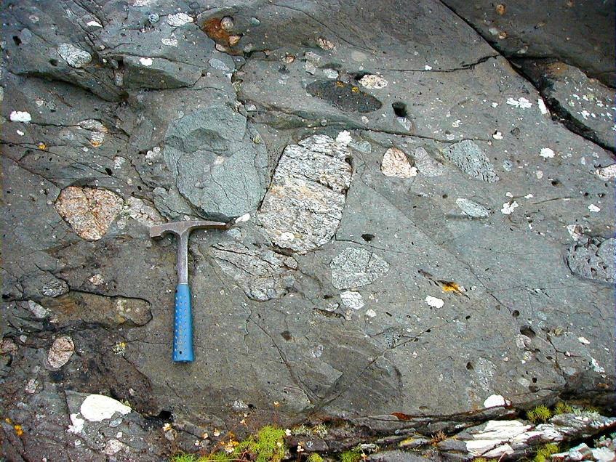
Tillite or glacial diamictite (lithified till) (Scotland)

Slide 54
neoProterozoic Ice Age and Snowball Earth
Cryogenian
720 to 635 ma

Slide 55
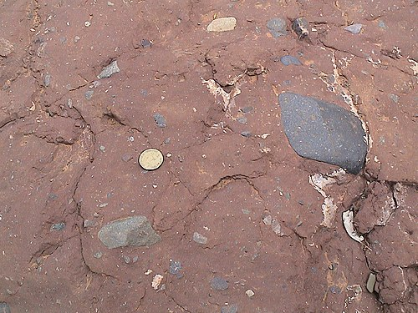
tillite
(Australia)

Slide 56
varves (Brazil)

Slide 57
striae (Brazil)

Slide 58
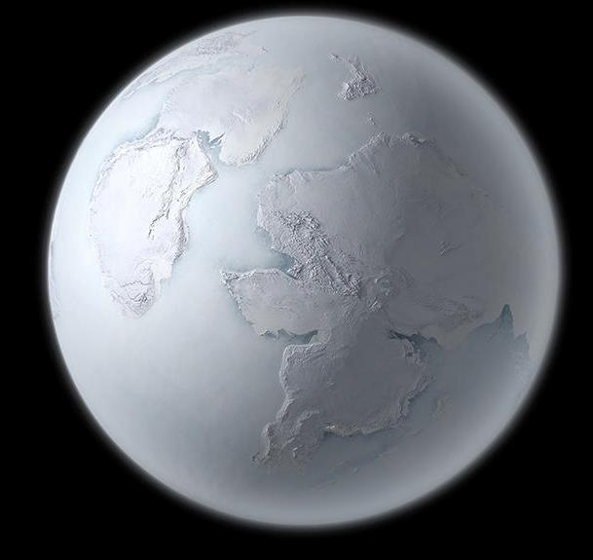
“Snowball Earth”
hypothesis that Earth
froze over during the Cryogenian
and especially that
the oceans were frozen

Slide 59
In a low-insolation era
albedo feedback could lead to frozen conditions

Slide 60
In a low-insolation era
albedo feedback could lead to frozen conditions
colder … more ice
more ice … higher albedo
higher albedo … less sunlight absorbed
less sunglight absorbed … colder

Slide 61
What turns it off?

Slide 62
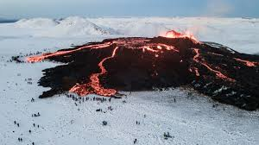
CO2 from volcanos

Slide 63
colder … less chemical weathering
less weathering … more buildup of volcanic CO2
more C02 … more greenhouse effect
more greenhouse … hotter

Slide 64
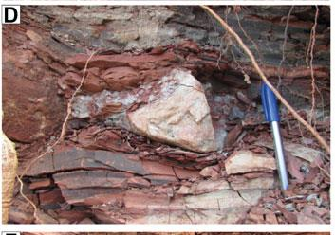
Droptone

Slide 65
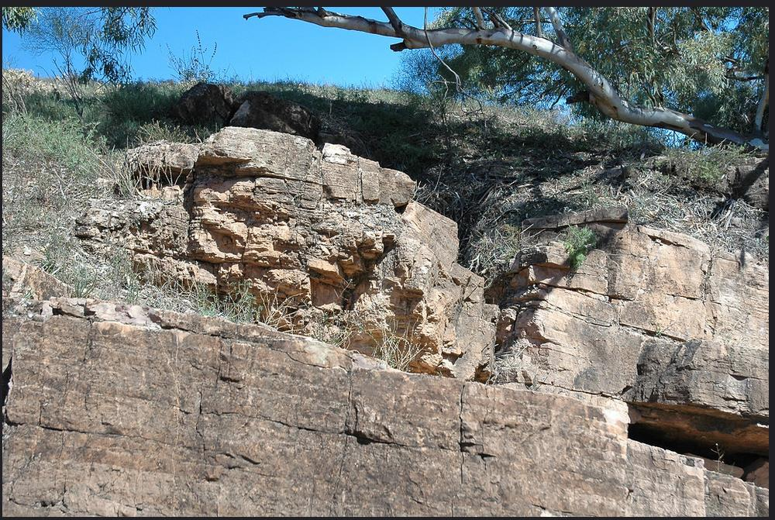

Slide 66
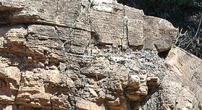

Slide 67
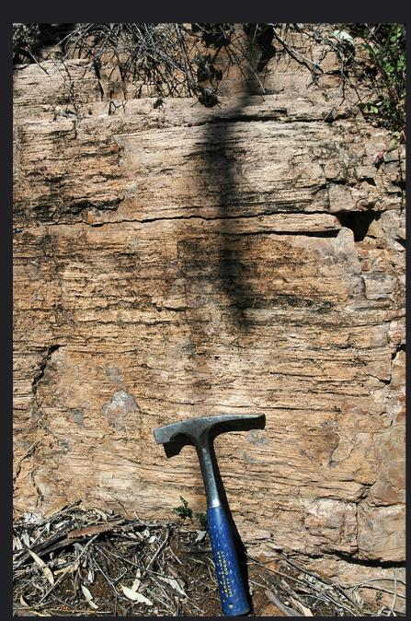
Cap carbonate (south Australia)
limestone … CaCO3
dolomite … (Ca,Mg) CO3
abiogenic deposit 1-30 m at top of glacial deposits
suggests major change in ocean chemistry
breakup of sea ice that covered the ocean for a very long time ???

Slide 68
