Slide 1
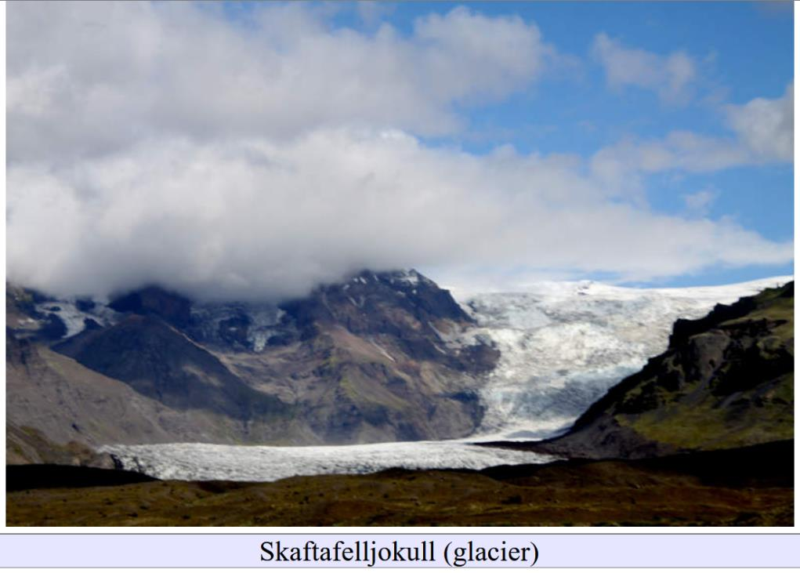
The Future of Glacial Geomorphology
Lecture 13

Slide 2
0. Social Media
Lecture 13

Slide 3
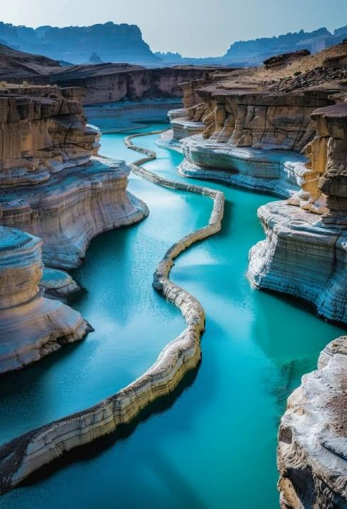
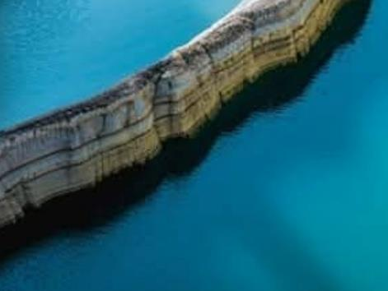
Following Julian’s cautionary comment from last week, could this possibly be a real place?
Lecture 13

Slide 4
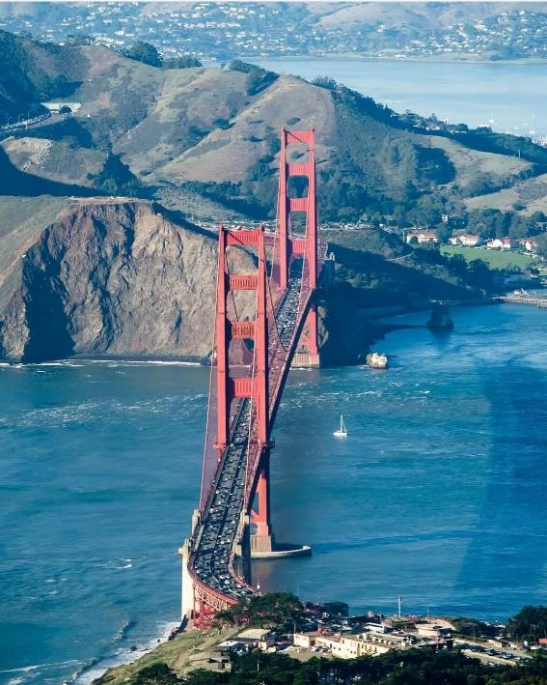
Could this be a cirque?
Lecture 13

Slide 5
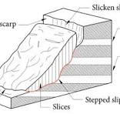
Probably actually a landslide scar
Lecture 13

Slide 6
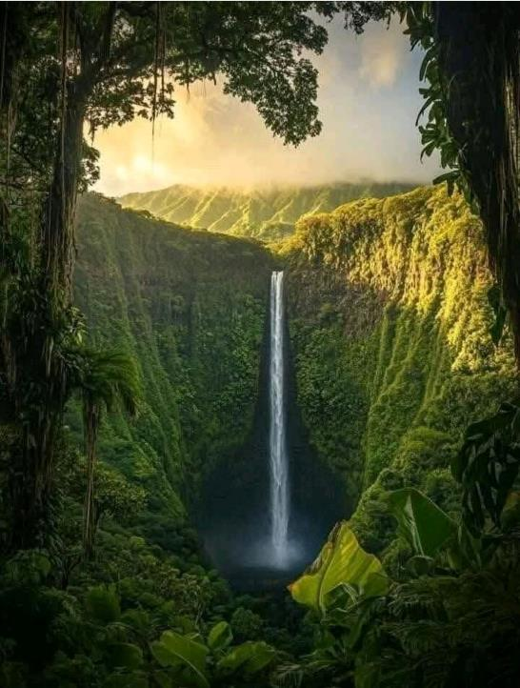
beautiful waterfall
Lecture 13

Slide 7
nothing specifically glacial about
hill in background has
V-shaped fluvial gullies
not cirques
Lecture 13

Slide 8
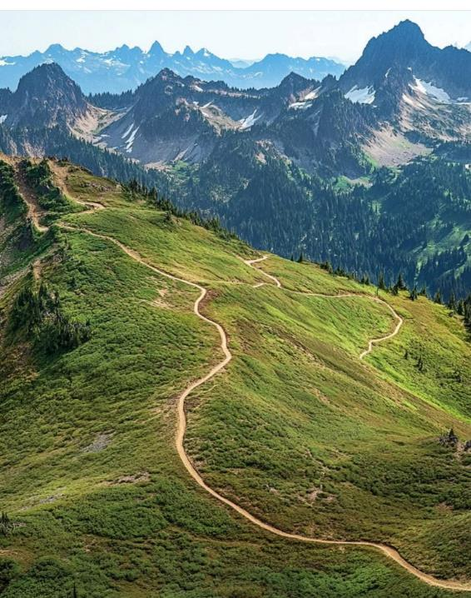
how about this one ...
Lecture 13

Slide 9
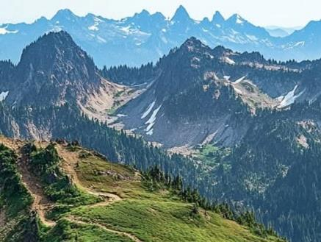
nothing in foreground specifically glacial but hill in background has very convincing cirques
Lecture 13

Slide 10
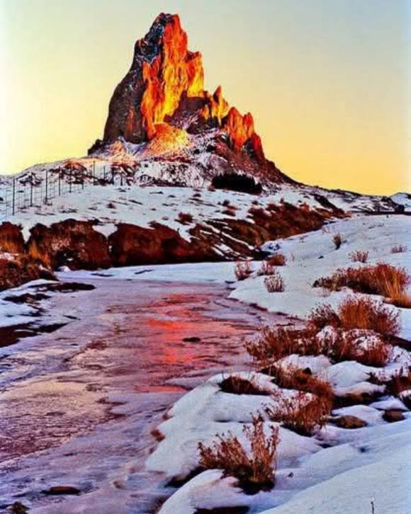
snow-covered terrain
stream
small jagged hill in background
(note telephone poles)
Lecture 13

Slide 11
nothing specifically glacial
hill more likely a volcanic plug
Lecture 13

Slide 12
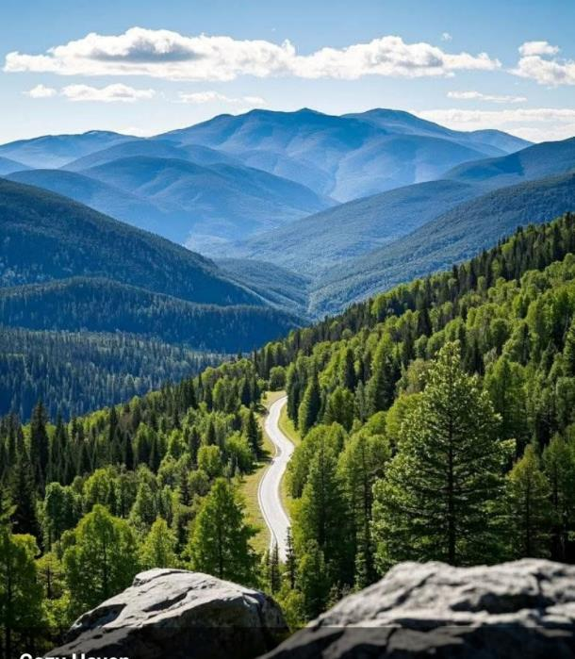
large valley
Lecture 13

Slide 13
V-shaped, so probably not glacial
Lecture 13

Slide 14
1. The future
Lecture 13

Slide 15
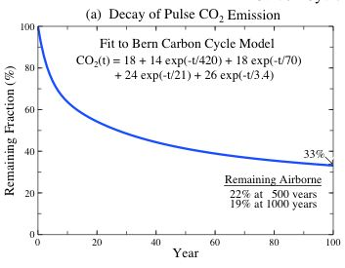
100
% CO2 remainin
0
0
100
years

Slide 16
100
% CO2 remainin
half remaining in 30 years
0
0
100
years

Slide 17
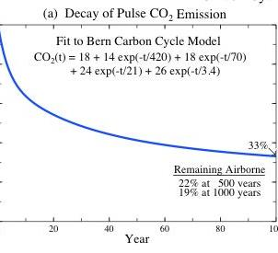
19% in 1000 years
500
1000

Slide 18
Timeline
Now
100
1,000
Lecture 13
10,000
100,000
Future
time, years

Slide 19
Atmospheric CO₂
high scenario
720
all glaciers
melt
425
low scenario
Now
100
1,000
Lecture 13
10,000
100,000
time, years

Slide 20
Glacial volume
alpine
Greenland & West Antarctica
East Antarctica
Now
100
1,000
Lecture 13
10,000
100,000
time, years

Slide 21
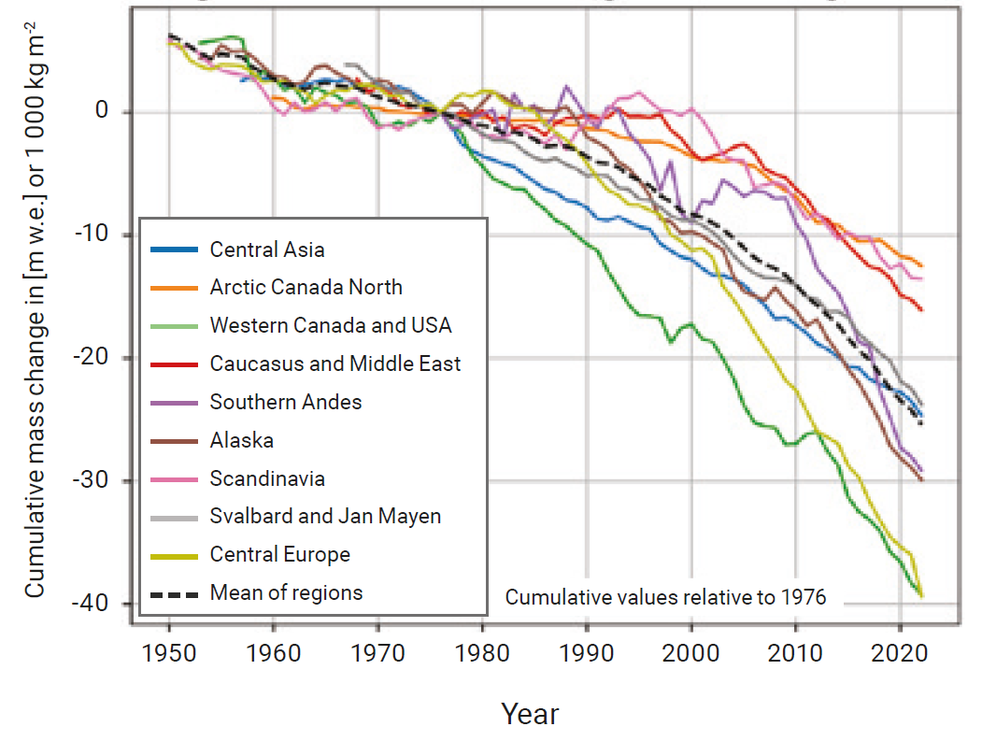

Slide 22
Sea Level
all glaciers gone
70
10
5
Now
100
1,000
Lecture 13
10,000
100,000
time, years

Slide 23
Human Impact of Rising Seas
all glaciers gone
70
Sea Level (meters)
Very high
10
High
5
Modest
Now
100
1,000
Lecture 13
10,000
100,000
time, years

Slide 24
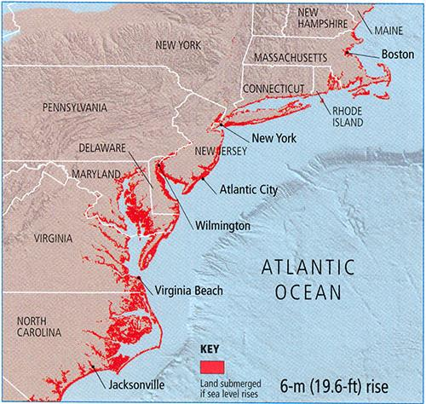
6 meters

Slide 25
70 meters

Slide 26
Other Human Impacts
70
all glaciers gone
increased glacial runoff
colonize Antarctica
colonize highlands
Sea Level (meters)
colonize Greenland
glacial landslides
glacial floods
10
5
advancing glaciers destroying habitations
Now
100
1,000
Lecture 13
10,000
100,000
time, years

Slide 27
Other Human Impacts: Glacial Floods

Slide 28
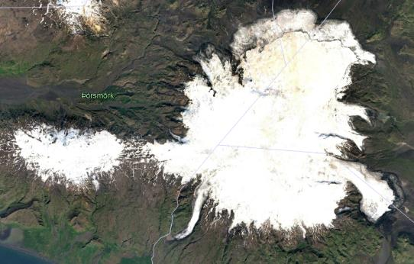
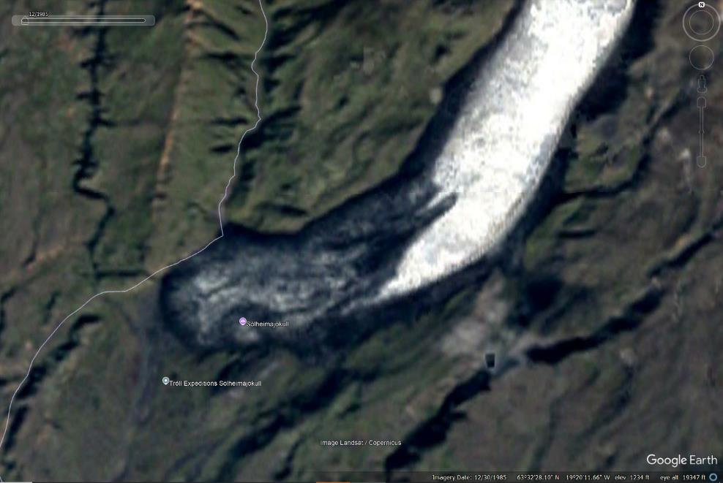
Solheimajokull,
Iceland
1986

Slide 29
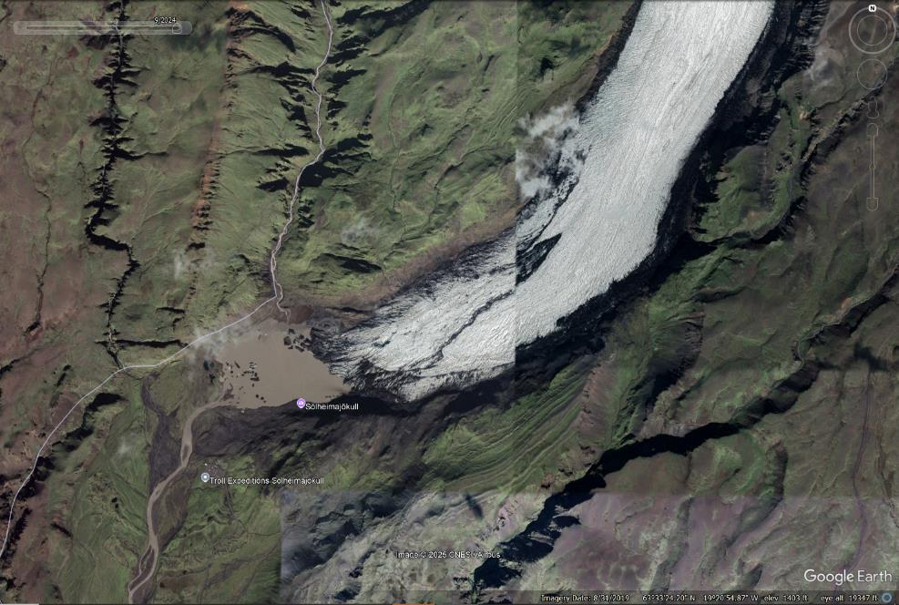
Solheimajokull,
Iceland
2024
Moraine lake

Slide 30
Juneau, Alaska, August 6, 2024

Slide 31
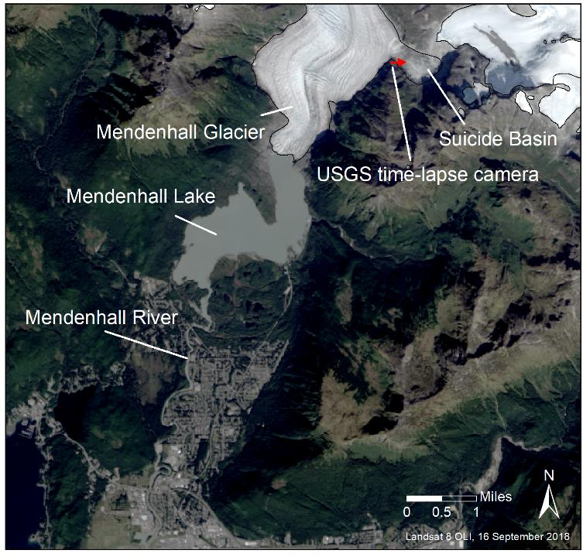
source of water: Suicide Bain (lake)
ice dam: Mendenhall Glacier

Slide 32
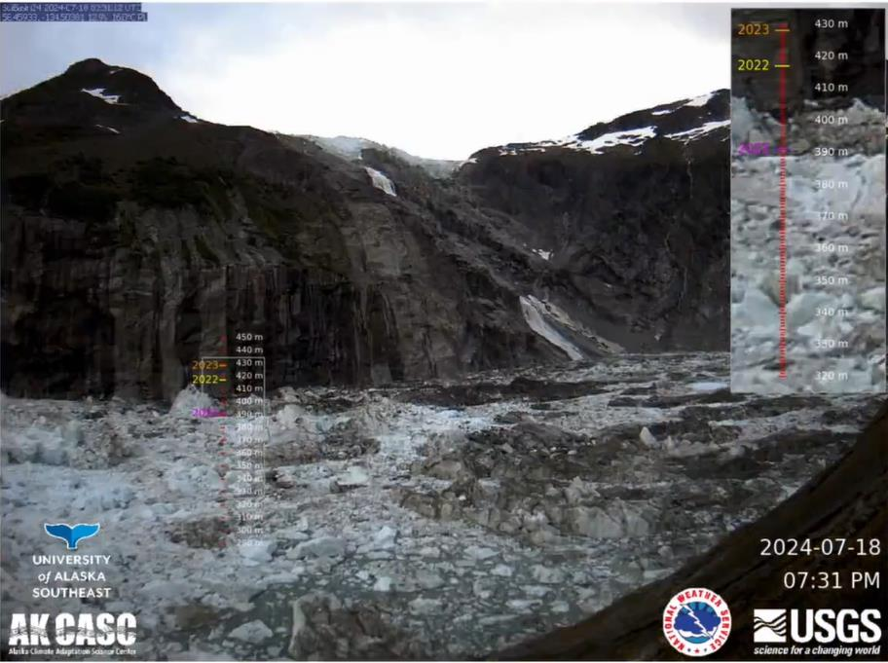
High water
in
Suicide
Basin

Slide 33
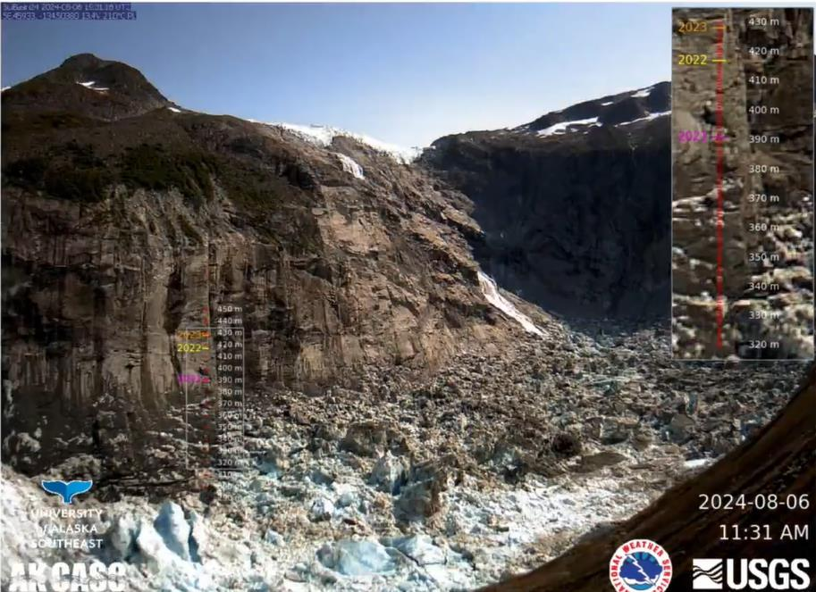
Low water
in
Suicide
Basin

Slide 34
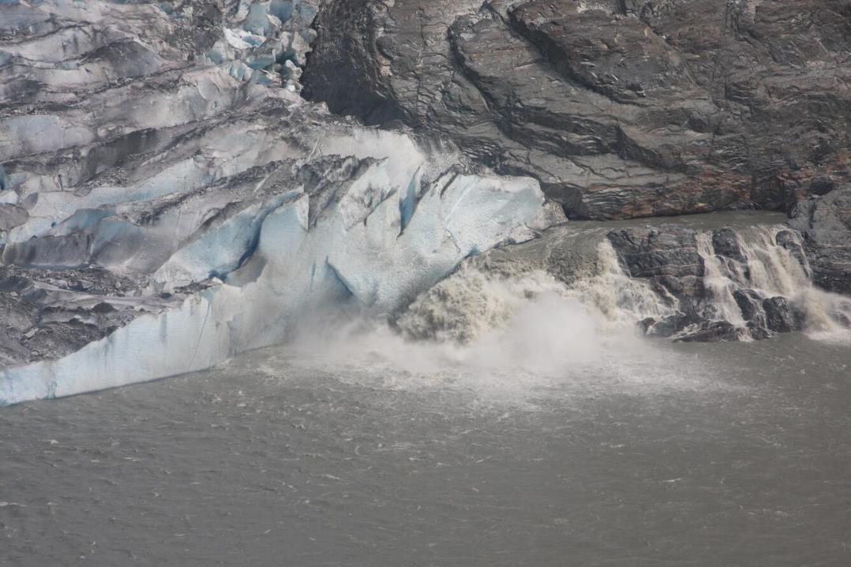
Water escaping under glacier

Slide 35
Other Human Impacts: Glacial Landslides

Slide 36
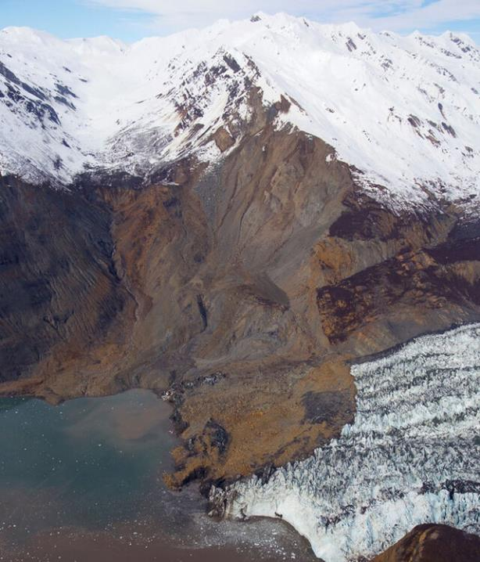
October 2015 landslide, Tyndall Glacier

Slide 37
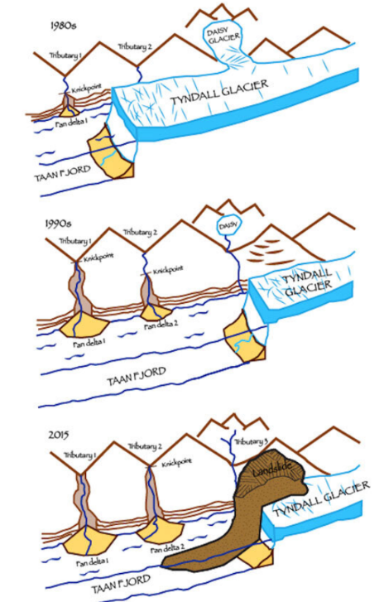
this is the hill that failed
note that it’s being
supported by the glacier
reduction in glacial ice
destabilized hillside

Slide 38
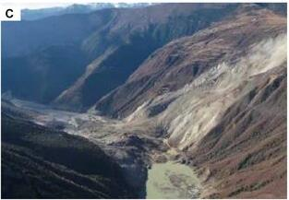
landslide can dam stream and lead to flood

Slide 39
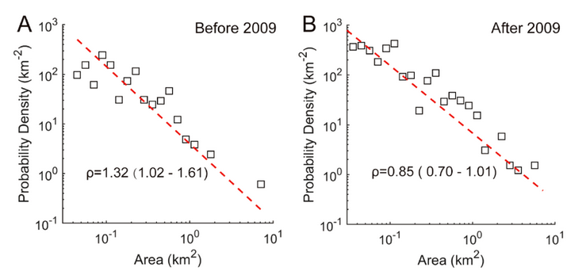
landslide probability
Frequency-size plots useful in understanding interplay of rate and size

Slide 40
Large landslides appear to have become more probable

Slide 41
Other Human Impacts: Changes in stream flow

Slide 42
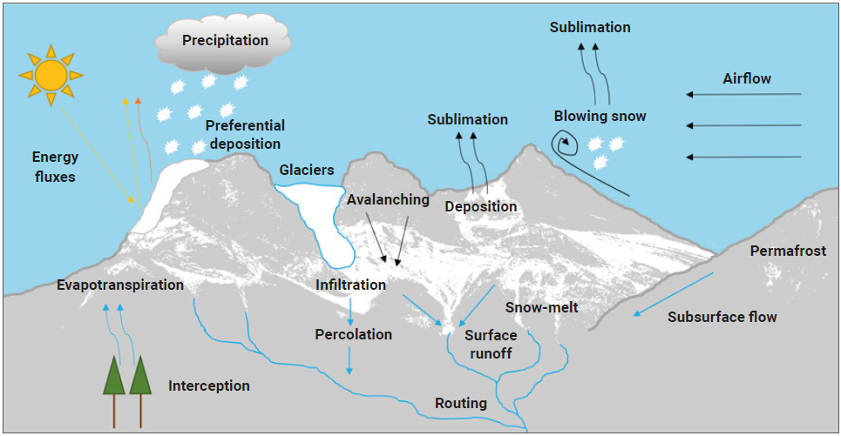
Alpine hydrology

Slide 43
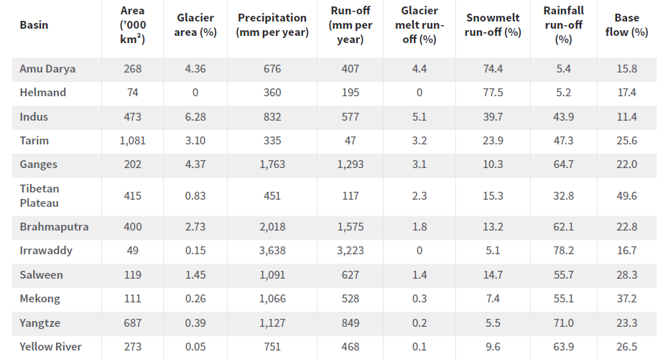

Slide 44
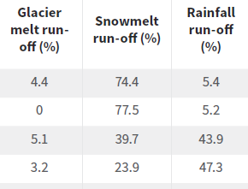

Slide 45
Glacial melting makes only a small contribution to river runoff
So critical question is degree to which global warming affects alpine snow pack
not glacial retreat, per se

Slide 46
Other Human Impacts: Colonization of formerly glaciated regions

Slide 47
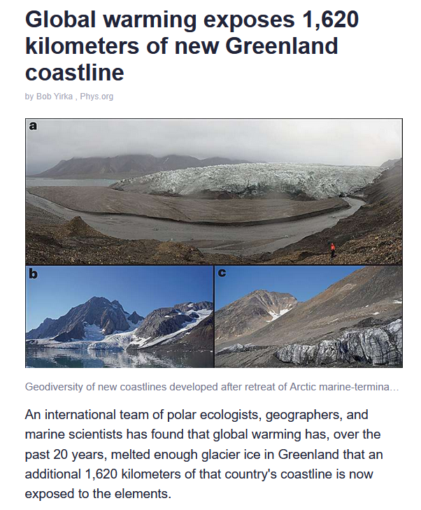

Slide 49
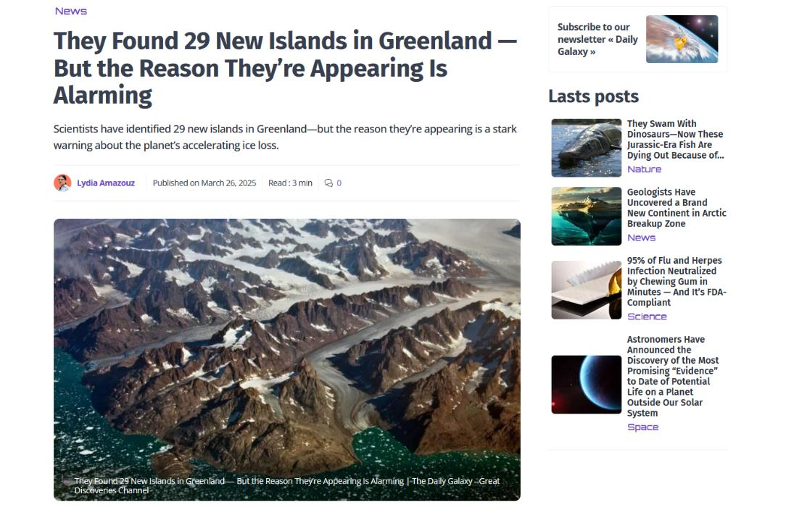

Slide 50
Other Human Impacts: Readvance of Alpine Glaciers

Slide 51
Other Human Impacts: Readvance of Alpine Glaciers

Slide 52
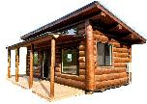
No one has yet built a house in the valley ...
but that’s not to say that a town could spring up there in a thousand years

Slide 53
Intellectual Impact of Loss of Glaciers
all glaciers gone
70
era of nostalgia
glacial features fading
Sea Level (meters)
discovering
Antarctica
loss of access
tracking ecology
under ice discoveries
discovering
Greenland
10
5
regaining access, studying advance
Now
100
1,000
Lecture 13
10,000
100,000
time, years

Slide 54
Intellectual Impacts: Under-the-ice discoveries

Slide 56
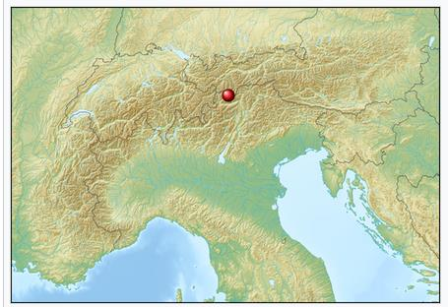
Ötzi, also called The Iceman, between 3350 and 3105 BCE

Slide 57
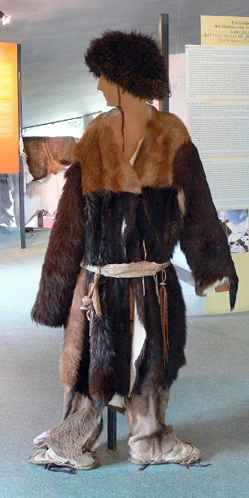
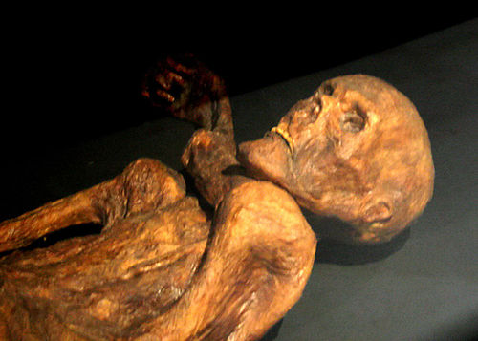
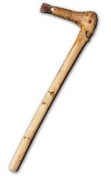
Ötzi
ax
reconstructed
clothes

Slide 58
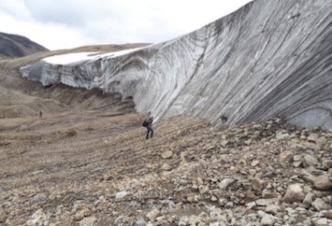
northern Canada

Slide 59
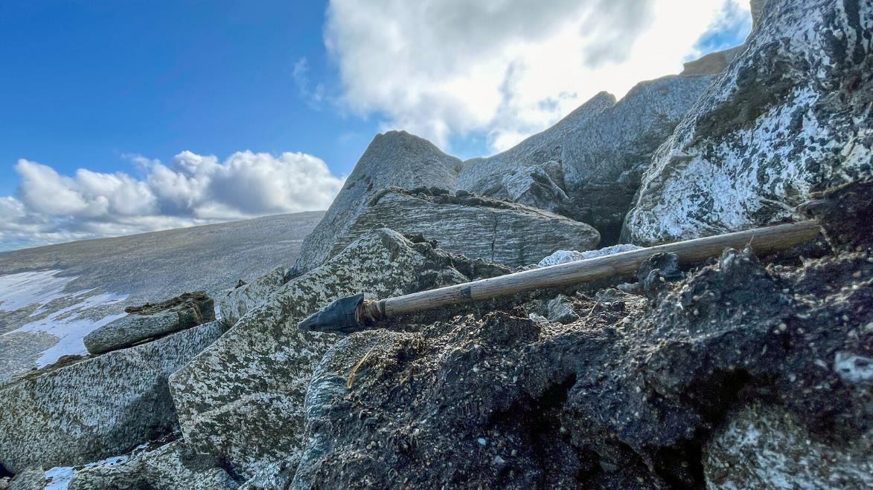

Slide 60
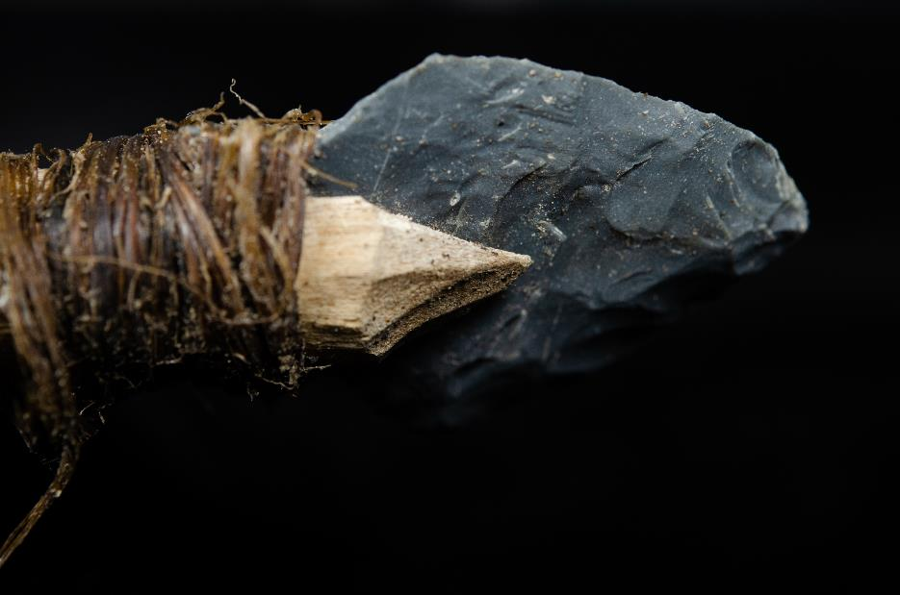

Slide 61
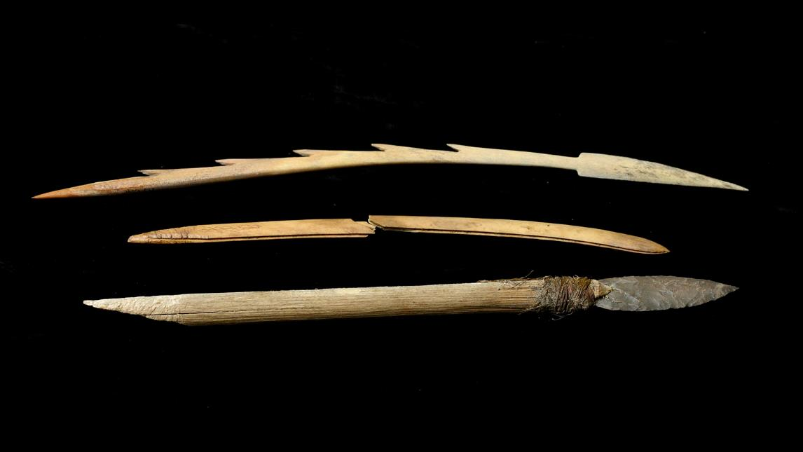

Slide 62
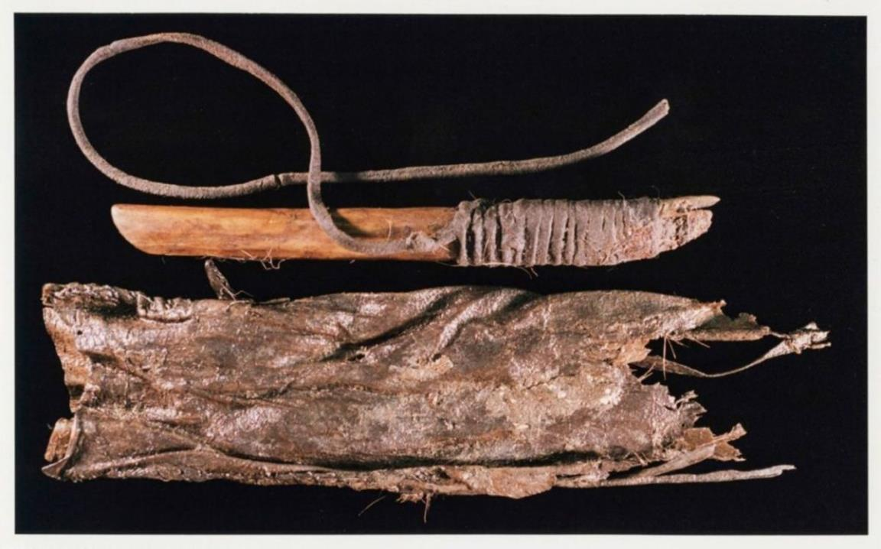

Slide 63
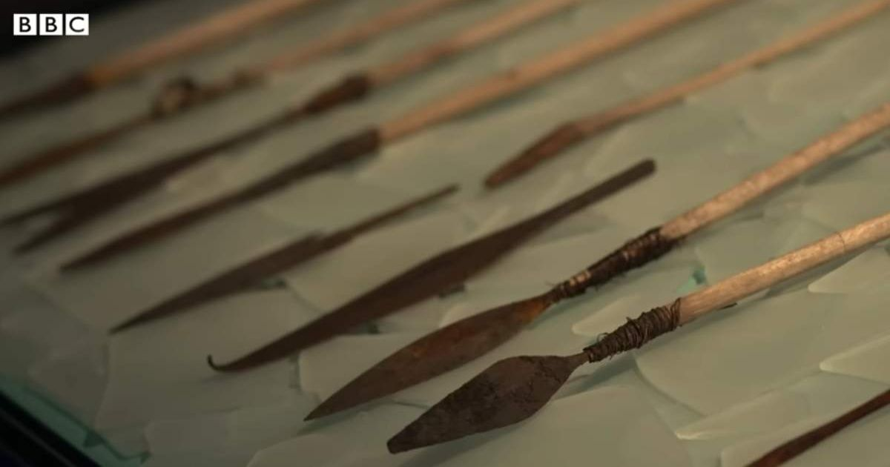

Slide 64
Intellectual Impacts: New ecology

Slide 65
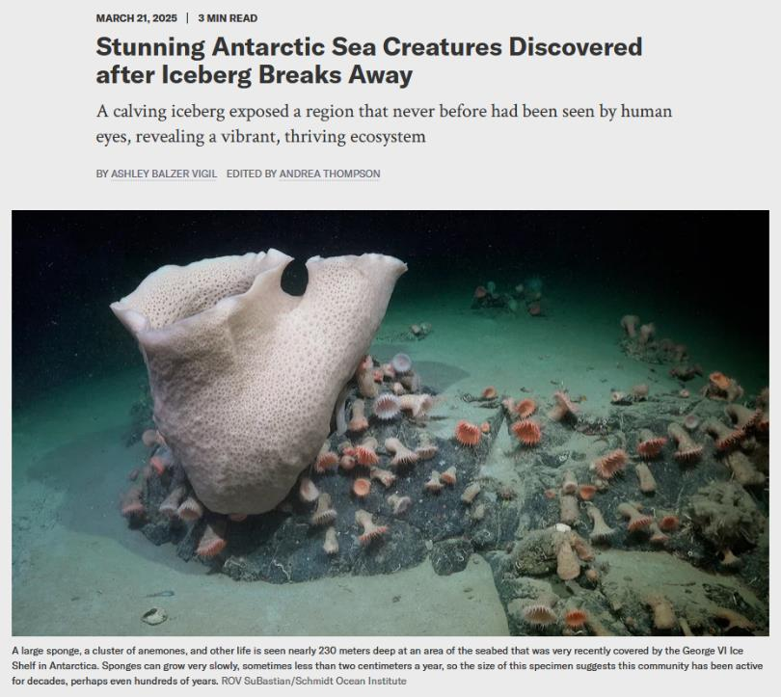

Slide 66
Intellectual Impacts: Loss of access

Slide 67
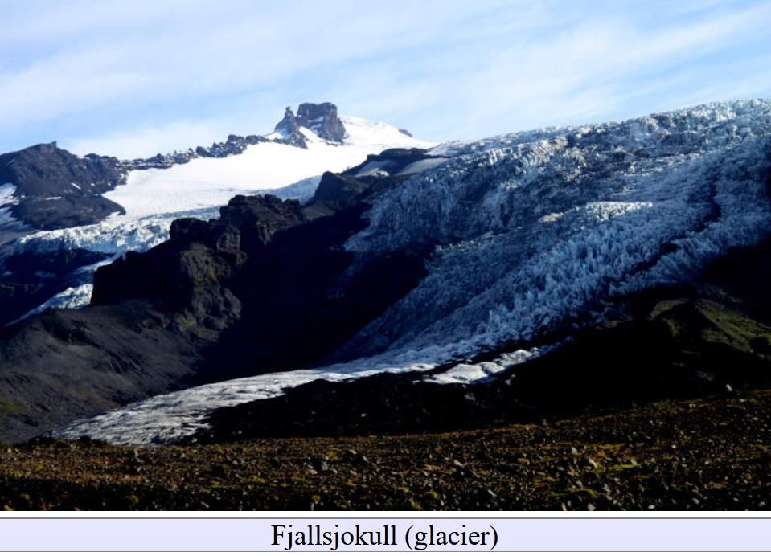

Slide 68
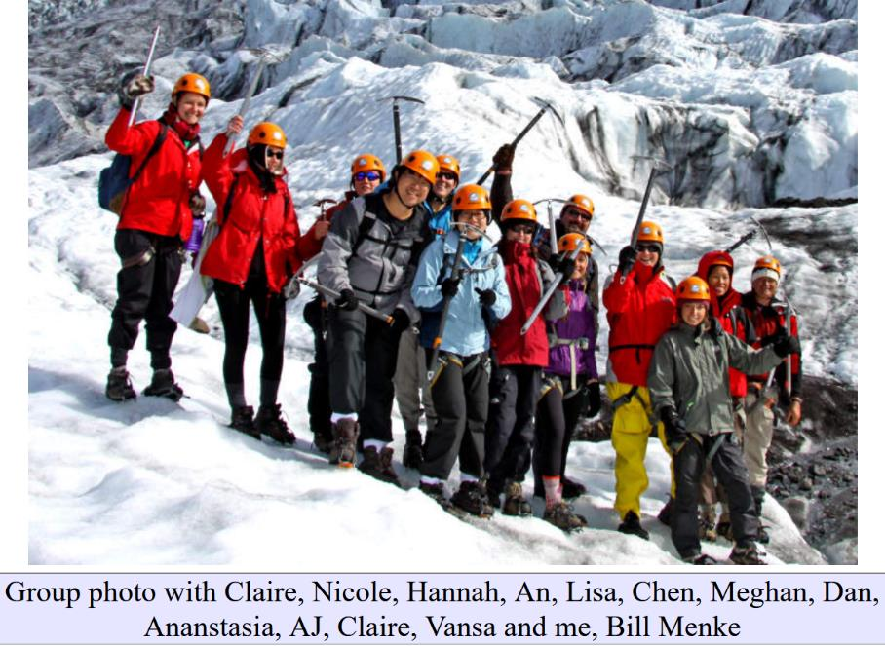
Fjallsjokull, 2011 Columbia University Iceland Fieldtrip

Slide 69
The present is the key to the past
The Ice Age was discovered by people who has ready access to modern glaciers
Swiss Geologist
Louis Agassiz
discoverer of the
Ice Age

Slide 70
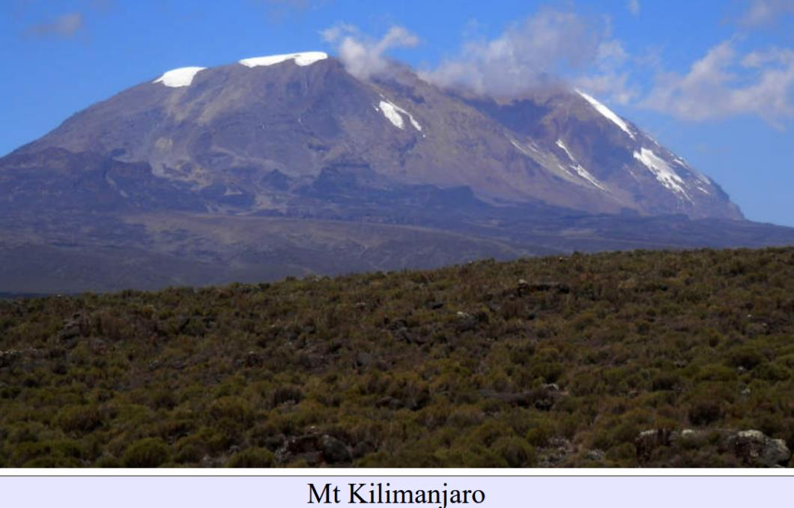

Slide 71
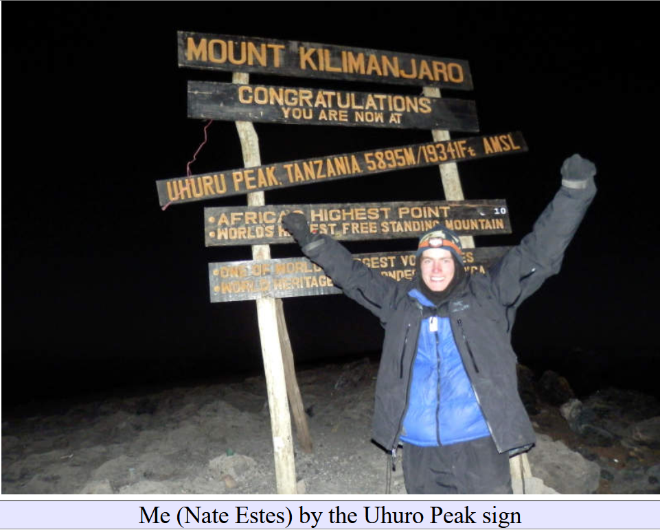
What if it took
a week-long hike
My cousin

Slide 72
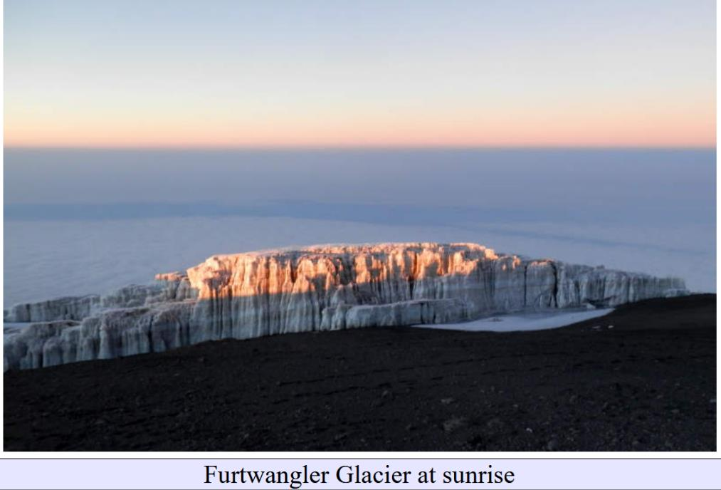
to see a tiny glacier this this?

Slide 73
Intellectual Impacts: Discovery of Greenland and Antarctic geology

Slide 74
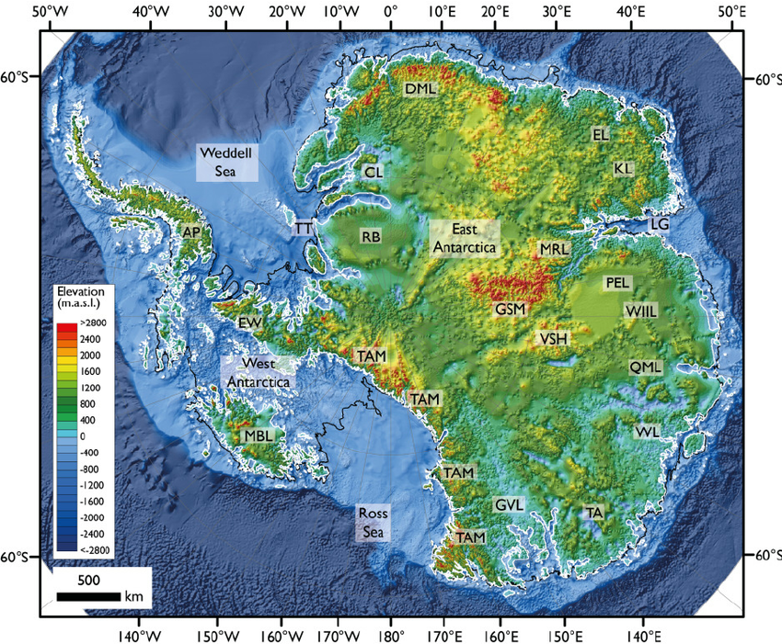
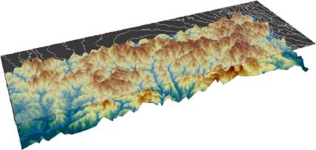
Although Antarctic bedrock topography has been mapped using radar, very little is known about its geology
Gamburtsev Subglacial Mountains

Slide 75
Intellectual Impacts in the Low CO2 Scenario:
Studies of Glacial Advance

Slide 76
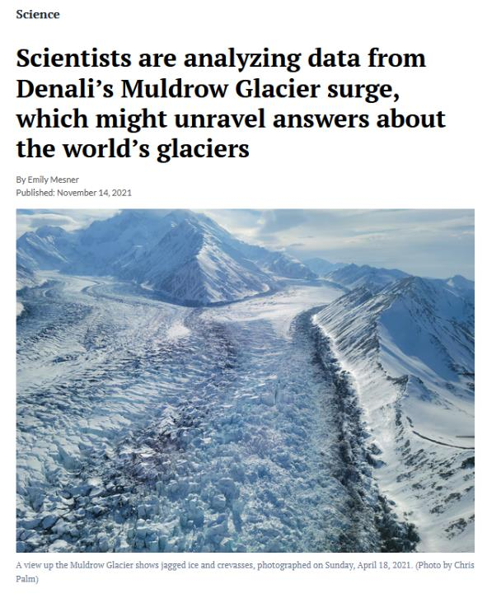
As most glaciers are in retreat,
studies of glacial advance are currently limited
to surging glaciers, which are atypical

Slide 77
Intellectual Impacts in the High CO2 Scenario:
Nostalgia over glaciers

Slide 78
Erosion wears away all of the Earth’s surficial features.
Shiprock (New Mexico), is all that is left of a 27 ma volcano
The remaining portion was formed ~1 km underground. The volcanic edifice is completely gone

Slide 79
Will glacial morphological features become limited to a few instances where they were lithified
Drop-stone from the Late Paleozoic Glaciation (300 ma)
Dinosaur Fossil
(80 ma)

Slide 80
It’s up to you

