Slide 1
Environmental Data Analysis with MatLab
Lecture 2:
Looking at Data
Notes:
Our experience is that many students don’t bother to look at data, they merely read it into data processing software and expect for the right answer to fall out. They need to be taught that they, themselves, can make useful inferences by carefully looking at data.

Slide 2
SYLLABUS
Lecture 01 Using MatLab
Lecture 02 Looking At Data
Lecture 03 Probability and Measurement Error
Lecture 04 Multivariate Distributions
Lecture 05 Linear Models
Lecture 06 The Principle of Least Squares
Lecture 07 Prior Information
Lecture 08 Solving Generalized Least Squares Problems
Lecture 09 Fourier Series
Lecture 10 Complex Fourier Series
Lecture 11 Lessons Learned from the Fourier Transform
Lecture 12 Power Spectra
Lecture 13 Filter Theory
Lecture 14 Applications of Filters
Lecture 15 Factor Analysis
Lecture 16 Orthogonal functions
Lecture 17 Covariance and Autocorrelation
Lecture 18 Cross-correlation
Lecture 19 Smoothing, Correlation and Spectra
Lecture 20 Coherence; Tapering and Spectral Analysis
Lecture 21 Interpolation
Lecture 22 Hypothesis testing
Lecture 23 Hypothesis Testing continued; F-Tests
Lecture 24 Confidence Limits of Spectra, Bootstraps

Slide 3
purpose of the lecture
get you started
looking critically at data
Notes:
You should stress that the students need to develop a habit of critically looking at their data, before they
start to analyze it in any detailed way. Many infamous data analysis mistakes and nonsensical interpretations
of the past could have been avoided if the people had taken the time to look carefully at the data before rushing into
a complicated analysis of it.

Slide 4
Objectives when taking a first look at data
Understand the general character of the dataset.
Understand the general behavior of individual parameters.
Detect obvious problems with the data.

Slide 5
Tools for Looking at Data covered in this lecture
reality checks
time plots
histograms
rate information
scatter plots

Slide 6
Black Rock Forest Temperature
I downloaded the weather station data from the International Research Institute (IRI) for Climate and Society at Lamont-Doherty Earth Observatory, which is the data center used by the Black Rock Forest Consortium for its environmental data. About 20 parameters were available, but I downloaded only hourly averages of temperature. My original file, brf_raw.txt has time in a format that I thought would be hard to work with, so I wrote a MatLab script, brf_convert.m, that converted it into time in days, and wrote the results into the file that I gave you.
Notes:
Stress the importance of maintain a narrative of where a dataset came from and what has been done to it.

Slide 7
format conversion
days from start of first year of data
calendar date/time
0100-0159 2 Jan 1997
1.042
sequential time variable need for data analysis
but
format conversions provide opportunity for error to creep into dataset

Slide 8
Reality Checks
properties that your experience tells you that the data must have
check you expectations against the data
Notes:
You should ask students to offer reality checks, and make a list of them on the board.

Slide 9
Reality Checks
What do you expect the data to look like?
hourly measurements
thirteen years of data
location in New York (moderate climate)
Notes:
Emphasize that you usually know something about a dataset even before looking at it.

Slide 10
take a moment ...
to sketch a plot of what you expect the data to look like

Slide 11
Reality Checks
What do you expect the data to look like?
hourly measurements
thirteen years of data
location in New York (moderate climate)
time increments by 1/24 day per sample
about 24*365*13 = 113880 lines of data
temperatures in the -20 to +35 deg C range
diurnal and seasonal cycles
Notes:
Emphasize that you usually know something about a dataset even before looking at it.

Slide 12
Does time increment by 1/24 days per sample?
1/24 = 0.0417
D(1:5,:)
0 17.2700
0.0417 17.8500
0.0833 18.4200
0.1250 18.9400
0.1667 19.2900
Yes
Notes:
Emphasize that you usually know something about a dataset even before looking at it.

Slide 13
Are there about 24*365*20 = 113880 lines of data ?
length(D)
110430
Yes
Notes:
Emphasize that you usually know something about a dataset even before looking at it.

Slide 14
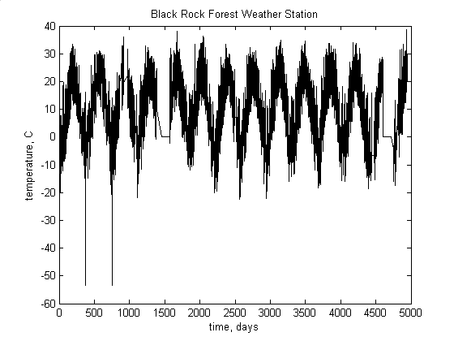
temperatures in the -20 to +35 deg C range?
diurnal and seasonal cycles?
Notes:
Have the students stare at the plot and try to answer the questions. You should prod them to identify the data drop outs, too.

Slide 15
hot spike
-20 to +35 range
data drop-outs
annual cycle
cold spikes
Temperatures in the -20 to +35 deg C range? Mostly
Diurnal and seasonal cycles? Certainly seasonal.
Notes:
Have the students check that the cold part of the seasonal cycles are in January. You should ask them what they would need to do to examone the diurnal cycle. (Answer: make an enlarged plot).

Slide 16
Data Drop-outs common in datasets
the instrument wasn’t working for a while …
take two forms:
missing rows of table
data set to some default value
0
n/a
-999
all common
Notes:
Ask the class which default value is the best choice.

Slide 17
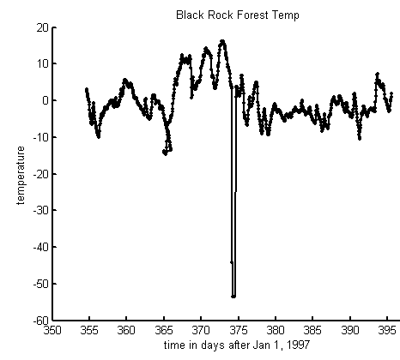
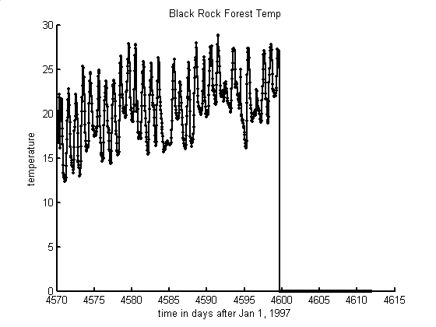
50 days of data from winter
50 days of data from summer
diurnal cycle
data drop-out
cold spike
Notes:
Mention that plots with both lines and dots at the data points. The cold spike, which is almost certainly and instrumental glitch, consists of two data points. The data drop out consists of a several days of zero values (as contrasted to missing data). Try to get the students to recognize that the diurnal cycle is more prominent in summer than in winter.

Slide 18
Histograms
determine range of the majority of data values
quantifies the frequency of occurrence of data at different data values
easy to spot over-represented and under-represented values

Slide 19
MatLab code for Histogram
Lh = 100;
dmin = min(d);
dmax = max(d);
bins = dmin+(dmax-dmin)*[0:Lh-1]’/(Lh-1);
dhist = hist(d, bins)’;
Notes:
The first 4 lines set up the bins, in this case 100 bins from dmin to dmax.
The hist() function returns the number of data in each of the bins.

Slide 20
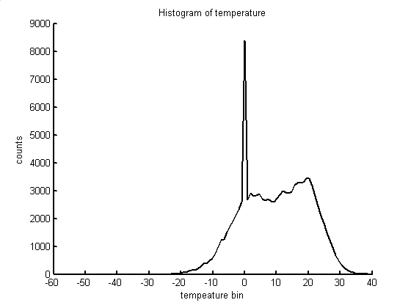
Histogram of Black Rock Forest temperatures
counts
temperature, ºC
Notes:
Ask the class to interpret the histogram. The range of most of the data is -20 to +35 deg C. The zero value is wildly over-represented. The histogram is not useful in spotting outliers (hot and cold spikes).

Slide 21
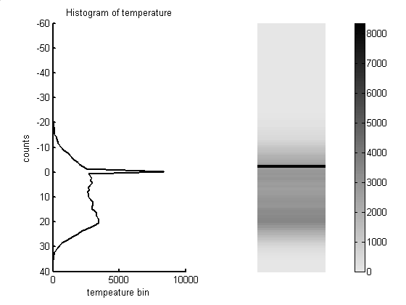
Alternate ways of displaying a histogram
A)
B)
counts
temperature, ºC
Notes:
The grey-shaded image method of displaying a vector or a matrix is heavily used in the text, and should be introduced here.

Slide 22
Moving-Window Histograms
Series of histograms, each on a relatively short time interval of data
Advantage: Shows the way that the frequency of occurrence of data varies with time
Disadvantage: Each histogram is computed using less data, and so is less accurate

Slide 23
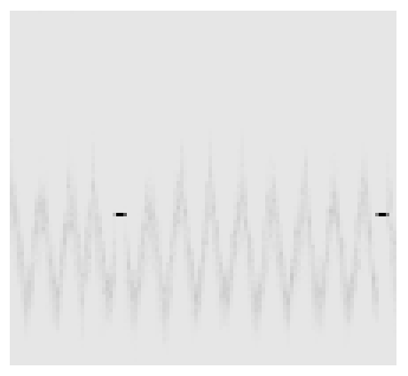
Moving-Window Histogram
of Black Rock Forest temperatures
time, days
0
5000
−60
temperature, °C
0
40
Notes:
Mention that intervals containing drop-outs are easily detected.

Slide 24
good use of FOR loop
offset=1000;
Lw=floor(N/offset)-1;
Dhist = zeros(Lh, Lw);
for i = [1:Lw];
j=1+(i-1)*offset;
k=j+offset-1;
Dhist(:,i) = hist(d(j:k), bins)';
end
Notes:
Explain that the matrix, Dhist, will contain a series of histograms, one histogram per column. Each histogram is for a different 1000-sample long section of data, d. Each pass through the loop computes the histogram on one window of data. Note that the matrix, Dhist, is pre-allocated using the zeros() function. Pre-allocation is a good scripting practice for a variety of reasons, foremost of which is that it focuses your attention on what the final size of the matrix ought to be. Note the use of the floor() command, which rounds a number down to the nearest integer.

Slide 25
Rate Information how fast a parameter is changing with time or with distance

Slide 26
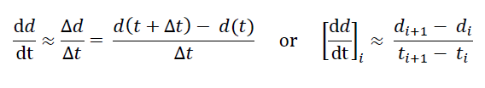
finite-difference approximation to derivative
Notes:
Mention that the starting point is the standard definition of a derivative.

Slide 27
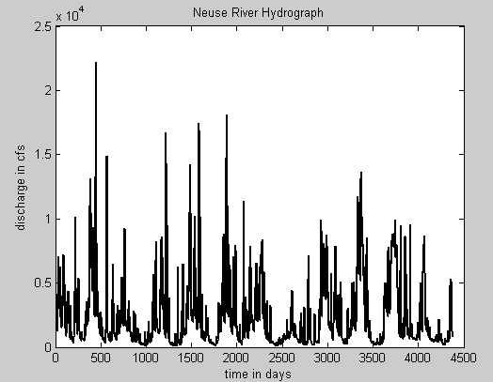
Notes:
We will use the Neuse River Hydrograph to study rates. Try to get the students to identify the annual cycle and the storm events.

Slide 28
MatLab code for derivative
N=length(d);
dddt=(d(2:N)-d(1:N-1))./(t(2:N)-t(1:N-1));
Notes:
Note that dddt is of length N-1.

Slide 29
hypothetical storm event
note that more time has negative dd/dt
rain
draining of land
Notes:
Show how the slope varies along the length of the discharge vs time curve (left), and that this pattern corresponds to the derivative dd/dt.

Slide 30
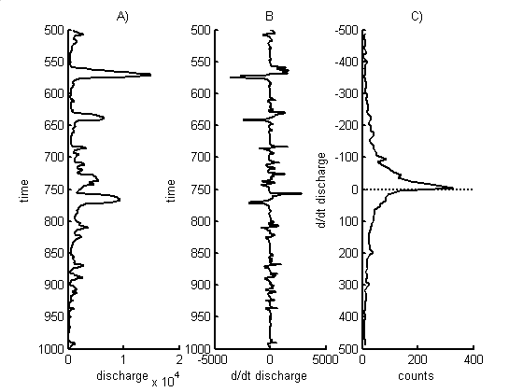
Notes:
A) is a an enlargement of part of the hydrograph. B) Is its derivative. C) is a histogram of the derivative. Note that it is not centered around zero, but instead has more negatives than positives.

Slide 31
Hypothesis
rate of change in discharge
correlates with
amount of discharge
logic
a river is bigger when it has high discharge
a big river flows faster than a small river
a river that flows faster drains away water faster
(might only be true after the rain has stopped)
Notes:
Discuss with class how rate information might be used to test this hypothesis. What kind of plot might be useful? (Answer: a scatter plot).

Slide 32
MatLab Script purpose: make two separate plots, one for times of increasing discharge, one for times of decreasing discharge
pos = find(dddt>0);
neg = find(dddt<0);
- - -
plot(d(pos),dddt(pos),'k.');
- - -
plot(d(neg),dddt(neg),'k.');
Notes:
Explain that a logical function, like (dddt>0) returns a vectors of zeros and ones, depending upon whether the test is false or true.
Explain that the find() function returns a list of all the elements of the vector for which the test is true.
explain that d(pos) and d(neg) are vectors of the discharge at times of positive and negative discharge.
Explain ‘k.’ is a black dot on the plot.

Slide 33
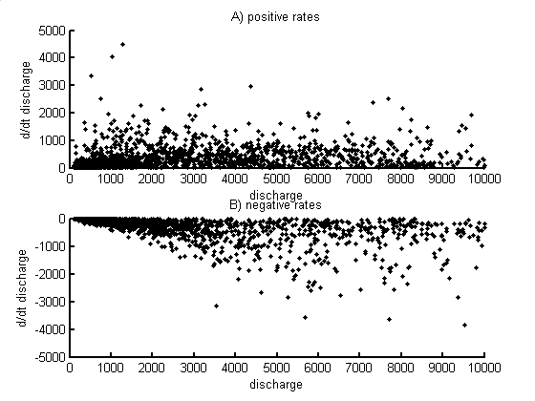
Notes:
Have the class interpret these results. Do they support the hypothesis?

Slide 34
Atlantic Rock Dataset
I downloaded rock chemistry data from PetDB’s website at www.petdb.org. Their database contains chemical information about ocean floor igneous and metamorphic rocks. I extracted all samples from the Atlantic Ocean that had the following chemical species: SiO2, TiO2, Al2O3, FeOtotal, MgO, CaO, Na2O and K2O My original file, rocks_raw.txt included a description of the rock samples, their geographic location and other textual information. However, I deleted everything except the chemical data from the file, rocks.txt, so it would be easy to read into MatLab. The order of the columns is as is given above and the units are weight percent.

Slide 35
Using scatter plots to look for correlations among pairs of the eight chemical species
8! / [2! (8-2!)] = 28 plots
Notes:
Marginally possible to examine 28 plots.

Slide 36
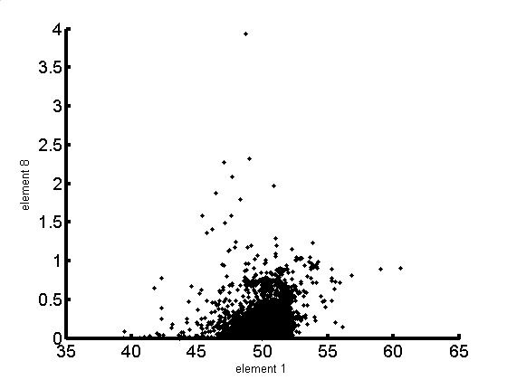
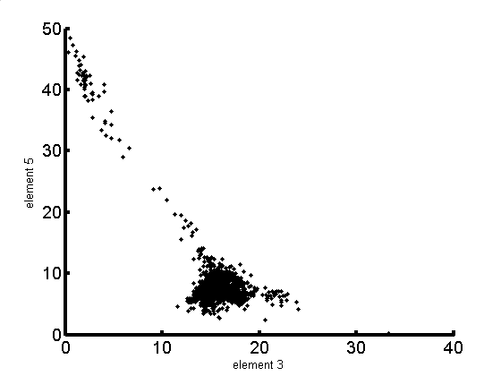
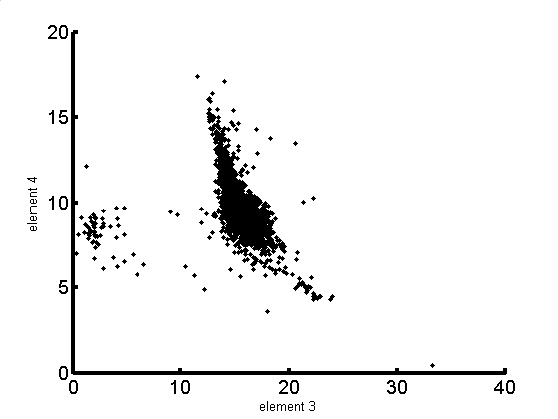
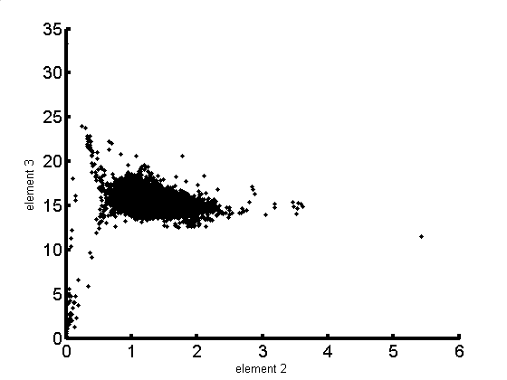
four interesting scatter plot
A)
B)
K₂0
Mg0
Si0₂
Al₂0₃
C)
D)
Fe0
Al₂0₃
Al₂0₃
Ti0₂
Notes:
a) Shotgun patter, with no obvious correlation. B) Data scatter about a line. C) Two populations. D) Something complicated. All from the same dataset! This points out a limitation of scatter plots. You see 2D, but the data re inherently multi-dimensional.

