Slide 1
Environmental Data Analysis with MatLab
Lecture 3:
Probability and Measurement Error

Slide 2
SYLLABUS
Lecture 01 Using MatLab
Lecture 02 Looking At Data
Lecture 03 Probability and Measurement Error
Lecture 04 Multivariate Distributions
Lecture 05 Linear Models
Lecture 06 The Principle of Least Squares
Lecture 07 Prior Information
Lecture 08 Solving Generalized Least Squares Problems
Lecture 09 Fourier Series
Lecture 10 Complex Fourier Series
Lecture 11 Lessons Learned from the Fourier Transform
Lecture 12 Power Spectra
Lecture 13 Filter Theory
Lecture 14 Applications of Filters
Lecture 15 Factor Analysis
Lecture 16 Orthogonal functions
Lecture 17 Covariance and Autocorrelation
Lecture 18 Cross-correlation
Lecture 19 Smoothing, Correlation and Spectra
Lecture 20 Coherence; Tapering and Spectral Analysis
Lecture 21 Interpolation
Lecture 22 Hypothesis testing
Lecture 23 Hypothesis Testing continued; F-Tests
Lecture 24 Confidence Limits of Spectra, Bootstraps

Slide 3
purpose of the lecture
apply principles of probability theory
to data analysis
and especially to use it to quantify error
Notes:
Error is a fundamental aspect of measurement and needs to be dealt with head-on, and not ignored.

Slide 4
Error,
an unavoidable aspect of measurement,
is best understood using the ideas of probability.

Slide 5
random variable, d
no fixed value until it is realized
d=?
d=?
d=1.04
d=0.98
indeterminate
indeterminate
Notes:
Explain that in this analogy, the random variable, x, has indeterminate value when it is in the box. Every time it is taken out of the box, it takes on a new value.

Slide 6
random variables have systematics
tendency to takes on some values more often than others

Slide 7
example: d = number of deuterium atoms in methane
H
D
D
D
D
H
C
H
H
C
H
H
C
D
H
C
D
D
C
D
H
H
H
D
D
d =0
d=1
d =2
d =3
d =4

Slide 8
tendency or random variable to take on a given value, d, described by a probability, P(d)
P(d) measured in percent, in range 0% to 100%
or
as a fraction in range 0 to 1

Slide 9
four different ways to visualize probabilities
d | P
0 | 10%
1 | 30%
2 | 40%
3 | 15%
4 | 5%
d | P
0 | 0.10
1 | 0.30
2 | 0.40
3 | 0.15
4 | 0.05
0.0
0.5
P
P
0
1
2
3
4
d
Notes:
Table of percentages, Table of fractions, bar graph, shaded vector.

Slide 10
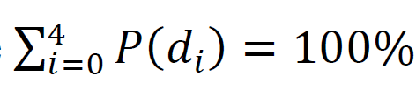
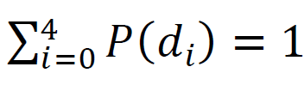
probabilities must sum to 100% the probability that d is something is 100%

Slide 11
continuous variables can take fractional values
0
d=2.37
  depth, d
5
Notes:
In the the methane example, the random variable, d, represented the number of deuterioum atoms, and took on the discrete values values, 0, 1, … 4. Here, the depth, d, of the fish is a continuous variable that can take on a fractional value between 0 and 5.

Slide 12
p(d)
area, A
d₁
The area under the probability density function, p(d), quantifies the probability that the fish in between depths d₁ and d₂.
d₂
d

Slide 13
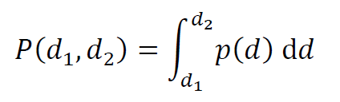
an integral is used to determine area, and thus probability
probability that d is between d₁ and d₂

Slide 14
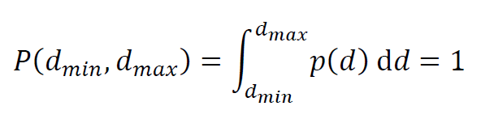
the probability that the fish is at some depth in the pond is 100% or unity
probability that d is between its minimum and maximum bounds, d_{min} and d_{max}

Slide 15
How do these two p.d.f.’s differ?
p(d)
d
0
5
p(d)
d
0
5
Notes:
Try to get the class to describe what these two p.d.f.’s mean. In the red p.d.f. case, most of the probability is concentrated on a fairly narrow range near d=4. In the blue p.d.f. case, the most of the probability is at lower values, near 2-3, but its is less concentrated.

Slide 16
Summarizing a probability density function
typical value
“center of the p.d.f.”
amount of scatter around the typical value
“width of the p.d.f.”

Slide 17
several possible choices of a “typical value”
Notes:
Emphasize that one choice is not better than the other in all circumstances. Each tells you something different.

Slide 18
p(d)
0
d_{mode}
5
mode
One choice of the ‘typical value’ is the mode or maximum likelihood point, d_{mode}.
It is the d of the peak of the p.d.f.
10
15
d

Slide 19
p(d)
0
area=
50%
d_{median}
Another choice of the ‘typical value’ is the median, d_{median}.
It is the d that divides the p.d.f. into two pieces, each with 50% of the total area.
median
10
area=50%
15
d

Slide 20
p(d)
0
5
d_{mean}
A third choice of the ‘typical value’ is the mean or expected value, d_{mean}.
It is a generalization of the usual definition of the mean of a list of numbers.
10
mean
15
d

Slide 21
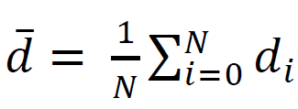
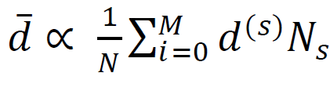
step 1: usual formula for mean
d
data
step 2: replace data with its histogram
N_{s}
≈
d_{s}
s
histogram
step 3: replace histogram with probability distribution.
N_{s}
≈
s
N
p
≈
P(d_{s})
s
d_{s}
probability distribution

Slide 22
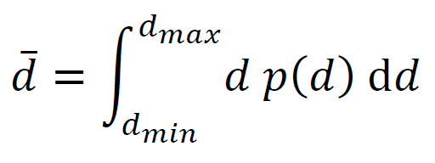
If the data are continuous, use analogous formula containing an integral:
≈
p(d_{s})
s

Slide 23
MabLab scripts for mode, median and mean
[pmax, i] = max(p);
themode = d(i);
pc = Dd*cumsum(p);
for i=[1:length(p)]
if( pc(i) > 0.5 )
themedian = d(i);
break;
end
end
themean = Dd*sum(d.*p);
Notes:
Go through each of these. The staring place are the vectors, d and p. In the case of the mode, the max() function returns both the value of the maximum of p and the index at which it occurs. In the case of the median, the cumsum() function produces a running sum, which is used to approximate the indefinite integral. The loop searches for the first instance of pc that is greater than 50%. The break command terminates the loop. In the case of the mean, the sum is being used to approximate the definite integral.

Slide 24
several possible choices of methods to quantify width
Notes:
In this case, one of the choices, “variance” really is more useful than the other.

Slide 25
p(d)
d_{typical} – d₅₀/2
area, A = 50%
One possible measure of with this the length of the d-axis over which 50% of the area lies.
This measure is seldom used.
d_{typical}
d_{typical} + d₅₀/2
d

Slide 26
A different approach to quantifying the width of p(d) …
This function grows away from the typical value:
q(d) = (d-d^{typical})²
so the function q(d)p(d) is
small if most of the area is near d^{typical} , that is, a narrow p(d)
large if most of the area is far from d^{typical} , that is, a wide p(d)
so quantify width as the area under q(d)p(d)

Slide 27
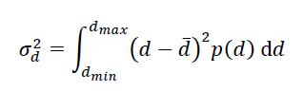
variance
use mean for d^{typical}
width is actually square root of variance, that is, σ_{d}.
Notes:
Variance as a measure of the width of the p.d.f. is the first of the two important concepts of the chapter. Be sure to emphasize it. Explain that width is a measure of uncertainty. Narrow p.d.f. corresponds to certain data. Wide p.d.f. corresponds to uncertain data.

Slide 28
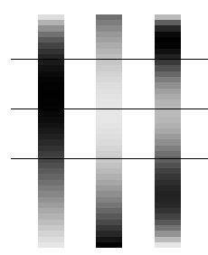
visualization of a variance calculation
d_{min}
d − σ
d
d +σ
d_{max}
now compute the area under this function
p(d)
q(d)
q(d)p(d)
d
Notes:
The p.d.f., p(d) is peaked at the mean, d-bar. The quadratic function, q(d), is zero at d-bar and grows in both directions away from it. The product, q(d)p(d) has two maxima, straddling d-bar. The size of the maxima depend upon the width of p(d), and are larger for wide p(d). The variance is the area under q(d)p(d).

Slide 29
MabLab scripts for mean and variance
dbar = Dd*sum(d.*p);
q = (d-dbar).^2;
sigma2 = Dd*sum(q.*p);
sigma = sqrt(sigma2);
Notes:
Go through each of the steps. The starting point are two vectors, d and p. The first line computes the mean. The second creates a quadratic function centered at the mean. The third computes the area under the product q(d)p(d) by approximating the intergral as a sum. The fourth just takes the square root of variance to produce a measure of the width of p(d).

Slide 30
two important probability density distributions:
uniform
Normal

Slide 31
uniform p.d.f.
p(d)
box-shaped function
1/(d_{max-} d_{min})
d
d_{min}
d_{max}
probability is the same everywhere in the range of possible values
Notes:
Explain that this p.d.f. is useful for characterizing a state of no information. The fish is in the pond, but we don’t know its depth. Mention that the area must be unity, so the amplitude is 1/(dmax-dmin).

Slide 32
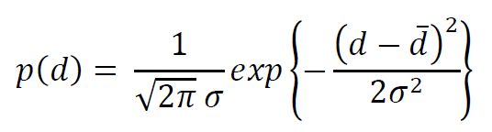
bell-shaped function
Normal p.d.f.
2σ
d
Large probability near the mean, d. Variance is σ².
Notes:
Mention the basic characteristics of the distribution: Symmetric around the mean, so mean=median=mode. Relatively short-tailed (little probability far from the mean).

Slide 33
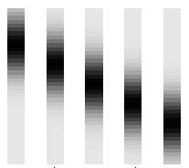
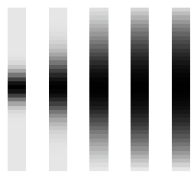
exemplary Normal p.d.f.’s
same variance
different means
same means
different variance
0
0
40
d =10
15
20
25
30
40
σ =2.5
5
10
20
40
d
d

Slide 34
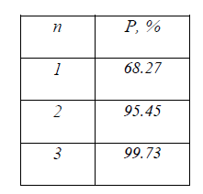
probability between d±nσ
Normal p.d.f.
Notes:
Discuss what level of certainty is needed to make decisions of various kinds. Suppose that you knew to 68.27% certainty that a pair of shoes were going to fit. Would you buy them. Suppose that you knew to 99.73% certainty that a wild mushroom was non-poisonus. Would you eat it?

Slide 35
functions of random variables
data with measurement error
inferences with uncertainty
data analysis process
Notes:
This is the second of the two most important concepts of the chapter. Be sure to emphasize it.

Slide 36
simple example
data with measurement error
inferences with uncertainty
data analysis process
one datum, d
uniform p.d.f.
0<d<1
one model parameter, m
m = d²
Notes:
In this context, a model parameter is a parameter whose numerical value contains the “knowledge” of the “inference” we are seeking.

Slide 37
functions of random variables
given p(d)
with m=d²
what is p(m) ?

Slide 38
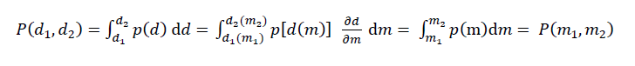
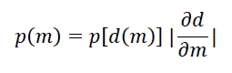
use chain rule and definition of probabiltiy to deduce relationship between p(d) and p(m)
=
absolute value added to handle case where direction of integration reverses, that is m₂<m₁

Slide 39
p(d)=1 so m[d(m)]=1
with m=d² and d=m^{1/2}
intervals:
d=0 corresponds to m=0
d=1 corresponds to m=1
p.d.f.:
p(d) = 1
so
p[d(m)]=1
derivative:
∂d/ ∂ m = (1/2)m^{-1/2}
so:
p(m) = (1/2) m^{-1/2}
on interval 0<m<1

Slide 40

p(d)
p(m)
0
0
note that p(d) is constant
while
p(m) is concentrated near m=0
1
1
d
m
Notes:
Note that p(m) is actually singular at m=0. However, a square-root singularity is integrable, so that the function has p.d.f. can be normalized to unit total area.

Slide 41
mean and variance of linear functions of random variables
given that p(d) has mean, d, and variance, σ_{d}²
with m=cd
what is the mean, m, and variance, σ_{m}², of p(m) ?

Slide 42
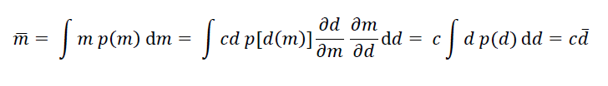
the result does not require knowledge of p(d)
formula for mean
the mean of m is c times the mean of d

Slide 43
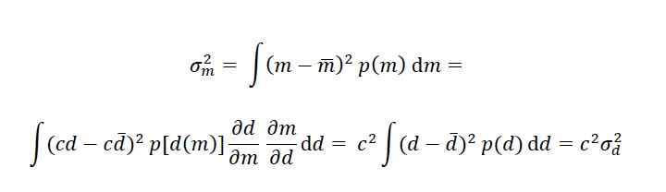
formula for variance
the variance of m is c² times the variance of d
Notes:
Emphasize that this is an error propagation formula valid when the model parameter is a linear function of the datum. The catch is that, since p(d) has not been specified, the amount of area enclosed by dbar±σ_{d} and mbar±σ_{m} is unknown.

Slide 44
What’s Missing ?
So far, we only have the tools to study a single inference made from a single datum.
That’s not realistic.
In the next lecture, we will develop the tools to handle many inferences drawn from many data.
Notes:
You should give examples where many data are combined to produce a few inferences. For example, many measurements of global temperature are combined to determine how much the world warmed in the last decade, and whether some areas, such as the poles, are warming faster than others.

