Slide 1
Environmental Data Analysis with MatLab
Lecture 5:
Linear Models

Slide 2
SYLLABUS
Lecture 01 Using MatLab
Lecture 02 Looking At Data
Lecture 03 Probability and Measurement Error
Lecture 04 Multivariate Distributions
Lecture 05 Linear Models
Lecture 06 The Principle of Least Squares
Lecture 07 Prior Information
Lecture 08 Solving Generalized Least Squares Problems
Lecture 09 Fourier Series
Lecture 10 Complex Fourier Series
Lecture 11 Lessons Learned from the Fourier Transform
Lecture 12 Power Spectra
Lecture 13 Filter Theory
Lecture 14 Applications of Filters
Lecture 15 Factor Analysis
Lecture 16 Orthogonal functions
Lecture 17 Covariance and Autocorrelation
Lecture 18 Cross-correlation
Lecture 19 Smoothing, Correlation and Spectra
Lecture 20 Coherence; Tapering and Spectral Analysis
Lecture 21 Interpolation
Lecture 22 Hypothesis testing
Lecture 23 Hypothesis Testing continued; F-Tests
Lecture 24 Confidence Limits of Spectra, Bootstraps

Slide 3
purpose of the lecture
develop and apply the concept of a
Linear Model
Notes:
A model connects observations with the inferences that we aspire to draw from them. Linear models
are a good starting place, for they are mathematically simple.

Slide 4
data, d
what we measure
quantitative model
links model parameters to data
model parameters, m
what we want to know
Notes:
This is the generic statement that the data are related to the model parameters through the quantitative model. The quantitative model might be a very simple formula, or a very complicated computer program.

Slide 5
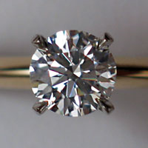
data, d
carats, color, clarity
quantitative model
economic model for diamonds
Photo credit: Wikipedia Commons
model parameters, m
dollar value, celebrity value
Notes:
Example of a diamond. You measure the “Three C’s”, but you want to know its value, expressed either in dollars or in social prestige.

Slide 6
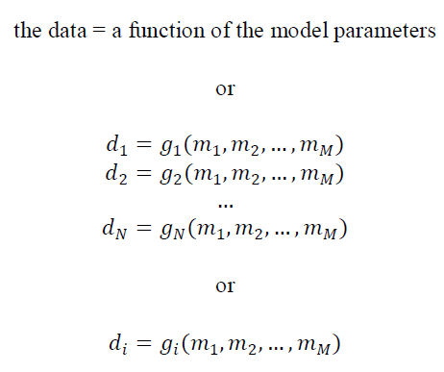
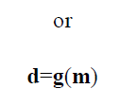
general case
Notes:
Here are a variety of ways of quantifying the generic statement that the data are related to the model parameters through the quantitative model. The quantitative model is represented by the vector function, g. Step through the different versions, showing how they are related to one another.

Slide 7
N = number of observations, d
M = number of model parameters, m
usually (but not always) N>M
many data, a few model parameters
Notes:
Imaging is a case where M is about equal to N. An image has a very large number (millions) of pixels. In a typical imaging experiment (e.g. medial tomography), the number of data are of similar size of the number of pixels.

Slide 8
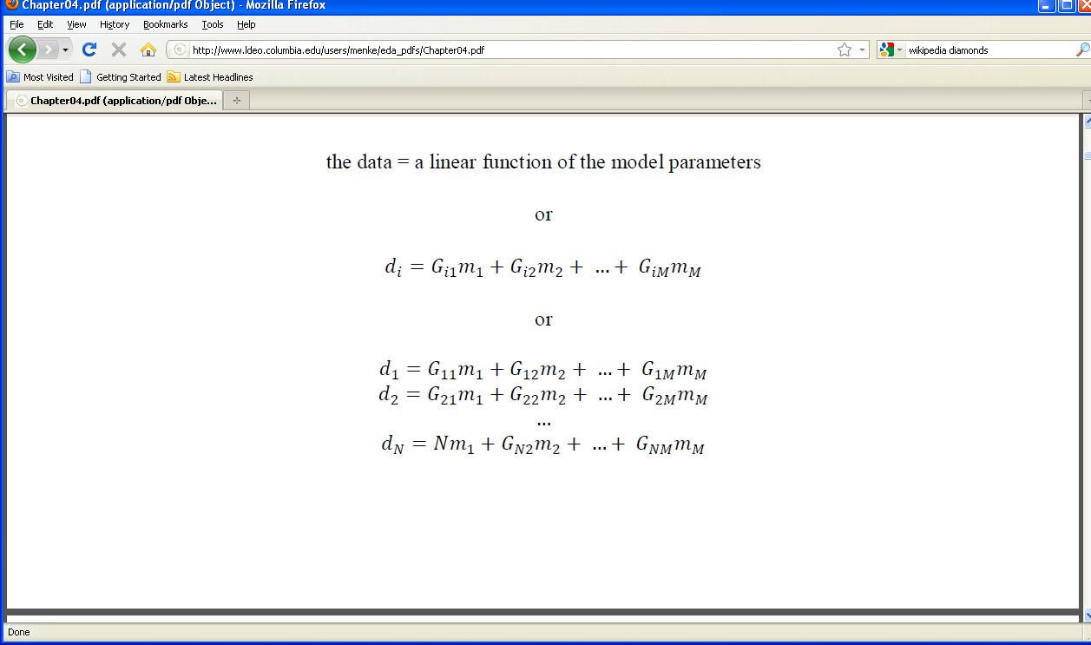
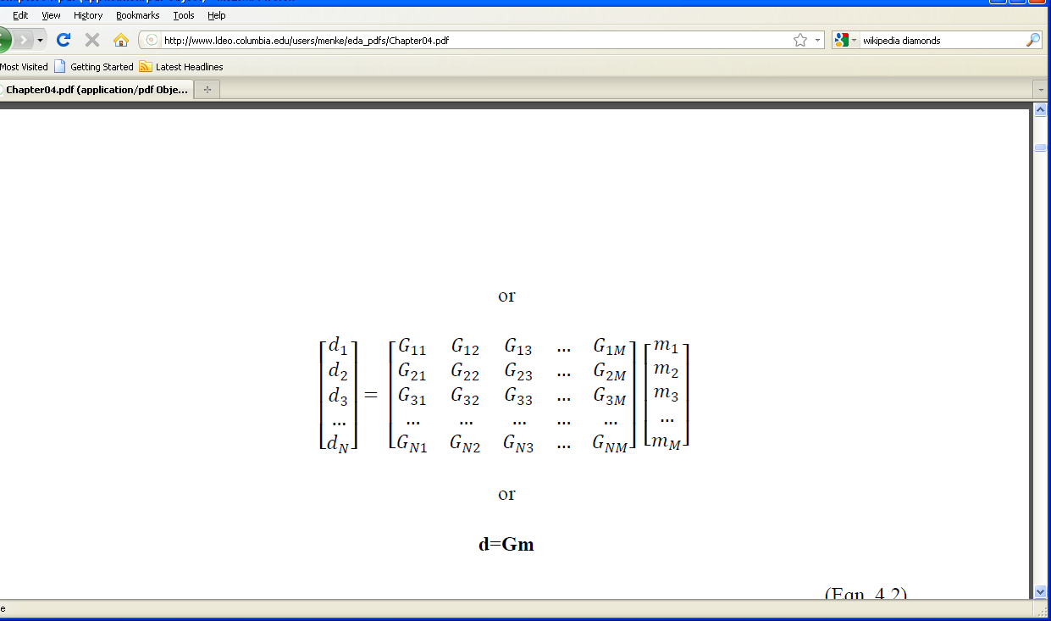
special case of a linear model
=
Notes:
Here are a variety of ways of quantifying the generic statement that the data are related to the model parameters through a linear model. The linear model is represented by the matric, G. Step through the different versions, showing how they are related to one another.

Slide 9
The matrix G is called the data kernel it embodies the quantitative model the relationship between the data and the model parameters
Notes:
The term “data kernel” derives from the theory of integral equations.

Slide 10
because of observational noise no m can exactly satisfy this equation it can only be satisfied approximately d ≈ Gm
Notes:
Mention that this can be viwed as an equation that becomes increasingly correct as the noise level is lowered.

Slide 11
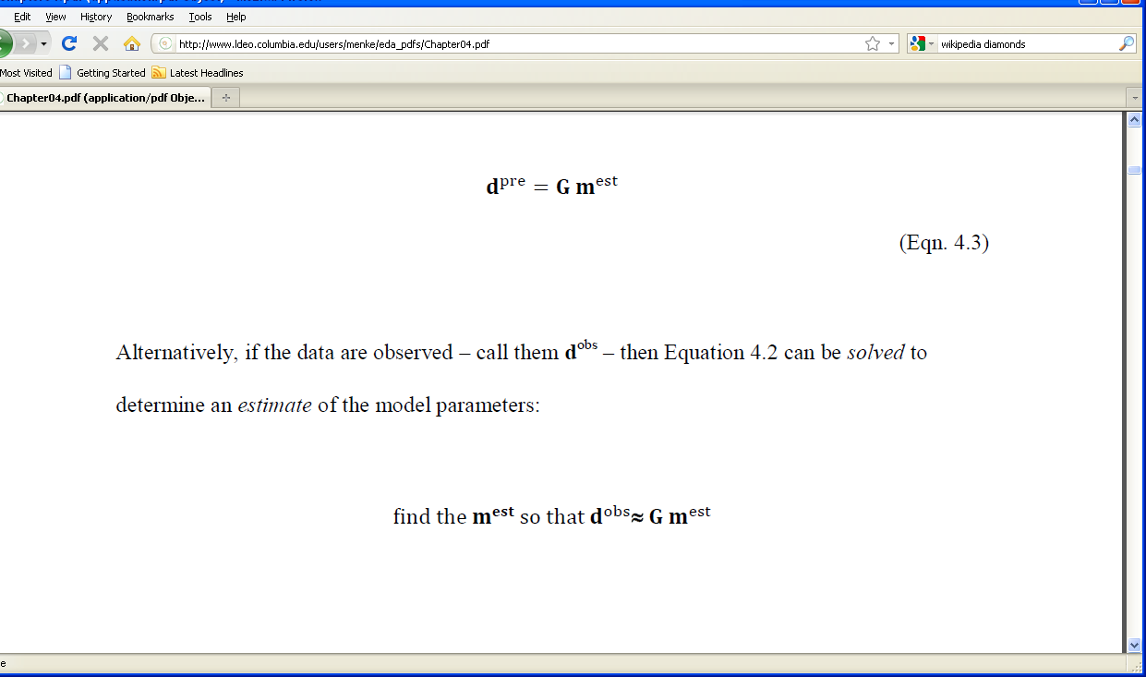
data, d^{pre}
prediction of data
evaluate equation
quantitative model
model parameters, m^{est}
estimate of model parameters
Notes:
here the model parameters are used to predict the data. No actual measurements are made.

Slide 12
data, d^{obs}
observation of data
solve equation
quantitative model
model parameters, m^{est}
estimate of model parameters
Notes:
Here the observed data are used to produce an estimate of the model parameters.

Slide 13
because of observational noise
m^{est} ≠m^{true}
the estimated model parameters differ from the true model parameters
and
d^{pre} ≠d^{obs}
the predicted data differ from the observed data
Notes:
Noise is always present. Thus the actual is always different from the ideal.

Slide 14
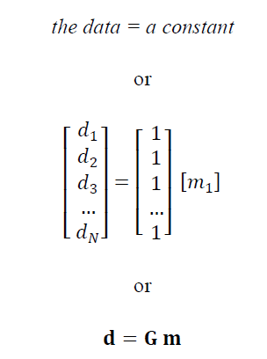
the simplest of linear models
Notes:
Explain that the model asserts that the data scatter about a typical value, such as the mean. Though simple, this is actually an extremely important idea.

Slide 15
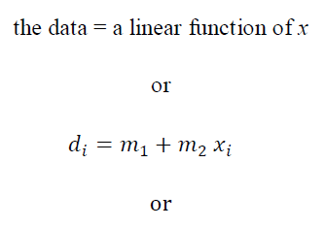
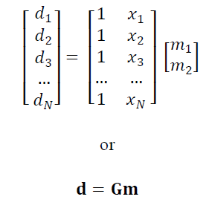
fitting a straight line to data
Notes:
Mention that m₁ is the intercept and m₂ is the slope.

Slide 16
interpretion of x_{i} the model is only linear when the x_{i}’s are neither data nor model parameters we will call them auxiliary variables they are assumed to be exactly known they specify the geometry of the experiment
Notes:
In many different situations, the structure of the data kernel is heavily influenced by the “geometry” of the experiment.

Slide 17
MatLab script for G in straight line case
M=2;
G=zeros(N,M);
G(:,1)=1;
G(:,2)=x;
Notes:
Note that x is a vector of x’s.
Note that G is pre-allocated with the zeros() function. This practice is good scripting techniques, for a variety of reasons including focusing the writer on the size of G.
The command G=[1,x]; would works, too.

Slide 18
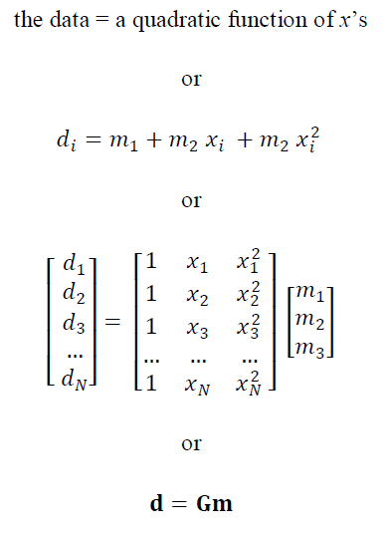
fitting a quadratic curve to data

Slide 19
MatLab script for G in quadratic case
M=3;
G=zeros(N,M);
G(:,1)=1;
G(:,2)=x;
G(:,3)=x.^2;
Notes:
Note that x is a vector of x’s.
G=[1,x,x.^2]; woruld work as well.

Slide 20
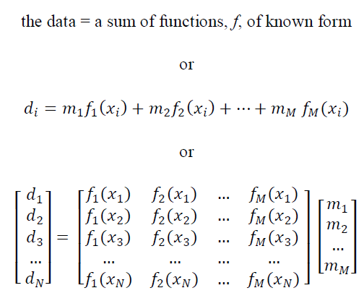
fitting a sum of known functions
Notes:
The key requirement is that the m’s appear as coefficients multiplying the f’s, and are not “within” the f’s.

Slide 21
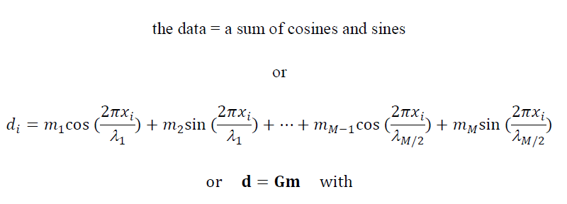
fitting a sum of cosines and sines
(Fourier series)
Notes:
Briefly explain that lambda is wavelength, that is the distance between successive crests of the wave. Note that cosines and sines of the same wavelength are paired. There’s a reason for this, which is explained in Chapter 5).

Slide 22
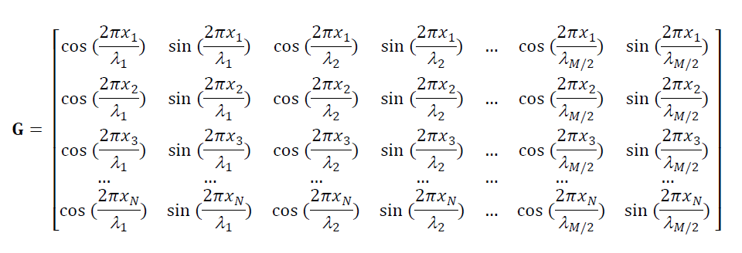
Notes:
Data kernel in Fourier case.
Point out that x vary down the rows of the equation, but are constant along the rows.
Point out that the lambda’s vary along the columns, but are constant along the rows.

Slide 23

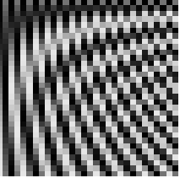
grey-scale images of data kernels
A) Polynomial
B) Fourier series
1
M
1
M
1
j
j
1
N
N
i
i
Notes:
(White to black is small to big). Images like these help give a sense of the structure of the problem.

Slide 24
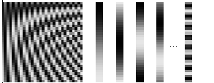
any data kernel can be thought of as a concatenation of its columns
G
c⁽¹⁾
c⁽²⁾
c⁽³⁾
c⁽⁴⁾
c^{(M)}
1
M
1
N
i
Notes:
The c’s stand for the columns of the matrix.

Slide 25
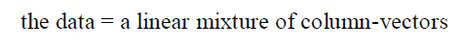
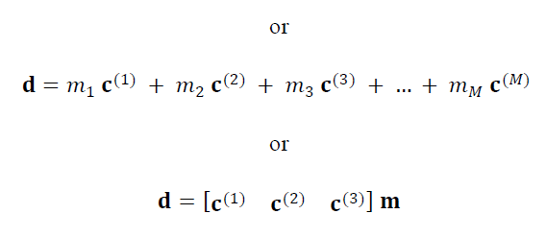
thought of this way, the equation d=Gm means

Slide 26
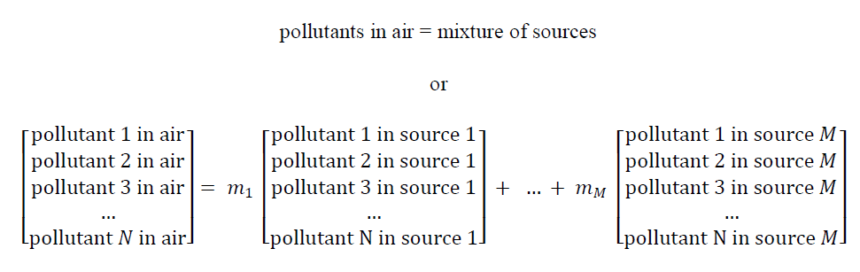
sometimes, models do represent literal mixing
but more often the mixing is more abstract
Notes:
Give some examples of the physical interpretation of sources: factories, power plants, traffic, etc.

Slide 27
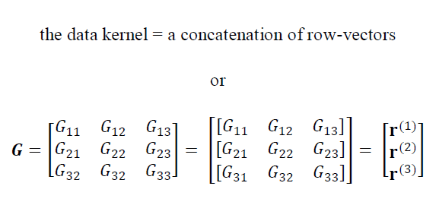
any data kernel also can be thought of as a concatenation of its rows
Notes:
The r’s stand for the rows of the matrix.

Slide 28
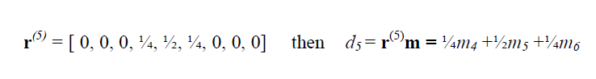
thought of this way, the equation d=Gm means data is a weighted average of the model parameters for example, if
weighted average
Notes:
Here d5 is the weighted average of three “neighboring” m’s, m₄, m₅ and m₆. The weights are the factors of ¼, ½ and ¼. For this quantity to represent a literal weighted average, the weights should sum to unity.

Slide 29



sometimes the model represents literal averaging data kernels for running averages
A) three points
B) five points
C) seven points
1
M
1
M
1
M
j
j
j
1
1
1
N
N
N
but more often the averaging is more abstract
i
i
i
Notes:
The width of the stripe is proportional to the number of model parameters in the weighted average.

Slide 30
MatLab script data kernel for a running-average
w = [2, 1]';
Lw = length(w);
n = 2*sum(w)-w(1);
w = w/n;
r = zeros(M,1); c = zeros(N,1);
r(1:Lw)=w; c(1:Lw)=w;
G = toeplitz(c,r);
Notes:
The average is assumed symmetric, so that only the right-half is specified in the vector, w.
The length of the average is thus 2*length(w)-1.
The average is normalized to unit amplitude.
The data kernel is a Toeplitz matrix, meaning that its diaginals are constant. It can therefore be specified using just the values along its top row and column using the toeplitz() function.

Slide 31
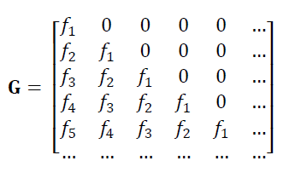
averaging doesn’t have to be symmetric
with this data kernel, each d_{i} is a weighted average of m_{j}, with i≥j, that is, just “past and present” model parameters.
Notes:
You might show on the board that when you multiply d=Gm out that you find that d_{i} is related to only “past and present” m’s. (When the d’s and m’s are ordered in time, that is).

Slide 32
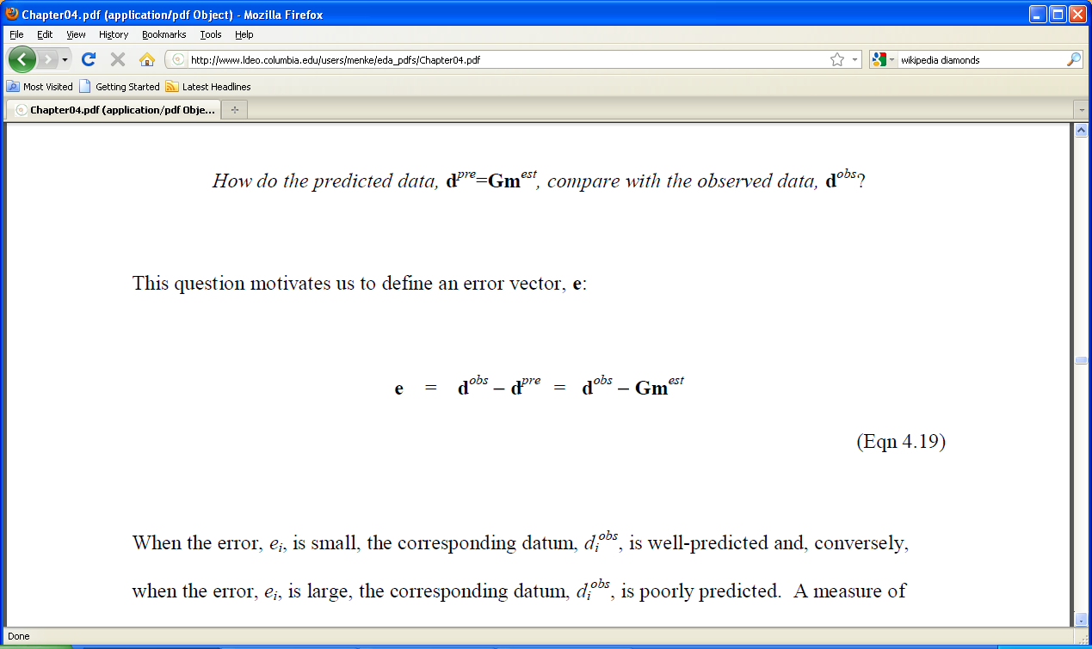
the prediction error
error vector, e
Notes:
Emphasize that every observation has a corresponding error.

Slide 33
prediction error in straight line case
d_{i}^{pre}
e_{i}
data, d
d_{i}^{obs}
auxiliary variable, x
Notes:
Point out each relevant quantity.

Slide 34
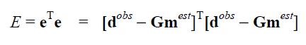
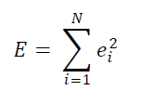
total error single number summarizing the error
sum of squares of individual errors
Notes:
Depending upon the level of the class, you might want to review the dot product.

Slide 35
principle of least-squares
that minimizes
Notes:
Emphasize that prescription on the left is very general and non-specific. There one on the left quantifies what we mean by “about equal”; two things are about equal if their error E is small. However, this is just one possible way to quantifying what we mean by “about equal”.

Slide 36
MatLab script for total error
dpre = G*mest;
e=dobs-dpre;
E = e'*e;
Notes:
This script presumes that an estimate of the model parameters, mest, is available.

Slide 37
grid search strategy for finding the m that minimizes E(m)
try lots of combinations of (m₁, m₂, …)
… a grid of combinations …
pick the combination with the smallest E as m^{est}.
Notes:
Explain that one advantage of computer-based computation is that you can rapidly try lots of possibilities. Nevertheless, the computational burden grows with the , M, of model parameters, and becomes impractical for relatively small M’s (say less than 10).

Slide 38

m₂^{est}
0
4
m₂
0
point of minimum error, E_{min}
m₁^{est}
region of low error, E
4
m₁
Notes:
White to black is small to big, so the minimum is in the center of the whitish patch.

Slide 39
the best m is at the point of minimum E choose that as m^{est}
but, actually, any m in the region of low E is almost as good as m^{est}.
especially since E is effected by measurement error
if the experiment was repeated, the results would be slightly different, anyway
Notes:
Emphasize that error is unavoidable; that it always effects the results of any calculation made with data.

Slide 40
the shape of the region of low error
is related to the
covariance of the estimated model parameters
(more on this in the next lecture)

Slide 41
think about error surfaces leads to important insights
but actually calculating an error surface with a grid search so as to locate m^{est} is not very practical
in the next lecture we will develop a solution to the least squares problem that doesn’t require a grid search

